Slide 1
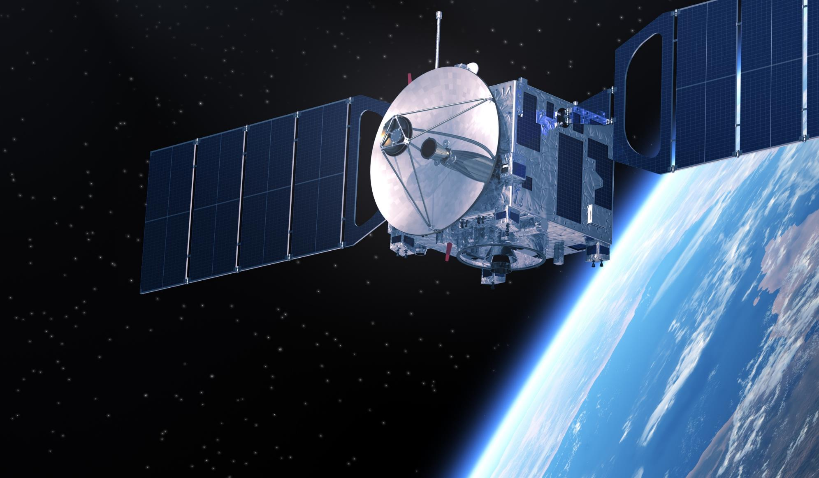
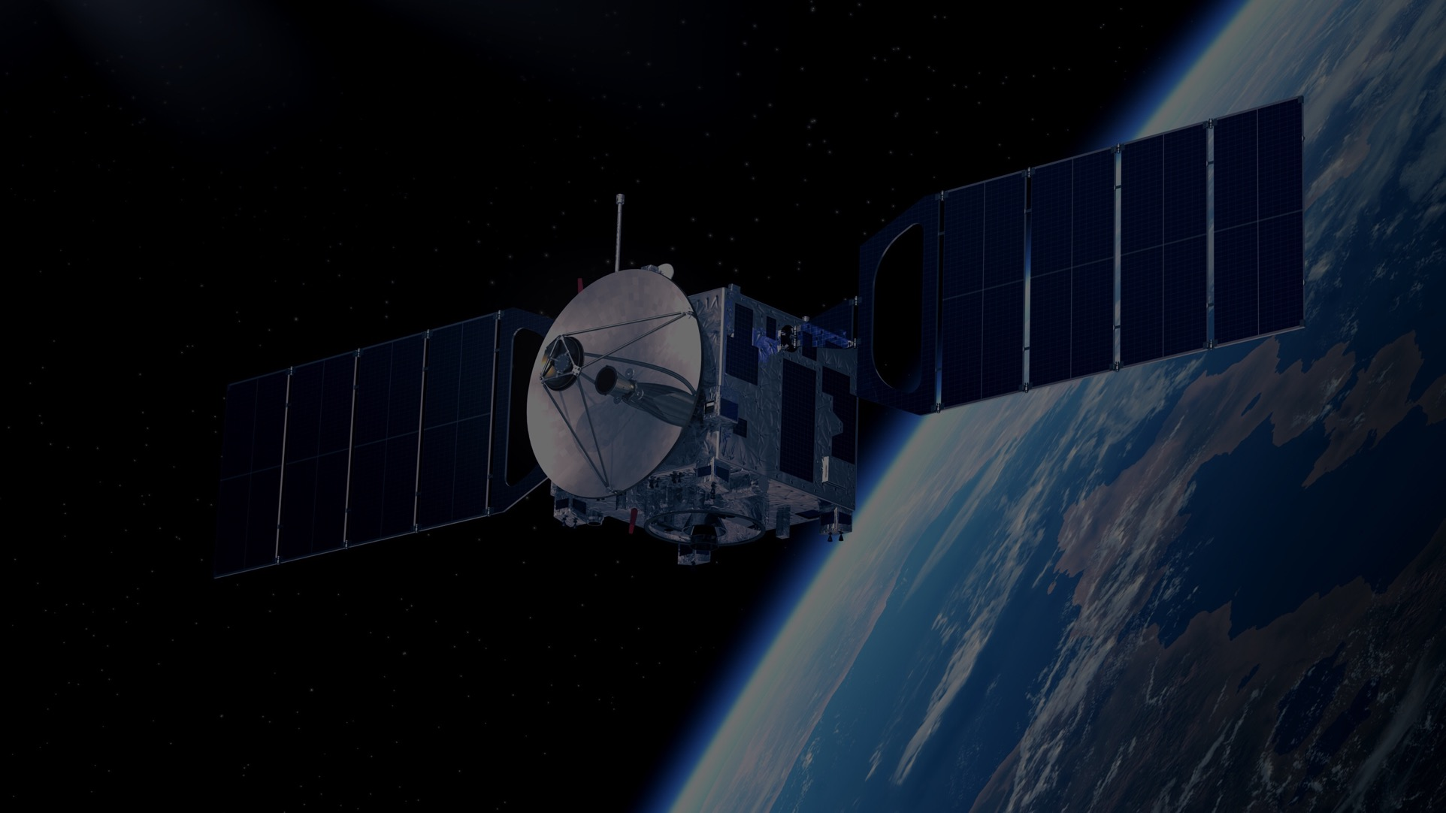
IEEE AEROSPACE AND ELECTRONIC SYSTEMS SOCIETY
ieee-aess.org

Slide 2
Field of Interest
The organization, systems engineering, design, development, integration, and operation of complex systems for space, air, ocean, or ground environments. These systems include but are not limited to navigation, avionics, mobile electric power and electronics, radar, sonar, telemetry, military, law-enforcement, automatic test, simulators, and command and control.

Slide 3
About AESS
Comprised of professionals who share your technical interests, joining AESS allows you to deepen ties to your technical community and take advantage of specialized opportunities. AESS has over 6,275 members and more than 140 chapters worldwide with programs like our Mentoring, Students, and Young Professionals to increase engagement and membership.
Conferences
Member Services
Publications
Education
Technical Panels
Awards
Notes:
Conferences: AESS financially and technically sponsors and co-sponsors over 30 conferences. Members are encouraged to submit papers, attend the conference, and network with your colleagues.
Publications: AESS sponsors and co-sponsors publications that provide differing levels of technology, invention and information to readers.
Technical Panels and Community: The creation of IEEE Standards, support of IEEE Conferences, and building a technical community are a primary responsibilities of the 6 AESS technical panels.
Member Services: AESS has over 5,000 members and more than 100 chapters worldwide with programs like our Mentoring, Students, and Young Professionals to increase engagement and membership.
Education: Provide technical content in-person and online to our members through the Distinguished Lecturers Program and Short Courses.
Awards: AESS has 17 awards recognizing our members for their contributions to publications, conferences, and technical achievements and two scholarships for undergraduate and graduate students.

Slide 4
Distinguished Lecturers Program
In-Person and Online Lecturers
100+
DL talk titles to choose from in a variety of technical fields
AESS Chapters and IEEE Sections are encouraged to take advantage of the AESS DL and Tutorial Program for their regular or special meetings, that allows them to select from an outstanding list of truly distinguished speakers who are experts in the technical fields of the society.
37
available DLs providing lectures online and in person at your next meeting, chapter event, and more
Education
Focused on providing technical content in-person and online to our members
Short Courses
While the desire is for short courses to be in-person and open to all members, they may be run virtually or exclusively to a specific company. To date, short courses have been run on four different continents, with a mixture of openly run in-person, virtual and exclusive offerings.
Online Library
130+ available recordings to watch on the IEEE Learning Network and growing!

Slide 5
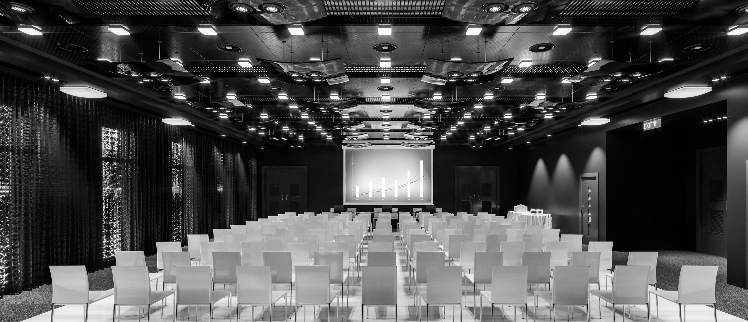
Conferences
As an AESS member, you receive a reduced registration rate, often the same amount as an IEEE Membership! A full listing of our conferences can be found on the AESS website.
AESS Financially and Technically Sponsors
AEROSPACE CONFERENCE
RADAR CONFERENCE
DIGITAL AVIONICS SYSTEMS CONFERENCE
AUTOTESTCON
Promotes interdisciplinary understanding of aerospace systems and applications for government and commercial .
Promotes radar engineering and hosts technical sessions, tutorials, and student challenges.
Brings together around 800 aerospace automatic test industry and gov/military attendees.
The preeminent R&D conference in the field of digital avionics offered.
Montana, USA
Colorado, USA
Maryland, USA
Barcelona, Spain
1-8 March 2025
6-11 May 2024
26-29 August 2024
29 Sept.-3 Oct. 2024

Slide 6
2024 Officers
President – M. Sabrina Greco
President Elect – Michael Braasch
Past President – Mark E. Davis
VP Conferences – Braham Himed
VP Publications – Luke Rosenberg
VP Education – Alexander Charlish
VP Finance – Peter Willett
VP Member Services – Lorenzo Lo Monte
VP Technical Operations – Rob Sabatini
VP Industry Relations – Stefano Coraluppi
Secretary – Walter D. Downing
Treasurer – Michael Noble
Contact Us
www.ieee-aess.org
admin@ieee-aess.org

Slide 7
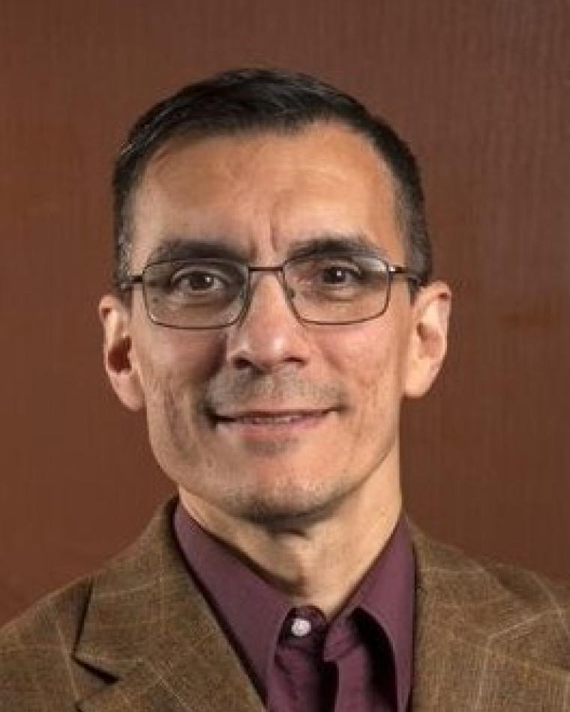
AESS Distinguished Lecturer
Carlos Insaurralde
EEE (SMIEEE), FHEA
Ontological Decision-Making Support for Air Traffic Management
Watch on the IEEE Learning Network

Slide 8
Biography
Carlos C. Insaurralde (S'95, M'99, SM’19) was born in Esperanza, Santa Fe, Argentina. He received the M.Eng. degree in Electronics from the National University of Cordoba, Argentina, in 1999, the M.Ast. and Ph.D. degrees in Computer Engineering from the Complutense University of Madrid, Spain, in 2005 and 2007 respectively, and the M.Phil. degree in Electrical Engineering from Heriot-Watt University, UK in 2014. He also received a PgCert in Learning and Teaching in Higher Education from Teesside University, UK in 2017. He is a Senior Lecturer in Electronic Engineering in the School of Engineering, Bristol Robotics Laboratory, University of the West of England, UK. In addition to teaching and research, he is the School Coordinator for Doctoral Training. His research interests are multidisciplinary development of high-integrity systems, architectures of intelligent and autonomous systems, and metric assessment of systems performance. He is author of over one hundred international publications and twenty technical reports from US-funded(DoD), UK-funded(MoD) and EU-funded projects. He also received a mention “Doctor Europaeus” accredited by the European University Association in 2007, and Best of Session Paper awards at the Digital Avionics Systems Conference (DASC), 2004, 2008, 2013, 2014, and 2022 as well as appreciation awards for significant contribution as Track and Session Chair at DASC in 2016, 2021, and 2022.

