Slide 1
IEEE AESS Radar Challenge Backyard Meteorologists
Mateo Lovato
Nick Leonard
Varun Dwarakanath

Slide 2
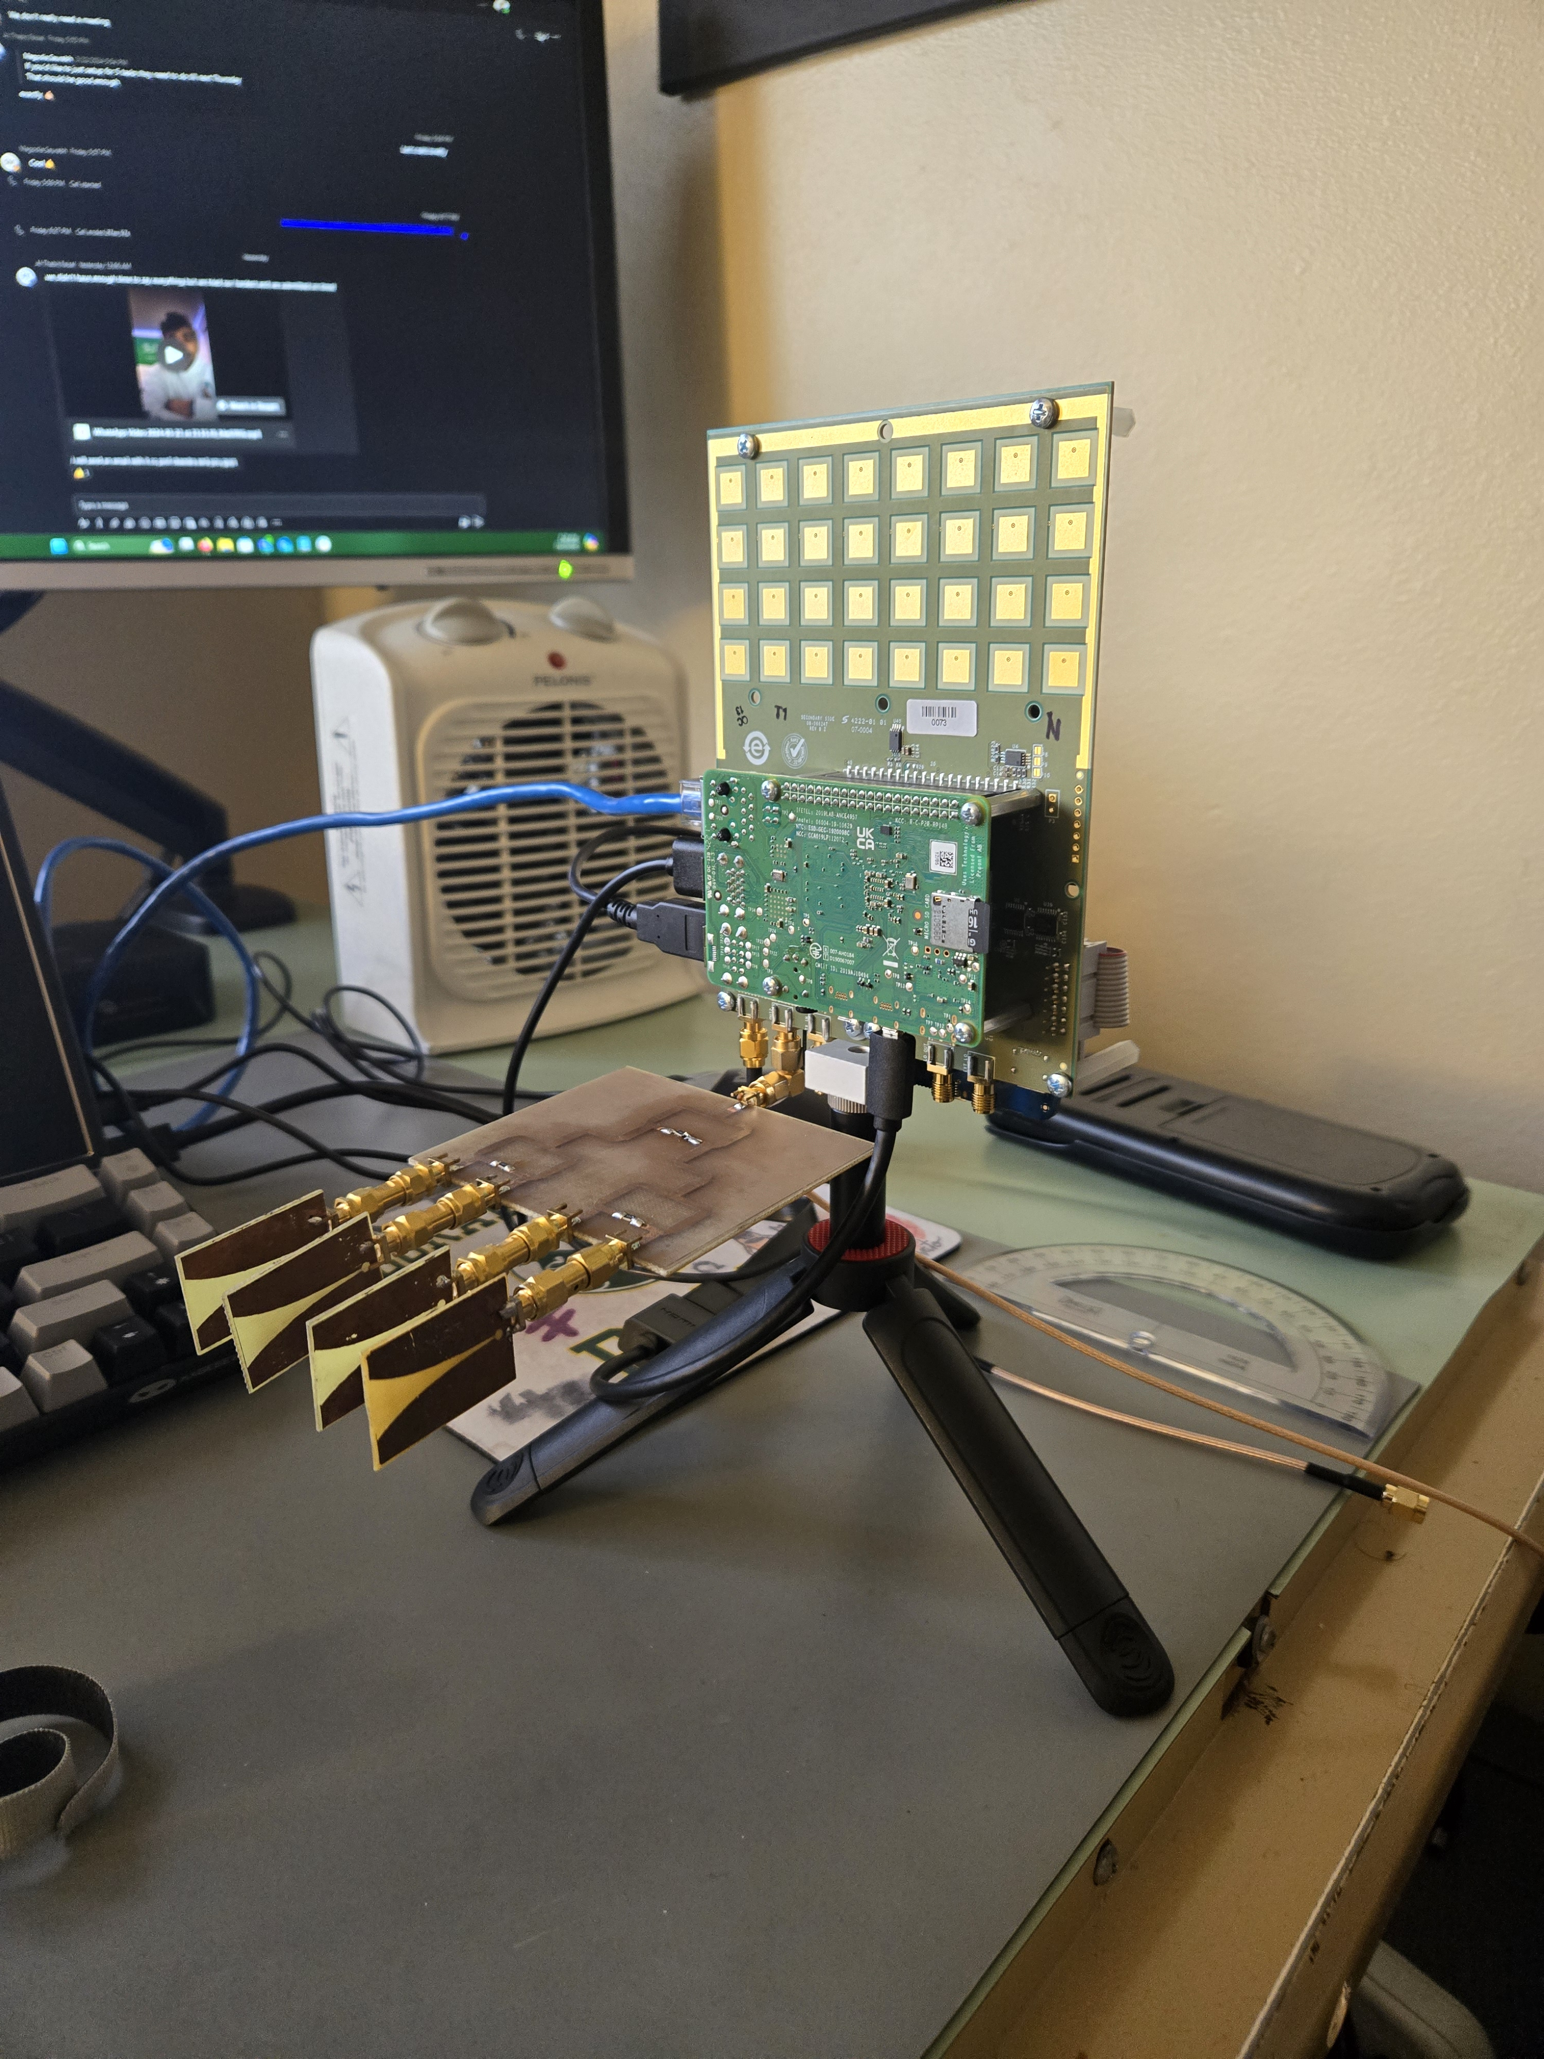
Backyard Weather Radar
FMCW Bistatic Phased Array on Receive
Carrier Frequency: 10.0 GHz
Tx Power: 1 mW ( 0 dBm)
Cell phones typically transmit 1 W (30 dBm)
Range: 1-10 m
Tx Antenna: 1x4 Vivaldi Array
Half-power Beamwidth:
35° azimuth
65° elevation
Rx Antenna: 4x8 Patch Array
Half-power Beamwidth:
13° azimuth
26° elevation

Slide 3
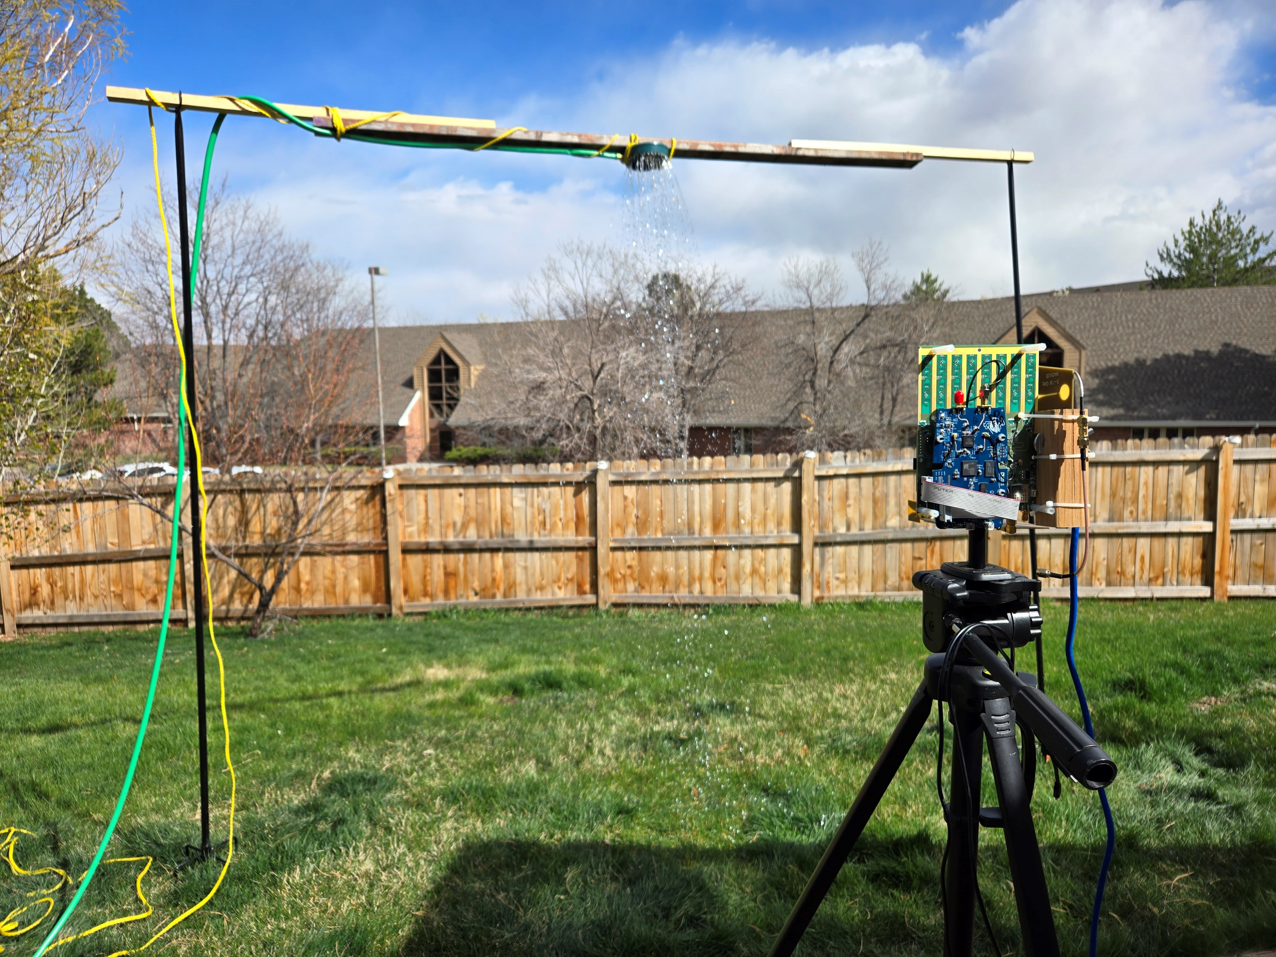
Simulated Rain Experiment
Modified sprinkler head for large-diameter water drops
Higher reflectivity and differential reflectivity
Drops fall approximately 3.3 m from radar
Reduced clutter
Large, open area
Wide sprinkler mount

Slide 4
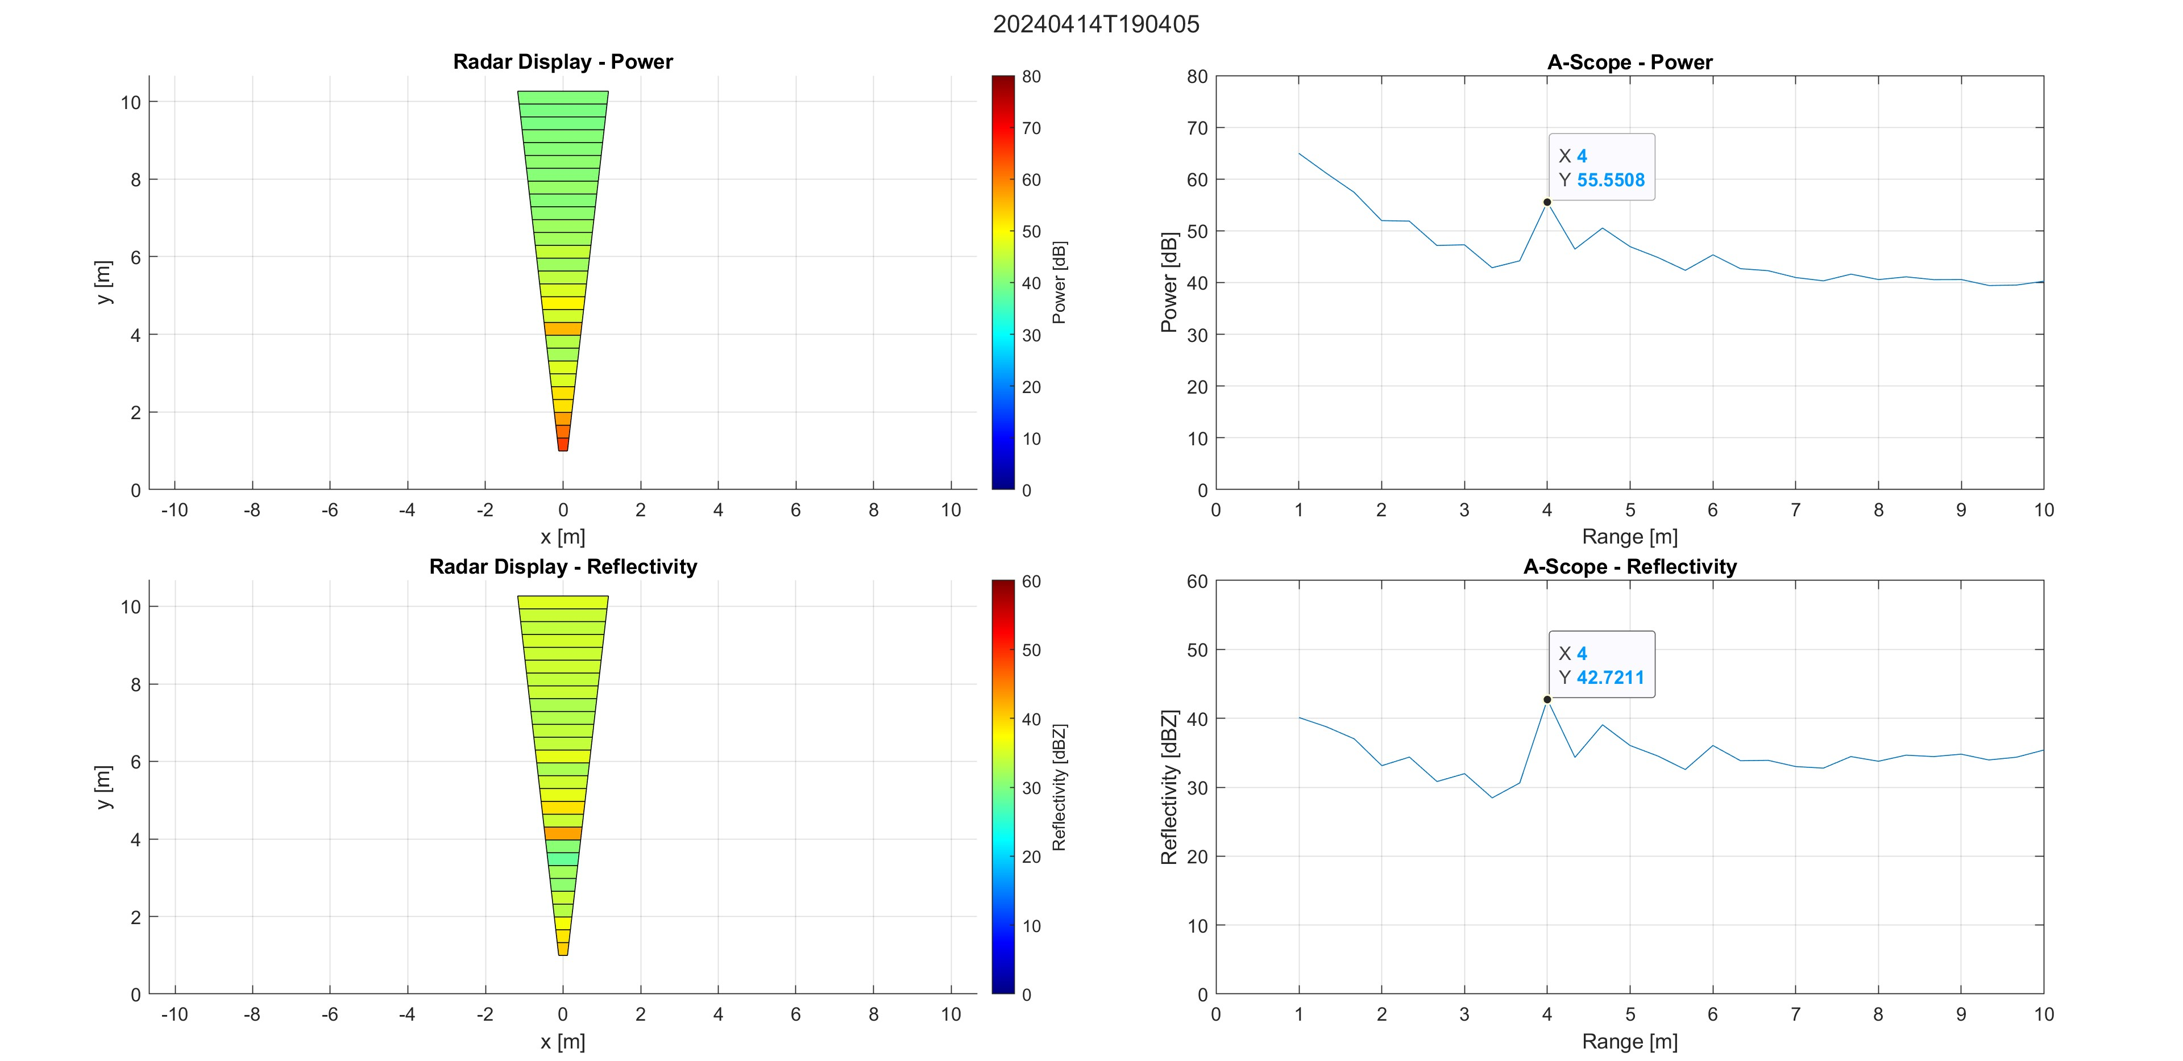
Radar Calibration
12-inch diameter sphere located 4 m from the radar
Radar Cross Section: $σ=πr^{2}=0.073{ m}^{2}$
Received Power (at antenna): $P_{r}=\frac{P_{t}G^{2}λ^{2}}{{\left(4π\right)}^{3}r^{4}}σ$
Receiver Power: $P_{o}=G_{rx}P_{r}$
Radar Constant: $C= \frac{G_{rx}P_{t}G^{2}π^{3}{\left|k_{w}\right|}^{2}∆r\sin{\frac{θ}{2}\sin{\frac{φ}{2}}}}{{128×{10}^{18}λ}^{2}\ln{2}}$
Equivalent Reflectivity: $Z_{e}=\frac{P_{o}r^{2}}{C}$
$dBZ=10\log_{10}{Z_{e}}$ = 41.6 dBZ
Measured Reflectivity: 42.7 dBZ
Equations above taken from
[1] Chandrasekar, V., Bechini, R., & Beauchamp, R. M. (2023). Introduction to dual polarization weather radar: Fundamentals, applications, and Networks. Cambridge University Press.

Slide 5
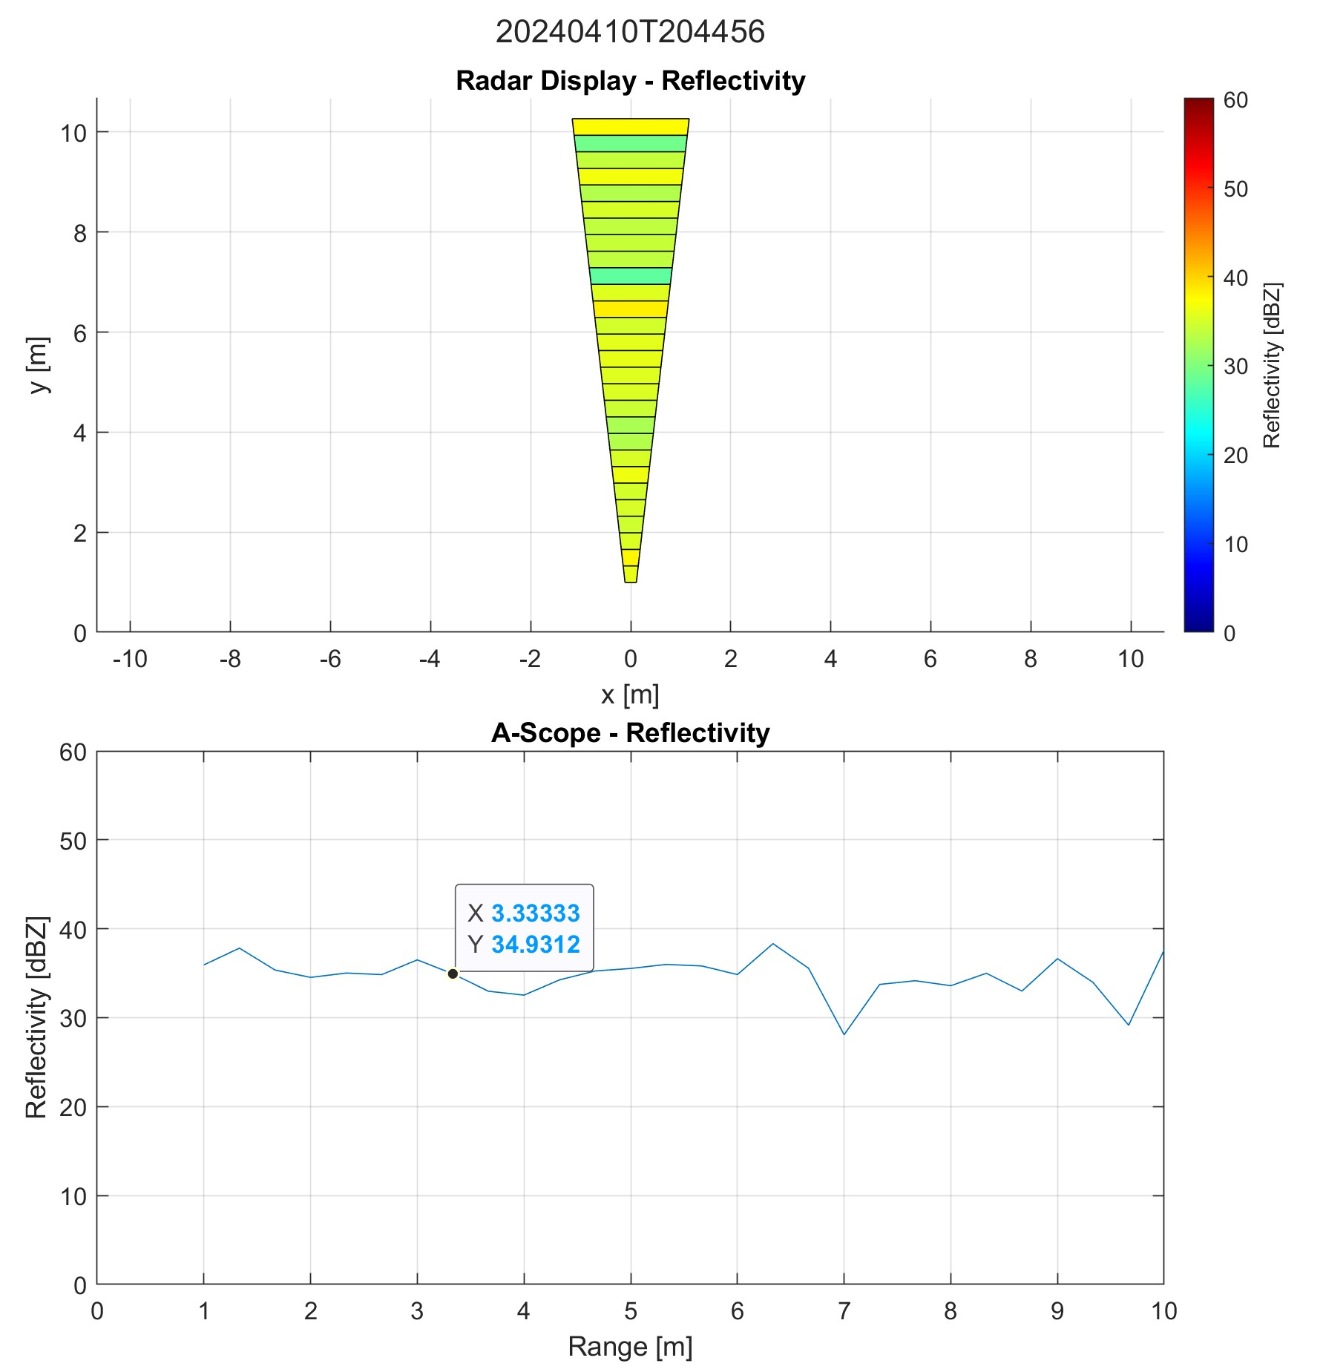
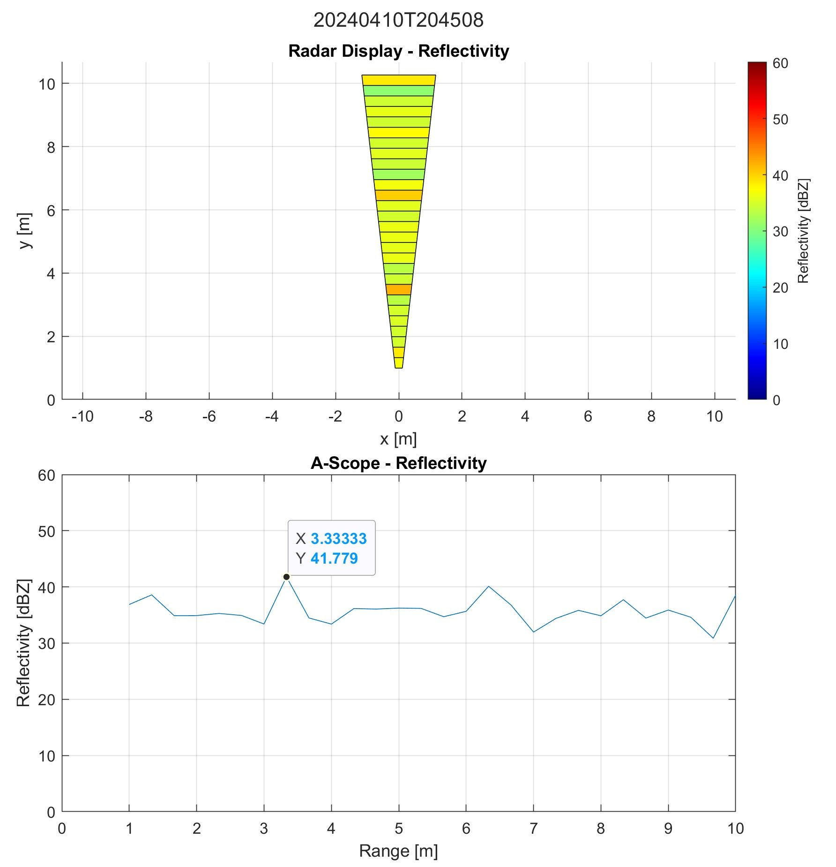
Reflectivity from Simulated Rain
Sprinkler Off
Sprinkler On
Vertical polarization
Rain curtain 3.3m from radar
12-second difference between sprinkler off and on
Averaging over 20 pulses
Measured Reflectivity: 41.8 dBZ
Corresponds with moderate to heavy rain
10 dB above background noise

Slide 6
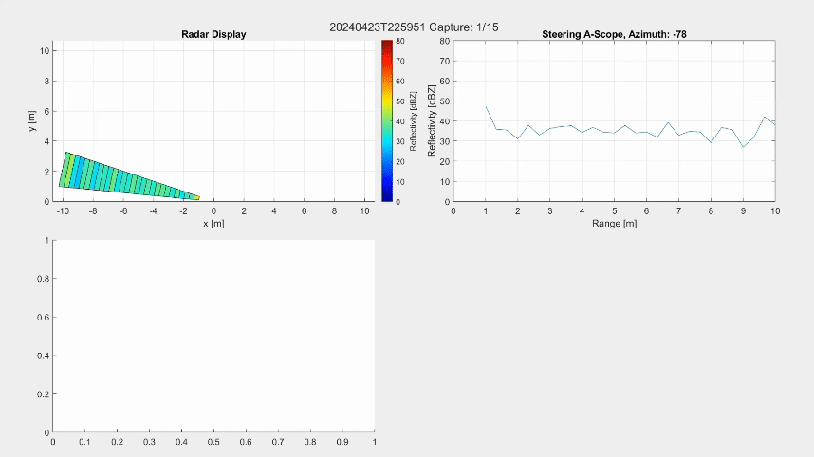
Electronic Scanning
Corner reflector located at mechanical boresight, 9.6 m from the radar
Reflectivity: 50 dBZ
13 steering angles
-78° to 78° in 13° increments
Half-power azimuth beamwidth of the receive antenna
Scan rate: 1.0°/s
Live MATLAB display/recording
Radar display (PPI scan)
Instantaneous A-scope
Mechanical boresight A-scope

Slide 7
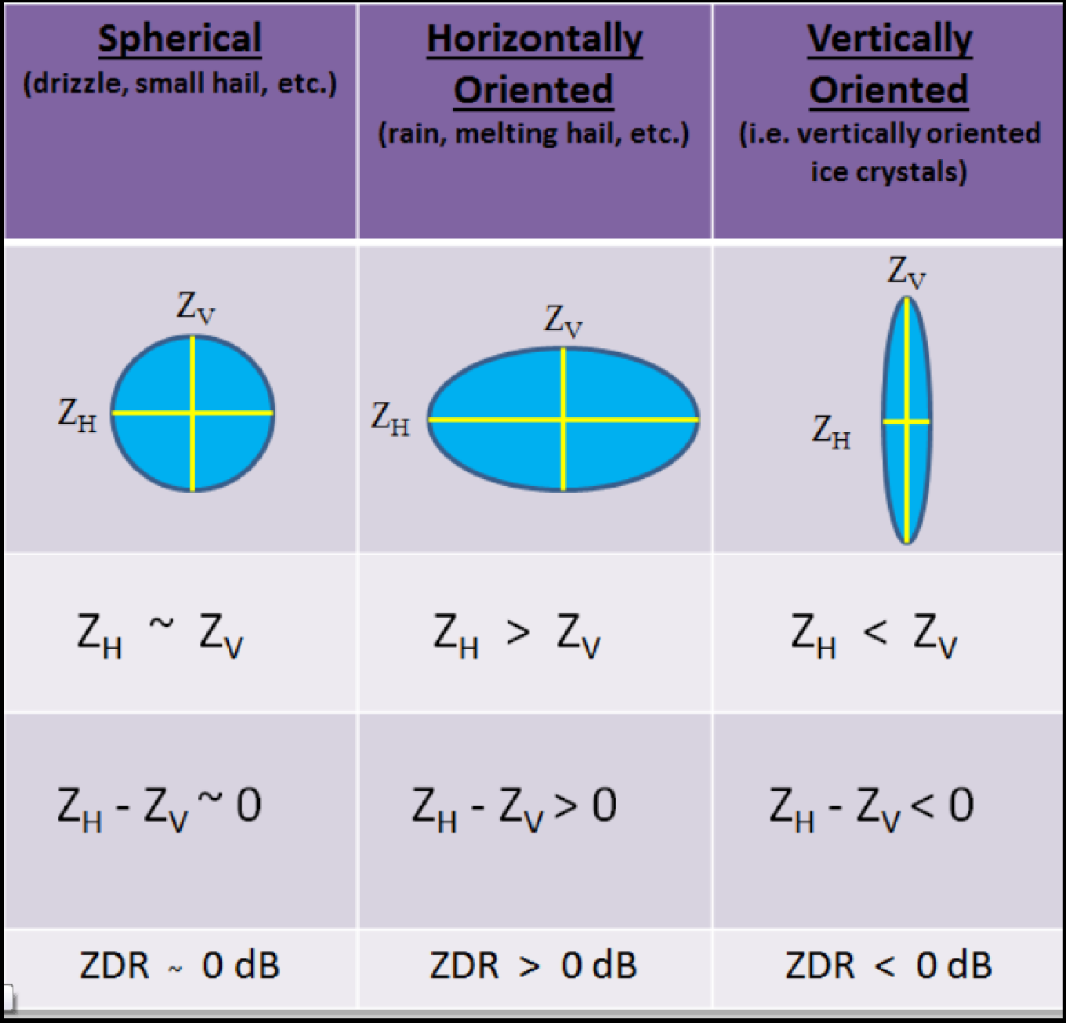
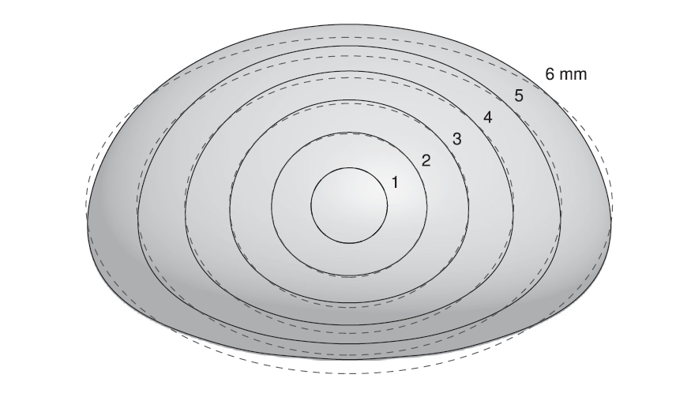
Future Work: Differential Reflectivity
$ZDR={dBZ}_{h}−{dBZ}_{v}$ [1]
Allows classification of drizzle, rain, snow, hail, etc.
Rain typically has a ZDR of 0 to 5
0 corresponds to light drizzle and 5 corresponds to heavy rain
Error in the current ZDR measurement caused by:
Non-symmetric Tx/Rx fan beams
Collections between polarizations being minutes apart
Single-polarization antennas - radar must be rotated by hand
Future implementations
Dual-pol Tx with X-Band horn
Rx with 4x4 array from phaser (disable 4 columns)
Simultaneous reception H/V Pol
ZDR Interpretation [1]
Raindrop size model [1]

Slide 8
Acknowledgements
Thanks to Jon Kraft from Analog Devices for the support and guidance throughout the project. We also want to thank George Mencoff and the Mathworks team for sharing MATLAB code to control the Phaser Board. Finally, we would like to thank our mentor and academic advisor, Dr. V. Chandrasekar (Dr. Chandra), for giving us direction and helping us reach our goals.

