Slide 1
Passive Radar with Phaser
Mason Stone & Matt Pierce

Slide 2
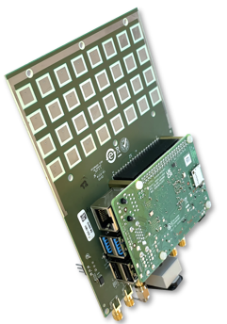
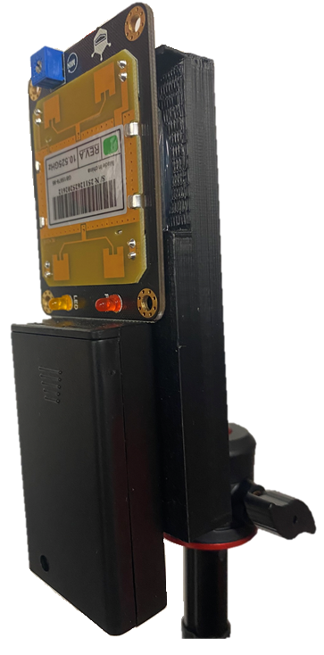
Passive Radar Concept
Passive radar utilizes signals in the electromagnetic spectrum
Signals are either detected directly or indirectly
Location can be done in several ways:
Two separate receivers doing triangulation
One receiver that is moving in location and time
The demo uses a direct detection scheme with 2 phasers
HB100
Direct Signal Detection
HB100
Indirect Signal Detection
Notes:
Matt

Slide 3
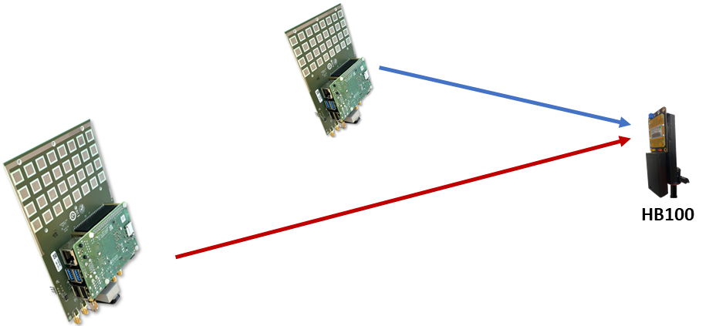
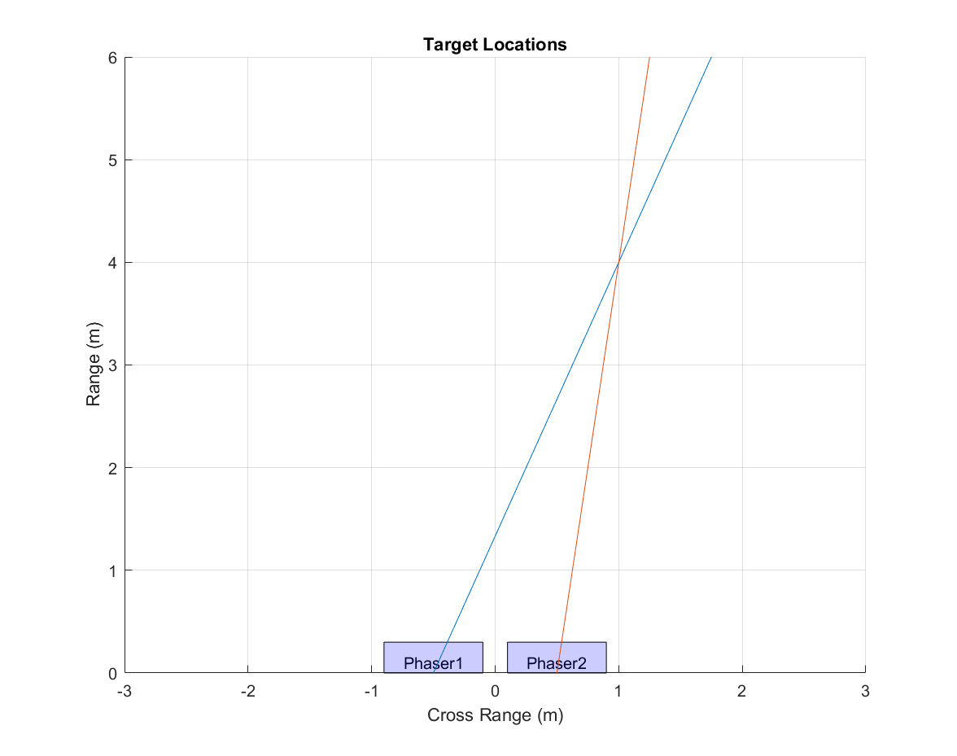
Triangulation
Each phaser’s location is known
The angle to the emitter is measured
Phaser sweeps from -60° to 60° in azimuth
Monopulse angle is used for higher accuracy
Notes:
Matt

Slide 4
Multiple Signals
The frequency and amplitude of each emitter is measured
Signals are sorted by frequency within a range
The scan of frequency over angle is from one phaser
HB100
HB100
Notes:
Mason

Slide 5
Tracking
Sorted signals are tracked over time
The angle from each phaser is computed for each phaser sweep
The location is plotted in a two-dimensional space
The red dots in “Target Locations” is one target, which is receding.
Note the recent hits are dark, and they grow fainter over time
Notes:
Mason

Slide 6
GUI
Amplitude over Angle (Beam Pattern)
Location in Space (Triangulated Position)
Amplitude, Frequency and Angle (Signal Sorting)
Signal Angle over Time
(Angle of Arrival)
Notes:
Mason

Slide 7
Demonstration
https://youtu.be/oQ30GX5wlZk
Demonstration for 2 Phaser Passive Radar
Notes:
Mason

Slide 8
Thank you very much for your attention!

