Slide 1
2024 IEEE Radar Challenge – Single CPI Classification of UAVs using Phaser 10 GHz Phased Array Radar Platform
Sean J. Kearney, Josh Haeker, and Emily Curl
Laboratory for Computational Intelligence in Radar (CI4R)
University of Alabama, Tuscaloosa, Alabama, USA

Slide 2
Problem Statement
Detection of Unidentified Unmanned Aerial Vehicles (UAVs) needs to be made with data collected over a small period of time

Slide 3
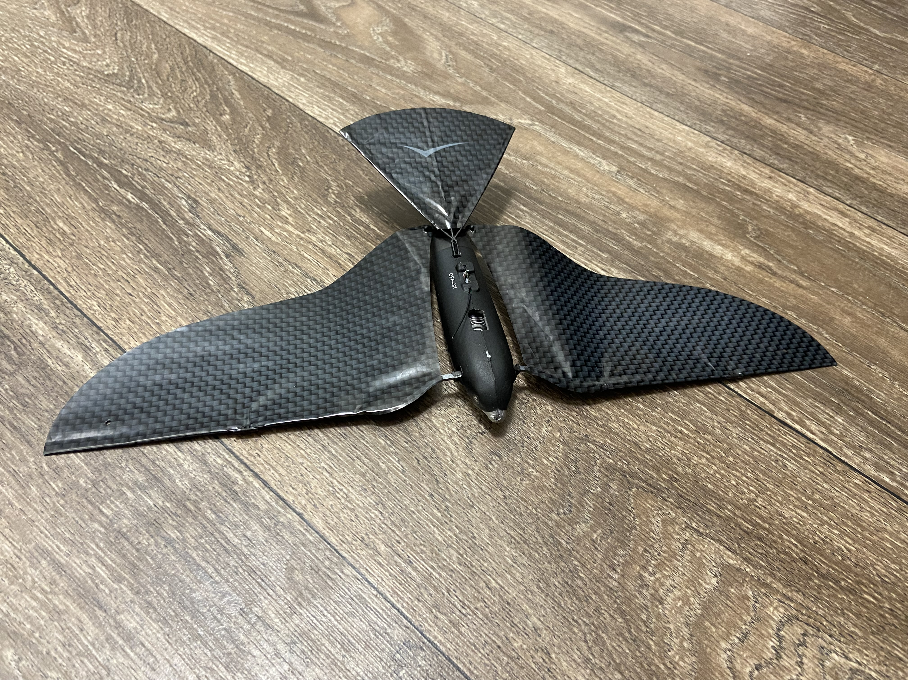
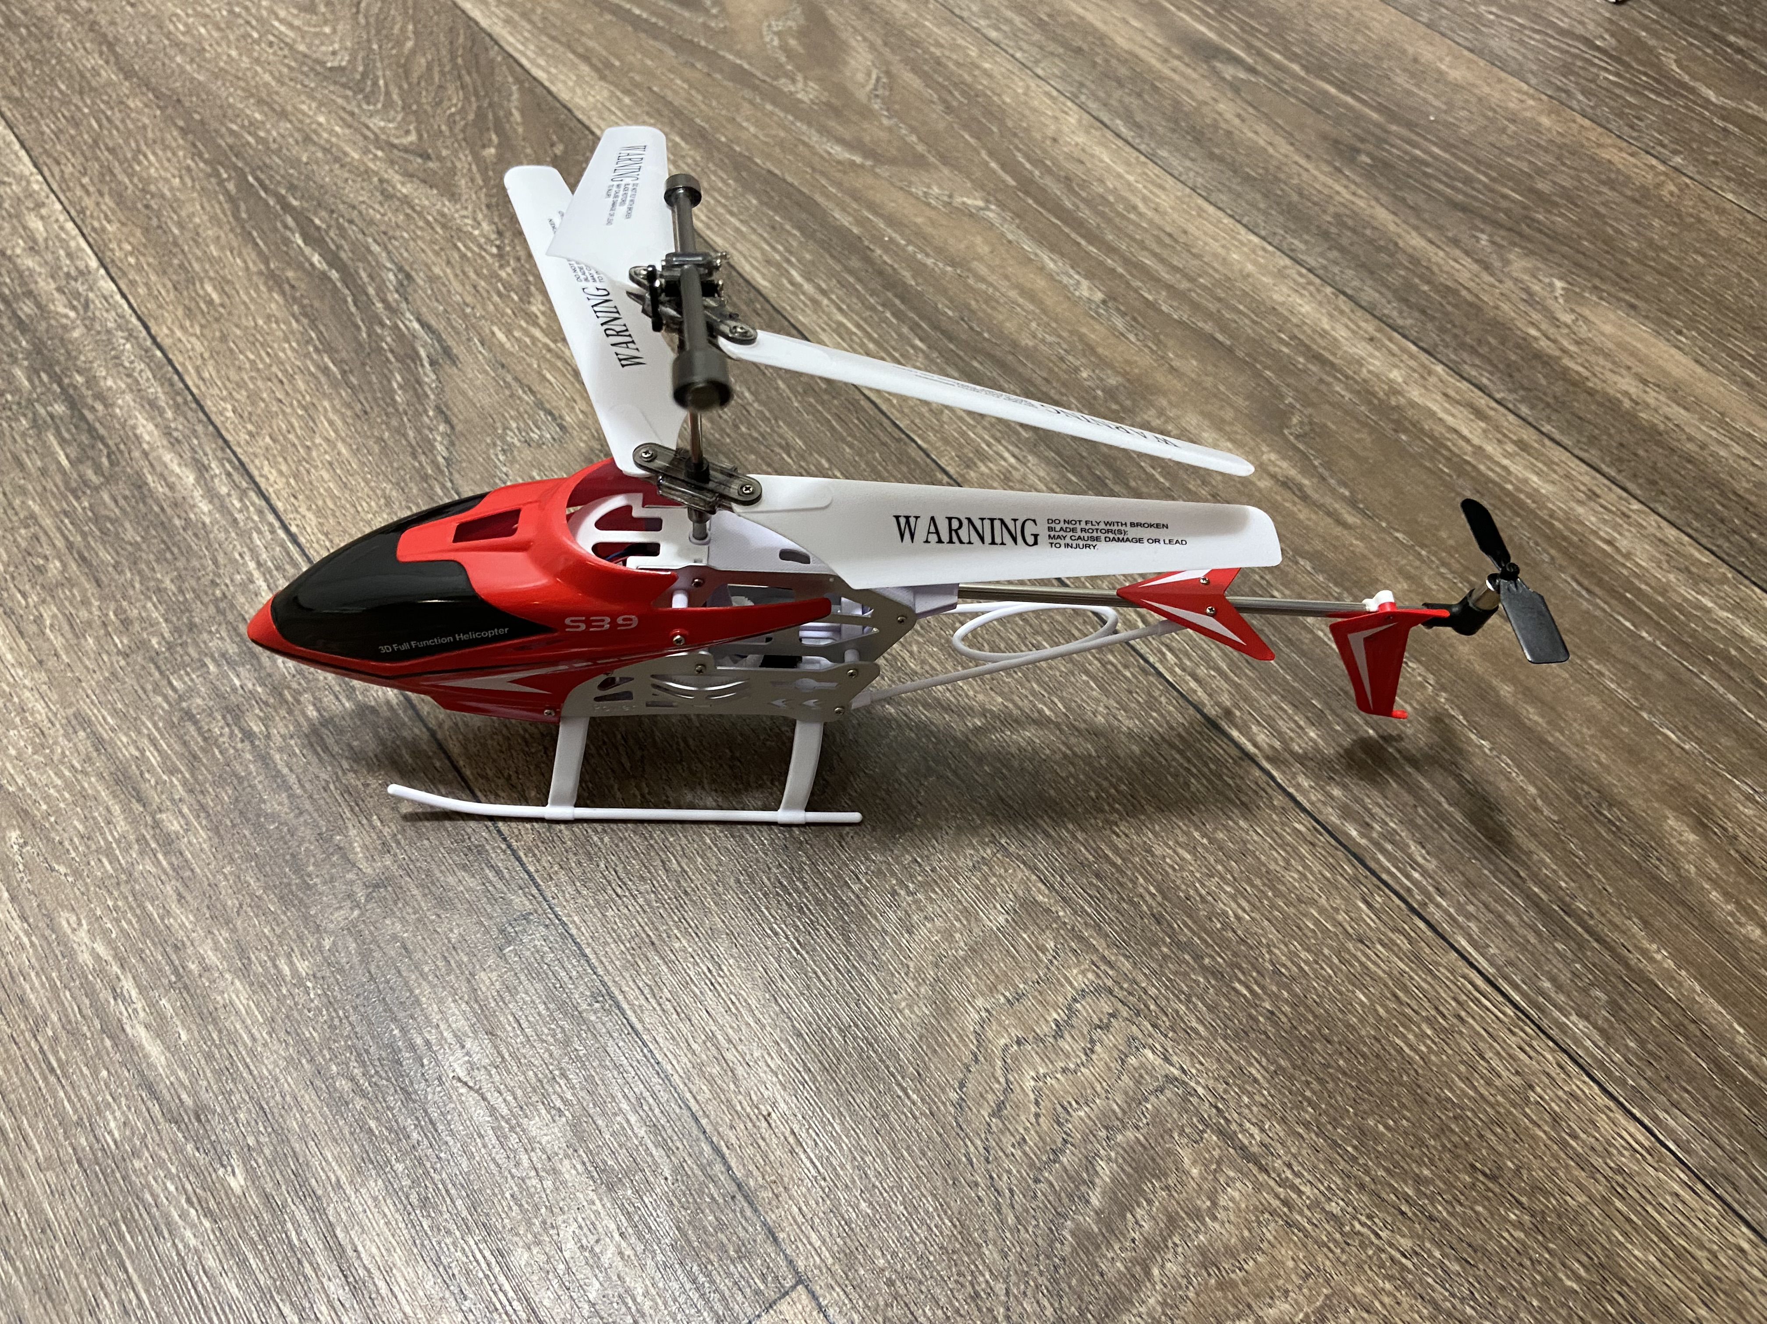
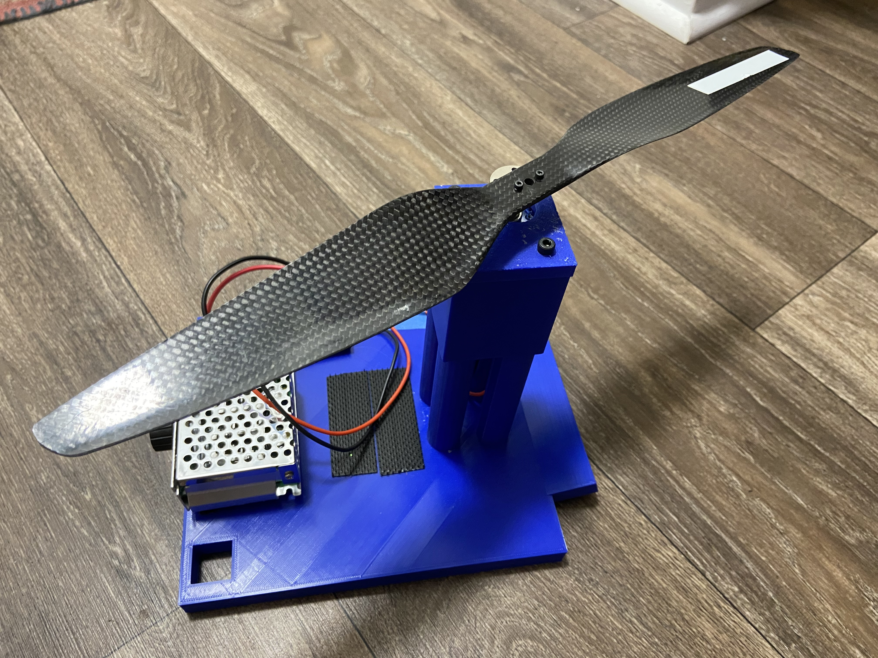
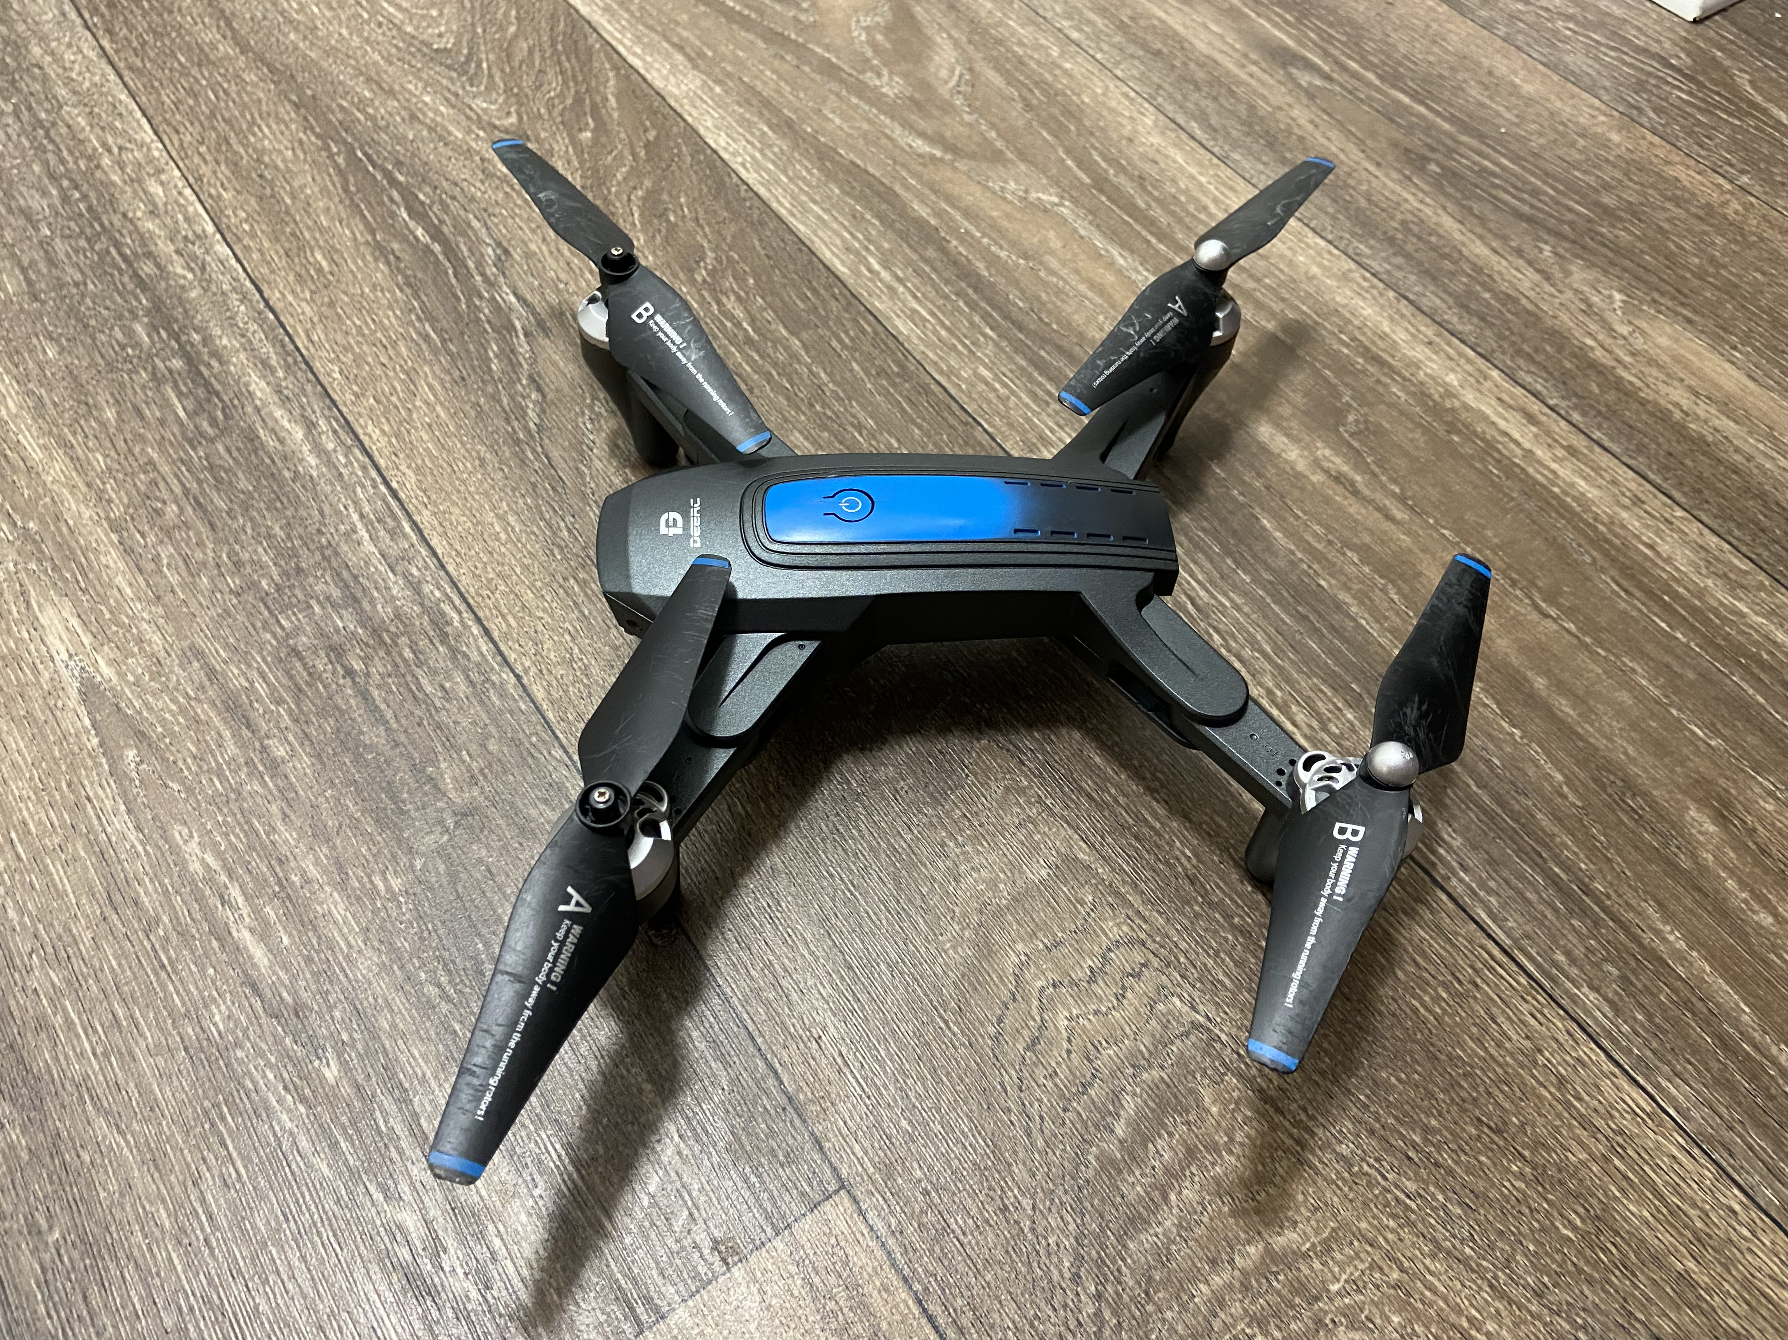
Targets
Left: MetaBird
Right: Syma RC Helicopter
Left: motor powered Propeller
Right: DEERC Quadcopter

Slide 4
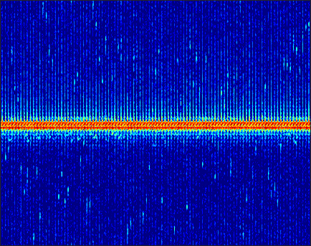
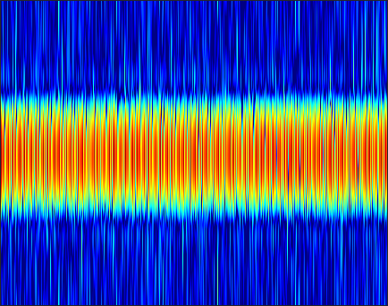
Radar Data
X band radar
Run with MATLAB
Maximum Range = 2m
Maximum Velocity = 5 m/s
Spectrogram:
STFT
Window size: Short vs. Long
Bin size: 10 vs 267
Overlap: 8 vs 250
STFT of Quadcopter with Long Window
STFT of Quadcopter with Short Window

Slide 5
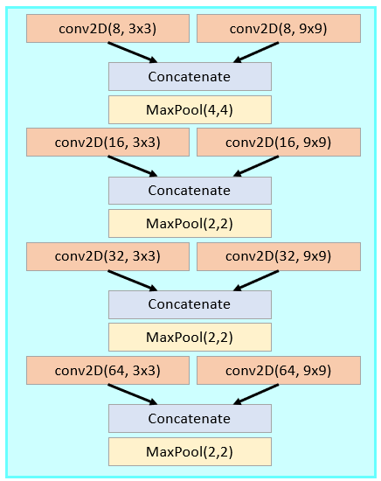
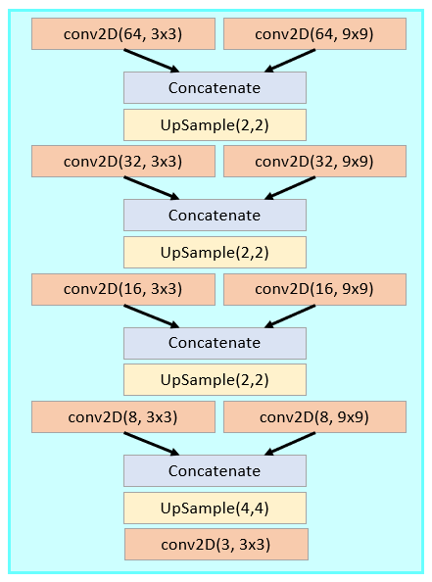
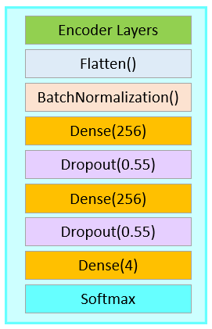
Classification Network
Encoder – 4 layers
2 Convolutions
Concatenation of Convolutions
Maxpooling
Decoder – 4 layers
2 Convolution
Concatenation of Convolutions
2D Upsampling
Encoder for Classification
Trained Encoder followed by fully connected layers and then a softmax layer

Slide 6
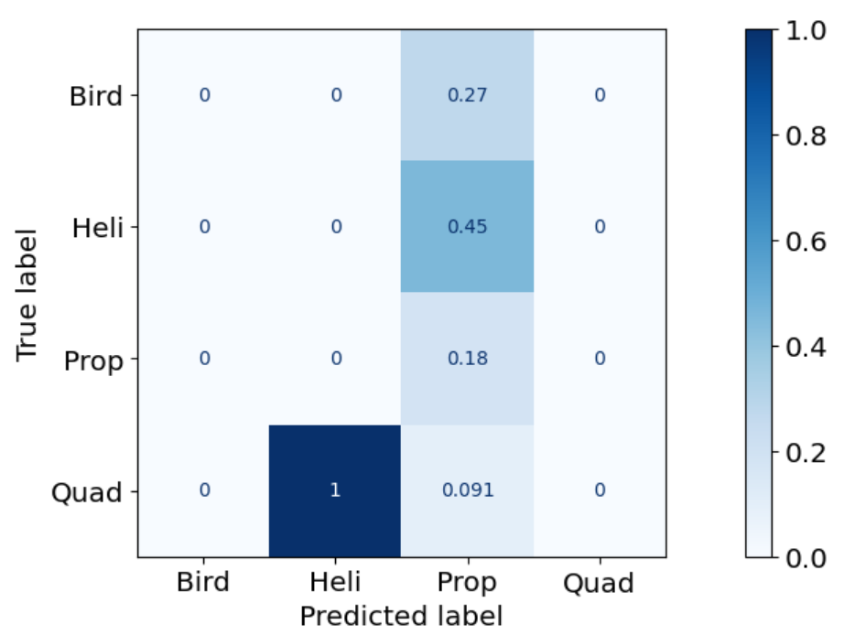
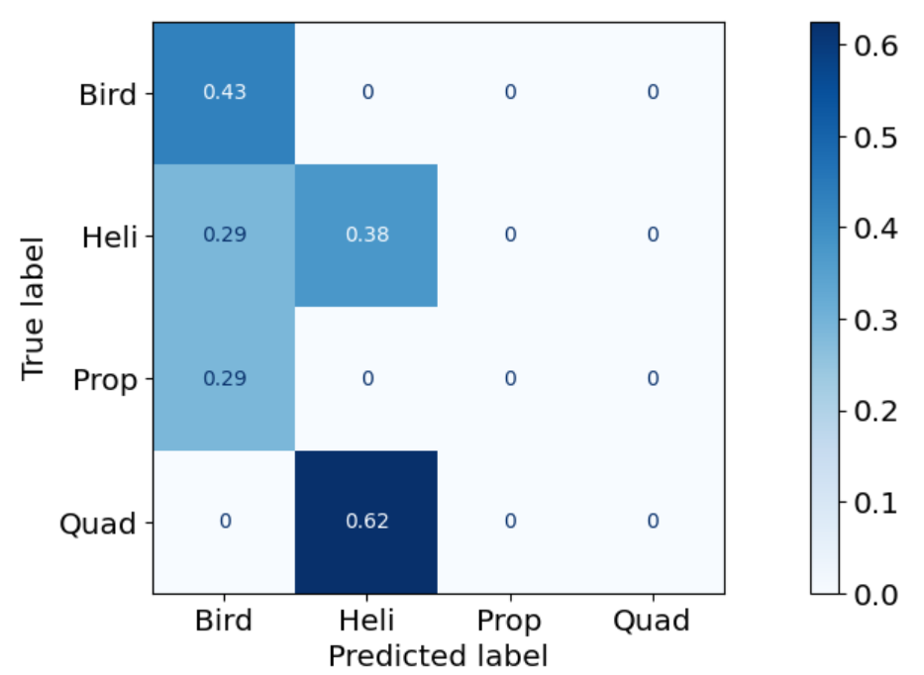
Classification Across 100 CPIs
9 samples per target
Long Window
Accuracy = 13.3%
Short Window
Accuracy = 40%
Confusion Matrix for Long Window
Confusion Matrix for Short Window

Slide 7
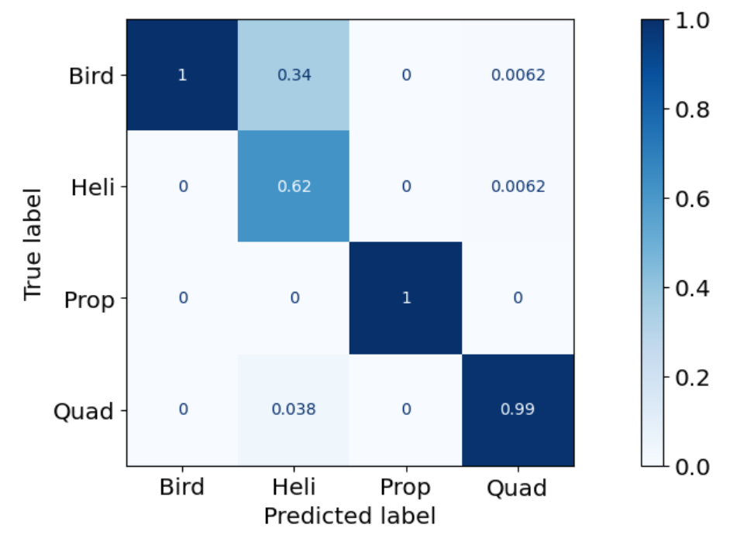
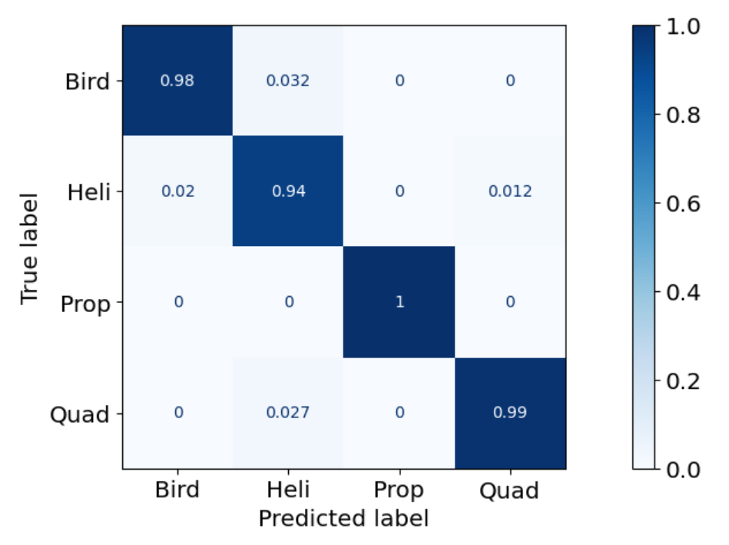
Classification Across 1 CPI
900 samples per target
Long Window
Accuracy = 84.4%
Short Window
Accuracy = 97.6%
Confusion Matrix for Long Window
Confusion Matrix for Short Window

Slide 8
Conclusion/Future Work
Conclusion
Phaser X-band Radar can detect features of UAVs
UAV detection per CPI boosts training dataset size and in turn model classification accuracy
Effectiveness of Blade Flashes vs HERM Lines per single CPI
Future Work
Detection over longer distances
How would equal sized datasets across different amounts of CPIs compare?
How does noise in environments affect Blade Flashes?

Slide 9
Thank you!
For further information and inquiries:
sjkearney@crimson.ua.edu
GitHub: sjkearney1228/2024_IEEE_Radar_Challenge
Laboratory of Computational Intelligence for Radar
http://ci4r.ua.edu

Slide 10
Appendix

Slide 11
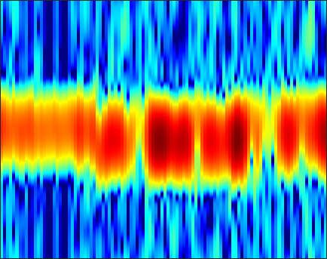
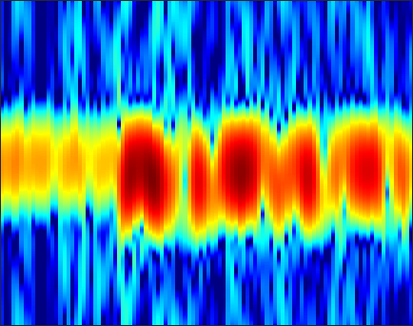
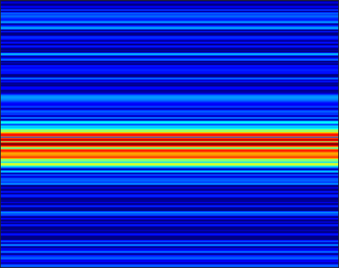
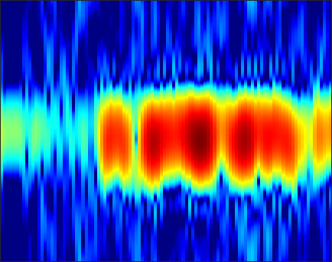
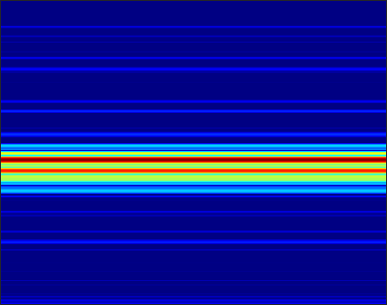
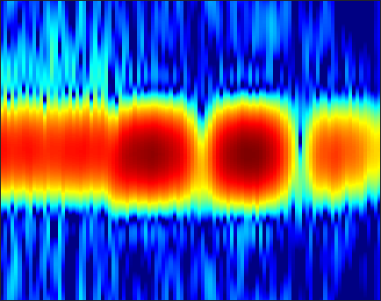
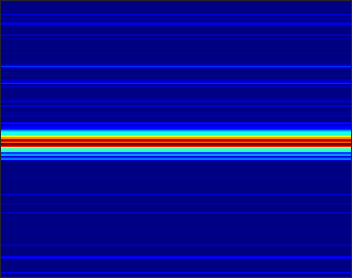
Single CPI Spectrograms
Bird (window 10 vs 200)
Heli (window 10 vs 200)
Propeller (window 10 vs 200)
Quad (window 10 vs 200)

