Slide 1


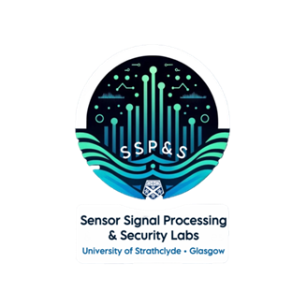
Micro-Doppler Extraction from SAR
X THE PLACE OF USEFUL LEARNING
Finlay Rollo
PhD Student – University of Strathclyde
Finlay.rollo.2019@uni.strath.ac.uk

Slide 2



Team
Finlay Rollo – Methodology, software, presentation
Thomas Wright – Setup, hardware, methodology
Greta Zefi – Software, theory

Slide 3
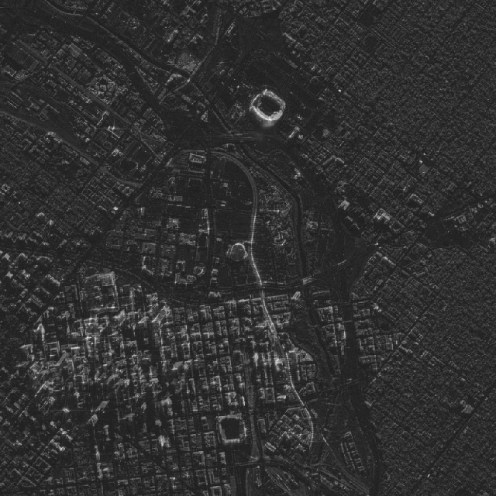
Introduction to SAR
SAR uses the motion of a platform to synthetise a longer antenna and increase resolution.
All weather, day and night imaging capabilities
Applications in earth observation, infrastructure monitoring and defence and security.
SAR image of Denver. Credit: Umbra Space.

Slide 4
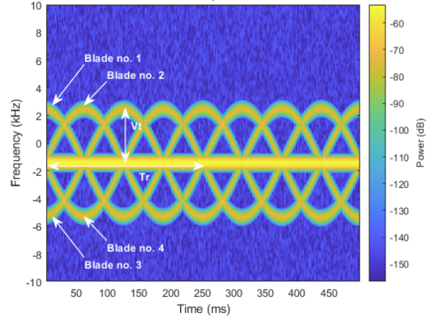
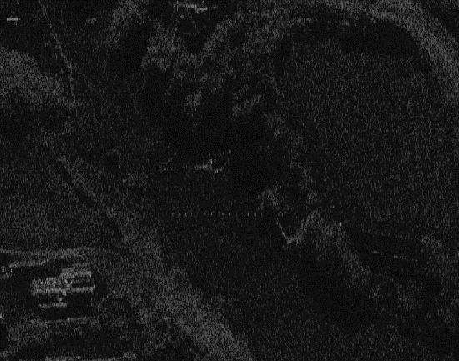
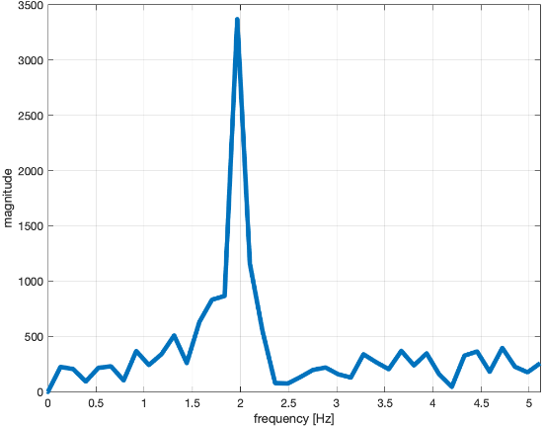
Introduction Continued
Micro-Doppler effects occur when parts of a radar target have a time-varying velocity in addition to the bulk movement.
Manifests itself as ‘paired echos’ or ghost targets in SAR imagery
Aim of this project was to extract micro-Doppler information from a miniature SAR system using the phaser kit.
Motivation to conveniently and cheaply reproduce SAR in a lab environment – avoiding prohibitively expensive commercial tasking.
Example micro-Doppler. Credit: MathWorks.
TerraSAR-X – 3cm PP, 2Hz
Clemente et al. “On Micro-Motion Extraction from High Resolution X-band SAR products” , IGARSS 2024, 7-12 July 2024, Athens, Greece.

Slide 5
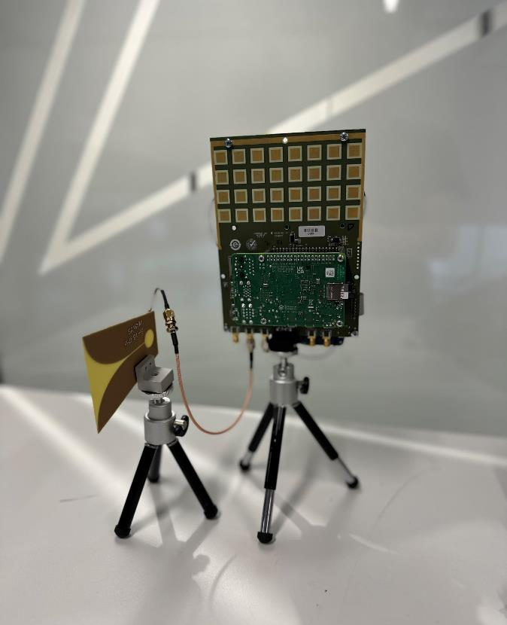
Why the phaser?
Cost effective solution
Very good documentation
Integration with MATLAB
Operates in X-band

Slide 6
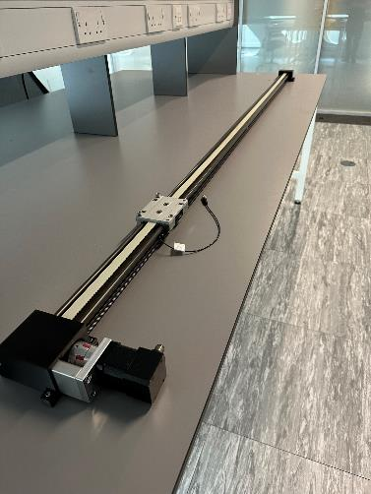
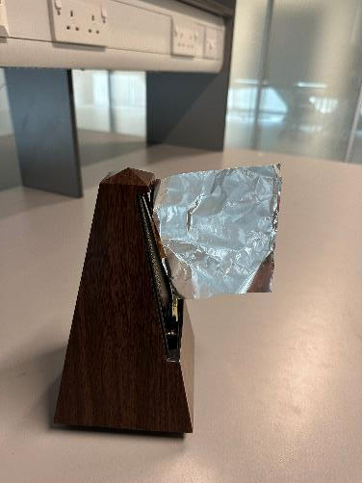
Method
Movement
2-meter linear axis rail with top speed of 0.45 m/s
Waveform
1000 pulses of single ramp burst with PRI of 2 ms. Bandwidth of 450 MHz
Micro-Doppler
Spectrograms of cross-range samples after rang compression

Slide 7
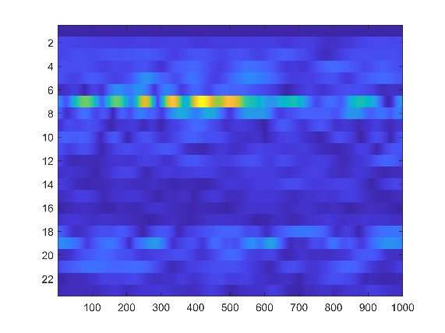
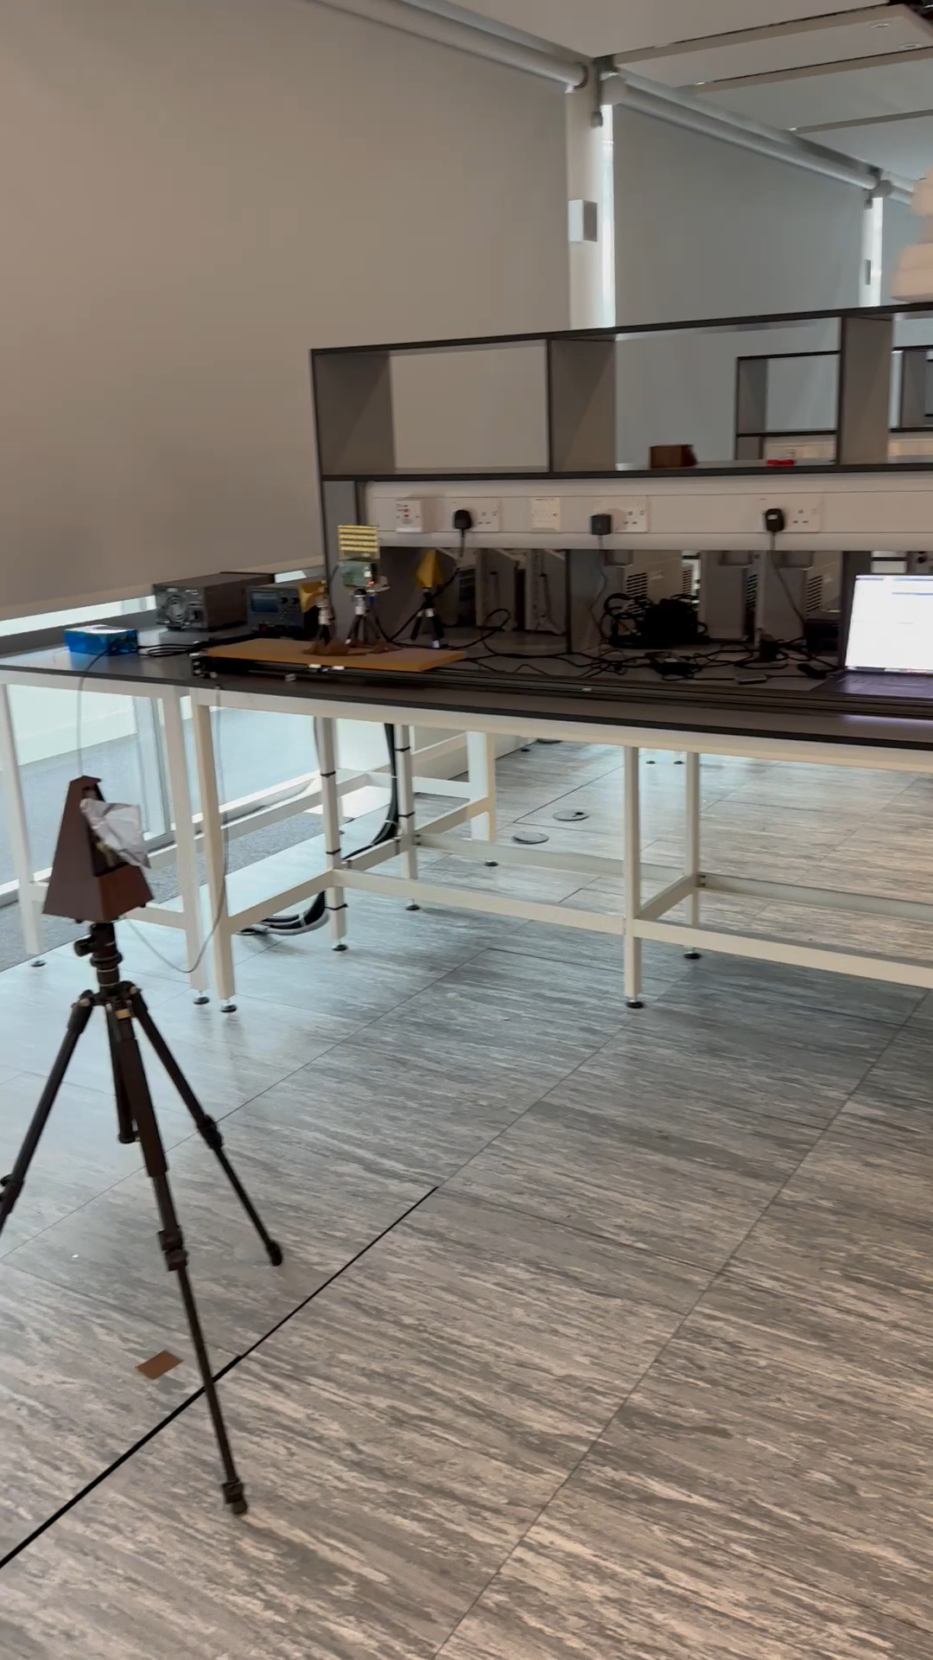
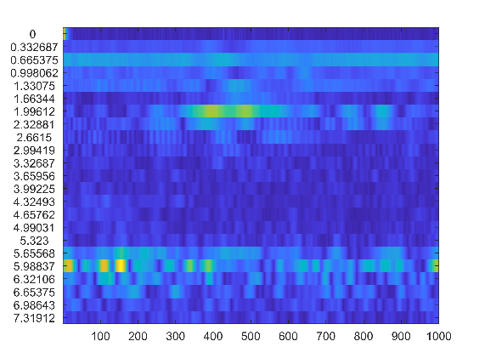
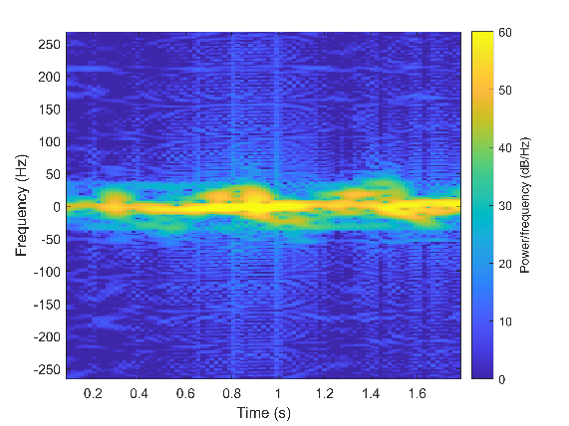
Demonstration and Pipeline
Azimuth compression
Range compression
Spectrogram

Slide 8
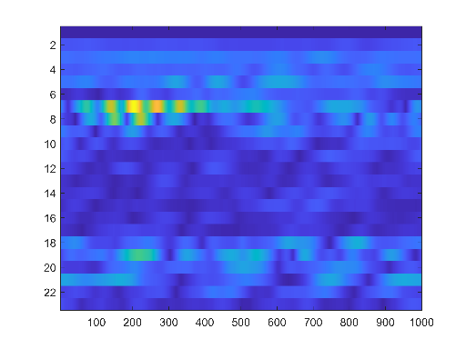

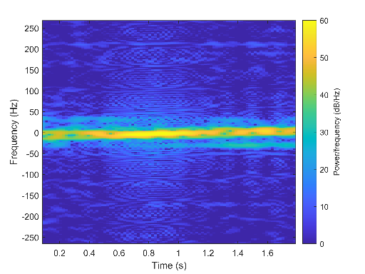

Results
Stationary Target
Vibrating Target
Results compare well to ‘ground truth’ of metronome which was recorded to be 70 BPM or 1.16 Hz.
This corresponds to a period of 0.86 seconds.
Corresponding azimuth shift with vibrating target due to non-zero velocity.
Focused SAR Image
Focused SAR Image
Spectrogram of range bin 7 from range compressed data
Spectrogram of range bin 7 from range compressed data

Slide 9
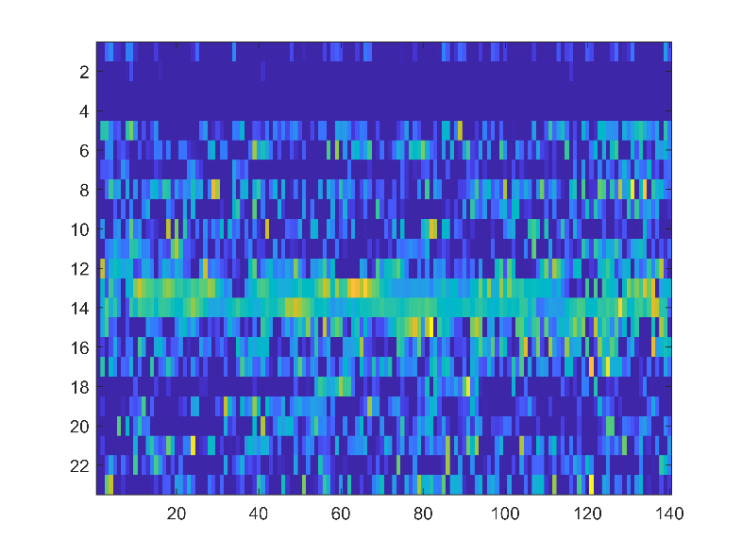
Limitations
Limited by samples per frame - attempted stop and go but lost coherency. The out of phase terms significantly increased clutter.
Indoor environment – multipathing
Synchronisation issues with rail and radar acquisitions
Range compressed data using multiple frames

Slide 10
Conclusions
Successfully created a miniature SAR system using phaser kit.
Micro-Doppler effects extracted with reasonable accuracy.
Next steps to refine methodology and use more precise ground truths and advanced algorithms.

Slide 11

X THE PLACE OF USEFUL LEARNING

