Slide 1



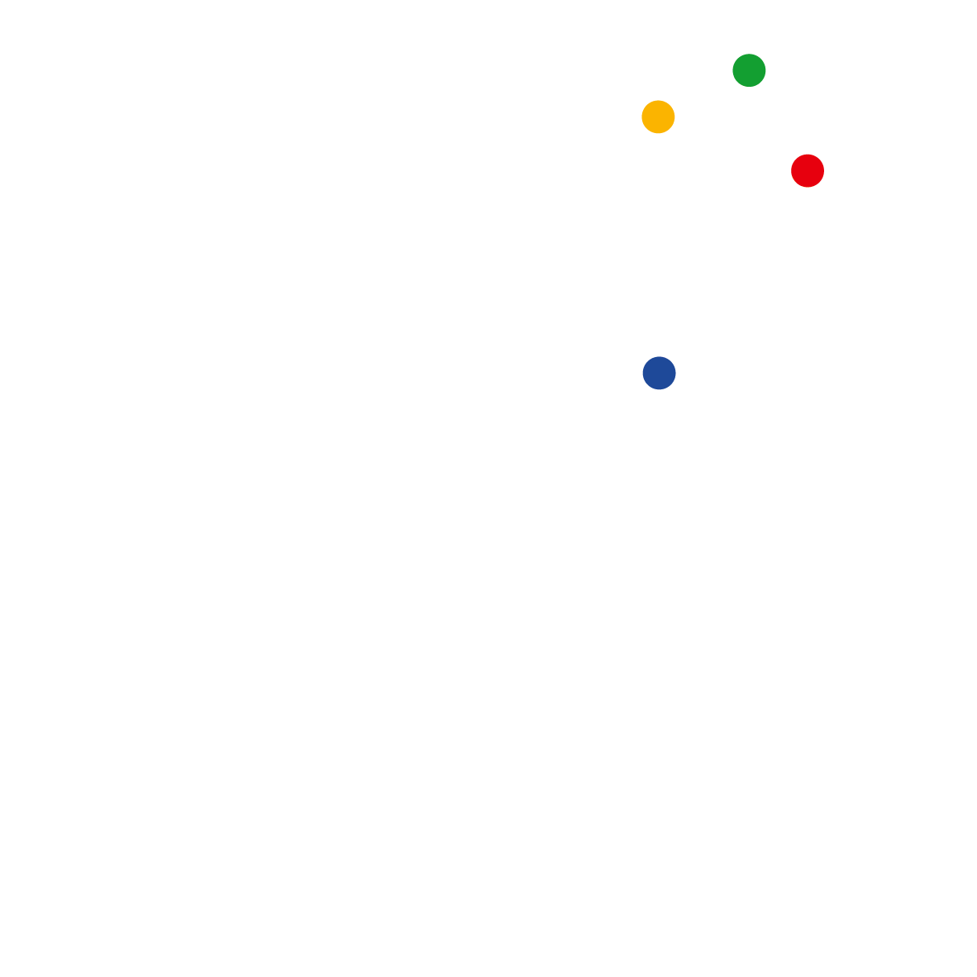

Autonomous Model Analytics for Avionic Systems
VIRTUAL DISTINGUISHED LECTURE SERIES
Dr Carlos C. Insaurralde
Bristol Robotics Laboratory
University of the West of England
Bristol, United Kingdom
School Coordinator for Doctoral Training
Former Programme Leader of BEng Robotics
Principal Investigator in the Bristol Robotics Laboratory
Visiting researcher in the US Air Force Research Laboratory
Associate Editor of the IEEE AESS Magazine
Member of the IEEE AESS Avionics Systems & Cyber Security Panel
Tutorial Instructor for Digital Avionics Systems Conf. & IEEE Int. Systems Conf.
Doctor Europaeus qualification, European University Association
v1.2
6 November 2024

Slide 2
Carlos C. Insaurralde, MEng, PgCTLHE, MAst, MPhil, PhD
IEEE Senior Member, HEA Fellow
US-funded(DoD), UK-funded(MoD) and EU-funded projects
  US research project in collaboration with the AFRL.
  UK research projects in collaboration with BAE Systems, Atlas Elektonik, and seabyte.
  EU research projects in collaboration with Airbus, Eurocopter, Goodrich, Autoflug, ASG, and Secondo Mona.
Autonomy-based projects
  Autonomous decision-making support for avionics analytics.
  Autonomously cross-checked models from multidisciplinary design teams of high-integrity systems.
  Remote integration of capabilities from autonomous ground vehicles for defence.
  Automation of distributed aircraft fuel management systems tested in lab and real-scale rigs.
  Intelligent control architecture for autonomous maritime vehicles.
  Autonomous reconfiguration of production lines.
Over 100 publications, including a book, 5 book chapters, and best papers.

Slide 3
Lecture Aims
Objectives of the Session
  To recap details of the context where model analytics is applied.
  To explain an innovative approach for autonomous model analysis for avionics.
  To discuss specific application examples to understand the approach.
Intended Outcomes of Learning
  To tell about ontologies as a technology for model analytics in avionics.
  To identify design cases in which the approach can be applied.
  To envision the use of the ontological approach for model cross-checking.

Slide 4
Contents
Introduction
Background for the approach
Application examples
Ontological Support for Model Cross-Checking
Framework Realization for Cross-Checked Modelling
Use of Standard for Realization
Conclusions and next session topics

Slide 5
Autonomous Model Analytics for Avionic Systems
Introduction
VIRTUAL DISTINGUISHED LECTURE SERIES
Dr Carlos C. Insaurralde
Bristol Robotics Laboratory
University of the West of England
Bristol, United Kingdom
6 November 2024

Slide 6
Introduction
Context
Avionic systems traditionally demands high integrity (highly dependable). They are required to maintain high performance (even in adverse conditions) whilst usually involving human beings.
Different computer tools to support the design of complex avionic systems.
The design process involves different engineering disciplines in which developers build their own models of a same avionic system.

Slide 7
Introduction
Justification
Motivation
  Modern avionic systems push conventional design methods beyond analysis and modelling capabilities
  Enabling control engineers, computer designers, software programmers, system architects, etc. to reduce design costs and risks when developing systems together.
Problem
  Cross-checked analysis required by developers from different disciplines.
  Evaluation of the impact of diverse viewpoints across multiple models.
  Updating, and then re-check of each model which increase of costs and risks.

Slide 8
Introduction
Challenge
Minimization of downtime and potential design problems with efficient and effective collaboration among stakeholders (from different engineering disciplines) involved in the design process.
Increase of the level of autonomy to interconnect and relate design outputs from each stakeholder with design inputs from other stakeholders.

Slide 9
Autonomous Model Analytics for Avionic Systems
Background
VIRTUAL DISTINGUISHED LECTURE SERIES
Dr Carlos C. Insaurralde
Bristol Robotics Laboratory
University of the West of England
Bristol, United Kingdom
6 November 2024

Slide 10
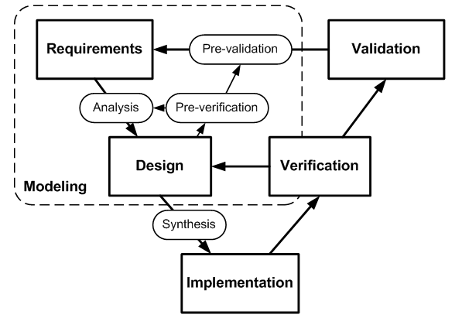
Background
System Development Life Cycle (SDLC)
A suitable approach for integration of engineering tools within a System Development Life Cycle (SDLC) is Model-Based System Engineering (MBSE).
MBSE is likewise an effective strategy to deal with the SDLC of complex systems.
SDLC represented by the V-model is usually utilized to depict the development process stages of software/hardware systems.

Slide 11
Background
Costs and Risks in the SDLC
MBSE is key for integrated analysis and can reduce costs and risks.
Functional and non-functional requirements are considered for pre-verification and pre-validation of the system under development.
Model analytics takes place at early SDLC stages.

Slide 12
Background
SDLC Framework, e.g., Software Development

Slide 13
Background
Different Views/Models of the Same System
One single (unified) system model would be ideal for cross-checked model analytics, but it is impossible.
But it could be potentially possible to interconnect notation from different system models.
The plan is to check the impact of each representation on others to reflect change on models.

Slide 14
Background
Related Existing Technologies
Integration of Models
  Cyber-Physical Modelling from IBM [1] which links SysML and Simulink.
  Open Services for Lifecycle Collaboration (OSLC) initiative [2] that links different software models, particularly requirements.
  Combination of different models (views) of the same software by means of meta-models such as the Model-Integrated Computing (MIC) approach [3].
  Model transformations of hybrid systems from one formalism to another, like the Compositional Interchange Format (CIF) [4].
However, these approaches only consider two engineering disciplines and still undergo deadlocks to connect models.
However, these approaches only take into account one engineering discipline although different models for that discipline are considered, they do not cross check models.

Slide 15
Background
Related Existing Technologies
Multi-View Tools
  Different views of the system dynamics from a control-engineering viewpoint such as Modelica [5] and a mechatronic-engineering viewpoint framework such as 20sim [6].
  Integration of existing models such as a multi-view methodology for the design of embedded mechatronic control systems [7], and model-integrated development of embedded software [1].
However, unlike the approach proposed, they do not crosscheck the impact of changes to one model on all other models.

Slide 16
Background
Related Existing Technologies
Projects that involve integration of modelling tools
  Architecture Analysis & Design Language (AADL) [8] and the Modeling and Analysis of Real-time Embedded Systems (MARTE) [9] also try to address the problem of integration of models but keep their focus only on software engineering.
  SysML captures modelling constraints with parametrics [10].
  The executable Unified Modeling Language (UML) use of multiple models, and partitioning of problem domains (through domain modelling) [11] to support trade-off design studies.
  The COMPASS project [12] (sharing resources and services between system models), and the CRYSTAL project [13] address trade-off decisions from diverse stakeholders at a higher level (systems-of-systems).
  The ISO/IEC/IEEE 42010 standard [14] provides a clear semantic distinction between models, viewpoints, and stakeholder concerns as a way to start considering new insight and perspectives for the design of HDASs.

Slide 17
Background
Assessing Related Existing Technologies
The approaches discussed mainly focus on two disciplines: software engineering (software notated on hardware) and control engineering (hardware and software solutions for control systems).
Current approaches has no automation or autonomy to cross-evaluate models; manual link of model inputs/outputs.
All the approaches are meant to work locally (one computer) and one stakeholder but OSLC; which makes good use of the cloud to link models and development teams.
Knowledge technologies is an attractive and promising solution to support the interconnectivity of models of different nature for autonomous cross-checking.

Slide 18
Autonomous Model Analytics for Avionic Systems
Cross-Checked Modelling
VIRTUAL DISTINGUISHED LECTURE SERIES
Dr Carlos C. Insaurralde
Bristol Robotics Laboratory
University of the West of England
Bristol, United Kingdom
6 November 2024

Slide 19
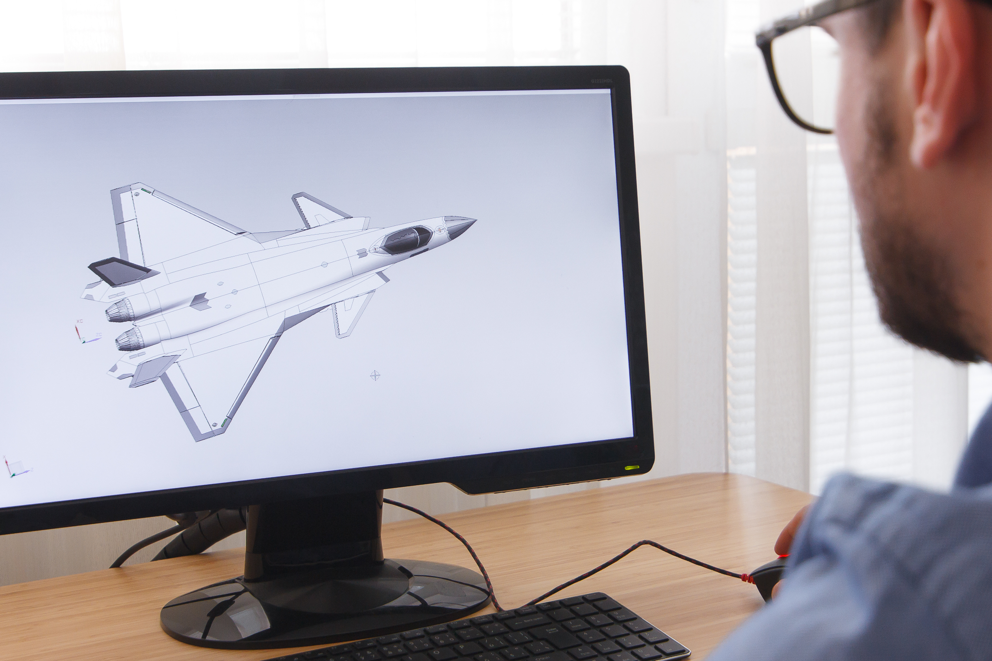
Cross-Checked Modelling
The Concept
A system under development.
Focus on the design stage.
System modelling using computer tools.
Two different views and stakeholders of
  Control
  Software
Updates on a model may have an impact on the other model.
Analysis of cross-checked impact between the control model and the software model.

Slide 20
Cross-Checked Modelling
Modelling of Control Aspects of the System
Block diagram for control systems where C is the controller, P is the plant, r is the reference, e is the error signal, u is the signal control, and y is the output.
D_{fd} is the delay in the output (actuating) of the controller, and D_{fk} is the delay in the input (sensing) of the controller.

Slide 21
Cross-Checked Modelling
Modelling of Software Aspects of the System
C is represented by the block named controller. It can be in turn a composition of other blocks. The open control loop is only shown.
t_{ic} is the incoming communication time, t_{s} is the data sampling time for the task controller, t_{p} is the processing time of the task controller, t_{dl} is the deadline of the task controller, and t_{d} is the data delivery time for the task(s) or thread(s), t_{oc} is the outgoing communication time.

Slide 22
Cross-Checked Modelling
Relation Between Control and Software Aspects
Control model
D_{fd} = t_{p} + t_{d} + t_{oc} and D_{fk} = t_{ic} + t_{s}.
Where 0 < t_{p} ≤ t_{dl}
Software model

Slide 23
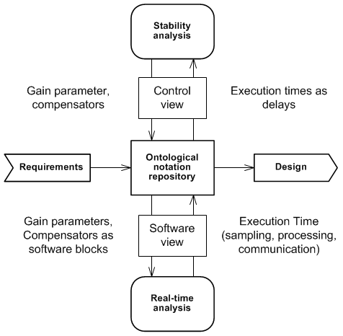
Cross-Checked Modelling
Interaction between Control and Software Design
Control view (model)
  For instance, to perform stability analysis
Software view (model)
  For instance, to perform real-time analysis
Crossed impact, for instance:
  Control -> software: controller-related aspects
  Software -> control: execution timing aspects

Slide 24
Autonomous Model Analytics for Avionic Systems
Application Example
VIRTUAL DISTINGUISHED LECTURE SERIES
Dr Carlos C. Insaurralde
Bristol Robotics Laboratory
University of the West of England
Bristol, United Kingdom
6 November 2024

Slide 25
Application Example
Three Stakeholders
Avionic system under development
The viewpoint of the control engineer is aligned with functionality which focuses on quality criteria such as controllability (stability), statefulness, and eventfulness.
The viewpoint of the hardware engineer is aligned with allocability which focuses on non-functional requirements such as deployment, footprint, and power.
The viewpoint of the software engineer is aligned with performance which focuses on quality criteria such as timeliness, readiness, and predictability.

Slide 26
Application Example
Requirements Analysis and Design: Quality Criteria
Functionality. The control engineer is concerned with controllability, in particular the system stability.
Allocability. The hardware engineer is concerned with the use of processing and networking resources such as network bandwidth, CPU processing time, power consumption, and memory space.
Performance. The software engineer is concerned with the timing for the software application (computation and communication), in particular end-to-end latency.

Slide 27
Application Example
The Autopilot System

Slide 28
Application Example
Control Engineering View
Control engineering model are based on mathematical notations (differential equations) or block diagrams (e.g., Laplace transform).
The Laplace equations used are from a generic system and they were adapted from a book example¹.
¹R. C. Dorf, R. H. Bishop, Modern Control Systems, 11th Ed., Pearson Prentice Hall, International Edition, 2008.

Slide 29
Application Example
Hardware Engineering View
System representations of hardware platforms can be made by means of the Architecture Analysis and Description Language (AADL).
AADL is a standard specially developed for avionic systems. However, other languages can be also used, e.g. SysML.

Slide 30
Application Example
Software Engineering View
System representations of software applications are typically made by means of the Unified Modeling Language (UML).

Slide 31
Application Example
Cross-Checked Model Impact
1) SW-CW:
Latency ⇒ Stability
2) CW-SW:
Modelling ⇒ Footprint
3) HW-CW:
Architecture ⇒ Strategy
4) CW-HW:
Data ⇒ Socket
5) HW-SW:
Processing ⇒ Execution
6) SW-HW:
Coding ⇒ Footprint

Slide 32
Application Example
Description of Cross-Checked Model Impact
Alterations on the end-to-end latency of the software application (software model) due to data buffers, message queues, task scheduling, data sampling, etc. has impact on the control stability of the autopilot system (control model).
Modifications on the Laplace equations that represent functionality (control model) impact on the software footprint (software model).
Implementations of different network technologies (hardware model) impact on the control strategy for the autopilot system (control model).
Switchovers from a reference data source to another (control model) impact on the configuration of input sockets or connectors (hardware model).
Changes on the task processing times (e.g. multitasking computation) in the autopilot system computers (hardware model) impact on the software execution (software model).
Variations on the software architecture (modules or algorithms) of the autopilot system (software model) impact on the hardware footprint (hardware model).

Slide 33
Application Example
Cross-Checked Model Impact: Case 1
This application example only shows and explains the cross-checked impact 1.
Potential delay sources in the end-to-end latency for a particular data flow of the autopilot system software execution are shown below.

Slide 34
Application Example
Cross-Checked Model Impact 1: End-to-end latency impact
The AFCS becomes less stable (smaller gain/phase margin) as latency is increased

Slide 35
Autonomous Model Analytics for Avionic Systems
Ontological Support
VIRTUAL DISTINGUISHED LECTURE SERIES
Dr Carlos C. Insaurralde
Bristol Robotics Laboratory
University of the West of England
Bristol, United Kingdom
6 November 2024

Slide 36
Ontological Support
Ontologies for Knowledge Representation
Ontologies define concepts (classes), instances of classes (individuals), and properties (roles) for classes and individuals.
Classes are divided into two categories: (1) atomic classes (stand-alone classes), and (2) associate classes (subclasses). The latter are typically “is-a” links. The main classes for the application example are: Discipline, Model, Parameter, and Quality.
Individuals are instances of classes, e.g. a UML diagram is an individual (instance of the class “Model”).

Slide 37
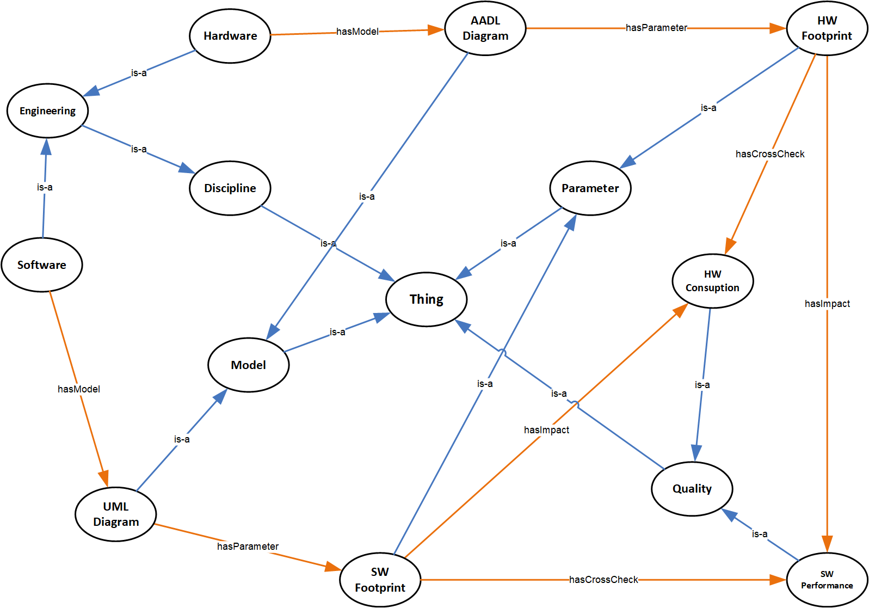
Ontological Support
Ontology for Application Example (Autopilot): Software-Hardware
Reasoners are the engine for the ontology-based reasoning queries.
These reasoning engines apply inference rules and check semantic consistency on ontologies.
They can arrive at logical conclusion (based on the ontology axioms) to generate asserted classes that provide axiomatic relations for cognition.

Slide 38
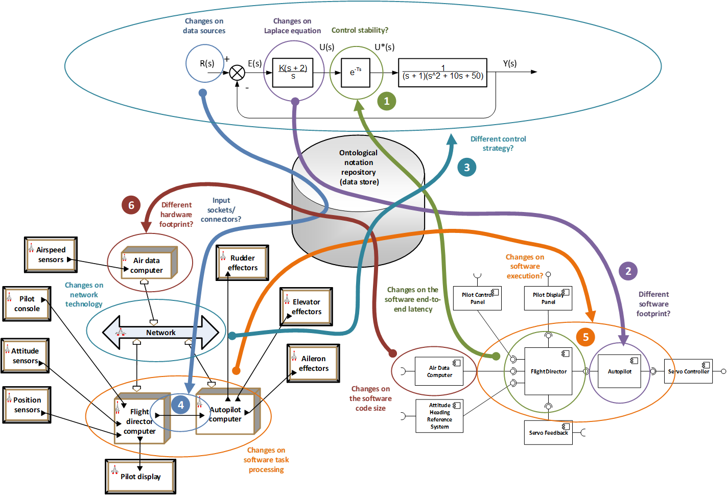
Ontological Support
Ontology for Application Example (Autopilot)

Slide 39
Ontological Support
Control Design Changes Impact on Software and Hardware
Modifications on the Laplace equations that represent functionality (control model) affect the software footprint (software model), and
Switchovers from a reference data source to another (control model) affect the configuration of input sockets or connectors (hardware model).

Slide 40
Ontological Support
Software Design Changes Impact on Control and Hardware
Alterations on the end-to-end latency of the software application (software model) due to data buffers, message queues, task scheduling, data sampling, etc. impact on the control stability of the avionic system (control model), and
Variations on the software architecture (modules or algorithms) of the avionic system (software model) affect the hardware footprint (hardware model).

Slide 41
Ontological Support
Hardware Design Changes Impact on Control and Software
Implementations of different network technologies (hardware model) impact on the control strategy for the avionic system (control model), and
Changes to the task processing times (e.g. multitasking computation) in the avionic system computers (hardware model) impact on the software execution (software model).

Slide 42
Autonomous Model Analytics for Avionic Systems
Framework Realization
VIRTUAL DISTINGUISHED LECTURE SERIES
Dr Carlos C. Insaurralde
Bristol Robotics Laboratory
University of the West of England
Bristol, United Kingdom
6 November 2024

Slide 43
Framework Realization
Framework Architecture
The approach proposes a methodology to merge the model notation (parameters) into a single repository for analysis.
Modelling notation includes the functional and non-functional requirements and constraints from different engineering disciplines.

Slide 44
Framework Realization
Model Connectivity
Model interfaces are described by means of the Resource Description Framework (RDF).
The RDF file acts as a front end for the stakeholders.
The structure of the RDF file has two main sections: the specification of the model management, and the specification of the model development.
The application interface is able to read RDF files, interpret them, and identify the key parameters to be checked against the ONR.
The above parameters are the input arguments for the SPARQL queries.
The output of a SPARQL query is used to update the RDF files of the remaining models (cross-impact).

Slide 45
Framework Realization
Software Design Changes Impact on Control and Hardware
Software Model Updates | Hardware Model Effects | Control Model Effects
End-to-end latency (QM) | SP: Execution SE: Task SC: Processing QF: Efficiency QC: Schedulability QM: Scheduling time | SP: Delay SE: Controller SC: Feedback control QF: Dependability QC: Responsiveness QM: Time response
 | SP: Transmission SE: Packet SC: Communication QF: Efficiency QC: Responsiveness QM: Network latency
Code size (QM) | SP: Footprint SE: Memory SC: Computation QF: Efficiency QC: Allocability QM: Hardware use | SP: Control parameter SE: Controller SC: Feedback control QF: Dependability QC: Stability QM: Root Locus, Bode margins
Data size (QM) | SP: Storage SE: Memory SC: Information QF: Efficiency QC: Mem Allocability QM: Mem use
 | SP: Bandwith SE: Network SC: Information QF: Efficiency QC: Network Usability QM: Network use
 | Computation
 | Communication
SP: System Property
SE: System Element
SC: System Capability
QF: Quality Factor
QC: Quality Criteria
QM: Quality Metric

Slide 46
Framework Realization
Portion of the RDF file of the software model (change source)
Old execution time
New execution time

Slide 47
Framework Realization
Portion of the RDF file of the Hardware model (change destination)
Hardware component affected by
The new execution time in CC

Slide 48
Framework Realization
Hardware Design Changes Impact on Control and Software
Hardware Model Updates | Software Model Effects | Control Model Effects
Task execution (SC) | SP: Response time SE: Thread SC: Computation QF: Efficiency QC: Responsiveness QM: Thread latency | SP: Delay SE: Controller SC: Feedback control QF: Dependability QC: Responsiveness QM: Time response
Message transmission (SC) | SP: Response time SE: Connector SC: Communication QF: Efficiency QC: Responsiveness QM: Connector latency | SP: Control parameter SE: Controller SC: Feedback control QF: Dependability QC: Stability QM: Root Locus, Bode margins
Computer architecture (SE) | SP: Footprint SE: Operating System SC: Computation QF: Efficiency QC: Deployability QM: Lines of code | SP: Delay SE: Controller SC: Feedback control QF: Dependability QC: Responsiveness QM: Time response
Network topology (SE) | SP: Comm pattern SE: Middleware SC: Communication QF: Efficiency QC: Link Usability QM: Link ratio | SP: Control strategy SE: Control system SC: Feedback control QF: Dependability QC: Fault tolerance QM: Fault tree, MTBF, FMEA
 | Computation
 | Communication
SP: System Property
SE: System Element
SC: System Capability
QF: Quality Factor
QC: Quality Criteria
QM: Quality Metric

Slide 49
Framework Realization
Portion of the RDF file of the Hardware model (change source)
Old network topology
New network
topology

Slide 50
Framework Realization
Portion of the RDF file of the Software model (change destination)
Software component affected by the change on the network topology

Slide 51
Autonomous Model Analytics for Avionic Systems
Use of Standard
VIRTUAL DISTINGUISHED LECTURE SERIES
Dr Carlos C. Insaurralde
Bristol Robotics Laboratory
University of the West of England
Bristol, United Kingdom
6 November 2024

Slide 52
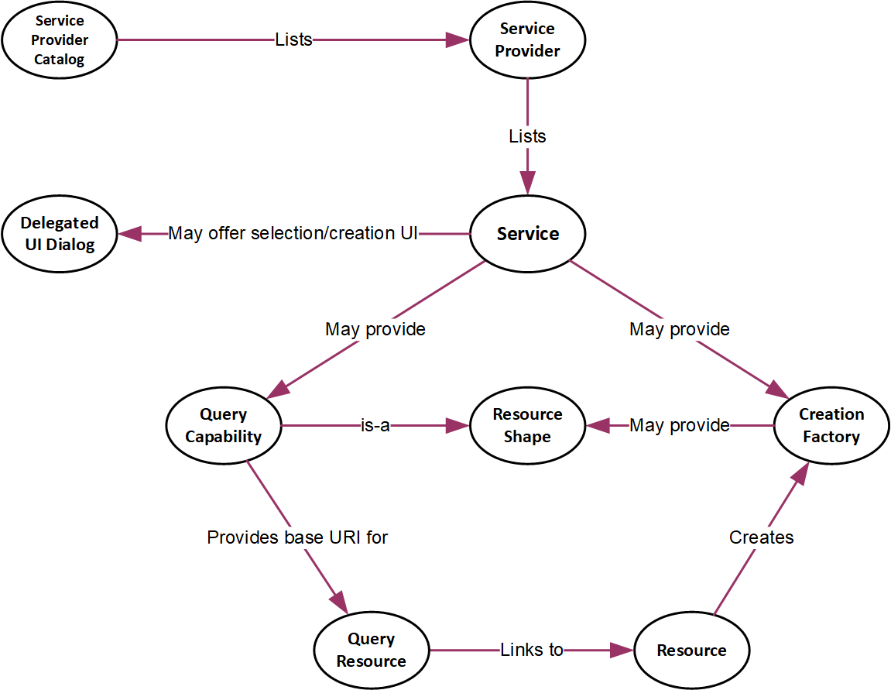
Use of Standard
Open Services for Lifecycle Collaboration (OSCL)
The OSLC [2] is meant to deal with all the tasks from the SDLC processes.
Joint achievement from the cooperation of a range of big technology companies that involve.
tool developers (e.g., IBM®, MathWorks®, Sparx Systems)
tool users like those companies linked to the aeronautical sector such as Boeing, Airbus, and Raytheon.
The main drivers for the creation of the OSLC technology are integration of computer tools, independency from vendors and sources, and data analytics.
The OSLC has its foundation on the connectivity provided by the World Wide Web (WWW) or just the Web as it relies on the interconnection between parties or stakeholders to share information.
OSLC links computer tools by dealing with data rather than documents.

Slide 53
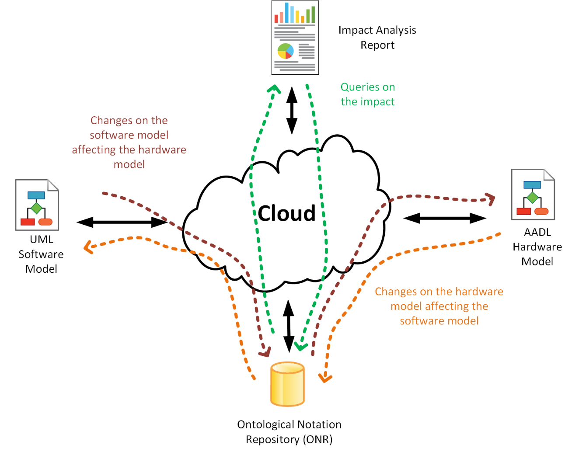
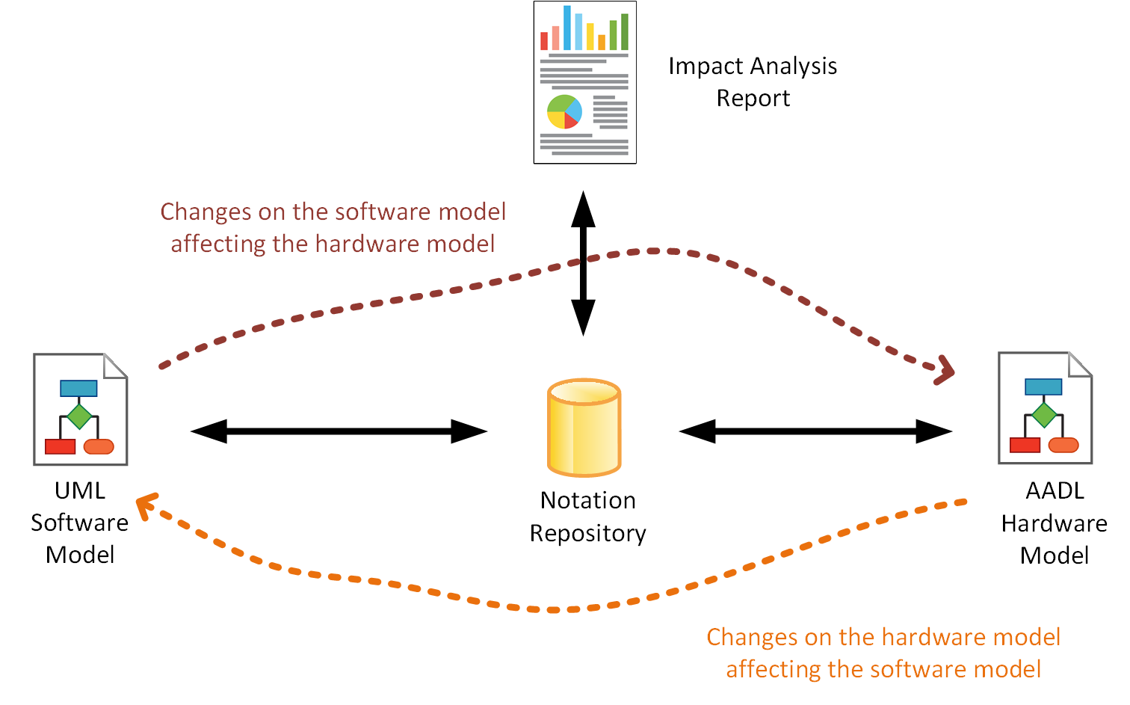
Use of Standard
Open Services for Lifecycle Collaboration (OSCL)
OSCL-Based
Cloud

Slide 54
Use of Standard
OSCL Software Model Service
<oslc:service>
<oslc:Service>
<oslc:domain rdf:resource=”http://open-services.net/ns/am#”/>
<oslc:creationFactory>
<oslc:CreationFactory>
<dcterms:tittle>Creation of Software Model Service</dcterms:tittle>
<!-- Creation of new resource (the software model)>
<oslc:creation rdf:resource=”http://host/creation/swmodelnotation”/>
<!-- Metadata of the XML resource>
<oslc:resourceShape rdf:resource=”http://host/shapes/swnotationshape”/>
<oslc:usage rdf:resource=”http://open-services/ns/core#default”/>
<oslc:resourceType rdf:resource=”http://open-services/ns/am#Resource”/>
</oslc:CreationFactory>
</oslc:creationFactory>
<oslc:queryCapability>
<oslc:QueryCapability>
<oslc:queryBase rdf:resource="http://host/query"/>
<oslc:resourceShape rdf:resource="http://host/shapes/ swhwlinkqueryshape "/>
</oslc:QueryCapability>
<oslc:queryCapability>
</oslc:Serice>
</oslc:service>
Software impacts on Hardware
OSLC service interface for the software model
  Creation of service
  Resource shape
  Query capability
    Query resource

Slide 55
Use of Standard
OSCL Software Model Resource Shape
<?xml version=”1.0” encoding=”UTF-8”>
<rdf:RDF xmlns:rdf="http://www.w3.org/1999/02/22-rdf-syntax-ns#"
xmlns:dcterms="http://purl.org/dc/terms/"
xmlns:foaf="http://xmlns.com/foaf/0.1/"
xmlns:oslc="http://open-services.net/ns/core#">
<oslc:ResourceShape rdf:about="http://host/shapes/swnotationshape">
<dcterms:title>Shape for the software model notation</dcterms:title>
<oslc:name>SWNotation</oslc:name>
<oslc:describes rdf:resource="http://host/services/swm#Notation"/>
<!—Resource shape for the software footprint parameter>
<oslc:property>
<oslc:Property>
<oslc:name>SWF</oslc:name>
<dcterms:title>Software Footprint</dcterm:title>
<oslc:propertyDefinition rdf:resource="http://host/services/swm#SWF"/>
<oslc:valueType rdf:resource="http://www.w3.org/2001/XMLSchema#integer"/>
<oslc:occurs rdf:resource="http://open-services.net/ns/core#Zero-or-one"/>
<dcterms:description>Use of hardware based on the software size</dcterms:description>
</oslc:Property>
</oslc:property>
<!—Resource shape for the software performance quality>
<oslc:property>
<oslc:Property>
<oslc:name>SWP</oslc:name>
<dcterms:title>Software Performance</dcterm:title>
<oslc:propertyDefinition rdf:resource="http://host/services/swm#SWP"/>
<oslc:valueType rdf:resource="http://www.w3.org/2001/XMLSchema#integer"/>
<oslc:occurs rdf:resource="http://open-services.net/ns/core#Zero-or-one"/>
<dcterms:description>Software performance based on hardware capacity</dcterms:description>
</oslc:Property>
</oslc:property>
</oslc:ResoruceShape>
</rdf:RDF>

Slide 56
Use of Standard
OSCL Software Model Query
<?xml version=”1.0” encoding=”UTF-8”>
<rdf:RDF xmlns:rdf="http://www.w3.org/1999/02/22-rdf-syntax-ns#"
xmlns:dcterms="http://purl.org/dc/terms/"
xmlns:oslc="http://open-services.net/ns/core#">
<oslc:ResourceShape rdf:about="http://host/shapes/swhwlinkqueryshape">
<dcterms:title>Shape for the software-hardware link</dcterms:title>
<oslc:type rdf:resource="http://open-services.net/ns/core#ResourceShape"/>
<oslc:name>SwHwLinkQuery</oslc:name>
<oslc:describes rdf:resource="http://open-services.net/ns/swm#"/>
<!—Resource shape for the software-hardware link query>
<oslc:property>
<oslc:Property>
<oslc:name>SWNotation</oslc:name>
<oslc:occurs rdf:resource="http://open-services.net/ns/core#Zero-or-many"/>
<oslc:valueShape rdf:resource="http://host/shapes/swnotationshape"/>
<oslc:propertyDefinition rdf:resource="http://host/services/swm#Notation"/>
<oslc:isMemberProperty>true</oslc:isMemberProperty>
</oslc:Property>
</oslc:property>
</oslc:ResourceShape>
</rdf:RDF>

Slide 57
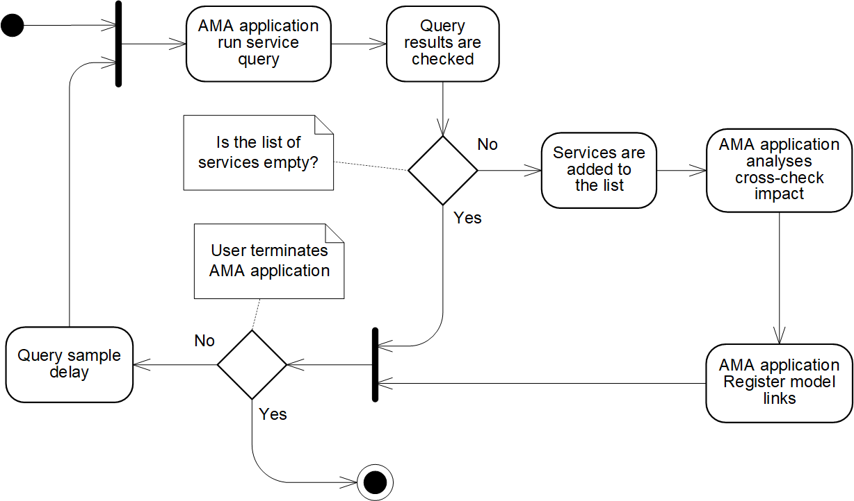
Use of Standard
OSCL Discovery & Retrieve of Service Info
AMA: Autonomous Model Analysis

Slide 58
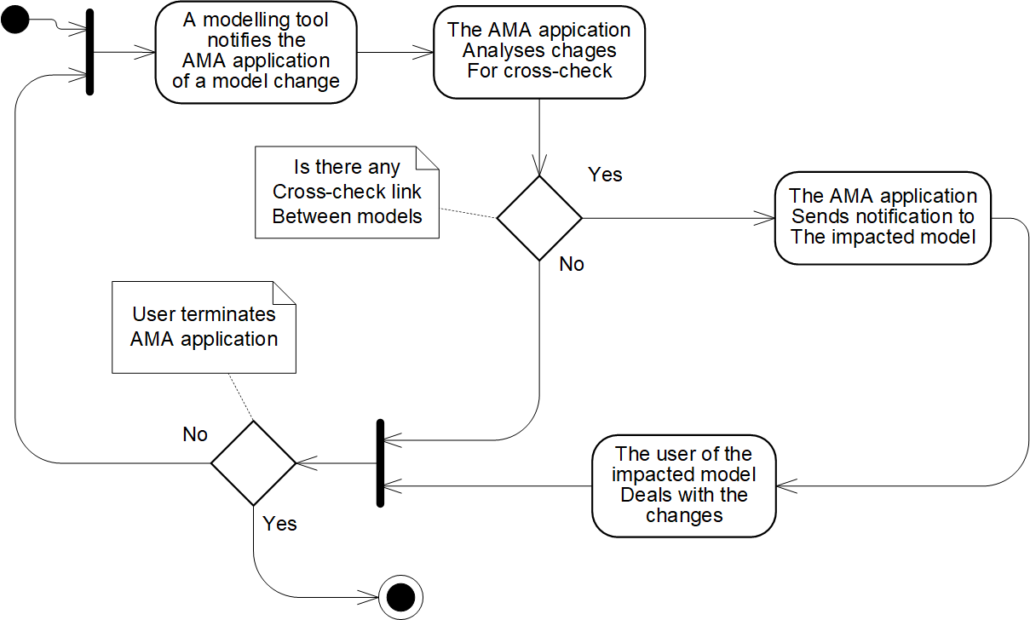
Use of Standard
OSCL Analysis of Model Information
AMA: Autonomous Model Analysis

Slide 59
Autonomous Model Analytics for Avionic Systems
Conclusions
VIRTUAL DISTINGUISHED LECTURE SERIES
Dr Carlos C. Insaurralde
Bristol Robotics Laboratory
University of the West of England
Bristol, United Kingdom
6 November 2024

Slide 60
Conclusions
Lecture remarks
  Avionic systems are complex more and more for which cross-checked models and an agile process for them is key.
  Ontologies are an attractive approach to support autonomous model cross-checking.
  Simple but useful examples show the potential of ontologies.
  Examples as proof of concepts shown promising success to build a framework for cross-checked model autonomy based on an industrial standard (OSCL).
Next related lecture topics
  Realization and experimental results of a more realist framework and the use of total or partial real avionic systems.
  Assessment on limitations when using ontologies for model cross-checking autonomy.

Slide 61

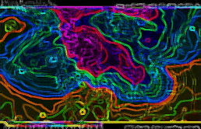
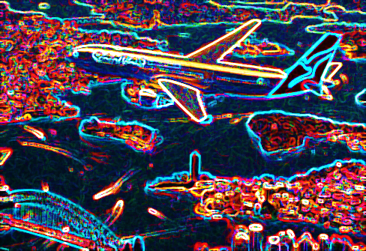
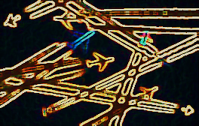
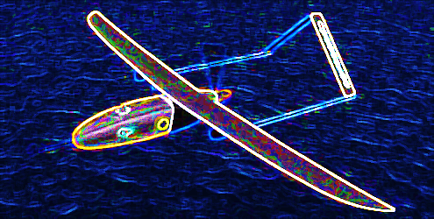
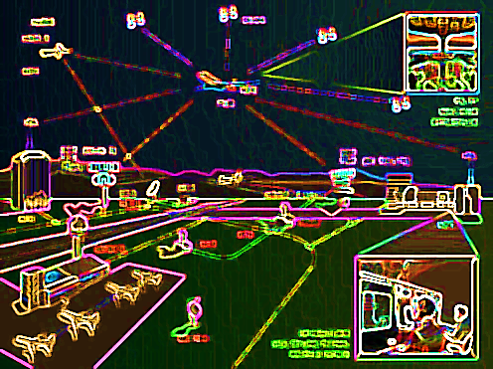
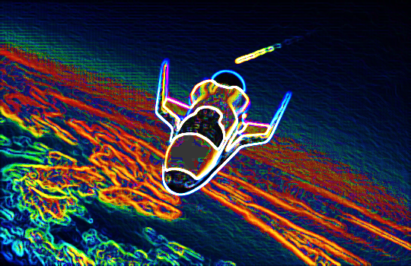
    Questions and Answers
Avionics Systems Panel
If you wish to discuss possible collaborations with the AESS Avionics Systems Panel (ASP) please send an email to: roberto.sabatini@ieee.org
You can find additional information about the ASP at:
https://ieee-aess.org/tech-ops/avionics-systems-panel-asp
IEEE/AIAA Digital Avionics Systems Conference: https://2021.dasconline.org/
IEEE/AIAA Integrated Communication, Navigation and Surveillance Conference: https://i-cns.org/about/

Slide 62
References
[1] E. Palachi, C. Cohen, S. Takashi, “Simulation of Cyber-Physical Models using SysML and Numerical Solvers”, 6th IEEE International Systems Conference, Orlando, FL, USA, pp. 164-169, Apr 2013.
[2] The Open Services for Lifecycle Collaboration (OSLC) Core Specification Version 2.0, available at http://open-services.net/bin/view/Main/OslcCoreSpecification.
[3] G. Karsai, J. Sztipanovits, A. Ledeczi, T. Bapty, “Model-Integrated Development of Embedded Software”, Proceedings of the IEEE, vol. 91, issue 1, pp. 145-164, 2003.
[4] The Compositional Interchange Format for hybrid systems, available at http://cif.se.wtb.tue.nl.
[5] Modelica, available at https://www.modelica.org.
[6] The 20sim tool, available at http://www.20sim.com.
[7] M. A. Groothuis, and J. F. Broenink, “Multi-view Methodology for the Design of Embedded Mechatronic Control Systems”, IEEE Conf. on Computer Aided Control Systems Design, Munich, Germany, 2006.
[8] Architecture Analysis & Design Language (AADL) - Modeling Language for Safety-Critical Systems, available at http://www.aadl.info.
[9] Object Management Group (OMG), A UML Profile for MARTE: Modeling and Analysis of Real-Time Embedded systems, Report, 2008.
[10] S. Friedenthal, A. Moore, R. Steiner, Practical Guide to SysML, Morgan Kaufman / OMG, 2nd Ed., 2012.
[11] C. Raistrick et al., Model Driven Architecture with Executable UML, Cambridge, 2004.
[12] COMPASS project, available at http://www.compass-research.eu.
[13] CRYSTAL project, available at http://www.crystal-artemis.eu.
[14] International Standard ISO/IEC/IEEE 42010, Systems and Software Engineering - Architecture Description, 1st Ed., 2011.

