Slide 1



Cognitive Radars for Integrated Sensing and Communications
Maria Sabrina Greco
Dept. Of Information Engineering
University of Pisa
17 December 2024

Slide 2
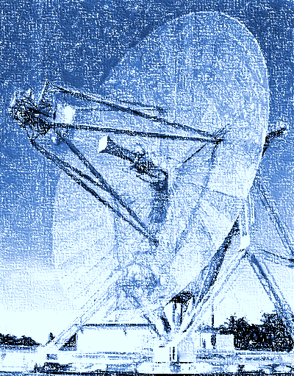
Outline of the talk
Cognitive radars and ISAC
Examples:
  Spectrum sharing
  ISAC with cognitive Massive MIMO radar
  ISAC for automotive MIMO radars
  Conclusions

Slide 3
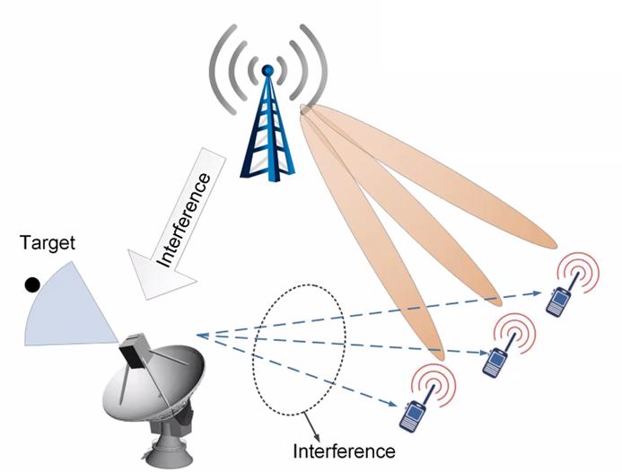
Non-cooperative sensing and communications systems
The systems work separately mitigating mutual interferences without a direct exchange of information. Good approach for large-scale radar systems, not for more dynamic scenarios and applications, as in the automotive branch or in the consumer market.
  Intelligent design of the receivers in the presence of thermal noise, clutter, interfering signals, malicious platforms and intentional interference.
  Use of cognitive techniques on both sensing and communication sides for an intelligent use of the spectrum resource.

Slide 4
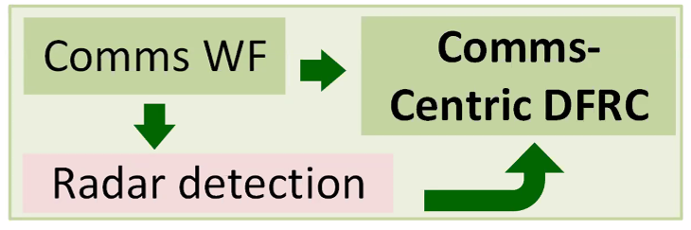
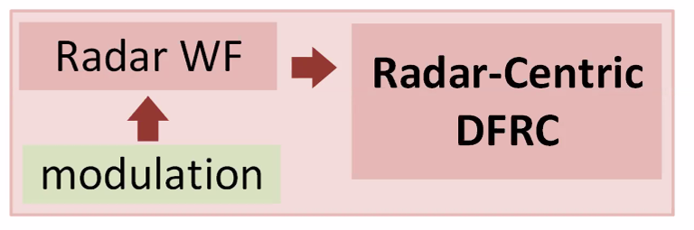
Partially cooperative sensing and communications systems
Augment their own capabilities using the other systems and exchanging only a limited set of information.
Communications-enabled sensing: the signal emitted by an existing access point or mobile device is exploited to sense the environment through one or more dedicated radar receivers.
Radar-enabled communication systems: the probing signal of an existing radar is exploited to deliver a data message to communication users. Effective strategies:
  use of frequency/spatial index modulations.
  control of sidelobes of the transmit beampattern towards the intended destination.

Slide 5
Joint Dual-Function Radar and Communication
    Dual-function transceiver architectures. The respective receivers are jointly designed and presuppose a certain degree of cognition in conjunction with the use of emerging technologies (RISs, distributed and massive MIMO antennas).
    Joint waveform design. Both the radar waveform and the communications codebook are chosen so as to guarantee the performance of the sensing system and that of the communication systems. There are two major waveform design approaches:
      Non-overlapped resource allocation: Time Division ISAC, Frequency Division ISAC Spatial Division ISAC (very promising in the Massive MIMO world);
      Fully unified waveform design (so far very complex and not fully explored).
    In all the 3 scenarios, radar cognition can play an important role

Slide 6
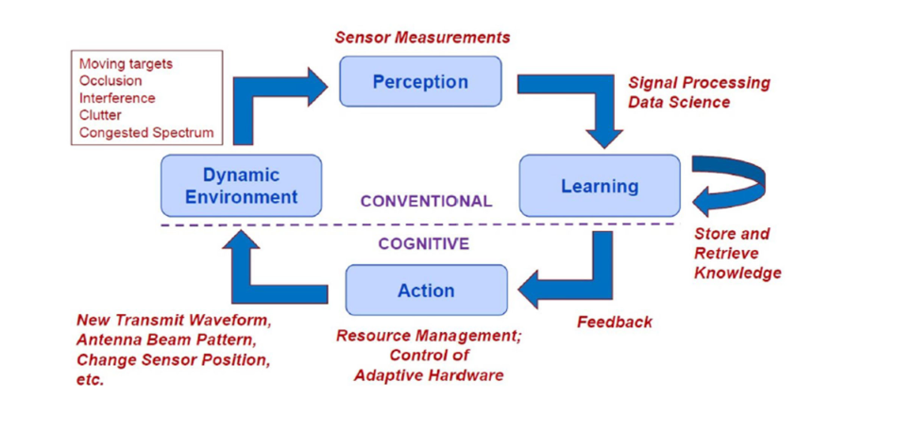
Cognitive Radar: a simple concept and its foundations
IEEE Standard Radar Definition 686: A cognitive radar is a radar system that in some sense displays intelligence, adapting its operation and its processing in response to a changing environment and target scene. In comparison to adaptive radar, cognitive radar learns to adapt operating parameters as well as processing parameters and may do so over extended time periods.
The Perception-Action Cycle (PAC)
Block diagram of cognitive radar seen as a dynamic closed-loop feedback system
6

Slide 7
ISAC: Spectrum Sharing
Spectrum congestion
Primary users are the users who have higher priority or legacy rights on the usage of a specific part of the spectrum.
Secondary users have lower priority and exploit this spectrum in such a way that they do not cause interference to primary users.
Secondary users need to have cognitive radio capabilities to check whether the spectrum is being used by a primary user and to change the radio parameters to exploit the unused part of the spectrum.
The spectrum opportunity means that not all the bands are used simultaneously, therefore some bands might be available for opportunistic usage.

Slide 8
ISAC: Spectrum Sharing
Spectrum Sensing via dual-radio architecture.
One radio chain is dedicated to radar functions while the other chain is dedicated to spectrum monitoring.
Drawback: high sampling rate and high resolution ADCs with large dynamic range, and high speed signal processors.
Compressed Sensing can provide a significant reduction in acquisition time reducing the cost for high resolution ADCs.
Channel Observation to model primary user dynamics.
Hidden Markov Model and Baum-Welch Method to estimate channel parameters.
Sequential Estimation for Statistical Spectrum Access
P. Stinco, M. Greco, F. Gini, "Spectrum Sensing and Sharing for Cognitive Radars", IET Radar, Sonar and Navigation, Vol. 10, No 3, pp. 595–602, 2016

Slide 9
ISAC: Spectrum Sharing
Statistical Spectrum Sharing
In each channel, the signal processor compares the probability to have a spectrum opportunity with a threshold λ, and transmits only if the probability >λ.
Two kinds of errors:
  e₀: the radar does not transmit and the channel is free (prob. to lose a spectrum opportunity).
  e₁: the radar transmits and the channel is occupied by the primary user (prob. to have a collision).
Error probabilities as a function of time:
the performance of the cognitive radar are constant during the time.
the cognitive radar outperforms the non cognitive radar that always transmits ignoring the primary user and than the radar that never transmits to avoid interference.
P. Stinco, M. Greco, F. Gini, B., Himed, "Cognitive Radars in Spectrally Dense Environments", IEEE AESS Magazine, Vol. 31, No. 10, pp. 20-27, Oct 2016

Slide 10
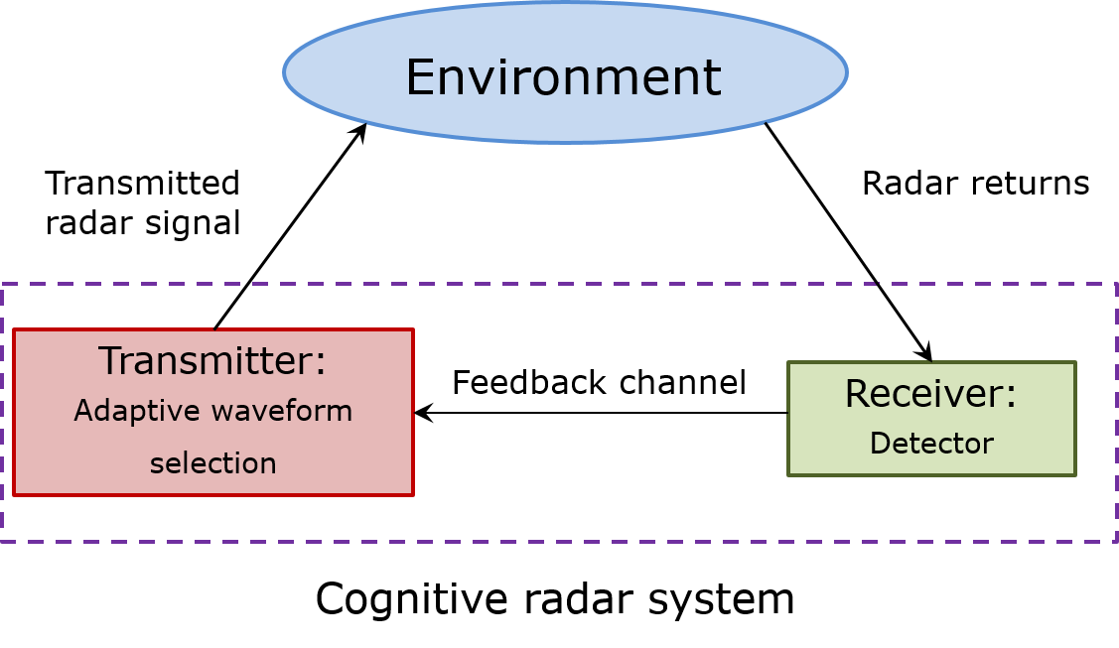
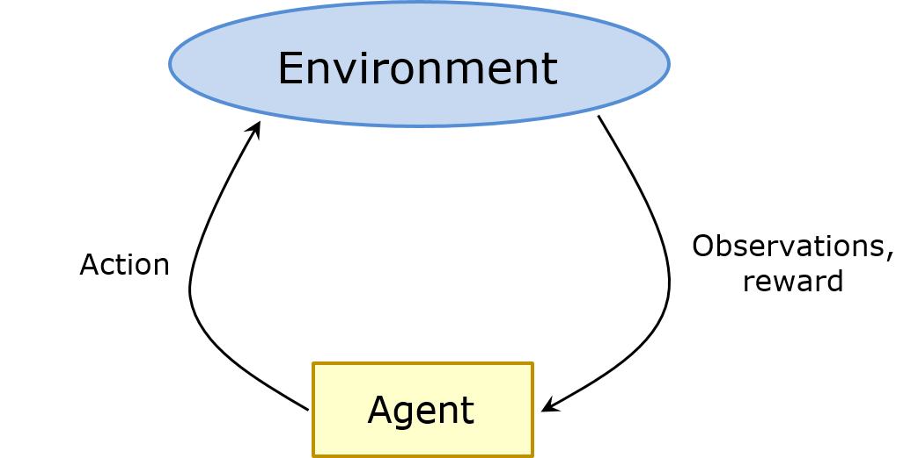
Cognitive Radar: Reinforcement learning
Cognitive radar
The agent learns how to make decisions to achieve a certain goal. This is done by trial and error interactions with the environment
Reinforcement learning (RL)

Slide 11
Cognitive Radar: Reinforcement learning
Formally, the interactions with the environment in RL is described by Markov Decision Processes (MDP)
The actions are ruled by a policy π: S → A, that is a function that maps a state s ∈ S into an action a ∈ A. So, it defines which action has to be executed at each state.
The reward is a scalar feedback signal that the agent always seeks to maximize.
A Markov decision process (MDP) is defined by a tuple {S, A, P, r}, where S is a finite set of states, A is a finite set of actions, P is the transition probability from state s to s′ ∈ S after action a ∈ A is performed, r is the immediate reward evaluated after a is executed.
R.S. Sutton, A.G. Barto , Reinforcement Learning, The MIT Press, Cambridge Massachusetts

Slide 12
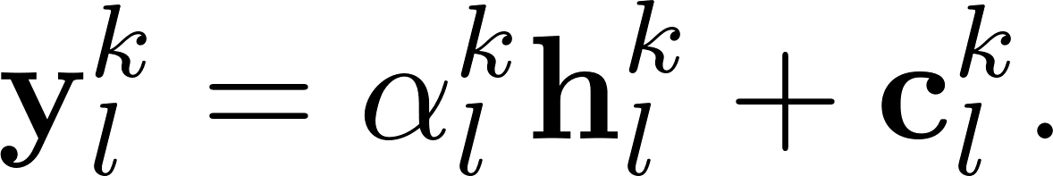
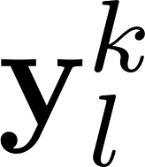
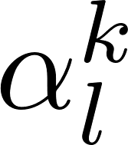





ISAC: Beamforming for cognitive colocated Massive MIMO radars
: data vector for each angle bin l at time k
: signal parameter
: transmitter steering vector
: receiver steering vector
: direction of arrival (DOA) of the target
: complex beamforming matrix to synthesize correlated waveforms at different transmitters
: complex unknown disturbance vector for each angle bin l at time k
N_{T} and N_{R}: transmit and receive antennas, respectively
S. Fortunati, L. Sanguinetti, F. Gini, M.S. Greco, B. Himed, “Massive MIMO Radar for Target Detection”, IEEE Transactions on Signal Processing, Vol. 68, 2020

Slide 13
ISAC: Beamforming for cognitive colocated Massive MIMO radars
We suppose that the disturbance vector c satisfies the following assumption:
Assumption A1 is weak enough to be satisfied by, for example, all the Gaussian and non-Gaussian Autoregressive-Moving Average (ARMA) models of arbitrary order and by all the Compound-Gaussian models (typically used in radar to model non-Gaussian spiky clutter).
Assumption 1:
The disturbance is a realization of a discrete-time, circular, complex random process with a polynomial decay of its autocorrelation function.

Slide 14
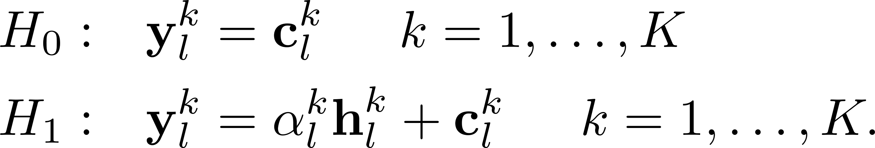
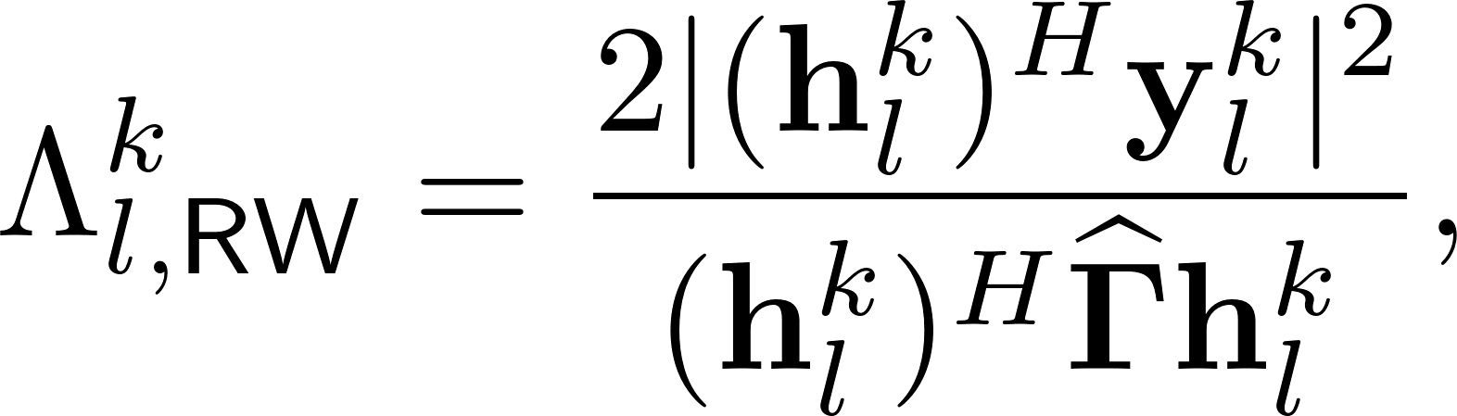



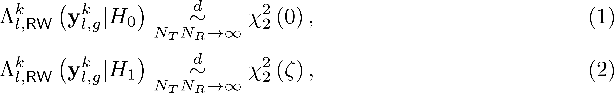
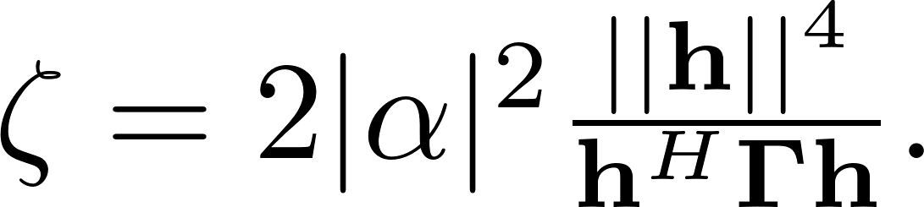
ISAC: Wald test-based target detection
Wald-type detector is proposed under the extremely general disturbance model
where is the estimate of the unknown clutter covariance matrix
is asymptotically chi-squared distributed, as the number of virtual spatial channels N increases infinitely (i.e., Massive MIMO regime),
is asymptotically CFAR for every disturbance vector satisfying Assumption 1.
Detector under H₁ depends on the beamforming matrix

Slide 15
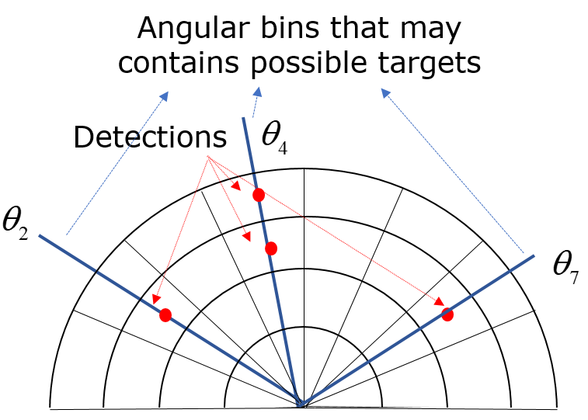
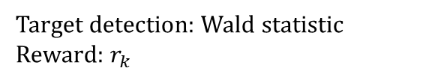
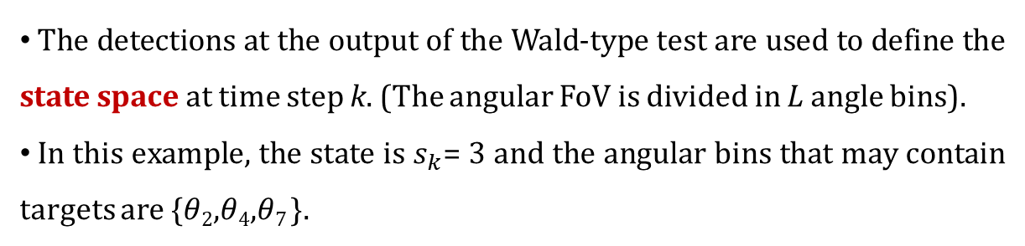
Target state space and Actions
The detections at the output of the Wald-type test are used to define the state space at time step k. (The angular FoV is divided in L angle bins).
In this example, the state is $s_{k}$= 3 and the angular bins that may contain targets are {$θ$₂,$θ$₄,$θ$₇ }.
Action: Given the state s_{k} at time k, choose the beamforming matrix W_{k+1} based on the “immediate” reward r_{k} and on the past rewards.
Action: Choose W_{k+1}
Observation at time k for all angle bins:
The best matrix W_{k+1} is the one that shapes the transmitted beam pattern by focusing the power towards the angular bins that contain potential targets.
Target detection: Wald statistic
Reward: $r_{k}$

Slide 16
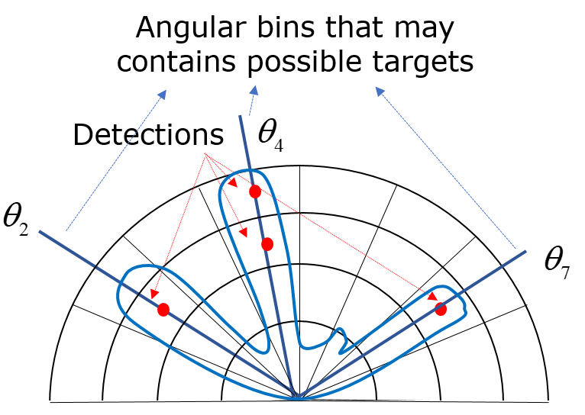
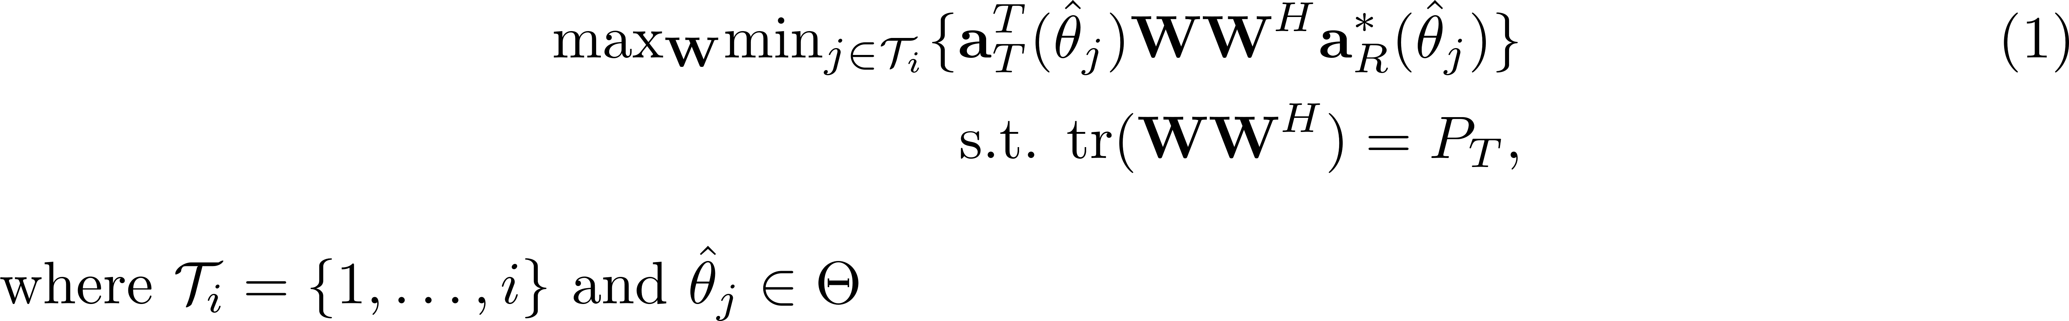

The actions
Actions
  Based on state s_{k}, the agent selects the corresponding i angle bins that most likely contain targets
  $$Θ=\{θ2,θ4,θ7 \},$$
  Optimize the beamformer matrix W_{k+1} to focus the beampattern towards the direction of those bins, solving the following optimization problem:

Slide 17
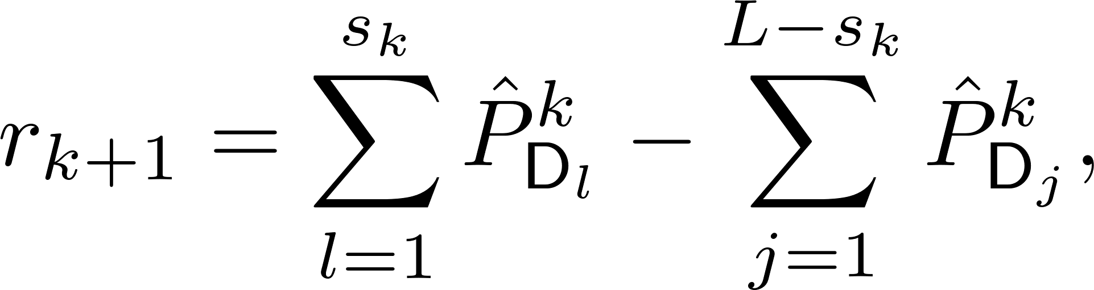
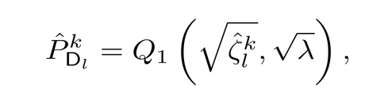
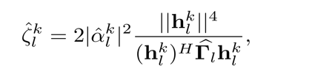

Immediate reward
The choice of a good reward function is a crucial aspect of any RL algorithm.
A reasonable reward might be related to the probability of detection
The positive part is a summation of P_{D} over all s_{k} (i.e., the bins that most likely contain a target)
The negative reward is summed over the bins that do not (penalty).
Other rewards might be chosen i.e., capped reward (+1,-1) , SINR,… etc.

Slide 18
Cognitive Radar: SARSA algorithm and the function Q
We used the SARSA (state-action-reward-state-action) algorithm to implement the RL.
The best action at time step k+1 is chosen by maximizing a function of the immediate reward r_{k} and of a weighted sum of the past rewards (cumulative rewards).
In RL, this function is called the state-action value function Q:
Learning rate
Discount factor
The discount factor controls the weight given to future rewards.
The learning rate is used to control how much the recent experiences override the old ones.
The matrix [Q]_{i,j} = Q(s_{i},a_{j}) is not a priori known and has to be recursively estimated from the data: Q₀, Q₁,…, Q_{k}, Q_{k+1},…

Slide 19
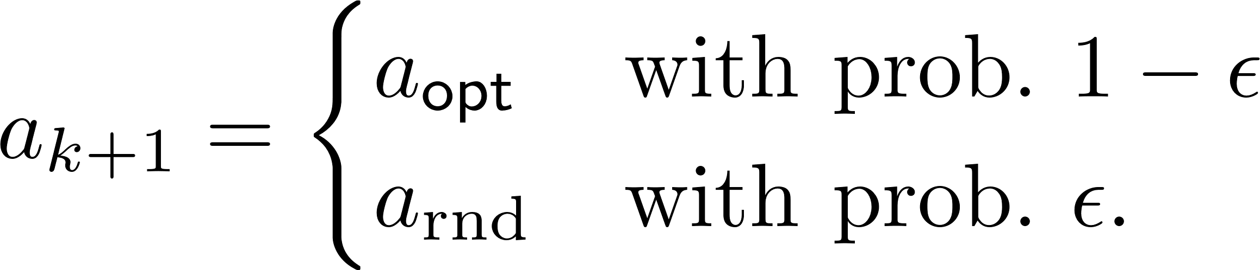
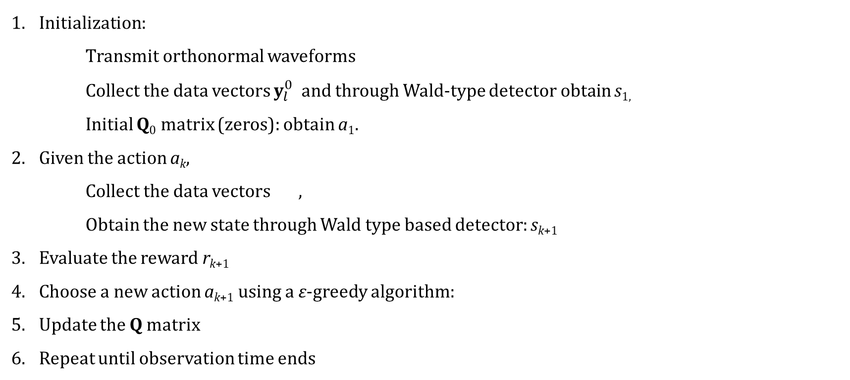
SARSA (state-action-reward-state-action) learning-detection algorithm
Cognitive Radar: SARSA
Initialization:
    Transmit orthonormal waveforms
Collect the data vectors $y_{l}^{0}$ and through Wald-type detector obtain s_{1,}
Initial Q₀ matrix (zeros): obtain a₁.
Given the action a_{k},
  Collect the data vectors ,
  Obtain the new state through Wald type based detector: s_{k+1}
Evaluate the reward r_{k+1}
Choose a new action a_{k+1} using a ε-greedy algorithm:
Update the Q matrix
Repeat until observation time ends

Slide 20
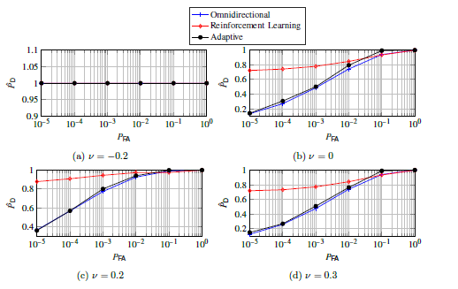
Cognitive Radar: Static environment
Four targets with different Signal to Noise ratio (SNR), N=10⁴
T1 at -0.2, SNR = -5dB,
T2 at 0, SNR = -8dB,
T3 at 0.2, SNR = -10dB,
T4 at 0.3, SNR = -9dB,
ROC using RL vs alternative approaches

Slide 21
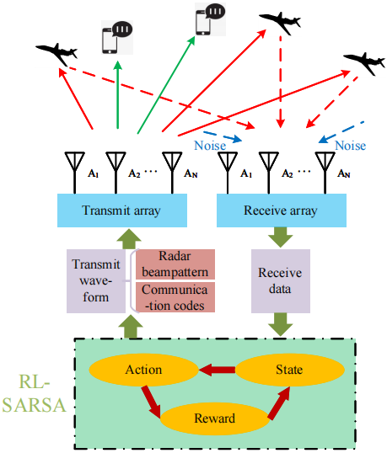
Integrated system based on RL
  RL based multi-target detection
    Design a robust Wald-type estimator for mMIMO
    Introduce RL into multi-target detection
    Achieve dynamic detection under unknown environment
    Enhance weak target detection performance
  Realization of integrated communication
    Embed communication information into radar transmit waveform via complex beampattern modulation (AM or PM)

Slide 22
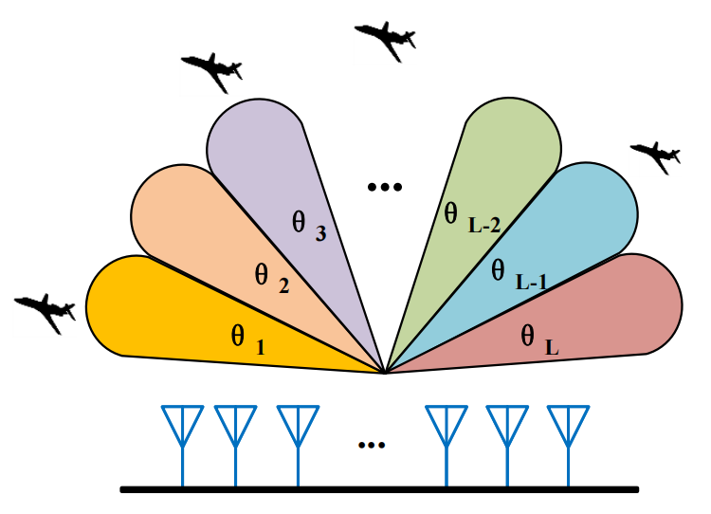
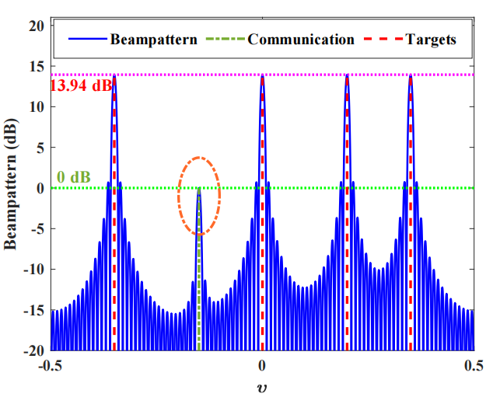
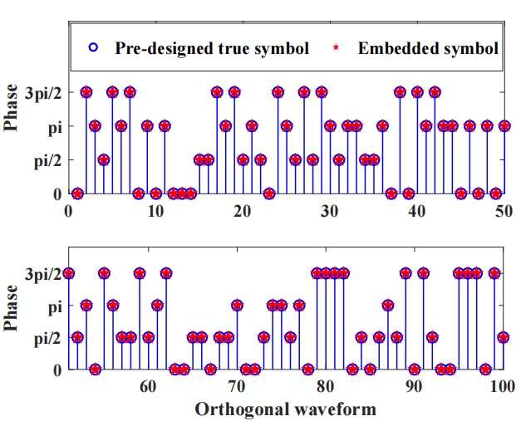
RL: Joint waveform design
Divide the detection area into L discrete angular bins
Steer the beams to the angular bins that most likely contains a target while ensuring the communication power
Embed communication codes modulated into the complex beampattern towards the communication direction
W. Zhai, X. Wang, X. Cao, M. S. Greco, F. Gini, “Reinforcement Learning based Dual-Functional Massive MIMO Systems for Multi-target Detection and Communications”, IEEE Transactions on Signal Processing, early access, 2023.

Slide 23
RL: Joint waveform design
                The communication receiver applies the conventional beamforming to amplify the communication signal. The output of the nth pulse after matched filtering is
                During the nth pulse, the communication symbol carried by the ith orthogonal waveform is modulated into the complex beampattern towards the communication direction
                The communication information can be embedded into both the amplitude and the phase of the complex beampattern. When using amplitude, it is referred to as AM mode, when phase, PM mode. Both can be retrieved at the receiver end.

Slide 24
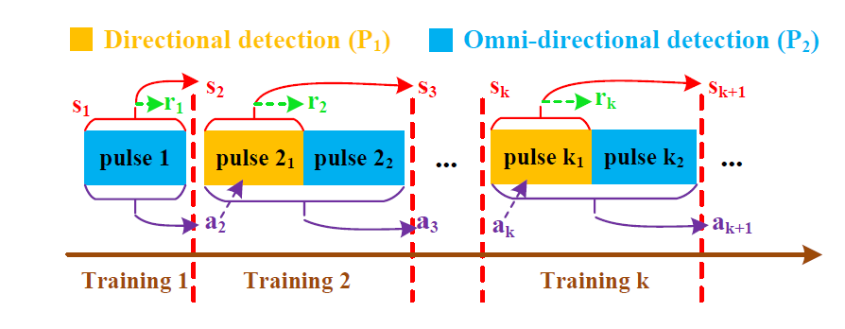
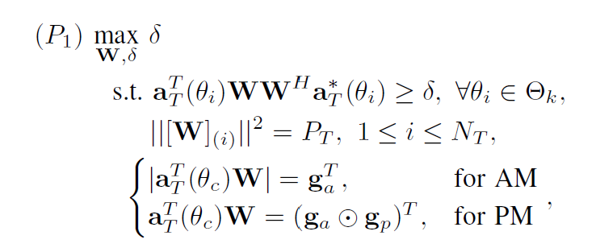
RL: Joint waveform design
Improved SARSA
The kth training is performed with two consecutive radar pulses, the first is directional, the second is omni-directional. In this way we increase the probability of detecting also very weak targets
The new optimization problem is given by the problem P₁ and gives into account the beamforming and the constraints on the communication signals.
g_{a} ∈ R^{NT} records the amplitude information of the N_{T} communication symbols
g_{p} ∈ C^{NT} records the phase information of N_{T} communication symbols

Slide 25
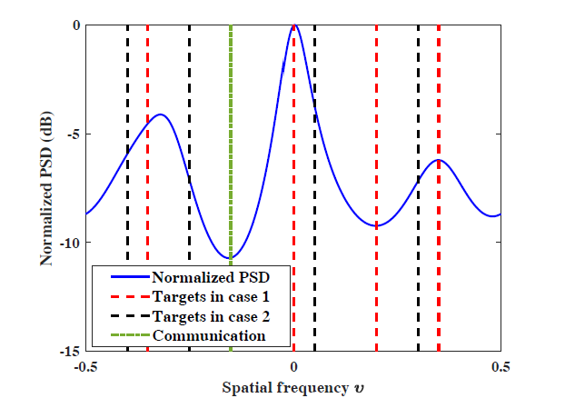
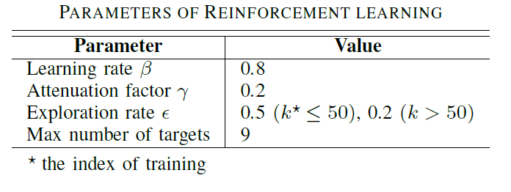
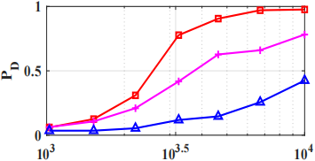
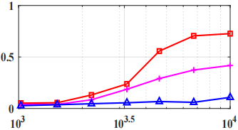
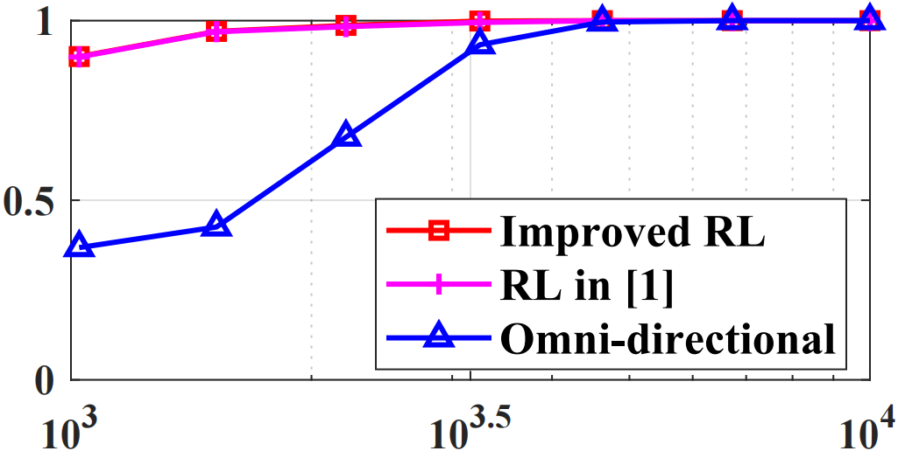
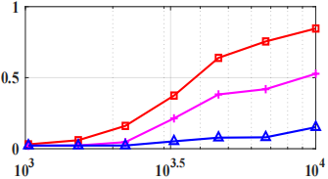
Simulations-Detection
Detection performance vs number of virtual antennas N
Results of case 1, static scenario.
Weak target 1
Weak target 2
T1 at -0.35, SNR = -10dB,
T2 at 0, SNR = -10dB,
T3 at 0.2, SNR = -5dB,
T4 at 0.35, SNR = -15dB,
CM at -0.15
N=N_{T}*N_{R}, P_{FA}=10⁻⁴
Strong target
Weak target 3

Slide 26
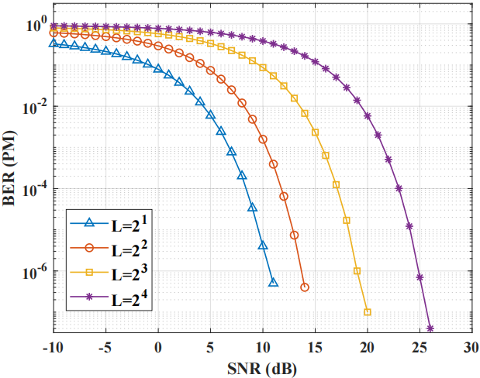
Simulations-Communication
Performance of the communication channel in PM mode
Total transmit beampattern, with 4 targets and 1 communication channel
Bit Error Rate (BER) in PM mode. It deteriorates with increased data rate and drops when SNR>5 dB
N_{T}=N_{R}=100

Slide 27
ISAC for automotive MIMO radars
Basic parameters
Colocated MIMO radar (TX):
Total number of transmit antennas: N
Number of antennas for communication: N₂
Number of antennas for sensing: N₁
Inter-element spacing: d_{t}
Colocated MIMO radar (RX):
Number of receive antennas: M
Inter-element spacing: d_{r} =Nd_{t}
Transmit signal (nth pulse)
sensing
communication
Steering vector of sensing subarray
Sensing orthogonal waveforms
Steering vector of communication subarray
Precoding matrix for K users
Communication orthogonal waveforms
W. Zhang, X. Wang, M. S. Greco, F. Gini, “Reinforcement learning based integrated sensing and communications for automotive MIMO radar,” 2023 IEEE Radar Conference, USA

Slide 28
Signal Model
Sensing model
Consider L targets to be detected, the received signal by the colocated MIMO receiver:
Applying matched filtering and vectorizing:
Communication model
Consider K downlink communication users, the signal vector received by the K users:
The SNR of the kth user:
Suppose H_{c} and H_{r} are known

Slide 29
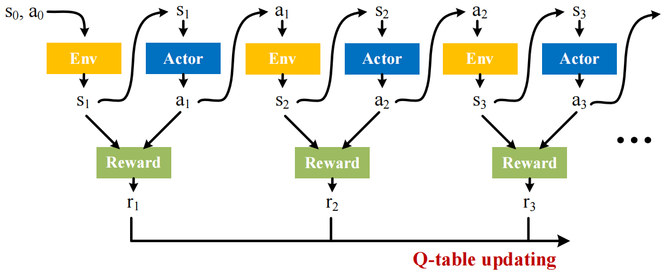
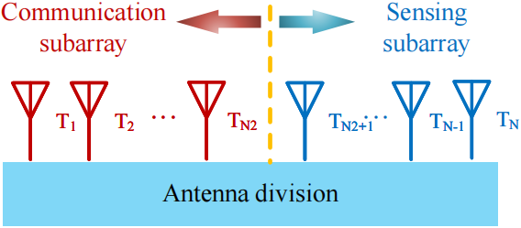
Step I: RL-based Antenna Division
RL-based antenna division
The number of antennas for sensing and communication need to be reasonably allocated under different scenarios, learning from the environment.
RL: state-action-reward-state-action framework
Training 1
Training 2
Training 3

Slide 30
Step I: RL-based Antenna Division
State-action-reward-state-action
Set of states (# of transmit sensing antennas) :
Set of actions:
Updating of Q-table:
ε-greedy policy to select appropriate action “a_{j}”
Rewards
: the reward of sensing, which is determined by the DOA estimation accuracy.
: the reward of communication, which is determined by the received SNR.

Slide 31
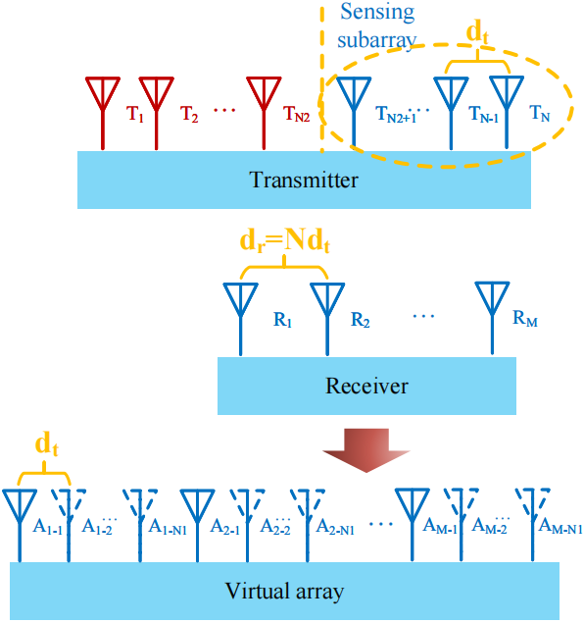
Step I: Reward “rj” of the j-th Training
Reward of sensing —— determined by CRB
The CRB of the DOA estimation for a given sparse sensing subarray:
where (L’ detected targets)
(diagonal)
(diagonal)
P. Stoica and A. Nehorai, “MUSIC, maximum likelihood, and Cramer-Rao bound,” IEEE T-SP, vol. 37, no. 5, pp. 720-741, May 1989

Slide 32
Step I: Reward “rj” of the j-th Training
To ensure the estimation accuracy for all targets, we take the maximum value of CRBs of all estimated DOAs as the objective function
As a smaller CRB indicates higher estimation accuracy, we define the normalized reward of sensing as
α₁ is a pre-set constant

Slide 33
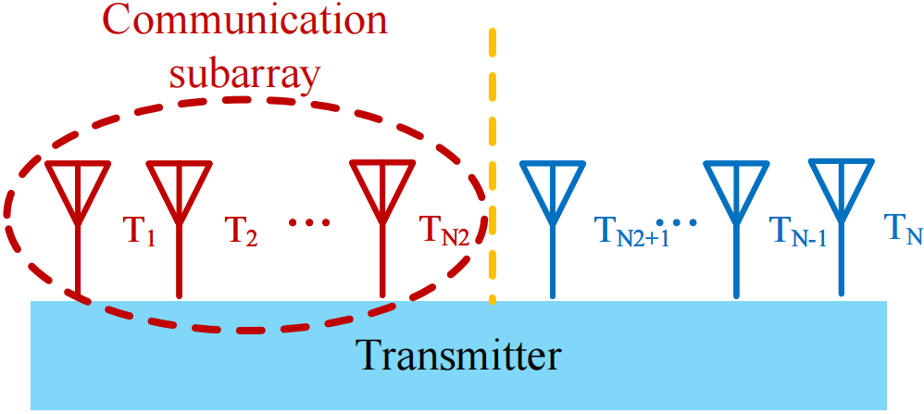
Step I: Reward “rj” of the j-th Training
Reward of communication—— determined by the user’s received SNR
The precoding matrix is designed to maximize the received SNR of each user:
The objective function is non-convex
We transform the fractional constraint into the denominator constraint with a fixed numerator constraint (convex relaxation)

Slide 34
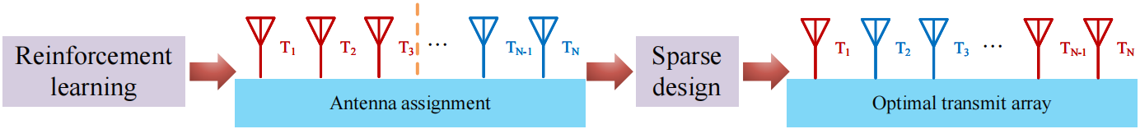
Step II: Array Configuration Optimization
Step I
Step II
Step I: The optimal antenna allocation scheme is obtained via reinforcement learning in the unknown environment.
Step II: The configurations of the two subarrays is optimized through antenna selection. (The number of antennas for different subarrays is given by Step I)
Array configuration optimization for joint sensing and communication

Slide 35
Step II: Array Configuration Optimization
We aim to enhance the sensing accuracy with a constrained communication quality
From the perspective of antenna selection, the maximum value of CRBs of all estimated DOAs can be rewritten as:
where “e” is the selection vector (of the virtual array) which exhibits the characteristic of group sparsity.
We define some auxiliary selection vectors :
Selection vector of the sensing subarray:
Selection vector of the communication subarray:
Transmit group selection matrix and vector:

Slide 36
Step II: Array Configuration Optimization
The array optimization for the joint sensing and communication:
Antenna selection constraints
Communication constraints
The non- convex constraints and objective function are then relaxed
W. Zhang, X. Wang, M. S. Greco, F. Gini, “Reinforcement learning based integrated sensing and communications for automotive MIMO radar,” 2023 IEEE Radar Conference, USA

Slide 37
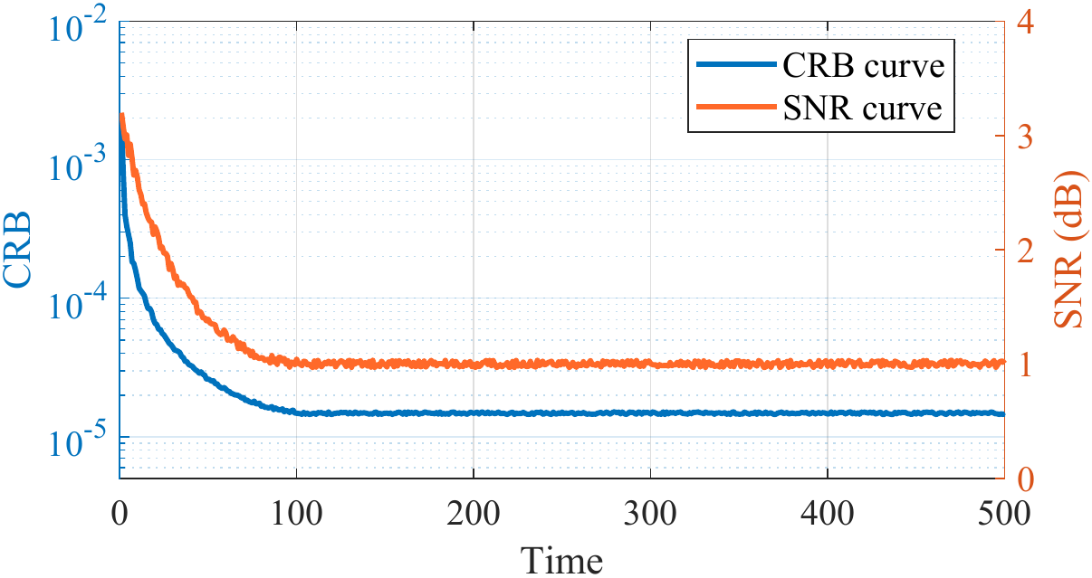
Simulation Results
Example 1: Adaptability of RL based algorithm to the unknown environment
Number of transmit antennas: N=10
Number of receive antennas: M=6
Radar targets: θ=[-70°, -30°, 10°, 40°，70°] with SNRs of -20dB
Communication users: θ=[-80°, -40°, 20°, 50°] with path loss [-10dB,-10dB, -5dB,-5dB]
The CRB and SNR performance with the training of RL.
Inizialization with first transmit antenna assigned for sensing and the remaining 9 for communication
Optimal antenna division obtained by RL: N₁=4, N₂=6.

Slide 38
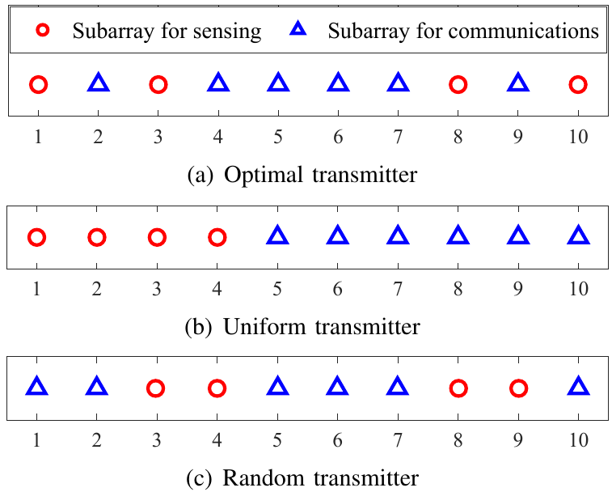
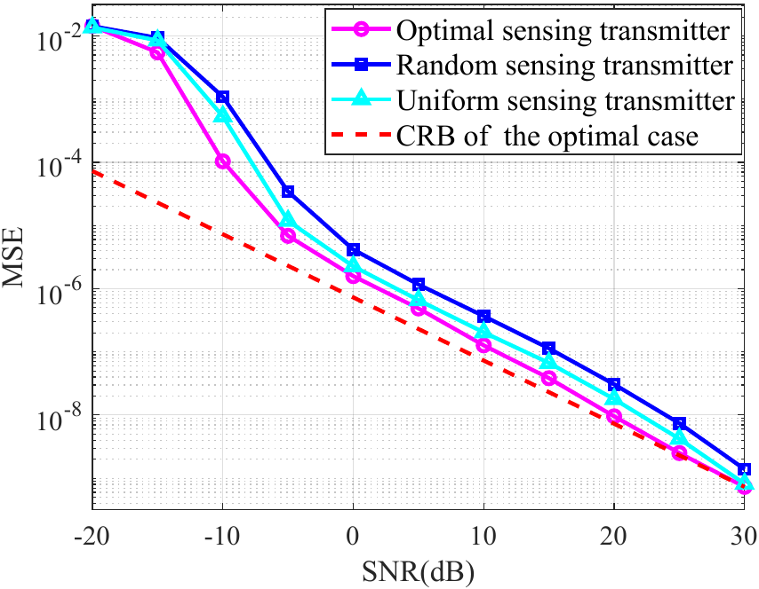
Simulation Results
Example 2: Jointly optimize the configurations of the 4-antenna subarray for sensing and another 6-antenna subarray for communications
γ₀=1.12
f_{c}=1.00dB
N₁=4
N₂=6
Sensing performance

Slide 39
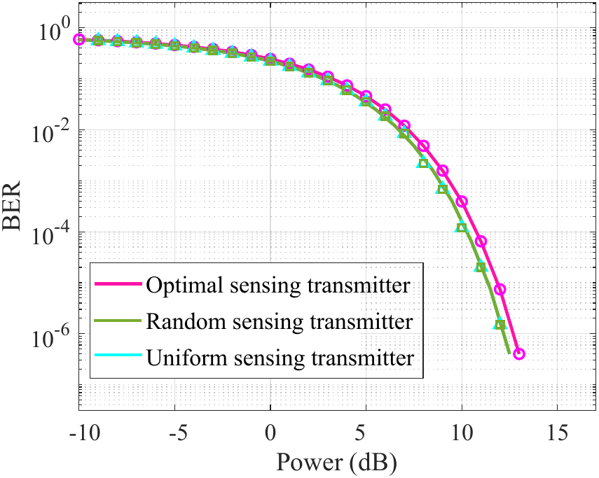
Simulation Results
Example 2: Jointly optimize the configurations of the 4-antenna subarray for sensing and another 6-antenna subarray for communications
γ₀=1.12
f_{c}=1.00dB
N₁=4
N₂=6
Communication performance

Slide 40
Conclusions
Cognitive techniques can be applied in many ways
Simple algorithm for spectrum sensing and sharing in ISAC
RL based ISAC system for massive MIMO radar.
RL based ISAC system for automotive MIMO radar.

Slide 41
Acknowledgements
Fulvio Gini, University of Pisa, Italy
Pietro Stinco, CMRE, Italy
Stefano Fortunati, Université Paris-Saclay, France
Braham Himed, AFRL, Dayton, USA
Murali Rangaswamy, AFRL, Dayton, USA
Kristine Bell, Metron, USA
Sevgi Zubeyde, University of Alabama, USA
Aya Ahmed, Ruhr University Bochum, Germany
Francesco Lisi, University of Pisa, Italy
Xiangrong Wang, Beihang University, Beijing, China

Slide 42
Some references
[1] M. La Manna, P. Stinco, M. Greco, F. Gini , "Design of a Cognitive Radar for Operation in Spectrally Dense Environments", IEEE 2013 Radar Conference, 29 April-3 May, 2013 Ottawa, Ontario, Canada.
[2] M. La Manna, P. Stinco, M. Greco, F. Gini, "Cognitive Techniques for a Wideband Phased Array Radar", 2013 IEEE International Symposium on Phased Array Systems and Technology (ARRAY 2013), 15-18 Oct. 2013,Waltham, MA, USA.
[3] P. Stinco, M.Greco, F. Gini, M. La Manna, "Compressed Spectrum Sensing in Cognitive Radar Systems", 2014 IEEE International Conference on Acoustics, Speech and Signal Processing (ICASSP2014), May 2014, Florence, Italy.
[4] E. Giusti, A. Bacci, P.Stinco, M. Martorella, A.L. Saverino, F. Gini, F. Berizzi, M.Greco, " Cognitive Multichannel ISAR Imaging for Maritime Coastal Surveillance and Ground Border Control“, CAMSAP2015, Cancun, Mexico, December 2015
[5] P. Stinco, M. Greco, F. Gini, B. Himed, "Cognitive Tracking in IEEE 802.22 Symbiotic Radars", EUSIPCO 2016, Budapest, August 2016.
[6] M. Greco, F. Gini, P. Stinco, “Cognitive Radars: Some Application,” invited speech, GlobalSIP 2016, Washington DC, December 2016.
[7] P. Stinco, M. Greco, F. Gini, "Spectrum Sensing and Sharing for Cognitive Radars", IET Radar, Sonar and Navigation, Vol. 10, No 3, pp. 595–602, 2016.
[8] P. Stinco, M. Greco, F. Gini, B., Himed, "Cognitive Radars in Spectrally Dense Environments", IEEE AESS Magazine, Vol. 31, No. 10, pp. 20-27, October 2016.
[9] P. Stinco, M. Greco, F. Gini, B. Himed, "Cognitive Passive Tracking in Symbiotic IEEE 802.22 ComRadE Systems", IEEE Transactions on Aerospace and Electronic Systems, Vol. 53, No. 2, pp. 1023-34, 2017.
[10] W. Li, S. Fortunati, M.S. Greco, F. Gini, “Waveform optimization for multi-target detection with a reinforcement learning approach”, Asilomar 2018, US, October 2018.

Slide 43
Some references
[11] M. Greco, F. Gini, P. Stinco, K. Bell, "Cognitive Radars: On the Road to Reality: Progress Thus Far and Possibilities for the Future", IEEE Signal Processing Magazine, Vol. 35, No.4, pp.112-125, July 2018.
[12] S. Fortunati, L. Sanguinetti, M.S. Greco, F. Gini, "Scaling up MIMO radar for target detection ", ICASSP 2019, Brighton, UK, May 2019.
[13] S.Z. Gurbuz, K. Bell, A. Charlish, M.S. Greco, H.D. Griffiths, and M. Rangaswamy, “An Overview of Cognitive Radar: Past, Present, and Future”, IEEE Aerospace and Electronic Systems Magazine, Vol. 34, No. 12, pp. 6-18, December 2019.
[14] S. Fortunati, L. Sanguinetti, F. Gini, M.S. Greco, B. Himed, “Massive MIMO Radar for Target Detection”, IEEE Transactions on Signal Processing, Vol. 68, 2020.
[15] A. Ahmed, A. Alameer-Ahmad, S. Fortunati, A. Sezgin, M.S. Greco, and F. Gini, “Reinforcement Learning based Beamforming for Massive MIMO Radar Multi-target Detection”, IEEE Transactions on Aerospace and Electronic Systems, Vol. 57, No. 5, 2021.
[16] A. Mostafa Ahmed, S. Fortunati, A. Sezgin, M. S. Greco, F. Gini, “Robust Reinforcement Learning-based Wald-type Detector for Massive MIMO Radar”, EUSIPCO 2021, Dublin, Ireland, August 2021.
[17] F. Lisi, S. Fortunati, M.S. Greco, F. Gini, “Enhancement to a state-of-the-art RL-based detection algorithm for Massive MIMO radars”, IEEE Transactions on Aerospace and Electronic Systems, Vol. 58, No. 6, pp. 5925-5931, December 2022.
[18] K. Metwaly, J. Kweon, K. Alhujaili, M.Greco, F. Gini, V. Monga, “Interpretable, Unrolled Deep Radar Beampattern Design”, ICASSP 2023, Rhodes, Greece, June 2023.
[19] W. Zhang, X. Wang, M. S. Greco, and F. Gini, “Reinforcement learning based integrated sensing and communications for automotive MIMO radar,” 2023 IEEE Radar Conference, San Antonio, TX, USA.
[20] W. Zhai, X. Wang, X. Cao, M. S. Greco, F. Gini, “Reinforcement Learning based Dual-Functional Massive MIMO Systems for Multi-target Detection and Communications”, IEEE Transactions on Signal Processing, Vol. 71, pp. 741 – 755, 2023.

Slide 44
Thanks for your attention
QUESTIONS?

