Slide 1
IEEE Aerospace Electronic Systems VP Membership
Abir TABARKI
AESS Board of Governors Meeting – Fall 2024
25-26 October 2024
Rennes, France

Slide 2
2024 Objectives
Empower Women in Engineering:
Create and promote initiatives that support women in aerospace and related fields.
Foster a global network of women student branches to share resources, mentorship, and experiences.
Enhance Awareness of AESS Benefits:
Develop campaigns to highlight AESS scholarships, grants, and professional development opportunities.
Utilize social media and webinars to reach a diverse audience and engage students worldwide.
Facilitate Collaboration and Knowledge Sharing:
Organize virtual and in-person events that encourage collaboration among student branches.
Share best practices, success stories, and resources to strengthen the global AESS community.

Slide 3
AESS Student & Young Professional Congress Overview
Annual Meeting Purpose
Participants: Students and young professionals who are members of AESS.
Objective: Serve as the central gathering to network and showcase achievements.
Activities and Opportunities
Poster Sessions: Share achievements of local units.
Keynotes: Attend presentations that highlight IEEE AESS benefits and knowledge.
Round-Table Discussions: Discuss pertinent topics in the Aerospace and Electronic Systems fields.
Workshops: Participate in workshops that delve into technical activities within AESS.
Awards and Recognition
Chapters Recognition: Student branch chapters and section chapters can receive awards.
Presenters: Awards presented by the AESS awards committee during the congress.

Slide 4
AES S&YP Congress host Submission Overview
Objective: Submit a comprehensive proposal to host the event
Content Requirements: Include general information, detailed hosting plans, and all supporting materials.
Experience: Emphasize past event organization, sponsor relations, and speaker engagements.
Committee Roles: Include Chairperson, Heads of Program, Meals, Accommodation, Technical and Social Activities, Young Professionals, Sponsorship, Treasurer, Secretary, and Webmaster.
Event Considerations:
Dates and Venues: Avoid significant holidays, consider logistics and accessibility.
Catering and Transportation: Account for diverse dietary needs and efficient local transport.

Slide 5
Congress Planning Timeline
Prepare Guidelines: DOA + 15
Details: Under the umbrella of the S&YP Committee, prepare the necessary guidelines for the congress.
Launch and Promotion: DOA + 30
Details: Officially launch and promote the call for congress participation.
Submission Deadline: DOA + 90 (2 months preparation)
Details: Deadline for potential participants to submit their proposals.
Review Period: DOA + 90 – DOA + 120
Details: Review all applications and select the top 3 applicants.
Selection and Budget Approval: DOA + 120
Details: Choose the organizer of the congress and approve the budget.
Preparation Phase: DOA + 120 🡪 Day of Event
Details: Begin collaboration with the organizing committee to make the congress a reality in Summer 2025.
DOA: Day of BoG Approval

Slide 6
Funding Strategy for AESS S&YP Congress
Objective: Allocate funds to support the attendance of active AESS S&YP volunteers at the congress, covering registration and travel expenses.
Key Strategies:
Reduce Costs & Increase Attendance: The location of the congress is a crucial factor. To make the congress more accessible, select an organizer in a region with a high density of members.
Selection Criteria for Organizer: Choose a Chapter or Student Branch Chapter (SBC) with a significant member base to host, ensuring a broader potential participant pool.
Preliminary Budget Proposal:
Estimated Attendance: 80 participants
Support Allocation: Funding proposed to support about 55 participants (until funds are exhausted)
Coverage Focus: Aim to provide substantial assistance with travel and registration costs to facilitate maximum participation.

Slide 7
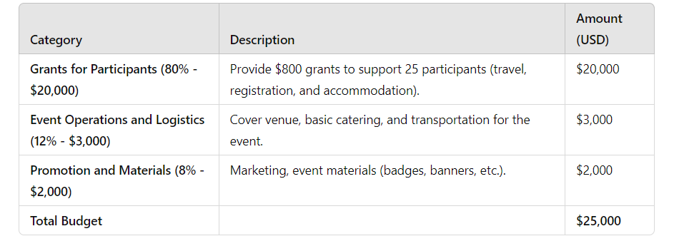
Funding Strategy for AESS S&YP Congress

Slide 8
Purpose and Eligibility
Purpose: Enable AES Student and Young Professionals members to participate in the AES SYP Congress.
Eligibility: Exclusive to IEEE AESS members of the grades “Undergraduate,” “Graduate,” or “Young Professionals.”
Expenses Covered
Includes: Airfare, registration fees, accommodation, visa, and transportation costs.
Review Process and Communication
Selection Committee: Members of the AES membership committee evaluate submissions.
Communication: Results announced via IEEE emails and official AES platforms.

Slide 9
Selection Criteria and Funding Allocation Priorities
Criteria for Selection
Engagement: Applicant's involvement in IEEE and AES activities.
Support Letters: Quality of the support letters provided.
Priority Order for Fund Allocation
Fair Representation: Ensures representation from each Region.
Inclusivity Goals: Balanced representation across all Sections within Regions, Student Branches, Chapters, and YP Affinity Groups.
Overall Objective: Achieve comprehensive inclusivity within the IEEE AES community.

Slide 10
Motion(s)
Abir Tabarki moves to moves to fund $25,000 for the 2025 AESS Student and Young Professionals (SYP) Congress
Pros:
First ever AESS SYP Congress
Students and YP worldwide will attend Congress to learn about AESS and career advice
Managed and organized by AESS Students/YP
Perfect opportunity for AESS to reach out to dozens of students/YP with a clear message
Cons:
To keep the budget affordable, students/YP are expected to take the lead and organize the conference
$25k may not suffice to run the conference. Past events cost >$50k, but were far larger.
Due to a relatively “limited” budget, the event may become “regional” rather than international.
Financial Implications: $25,000

