Slide 1
IEEE Aerospace Electronic Systems
VP Conferences
Braham Himed
AESS Board of Governors Meeting – Fall 2024
25-26 October 2024
Rennes, France

Slide 2
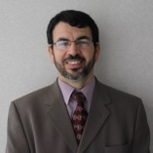

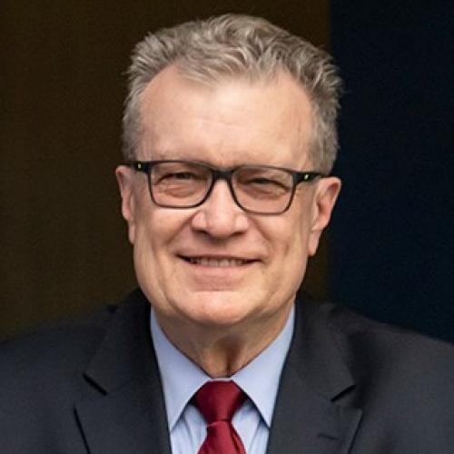

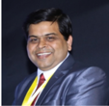
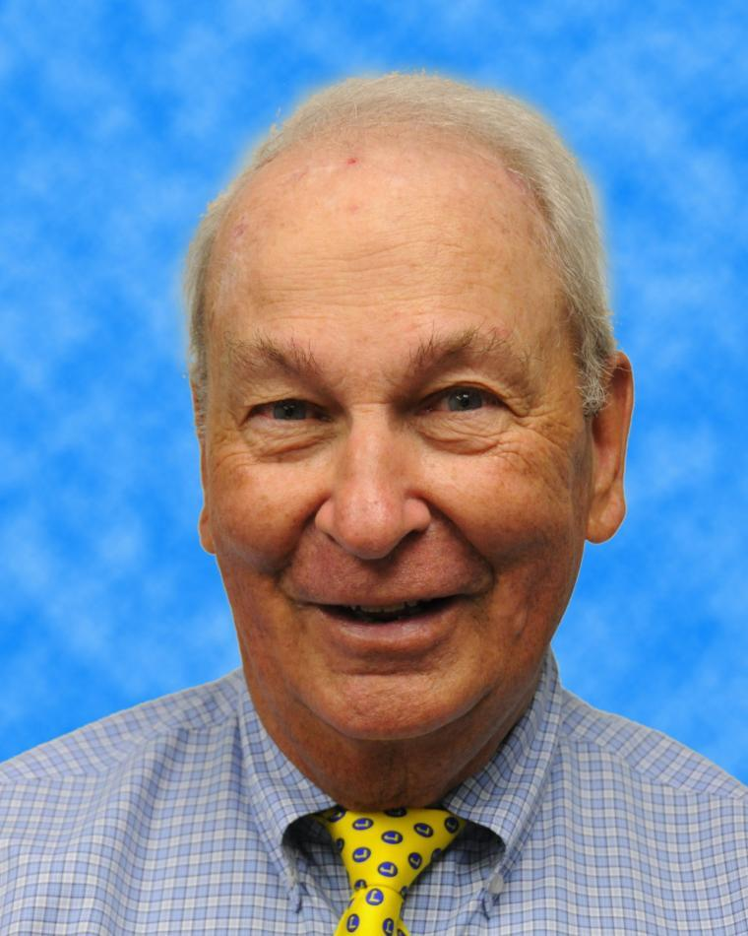
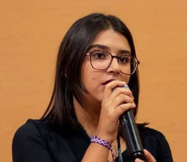
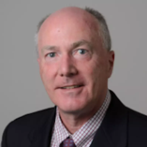
2024 Conference Committee
Braham Himed
VP-Conferences
Fabiola Colone
Walt Downing
Hugh Griffiths
Puneet Mishra
Bob Rassa
Abir Tabarki
Peter Willett

Slide 3
Conference Committee Activities
Coordinating and approving upcoming (financially and technically – sponsored) conferences, symposia, and workshops
  Detailed review of applications, including budgets
Received record number of MOUs, including proposals for financial and technical sponsorship
  Over 25 proposals from all over the world
Increased AESS participation/visibility/engagement at newly identified events
  Focus on student and YP events
  Grants provided to events
  US, France, Spain, Turkey, Tunisia, Egypt, Algeria, and India

Slide 4
Goals
Continue offering and supporting high quality and healthy conferences / symposia / workshops
  Flagship conferences (RadarConf, Aerospace, AUTOTESTCON)
    Financially strong, attendance increasing, and provide greater than 20% surplus
Increase joint (IEEE and others) workshops/conferences
  ISAC discussions currently underway with COMSOC and SPS
Encourage student participation in under-developed regions via subsidy & travel grants to offset high cost of attendance
  Make travel grants available to all financially-sponsored events

Slide 5
Goals
Proposed creation of Action Group to develop strategy and roadmap for engagement with Africa and Asia
  Ask Mark Davis and Puneet Mishra to lead it
Create AESS conference advising committee
  New AESS VP-Conferences to lead it
Address strong competition
Address high cost of conference attendance
  Registration
  Travel and lodging

Slide 6
Issues
International Carnahan Conference on Security Technology (ICCST)
2023 (India)
  $10,000 of AESS loaned funds were used to pay for travel
  Net loss to AESS
2024 (Brazil)
  Cancelled due to poor paper submission

Slide 7
Repayment and Accounting Issues
Reimbursed via concur
  Hotel accommodation
  Flights and travel cost
Conference expenses
  Complimentary registrations and tutorials
  YP grants, YP events, boot camps, and challenge events – must provide invoice of actual expenses incurred (increase administrative efforts for both conference and AESS staff)

