Slide 1
IEEE Aerospace Electronic Systems
DSTEI Phase 2 Status
Mark E Davis. DSTEI Project Manager
AESS Board of Governors Meeting – Fall 2024
25-26October 2024
Rennes France,

Slide 2
DSTEI Phase 2 Project Teams
Region 9 -- South America
AESS Board Liaison – Giovanna Ramirez Ruiz, Bogota Colombia
“Drone Swarm System for Agricultural Surveillance of Coffee Crops ", Univ. del Cauca, Cauca Colombia, IEEE Colombia Section
Camilo Segura, Student Branch ; Dr. Liseth Viviana Campo, Student Branch Advisor
$25,000 Funds Sent to UniCauca by 15 June 2024
“Smart Drones for Prevention of Forest Fires", Universidad National San Antonio Abad del Cusco (UNSAAC), Cusco Peru, AESS Peru Section
Alberto Arturo Quinones, Student Branch; Dr. Walter Mego, Student Branch Advisor
Peru Section Not Processing, Region 9 Working With MGA For Consolidated Banking
Region 10 – India
AESS Board Liaison – Puneet Mishra, Bangalore, India
“ Fire Extinguisher Unmanned Aerial Vehicle ”, Nitte Meenakshi Inst Of Tech Student (NMIT), Bengaluru, India, AESS Bangalore Section
Pradeep Kumar, Student Branch ; Dr. Parameshachari B. D, Student Branch Advisor
$25,000 Funds Sent To NMIT by 1 August 2024
SPIT Funding Not Approved By MGA and Region 10 Due To Bombay Section Financial Irregularities. -- TAB Notified for Not Proceeding to Phase 2
Staggered Start Due To Regions 9 & 10 Issues

Slide 3
MGA Approval on UNSAAC Fiunding
Jenifer Castillo Rodriguez October 25, 2024
Dear Mark,
Yesterday the ExCom met and the creation of the custody account of this
SB for this specific project has been approved. Please mind:
This is an exception we are making so the project can move forward. This should not become the rule for
future operation
and projects as this can become something difficult to control.
We accept your offer of monitoring the project and its disbursements in the best way possible.
For example, the officers of Peru Section advised that sometimes the requested came without invoices or
support and this is not the best way to go.
The account should be dissolved by the end of December 2025 or the end of the project. Whatever comes first.
Teresa advised there is no issue to manage the funding from the account, as long as the payments are done from the
custody account to the vendors (international payments).
Please avoid sending the payments to a local account that is not an IEEE related one.
Please remember the SB does not have a tax number in Peru.
I am including @Teresa in this message. Teresa, any further information
you would like to share? After this, I will proceed informing the Section chair.
Thanks all for your support in this case.
Jen
Jenifer Castillo Rodriguez | Oct 25, 2024, 11:47 AM (18 hours ago)
to Teresa, Christie, me, Ignacio, Maria

Slide 4
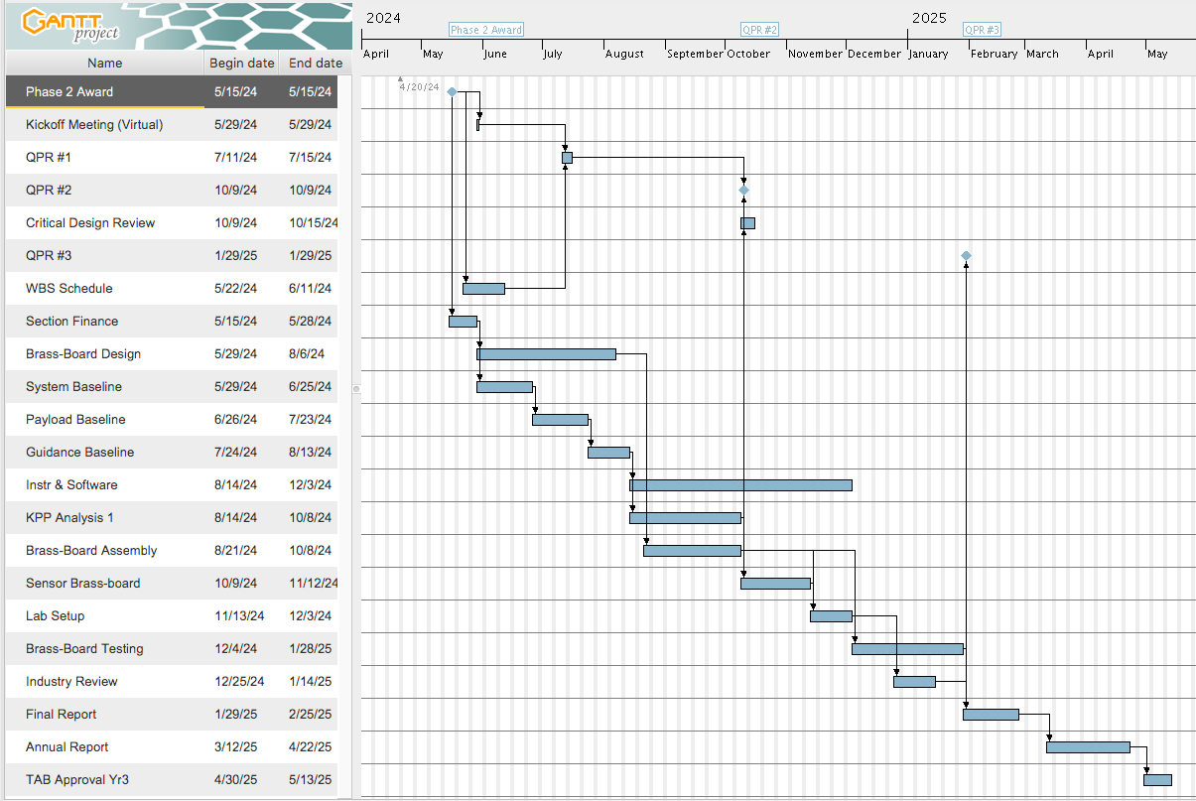
Phase 2 Master Schedule
2024
2025
Phase 2
Each SBC Phase 2 Provided WBS and Schedule At Kickoff Meeting,
Note To Anticipate The Budget Finance Transition Over 2025

Slide 5
Summary Of DSTEI Phase 2
Phase 2 Monthly Status Report on plan
Quarterly Progress Virtual Review In December or Early January
Region 9 Facilitating Funding For UNSAAC Phase 2 CB Transfer
UNSAAC Will Have A 4-5 Month Delay
Phase 2 Critical Design Review
Planning on January or February For In Person Reviews at Peru and Colobmbia
NMIT Bangalore CDR In July For SPACE2025
Tutorials Planned For CDR At Both Regions
3 SBCs Phase 2 CDR In Early 2025

Slide 6
Back Up Material

Slide 7
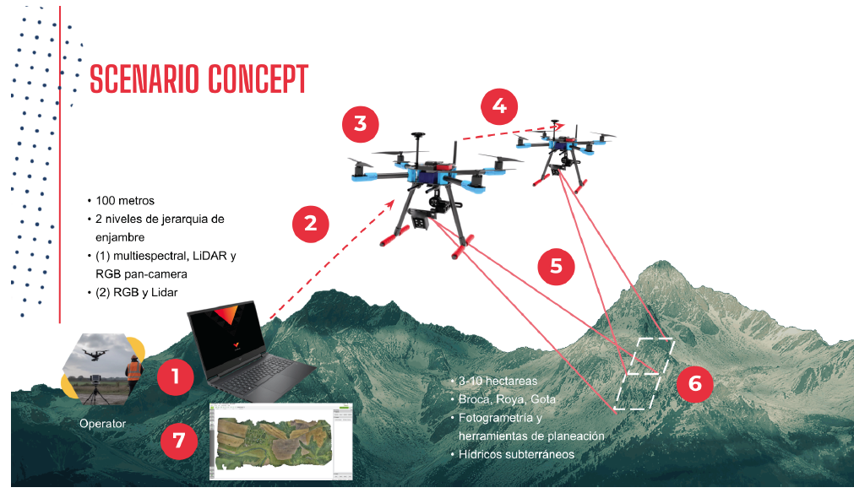
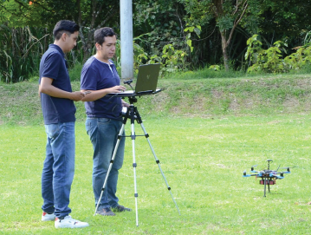
DSTEI UniCauca Student Branch PDR
Flight Tests 2 Drone Types
UniCauca Student Branch Growth
17 Students, With Succession Plan
Advisor Dr. Campo: Innovative Mgt. In Drone Management, Crop Applications
Strong Interface With AESS COL
Alliances With Students and YP
Colombia SBC Meetings
Embry Riddle Univ. USA
Small Business in Colombia, Ireland & Mexico
Collaboration With Regional Crop Growers
Phase 1 Accomplishments
High Level System Architecture
Tradeoff On 2 Drone Platforms
Flew Multispectral 4-Band Sensor
Demo Key Performance Parameters
Machine Learning On Crop Health
Real Time Processing Breadboard
Comm/Cyber Protocol
Phase 2 Plan
UAV/ROV Geoscience Network
Mentorship With Multiple AES Chapters
Grow Industry Supporters
Phase 2 Funding July 2024

Slide 8
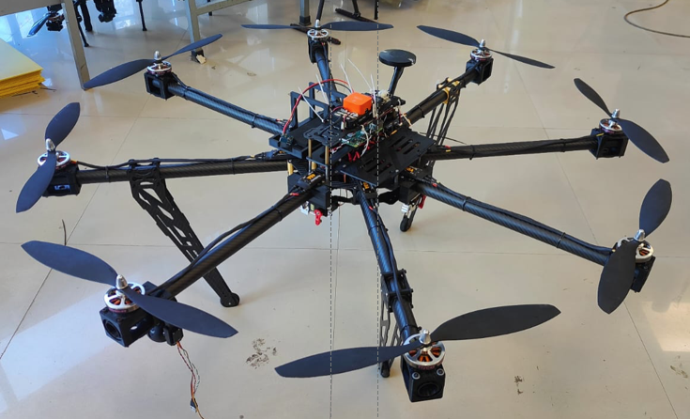
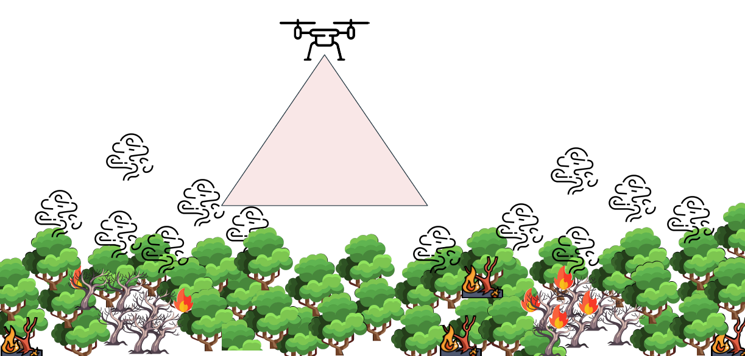
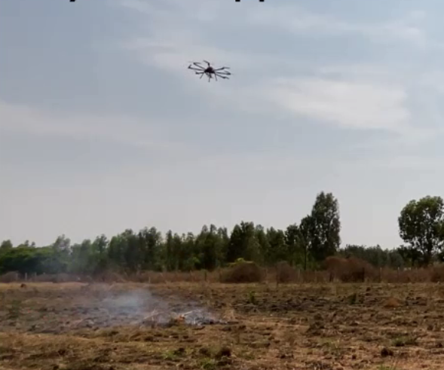
DSTEI N.M.I.T. Student Branch PDR + QPR
Fire Extinguisher UAV
Fire Ball Released
NMIT Student Branch Growth
7 Students, With Succession Plan
Faculty Advisor Dr. Parameshachari BD
Strong Interface With AESS Bengaluru
Alliances With Students and YP
Invited Local SBC For PDR In October 2023
NMIT Technology Transition Coordinator
Bangalore 2024 Best Chapter From Section
Collaboration With AEROGO Industry
Phase 1 Accomplishments
High Level System Architecture
Developed And Flew An Octocopter Drone
PixHawk UAS Flight Controller
Operated 3D CAD Stress Analysis
Machine Learning Algorithms
Day Night Fire Suppression Test
Phase 2 Plan
Work With AEROGO Mentor On Sensor
Complete Cyber and Thermal Fusion Design
Grow Industry Supporters
Phase 2 Funding August 2024

Slide 9
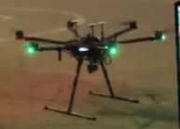
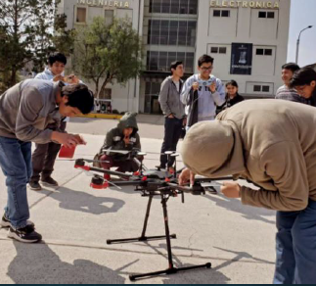
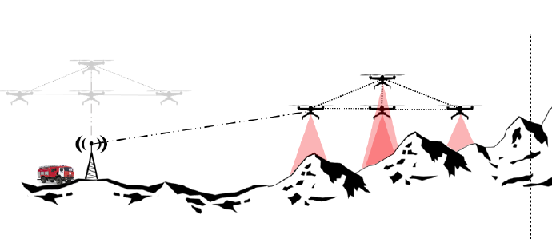
DSTEI UNSAAC Student Branch PDR
Matrice Drone In Mountain Terrain
Demo Drone At ELCON 2023
Matrice 600 Pro
UNSAAC Student Branch Growth
44 Students, With Succession Plan
Advisor Dr. Walter Mego:
Alliances With Students and YP
4 SBC Meetings In 2023 With 5 Peru SBC
Project Ar Peru Zagi and ROV
2023 Student Branch Award
Collaboration With Peru Emergency & Fires
Tighter Financial Linkage To Peru Section
Phase 1 Accomplishments
Matrice 600 Pro Drone Flight Test
Technical Performance Measurements
Sensor Fusion System Data Processing
Drone Flight Mg’ment and Sensor Control
Ground Control System Protocol for Environmental and Geographic Factors
Key Parameters With Peru Fire Experts.
Phase 2 Plan
Integrate Thermal Sensor To Drone
Grow Government & Emergency Organization Supporters
Peru Section Issue Continuing
Region 9 Working with MGA To Solve

