Slide 1
IEEE Aerospace Electronic Systems VP Education
Alexander Charlish
AESS Board of Governors Meeting – Fall 2024
25-26 October 2024
Rennes, France

Slide 2
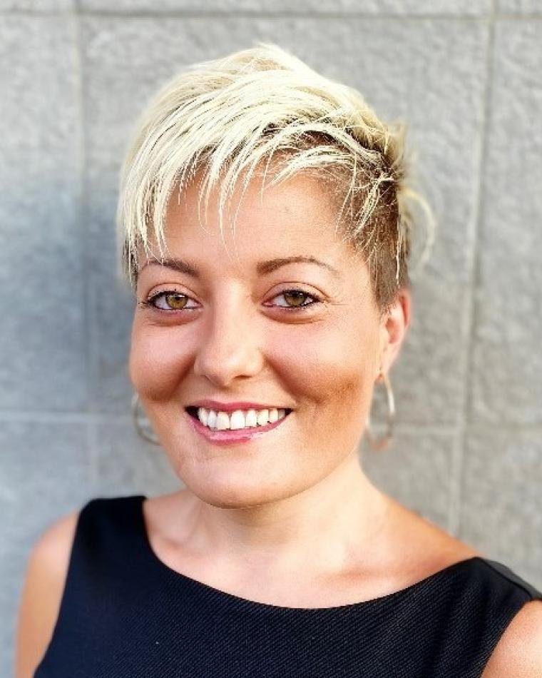
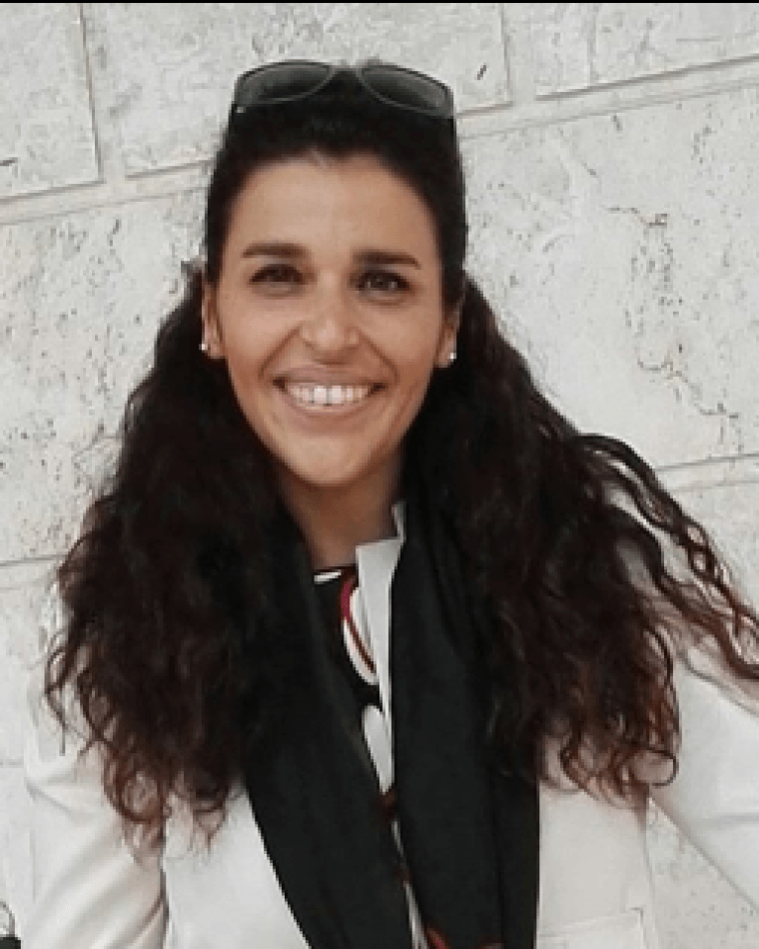
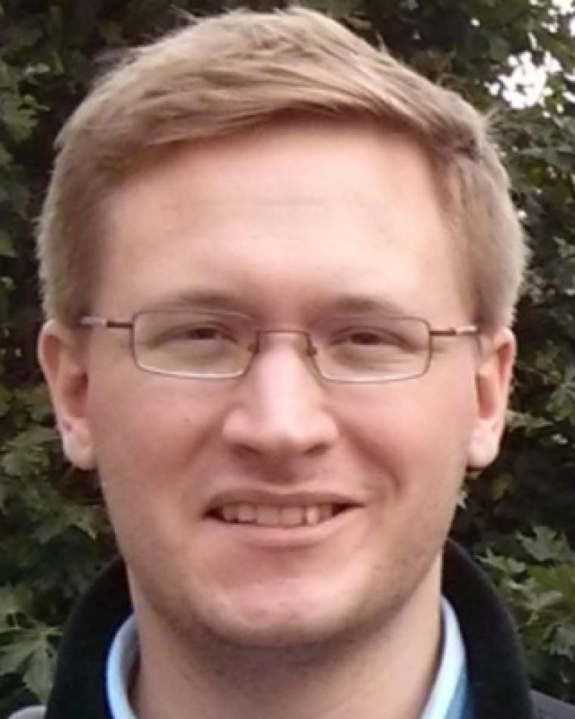
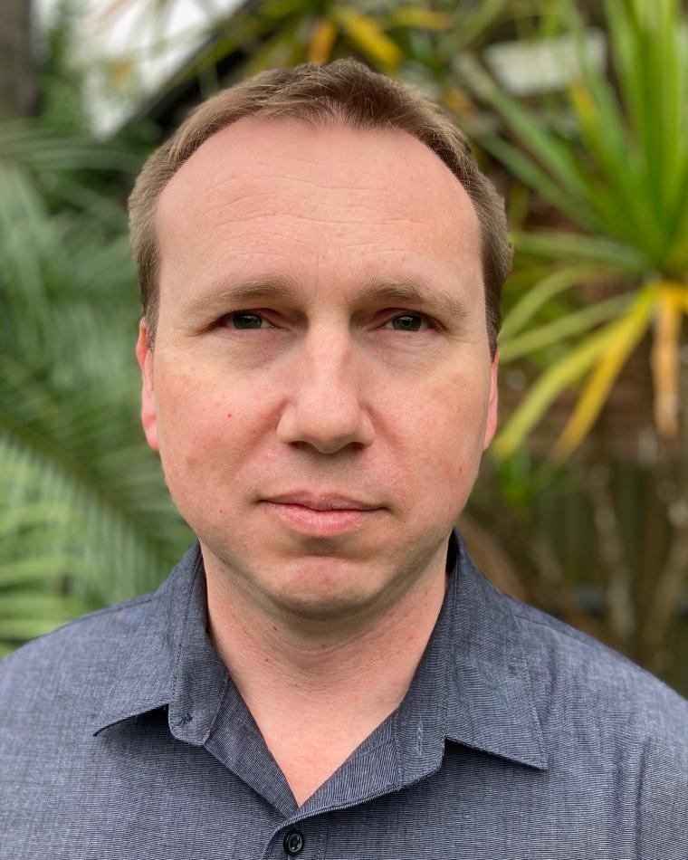
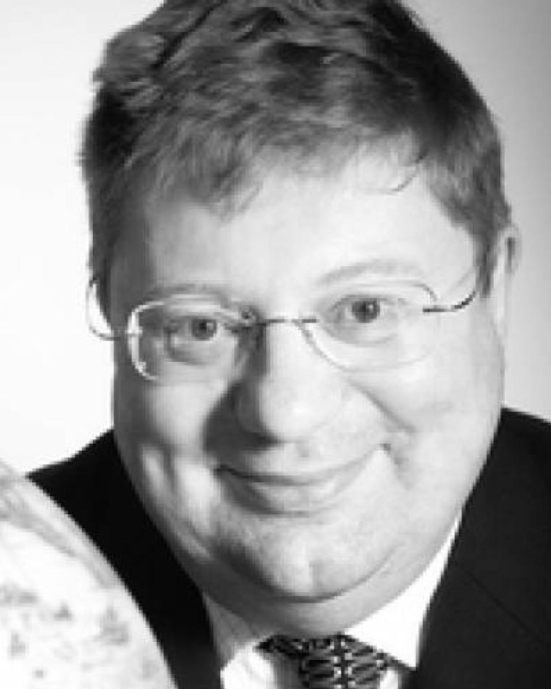
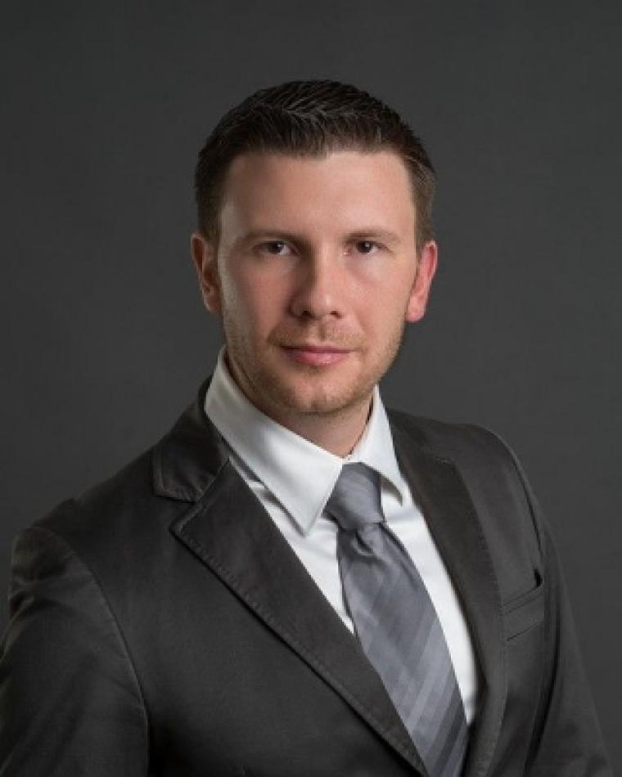
Objectives
Facilitate quality in-person and online educational events while reducing barriers to accessing education resources.
Expand online educational offerings
Facilitate the organization of in-person educational events within the society
Aid members in accessing educational resources

Slide 3
Summary of Activities
Virtual Distinguished Lecturer Program
31 webinars scheduled for 2024.
171 videos on ILN, AESS is the fourth largest supplier of content.
28 VDL webinars hosted in 2023 with an average attendance of 125 attendees per webinar and attendees from 81 different countries.
Distinguished Lecturer Program
Application process for new term 2025 – 2026 is underway.
Proposal: Increase cost limit from $2000 to $2500 for intercontinental travel and from $1000 to $1500 for intracontinental travel.
Educational Events
RadarConf: Boot camp, Radar challenge and YP event.
Fusion: Boot camp.
Conferences need to invoice AESS for actual costs incurred, conference items cannot be considered as costs.
Robert Hill Best Dissertation Award
Deadline on 31st October 2024.

Slide 4
Summary of Activities
YP Travel Grants
87 applications submitted by the 1st March deadline.
RadarConf: 29, Fusion: 18, AutotestCon 6, DASC: 12, International Radar Conference: 9.
To be run as part of member services from 2025.
Changes will be necessary to the grants for 2025:
Use the correct definition of “professionals”, i.e. not for students.
Packages will need to change, i.e. conferences give their items for free and invoice AESS for accommodation. Potentially possible to reimburse flight costs.
Michael Wicks Award
Four recipients in 2024, award to be run again in 2025.
Next year awards can in principle be given for both Atlanta and Krakow.
AESS Engineering Scholarship
Deadline approaching
Process to be changed according to lesson learnt from last year

Slide 5
Motion
MOTION: Education committee moves to fund travel grants for participants of the Radar Challenge at the IEEE Radar Conference (RadarConf) in Krakow, Poland, in the amount of $6,000.00 in 2025.
This motion is not connected to the AESS Challenge being held in Atlanta.
The Radar Challenge in Denver was very successful, however, it was found that the costs of attending the challenge was a barrier to participation. Therefore, these grants should be used to incentivize participation in the challenge.
Pros:
Aid challenge teams in presenting their work at the conference.
Advance the professional development of participants.
Help develop a engagement in the community.
Cons:
Cost
Financial Implications: $6,000.00.

Slide 6
Short Course Program

Slide 7
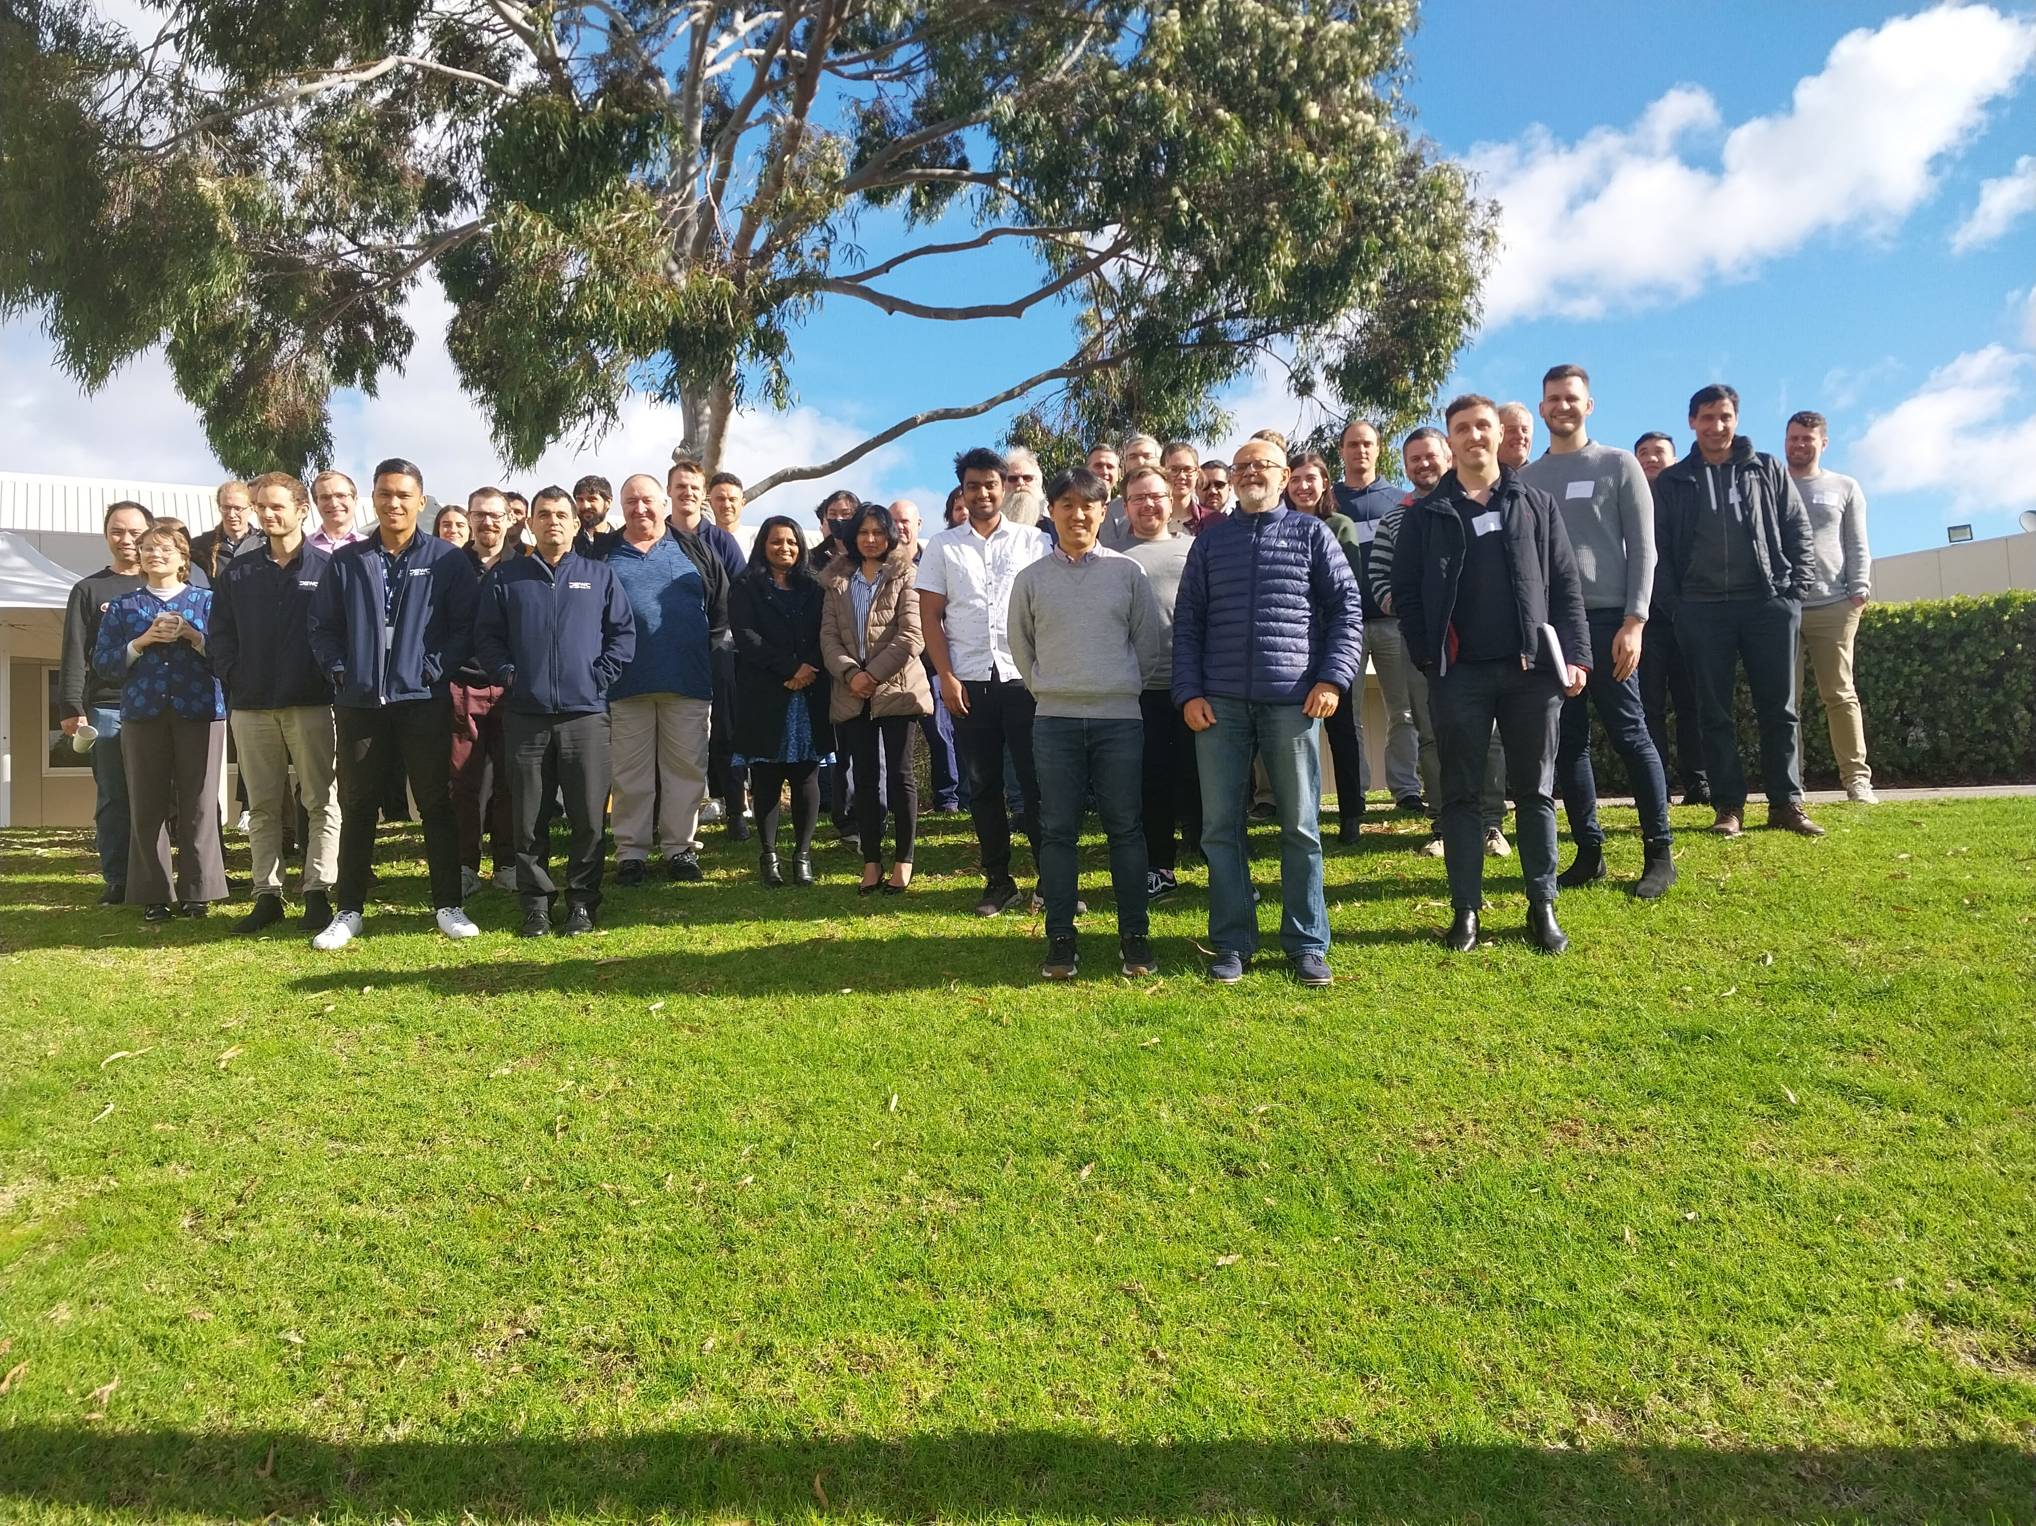
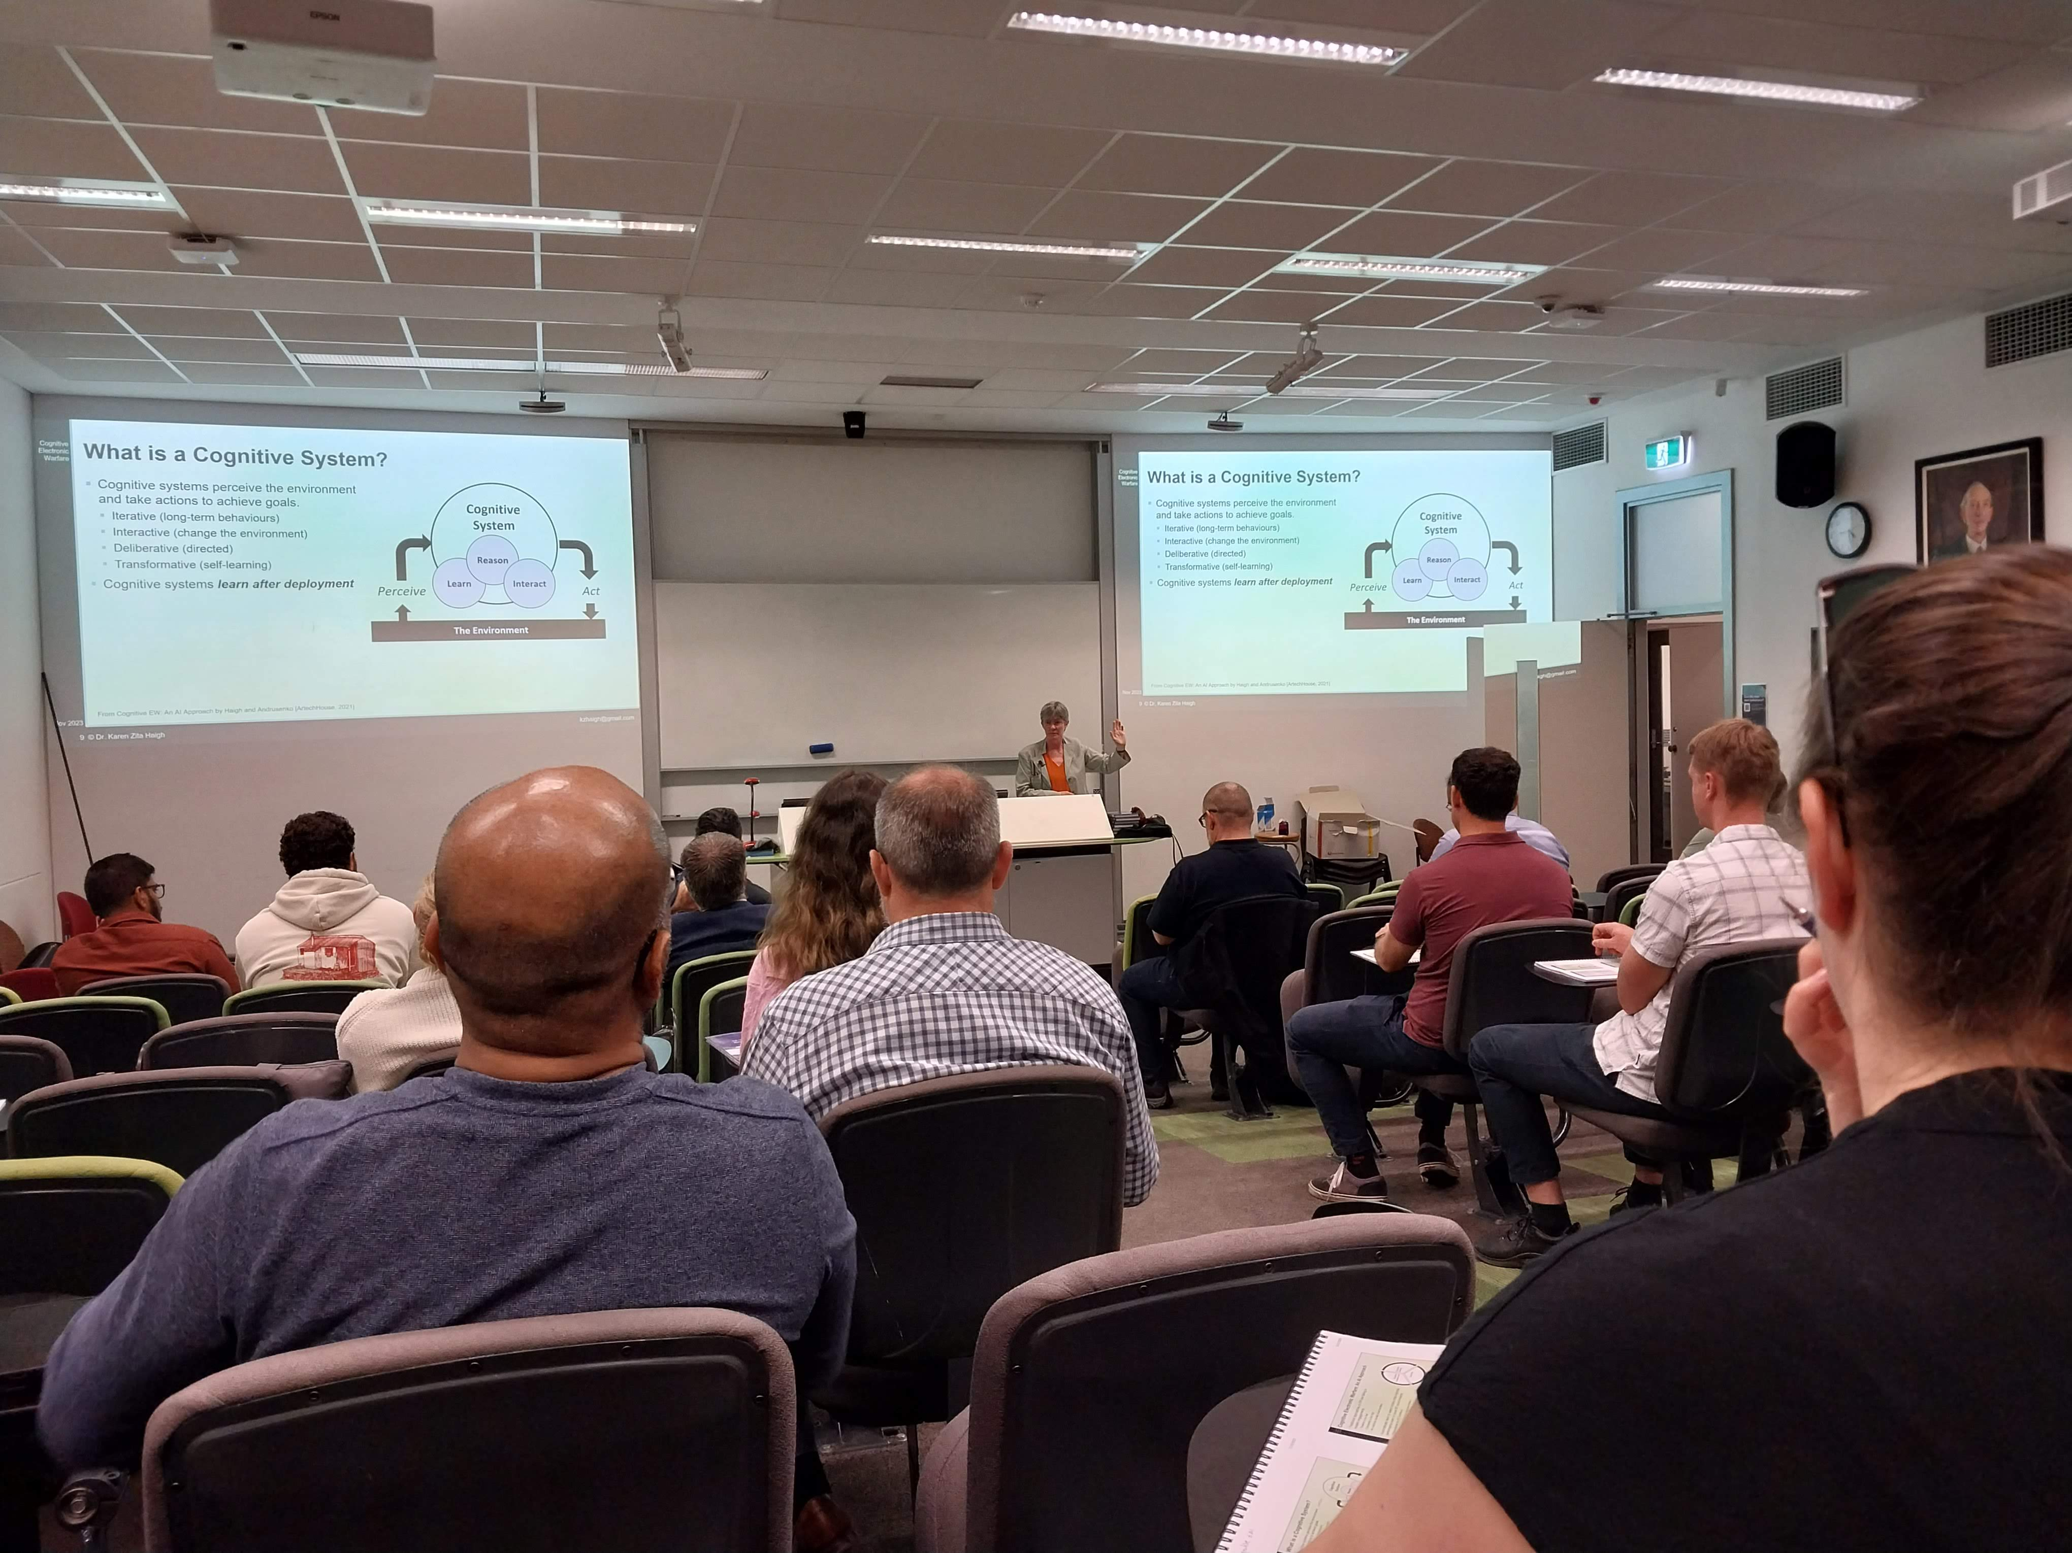
Short Course Program
Short Course Options
In-person/hybrid course run at a public venue, open to everyone
Virtual course open to everyone - more attractive for chapters with less money.
Industry focused short course, run for a specific company.
Short course website
New form for logging short courses – not widely used
Short courses since May 2024
Joe Fabrizio - Over the Horizon Radar – various venues / audiences
How to reinvigorate program?
Further communication to promote short course program
Work closer with AESS industry group to test out this working model
Further outreach to AESS chapters – continue to talk at the region summits
Online training session for each region – how to coordinate?
7

Slide 8
AESS Lecture Tour
AESS Lecture Tour Plan
Lecture series focused on a single topic with a group of up to 4 presenters
Local chapters can propose for the lecture tour to visit (max. 4 locations spread over 2 regions).
Suggestion is for 4 x half-day lectures / short-courses over 2 days per location (max. 2 week trip)
Choose one person to lead the tour and let them suggest colleagues to include
Surveyed AESS chapters around the world
15 responses from Europe (Germany, Italy, Greece, Ukraine), India, Peru, Tunisia, Singapore
Most requested topic was space, drones, radar and tracking
Next steps:
Find a ‘space’ leader and build a team (approached Mike Noble – TBC)
Determine the exact locations and timing for a 2025 lecture tour
8

