Slide 1
IEEE Aerospace Electronic Systems VP Industry Relations
Stefano Coraluppi
AESS Board of Governors Meeting – Fall 2024
25 and 26 October 2024
Rennes, France

Slide 2
Overview
Industry Relations committee
Stefano Coraluppi (Chair), Steven Butler, Michael Noble, Roberto Sabatini, Barry Tilton
2024 Objectives
Promote AESS industry member recognition
Organize AESS events focused on industry members
Participate in IEEE-wide activities on industry engagement

Slide 3
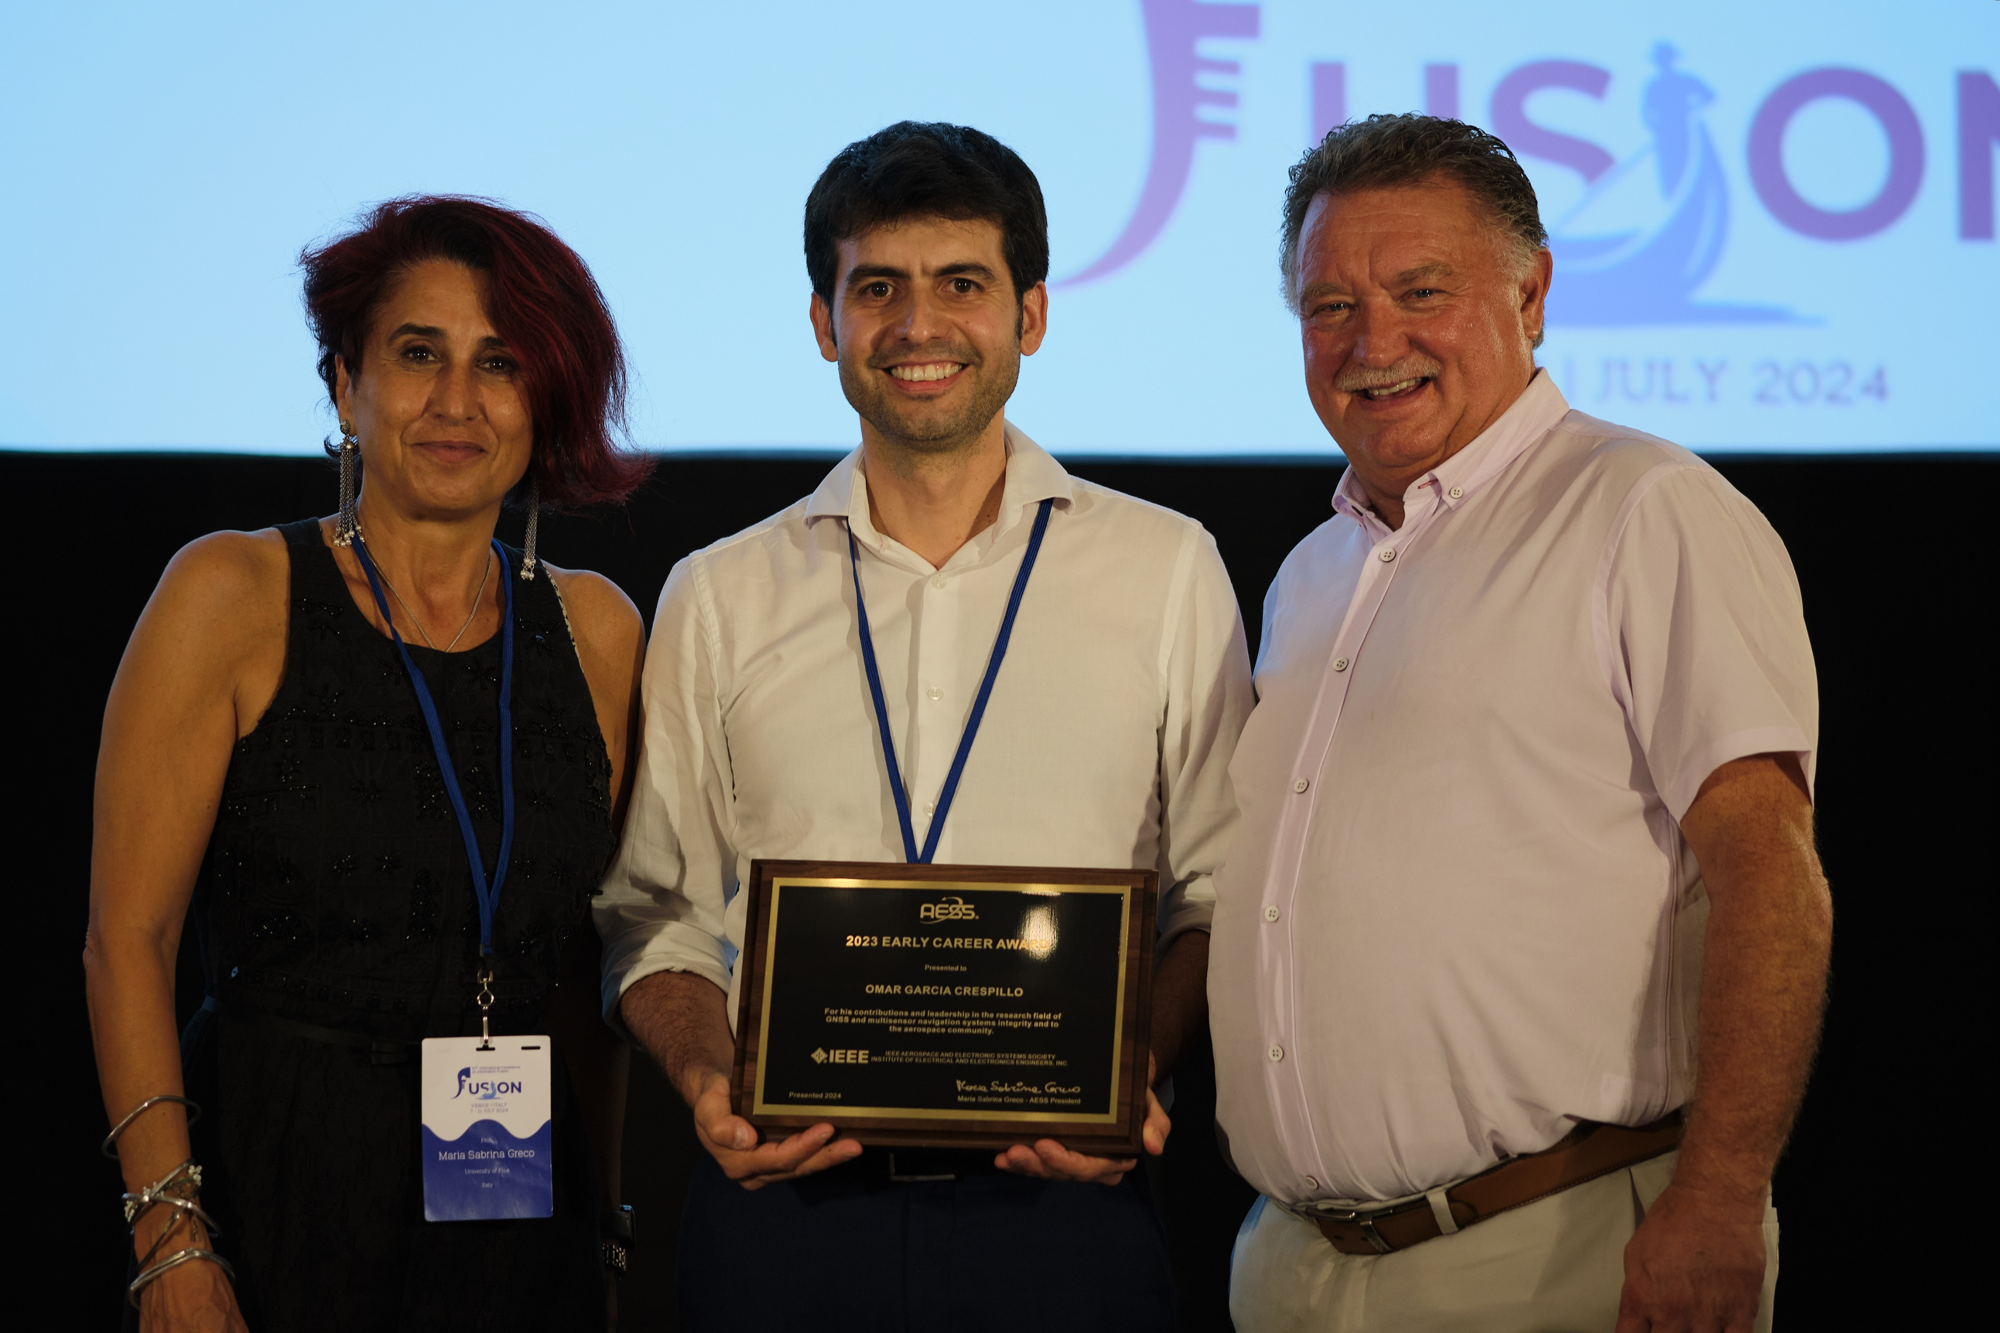
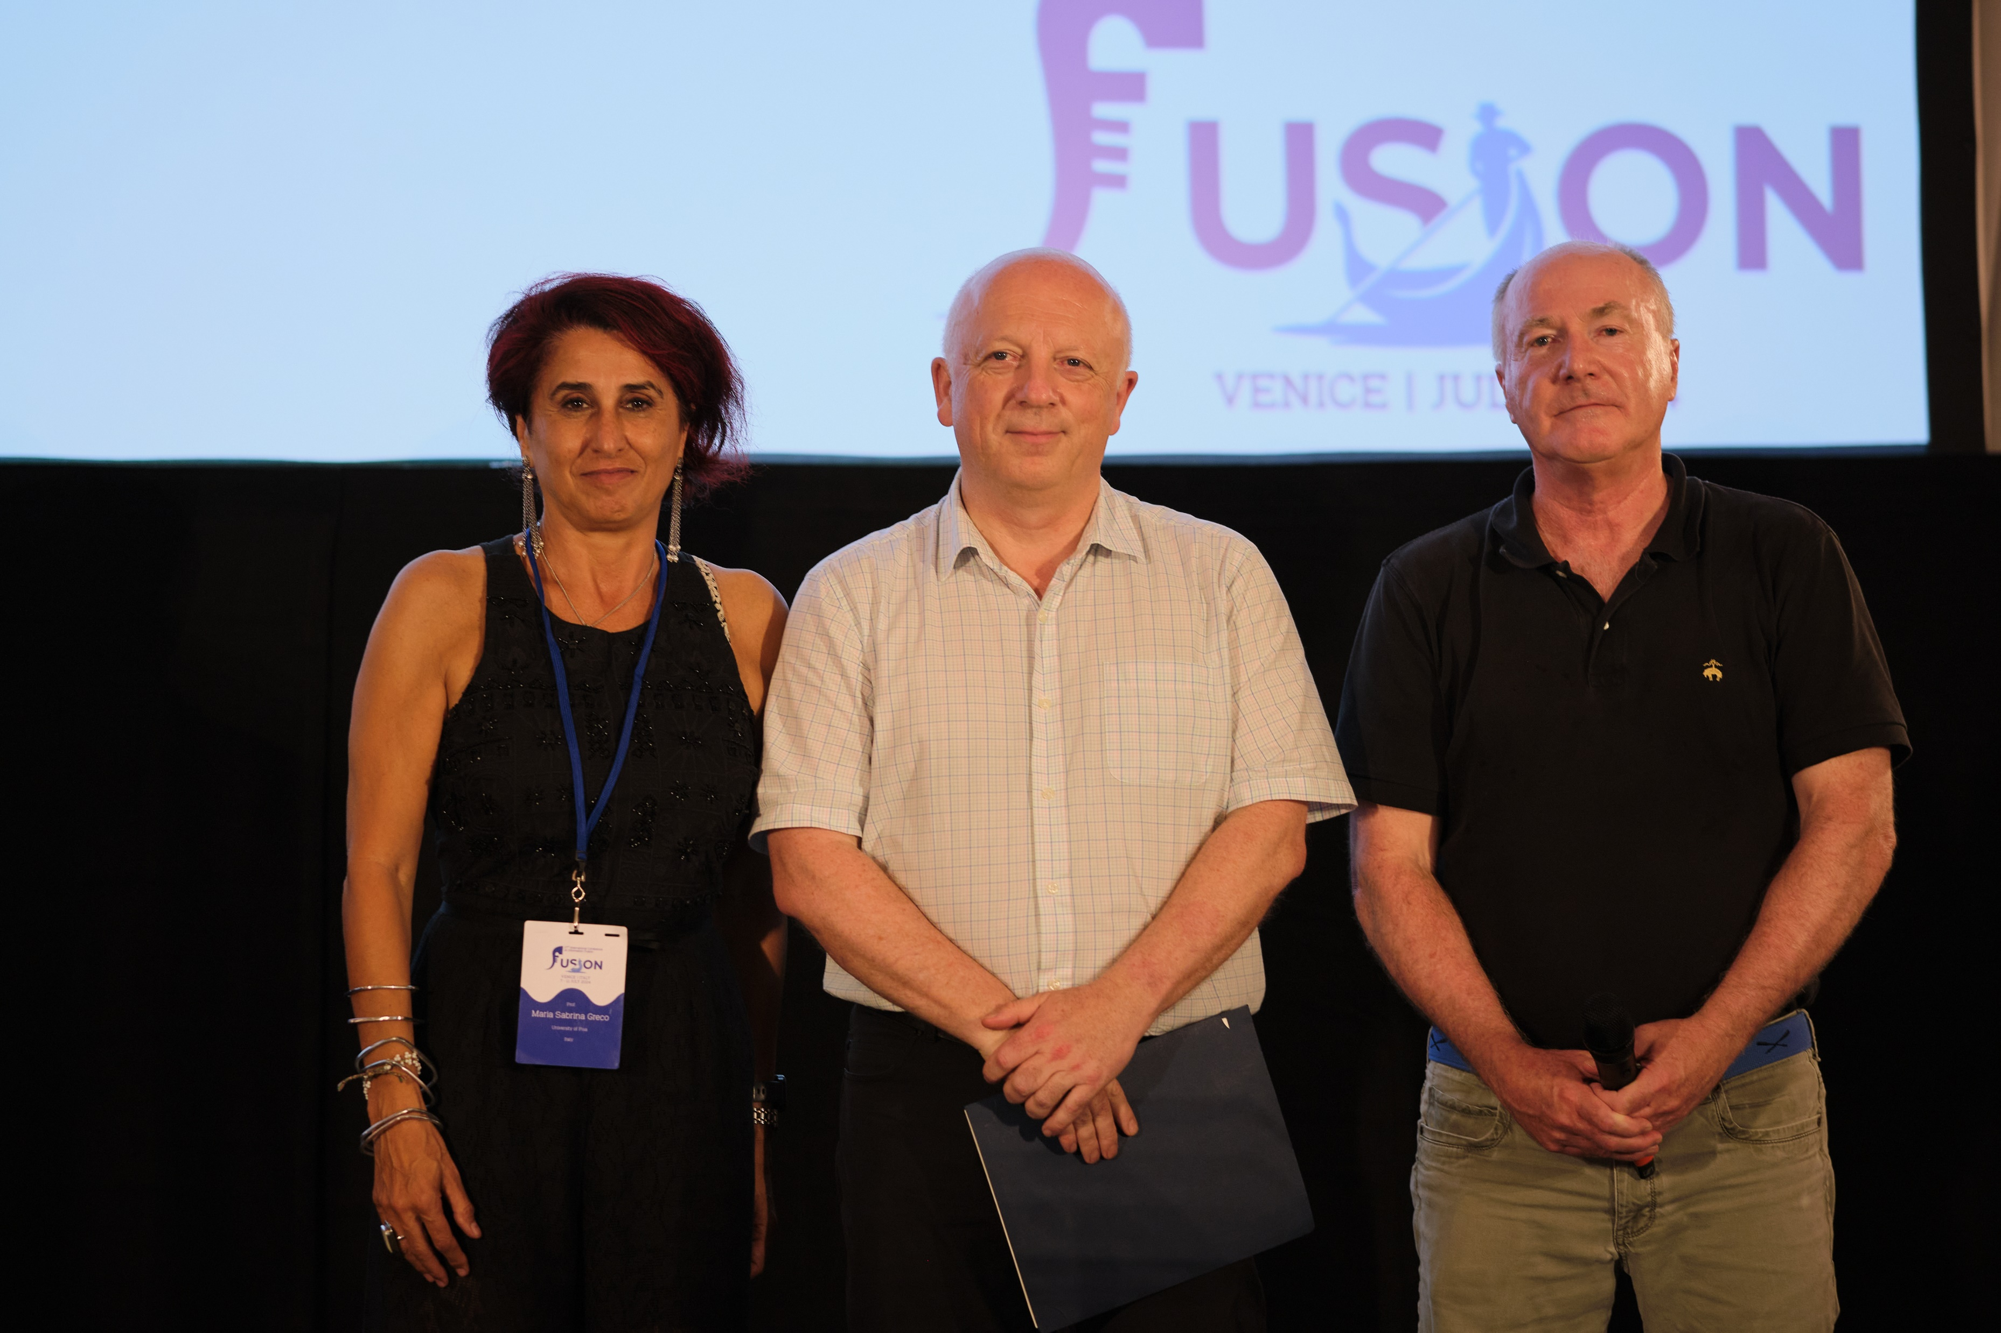
Industry member recognition
Awards
Industrial Innovation Award
Chaired by Mila Mihaylova
Three nominees evaluated for 2024 award
Awarded to Ilga Bilik (GM, for innovations in automotive imaging and electronically steerable radars implemented in autonomous vehicles and used for active safety capabilities)
Recognition of industry award winners
2023 Early Career Award to Omar Crespillo (DLR, for his contributions and leadership in the research field of GNSS and multisensor navigation systems integrity and to the aerospace community)
2024 IEEE Fellow to Neil Gordon (DSTG, for contributions to sequential Monte Carlo methods and applications)
Award to Omar Crespillo presented at FUSION 2024
Award to Neil Gordon presented at FUSION 2024

Slide 4
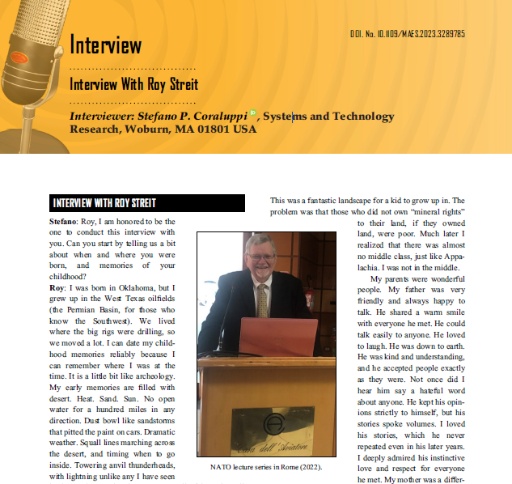
Industry member recognition
Member grade elevation
Senior member
Direct outreach, email blast, social media postings
2024 Fellow Search Committee
Industry members (4/9) are tasked with soliciting nominations from industry
Composition: Stefano Coraluppi (Chair), Dan Bliss, J. Scott Goldstein, Uwe Hanebeck, Karen Haigh, Yu (Jade) Morton, Michael Rice, Brian Rigling, Neil Gordon
Interviews in AES-M
Fall 2023: Interview with Roy Streit
Wolfgang Koch – by Hugh Griffiths or Roy Streit
Chee-Yee Chong – by Erik Blasch

Slide 5
AESS panel discussions
AESS Virtual Panel: How to Succeed in Your Engineering Career
First edition
17 March 2023 (90min)
Moderated by Mike Noble
Panelists: Arik Brown, Steven Butler, Stefano Coraluppi, Robert Rassa, Francesca Scire-Scappuzzo
Second edition proposed timing: Spring 2025
AESS Virtual Panel: Issues in Autonomy and Defense
Potential panelists
Wolfgang Koch (AESS DL), Ariel Conn (IEEE SA Research Group on Issues of Autonomy for Defense Systems), Matthew Cornick (STR VP), Gokhan Inalhan (AESS DL), Heather Roff (Center for Naval Analyses), etc.
Proposed timing: Fall 2025
AESS Conference Industry Panels

Slide 6
IEEE-wide activities
Web-based Industry Relations Platform (IRP)
POC: Patrick Russoniello, IEEE Senior Corporate Development Lead
World Technology Summit
POC: Michael Condry, IEEE Technology and Eng. Mgmt. Society Past President
IEEE Industry Engagement Committee
POC: Celia Desmond, IEEE Technical Activities (Engagement and Governance)
Meeting with Eugene Chang and Marc Perron, 6 May 2024
IEEE Fellow Committee
POC: Don Tan, Vice Chair of IEEE Industry Engagement Committee
Online presentation, 8 August 2024
IEEE TAB Membership and Engagement Forum on Industry Engagement
POC: Roberto de Marca, Chair, TAB Committee on Technical Community Outreach, Engagement and Society Membership
Online meeting, 28 August 2024

Slide 7
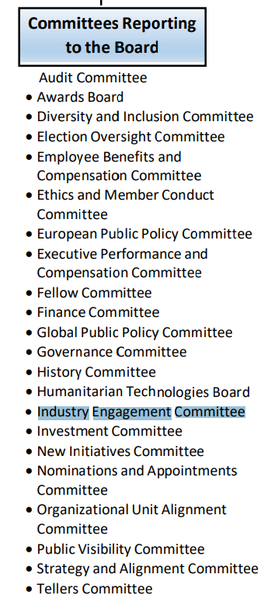
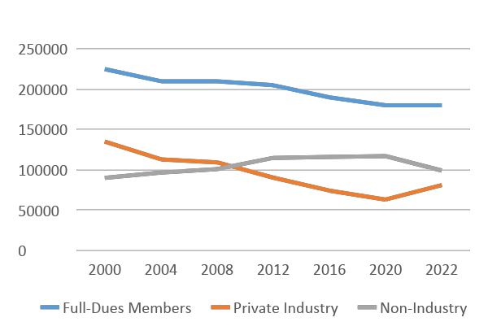
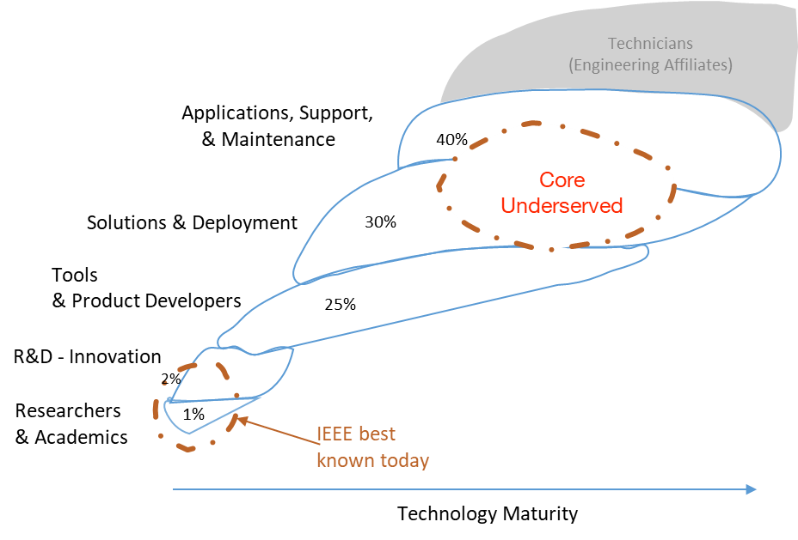
IEEE Industry Engagement Committee
Industry presence in IEEE is declining
This is despite great potential (industry engineers > 10x researchers)
IEEE value
Publications, Conferences, Standards, Education
What should be the focus to appeal to those in industry?
Local, affordable, short events (2-3 days)
Limited time horizon technologies (0-24 months)
Local market needs, e.g., in R7 Oil & Gas (West), Automotive & Semiconductor (Ontario), Aerospace & Defense (Quebec)

Slide 8
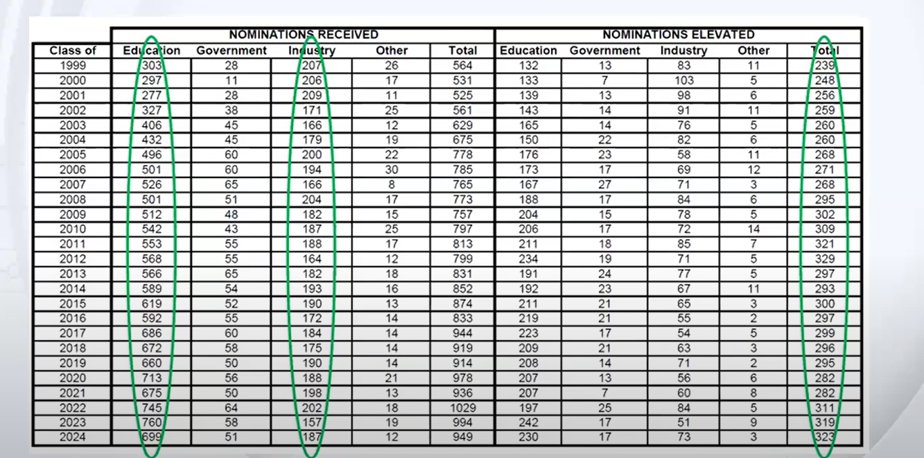
IEEE Fellow and Industry Engagement Committees
It is not the intention of the IEEE BoD that the Fellow Grade be an academia pursuit
We need industry members to advance our mission of advancing technology for humanity and to be the professional home for engineers

Slide 9
IEEE TAB Forum on Industry Engagement
Introduce industry bundle memberships
There is a perceived gap between Senior member and Fellow grade
Introduce an additional level?
Increase recognition of contributions to standards and standards-related publications
All IEEE activities must be perceived as a win-win that adds visibility to companies and skills to employees
Don’t go to industry only when we need money
Offer free courses
No need for abridged versions of papers, i.e., don’t speak down to industry members
Must change perception of job forums as dangerous to industry

Slide 10
Summary
Industry members (many in defense technology) are a key component of AESS membership
The IR Committee focus is on recognition and services for this constituency
Industry member recognition
AESS events
IEEE-wide engagement
SWOT Analysis
The limitations on what we can achieve are dictated by volunteer time
No dedicated funds are needed (and no BoG motions) at present

