Slide 1
IEEE Aerospace Electronic Systems Prof. Networking & Mentoring Chair
Arik Brown
AESS Board of Governors Meeting – Fall 2024
25-26 October 2024
Rennes, France

Slide 2
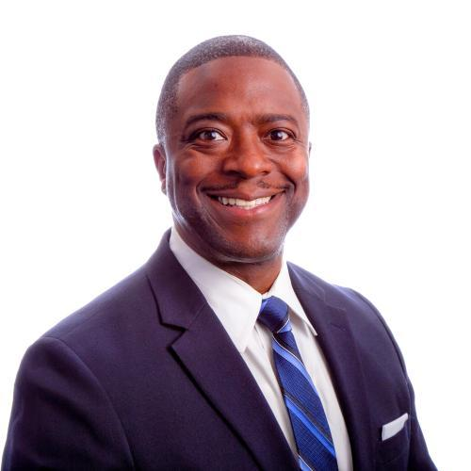
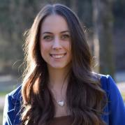
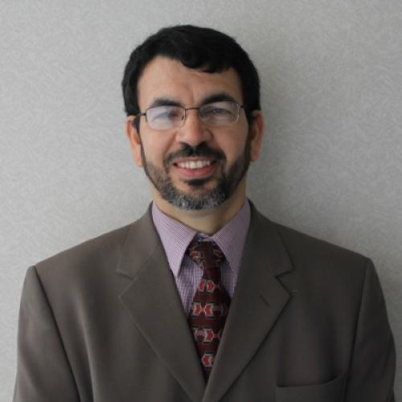
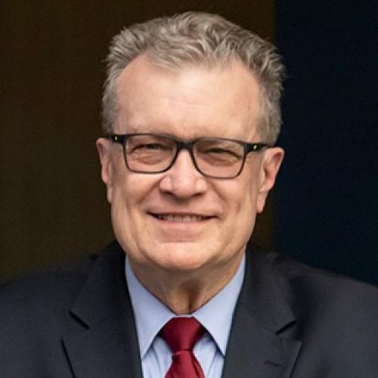
Professional Networking and Mentoring Committee
Arik
Brown
Francesca Filippini
Braham Himed
Walt Downing

Slide 3
2024 Objectives
Solidify metrics output for mentor/mentee pairs to gauge progress
Status: In Progress
Comparing the output from Collabratec with AESS membership list to determine mentors and mentees
Expected Completion Date: Dec 2024
Online Networking & Mentoring meeting with AESS members(1 hr)
Status: Completed
Conducted two sessions on 6/14/24: 2am – 3am EST and 12pm – 1pm EST
Online Follow-up Meeting with AESS members focused on a summary of the program status and address any questions/suggestions (30 min)
Status: TBD
Based on low attendance for the online meeting this won’t be productive until next year
Send to AESS members a short video to advertise the program and how to get involved (signing up with Collabratec included)
Status: In Progress
Expected Completion Date: Dec 2024 (Send out Video in Q1 2025)
Create a planned agenda for DEI/Networking and Mentoring event collaboration at the 2025 IEEE Radar Conference
Status: Completed
Collaborating with Dr. Jacqueline Fairley (Radar Systems Panel) to combine DEI and Networking/Mentoring for several activities at the 2025 IEEE Radar Conference
Preliminary agenda has been established (see next slide)

Slide 4
Online Networking and Mentoring Virtual Meeting Held in June 2024
Introduction and Overview of the IEEE AESS Networking and Mentorship Program:
Expanding Your Network and Growing Your Career
Held two sessions on June 16th to accommodate time zones
2am – 3am EST and 12pm – 1pm EST
Provided the following:
Overview of the program
Benefits of the program
Live polling
Overview of Collabratec
Live Demonstrations (specifically navigating Collabratec)
Benefits of both mentoring partnerships and our program
Live Polling
Program Overview
Live Demonstrations
Thanks and Appreciation to Amanda for her help.

Slide 5
DEI and Networking/Mentoring Collaborative Events Planned for 2025 IEEE Radar Conference
This year collaborative planning has been done with Dr. Jacqueline Fairley to merge DEI events with our Networking and Mentoring Program
Goal: Foster/develop current and new relationships between diverse participants in an inclusive environment
Date | Morning | Afternoon | Evening
May 4th (Mon) | Radar Boot Camp | Radar Boot Camp
May 5th (Tue) | Tutorials | Tutorials | Opening Reception Young Professionals Event Mentor-Mentee Connect Event (~1hr)
May 6th (Wed) | Professional Development Breakfast/Raffle | Radar Trivia (20-30 min)/Raffle Ticket Handouts | FireSide Chat/Meet the Authors Raffle Ticket Handouts
May 7th (Thu) | Professional Development Breakfast/Raffle (Back-Up Date) |  | Conference Dinner @ the Aquarium
May 8th (Fri) |  | Fire Side Chat/Meet the Authors Close Out Event Raffle
May 9th (Sat) | Tutorials | Tutorials
2025 IEEE Radar
Conference
Events
DEI and Professional Networking & Mentoring Events

Slide 6
SWOT Summary
Strengths | Collabratec infrastructure setup (Guidelines and instructions in place) Program framework is established
Weaknesses | Need to continue building interest/momentum for the program Process for generating metrics not complete yet
Opportunities | Video to publicize the program In-person events at next year’s conference in Atlanta
Threats | Creating mentoring partnerships globally is a challenge

