Slide 1
IEEE Aerospace Electronic Systems Nominations and Appointments
Mark E. Davis
2024 AESS Fall Board of Governors Meeting
25-26 October 2024
Rennes, France

Slide 2
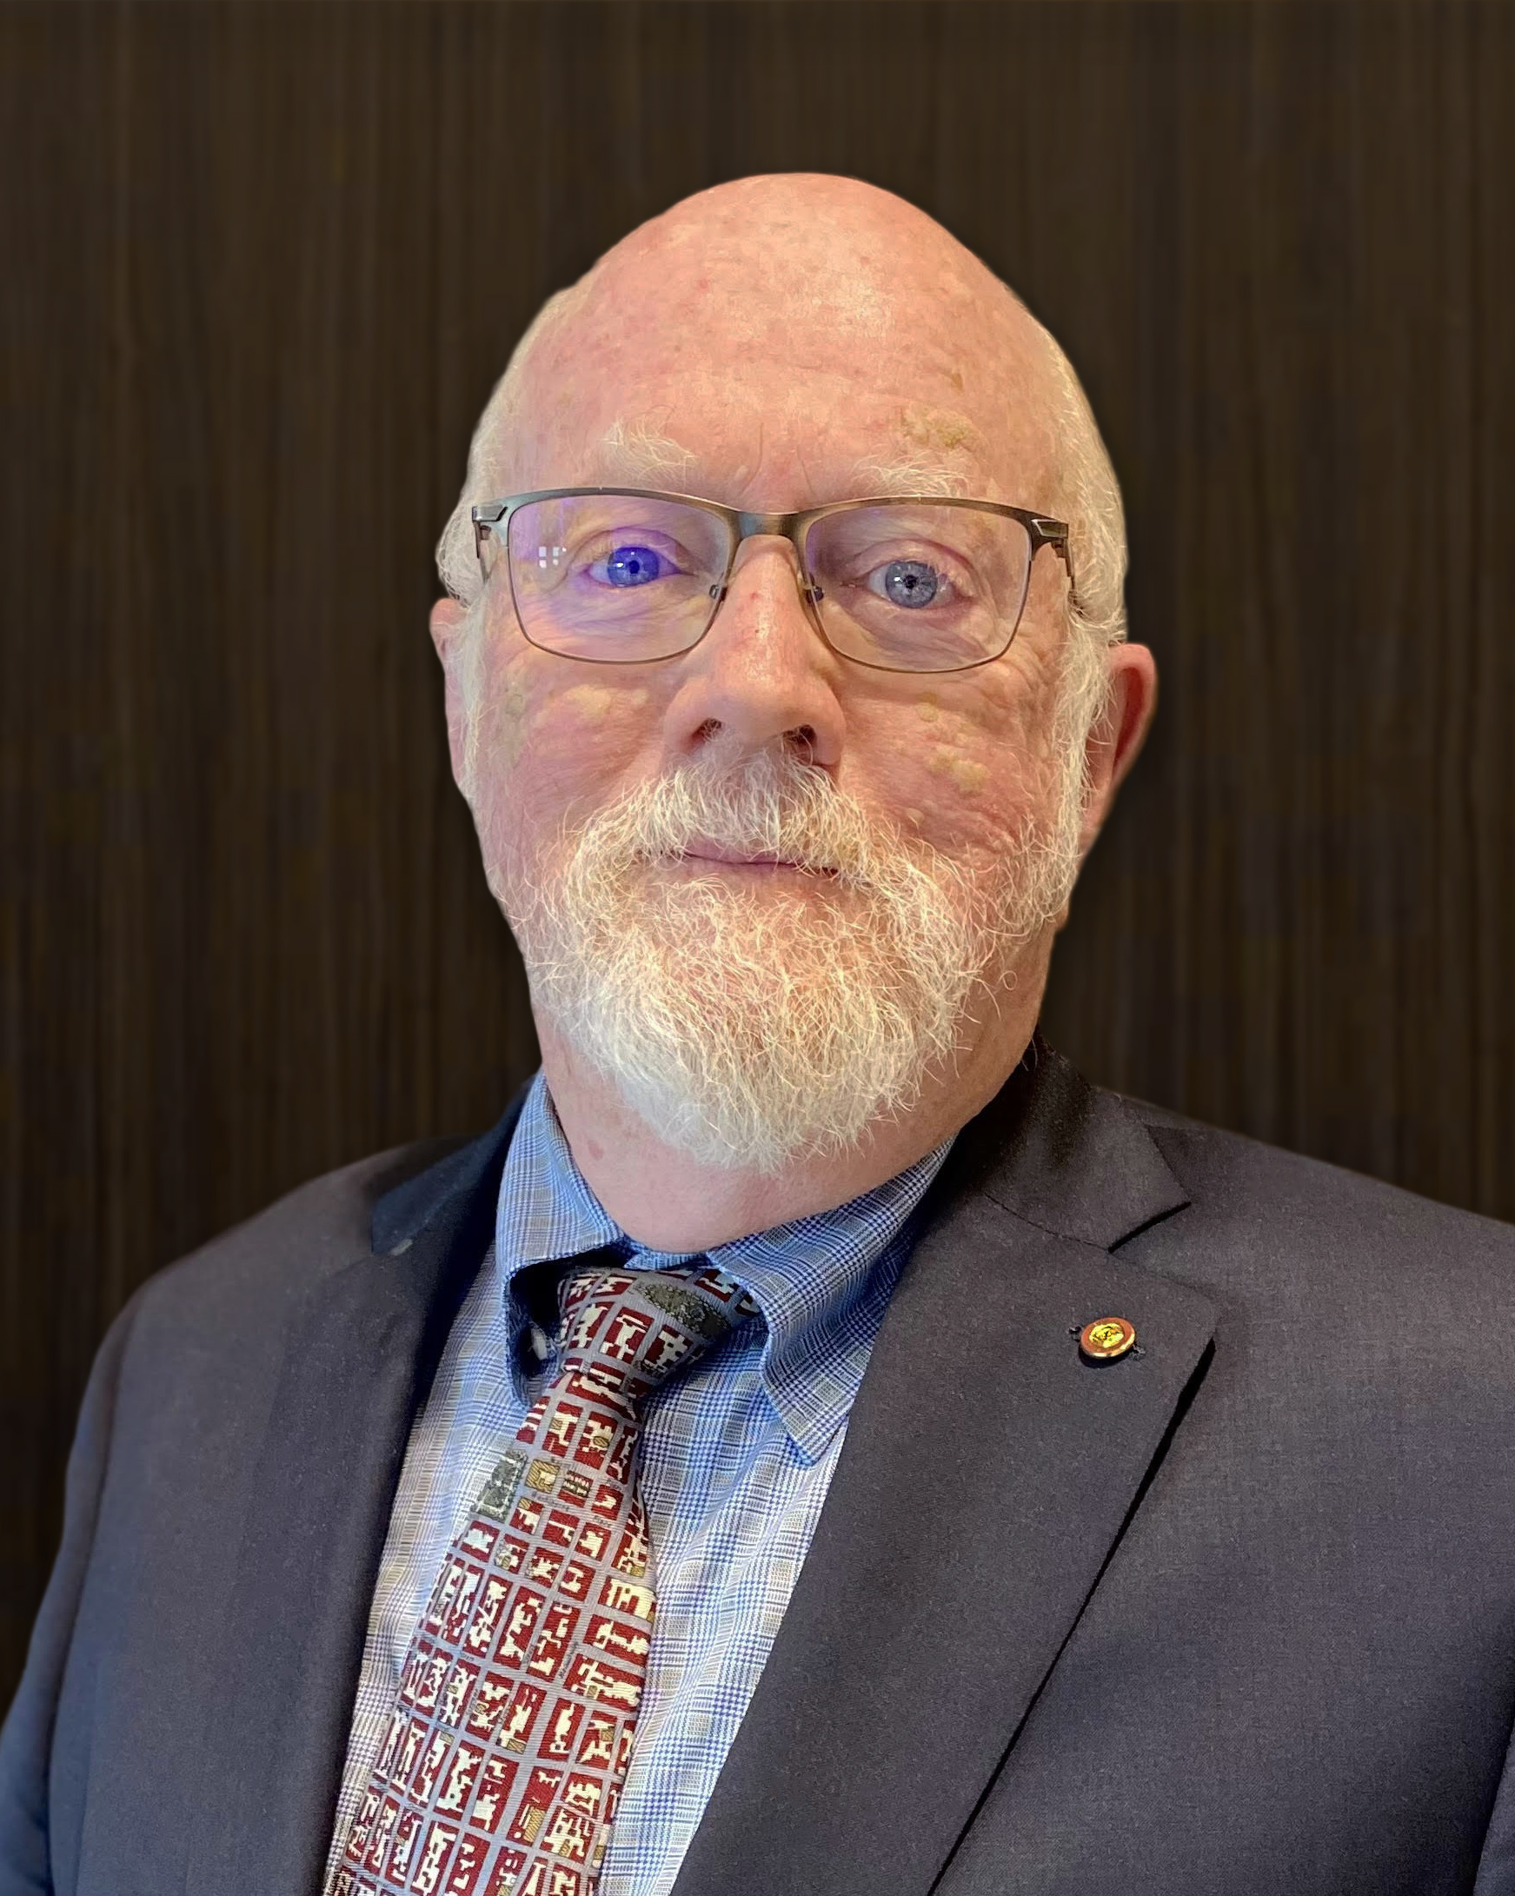
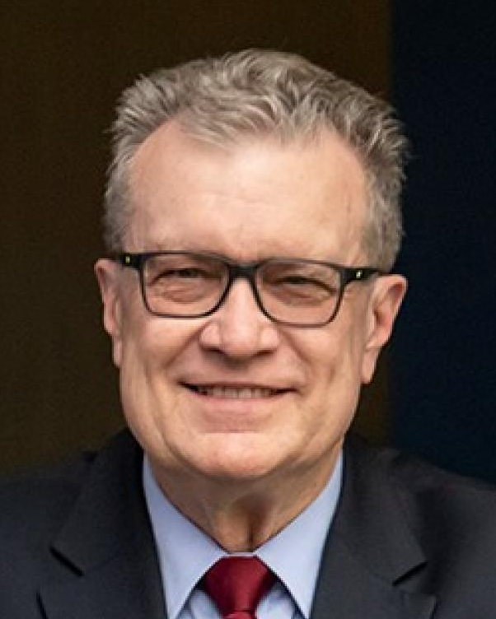
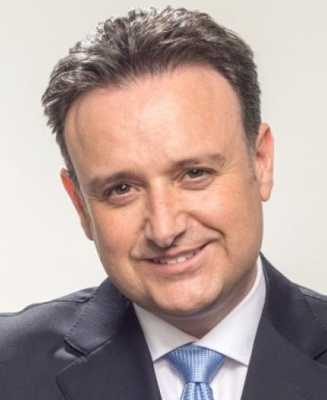
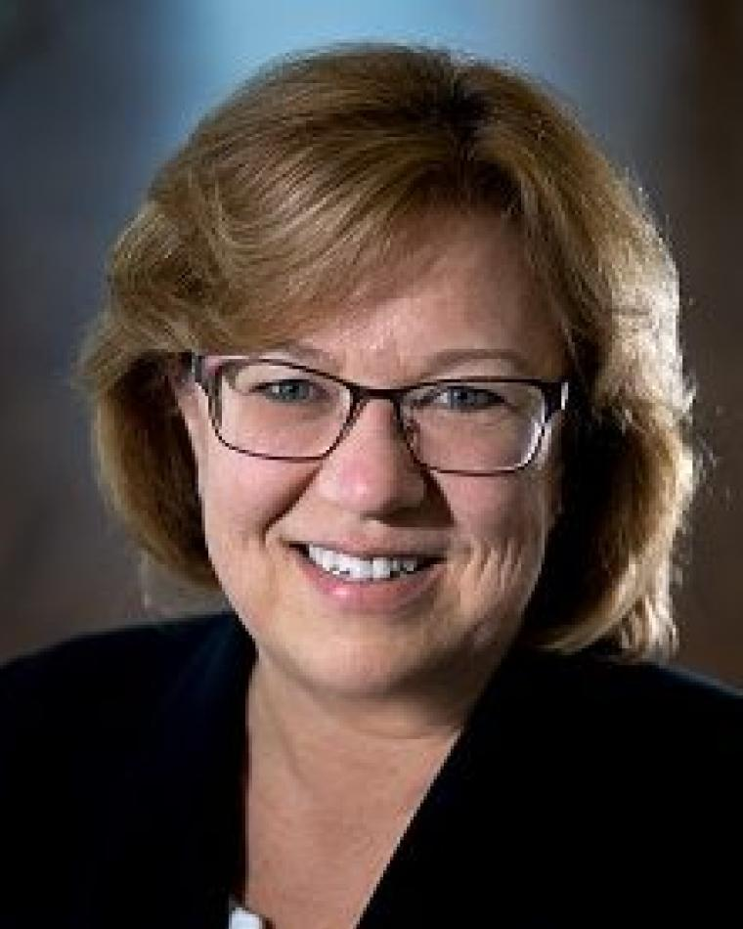
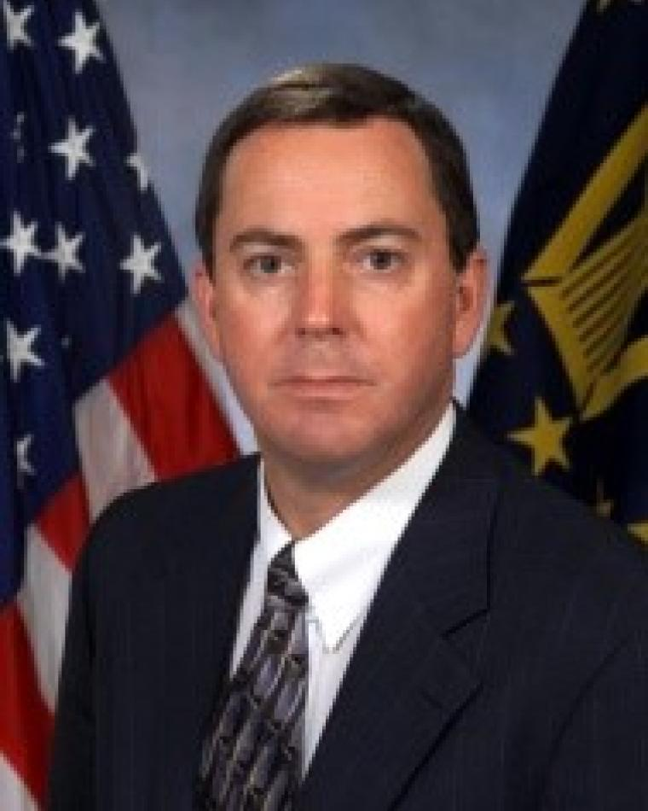
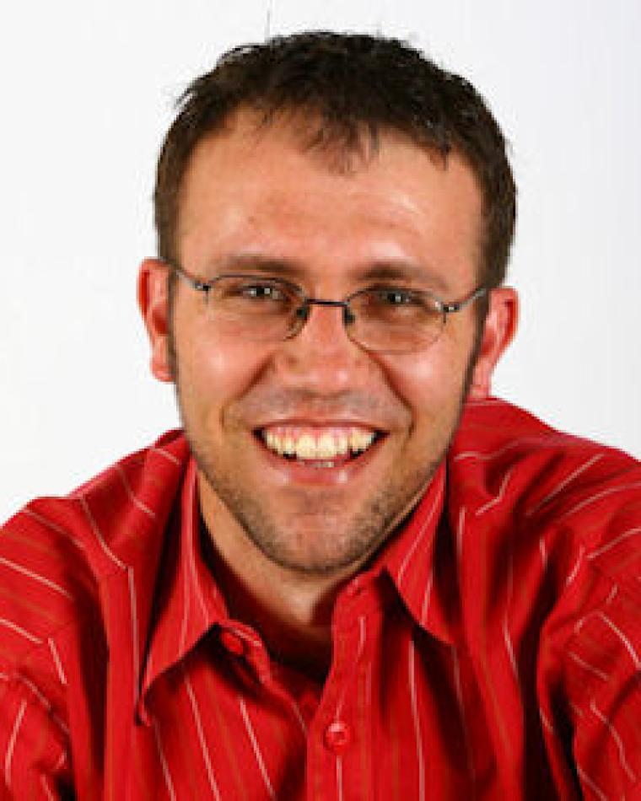
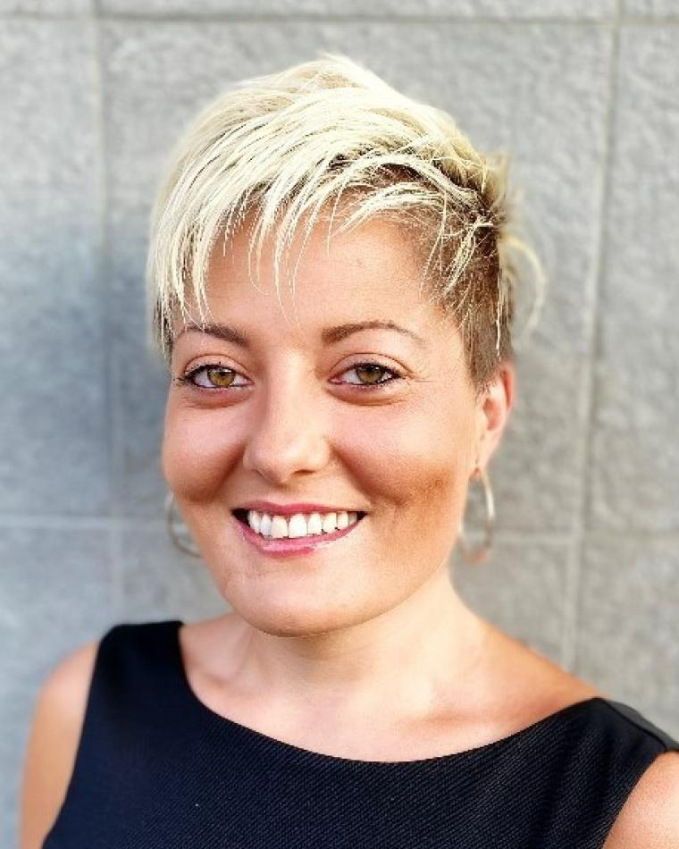
2024 N&A Committee
Mark E. Davis
Past-President/N&A Chair
Walt Downing
Joe Fabrizio
Jill Gostin
Steve Butler
Willie Nel
Laura Anitori*
resigned

Slide 3
Nominations
BoG 2025-2027 Slate
Jenifer Castillo Stefano Coraluppi Fulvio Gini Elisa Giusti J. Scott Goldstein Gokhan Inalhan Lorenzo Lo Monte Philipp Markiton Kumar Vijay Mishra Puneet Kumar Mishra Giovanna Ramirez Ruiz Matthew Ritchie Avid Roman-Gonzalez Vincent Socci Peter Willett
Selected by Membership
Stefano Coraluppi
Fulvio Gini
Elisa Giusti
J. Scott Goldstein
Lorenzo Lo Monte
Peter Willett
Final 2 Selected by BoG
Philipp Markiton
Matthew Ritchie

Slide 4
Committee Ongoing Activities
N&A Tentative Timeline - BoG 2026-2028
January 3 – Call for Nominations
January 3-31 – Approval of N&A Committee
February 28 – Nominations Close
March 4-10 – N&A Committee Reviews Packets
March 4-31 – IEEE confirms eligibility of slate
April 4-7– AESS BoG Discussion Period
April 8-14– AESS BoG Voting Period
April 15 – Slate sent to IEEE
May 15-June 15 – IEEE Voting
July – Discussion period and voting for 2 final candidates
August/September– N&A Committee Prepare Officer Slate
September – Announcement of slate
October 11 – BoG Vote on Officer Slate at RadarConf’25 in Krakow.

Slide 5
AESS Officer Election Process
At a meeting of the Board of Governors, normally held before the first of November of every year, the Board of Governors shall appoint, from among current members, all Vice Presidents as defined in the Constitution who will take office on the First of January of the Following year. Such appointment shall occur after selection of their preferred candidate from the proposed slate.
The President shall annually appoint, with the concurrence of a majority of the Board of Governors, a Secretary, Treasurer, Young Professionals Representative, Undergraduate, and Graduate Student Representatives.

Slide 6
AESS Officer Election Process
We will elect each VP one at a time. Each candidate will have 5 minutes to address the Board (replaced by a recorded presentation in 2024), followed by 5 minutes for questions. The President-Elect candidates will have 10 minutes to address the Board (replaced by a recorded presentation in 2024), followed by 10 minutes for questions.. When not speaking and during discussion, candidates will be moved into the Waiting Room if online or outside of the meeting room.
Once the vote has taken place, the platform tallies the votes automatically and anonymously. Please be reminded that the President will only vote to break a tie.
Each vote will be taken electronically via Google Form. Before we begin, the Operation Manager will take us through a practice vote. TAKE PRACTICE VOTE.
There is no reason to abstain in a secret ballot vote, but if someone does abstain, it will not count one way or another in the vote count, nor will it be included in the total count to figure how many votes required for a majority vote.
Please be reminded that you must be in the room (either in-person or virtually) in order to vote.
For discussion, do not use the general chat for discussion of candidates, as this will not be private.

Slide 7
AESS Officer Election Process
Each candidate will have a 5-minute time limit.
The Operations Manager will provide a 1-minute courtesy warning by raising her hand.

Slide 8
Officer Slate Proposed by N&A Committee
The order of offices for election are in alphabetical order after President-Elect, which will be first. The names to be considered are in alphabetical order.
President-Elect
Dale Blair
Braham Himed
VP Awards
Dale Blair (2nd term)
VP Conferences
Lorenzo Lo Monte
VP Education
Luke Rosenberg
Puneet Kumar Mishra
VP Finance
Michael Noble
VP Industry Relations
Barry Tilton
VP Member Services
Scott Goldstein
VP Publications
Luke Rosenberg (2nd Term)
VP Technical Operations
Roberto Sabatini (2nd Term)

Slide 9
Pause meeting recording

Slide 10
President-Elect

Slide 11
President-Elect
Dale Blair
Braham Himed
Are there any Nominations from the floor?
Braham to the Waiting Room.
Dale will have 10 minutes for Q&A.

Slide 12
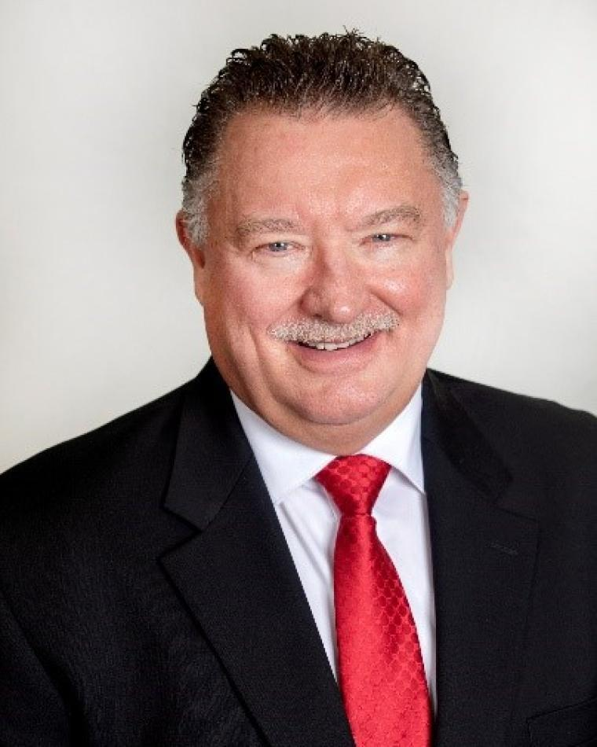
Dale Blair Bio
Dale Blair is a Principal Research Engineer with the Georgia Tech Research Institute (GTRI) and GTRI Fellow. He received the BS and MS degrees in Electrical Engineering from Tennessee Tech in 1985 and 1987, respectively. He received the Ph.D. degree in Electrical Engineering from the University of Virginia in 1998. Dale is an IEEE Fellow class of 2002 and recipient of the 2001 IEEE Fred Nathanson Award and the 2023 Warren White Award. His publications include coeditor and coauthor of Multitarget-Multisensor Tracking: Applications and Advances III (ARTECH House, 2000); two chapters in Principles of Modern Radar: Vol I (SciTech Publishing, 2010); a chapter in Modeling and Simulation Support for System of Systems Engineering Applications (Wiley, 2015); 38 refereed journal articles, more than 100 refereed conference papers; and more than 200 other technical papers and reports. His editorial accomplishments include Editor for Radar Systems of the IEEE Transactions on Aerospace and Electronic Systems (T-AES) (1996-1999), Editor-In-Chief (EIC) of the T-AES (1999-2005), and founding EIC for the Journal for Advances in Information Fusion (2005-2013). He currently serves as the founding EIC for the IEEE Open Journal of Systems Engineering (OJSE). Dale has served the IEEE AESS BoG as Associate VP for Publications (2008-2011), Chair for Strategic Planning (2009-2010), and VP for Publications (2015-2017). He is serving in his 22th year as a member of the BoG. Dr. Blair served International Society for Information Fusion (ISIF) as President in 2005, as VP for Conferences (2006-2012), and VP for Publications (2012-present). Dr. Blair has served as the general chair for two IEEE conferences and a key member of the organizing committee for more than ten professional conferences. He reviews regularly for conferences and journals and currently serves as Tutorial Editor for the IEEE Aerospace and Electronic Systems Magazine.

Slide 13
Dale Blair Statement
IEEE is as an organization that supports advancement of the professional of electrical, electronic, and computer engineers and IEEE AESS focuses on those of us involved in the area of aerospace and electronic systems. As President of IEEE AESS, I will see to expand our impact to more of our members through enhancing our conferences, publications, technical panels, awards, IEEE Standards, and industrial relations. IEEE AESS does these very well already. More specifically, I will focus on our engagement of members in industry and impacting students. As President, I would like to pursue the engagement of students through the funding of senior capstone projects at the levels of about $2.5k and fund many of those. I would like to involve IEEE AESS members from industry as the customers for those projects. We could take proposals for capstone projects from our members joined with universities. If members of the IEEE AESS BoG could develop standard capstone problems, IEEE AESS could sponsor bake off events at one our conferences or a regional event. I think making a positive impact on students is the best avenue to growing our membership as they join us in the advancement of our profession.

Slide 14
President-Elect
Dale to the Waiting Room.
Re-admit Braham Himed to the meeting.
Braham will have 10 minutes for Q&A.

Slide 15
Braham Himed Bio
Dr. Braham Himed received his Engineer Degree in electrical engineering from Ecole Nationale Polytechnique of Algiers in 1984, and his M.S. and Ph.D. degrees both in electrical engineering, from Syracuse University, Syracuse, NY, in 1987 and 1990, respectively. From 1990 to 1991 he was an Assistant Professor in the Electrical Engineering Department at Syracuse University, where he taught graduate courses in analog and digital communications, digital signal processing, probability, and random processes. In 1991, he joined Adaptive Technology, Inc., Syracuse, NY, where he was responsible for radar systems analyses and the design of antenna measurement systems. In 1994 he joined Research Associates for Defense Conversion, Marcy, NY, where he was responsible for radar systems analyses and radar signal processing, including techniques for the detection and estimation of targets in severe clutter and jamming environments. From March 1999 to July 2006, he was a senior research engineer with the U.S. Air Force Research Laboratory, Sensors Directorate, Radar Signal Processing Branch, Rome, NY, where he led scientific and management aspects of airborne and space-borne phased array radar systems. From August 2006 to June 2008, he served as the Chief Research Officer with Signal Labs Inc, in Reston VA, directing R&D for the company. From 2008 - 2018, he served as Technical Advisor for the RF Technology branch with the Air Force Research Laboratory, Wright Patterson Air Force Base, OH. Since January 2019, he serves as Division Research Fellow in the Distributed RF Sensing Branch, Multi-Spectral Sensing and Detection Division, of the Sensors Directorate. His research interests include detection, estimation, multi- channel adaptive signal processing, time series analyses, array processing, adaptive processing, waveform design, diversity, and optimization, distributed MIMO radar, passive radar, and over the horizon radar. Dr. Himed serves as the US Air Force representative on several international forums, including The Technology Cooperation Program (TTCP), NATO SET panels, and leads several bilateral and trilateral international agreements. Currently, he serves as both the US National lead and Panel Chair of the TTCP Intelligence Surveillance, Target Acquisition, and reconnaissance (ISTAR) Technical Panel -2 on RF Sensing. Dr. Himed has published over 300 peer-reviewed journals and conference papers. He served as the general technical co-chair for the 2010 and 2015 IEEE International Radar Conferences. He served as general co-chair of the 2022 IEEE Radar conference and will serve as general co-chair for the 2024 IEEE radar conference. Dr. Himed is the recipient of the 2001 IEEE Region I award for his work on bistatic radar systems, algorithm development, and phenomenology. He joined the IEEE AESS Radar Systems Panel in 2001, served as vice-chair from 2014-2016, and panel chair from 2016-2018. Currently, he serves the RSP as member, and chairs the Nathanson award. Dr. Himed is a Fellow of IEEE (2007) and a Fellow of AFRL (2013). He was the recipient of the 2012 IEEE Warren White award for excellence in radar engineering. Braham is a member of the AESS board of governors, serving as VP of conferences.

Slide 16
Braham Himed Statement
I was elected to the AESS board of governors in 2020 and have actively used my experience and expertise to support several committees, including educational and awards. I have served as VP-Conferences since 2021, and during this period, we put in place a system specifying the requirements for receiving AESS technical and financial sponsorship, keep high-quality conferences with strong peer-reviewed technical contents, and AESS approval received in less than 48 hours. As President-Elect, my priority is to support and implement Sabrina’s vision for AESS. I will ensure to attend all AESS-mandated events, to provide the needed leadership. I will work hard to grow AESS participation in sponsored events, will initiate activities in under-developed regions, and strengthen AESS presence in well-to-do regions. I will recommend including non-voting members from under-developed regions to strengthen our relationships. I will work with the VP-Industry to initiate and conduct year-long programs that cater to industry around the world. I will work with the student and YP representatives to conduct periodic events and forums for mentorship, networking, education, and hands-on experience.

Slide 17
President-Elect
Move candidate(s) to the Waiting Room.
BoG Discussion
Re-admit candidat(es)
Vote
Announce Winner

Slide 18
VP Awards

Slide 19
VP Awards
Dale Blair
Are there any Nominations from the floor?
Dale will have 5 minutes for Q&A.

Slide 20
Dale Blair Bio
Dale Blair is a Principal Research Engineer with the Georgia Tech Research Institute (GTRI) and GTRI Fellow. He received the BS and MS degrees in Electrical Engineering from Tennessee Tech in 1985 and 1987, respectively. He received the Ph.D. degree in Electrical Engineering from the University of Virginia in 1998. Dale is an IEEE Fellow class of 2002 and recipient of the 2001 IEEE Fred Nathanson Award and the 2023 Warren White Award. His publications include coeditor and coauthor of Multitarget-Multisensor Tracking: Applications and Advances III (ARTECH House, 2000); two chapters in Principles of Modern Radar: Vol I (SciTech Publishing, 2010); a chapter in Modeling and Simulation Support for System of Systems Engineering Applications (Wiley, 2015); 38 refereed journal articles, more than 100 refereed conference papers; and more than 200 other technical papers and reports. His editorial accomplishments include Editor for Radar Systems of the IEEE Transactions on Aerospace and Electronic Systems (T-AES) (1996-1999), Editor-In-Chief (EIC) of the T-AES (1999-2005), and founding EIC for the Journal for Advances in Information Fusion (2005-2013). He currently serves as the founding EIC for the IEEE Open Journal of Systems Engineering (OJSE). Dale has served the IEEE AESS BoG as Associate VP for Publications (2008-2011), Chair for Strategic Planning (2009-2010), and VP for Publications (2015-2017). He is serving in his 22th year as a member of the BoG. Dr. Blair served International Society for Information Fusion (ISIF) as President in 2005, as VP for Conferences (2006-2012), and VP for Publications (2012-present). Dr. Blair has served as the general chair for two IEEE conferences and a key member of the organizing committee for more than ten professional conferences. He reviews regularly for conferences and journals and currently serves as Tutorial Editor for the IEEE Aerospace and Electronic Systems Magazine.

Slide 21
Dale Blair Statement
IEEE is as an organization that supports advancement of the professional of electrical, electronic, and computer engineers and IEEE AESS focuses on those of us involved in the area of aerospace and electronic systems. As Vice President for Awards, I will seek to continue our excellent awards program and expand our impact to more of our members through more nominations from throughout our membership. The first responsibility of the VP for Awards is the review, update, and maintenance of the TABARC documentation for our awards. This includes initiation of new awards as approved the BOG. The second responsibility is the coordination of committee appointments, nominations, selection, and award delivery. I am initiating the preparation of an Operation Manual for AESS Awards that will codify and support the execution of the AESS award program. As VP for Awards, I have initiated a trial program in the funding of Senior Design Projects in order to expand AESS reach into universities and in conjunction with Sabrina as President, we have initiated AESS Challenge Problems.

Slide 22
VP Conferences

Slide 23
VP Conferences
Lorenzo Lo Monte
Are there any Nominations from the floor?
Lorenzo will have 5 minutes for Q&A.

Slide 24
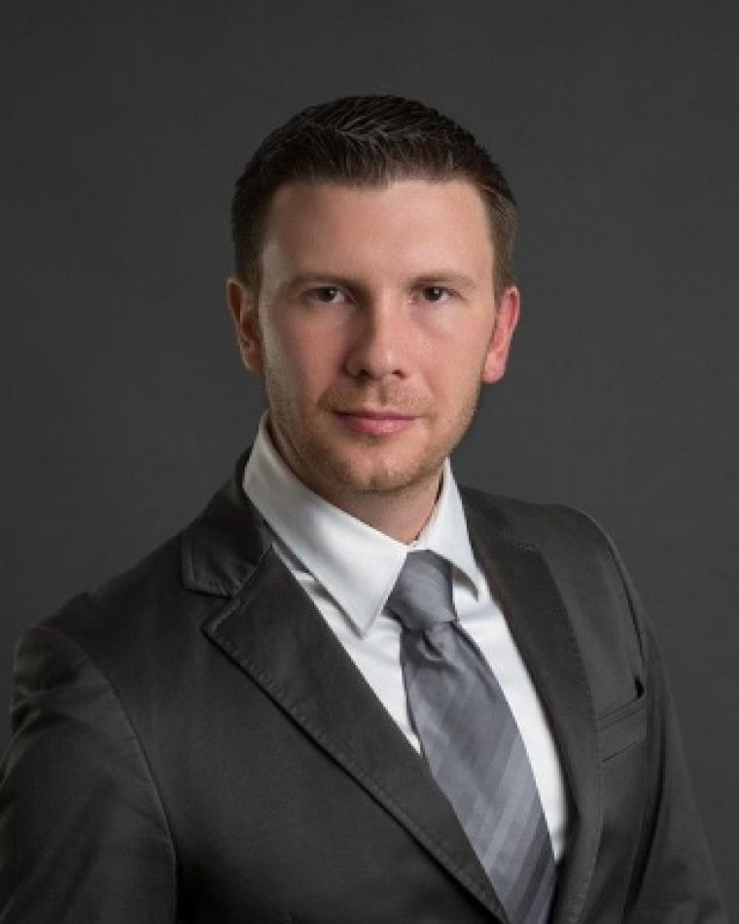
Lorenzo Lo Monte Bio
Dr. Lorenzo Lo Monte has experience in Radar, RF, DSP, and EW systems design and prototyping, from small companies, consulting, academia, research institutions, to large defense contractors and government agencies worldwide. He serves as Chief Scientist at TTM Technologies, a top-40 U.S. defense corporation specializing in ISR, with the role of translating research innovations into commercial products. Before that, he was a Professor at the University of Dayton and the Executive Director of the Mumma Radar Laboratory. Lorenzo has published over 70 peer-reviewed journal papers, conference proceedings, book chapters, and patents.
Throughout his career, he gained experience in radar systems prototyping from HF to W Band, including AESAs, fully digital arrays, automotive/FMCW radars, health radars, ASW/ASuW, AEW, multistatic and MIMO radars, SAR/ISAR, Tomography, GPR, DAA/ABSAA, passive sensing and geolocation, LO/CLO, RCS, counter IED/EFP/UAS, BMD target discrimination, resonance and nonlinear exploitation, EA/EP/ES, AMTI/GMTI/MMTI/DMTI, CCA and MUM-T, MCA/ATR, clutter modeling, antenna/microwave design and measurements, instrumentation control, computational EM, inverse scattering, Digital and Statistical Signal Processing, Adaptive/Systolic Array Processing, STAP, MIL-STD/NTIA/RTCA compliance, PCB, packaging, MxFE, SysML/DoDAF and MBSE.
Lorenzo is highly active in the IEEE community: he was the General Chair for IEEE RadarConf’22 and serves as an AESS Officer (VP Member Services). He held the VP role for Education (AESS) and VP for Industry (Region 1). Lorenzo was also a Technical Editor of the IEEE Sensors Journal for many years. Lorenzo is also an AESS Distinguished Lecturer and an approved AESS Short Course Instructor. He taught many short courses in radar, EW, and RF worldwide, including at AFRL, NASIC, AFLCMC, MIT, Fraunhofer Institute, DSTG Australia, Singapore, as well as underrepresented sections such as Algeria, Tunisia, Saudi Arabia, Colombia, Sri Lanka, Turkey and Bolivia.

Slide 25
Lorenzo Lo Monte Statement
During my service in AESS, I created the “Virtual Distinguished Lecture,” a growing program highly appreciated by our members. I doubled the Distinguished Lecturers, so that members have more opportunities to learn and network. I am training chapter chairs worldwide to ensure they know how to run your local chapter effectively. To date, I have approved the largest funding to local chapters to create initiatives. As a passionate educator, I take great pleasure in volunteering to teach AESS in underrepresented areas without any cost to IEEE, as it brings me immense joy to empower others.
If I am given the opportunity to serve as VP Conference, I will
Establish better channels, rules and funding/sponsoring mechanisms for the myriad of student/YP conferences worldwide.
Coordinate funding mechanisms with VP Member Services and Chapter Coordinator (avoid redundancies, set boundaries) for student/YP events.
Coordinate with Undergraduate/Graduate/YP Reps to advertise worldwide funding and sponsoring possibilities offered by AESS
Empower Conference Committee members in the periodic audit, monitoring, and decision-making of financially sponsored conferences to prevent budget overruns.

Slide 26
VP Conferences
Move candidate(s) to the Waiting Room.
BoG Discussion
Re-admit candidat(es)
Vote
Announce Winner

Slide 27
VP Education

Slide 28
VP Education
Puneet Kumar Mishra
Are there any Nominations from the floor?
Puneet will have 5 minutes for Q&A.

Slide 29
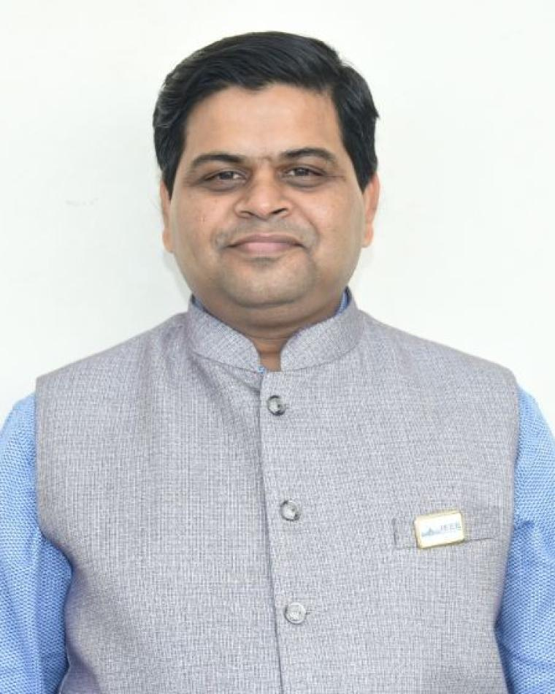
Puneet Kumar Mishra Bio
Puneet Kumar Mishra earned his M.Tech (RF & Microwave) from IIT Roorkee in the year 2004. Since 2004 he is with U R Rao Satellite Centre (URSC), Bangalore. Presently, he is He has rich experience of RF characterization of 51 Satellites, 375 antennas and radomes. He has indigenously developed C-Band, Ku-Band and Ka-Band Compact range feeds to meet various requirements of ISRO’s satellite program. He has played a pivotal role in establishing satellite level EMC facility and Asia’s largest Magnetic Field Measurement Facility. He is also responsible for conceiving, conceptualizing and establishing World’s first compact range with 10 m quiet zone. He has Received IETE-IRSI Young Scientist Awards in the year 2012, ISRO Young Scientist Award in the year 2013, ASI-ISRO Space Gold Medal in the year 2014, GE Foundation Award for Academic Excellence and Leadership (2002-2004), IEEE MGA Achievement Award 2017 and 7 best paper awards. He has indigenously developed a payload to study the RF blackout phenomenon during re-entry of space vehicle. He has successfully developed Indigenous Bus Bars for High power satellites, which are used in multiple spacecrafts. Presently he is Heading Electrical Integration Section and designated as Deputy Project Director for Resoursesat-3S&3SA Spacecrafts.
He has published more than 60 technical papers. He is Senior Member of IEEE, Fellow of IETE & IE(I) and Life Member of ASI. He is a passionate Volunteer and served Bangalore Section (2013-2021) at various capacities including Chair 2020 and India Council (2017-2024) as Vice Chair for Industry Relations, Professional Activities and technical Activities and Secretary. Presently he is serving as BoG IEEE AESS, Chair IEEE AESS Bangalore Chapter and Member of Global Committees of IEEE Industry Engagement (IEC).

Slide 30
Puneet Kumar Mishra Statement
As the VP-Education my focus will be to initiate:
1. AESS University to give Online Certification Course in AESS Designated Fields
2. Internship for Students
3. Startup initiative for YPs and WiE Members by collaborating with Management Institutes
4. Regional Radar School involving AESS DLs and Local Experts
5. Workshops in AESS Designated Fields
Successful execution of these initiatives will make AESS more relevant to practicing technologists and academics and attract potential members across globe.

Slide 31
VP Education
Move candidate(s) to the Waiting Room.
BoG Discussion
Re-admit candidates
Vote
Announce Winner

Slide 32
VP Finance

Slide 33
VP Finance
Michael Noble
Are there any Nominations from the floor?
Michael will have 5 minutes for Q&A.

Slide 34
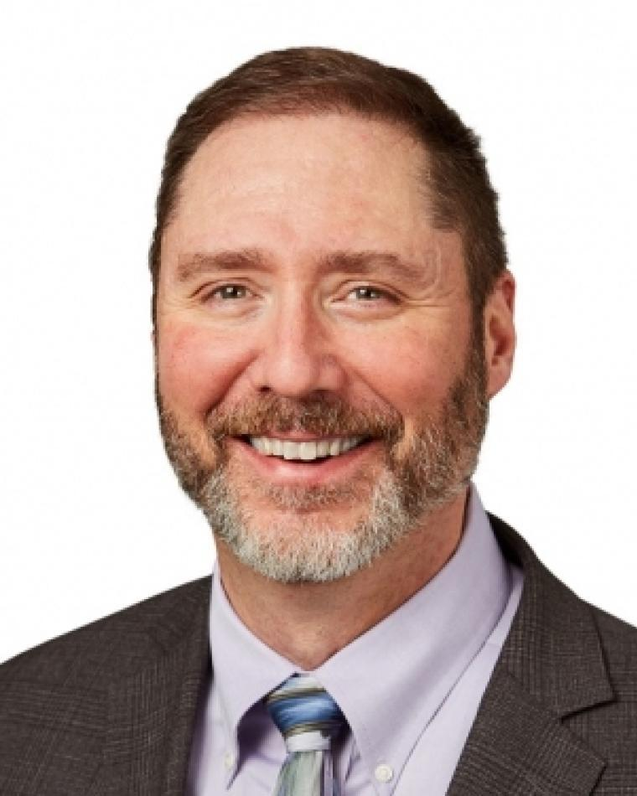
Michael Noble Bio
Dr. Noble leads the capture and development of major advanced mission systems. Moreover, Mike leads Anduril’s engagement across the advanced research and development community.
Previously, Dr. Noble developed technology strategy and novel new multi-domain mission solutions as a direct report to the L3Harris CTO. And, he helped lead company outreach to academia and Silicon Valley to access and collaborate with a broad set of non-traditional innovators.
Before joining industry, Dr. Noble served 26 years as a United States Air Force acquisition officer, focusing largely on advanced systems, technology, and prototyping. He led a 450-person government-industry team executing a three-billion dollar budget developing, testing, and deploying several Presidential-priority space capabilities; co-led the Space Based Infrared Systems directorate; and commanded a Missile Defense Agency test squadron. At the Pentagon he led multiple national-priority programs. He stood up a technology accelerator office at the NRO and ran advanced ISR and EW programs at Hanscom AFB. And, he performed hands-on research on multi-spectral sensors and semiconductor lasers at the Air Force Research Laboratory.
Dr Noble graduated from Rensselaer Polytechnic Institute with a BSEE. He received his Ph.D. from the Air Force Institute of Technology as the top doctoral student. He has received over a dozen Air Force Research Laboratory technical achievement awards and the AFRL award for best fundamental sensors research. Dr Noble has published in multiple IEEE journals and has presented at IEEE and SPIE conferences. He co-holds a patent with three fellow inventors for a novel Vertical Cavity Surface Emitting Laser.

Slide 35
Michael Noble Statement
AESS has had the good fortune to accumulate a sizable surplus over the last several years. This surplus has come up repeatedly in our board meetings, often in the context of new initiatives requiring new funding which was not included in our annual budget. In these discussions, IEEE’s common rejoinder to include these requests as part of our operating budget rather than as ad hoc initiatives.
My first priority as VP Finance will be to work with the VPs of the AESS committees to ensure we capture these potential initiatives and explore additional ways to invest our resources. The objective is not to try harder to spend, but rather to see how we can use our funds to do even more to advance our mission to foster technological innovation and excellence for the benefit of humanity.
I’ve had the good fortune as Treasurer to partner with Peter Willett, the incumbent VP Finance. And, if elected, look forward to working with him to ensure a seamless transition of responsibility.

Slide 36
VP Finance
Move candidate(s) to the Waiting Room.
BoG Discussion
Re-admit candidates
Vote
Announce Winner

Slide 37
VP Industry Relations

Slide 38
VP Industry Relations
Barry Tilton
Are there any Nominations from the floor?
Barry will have 5 minutes for Q&A.

Slide 39
Barry Tilton Bio
Barry C. Tilton is the Technology Evangelist and Senior Director of Engineering for Maxar Intelligence. He has over 39 years’ experience as an EE in the aerospace field, is a Licensed PE and Certified PMP. He is the 2025 IEEE-USA President Elect, and currently a member of the AESS BoG. An Air Force veteran, he worked as a Chief Engineer, Scientist, and Program Director while on active duty. He completed assignments at Space Division, NRO, Space Command and NGA. Subsequent to his retirement from the AF in 2005, Barry has worked in industry supporting both air and space programs in remote sensing, space surveillance and resilience and GEOINT for both commercial applications, the NRO and NGA.
Barry is the immediate Past-Director of IEEE Region 2 (and as a result of MGA and IEEE-USA Region 2 as well). He is a Senior Member of IEEE, HKN and AIAA, who has both been involved with (and served in positions of leadership in) the organization and community for over 39 years. He has been a member of IEEE since 1985, and has been involved as a volunteer, author, conference attendee and thought leader in the AESS and GRSS for most of that time. Upon retirement from the US Air Force, Mr. Tilton became active in leadership of several technical activities and Including The IEEE-USA CTAP which he chaired.
Barry earned his BSEE from USC and his MSEE from Northrop University. He is married to the former Elaine Belen, and has three children.

Slide 40
Barry Tilton Statement
I am thrilled at the opportunity to increase my involvement with AESS. I have been a member as long as I have been in IEEE, and have attended the meetings in Colorado before they were moved to Big Sky. My career has been along the boundary of aerospace and geoint. During my 20 years in the USAF I worked on programs in all phases of space operations – launch, satellite protection, navigation, communications, remote sensing, on orbit servicing, and de-orbit. I have also operated systems on board aircraft as diverse as a Twin-Otter up to the NASA Long-Wing WB-57F at 62,000 feet.
I have been passionate about aerospace since I was 7 years old, and greatly desire to give back to the community now that I am in the senior phase of my career. With time split nearly evenly now between government and industry I believe I have a lot to offer the BoG in terms of insight and context for current and future planning and solutions. I would like to focus on industry/government alignment.

Slide 41
VP Industry Relations
Move candidate(s) to the Waiting Room.
BoG Discussion
Re-admit candidates
Vote
Announce Winner

Slide 42
VP Member Services

Slide 43
VP Member Services
Scott Goldstein
Are there any Nominations from the floor?
Scott will have 5 minutes for Q&A.

Slide 44
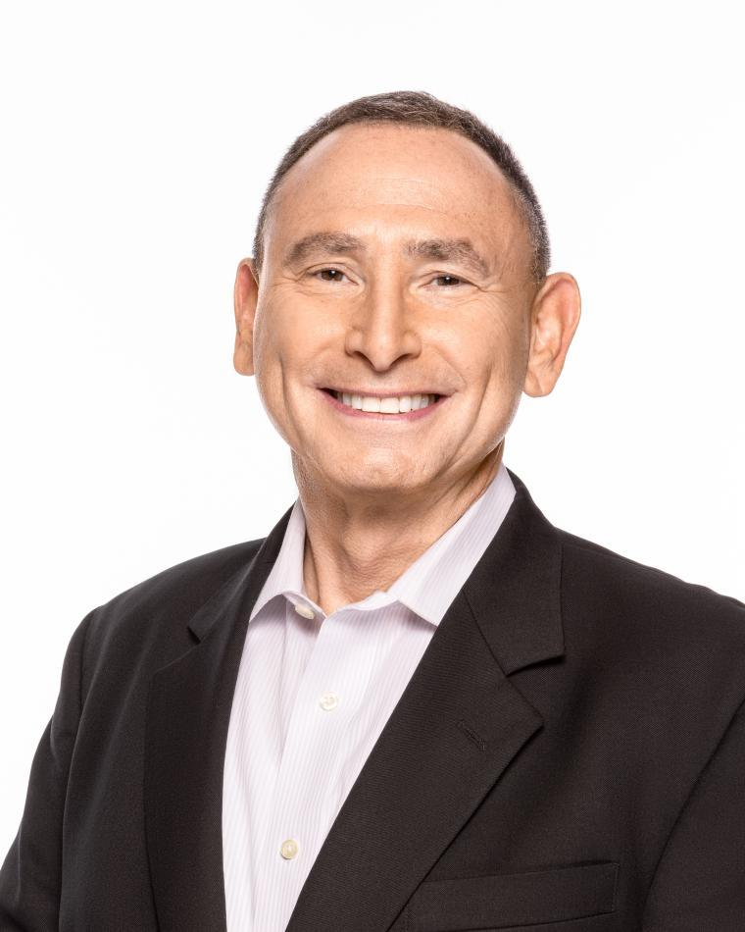
Scott Goldstein Bio
Dr. Scott Goldstein is a Senior Vice President at Parsons Corporation with experience leading organizations ranging from venture-funded startups to Fortune 500 companies. He retired as a Major General in the United States Air Force, where he held leadership assignments in acquisition, research & development, space and cyber. He is a Fellow of the IEEE, a Fellow of the Washinton Academy of Sciences, and on multiple advisory boards for the Department of Defense and the National Academies of Science, Engineering, and Medicine. He is a member of Sigma Xi, Tau Beta Pi and Eta Kappa Nu. He received the 2019 IEEE Warren D. White Award, the 2002 IEEE Fred Nathanson Award, and the 1999/2000 Clarke Griffiths Memorial Premium for best paper in the IEE Proceedings - Radar, Sonar and Navigation. He has authored well over 200 refereed technical publications, was a special editor for AESS Magazine, and holds four U.S. patents in spread spectrum communications, advanced sensor data compression, ISR and adaptive processing for signal detection. Dr. Goldstein is a member of the IEEE Radar Systems Panel and chaired the Warren White Award Committee (2022-2024). He was a member of the AESS BOG (2004-2006) and VP for Education (2003-2004), as well as one of the original AESS Distinguished Lecturers. He served on the IEEE Fellow Selection Committee (2002) and held every position within the IEEE Northern Virginia Section, including Chairman in 1992 and 2001. He received his Ph.D. in Electrical Engineering from the University of Southern California, Los Angeles, CA.

Slide 45
Scott Goldstein Statement
I have exceptional experience having been a former IEEE Section Chairman, held every elected position at the Section level, and served as an officer and Chairman of IEEE Society Chapters over many years. This experience and knowledge will enable me to effectively lead the Member Services Committee and develop those programs that will most strongly support and grow AESS Chapters at IEEE Sections internationally. I served as an IEEE Student Branch Chairman (and every other elected position at that level as well) and will strive to invigorate student activities, recognition, awards travel grants, professional development and technical involvement in conferences. I will work closely with Lorenzo Lo Monte to ensure his past efforts in this position are fostered and coordinate across the BOG to effectively integrate and foster young professional and student activities at the Chapter, Section and Society levels.

Slide 46
Lorenzo Lo Monte Bio
Dr. Lorenzo Lo Monte has experience in Radar, RF, DSP, and EW systems design and prototyping, from small companies, consulting, academia, research institutions, to large defense contractors and government agencies worldwide. He serves as Chief Scientist at TTM Technologies, a top-40 U.S. defense corporation specializing in ISR, with the role of translating research innovations into commercial products. Before that, he was a Professor at the University of Dayton and the Executive Director of the Mumma Radar Laboratory. Lorenzo has published over 70 peer-reviewed journal papers, conference proceedings, book chapters, and patents.
Throughout his career, he gained experience in radar systems prototyping from HF to W Band, including AESAs, fully digital arrays, automotive/FMCW radars, health radars, ASW/ASuW, AEW, multistatic and MIMO radars, SAR/ISAR, Tomography, GPR, DAA/ABSAA, passive sensing and geolocation, LO/CLO, RCS, counter IED/EFP/UAS, BMD target discrimination, resonance and nonlinear exploitation, EA/EP/ES, AMTI/GMTI/MMTI/DMTI, CCA and MUM-T, MCA/ATR, clutter modeling, antenna/microwave design and measurements, instrumentation control, computational EM, inverse scattering, Digital and Statistical Signal Processing, Adaptive/Systolic Array Processing, STAP, MIL-STD/NTIA/RTCA compliance, PCB, packaging, MxFE, SysML/DoDAF and MBSE.
Lorenzo is highly active in the IEEE community: he was the General Chair for IEEE RadarConf’22 and serves as an AESS Officer (VP Member Services). He held the VP role for Education (AESS) and VP for Industry (Region 1). Lorenzo was also a Technical Editor of the IEEE Sensors Journal for many years. Lorenzo is also an AESS Distinguished Lecturer and an approved AESS Short Course Instructor. He taught many short courses in radar, EW, and RF worldwide, including at AFRL, NASIC, AFLCMC, MIT, Fraunhofer Institute, DSTG Australia, Singapore, as well as underrepresented sections such as Algeria, Tunisia, Saudi Arabia, Colombia, Sri Lanka, Turkey and Bolivia.

Slide 47
Lorenzo Lo Monte Statement
During my service in AESS, I created the “Virtual Distinguished Lecture,” a growing program highly appreciated by our members. I doubled the Distinguished Lecturers, so that members have more opportunities to learn and network. I am training chapter chairs worldwide to ensure they know how to run your local chapter effectively. To date, I have approved the largest funding to local chapters to create initiatives. As a passionate educator, I take great pleasure in volunteering to teach AESS in underrepresented areas without any cost to IEEE, as it brings me immense joy to empower others.
If I am given the opportunity to continue serving as VP Member Services, I will
Establish, once and for all, the Global Merchandise Program, where chapter chairs can select online the gadgets, they need without international shipping costs and delays.
Coordinate funding mechanisms, rules and boundaries with VP Conference for the myriad of student/YP events worldwide.
Establish “Online” Chapter Summits for hard-to-reach regions.
Empower Undergraduate/Graduate/YP Reps with funding mechanisms to create more initiatives worldwide.

Slide 48
VP Member Services
Move candidate(s) to the Waiting Room.
BoG Discussion
Re-admit candidates
Vote
Announce Winner

Slide 49
VP Publications

Slide 50
VP Publications
Luke Rosenberg
Are there any Nominations from the floor?
Luke will have 5 minutes for Q&A.

Slide 51
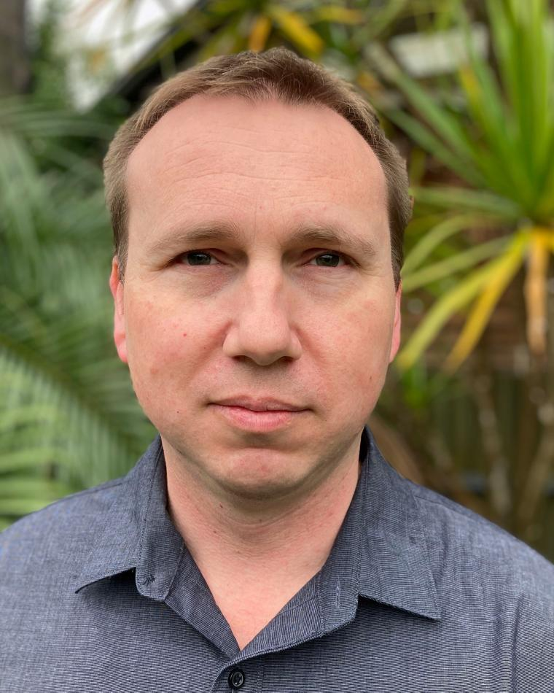
Luke Rosenberg Bio
Luke Rosenberg received the bachelor’s degree in electrical and electronic engineering, the master’s degree in signal and information processing, and the Ph.D degree from the University of Adelaide, Australia in 1999, 2001, and 2007, respectively. He is currently an adjunct Associate Professor with the University of Adelaide and a Senior Research Engineer at STELaRLab, Lockheed Martin Australia. Prior to this he worked at the Defence Science and Technology Group Australia as a research specialist in maritime radar and during 2021-2022 as an acting Group Leader, leading teams across a wide range of radar technologies.
In 2014, Dr Rosenberg spent twelve months with the U.S. Naval Research Laboratory working on algorithms for focusing moving scatterers in synthetic aperture radar imagery. Dr. Rosenberg received the prestigious Defence Science and Technology Achievement Award for Science and Engineering Excellence in 2016 and the IEEE AESS Fred Nathanson award in 2018 for ‘Fundamental Experimental and Theoretical Work in Characterizing Radar Sea Clutter’. He is a senior member of the IEEE, the past chair of the IEEE South Australian section and a past chair of the local AESS chapter. He is a distinguished lecturer for the AESS, a senior editor for the Transactions on Aerospace and Electronic Systems and a member of Radar Systems panel and the AESS Board of Governors. Dr Rosenberg has been involved in several NATO SET groups and is the general co-chair for the International Radar conference in 2023. He has published over 170 technical publications, several book chapters and an authored book.

Slide 52
Luke Rosenberg Statement
The TAES has been gradually reducing its time to publication to meet the average across the IEEE. In my role as the Radar Systems Senior Editor, I’ve observed that most people still leave reviews till the last minute, and reducing the required time from two months to one would make little difference. Secondly, there are still issues with the online publication platform, making it difficult for associate editors to find suitable reviewers and then work with reviewers who don’t complete their review. I plan to work with Manuscript Centre to improve this issue and others that our associate editors and authors are experiencing.
Where there is a cross over in technical areas between IEEE societies, I want to encourage authors to publish with the AESS by increasing the scope and number of special editions. We can offer incentives such as free pages, making their paper open access and also linking the AESS journals to conferences with extended special editions. I will also continue to advocate that we should keep our journals hybrid with both traditional and open access options.

Slide 53
VP Publications
Move candidate(s) to the Waiting Room.
BoG Discussion
Re-admit candidates
Vote
Announce Winner

Slide 54
VP Technical Operations

Slide 55
VP Technical Operations
Roberto Sabatini
Are there any Nominations from the floor?
Roberto will have 5 minutes for Q&A.

Slide 56
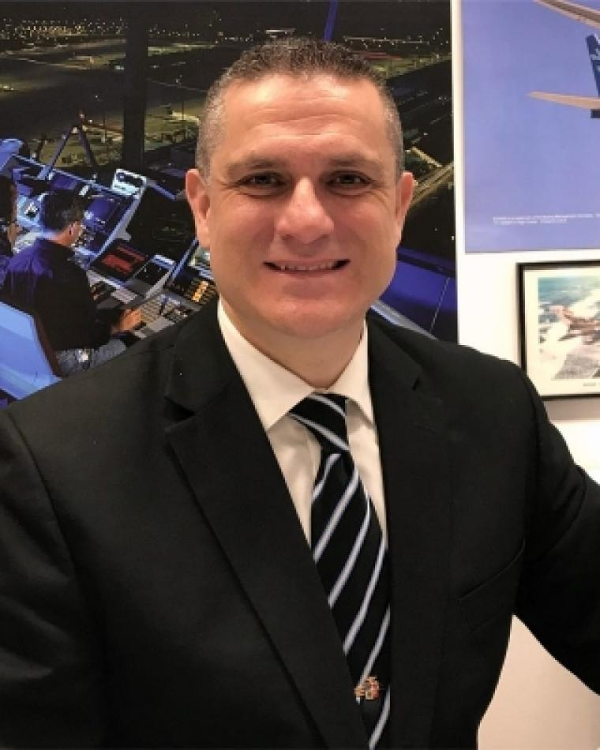
Roberto Sabatini Bio
Roberto Sabatini is a Professor of Aeronautics and Astronautics with over thirty years of experience in aerospace, defense and geospatial systems research and education. He has made significant contributions to industry, government and academic organizations across Europe, North America, Australia and Asia. His primary focus is on advancing the science, technology and commercial impact of avionics and autonomous aerospace systems, working at the intersection of digital transformation, sustainable development and innovation management.
Prof. Sabatini holds doctoral degrees in Aerospace Engineering from Cranfield University and Geospatial Systems from Nottingham University. He is a licensed Flight Test Engineer, Private Pilot, and Remote Pilot, with over 2,000 flight hours on various aircraft types. Additionally, he is a Chartered Engineer and a Fellow of IEAus, RAeS and RIN, as well as a Senior Member of IEEE and AIAA.
Throughout his career, Prof. Sabatini has led numerous industry and government-funded research projects and authored over 350 peer-reviewed publications. He has received prestigious national and international awards and, since 20219, has been included in the top 2% of scientists globally in Aeronautics and Aerospace Engineering, according to Stanford rankings.
Since 2020, Prof. Sabatini has served as a Distinguished Lecturer for the AESS. Since 2021, he has chaired the AESS Avionics Systems Panel. In 2022, he joined the AESS Board of Governors, and since January 2024, he has served as VP Technical Operations. Prof. Sabatini is on the editorial boards of several journals, including the IEEE Transactions on Aerospace and Electronics Systems, and the AESS Systems Magazine.

Slide 57
Roberto Sabatini Statement
As VP Technical Operations, I envision a future where our society capitalizes on its strengths, embraces constant improvement, and leverages collaboration opportunities to maximize impact. I bring to the role three decades of experience in aerospace electronic systems research and education, having served in various industrial, government and academic positions across Europe, Northa America, Australia and Asia.
I am strongly committed to the AESS mission and values, and I have actively contributed to our society since 2008 in various technical leadership roles. Since January 2024, I have served as VP Technical Operations, and I have worked with the team to uphold the highest possible standards, contributing to high-impact publications, educational initiatives, conferences, and standardization working groups.
I am also addressing areas of improvements, such as a revitalization of the Cyber-Security Panel, and the evolution of the "Autonomy for Sustainability" supertopic. I am convinced that collaboration is pivotal, both internally within the AESS and externally. Synergies with the other IEEE Societies and with the IEEE Standards Association will also broaden our engagement and maximize our impact.

Slide 58
VP Technical Operations
Move candidate(s) to the Waiting Room.
BoG Discussion
Re-admit candidates
Vote
Announce Winner

Slide 59
Resume meeting recording

