Slide 1
IEEE Aerospace Electronic Systems President
Maria Sabrina Greco
AESS Board of Governors Meeting – Fall 2024
25 and 26 October 2024
Rennes, France

Slide 2
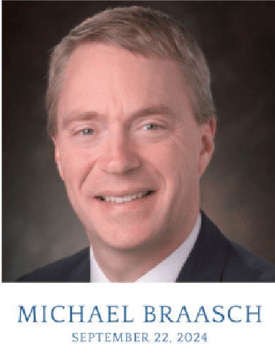
In Memoriam: Michael Braasch
On August 31, 2024, he was diagnosed with pancreatic cancer, and three weeks later, he passed away.
Michael Braasch was elevated to Fellow of the Institute of Navigation (ION) in 2009 and the IEEE in 2023. He was President-Elect of IEEE AESS after serving in numerous leadership positions in both ION and IEEE.

Slide 3
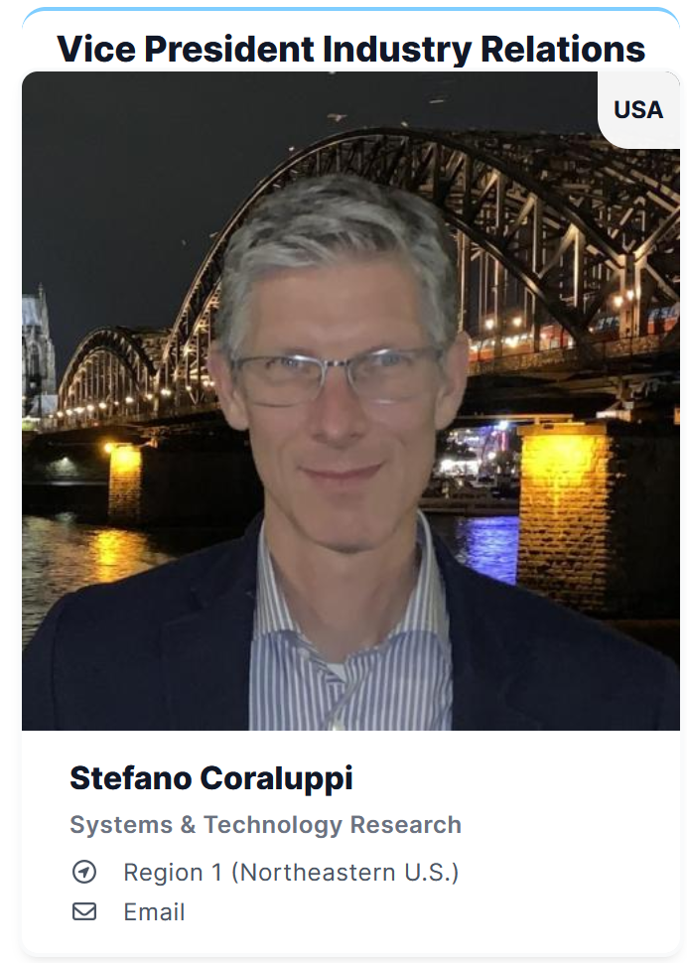
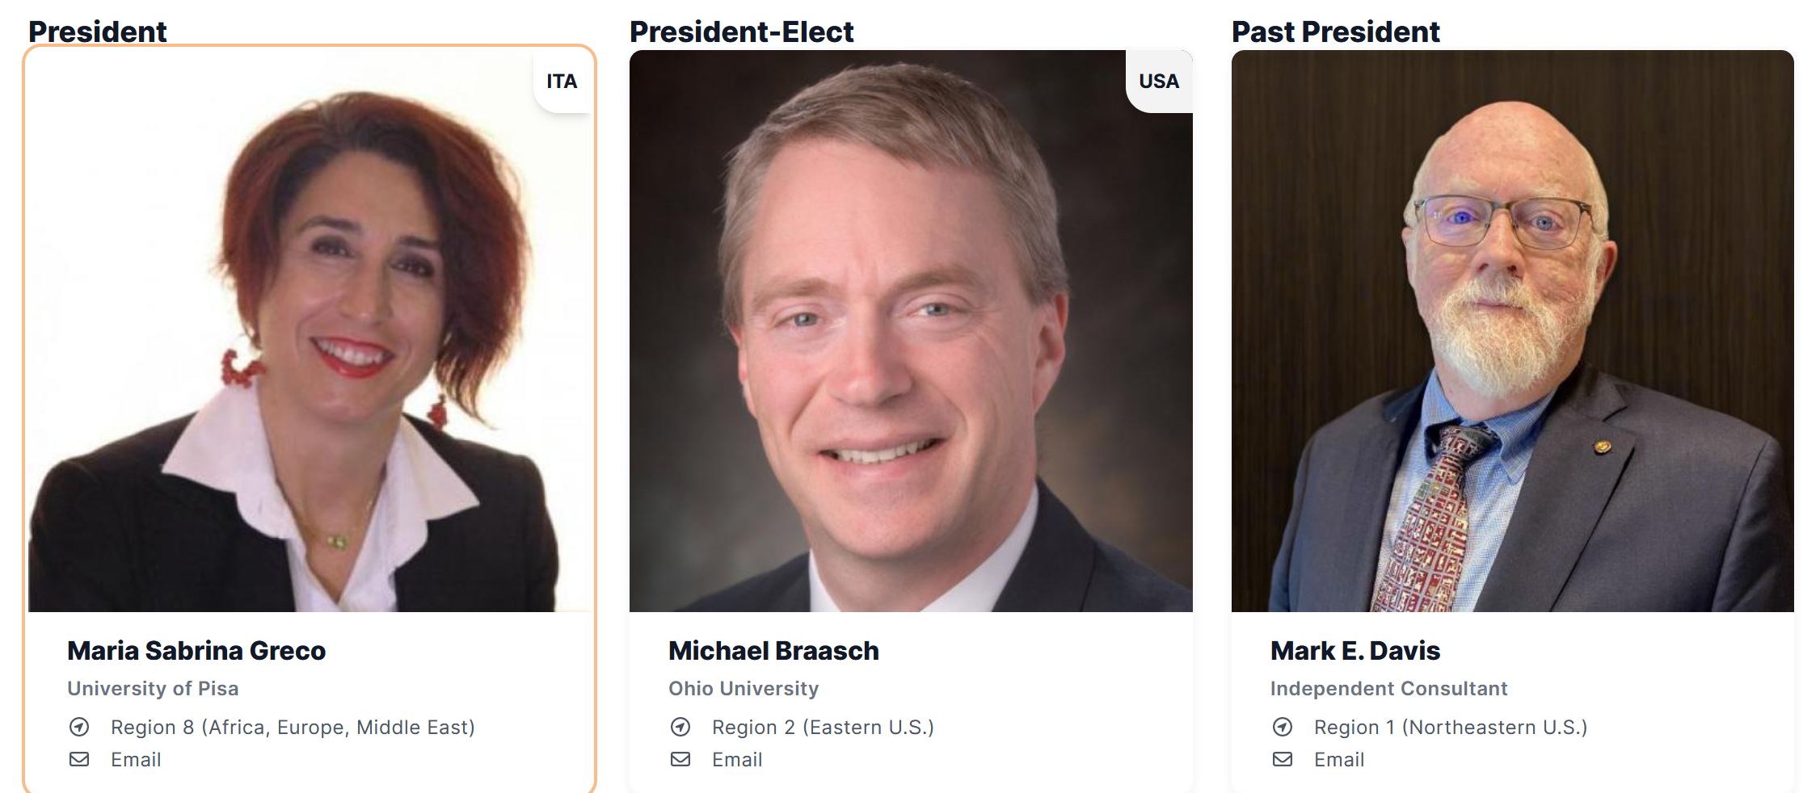
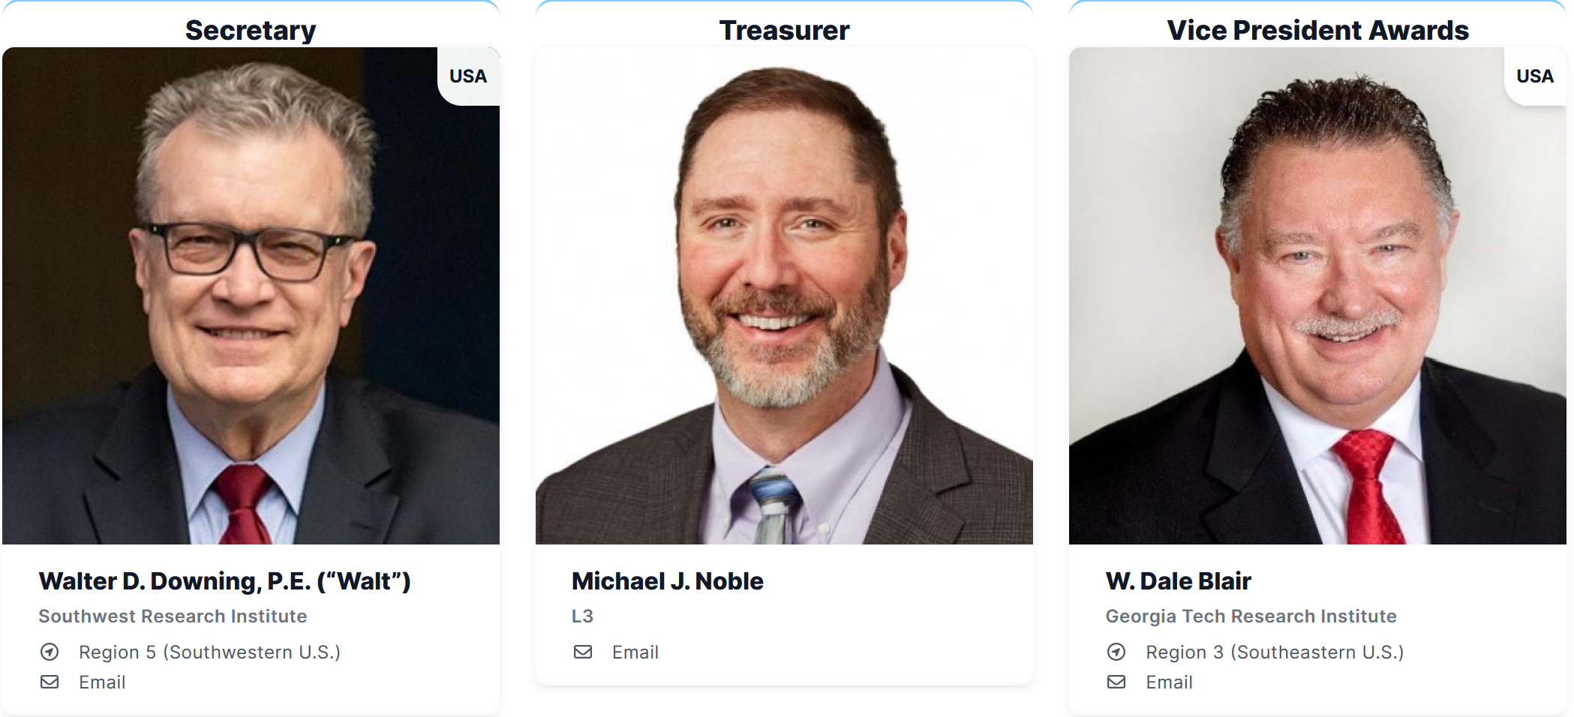
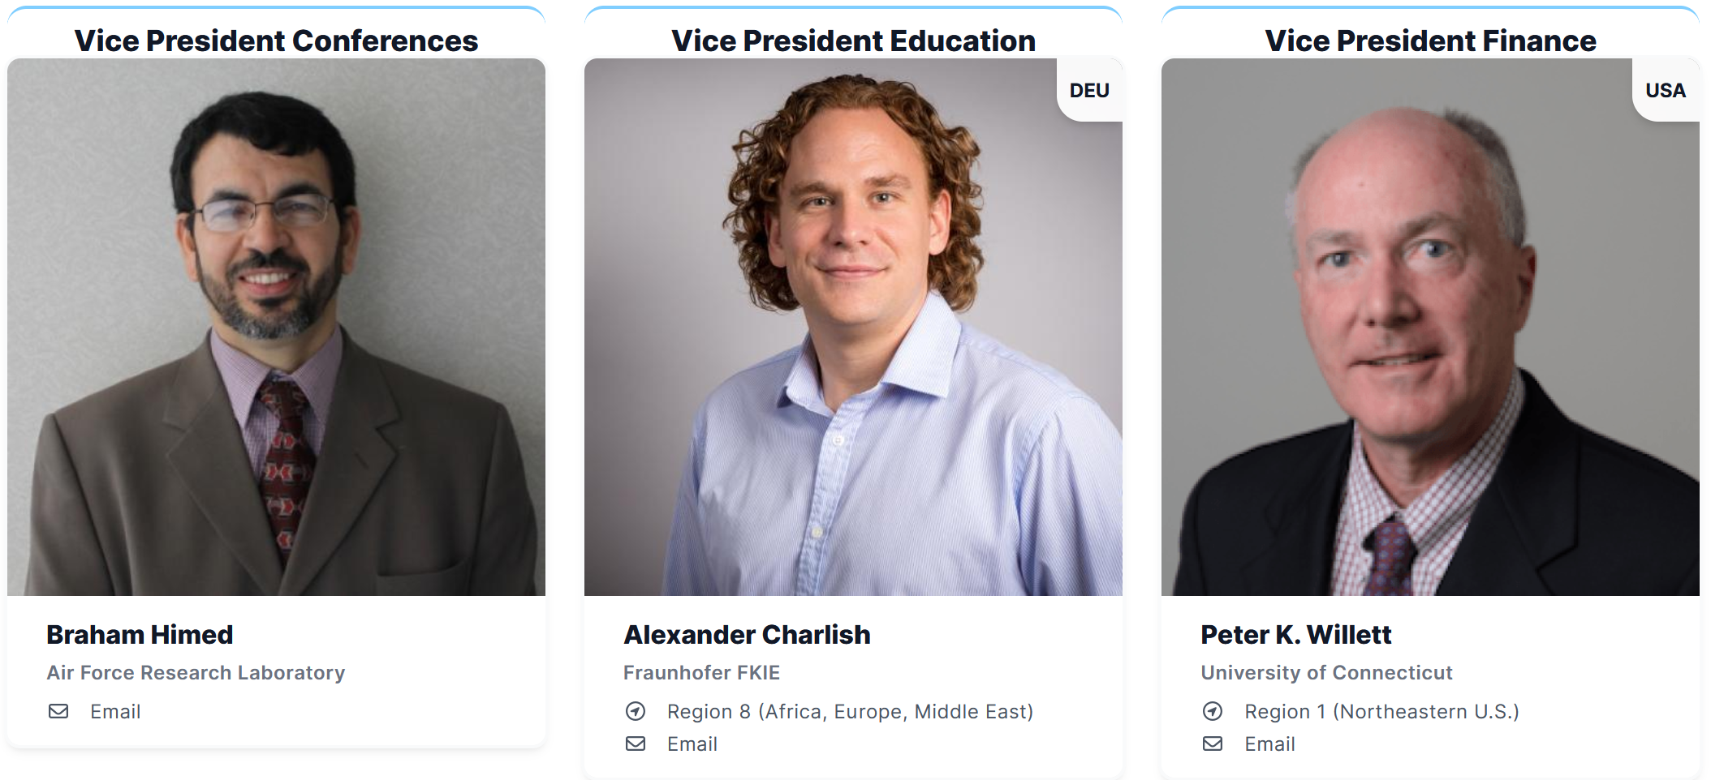
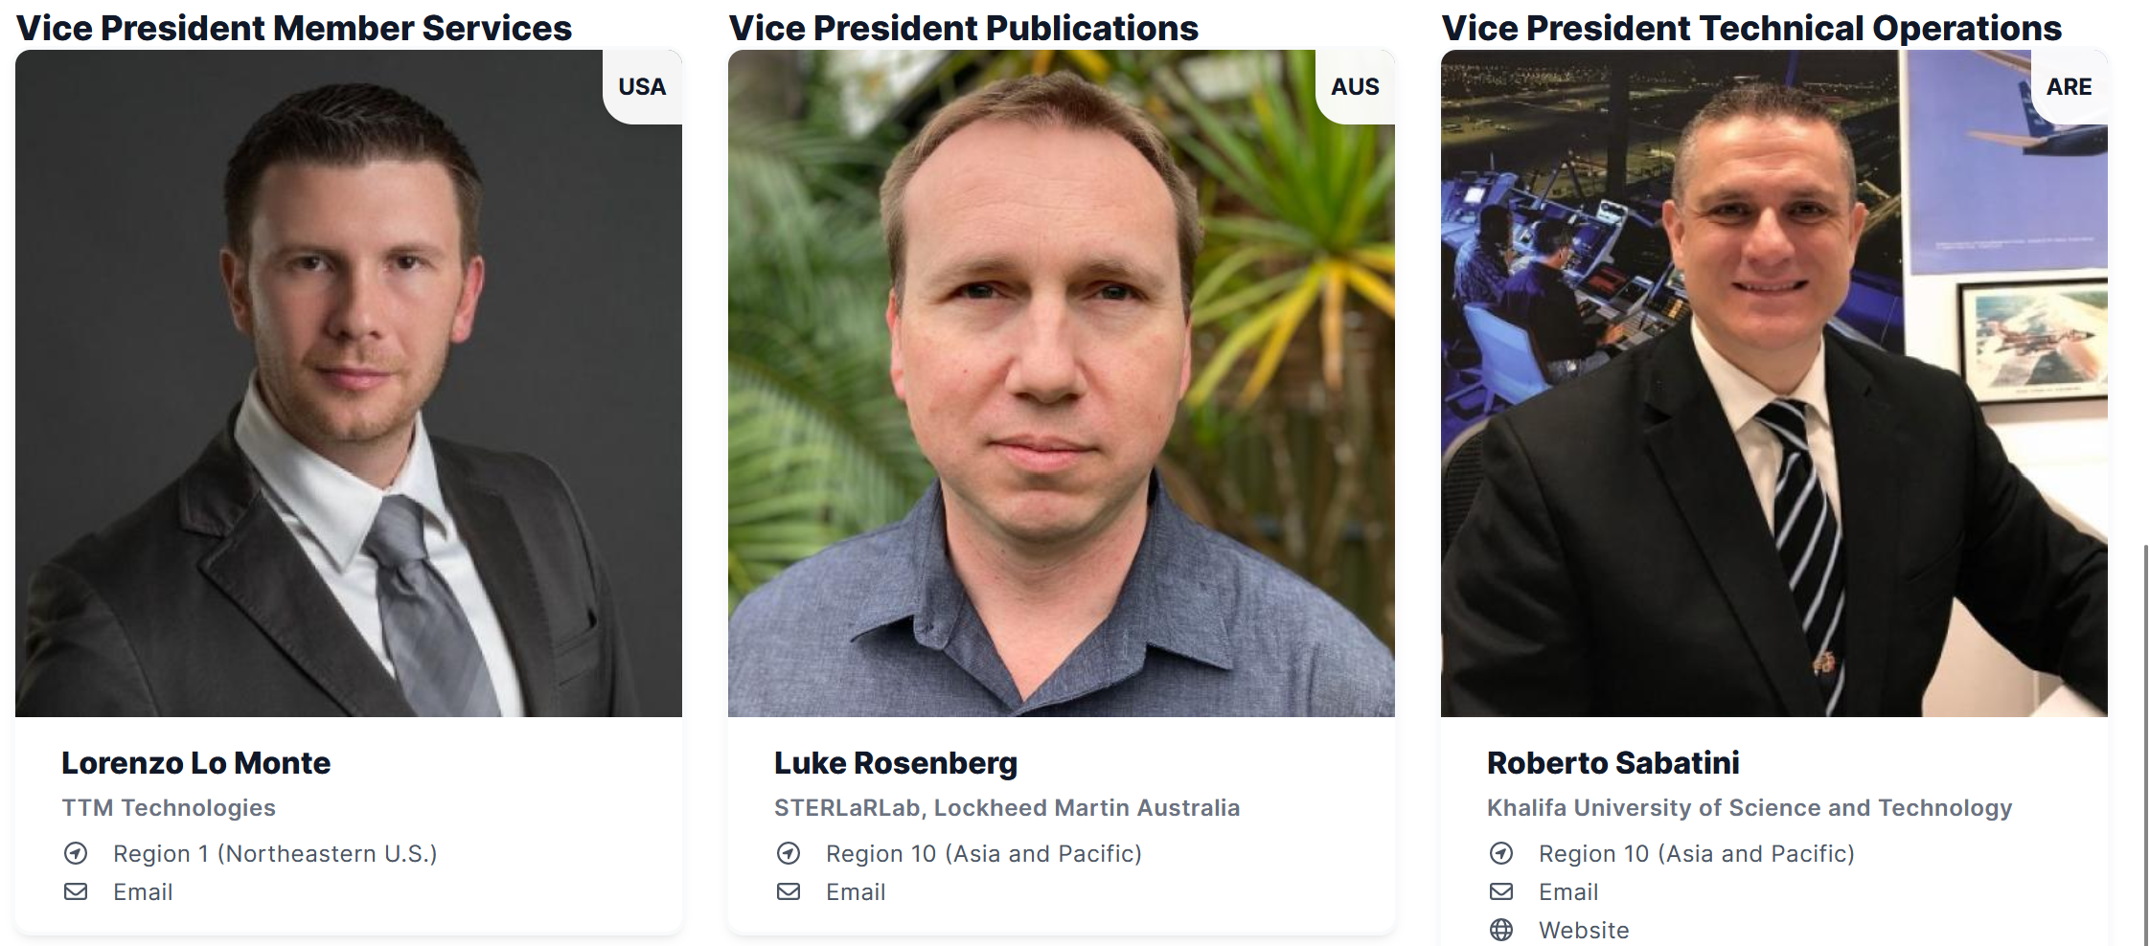
AESS Officers

Slide 4
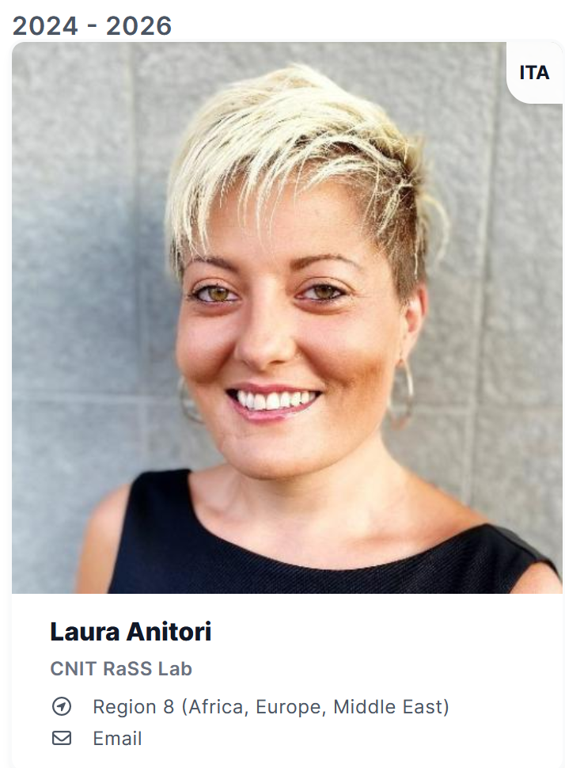
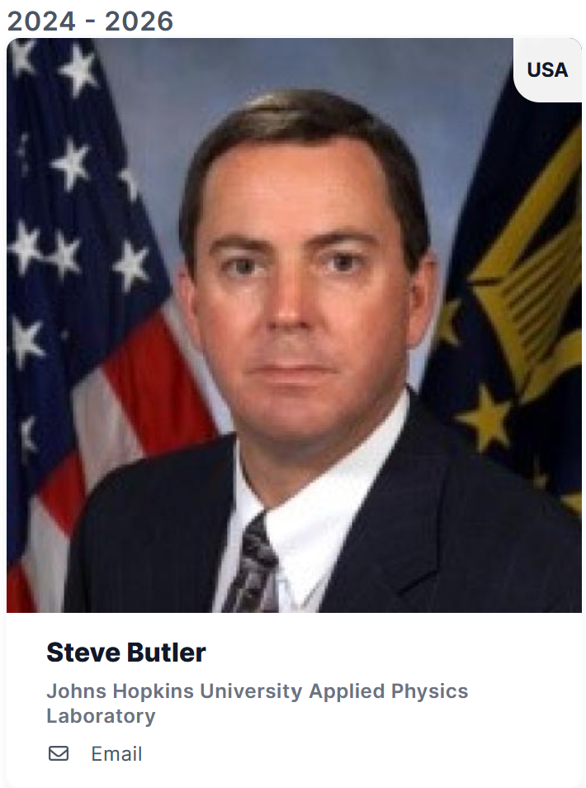
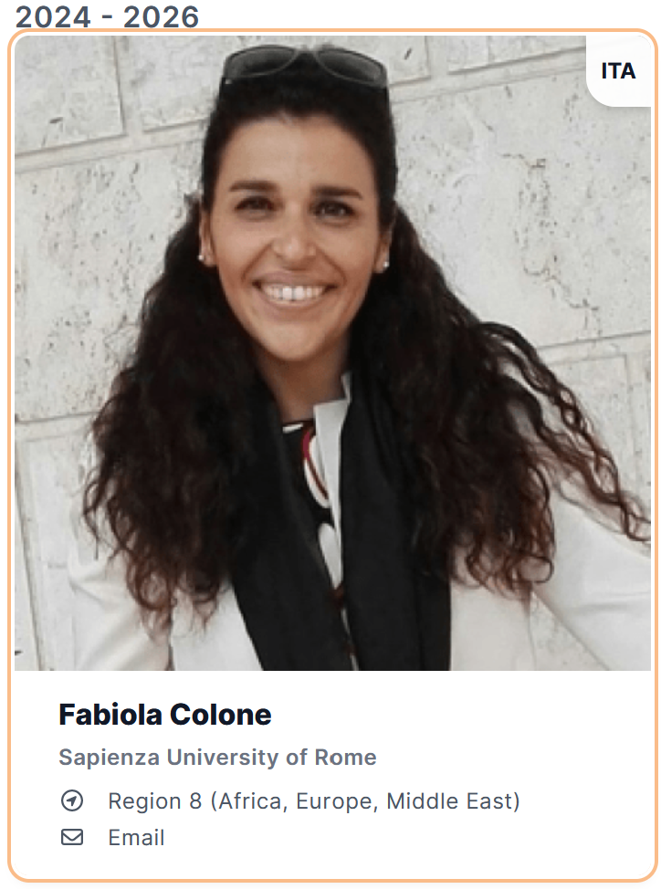
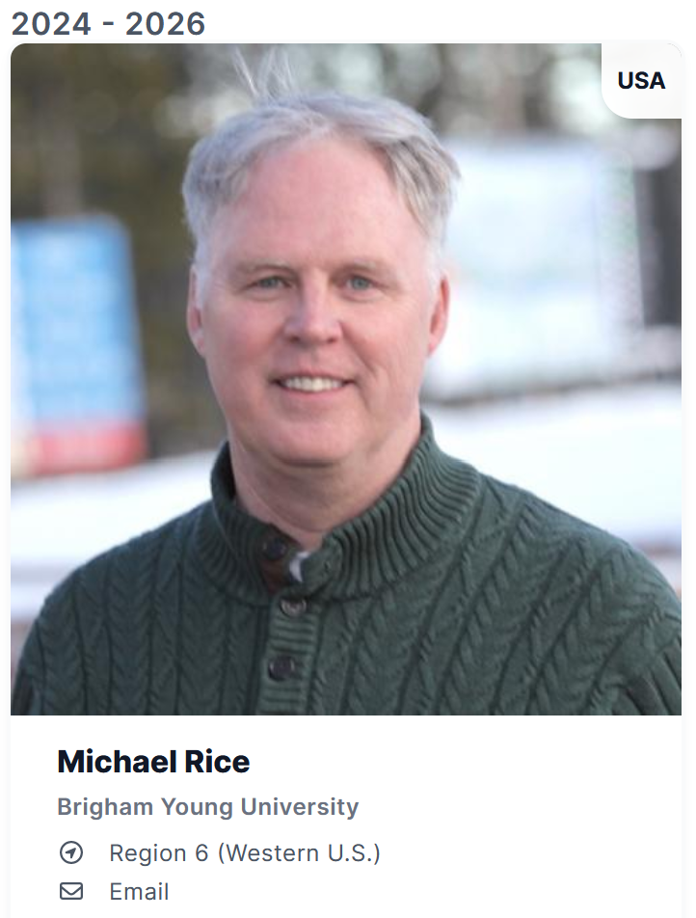
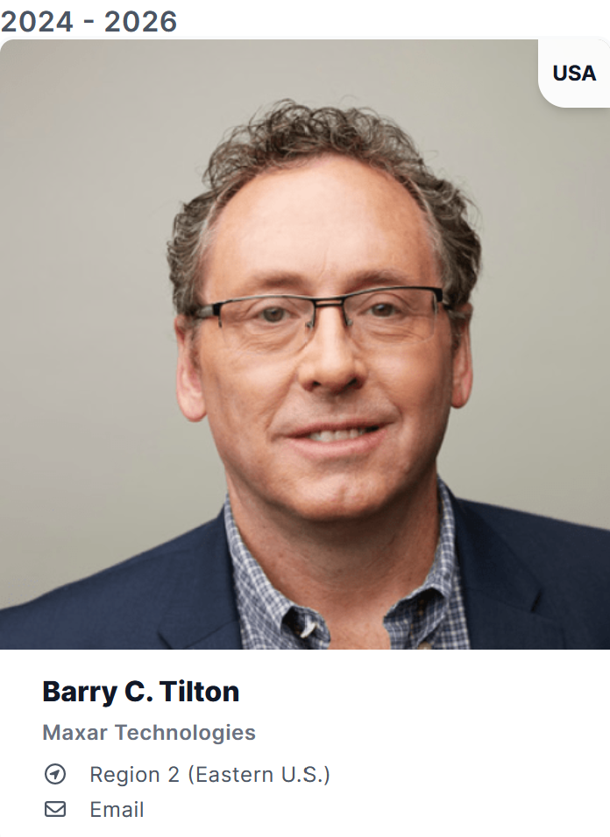
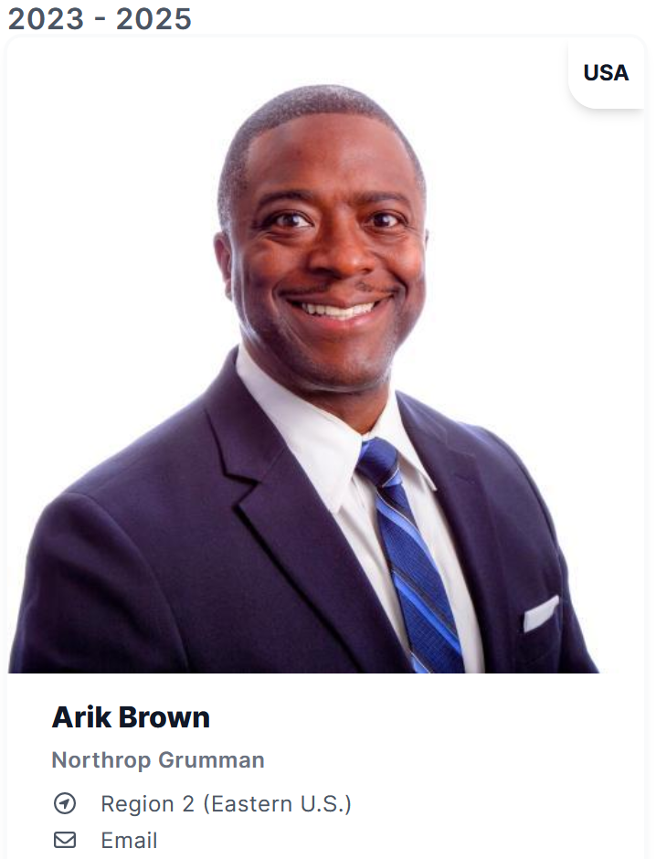
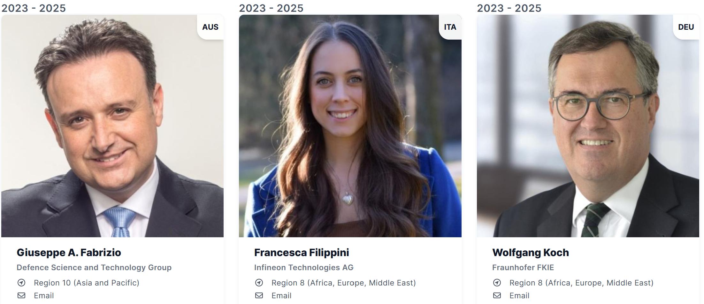
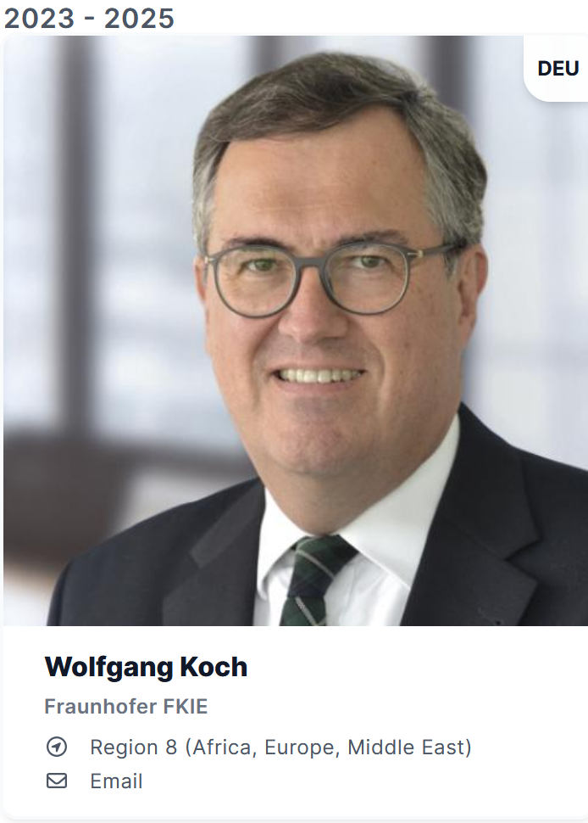
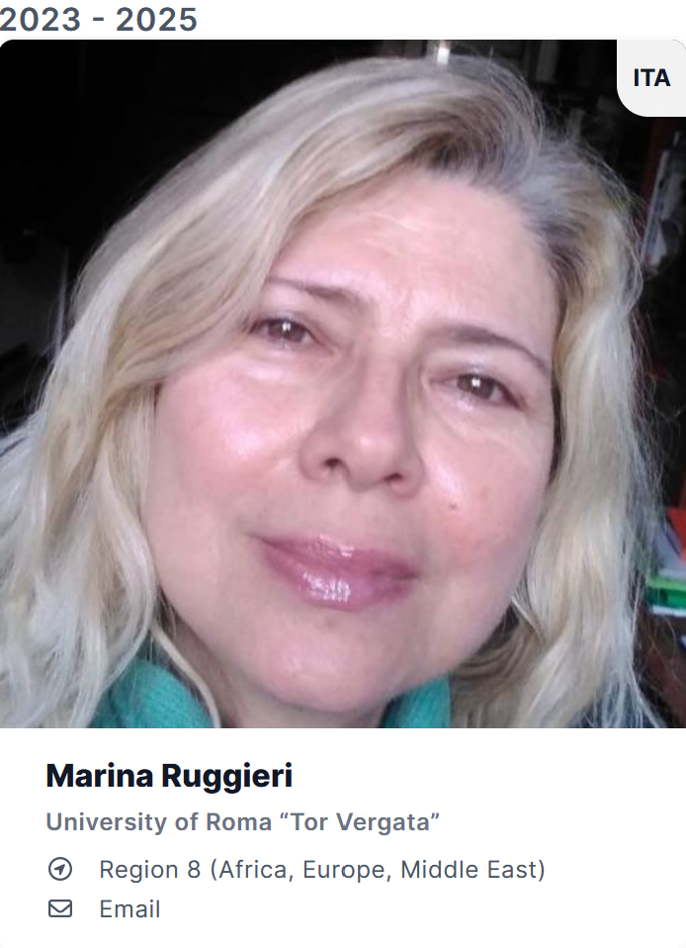
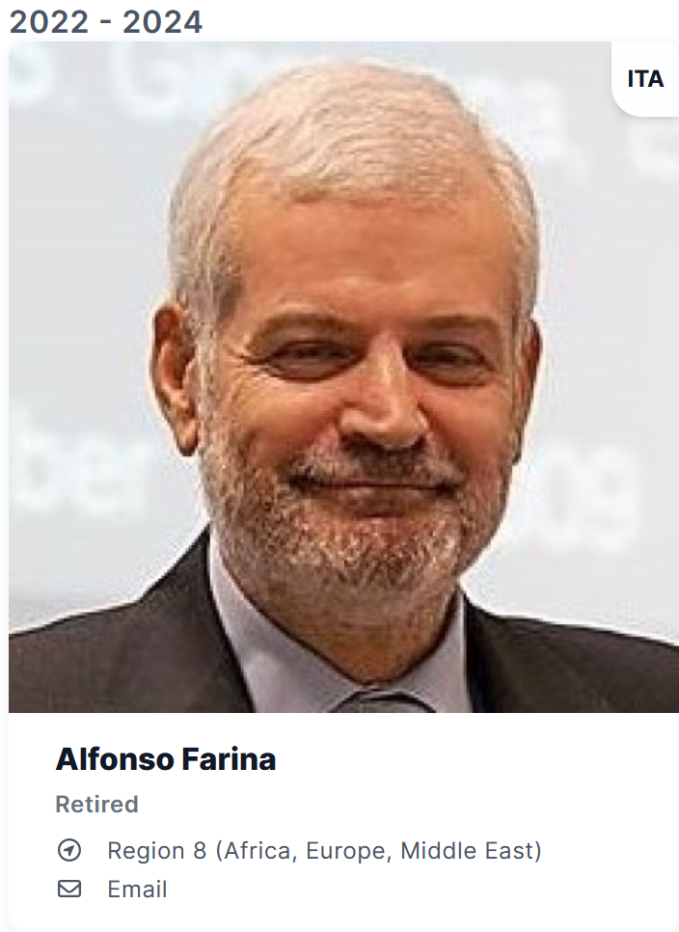
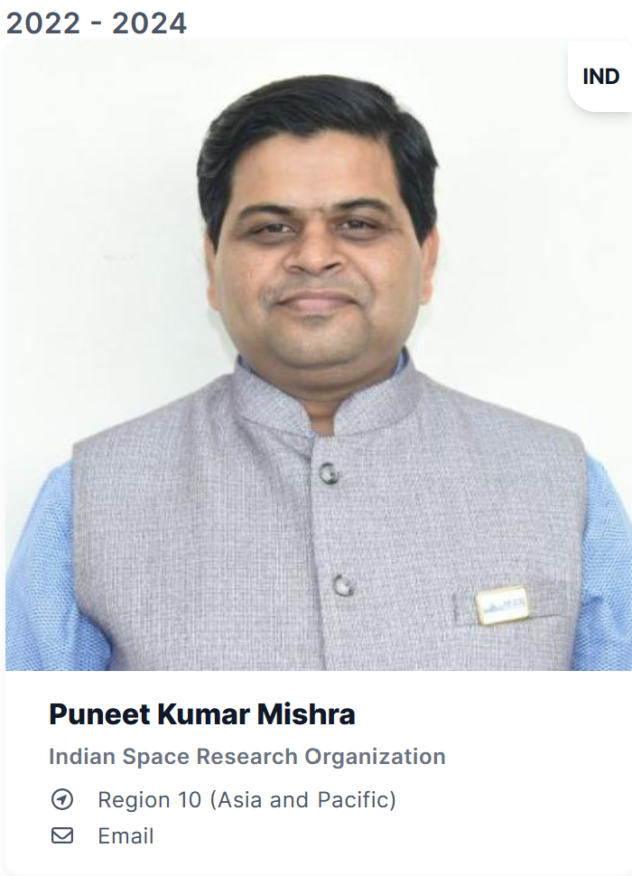
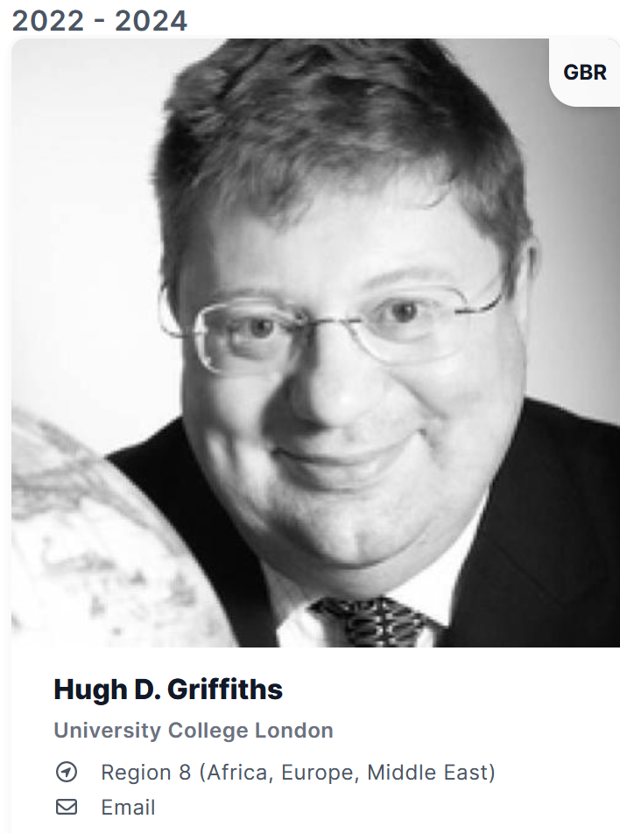
Members-at-Large

Slide 5
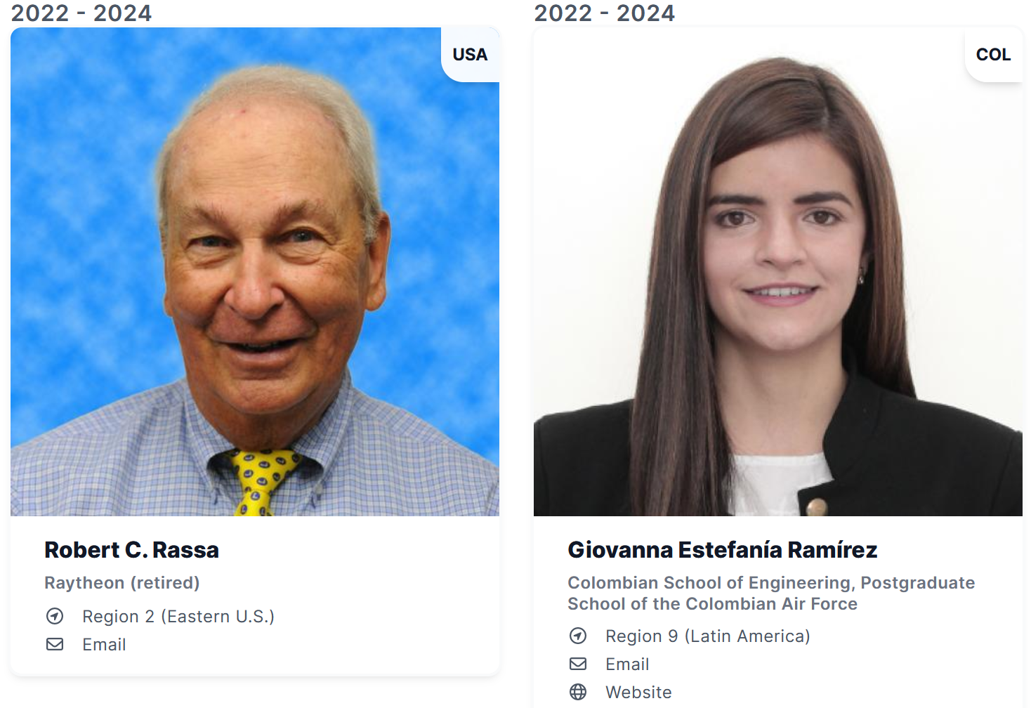
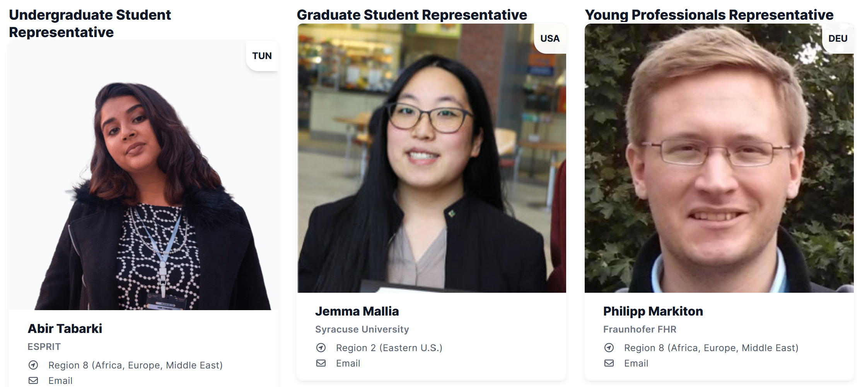
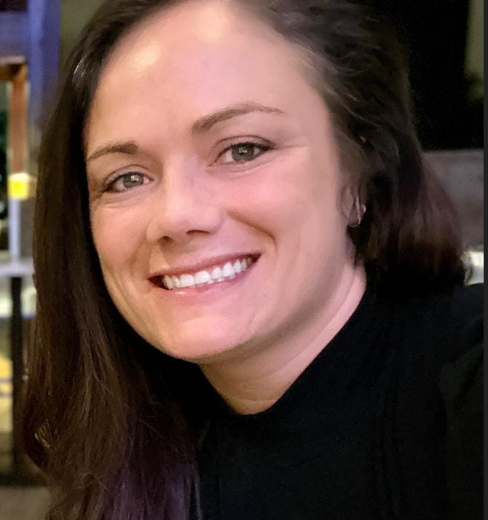
Members-at-Large – Appointed Members
Amanda Osborn
Operations Management

Slide 6
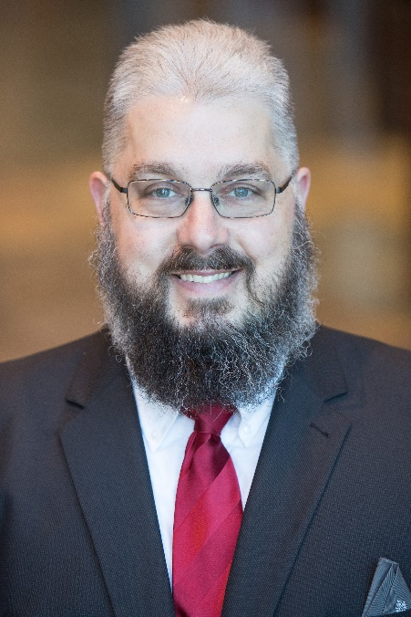
Presidential Appointment: MAL
Vince Socci
Vince Socci is Chief Technologist at On Target Motion where he delivers systems engineering, program management and intellectual property services for safety-critical applications such as aerospace, automotive, rail, marine, and medical. His engineering career spans more than 35 years developing hardware, software, and systems in various fault-tolerant embedded controls applications. He developed products for autonomous systems, UAVs, vehicle propulsion and communications, fuel control systems, power and energy systems, navigation systems, avionics, medical devices, flight control systems, diagnostic/prognostic systems, radar, electrical system, health and fault managers, X-ray scanners, engine and motor controls, automotive and aerospace control systems, and military ground electric vehicles. He has BS and MS degrees in electrical engineering, an MBA in technology management specializing in IP management, an MA in mentoring and counseling and is a PhD candidate. He is a certified Project Management Professional and serves on PMI and SAE standards and technical committees.

Slide 7
Presidential Appointment: MAL
MOTION: Sabrina Greco seeks BoG approval of the appointment of Vince Socci for the remainder of Michael Braasch’s appointment through 31 December 2026.

Slide 8
Presidential Appointment: Graduate Student Rep

Slide 9
Presidential Appointment: Graduate Student Rep
MOTION: Sabrina Greco seeks BoG approval of the appointment Kayoum Djedidi as AESS Graduate Student Representative for the term January 1, 2025-December 31, 2026.

Slide 10
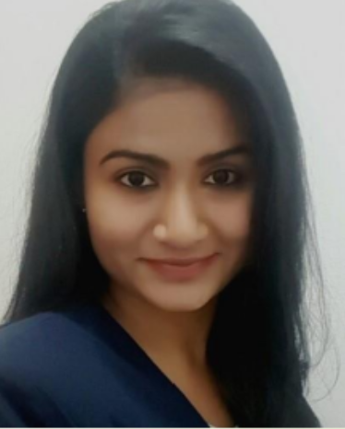
Presidential Appointment: YP Rep
Chandana Panati
Research Employee
chandana.panati@fhr.fraunhofer.de
Fraunhofer Institute for High Frequency Physics and Radar Techniques (FHR),
Wachtberg, Germany
Role & Expertise:
Research in Deep Learning and Explainable AI (XAI) since 2019
Focus on Automatic Target Recognition (ATR) using DNNs
PhD candidate specializing in explainability metrics integrated into the training process of neural networks

Slide 11
Presidential Appointment: YP Rep
Abir Tabarki

Slide 12
Presidential Appointment: YP Rep
Vote has been sent to your email or scan the QR code.
Voting Rules:
You must be in attendance (in person or on Zoom) to be eligible to vote. Proxy voting is not allowed.
The polls will open and close following the election for each respective position.
You cannot vote for these until the voting has been announced live during the meeting.
You will select 1 of the 2 candidates.

Slide 13
Presidential Appointment: YP Rep
MOTION: Sabrina Greco seeks BoG approval of the appointment of [[Insert Name]] as AESS Young Professionals Representative for the term January 1, 2025 through December 31, 2026.

Slide 14
Suggestions for Undergraduate Student Rep
Current undergraduate rep, Abir Tabarki, is graduating.
BoG members to send suggestions with resumes for 2025-2026 u.g. representative to Sabrina and Amanda.

Slide 15
International Directors: Current Bylaws
Article XVII – International Directors
A. International Directors may be appointed by the President, with consent of the Board, from the ranks of the currently serving Board members, to coordinate the activities of Society members in non-US locations. Such Directors may be
appointed for as many non-US locations as deemed advisable and/or necessary based on AES member components.
B. A lead Director, International Operations may be appointed by the President, with consent of the Board, from the ranks of the currently serving Board members, if such is deemed needed, to serve as a coordinating activity for the International
Directors.
C. The duties and responsibilities of the International Directors shall be as follows:
a. Provide interaction between the academia, industry, government and the professionals in innovative manner
b. Provide means for global interaction of professionals in new and emerging areas of concern for AESS
c. Provide forums for discussing means for enhancing the quality of life globally using AESS technological areas, and educating the professionals accordingly
d. Encourage involvement of industries in AESS events for mutual benefit, including the practice of systems engineering and system-of-systems approach
e. Provide a comprehensive package of achieving AESS membership growth, and chapter growth.

Slide 16
International Directors: Proposed Bylaws Changes
Article XVII – International Directors
A. International Directors may be appointed by the President, with consent of the Board, from the ranks of the currently serving Board members or among AESS members in good standing, external to the Board, to coordinate the activities of Society members. The maximum number of Directors per IEEE Region is as follows:
Region 1-6 : One Director
Region 7: One Director
Region 8: Two Directors
Region 9: One Director
Region 10: Two Directors
B. A lead Director, International Operations may be appointed by the President, with consent of the Board, from the ranks of the currently serving Board members, if such is deemed needed, to serve as a coordinating activity for the International Directors.

Slide 17
International Directors: Proposed Bylaws Changes Cont’d.
C. The duties and responsibilities of the International Directors shall be as follows:
a. Represent the Society at AESS Sponsored events where deemed as necessary.
b. Help the VP of Member Services in overseeing the Chapter activities in their respective Regions.
c. Help the VP of Education in overseeing the Distinguished Lectures program in their respective Regions.
d. Encourage involvement of industries in AESS events for mutual benefit in their respective Regions.

Slide 18
International Directors: Bylaws change
MOTION: Mark Davis moves to approve the position description change of the International Director in the AESS Bylaws.

Slide 19
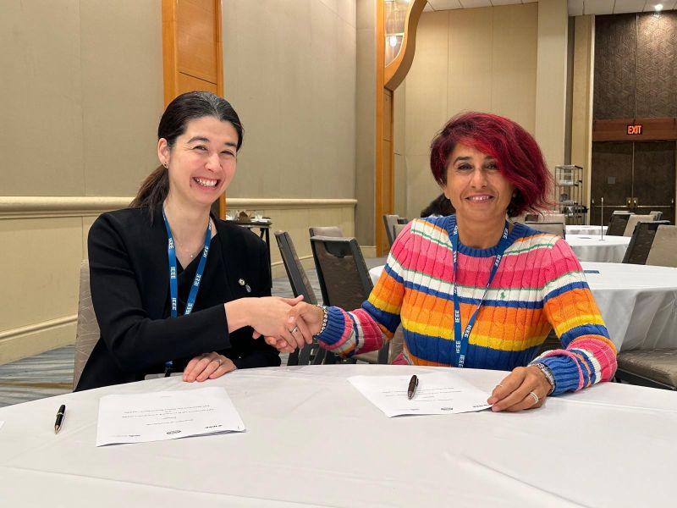
MOU with GRSS
IEEE Geoscience and Remote Sensing Society has announced strategic partnerships with the IEEE Aerospace and Electronic Systems Society (AESS) and the IEEE Oceanic Engineering Society (OES). These collaborations aim to enhance interdisciplinary research, foster innovation, and drive advancements in remote sensing, aerospace, and oceanic engineering fields.

