Slide 1
IEEE Aerospace Electronic Systems VP Publications
Luke Rosenberg
AESS Board of Governors Meeting – Fall 2024
25-26 October 2024
Rennes, France

Slide 2
TAES Journal update
Impact factor (IEEExplore) is 5.1
Submissions from Jan –> Oct is 2959, projected number for this year is 4000! (For comparison: 2863 in 2023, 2502 in 2022)
22 new AEs since Jan. 2024, 1 new SE (Radar Systems)
New track from Jan 2025: Aerospace Information Systems – SE will be Prof Umut Durak from DLR
New call for papers: Near-Field Radar Technologies and Applications
Still under transformative OA agreement, but number of OA submissions is insufficient to remain.
Journal changes implemented:
Removed single page submission
Reduced review time from 60 to 45 days. Second round is 30 days.
Removed bimonthly volumes and going to single volume per year (from Jan 2025)
Journal changes pending:
Switch to author central for submissions (late 2024)
Advertise for new special sections which are complimentary open access.
Setup an editorial advisory group with VP Pubs, EiC and past EiCs to meet twice yearly and discuss any issues.
Complete operations manual.
Keen to make TAES free for AESS members – expect little impact in revenue (hard to know for sure).
Senior Editor Meeting – Oct. 19, Paris
12 Senior Editors attended + EiC
Focus is on editorial changes, updates from each SE and how to improve best practices
Replayed videos on author misconduct from Panel of Editors meeting

Slide 3
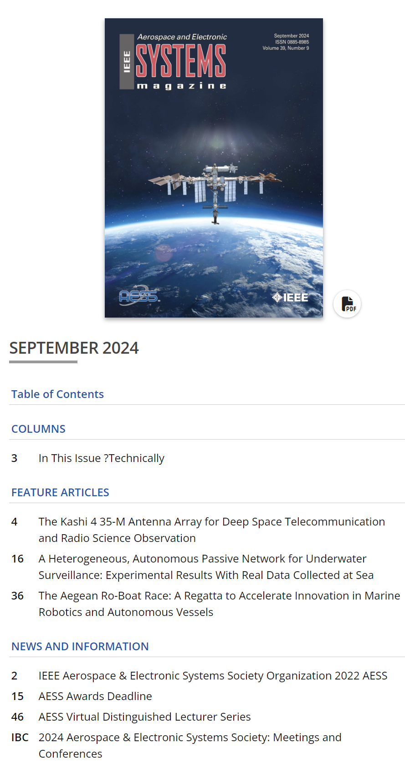
Systems Magazine update
Current impact factor is 3.4
Pau and Alessio discovered several papers delayed by 100s of days!
Generating bi-weekly reports for AEs to help them manage their workload
New author guidelines being developed
Increased frequency of history columns (quarterly to bi-monthly)
Proposal to increase advertisement in the magazine?
New online version of magazine
Plan to refresh website.

Slide 4
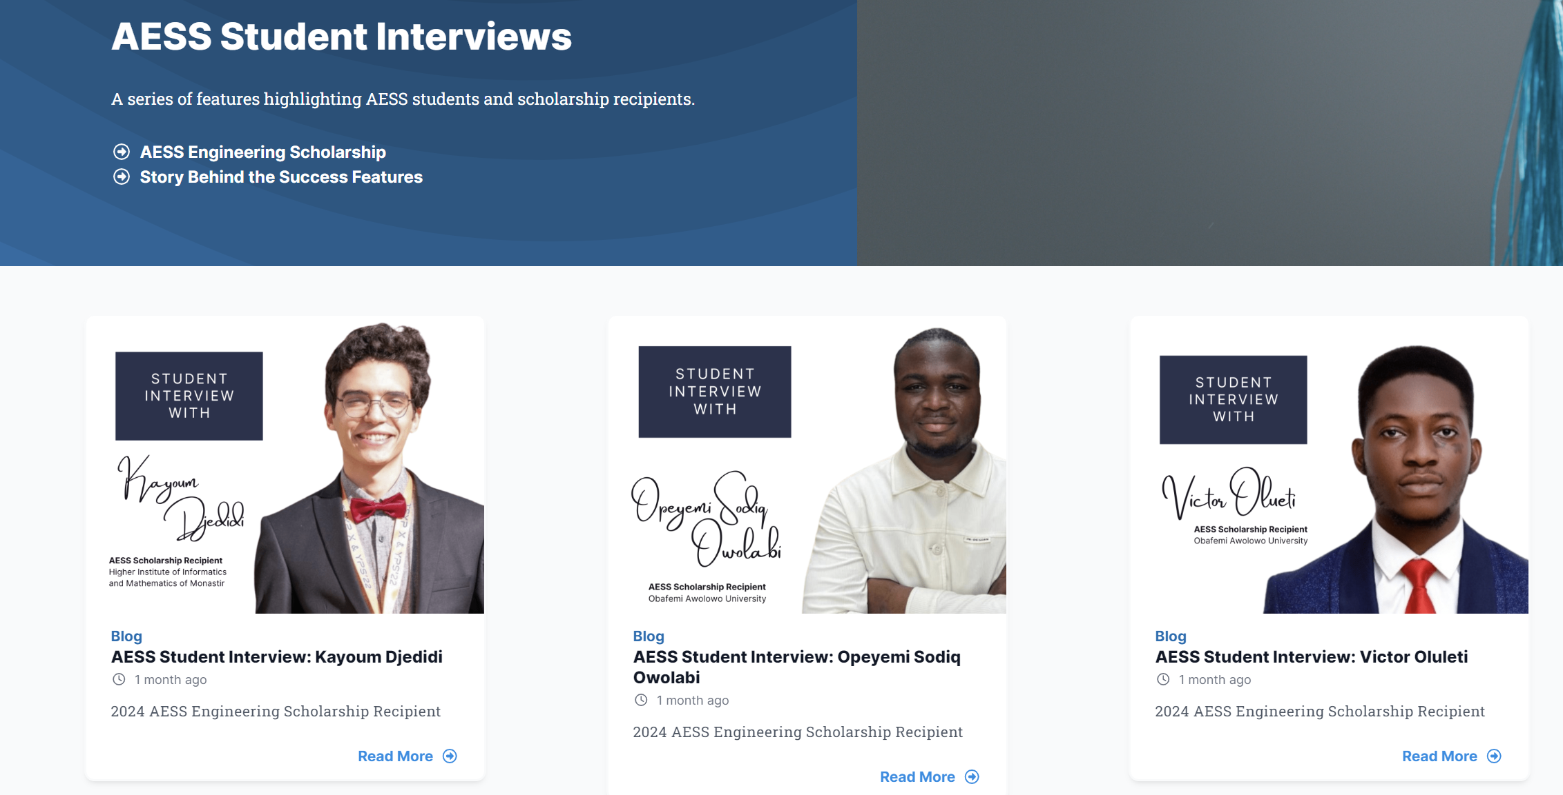
Quarterly Email Blast
Phillip Markiton is the sole EiC as Francesca stepped down.
New email layout is very good.
New feature being trialled - AESS Student Interviews

Slide 5
Co-sponsored Journals
Transactions on Radar
AESS has 24% share
On track to get impact factor in 2026 (3 years after start)
Editorial Board comprises 2 Assoc. EiCs and 20 AEs
Currently reviewing special section on AI for Radar
In last 6 months, have received 146 original manuscripts and accepted 41/113 papers (36.3%)
Average time to first decision is 35 days - deemed a “High Performer” for every quarter since launched
Open Journal of Systems Engineering
AESS has 20% share
Needs to achieve > 20 publications to start building up to an impact factor.
Journal of Lightwave Technology
AESS has 2.5% share
Impact factor is 4.1
Journal of Miniaturization for Air and Space Systems (J-MASS)
AESS has 20% share
Impact factor is 4.4

Slide 6
Newly proposed journals
IEEE Journal of Digital Twins and Parallel Intelligence
Poorly defined scope that overlaps with Open Journal of Systems Engineering (OJSE)
Latest meeting minutes (13 Sept 24) about clarifying scope between:
IEEE Technical Committee on RFID (CRFID)
IEEE Digital Reality Technical Community (DRTC)
Next TAB pub. meeting – “Endorsement of Phase 1 Proposal for IEEE Journal on Digital Twins and Parallel Intelligence”
Need to clarify our involvement in this journal
IEEE Journal of Selected Topics on Electromagnetics, Antennas and Propagation
Gold open access
Focussing on special topics relevant to the society.
Exaggerated number of papers arising from Radar Conferences.
Chose not to go with IEEE Access as it ‘may not provide the same thematic concentration as a special issue or section’.

Slide 7
IEEE Access
Many on the BoG feel that Gold open access may not be required for the AESS
Plan-S appear to be less of an issue than expected.
Still uncertainty about requirements in the broader AESS community – strong uptake of OA in other journals
Trial section with IEEE Access offers us a mechanism to find out without committing to a new OA Journal
Funding – AESS receives ~$1200 per paper after processing fees
Startup requirements
Blurb that describes the scope – allow any AESS topic or do we select themes?
List of at least 3 Associate Editors
Peter Willett has offered to be the lead editor.
Once confirmed, plan to poll TAES Senior Editors to get suggestions (agreed no common AEs with TAES).
Agreement from the BoG

Slide 8
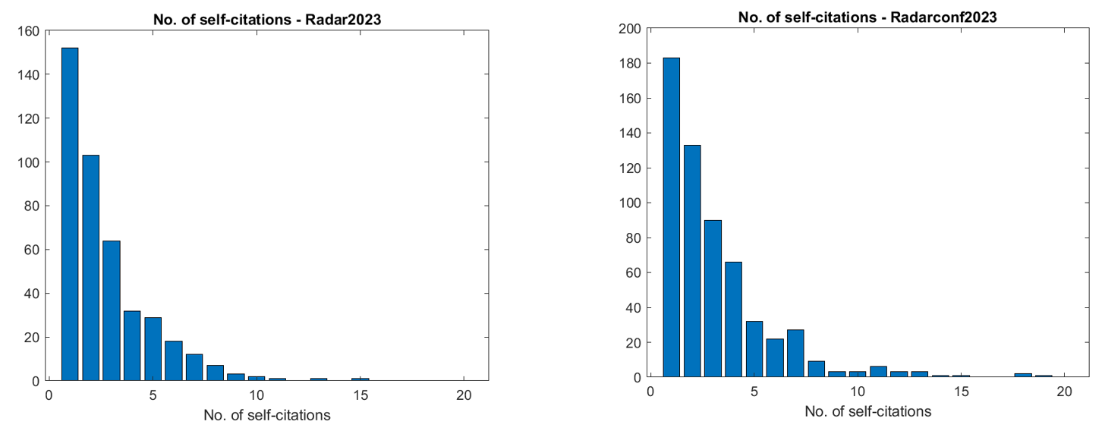
IEEE Conference Indexing with Clarivate
Scopus have not been indexing some AESS conferences – e.g. Radar 2023 and Fusion 2023
Difficult to understand the exact reasons:
Committee affiliations: Committee affiliations are not provided
There are too many self-citations.
There are too many citations to papers co-authored by the conference organizers, particularly the general chairs.
We observed a high concentration of citations to a particular author or small group of authors
Reviewers have been assigned to review papers of authors with whom they have frequently co-authored other papers.
Worked with Bill Trippe (Senior manager, Academic Products) on a rebuttal for Clarivate.
Completed analysis of the Radar 2023 conference – comparing with Radarconf 2023 which was accepted.

Slide 9
2024 Objectives
TAES
Changes proposed:
Remove single page submission,
Switch to author central for submissions,
Remove bimonthly volumes and go to single volume per year – articles get published immediately after typesetting,
Reduce review time from 60 to 45 days.
Advertise for new special sections which are complimentary open access.
Setup an editorial advisory group with VP Pubs, EiC and past EiCs to meet twice yearly and discuss any issues.
TAES - workshop to get the EICs and SEs together to plan a strategy to deal with increased workload.
Complete operations manual.
Systems Magazine
Work with the new EiC / AEIC to expand the content in the Systems Magazine and increase submissions.
Introduce 3-year terms (with second term possible) and define expectations.
Draft operations manual similar to the TAES.
Remove AEs who are not performing and recruit new AEs.
Advertise for new Special Editions, including tutorials.
QEB
Develop student ‘corner’ to increase readership.

