Slide 1
IEEE Aerospace Electronic Systems VP Technical Operations
Rob Sabatini
AESS Board of Governors Meeting – Fall 2024
25-26 October 2024
Rennes, France

Slide 2
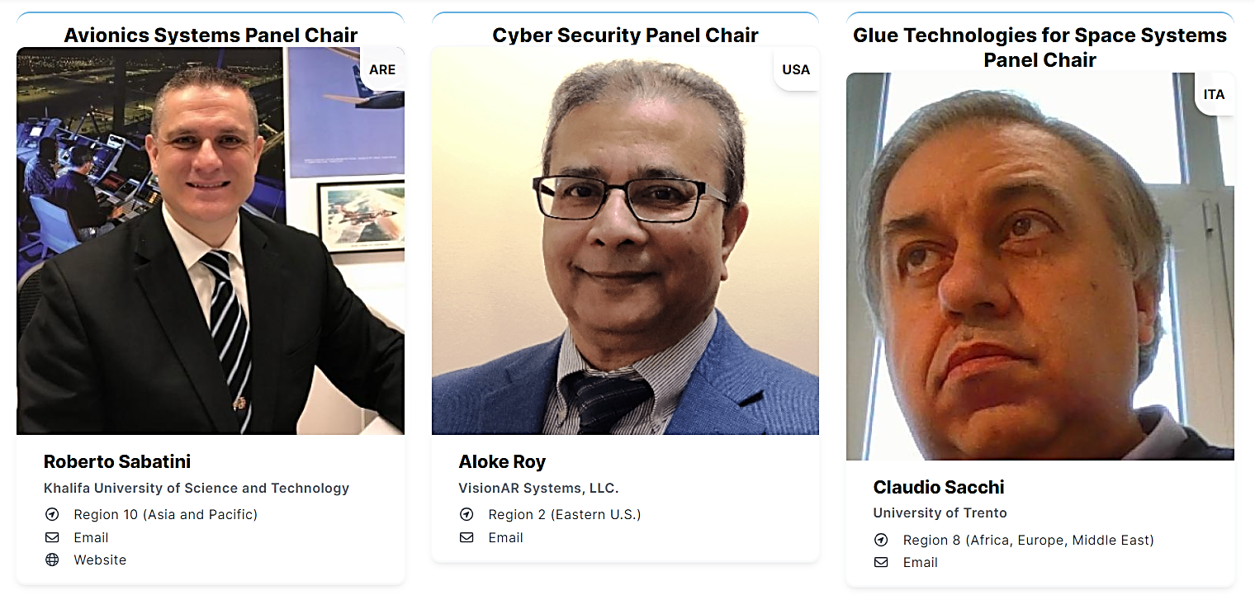
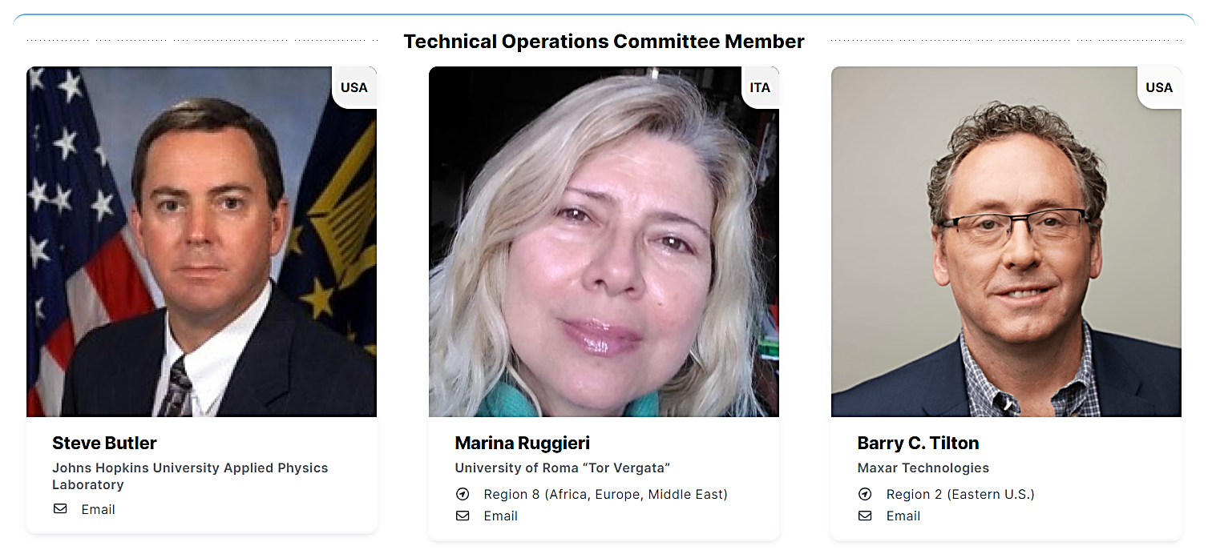
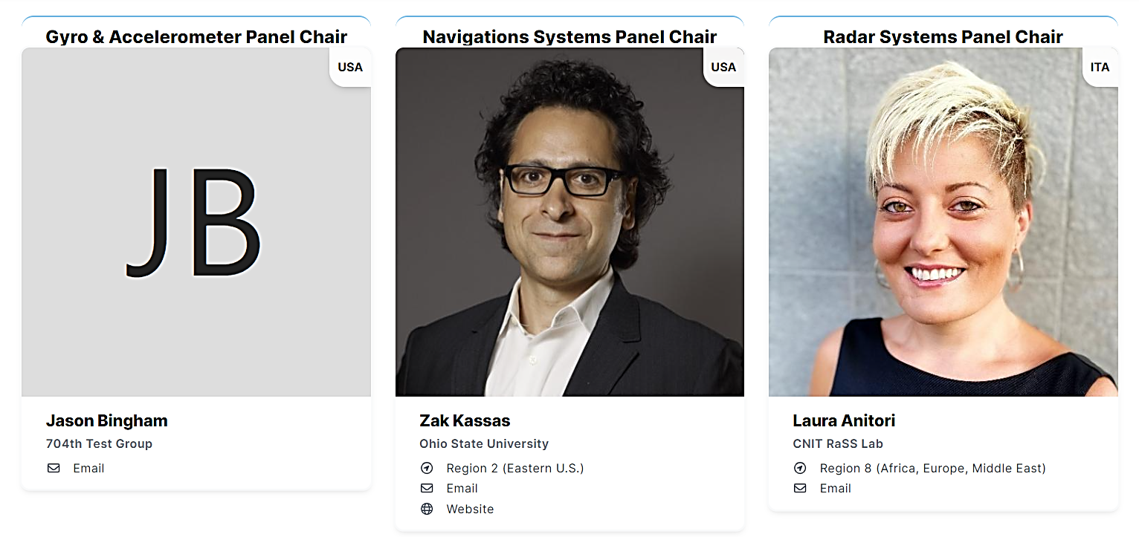
Introduction
2

Slide 3
2024 Short-Term Objectives
Support the AESS Technical Panels (TPs) in developing coherent and effective roadmaps for their activities:
Identify strategic areas of operation (R&I, education, publications, standards, etc.) and identify appropriate ways to support the TPs financially
Restructuring and revitalizing the Cyber-Security Panel (CSP)
Identify key deliverables for each panel (as part of the roadmaps) in each area of activity
Standardize TP reporting to the TechOps Panel (develop and implement a new template)
Required resources and support to accomplish these goals:
Administrative support for meetings and reporting activities
Financial support to allow participation to selected/relevant IEEE and non-IEEE standardization activities (meetings, workshops, etc.), educational initiatives (bootcamps, short courses, public tutorials, etc.), and other tasks (R&I, publications, inter-panel collaborations, etc.)
3

Slide 4
Long-Term Objectives
Develop an integrated AESS TechOps roadmap (1-2 years) and boosting the TechOps role as a catalysts of a productive innovation ecosystem (2-3 years):
Evolution of the “Autonomy for sustainability” supertopic
Balancing industry, government and academia representation
Enhancing regional representation and expanding conference contributions
Maximizing synergies with IEEE/AESS publication and education activities (beyond DLs)
Increase industry representation and consultation (collaboration with Industry Relations)
More direct and effective involvement in IEEE and non-IEEE standardization working groups
4

Slide 5
EOY Report – AI Status
Dedicated meetings with all Technical Panel Chairs and BoG TechOps Panel Members were held to discuss the possibility of funding TP initiatives:
Various proposals were discussed. There is a consensus to fund Technical Panel contributions to standardization, education and other pro-bono activities (student competitions, challenges, bootcamps, lecture series, tutorials, etc.)
An action was taken at the Spring 2024 BoG meeting to develop a motion to financially support TP activities. Consultations with TechOps panel members and other BoG members took place and a draft motion was circulated by email to all BoG members in July 2024 (only positive feedback was received)
Action item ‘In Progress’
Continues on next page
5

Slide 6
EOY Report – AI Status
TechOps Motion to Financially Support TPs (see slide 14):
The initial idea presented at the Spring 2024 BoG was to allocate a budget of USD 10,000 per year to each TP to perform pro-bono educational activities and an additional USD 10,000 per year to fund participation in prominent standardization working groups aligned with the TP missions
There was consensus among BoG members that TPs cannot operate effectively without any budget allocated. Empowering TPs is integral to their ability to deliver value to the AESS and will strengthen both participation and accountability
Discussions within the TechOps and with various BoG members (during and after the 2024 Spring meeting) confirmed the importance of this initiative. However, it was prompted that a smaller budget (up to USD 4,000) should also be considered to support regular/recurring TP activities, primarily in the context of education and standardization. It was also pointed out that special initiatives (funding up to USD 8,000) should include mission-related work beyond regular/recurring education and standardization activities (research, publications, multi-panel activities, etc.)
From a procedural perspective, it was agreed that a TP Chair should submit funding applications to the VP for TechOps for an initial screening. The TechOps Committee will then discuss and approve/reject these applications with a majority vote
This initiative aligns with AESS's strategic goals and supports the development of TPs and their mission. No contras were identified
6

Slide 7
EOY Report – AI Status
Efforts to revitalize the Cyber-Security Panel (CSP) and increase its contributions to AESS Tech Ops, alongside fostering collaborations with other technical panels and our broader community:
Thanks to the BoG’s contributions in recommending new members and some dedicated meetings with cyber-security experts that took place since last BoG meeting, the Cyber-Security Panel has a new roster, comprising several well-qualified and motivated members
Regular meetings of the CSP took place since April (independently from the ASP), which were well attended and contributed to
The CSP developed/approved a new charter and several activities are ongoing (see attached CSP report)
7

Slide 8
EOY Report – AI Status
Supertopic Integration with Technical Panels:
Following the meeting with Joe Dauncey (Supertopic Committee Chair) the TPs provided their feedback
A notable comment highlighted the challenge of aligning industry profit motives with sustainability goals, questioning how IEEE AESS can influence industry to prioritize sustainability while remaining profitable. This comment is seen as a foundation for future developments, emphasizing the need for a Triple-Bottom-Line (TBL) approach involving industry in the discussion
Positive feedback was received on the "Concrete initiatives" proposed, though some require further specification
Proposals for Supertopic-Related Initiatives:
Introduce the autonomy for sustainability topic in panels and special sessions at AESS conferences
Organize ad-hoc events like webinars and workshops for diverse role exchanges
Prepare special issues of AESS journals and white papers on the supertopic
Organize challenges, contests, and awards to engage students and young professionals
Publish periodic "panel recommendations" to advance the AESS vision and strategy
Promote an AESS PhD network program to develop professionals skilled in innovative autonomous systems for sustainability
Consider TP public tutorials related to the supertopic (*)
(*) A tutorial on “Avionics for Sustainability” was delivered at the IEEE/AIAA 43rd Digital Avionics Systems Conference in San Diego on September 30, 2024
8

Slide 9
EOY Report – AI Status
Discussion on Establishing a New Conference in Europe: The NSP and ASP Chairs have explored the idea of launching a new conference in Europe. Key points from the discussion include:
Proposed Topic: The suggested focus is "Aerospace Navigation and Guidance Systems," which is expected to attract significant interest in the European, African, and Middle Eastern regions (IEEE Region 8), as well as contributions from North America and the Asia-Pacific regions.
Conference Format: To encourage diverse contributions and cross-disciplinary collaboration beyond aerospace, such as in Intelligent Transportation Systems (ITS), ground robotics, and maritime systems, there is agreement that an IEEE Guidance, Navigation, and Control (GNC) Conference would be ideal.
Current Challenges: The AIAA GNC conference's integration into SciTech has not been well-received by the IEEE community, leading to reduced international participation and complicating potential IEEE/AIAA co-sponsorship.
Gap in European Conferences: There are currently no European conferences that cover the full range of GNC systems. The European Navigation Conference (ENC) focuses solely on navigation systems and is sponsored by different national "Institutes of Navigation" each year, with proceedings that are not indexed, limiting academic participation.
Existing Conferences: Other relevant conferences include ION, with the only ION/IEEE co-sponsored event being PLANS, which is always held in the United States.
Action item ‘In Progress’
9

Slide 10
EOY Report – AI Status
After the 2024 Spring BoG, a meeting was held with the VP Conferences, who provided guidance material on how to launch the new IEEE GNC Conference
Further discussions took place within the TechOps panel and advice was sought from the EiC of TAES to assess the relative “weight” of GNC submissions compared to other areas of focus
From the statistics provided in July 2024, it is evident that the GNC theme and the Radar theme are the ones that receive the majority of submissions
This evidence further supports the vision for a new IEEE/AESS GNC Conference
Submission Year | Techincal Area | # of submissions
2024 | Autonomous Systems | 109
(As of July 2024) | Avionics Systems | 36
 | Communication Systems and Networks | 130
 | Electro-optic and Infrared Systems | 11
 | Electronic Warfare Systems | 82
 | Energy Conversion Systems | 36
 | Fault Tolerant Systems | 49
 | Guidance and Control Systems | 351
 | Intelligent Systems | 79
 | Navigation | 134
 | Networked Sensor Systems | 22
 | Radar Systems | 468
 | Signal Processing in Aerospace and Acoustic Systems | 155
 | Space Systems | 82
 | Target Tracking and Multisensor Systems | 179
Summary |  | 1923
Submission Year | Techincal Area | # of submissions
2023 | Autonomous Systems | 200
 | Avionics Systems | 42
 | Communication Systems and Networks | 187
 | Electro-optic and Infrared Systems | 21
 | Electronic Warfare Systems | 81
 | Energy Conversion Systems | 62
 | Fault Tolerant Systems | 72
 | Guidance and Control Systems | 531
 | Intelligent Systems | 115
 | Navigation | 268
 | Networked Sensor Systems | 34
 | Radar Systems | 651
 | Signal Processing in Aerospace and Acoustic Systems | 222
 | Space Systems | 103
 | Target Tracking and Multisensor Systems | 274
Summary |  | 2863
10

Slide 11
EOY Report – AI Status
Submission Year | Techincal Area | # of submissions
2022 | Autonomous Systems | 112
 | Avionics Systems | 41
 | Communication Systems and Networks | 194
 | Electro-optic and Infrared Systems | 19
 | Electronic Warfare Systems | 71
 | Energy Conversion Systems | 36
 | Fault Tolerant Systems | 62
 | Guidance and Control Systems | 432
 | Intelligent Systems | 135
 | Navigation | 245
 | Networked Sensor Systems | 46
 | Radar Systems | 548
 | Signal Processing in Aerospace and Acoustic Systems | 194
 | Space Systems | 110
 | Target Tracking and Multisensor Systems | 257
Summary |  | 2502
Submission Year | Techincal Area | # of submissions
2021 | Autonomous Systems | 71
 | Avionics Systems | 24
 | Communication Systems and Networks | 95
 | Electro-optic and Infrared Systems | 16
 | Electronic Warfare Systems | 43
 | Energy Conversion Systems | 36
 | Fault Tolerant Systems | 27
 | Guidance and Control Systems | 208
 | Intelligent Systems | 77
 | Navigation | 137
 | Networked Sensor Systems | 13
 | Radar Systems | 263
 | Signal Processing in Aerospace and Acoustic Systems | 105
 | Space Systems | 69
 | Target Tracking and Multisensor Systems | 105
Summary |  | 1289
11

Slide 12
EOY Report – AI Status
The annual AESS Technical Panel of the Year Award is currently conferred based on the contributions documented in the presentations submitted to the BoG semi-annual meetings. Key points:
There are advantages in using the presentations, as this allows a clear and evidence-based approach
The TechOps Committee is required to assess the presentation material (and this is not an issue)
A new template with detailed instructions was provided in Sept 2024 for the TP EOY reports
An experimental phase is ongoing to test the validity of the new template
Open | 12/31/2024 | Dale Blair Roberto Sabatini | BoG | Spring | 2024 | 1195 | Dale Blair and Roberto Sabatini to review the criteria for judging the Technical Panel of the Year Award
Action in progress
12

Slide 13
TechOps Panel Motion TP Financial Support

Slide 14
TechOps Motion
The Technical Operations Panel moves to allocate a yearly budget to the AESS Technical Panels (TPs) of USD 4,000 for normal operations and up to USD 8,000 for special initiatives aligned with their missions. The funding applications shall be submitted by a TP Chair to the VP of Technical Operations and approved by the BOG Technical Operations Committee with a majority vote
Pros:
Empowers Technical Panels
Supports AESS Strategic Goals
Strengthens AESS/TP Representation
Promotes Active Participation and Accountability
Enhances the Standing of TPs and Attracts New Members
Cons:
There are no identified contras associated with this initiative
Financial Implications: USD 72,000 max per financial year (USD 12,000 max for each of the 6 AESS TPs)
14

Slide 15
2024 EOY Reports from Technical Panels

Slide 16
Avionics Systems Panel Report to BoG TechOps Panel
Rob Sabatini
Chair, Avionics Systems Panel
AESS Board of Governors Meeting – Fall 2024
25-26 October 2024
Rennes, France

Slide 17
Avionics Systems Panel
The Avionics Systems Panel (ASP) is composed of IEEE Associate or higher-level members who are representatives of industry, government laboratories, educational institutions and professional societies, and who are active in the domain of Avionics. Its main objectives are:
Promote and support collaborative research initiatives in the domain of Avionics
Develop and disseminate high-quality IEEE publications in the domain of Avionics
Promote and support educational activities in the domain of Avionics
Sustain and oversee the programs of the IEEE/AIAA Digital Avionics Systems Conference (DASC) and the Integrated CNS Conference; and contribute to other conferences and dissemination initiatives
Manage the nomination and selection of candidates for IEEE Awards in the domain of Avionics
Encourage submission of nominations for IEEE Fellows and Senior Members in the domain of Avionics
Recommend and support new IEEE avionics standards or revisions of existing standards

Slide 18
ASP Committees
The ASP relies on a diverse community of experts (currently from US, EU, UK and Asia), contributing to the work of five different committees. The panel holds regular monthly meetings addressing the following topics, managed by separate panels:
Research and Innovation (R&I). Participation to NASA UTM and AAM activities; connections/collaborations with NextGen in the US and SESAR in the EU; other national and international Avionics/ATM/UAS programs; Collaborations with JARUS, ICAO, IFATCA, and others
Publications Committee. Editorial Board and reviewer contributions to the Transactions on Aerospace and Electronic Systems and AESS Systems Magazine; Special Issues on Avionics, UTM/UAM and Space Systems; joint journal publication initiatives (e.g., Avionics Systems for Trusted Autonomy, Multi-Domain Traffic Management, Avionics Education)
Conferences. IEEE/AIAA Digital Avionics Systems Conference (DASC); IEEE/AIAA Integrated Communications, Navigation and Surveillance Systems (ICNS) Conference; IEEE/AIAA/PHM Aerospace Conference; other conferences
Education Activities. AESS Distinguished Lecturers/VDL Program updates; Webinars, Tutorials and Short Course initiatives
Industry Engagement and Standards. UAS/Autonomy, AI, V2X Communications, Cyber Security, etc.
Nominations and Awards. Senior Member/Fellow nominations and relevant awards

Slide 19
Summary of 2024 Activities
Research and Innovation:
Advanced CNS/ATM systems and AI-based decision support systems
Integration of UAS in airspace and development of low-emission technologies
Focus on Multi-Domain Traffic Management (MDTM) and AI-based Cyber-Physical Systems
Conferences and Publications:
Co-led the 43rd IEEE/AIAA Digital Avionics Systems Conference
Contributed to IEEE/AIAA ICNS 2024 and IEEE/AIAA/PHM AeroConf 2024
Actively engaged in editorial activities for IEEE AESS publications and developed a new IEEE Series book proposal
Education Activities:
Delivered a public AESS tutorial on “Digital Avionics for Sustainability”
Developed educational materials focusing on UAS/UTM, AI/ML and avionics systems design
Delivered several virtual and live Distinguished Lectures on digital avionics and space systems
Industry Engagement and Standards:
Engaged in the development of new methodologies and standards for AI/ML certification in avionics systems
Contributed to the development and dissemination of JARUS Automation WG recommended practices
Contributed to ICAO and other international WGs on environmental sustainability
5. Awards and Nominations:
Promoted nominations for relevant AESS awards
Contributed to the Robert T. Hill Best Dissertation Award
Nominated the winning candidate of the AESS Early Career Award

Slide 20
Cybersecurity Panel
Report to BoG TechOps Panel
Aloke Roy
Chair, Cybersecurity Panel
2024 AESS Board of Governors Meeting – Fall 2024
25-26 October 2024
Rennes, France

Slide 21
2024 Cybersecurity Panel Annual Updates
The Objectives of the Cybersecurity Panel are:
To understand the cybersecurity threats and risks that affect the AESS sectors. This will be accomplished by developing and maintaining a comprehensive knowledge base of cybersecurity vulnerabilities and threats that can affect the sectors of interest and their respective assets. The threats and vulnerabilities will be prioritized to identify the most critical cybersecurity vulnerabilities.
To develop recommended mitigation strategies and controls for the ecosystem of each sector that can prevent, detect, respond to, and recover from cybersecurity incidents.
To promote and support the adoption of cybersecurity best practices throughout the AESS to improve its cybersecurity posture.
To Provide cybersecurity training and education to associated industry personnel to equip them with the skills and knowledge to deal with cybersecurity incidents. This will be accomplished by papers and publications in various industry and cybersecurity conferences, magazines, and journals. In addition, distinguished lectures will be prepared by the Panel member and offered to IEEE member organizations, Local Chapters and through virtual media.
To enhance the cybersecurity awareness and knowledge of AESS industry personnel to enable them to detect and respond to cybersecurity incidents.
To collaborate with other stakeholders to ensure a coordinated and comprehensive approach to AESS cybersecurity that aligns with the underlying sector's needs and priorities.

Slide 22
2024 Cybersecurity Panel Annual Updates
Goals of the Cybersecurity Panel:
Develop and maintain a comprehensive understanding of the cybersecurity threats and risks to the aerospace sector.
Identify and prioritize the most critical cybersecurity vulnerabilities and threats.
Develop and implement effective cybersecurity mitigation strategies and controls.
Promote and support the adoption of cybersecurity best practices throughout the aerospace sector.
Enhance the cybersecurity awareness and knowledge of aerospace industry personnel.
Coordinate and collaborate with other stakeholders to ensure a coordinated and comprehensive approach to aerospace cybersecurity.

Slide 23
2024 Cybersecurity Panel Summary of Activities
The CSP held bi-monthly telecons among the members to discuss work plan
The telecons were attended by members from the US, EU, UK and Asia)
The attendees reviewed and approved the Charter and the Goals of the Panel
With leadership from SWRI, DLR, JHU-APL, the team started developing an article for publication at the Systems Magazine article. The title of the proposed article is: “risk management methodologies in the aerospace sector”.
The Chair proposed and the group agreed to hold a Cybersecurity Panel discussion at the upcoming DASC in San Diego. The proposed Panellists were representatives from Boeing, ERAU, JHU-APL and SWRI. The Chair agreed to moderate the Panel.
A Joint meeting was held with the IEEE SA Cybersecurity for Space Systems. Both groups agreed that there is value in periodic colaborations
Held joint meetings with the Avionics System Panel on a quarterly basis.
23

Slide 24
Gyro and Accelerometer Panel Report to BoG TechOps Panel
Jason Bingham
Chair, Gyro and Accelerometer Panel
AESS Board of Governors Meeting – Fall 2024
25-26 October 2024
Rennes, France

Slide 25
About the Gyro and Accelerometer Panel
Gyro and Accelerometer Panel
The Gyro and Accelerometer Panel (GAP) is composed of representatives of industry, government laboratories, educational institutions and professional societies, and who are active in the domain of inertial sensors and systems. Its main objectives are:
Create and maintain terminology, specification format, and test procedure standards for components and systems designed to detect or measure inertial motion.
Promote understanding of inertial components and systems.
Establish accepted ways to describe inertial technologies and products.
Create a common language that can be used by the inertial industry.
25

Slide 26
Summary of Activities
The GAP held bimonthly meetings to address the following standards:
IEEE Std 836 Recommended Practice for Precision Centrifuge Testing of Linear Accelerometers – Working to revise the standard to address technical issues and bring it inline with current industry practices. Work on this standard is nearing completion.
IEEE Std 1431 IEEE Standard for Specifying and Testing Coriolis Vibratory Gyros – Working to revise the standard to address technical issues and bring it inline with current industry practices. Revision of this standard continues and will require a PAR extension to allow for a complete update to current industry practices. PAR extension submitted on 5 October 2024.
Draft Inertial Navigation System Standard Initial concept development of a future standard to address the recommended practice for specifying inertial navigation systems.
Past meeting hosts:
July 2024 meeting was cancelled and September 2024 meeting was held virtually.
Future meeting hosts:
Cleon Barker Consulting (11-12 Nov ‘24)
Meetings beyond November 2024 will all be virtual.
26

Slide 27
Glue Tech for Space Systems Panel Report to BoG TechOps Panel
Claudio Sacchi
Chair, Glue Technologies for Space Systems
AESS Board of Governors Meeting – Fall 2024
25-26 October 2024
Rennes, France

Slide 28
Glue Technologies for Space Systems
About the ”Glue Tech” panel:
The Glue Technologies for Space Systems (Glue-Tech) is composed by members who are representatives of industry, research laboratories, educational institutions and professional societies, and who are active in the domain of future Space systems, where Space communications are regarded as the “glue” for a new interconnected world. The panel aims to:
Promote the coordination of the technical activities related to the technologies that constitute the necessary common platform for innovative Space Systems.
Promote and support publications concerning the panel topics;
Organize panels and special sessions in featured-topic conferences.
Promote educational activities.
Encourage the submission of nominations for IEEE Fellows and Senior Members in the fields of interest of the panel.
Manage the nomination and selection of candidates for IEEE Awards in the fields of interest of the panel.
Create of communities and forums cooperating in the development of panel technical activities.

Slide 29
Glue Technologies for Space Systems
Panel (updated) membership
So far, the panel accounts 42 members, distributed in terms of geography, affiliation and fields of interest as follows (picture updated on: October 2024):

Slide 30
Glue Technologies for Space Syst. - Summary of Activities
Organization and presentation of the special session 4.03: “Next Generation Space Systems: AESS GLUE” at IEEE Aerospace Conference 2024 (Big Sky, MT, March 2-9, 2024)
Organization and presentation of the special track: “Criteria and Technologies for the Development of a New Space Ecosystem (CASTAWAYS)” at IEEE MetroAeroSpace Workshop 2024 (Lublin, Poland, June 3-5, 2024).
Organization of the Summer School: “Frontier Technologies for Space 2.0 Communications”, organized online, September 2-6, 2024.
Spring panel meeting, organized online on June 11, 2024.

Slide 31
Navigation Systems Technical Operations Panel Report
Zak Kassas
Chair, Navigation Systems Panel
AESS Board of Governors Meeting – Fall 2024
25-26 October 2024
Rennes, France

Slide 32
About the Navigation Systems Panel
The Panel shall address navigation systems for aircraft, spacecraft, ground and marine vehicles and pedestrians as well as history of navigation systems and navigation education.
Objectives
The objectives of this Panel are:
Work with the Institute of Navigation (ION) and the PLANS Executive Committee to select and support volunteers for PLANS (e.g., track chairs, session chairs, etc.).
Maintain a repository of past conference Budgets, Final Reports, Best Practices and lessons learned.
Promote the submission of navigation manuscripts to the IEEE Transactions on Aerospace and Electronic Systems and the AESS Magazine.
Facilitate NSP nominations/endorsements for Senior Member and Fellow Grade.
Develop, as needed, new conferences related to the NSP’s areas of interest.

Slide 33
2024 Navigation Systems Panel Activities
Panel Meetings
Virtual meetings in January 2024, April 2024, August 2024.
In-person meeting in September 2024 at ION GNSS+ Conference, Baltimore, MD.
Vision and Perspectives
NSP Chair Zak Kassas co-authored with AESS Committee on Vision and Perspectives members E. Cianca, J. Dauncey, G. Fasano, W. Nel, and M. Ruggieri an article titled “Autonomy for sustainability: An AESS vision and perspective,” published in IEEE AES Magazine, June 2024.
TAES Special Section
NSP members K. Yu, J. Dunik, M. Braasch, P. Closas, and F. Dovis organized a special section in IEEE TAES titled “Machine Learning Methods for Aerial and Space Positioning and Navigation,” June 2024
Distinguished Lectures
Panelists Braasch and Kassas delivered virtual and in-person Distinguished Lectures on topics related to the panel’s scope (navigation systems).
Panel Bylaws
Panel bylaws were revised to specify how membership in the panel is established, namely
“Membership to the Panel can be via nomination by current panel members or via self-nomination. Upon receiving a nomination, the Chair will inform the Panel members. The candidate's credentials will be discussed by the Panel, leading to a vote. An "in-favor" vote from 2/3 of the Panel members is needed to join the Panel.”
Notes:
Blasch and Walsh, Erik Thienissen, Aloke Roy (DASC34, DASC35 TPCs) William Claycomb, Gordon Thomas (ICCST chairs in 2016 and 17)
Others volunteer and participate in conference sessions (I have them sign in).

Slide 34
2024 Navigation Systems Panel Activities
Membership
Membership was updated to add Dr. Elena Simona Lohan, Tampere University, Finland, while Dr. Mike Veth left the panel.
Conference Activities
The NSP was heavily engaged with organization of IEEE/ION PLANS 2025
Two of the four Track Chairs are NSP Members: Z. Kassas and T. Pany
The NSP worked NSP-nominated PLANS Program Chair (Christian Gentner, German Aerospace Institute- DLR) on several initiatives for IEEE/ION PLANS
Added a Plenary Presentation to the conference and identified the inaugural plenary presenter: Dr. Brad Parkinson, who is considered the “Father of GPS”
Helped identify a diverse set of Session Chairs, focusing on quality aspects
Introduced new sessions in timely topics, while phasing out older topics
Added 4 Invited Sessions in some of the hottest topics in positioning, navigation, and timing (PNT): Cutting-Edge Inertial-Based Pedestrian Localization; Frontiers of GNSS; Frontiers of Radionavigation: Signals of Opportunity, 5G, LEO, and Beyond; Optimization for PNT and Sensor Fusion
The NSP continued discussing the newly created AESS-sponsored conference: “IEEE Navigation Systems Conference” during PLANS “off-years.” German Aerospace (DLR) volunteered to host the conference. NSP discussed with representatives from DLR about the logistics and started planning out the conference’s scope, format, submission process, and key differentiating identity from other navigation conferences. The objective is to get this conference to be a flagship IEEE AESS conference and the highest-quality PNT conference.
Notes:
Blasch and Walsh, Erik Thienissen, Aloke Roy (DASC34, DASC35 TPCs) William Claycomb, Gordon Thomas (ICCST chairs in 2016 and 17)
Others volunteer and participate in conference sessions (I have them sign in).

Slide 35
Radar Systems Panel
Report to BoG TechOps Panel
Laura Anitori
Chair, Radar Systems Panel
2024 AESS Fall Board of Governors Meeting
October 2024
Rennes, France

Slide 36
Radar Systems Panel
The Radar Systems Panel (RSP) is composed of IEEE members who are representatives of industry, government laboratories, educational institutions and professional societies, and who are active in the domain of Radar.
Its main objectives are:
Sustain and oversee the program of IEEE Radar Conferences;
Manage the nomination and selection of candidates for IEEE Awards in the domain of radar;
Promote and support publications in the domain of radar;
Promote educational activities in the domain of radar;
Encourage the submission of nominations for IEEE Fellows and Senior Members in the domain of radar;
Provide periodic revision of IEEE Standards pertaining to the domain of radar.

Slide 37
RSP Committees
The RSP meets yearly at IEEE Radar Conferences, and ad-hoc at IEEE Int. Radar conferences. Throughout the year, activities are carried out by the committees via online meetings and emails.
The RSP consists of 8 committees and also provides representatives to AESS committees, including:
Radar Conference Committee
Awards Committee
Standards Committee
Education Committee
Nomination and Appointments Committee
Spectral Innovation Committee
Civilian Radar Committee
Publications Committee
AESS ISAC Working Group (WG) representatives
37

Slide 38
RSP Summary of Activities
The RSP has continued to
update/create “best practice” reference documents for all committees;
consolidate the use of the RSP Google drive to archive and share RSP documents;
establish the use of digital forms for voting and surveys;
RSP is establishing new policies for the RadarConf series proposals’ presentation and evaluation, and for hand-over meetings between conference organizing committees:
In summer 2024, the selection process for IEEE RadarConf 2027 was held, and India was selected to host the conference;
RSP has established a new policy (March 2024) for vice-chair automatic succession to Chair position (updated charter and ToR);
In May 2024 the IEEE AESS Radar Challenge, organized by the education committee in collaboration and with the support of industry, was held during the 2024 radar conference and 7 teams participated to the challenge;
The Standards Committee has worked with IEEE for updating the “RSP Policy and Procedure baselines for Standards Committee” document (Sept. 2024).
38

Slide 39
IEEE Aerospace Electronic Systems VP Technical Operations
Results of TP of the Year Award
AESS Board of Governors Meeting – Fall 2024
25-26 October 2024
Rennes, France

Slide 40
Vote Results
1. Avionics Systems Panel (18 tokens)
2. Radar Systems Panel (14 tokens)
3. Glue-Tech for Space Panel (13 tokens)
4. Gyro and Accelerometer Panel (8 tokens)
5. Navigation Systems Panel (6 tokens)
6. Cyber-Security Panel (5 tokens)
40

Slide 41
Vote Results
VOTER 2
1 ASP (6 tokens)
2 RSP (5 tokens)
3 GAP (4 tokens)
4 Glue-Tech (3 tokens)
5 Cyber (2 tokens)
6 NSP (1 tokens)
VOTER 3
1 ASP (6 tokens) and Glue-Tech (6 tokens)
3 RSP (4 tokens)
4 GAP (3 tokens)
5 NSP (2 tokens)
6 Cyber (1 tokens)
VOTER 1
1 ASP (6 tokens)
2 RSP (5 tokens)
3 Glue-Tech (4 tokens)
4 NSP (3 tokens)
5 Cyber (2 tokens)
6 GAP (1 tokens)
41

