Slide 1
IEEE Aerospace Electronic Systems YP representative
Philipp Markiton
AESS Board of Governors Meeting – Fall 2024
25-26 October 2024
Rennes, France

Slide 2
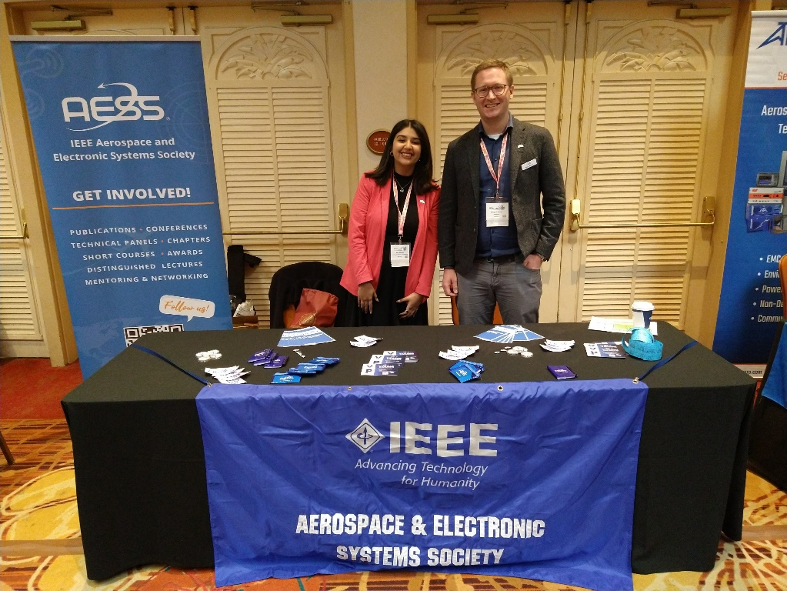
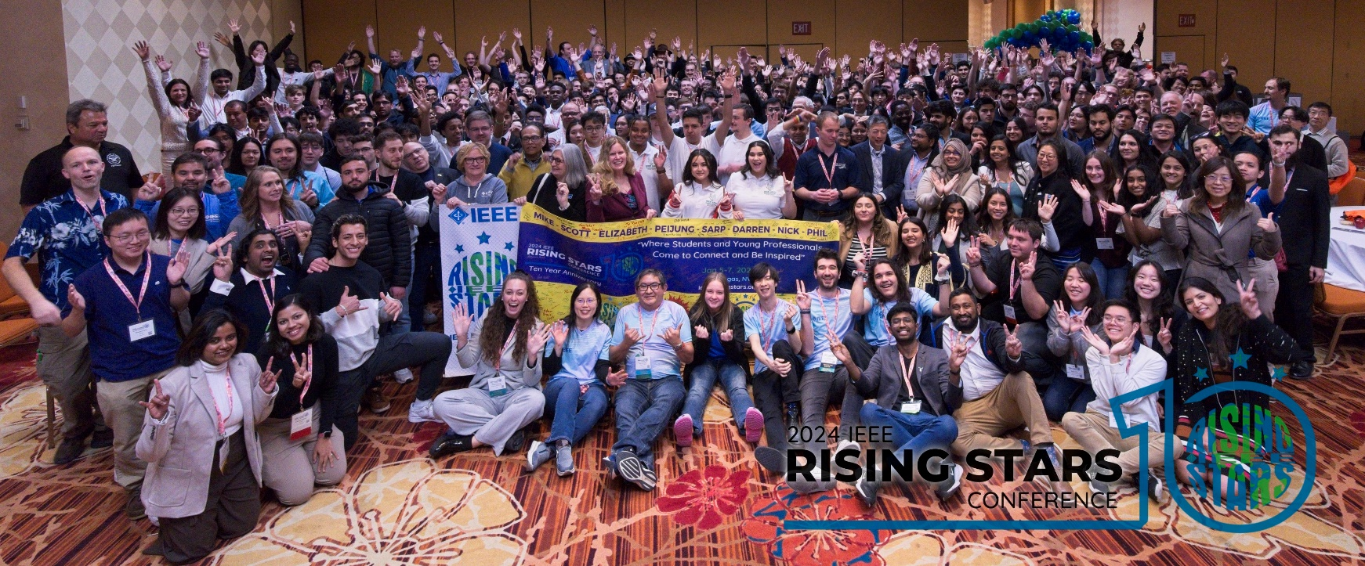
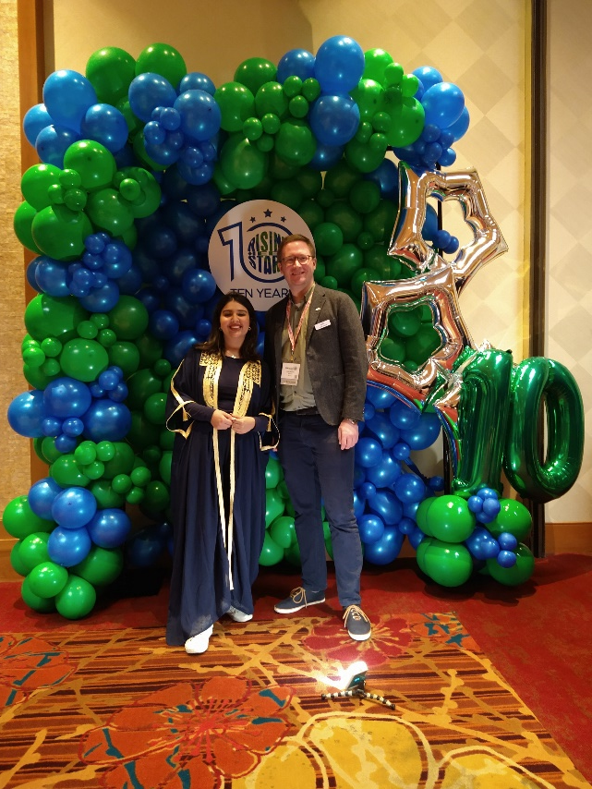
Update on activities 2024
IEEE Rising Stars 2024:
January 5-7, Las Vegas, NV, USA.
Sponsorship from AESS.
Attendance: Philipp Markiton and Abir Tabarki
QEB article.

Slide 3
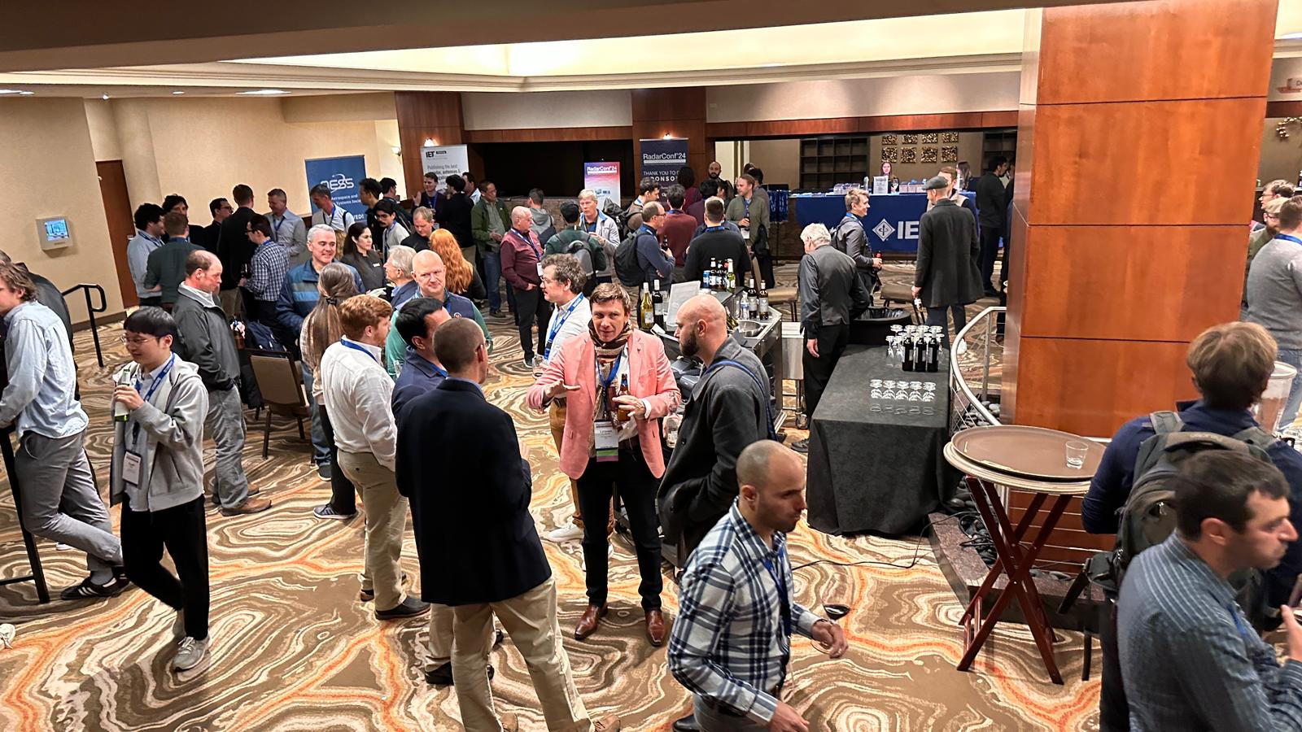
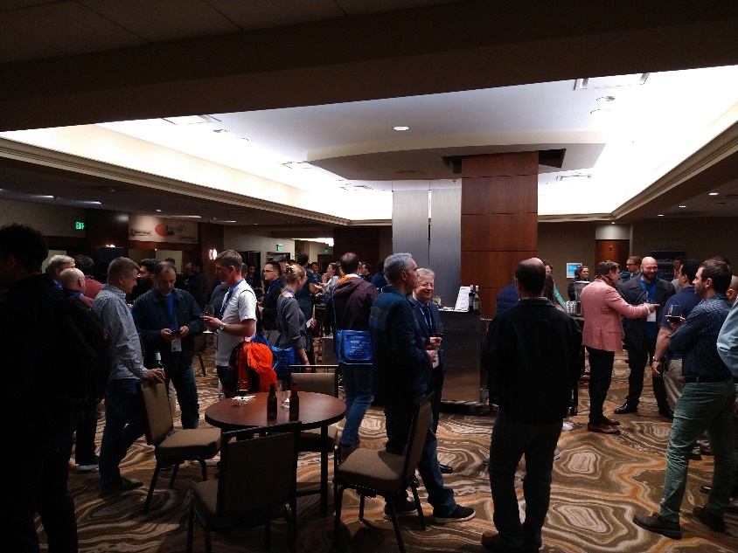
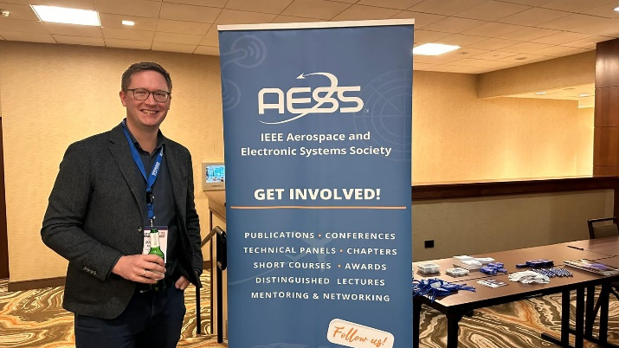
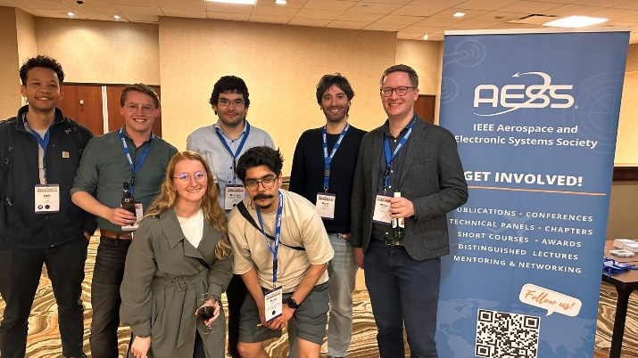
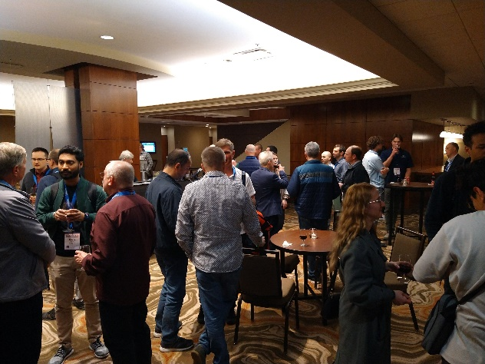
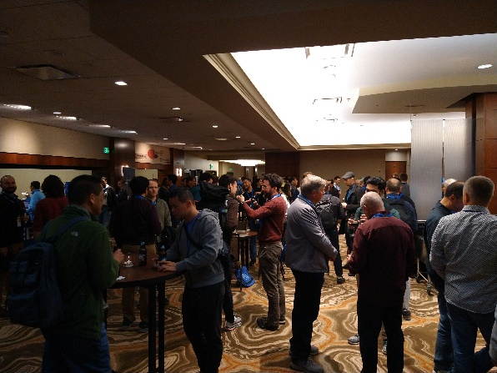
Update on activities 2024
YP event at IEEE Radarconf 2024 in Denver, CO, USA:
Monday, May 6.
High attendance, many YPs.
Great networking!
Before networking…
After networking!!

Slide 4
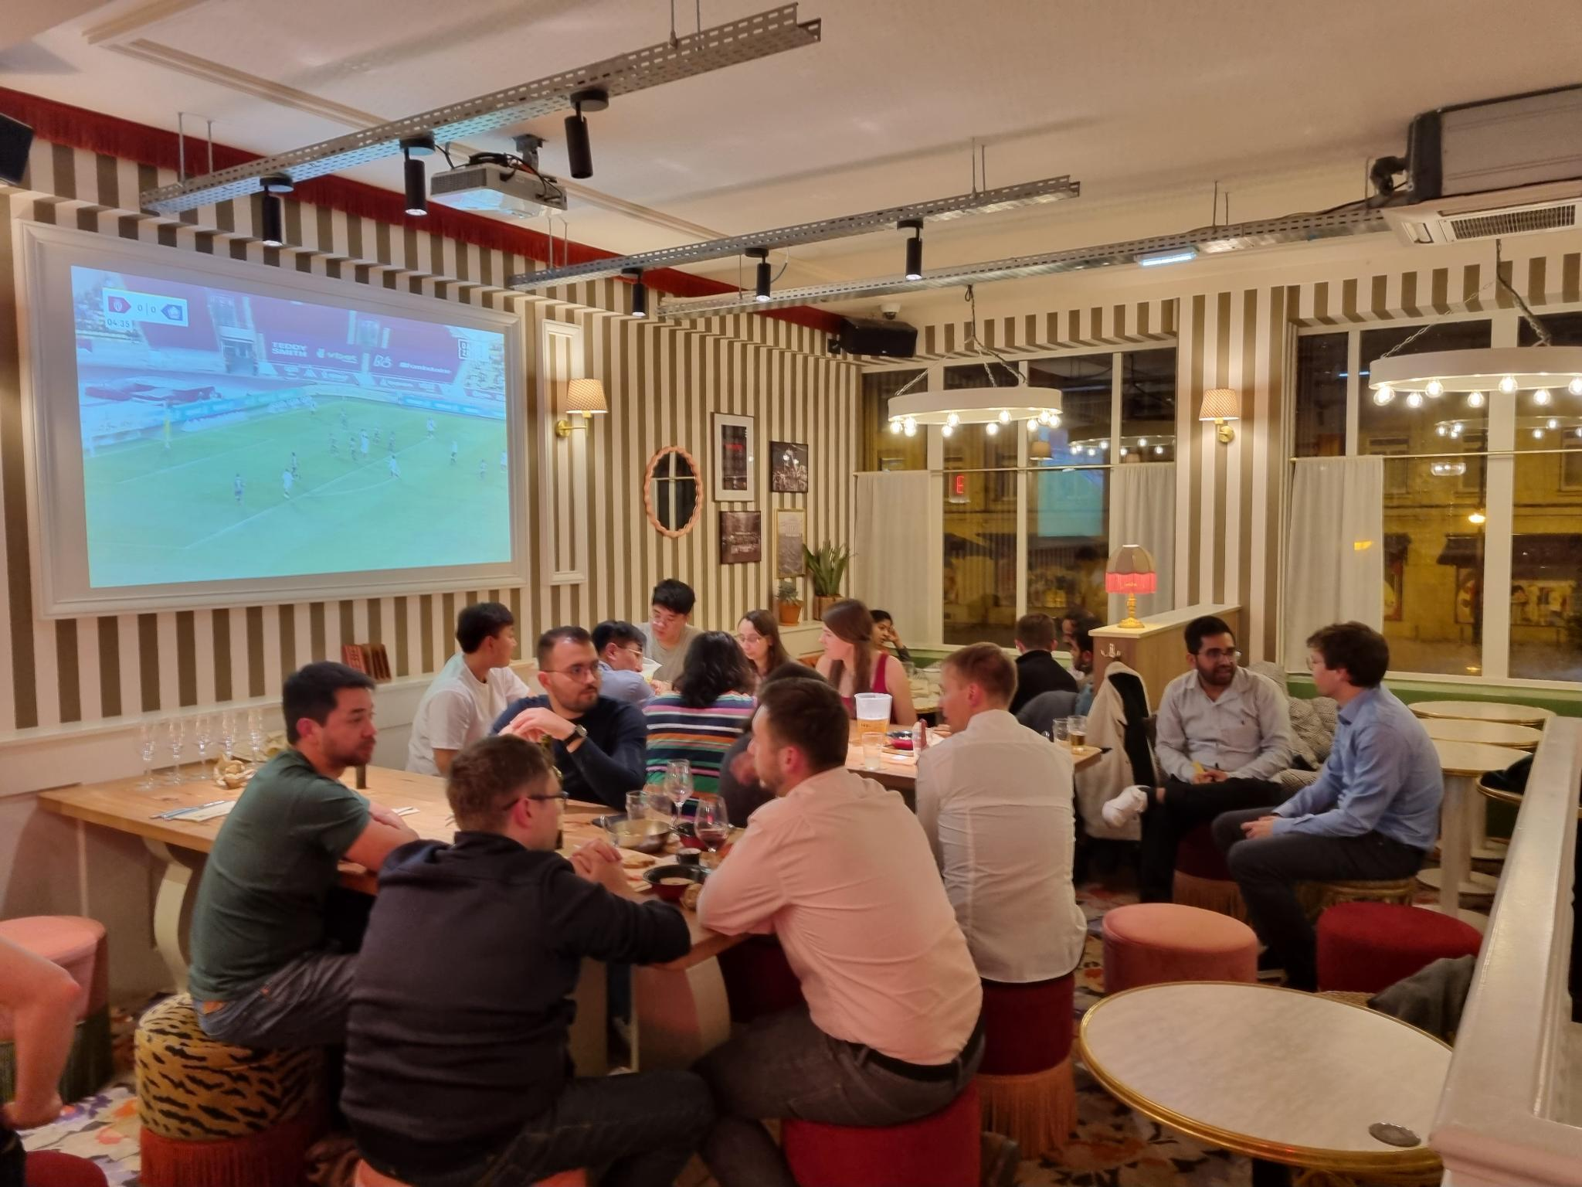
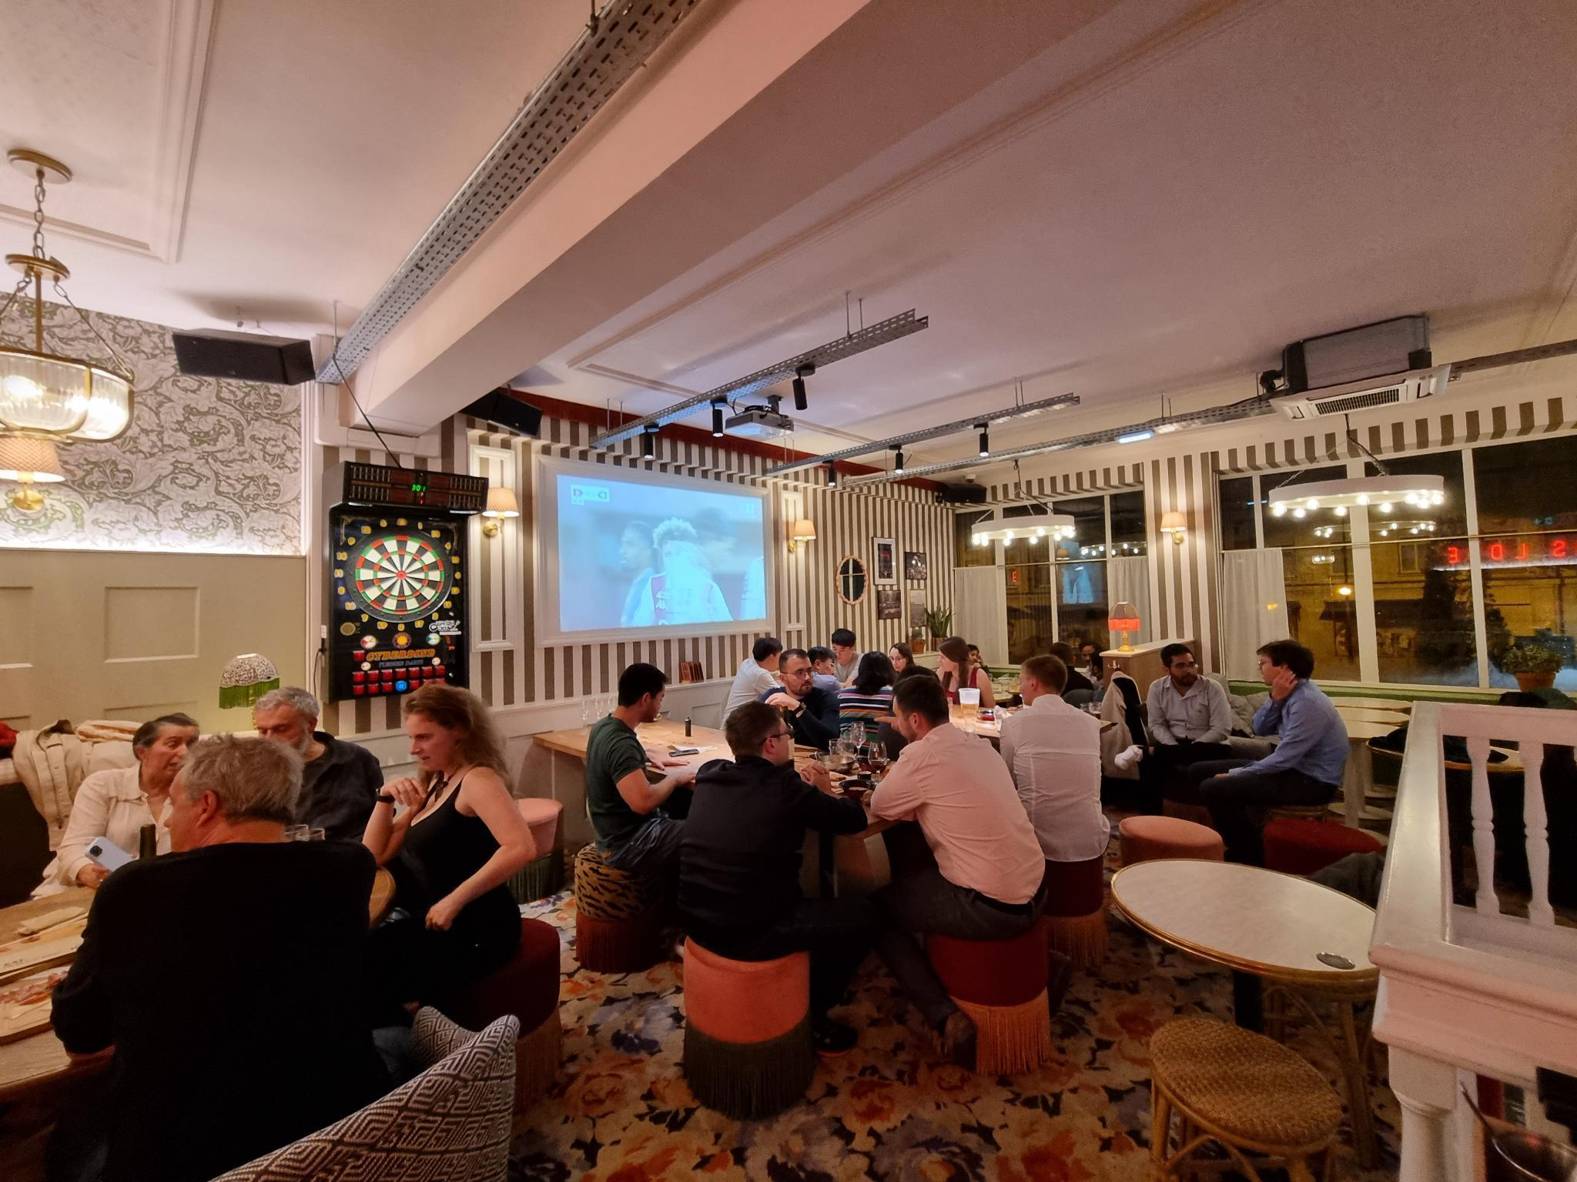
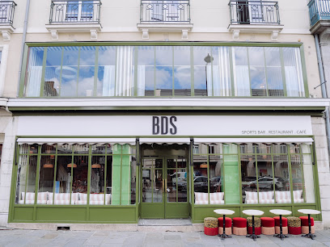
Update on activities 2024
YP event at Int. Conference Radar 2024:
Sunday, 20-Oct-2024.
At restaurant BDS
Pierre-Auguste Renoir, Le Moulin de la Galette, 1876, Musée d'Orsay, Paris

Slide 5
Next…
YP event at Int. Conference Radar 2025, May 5-9, 2025:
As discussed at last meeting for conference planning:
Aimed for Sunday, May 4 2025 (After Radar Boot Camp.)
Group of YPs/students/teachers, aimed to facilitate networking for YPs.

Slide 6
Next…
IEEE Rising Stars 2025, Luxor Hot:
January 3-5, Las Vegas, NV, USA.
Sponsorship from AESS: USD 3000.
One free conference registration.
Booth space.
Bag items.
Attendance?
New YP rep?!
Booth:
AESS Roll-up banner, flag.
Give-aways, items.

