Slide 1
IEEE Aerospace Electronic Systems DSTEI Status
Mark E Davis
2025 AESS Officer Strategic Planning Meeting
28 February – March 1, 2025
Big Sky, Montana, USA

Slide 2
Outline
Recent Accomplishments
Pending Action Items & Next Steps
Short-Term Goals (Select 1 to 2 Years)

Slide 3
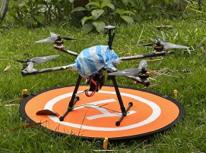
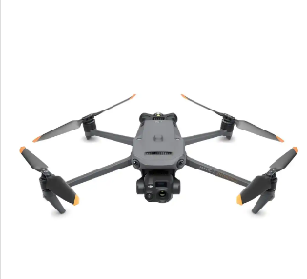
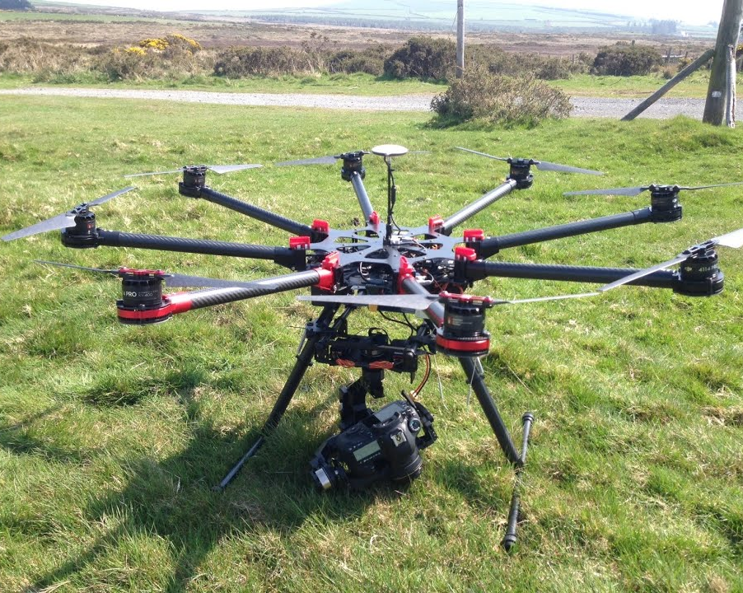
Recent Accomplishments
DSTEI Critical Design Review (CDR)
UNSAAC, Cusco Peru 3-4 February 2025
UniCauca, Popayan Colombia 6-7 February
Virtual Quarterly Program Review (QPR)
NMIT, Bangalore, India, 14 February 2025
AESS Tutorials
Drone Tutorial – Vincent Socci
Fusion Tutorial – Stefano Coraluppi
“Day in the Life” Astronaut– Giovanna Ramirez
EO/IR Sensor Tutorial – Mark E Davis
Fire Detection Drone
Healthy Crop Drone
Fire Detection
Fire Fighting Drone

Slide 4
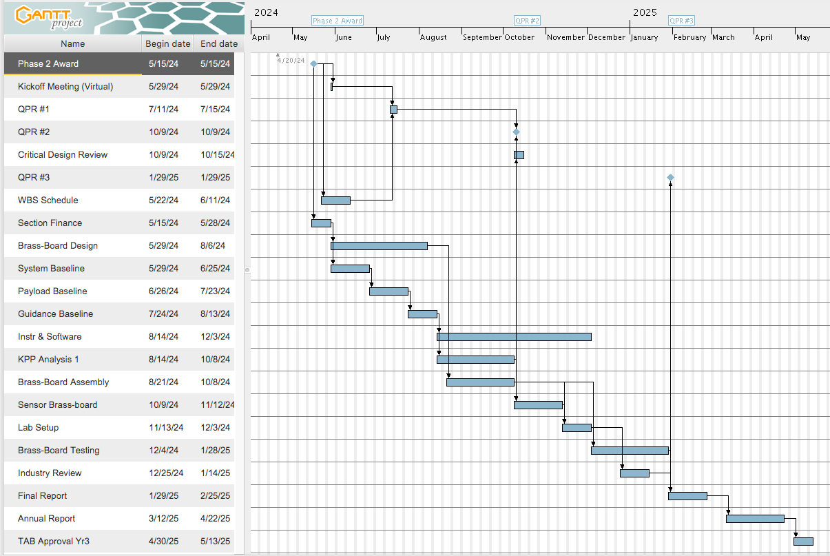
Phase 2 Master Schedule (Original)
July
February
July
Phase 3
2024
2025
Phase 2
Each SBC Phase 2 Provided WBS and Schedule Quarterly Meetings,
Final Report By 15 July And TAB Approval By September

Slide 5
Pending Action Items & Next Steps
Each Student Branch Chapter Provides:
Phase 2 Final Report by 15 July – Demonstrate Hardware/Software
Memorandum for Understanding for Transition Plan To Agent/Company
AESS Decides On Which Proceed to Phase 3 by September 2025
Business Plan For Phase 3 and Beyond
TAB Funding $25,000 For (each) Team
Transition Partner Provides ”Investment In Kind” – Funds or Personnel
Demonstrate Multiple (3) Drones In Final Test

