Slide 1
IEEE Aerospace Electronic Systems VP Member Services
Scott Goldstein
AESS 2025 Strategic Meeting
February 2025
Big Sky, MT

Slide 2
Part 1: Statistics

Slide 3
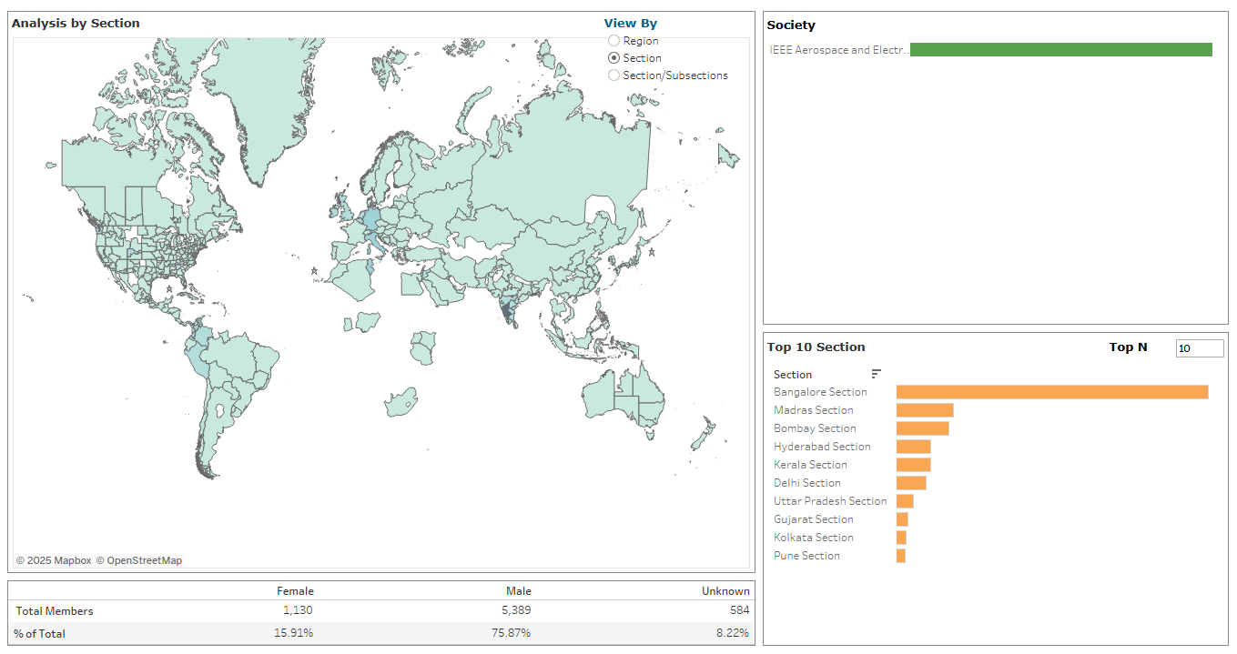
Membership Overview (Jan 2025)

Slide 4
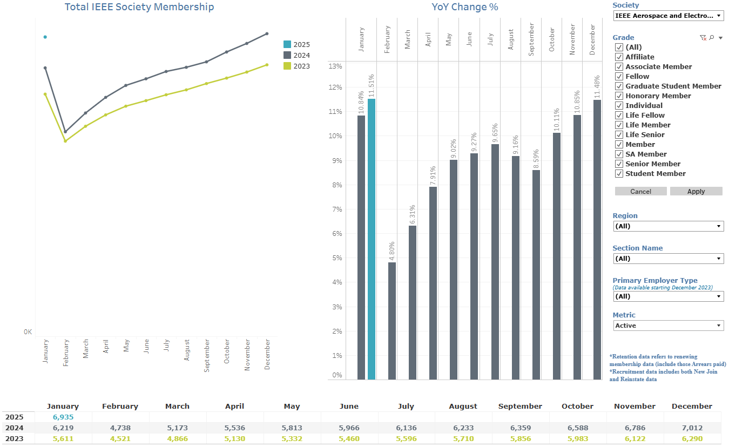
AESS Membership Monthly Statistics

Slide 5
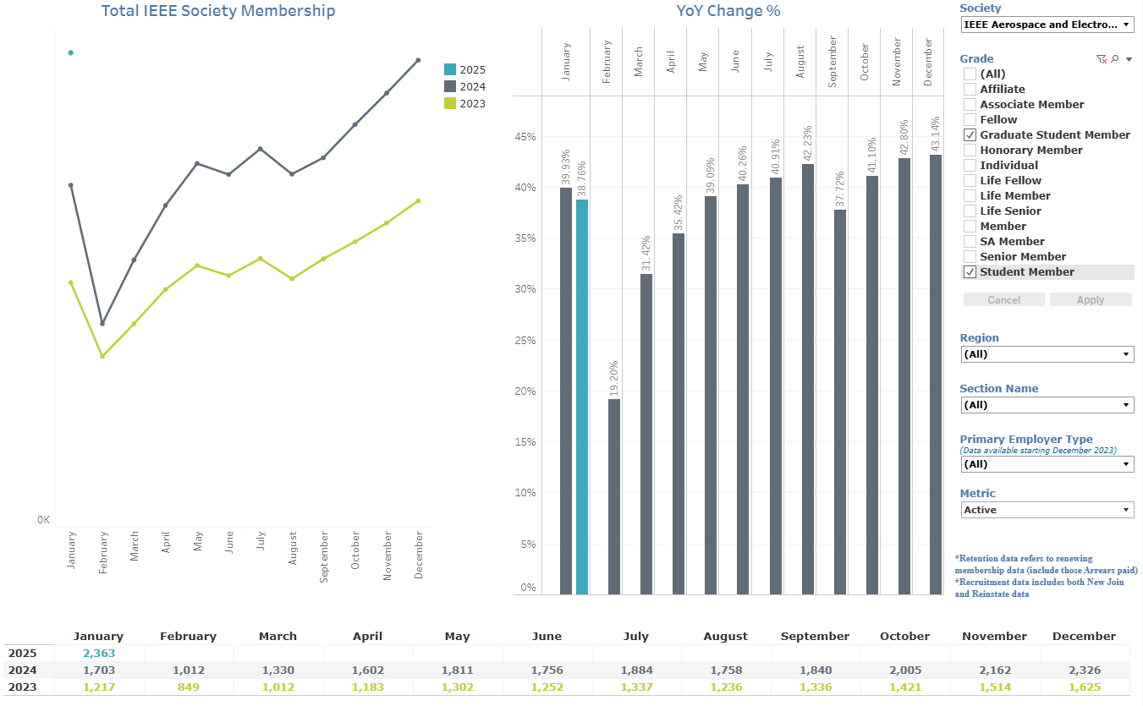
AESS Student Members Monthly Statistics

Slide 6
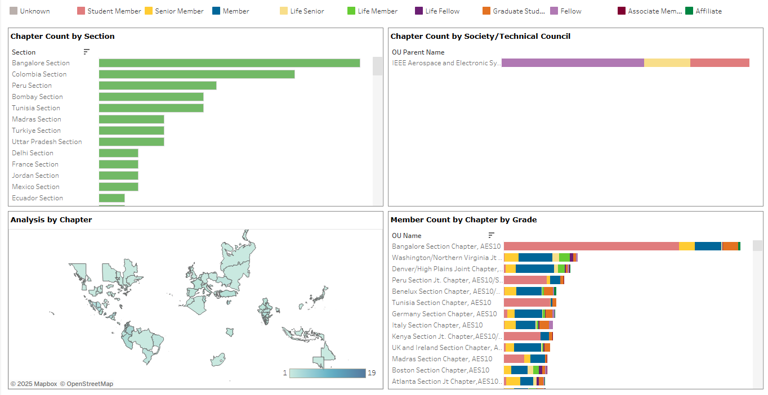
Most Populous AESS Chapters

Slide 7
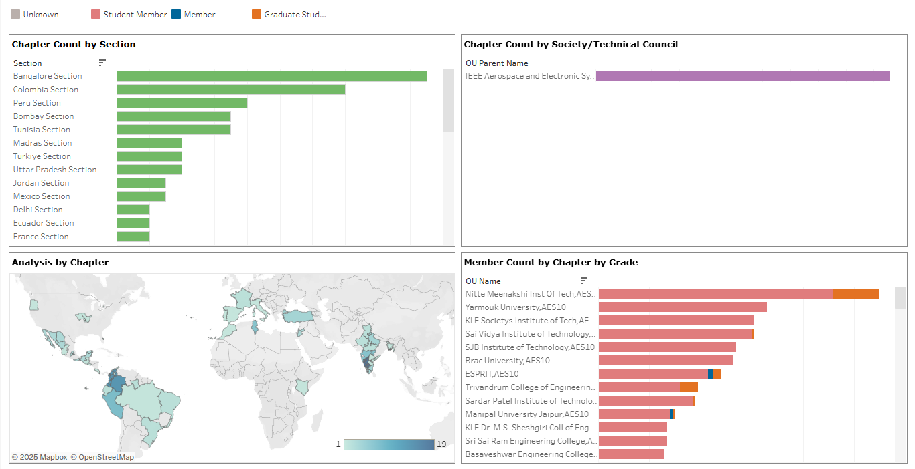
Most Populous Student Branch Chapters

Slide 8
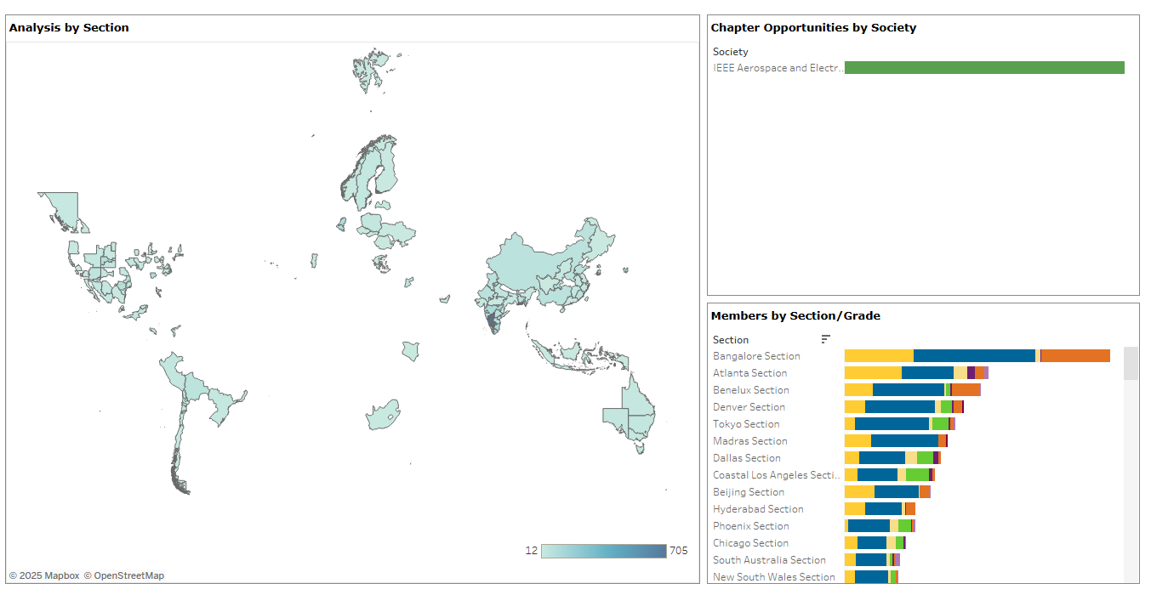
Potential New Chapter Map

Slide 9
Part 2: Strategy

Slide 10
2025 Way Ahead
I need to learn the job and the current state, being new both to the position and to the BoG.
Work closely with Lorenzo Lo Monte to ensure his past efforts in this position are fostered and chapter coordinator role is closely synchronized.
Coordinate across the BOG to effectively integrate and foster young professional and student activities at the Chapter, Section and Society levels.
Study and implement ways to improve membership through recruitment and retention.
Initiate contact and work with the existing chapters while encouraging the formation of new chapters

