Slide 1
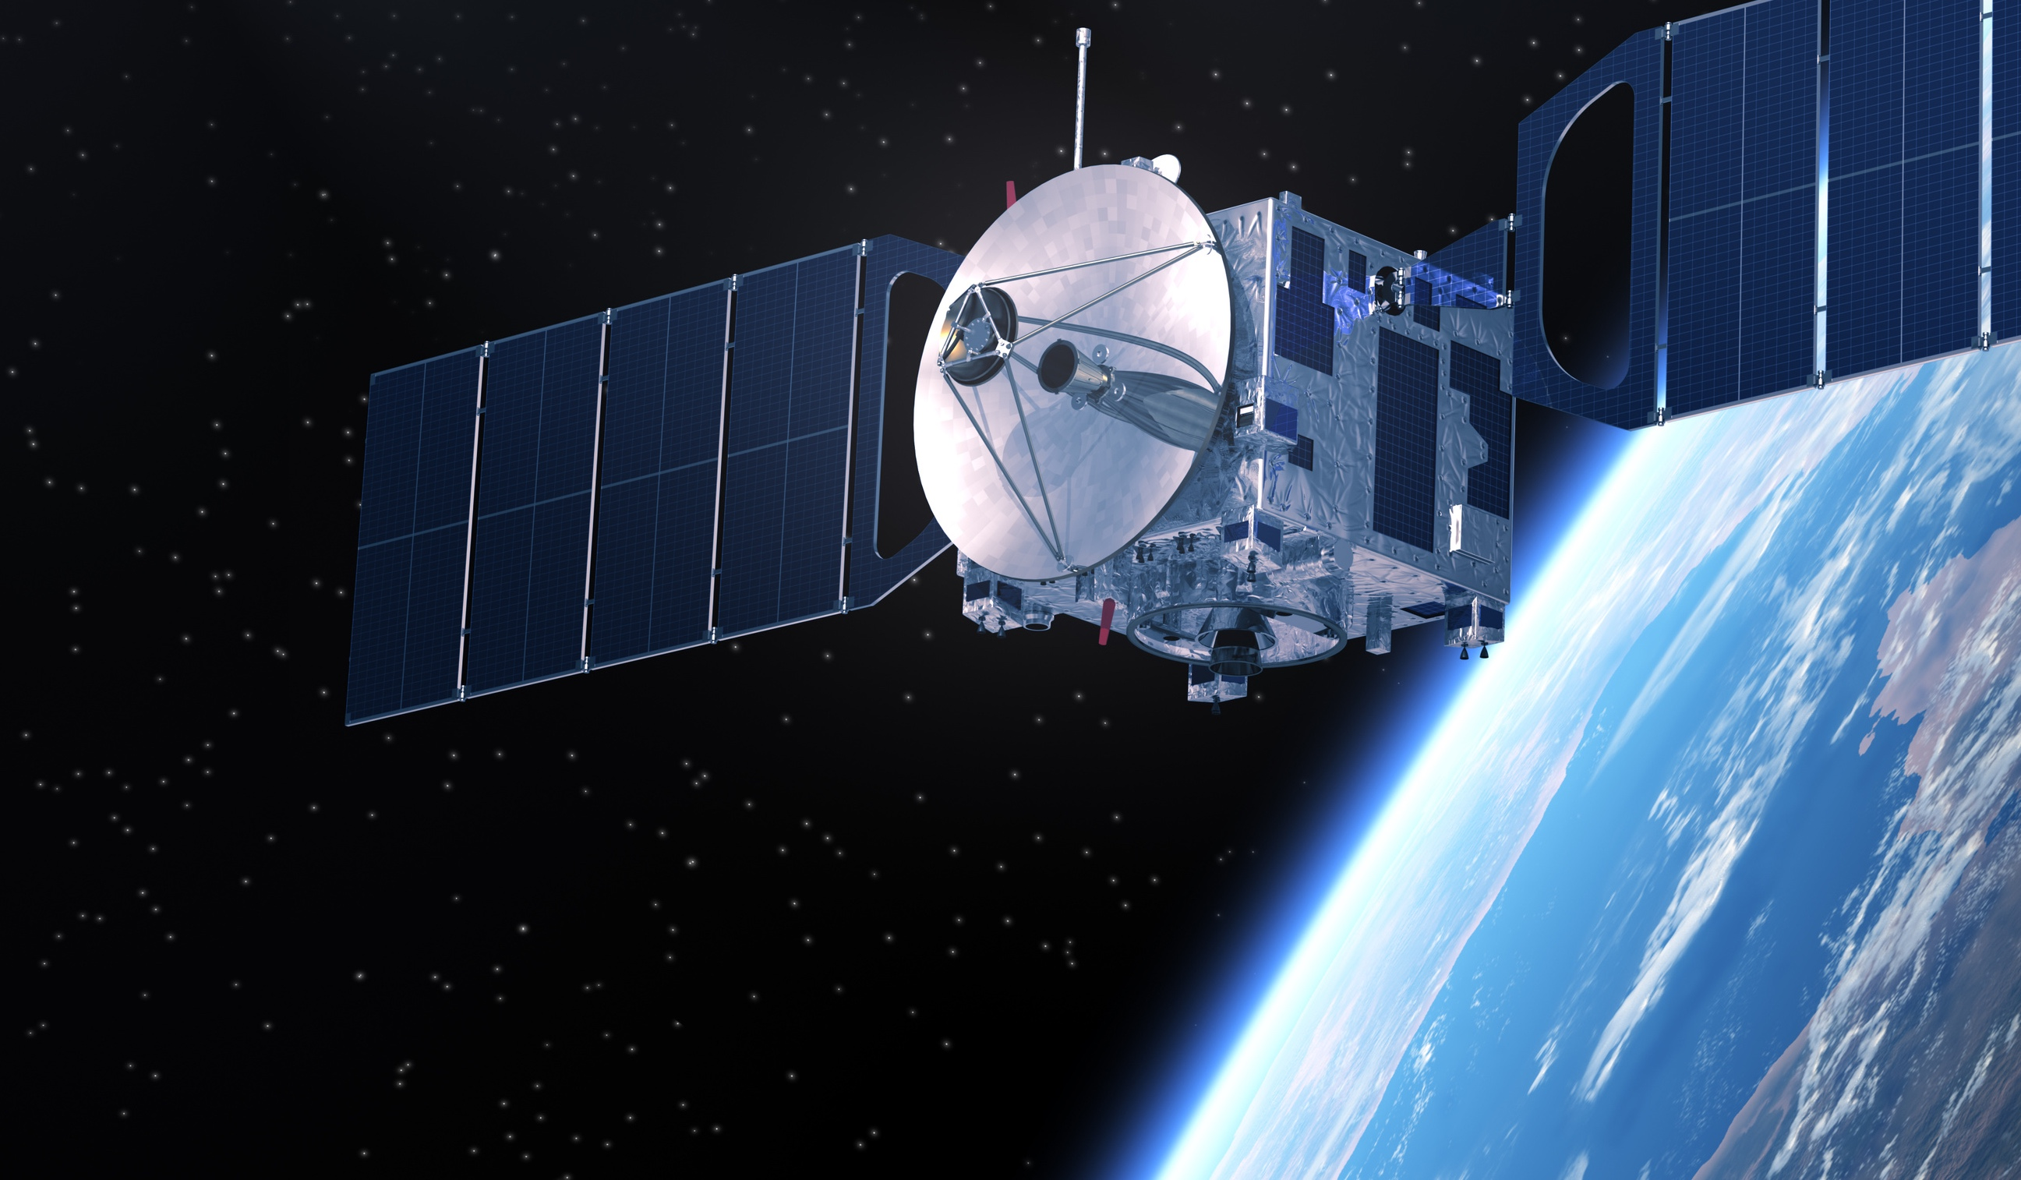
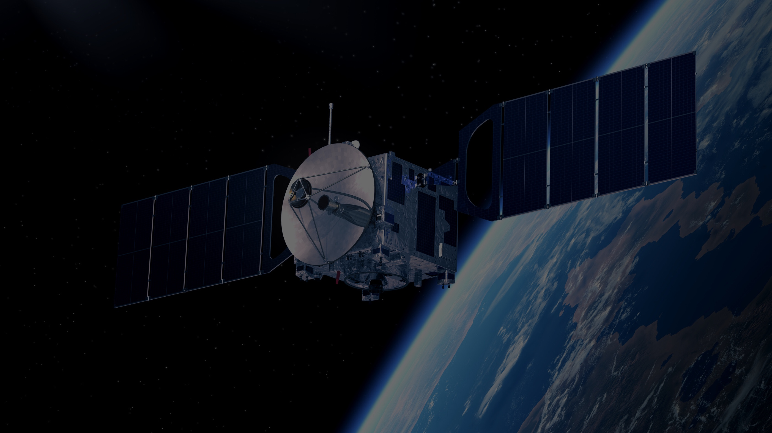
IEEE AEROSPACE AND ELECTRONIC SYSTEMS SOCIETY
ieee-aess.org

Slide 2
Field of Interest
The organization, systems engineering, design, development, integration, and operation of complex systems for space, air, ocean, or ground environments. These systems include but are not limited to navigation, avionics, mobile electric power and electronics, radar, sonar, telemetry, military, law-enforcement, automatic test, simulators, and command and control.

Slide 3
About AESS
Comprised of professionals who share your technical interests, joining AESS allows you to deepen ties to your technical community and take advantage of specialized opportunities.
Conferences
AESS financially and technically sponsors and co-sponsors over 30 conferences. Members are encouraged to submit papers, attend the conference, and network with your colleagues in your area of interest.
Publications
AESS sponsors and co-sponsors publications that provide differing levels of technology, invention and information to readers.
Technical Panels and Community
The creation of IEEE Standards, support of IEEE Conferences, and building a technical community are a primary responsibilities of the 6 AESS technical panels.

Slide 4
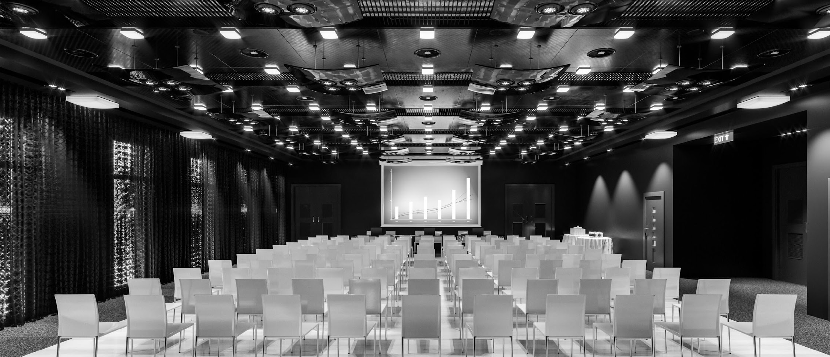
Conferences
AESS Financially and Technically Sponsors 30 Conferences Annually
AESS Members receive discounts to sponsored conferences. Visit the AESS website for a full listing of sponsored conferences.
Promotes interdisciplinary understanding of aerospace systems and applications for gov/commercial.
The preeminent R&D conference in the field of digital avionics offered.
Brings together around 800 aerospace automatic test industry and gov/military attendees.
Promotes radar engineering and hosts technical sessions, tutorials, and student challenges.
Montana, USA
Montreal, Canada
Maryland, USA
Krakow, Poland
7-14 March 2026
14-18 Sept. 2025
15-18 Sept 2025
4-10 October 2025

Slide 5
Publications
AESS sponsors and co-sponsors publications that provide differing levels of technology, invention and information to the AESS readers
Featured Publications
Transactions on Aerospace and Electronic Systems
Aerospace and Electronic Systems Magazine
Co-Sponsored Publications
Open Journal of Systems Engineering
Journal on Miniaturization for Air and Space Systems
Journal of Lightwave Technology
Transactions on Radar Systems
Quarterly Email Blast (QEB)
Provides members with up-date-news and Information on the Society's activities and Initiatives In their Inboxes.

Slide 6
100+
Distinguished Lecturers Program
In-Person and Online Lecturers
DL talk titles to choose from in a variety of technical fields
AESS Chapters and IEEE Sections are encouraged to take advantage of the AESS Distinguished Lecturer and Tutorial Program for their regular or special meetings, that allows them to select from an outstanding list of truly distinguished speakers who are experts in the technical fields of the society.
40
available DLs providing lectures online and in person at your next meeting, chapter event, and more
Education
Focused on providing technical content in-person and online to our members
Short Courses
While the desire is for short courses to be in-person and open to all members, they may be run virtually or exclusively to a specific company. To date, short courses have been run on four different continents, with a mixture of openly run in-person, virtual and exclusive offerings.
Online Library
180+ available recordings to watch on the IEEE Learning Network and growing!

Slide 7
TECHNICAL PANELS
Avionics Systems Panel
Cyber Security Panel
addresses avionics systems for aircraft systems supporting commercial, military, and general aviation operations
supports cyber security technical interests, technical articles and conference activities, and educational activities
Glue Technologies for Space Systems
Gyro and Accelerometer Panel
focused on technologies necessary for innovative systems based on Space components deployed in the near future
creates standards for components and systems for detection or measurement of linear or angular motion
Navigation Systems Panel
Radar Systems Panel
addresses navigation systems for aircraft, spacecraft, ground and marine vehicles and pedestrians
promotes and supports publications, education, standards, and other activities in the domain of Radar

Slide 8
Member Services
7,000+ AESS Members in 2025
Awards
AESS has 16 awards recognizing our members for their contributions to publications, conferences, and technical achievements.
Chapters
AESS has over 185 chapters and student branch chapters from around the world representing IEEE's 10 regions.
Mentoring
Connecting distinguished, International members from academia, government, and industry connect with students and Young Professionals.
AESS also offers scholarships for undergraduate and graduate-level students; and supports the Radar Summer Schools, boot camps, and challenges; and YP in Space, and Rising Stars conference.
Students/YP

Slide 9
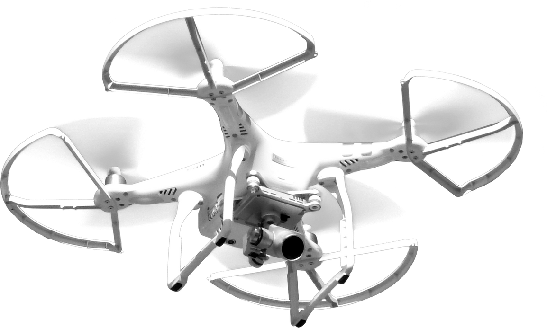
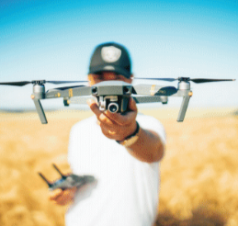
DSTEI
Distributed Sensing Technology and Education Iniatives
3-Year Initiative for Underrepresented Regions
New businesses that support commercial growth in distributed sensing technology
Increase AESS membership
Courses for engineering growth in regional aerospace technology Encourage YP and small businesses to establish technical and sustainable products
Expect to Grow Technical Capabilities
Focus on small drones, cyber security, and distributed sensing (Radar/EO/Data Fusion) for future commercial applications within geoscience and border security
Significant increase in students and YP for Region 10
Encourage industry support and development of new technology courses

Slide 10
2025 Officers
President – M. Sabrina Greco
President Elect – Braham Himed
Past President – Mark E. Davis
VP Conferences – Lorenzo Lo Monte
VP Publications – Luke Rosenberg
VP Education – Puneet Kumar Mishra
VP Finance – Michael Noble
VP Member Services – Scott Goldstein
VP Technical Operations – Rob Sabatini
VP Industry Relations – Barry Tilton
Secretary – Walter D. Downing
Treasurer – Fulvio Gini
Contact Us
www.ieee-aess.org
admin@ieee-aess.org

