Slide 1
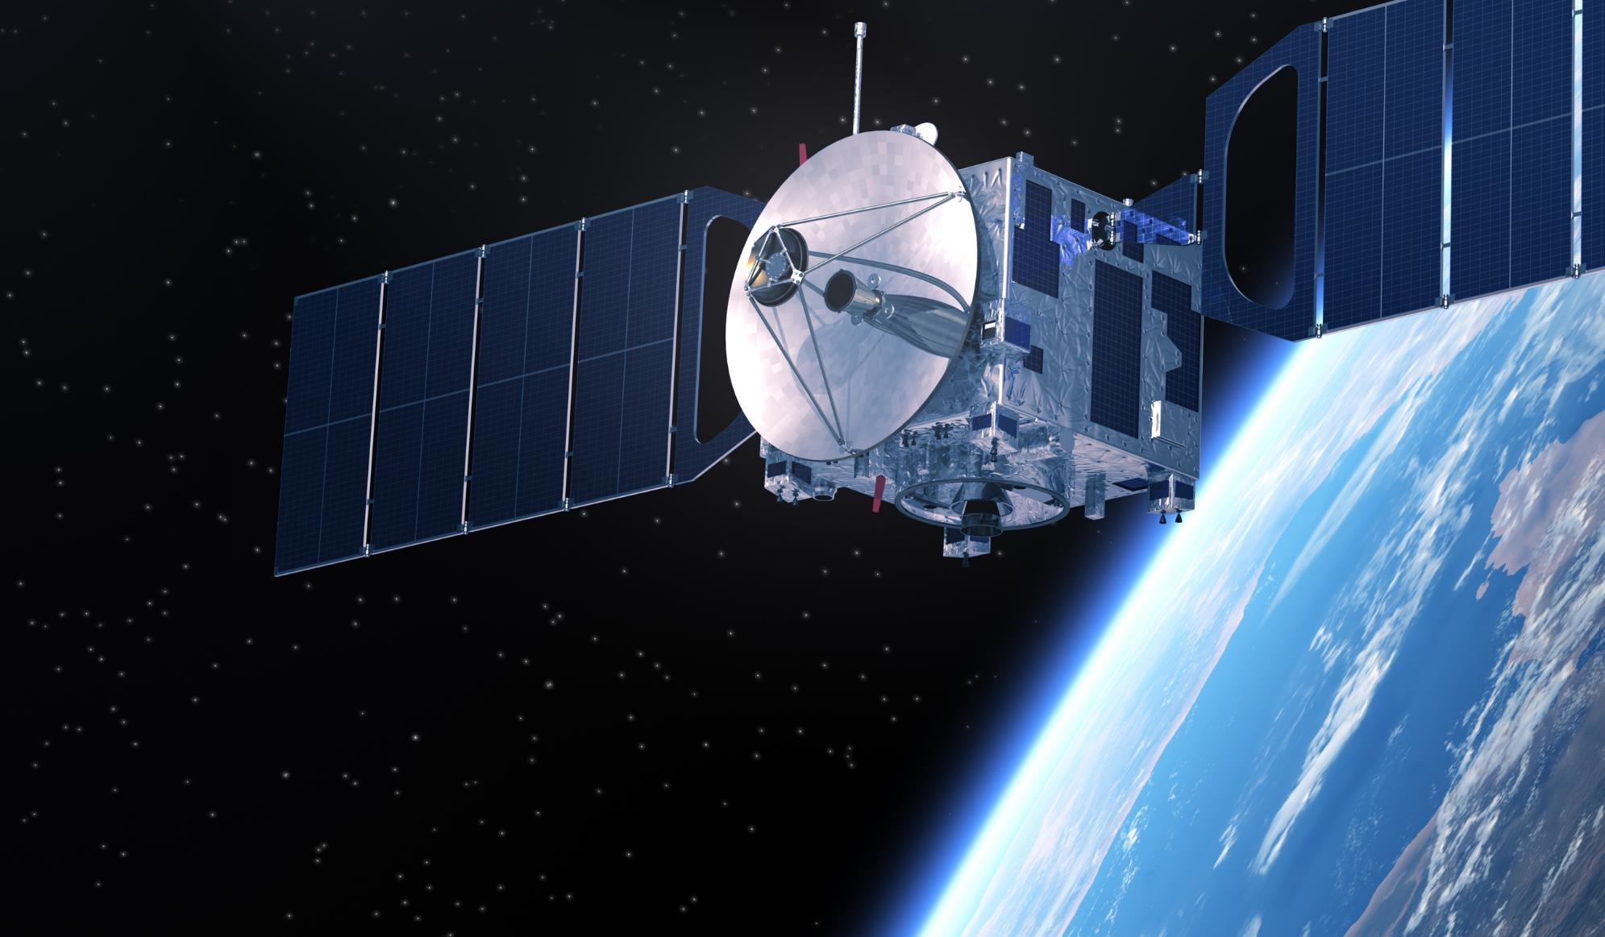
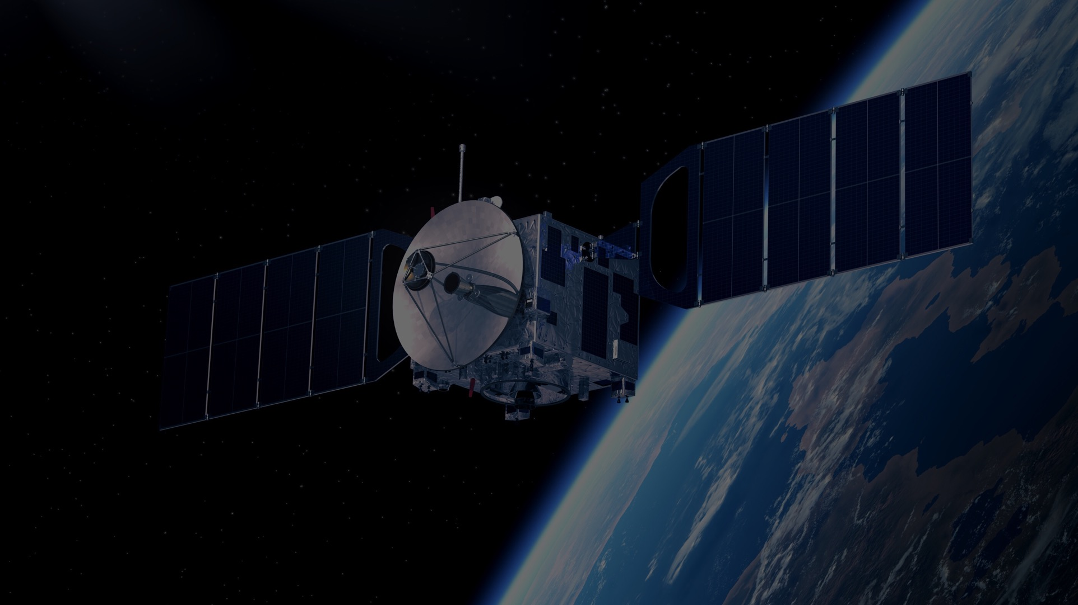

IEEE AEROSPACE AND ELECTRONIC SYSTEMS SOCIETY
ieee-aess.org

Slide 2




Field of Interest
The organization, systems engineering, design, development, integration, and operation of complex systems for space, air, ocean, or ground environments. These systems include but are not limited to navigation, avionics, mobile electric power and electronics, radar, sonar, telemetry, military, law-enforcement, automatic test, simulators, and command and control.

Slide 3









About AESS
Comprised of professionals who share your technical interests, joining AESS allows you to deepen ties to your technical community and take advantage of specialized opportunities. AESS has over 7,000 members and more than 180 chapters and student branch chapters worldwide with programs like our Mentoring, Students, and Young Professionals to increase engagement and membership.
Conferences
Member Services
Publications
Education
Technical Panels
Awards
Notes:
Conferences: AESS financially and technically sponsors and co-sponsors over 30 conferences. Members are encouraged to submit papers, attend the conference, and network with your colleagues.
Publications: AESS sponsors and co-sponsors publications that provide differing levels of technology, invention and information to readers.
Technical Panels and Community: The creation of IEEE Standards, support of IEEE Conferences, and building a technical community are a primary responsibilities of the 6 AESS technical panels.
Member Services: AESS has over 7,000 members and more than 180 chapters worldwide with programs like our Mentoring, Students, and Young Professionals to increase engagement and membership.
Education: Provide technical content in-person and online to our members through the Distinguished Lecturers Program and Short Courses.
Awards: AESS has 18 awards recognizing our members for their contributions to publications, conferences, and technical achievements and two scholarships for undergraduate and graduate students.

Slide 4

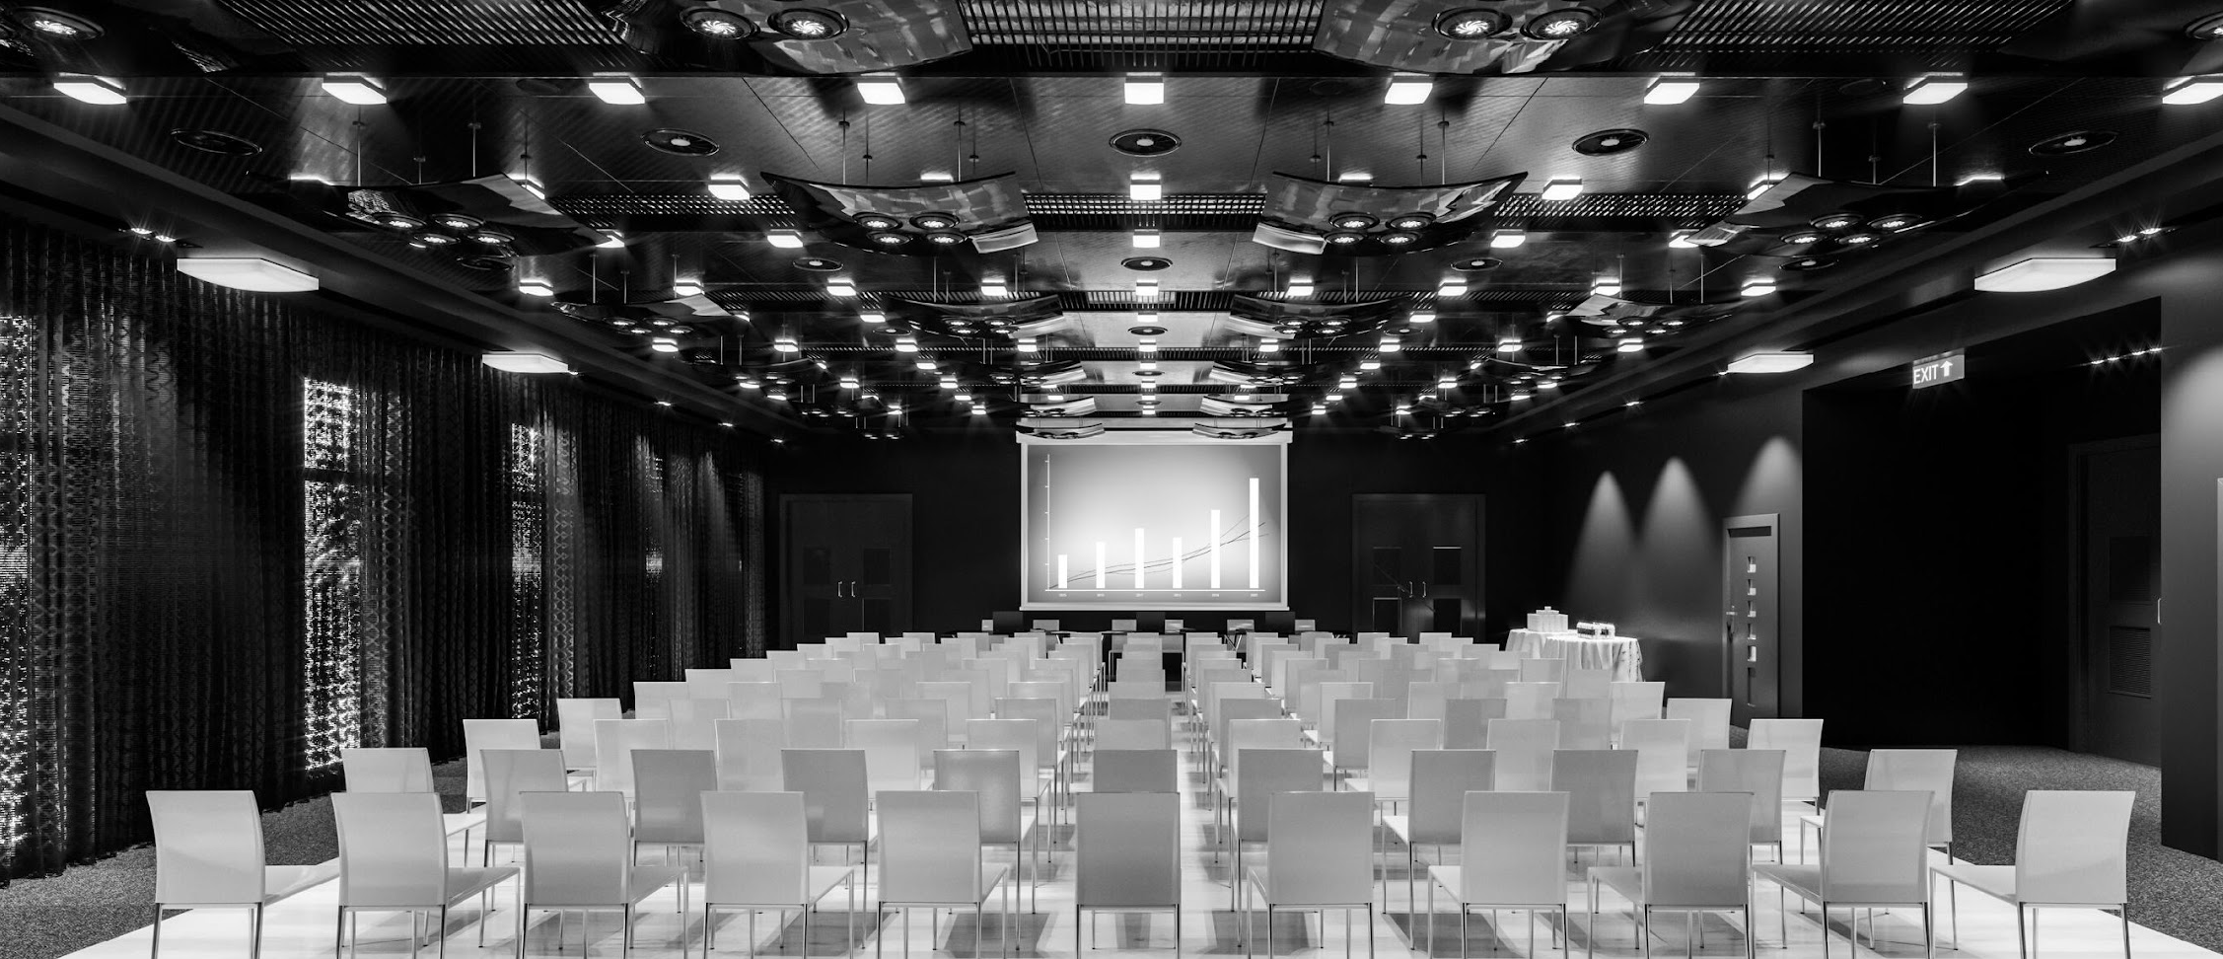


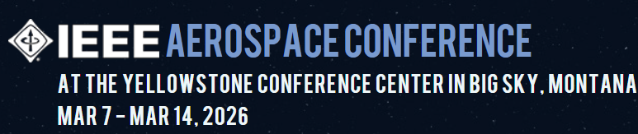



Conferences
AESS Financially and Technically Sponsors 30 Conferences Annually
AESS Members receive discounts to sponsored conferences.
Visit the AESS website for a full listing of sponsored conferences.
Promotes interdisciplinary understanding of aerospace systems and applications for gov/commercial.
The preeminent R&D conference in the field of digital avionics offered.
Brings together around 800 aerospace automatic test industry and gov/military attendees.
Promotes radar engineering and hosts technical sessions, tutorials, and student challenges.
Montana, USA
Montreal, Canada
Maryland, USA
Krakow, Poland
7-14 March 2026
14-18 Sept. 2025
15-18 Sept 2025
4-10 October 2025

Slide 5





100+
Distinguished Lecturers Program
In-Person and Online Lecturers
DL talk titles to choose from in a variety of technical fields
AESS Chapters and IEEE Sections are encouraged to take advantage of the AESS Distinguished Lecturer and Tutorial Program for their regular or special meetings, that allows them to select from an outstanding list of truly distinguished speakers who are experts in the technical fields of the society.
40
available DLs providing lectures online and in person at your next meeting, chapter event, and more
Education
Focused on providing technical content in-person and online to our members
Short Courses
While the desire is for short courses to be in-person and open to all members, they may be run virtually or exclusively to a specific company. To date, short courses have been run on four different continents, with a mixture of openly run in-person, virtual and exclusive offerings.
Online Library
165+ available recordings to watch on the IEEE Learning Network and growing!

Slide 6




2025 Officers
President – M. Sabrina Greco
President Elect – Braham Himed
Past President – Mark E. Davis
VP Conferences – Lorenzo Lo Monte
VP Publications – Luke Rosenberg
VP Education – Puneet Kumar Mishra
VP Finance – Michael Noble
VP Member Services – Scott Goldstein
VP Technical Operations – Rob Sabatini
VP Industry Relations – Barry Tilton
Secretary – Walter D. Downing
Treasurer – Fulvio Gini
Contact Us
www.ieee-aess.org
admin@ieee-aess.org

Slide 7

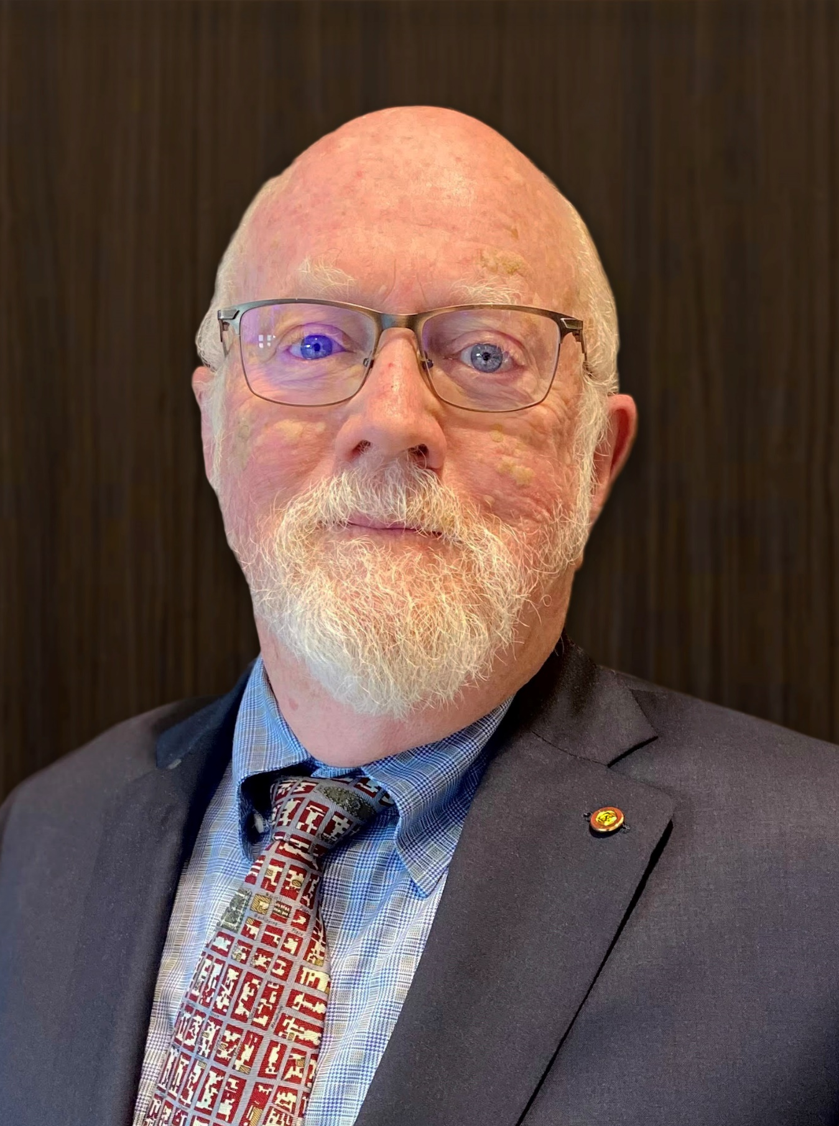

AESS Distinguished Lecturer
Mark E. Davis
Independent Consultant
Foliage Penetration Radar
Watch on the IEEE Learning Network

Slide 8
Biography
Mark Davis has over 45 years experience in Government and Industry in developing technology and systems for Radar and Electronic Systems. In 2008 he established medavis consulting as a Sole Proprietorship, to assist in review and development of advanced sensor systems, with customers in Government, Industry and Small Businesses. He held senior management positions at DARPA as Deputy Director Information Exploitation Office (2006-08), Technical Director for Air Force Research Laboratory Space Based Radar Technology (1998-2006) and Program Manager in DARPA Information Systems Office for Counter CC&D technologies (1995-1998). Dr Davis also had senior Engineering and Program Management positions with General Electric Aerospace, and General Dynamics Missile Systems. His interests are in Radar and microwave system design, phased array antennas and adaptive signal processing. Dr Davis is a Life Fellow of the IEEE, a Fellow of the Military Sensing Symposia, and Chair of the IEEE Radar Systems Panel. Within the IEEE Aerospace and Electronics Systems Society, he has been a member of the Board of Governors (2008-2013) holding positions of VP of Conferences (2010-2012) and VP of Finance (2013). Dr Davis is currently serving on the US Air Force Scientific Advisory Board, and is a member of the NASA review board on earth resource monitoring. He has received a PhD in Physics from The Ohio State University, and Bachelor and Masters Degrees in Electrical Engineering from Syracuse University. In addition to these technical duties, he has published over 75 journal and conference papers on Radar and Microwave Systems. More recently, he has authored a book Foliage Penetration Radar - Detection and Characterization of Objects under Trees published by Scitech Publishing in March 2011, and a Chapter on Principals of Modern Radar on FOPEN.

