Slide 1
Glue Tech for Space Systems Panel Report to BoG TechOps Panel
Claudio Sacchi
Chair, Glue Technologies for Space Systems
AESS Board of Governors Meeting – Fall 2024
25-26 October 2024
Rennes, France

Slide 2
Glue Technologies for Space Systems
About the ”Glue Tech” panel:
The Glue Technologies for Space Systems (Glue-Tech) is composed by members who are representatives of industry, research laboratories, educational institutions and professional societies, and who are active in the domain of future Space systems, where Space communications are regarded as the “glue” for a new interconnected world. The panel aims to:
Promote the coordination of the technical activities related to the technologies that constitute the necessary common platform for innovative Space Systems.
Promote and support publications concerning the panel topics;
Organize panels and special sessions in featured-topic conferences.
Promote educational activities.
Encourage the submission of nominations for IEEE Fellows and Senior Members in the fields of interest of the panel.
Manage the nomination and selection of candidates for IEEE Awards in the fields of interest of the panel.
Create of communities and forums cooperating in the development of panel technical activities.

Slide 3
Glue Technologies for Space Systems
Panel (updated) membership
So far, the panel accounts 42 members, distributed in terms of geography, affiliation and fields of interest as follows (picture updated on: October 2024):

Slide 4
Glue Technologies for Space Syst. - Summary of Activities
Organization and presentation of the special session 4.03: “Next Generation Space Systems: AESS GLUE” at IEEE Aerospace Conference 2024 (Big Sky, MT, March 2-9, 2024)
Organization and presentation of the special track: “Criteria and Technologies for the Development of a New Space Ecosystem (CASTAWAYS)” at IEEE MetroAeroSpace Workshop 2024 (Lublin, Poland, June 3-5, 2024).
Organization of the Summer School: “Frontier Technologies for Space 2.0 Communications”, organized online, September 2-6, 2024.
Spring panel meeting, organized online on June 11, 2024.

Slide 5
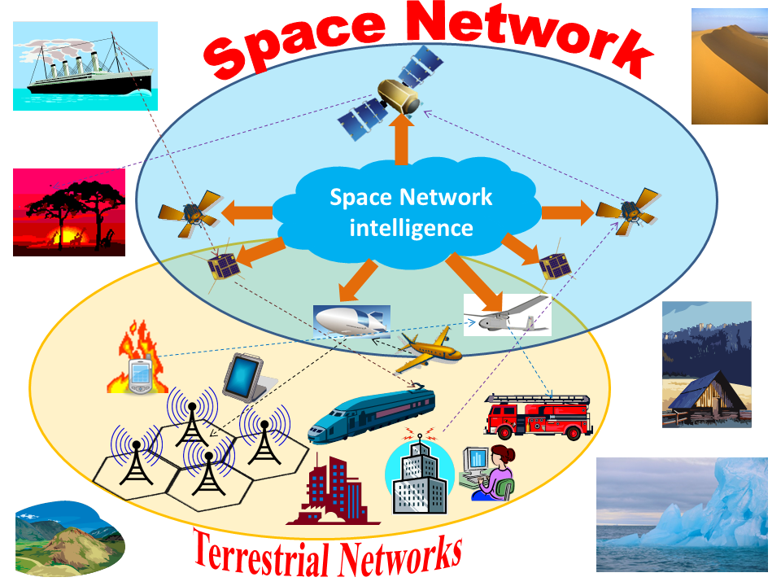
Glue Technologies for Space Systems - 2024 EOY Report
Research and Innovation
7) Integrated communications, navigation and sensing
8) Advanced signal processing and data fusion techniques for Space applications
9) Interplanetary and extra-terrestrial networking
Lunar communications
Martian communications
1) Broadband space transmissions:
Multibeam satellites, EHF for satellite transmission
Free-space optical links for IOL, optical satellites
2) Softwarization of Space networking:
Software Defined Radio, Software Defined Networking, AI in the Space
Cloud-RAN in the Space, Resource virtualization
3) Internet of Remote Things and Internet of Space Things:
Using also small satellites and CubeSats;
4) Seamless integration of intelligent aerial networks and with cognitive and softwarized sky networks:
Multi-layered integrated Terrestrial—Non-Terrestrial Networks (T-NTN) in the framework of “6G and beyond”
5) Augmented 3D reality for manned exploration missions (e.g.: on Mars)
Digital Twin for emulating extra-terrestrial environments.
6) End-to-end system considerations for Space systems
GLUE TECHNOLOGY is inside the Space-networked intelligence and the (true) seamless integration with terrestrial networks

Slide 6
Glue Technologies for Space Systems - 2024 EOY Report
Conference Contributions
Organization and presentation of the special session 4.03: “Next Generation Space Systems - AESS GLUE” at IEEE Aerospace Conference 2024 (2 presented papers).
Organization of the above-mentioned session also for the edition 2025.
Chairing and co-chairing of the following sessions of IEEE Aerospace Conference (2024 and 2025 editions):
4.09
4.10
4.11
Organization and presentation of the special track “Criteria and Technologies for the Development of a New Space Ecosystem (CASTAWAYS)” at the IEEE MetroAeroSpace Workshop 2024 (Lublin, Poland, 3-5 June 2024) (6 presented papers).

Slide 7
Glue Technologies for Space Systems - 2024 EOY Report
Publication Activities
The following conference papers with the acknowledgment of the “Glue-Tech” technical panel have been published in 2024:
L. Valcarenghi, C. Sacchi et al., "5G New Radio Techniques for 3D Networks in Connection-critical Scenarios," 2024 IEEE Aerospace Conference, Big Sky, MT, USA, March 2024, pp. 1-9.
H. B. Tsegaye and C. Sacchi, "MEC-based Experimental Framework for Service Availability in 3D Non-Terrestrial Networks," 2024 IEEE Aerospace Conference, Big Sky, MT, USA, March 2024, pp. 1-10.
T. F. Rahman, V. Marojevic and C. Sacchi, "An Advanced MIMO Multicarrier Framework for NTN-Based 5G Broadcast/Multicast Transmissions," 2024 11th International Workshop on Metrology for AeroSpace (MetroAeroSpace), Lublin, Poland, June 2024, pp. 321-326.
H. B. Tsegaye and C. Sacchi, "Graph Neural Network-based C-RAN Monitoring for Beyond 5G Non-Terrestrial Networks," 2024 11th International Workshop on Metrology for AeroSpace (MetroAeroSpace), Lublin, Poland, June 2024, pp. 338-343.
D. Darsena, G. Gelli, I. Iudice and F. Verde, "A Hybrid NOMA-OMA Scheme for Inter-Plane Intersatellite Communications in Massive LEO Constellations," in IEEE Transactions on Vehicular Technology, 2024, doi: 10.1109/TVT.2024.3432170.
Y. M. Worku, P. M. Tshakwanda, H.B. Tsegaye, C. Christodoulu, M. Devetsikiotis, C. Sacchi, “Blockchain-Enhanced Security for LEO Satellite Firmware Updates in Beyond-5G NTN Networks”, IEEE CAMAD Conference, Athens (GR), 21-24 October 2024, paper accepted, in press.

Slide 8
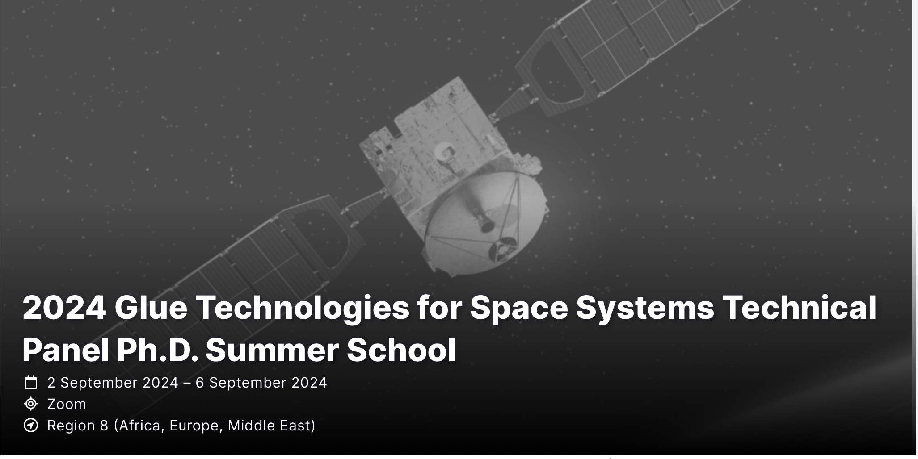
Glue Technologies for Space Systems - 2024 EOY Report
Education Activities
Organization of the Summer School: “Frontier Technologies for Space 2.0 Communications” (IV edition), organized online, September 2-6, 2024, endorsed by AESS (35 attending students):
SECOND DAY: September 3, 2024
H. 9.00 a.m. – 12.00 p.m. CEST
Space Softwarization: from Physical Layer to Services: a new paradigmatic vision of Space networks (Fabrizio Granelli, Claudio Sacchi, University of Trento, Trento, Italy, Alessandro Guidotti, CNIT, Italy)
H. 3.00 p.m. – 6.00 p.m. CEST
EHF for Satellite Communications: the latest developments and experimentations (Giorgia Parca, Giuseppe Codispoti, Italian Space Agency – ASI, Rome, Italy, Tommaso Rossi, University of Rome”Tor Vergata”, Rome, Italy)
THIRD DAY: September 4, 2024
H. 9.00 a.m. - 12.00 p.m. CEST
Space Quantum Communications (R. Bassoli, R. Ferrara, J. Notzel, Technical University of Dresden, Dresden, Germany)
H. 4.30 p.m. - 6.30 p.m. CEST
Software Defined Radio for Satellite Communications
(Eugene Grayver, Aerospace Corporation, El Segundo, CA)
FOURTH DAY: September 5, 2024
H. 9.00 a.m. - 12.00 p.m. CEST
Satellite networking in “5G and beyond 5G” scenarios (Mohammed Slim Alouini, King Abdullah University of Science and Technology, Saudi Arabia, Mario Marchese, Fabio Patrone, University of Genoa, DITEN, Italy)
H.4.30 p.m. -7.30 p.m. CEST
End-to-End System Considerations for Space Communications Systems (Kar-Ming Cheung, JPL, Pasadena, CA)
FIRST DAY: September 2, 2024
H. 8.45 a.m. - 9.00 a.m. CEST
Welcome to the participants (Claudio Sacchi, University of Trento, Trento, Italy)
H. 9.00 a.m. – 12.00 p.m. CEST
“Space 2.0”: the new Space Revolution (Claudio Sacchi, University of Trento, Italy, Marina Ruggieri, University of Rome Tor Vergata, Rome, Italy, Cosimo Stallo, ESA, UK)
LAST DAY: September 6, 2024
H. 2.30 p.m. - 4.30 p.m. CEST
Exam test (managed by C. Sacchi)

Slide 9
Glue Technologies for Space Systems - 2024 EOY Report
Industry Engagement and Standards
The ”Glue-Tech” technical panel aims at contributing to the international standardization activities concerning with 6G Non-Terrestrial Networks (NTNs).
Such a contribution is carried on in the context of the dissemination activities of the structural research project “ITA-NTN”, funded by EU in the framework of the Italian National Recovery and Resilience Plan (NRRP) of NextGenerationEU, partnership on “Telecommunications of the Future”(PE00000001 – program “RESTART”).

Slide 10
Glue Technologies for Space Systems - Future Plans
Organization of special sessions and special tracks in international workshops and conferences dealing with panel topics (some of these activities are already planned and in due course of organization).
Organization of the V edition of the AESS Summer School “Frontier Technologies for Space 2.0 Communications”, possibly opening to new topics and gathering the contributions of new speakers.
Submission of a “panel position paper” organized as a survey of “Space 2.0” technologies, followed by considerations about their current and future development.
Strengthen the synergies with EU NRRP workprogramme with objective of disseminating research ideas concerning 6G NTNs (at least at European level) and contributing to the related standardization activities.
Organization of new didactic events (e.g., Summer Schools, seminars, etc.).
Next panel meetings: Autumn 2024 (late November - early December, TBC), Spring 2025 (May-June, TBC), Autumn 2025 (late November-early December, TBC).

