Slide 1
Radar Systems Panel
Report to BoG TechOps Panel
Laura Anitori
Chair, Radar Systems Panel
2024 AESS Fall Board of Governors Meeting
October 2024
Rennes, France

Slide 2
Radar Systems Panel
The Radar Systems Panel (RSP) is composed of IEEE members who are representatives of industry, government laboratories, educational institutions and professional societies, and who are active in the domain of Radar.
Its main objectives are:
Sustain and oversee the program of IEEE Radar Conferences;
Manage the nomination and selection of candidates for IEEE Awards in the domain of radar;
Promote and support publications in the domain of radar;
Promote educational activities in the domain of radar;
Encourage the submission of nominations for IEEE Fellows and Senior Members in the domain of radar;
Provide periodic revision of IEEE Standards pertaining to the domain of radar.

Slide 3
RSP Committees
The RSP meets yearly at IEEE Radar Conferences, and ad-hoc at IEEE Int. Radar conferences. Throughout the year, activities are carried out by the committees via online meetings and emails.
The RSP consists of 8 committees and also provides representatives to AESS committees, including:
Radar Conference Committee
Awards Committee
Standards Committee
Education Committee
Nomination and Appointments Committee
Spectral Innovation Committee
Civilian Radar Committee
Publications Committee
AESS ISAC Working Group (WG) representatives

Slide 4
RSP Summary of Activities
The RSP has continued to
update/create “best practice” reference documents for all committees;
consolidate the use of the RSP Google drive to archive and share RSP documents;
establish the use of digital forms for voting and surveys;
RSP is establishing new policies for the RadarConf series proposals’ presentation and evaluation, and for hand-over meetings between conference organizing committees:
In summer 2024, the selection process for IEEE RadarConf 2027 was held, and India was selected to host the conference;
RSP has established a new policy (March 2024) for vice-chair automatic succession to Chair position (updated charter and ToR);
In May 2024 the IEEE AESS Radar Challenge, organized by the education committee in collaboration and with the support of industry, was held during the 2024 radar conference and 7 teams participated to the challenge;
The Standards Committee has worked with IEEE for updating the “RSP Policy and Procedure baselines for Standards Committee” document (Sept. 2024).

Slide 5
RSP 2024 EOY Report
Conferences Activities
Completed review and selection of 2027 IEEE Radar Conf Location/Chairs:
Bengaluru, India (Puneet Mishra, Mark Davis, K Menon)
Call for 2028 open
Recommend non-selected 2027 proposal resubmit
Minor updates to proposal template; new templates are working very well
Upcoming conferences
RADAR 2024: Oct 21-25 in Rennes, France (Myriam Nouvel)
2025 IEEE International Radar Conf: May 3-9, 2025 in Atlanta, GA (Ryan Hersey)
2025 IEEE Radar Conf: Oct 4-10, 2025, in Krakow, POL (Mateusz Malanowski & Piotr Samczynski)
2026 IEEE Radar Conf: May 11-15, 2026, Phoenix, AZ (Brian Cordill & Dan Bliss)
2026 CIE International Conf on Radar: China, No Info Available
2027 IEEE Radar Conf: May 3-7, 2027, Bengaluru, India (Puneet Mishra, Mark Davis, K Menon)

Slide 6
RSP 2024 EOY Report
Awards Activities
Publicized nominations for and selected winners of Nathanson and White Awards with winners as follows
Nathanson – Francesco Fioranelli
White – Antonio De Maio
Encouraged selection of RSP Award winners as lecturers in 2024 Radar Boot Camp to create a cycle of service back to the community
Updated Best Practices document for RSP Awards
Collected feedback from all RSP members on how to better publicize awards
Surveyed RSP membership regarding the 2023 Awards (presented in 2024) with improved participation from previous year
35 participated in survey
94% aware of RSP award deadlines
31% nominated/endorsed candidate for Picard Medal
31% nominated/endorsed candidate for IEEE Fellow
9% nominated/endorsed candidate for Mimno Award
9% nominated/endorsed candidate for Carlton Award
6% nominated/endorsed candidate for Robert T. Hill Best Dissertation Award
14% nominated/endorsed candidate for Pioneer Award
0% nominated/endorsed candidate for Distinguished Service Award
6% nominated/endorsed candidate for Industrial Innovation Award

Slide 7
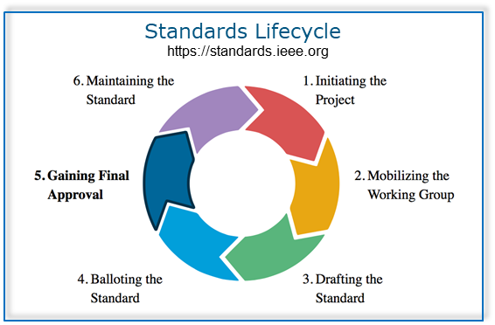
RSP 2024 EOY Report
Standards Committee Activities
RSP very active in definition and update of several IEEE Standards, including:
SASC: Many WGs (#2 and #3)
P4002: Will move to #4 in about a year
686-2023: Will move from #5 to #6 soon
521-2019: Will move from #1 to #2 soon
RSP participates in new Synthetic Aperture Standards Committee (SASC):
Operating since January 2022, RSP is well-represented: leadership (Mishra) and SA-TWG (Mishra, Ram);
Radar Study Group has been mobilized and now called the “P3355 Synthetic Aperture Radar Working group”. A large team has been assembled to achieve working group tasks. New working groups:
P3399 Automotive SAR
P3397 Synthetic Aperture Radar (SAR) Image Quality Metrics
P3384 ISAC Vocabulary
P3383 ISAC Performance Metrics
P3370 Collocated Multiple-Input Multiple-Output (MIMO) SAR

Slide 8
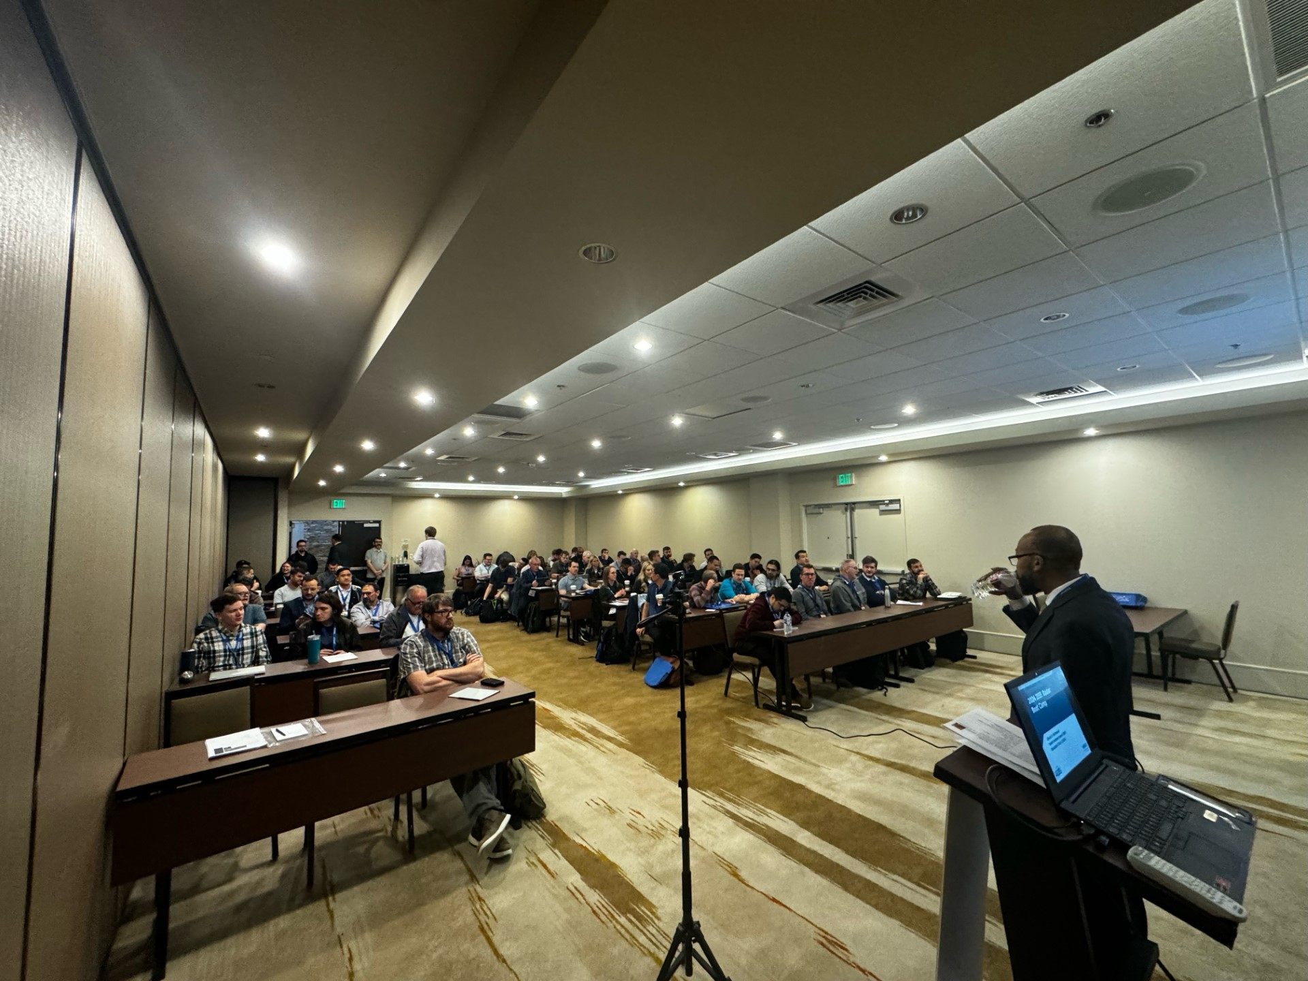
Educational Activities
RSP 2024 EOY Report
Radar Boot Camp (RBC) 2024
2024 RBC to held in-person at the Hilton Denver City Center Hotel located in the heart of downtown Denver.
Organizers: Christ Richmond, Antonio DeMaio, Kristin Bing, David Schvartzman
RSP support: Matt Ritchie, Francesco Fioranelli, Stéphanie Bidon, Justin Metcalf
2023 Registration:
In-person: ~52 enrolled (well-attended)
2024 Agenda finalized
8 lectures by noted experts on Saturday 5/4/2024 and Sunday 5/5/2024
Hands-on demonstrations at the end of each day
In-person: ~106 enrolled (~100% increase wrt 2023)
Several unenrolled also attended
Saturday, May 4, 2024
Opening Ceremony | Christ Richmond
History of Radar | Alfonso Farina and Salvatore Ponte
Radar Range Equation | Justin Metcalf
Introduction to Radar Systems | Justin Metcalf
Estimation and Detection | Christ Richmond
Array Signal Processing | David Schvartzman
Low Cost GNU Radio Radar Demo | Shane Flandermeyer
Sunday, May 5, 2024
Space-Time Adaptive Processing | Mike Picciolo and Scott Goldstein
Tracking | Kristine Bell
Radar Imaging | Elisa Giusti
Hands On Lab Exercises I: Phased Array Beamforming | Matt Ritchie and Jon Kraft
Hands On Lab Exercises II: Radar Signal Processing | Matt Ritchie and Jon Kraft

Slide 9
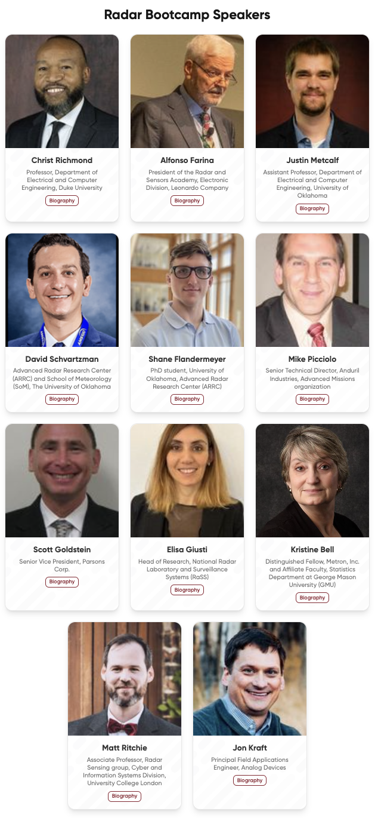
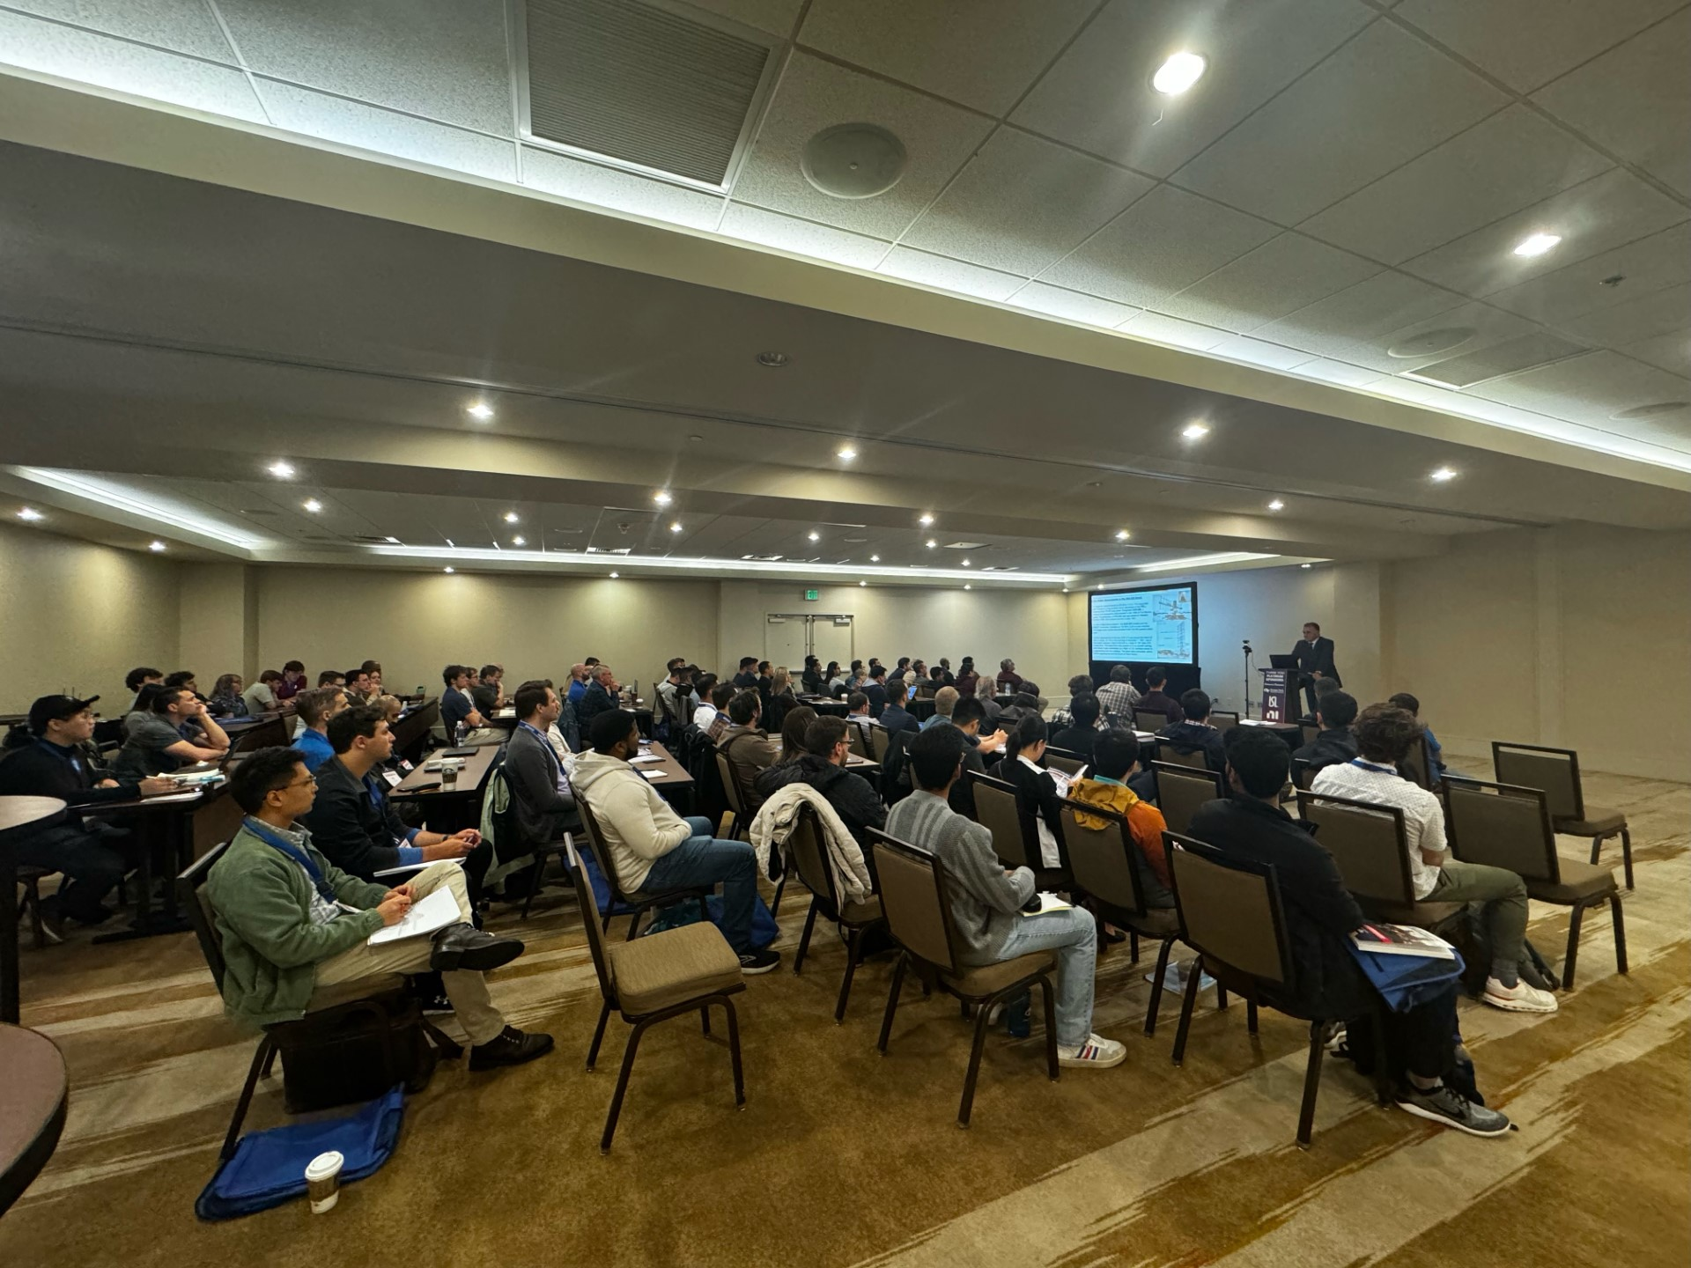
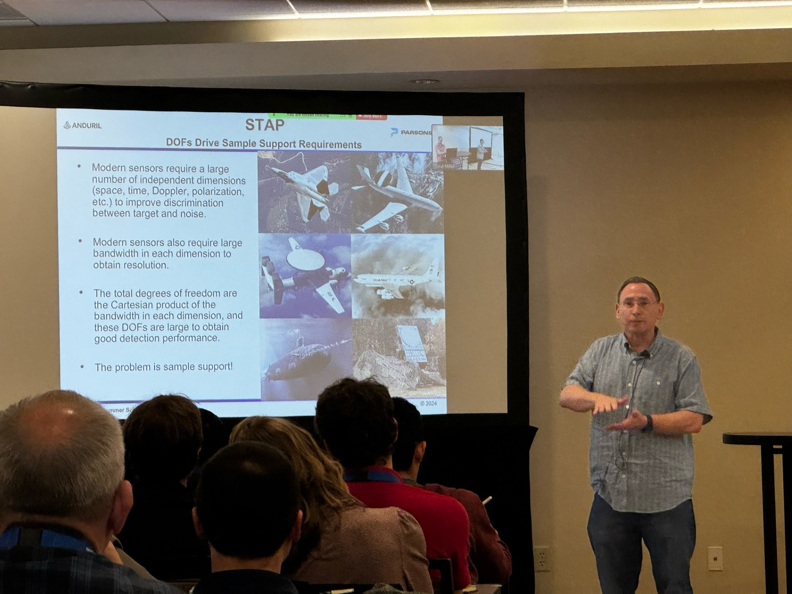
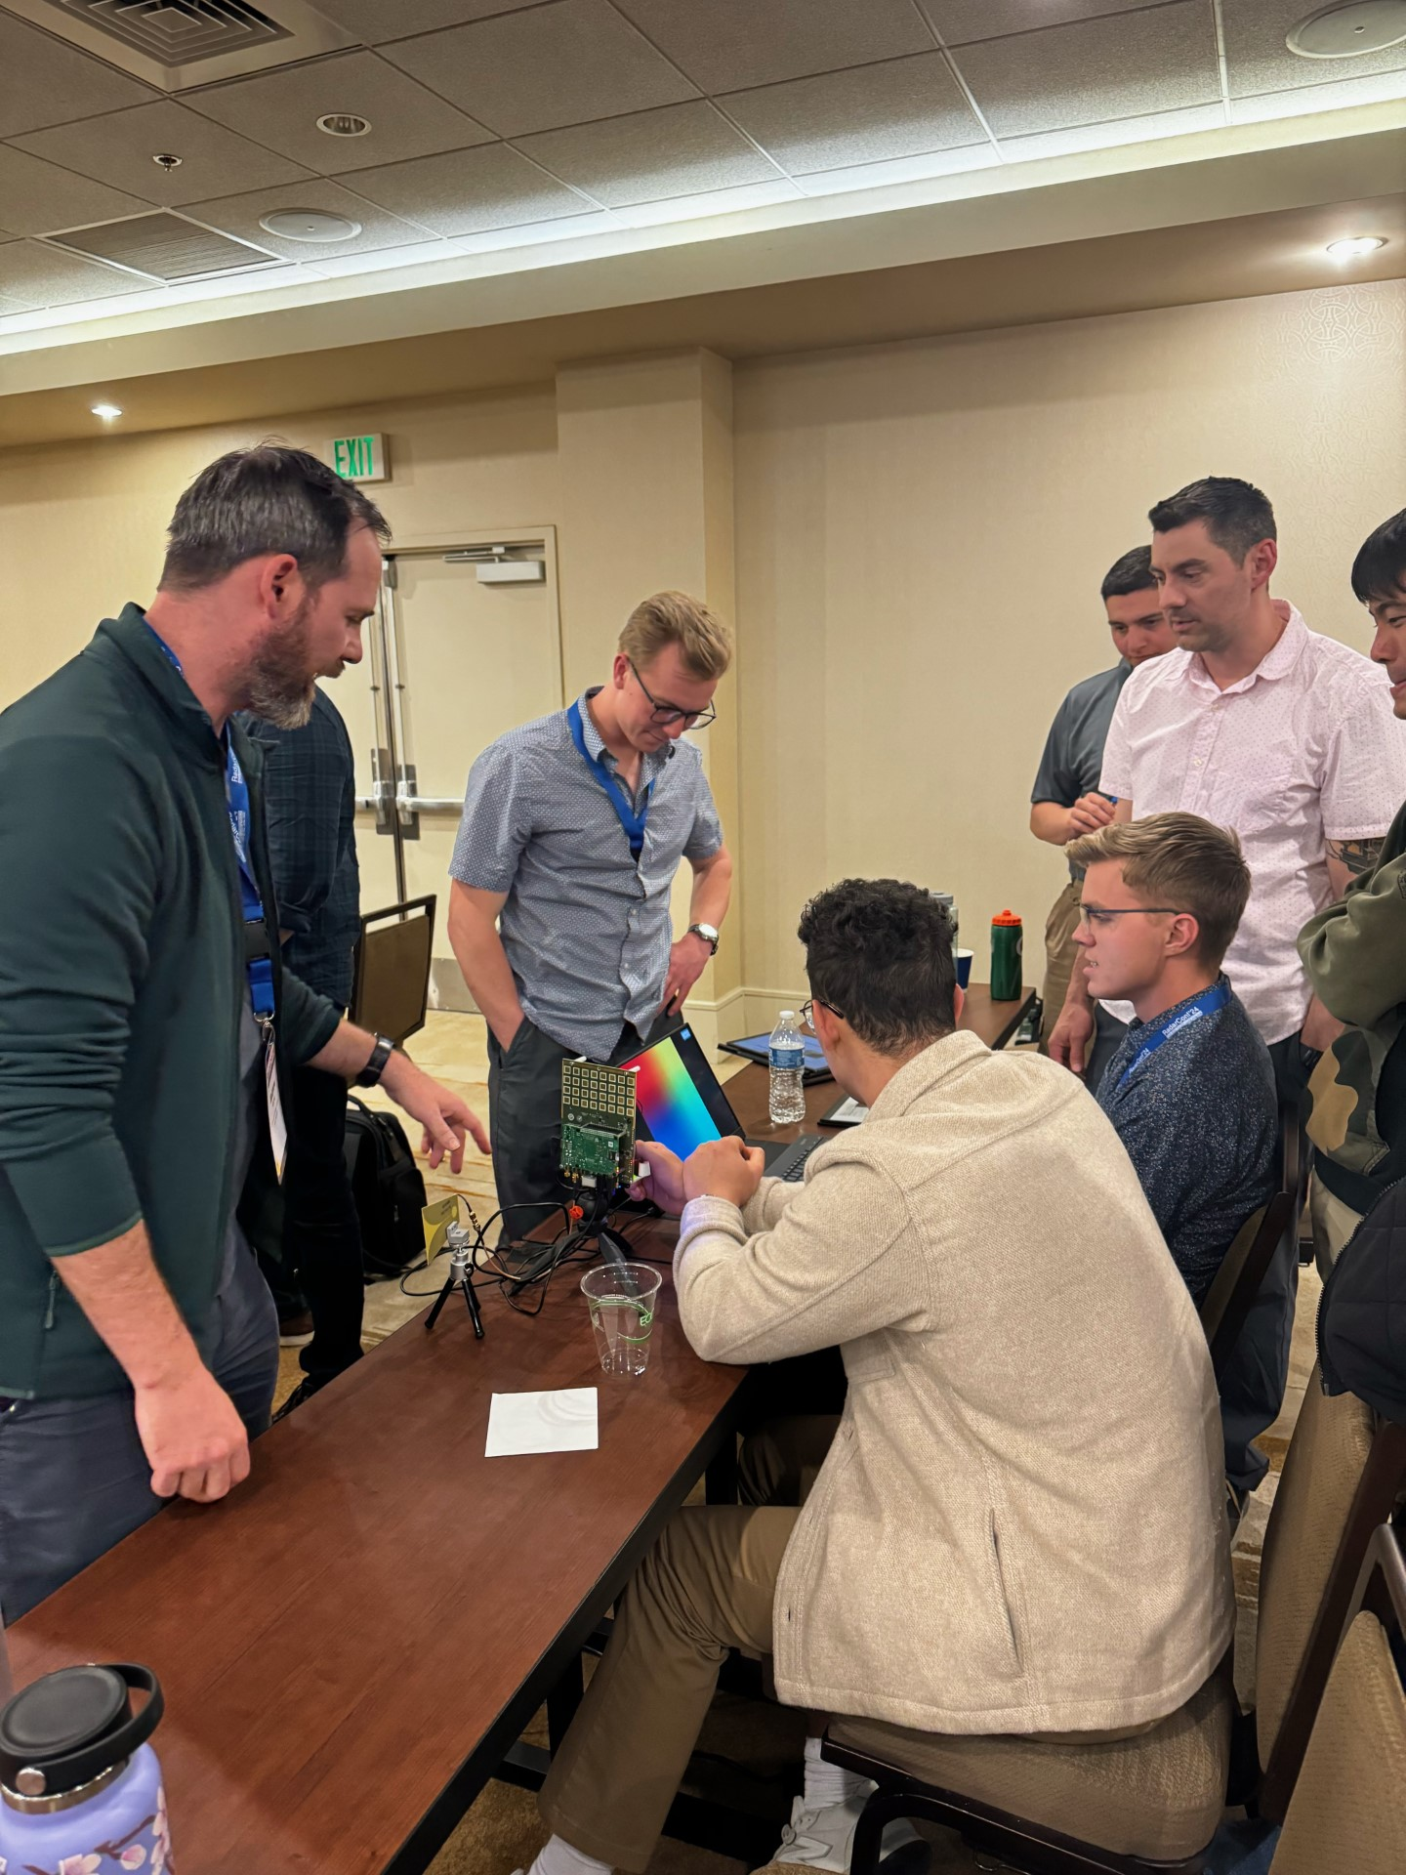
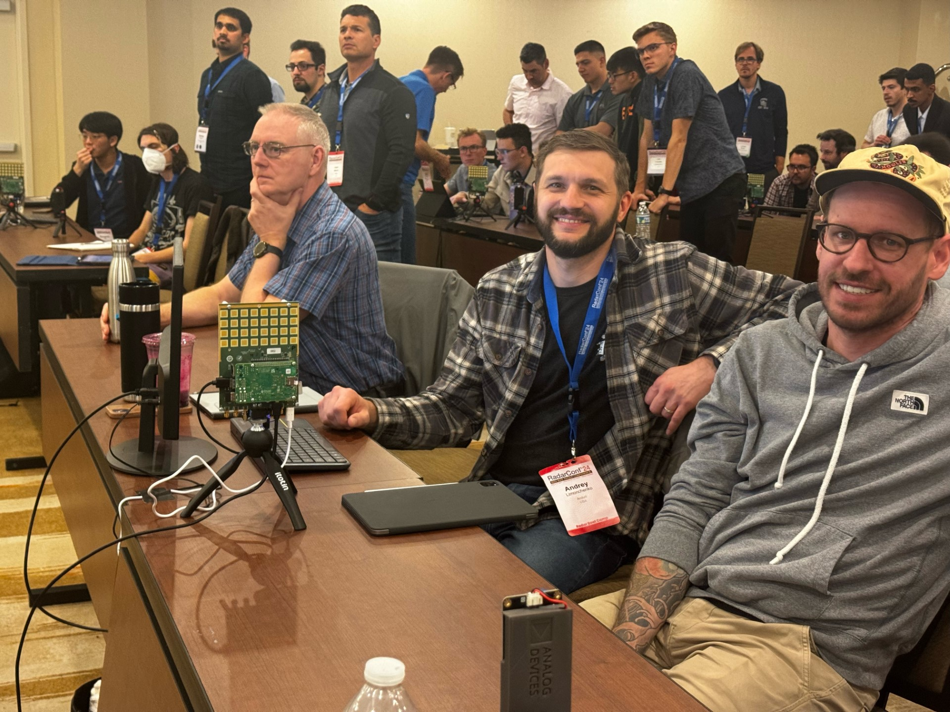
Radar Boot Camp (RBC) 2024 (continued)
RSP 2024 EOY Report
RBC Speakers 2024:
RBC Snippets 2024

Slide 10
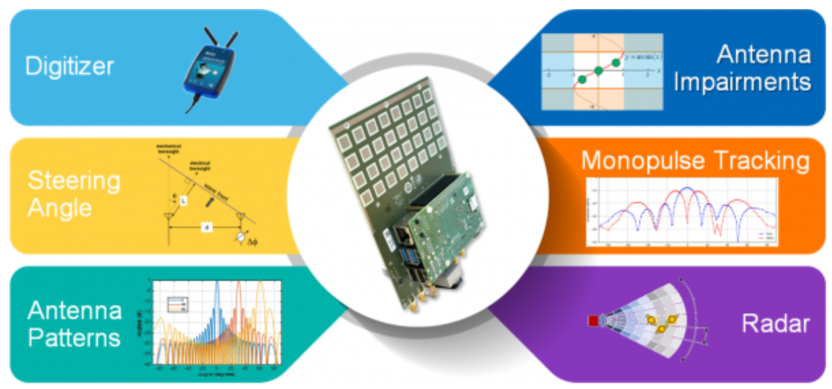
Educational Activities
RSP 2024 EOY Report
This year’s Radar Challenge is led by Jon Kraft (ADI), Matt Ritchie (UCL), Francesco Fioranelli (TUDelft), Sevgi Gurbuz (UA), Robin Getz (Mathworks), Honglei Chen (Mathworks)
First year that focuses on a single hardware option that was shipped to teams that nominated.
Same hardware used at RBC for live demo of array concepts

Slide 11
Educational Activities
RSP 2024 EOY Report
We had 22 teams that were then narrowed down to 10. Eventually 7 made it through the process.
7 Teams for challenge were:
3D Tomography OU
Backyward Weather CSU
KAUST
Mantis UW
Roll Tide Radar UA
Strathclyde Uni UK
Ball Aerospace
Submitted a short presentation / Video BEFORE the conference. Then also presented live during the conference on Mon PM (5pm-7pm)
Winner announced at YP Event Mon Evening
Top team was then selected by panel based on:
Technical Depth
Creativity Quality/clarity of the material submitted
Presentation, Q&A

Slide 12
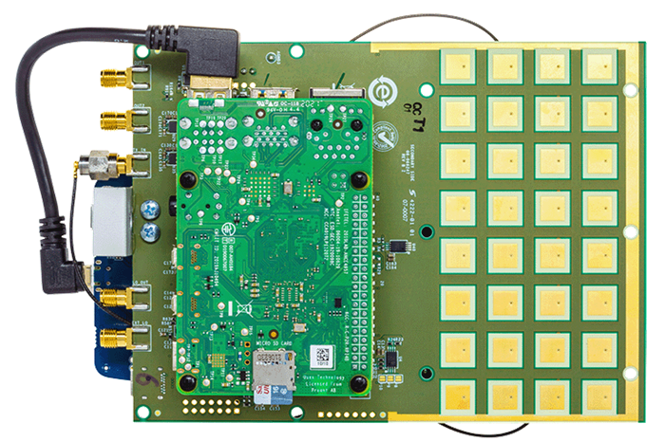
RSP 2024 EOY Report
Educational Activities
Plans for 2025
Radar Boot Camp (RBC) @ RadarConf25
2025 RBC to be held in-person in Krakow, Poland @ RadarConf on 4-5 May 2025
2025 Agenda planned:
8 lectures by noted experts
Several hands-on demos for students
Lectures to be recorded & posted online @ ILN
2024 Registration: ~106 enrolled
Radar Challenge @ RadarConf25
The Radar Challenge 2024 partnered with Analog Devices & MathWorks to provide an exciting opportunity to practice skills with state-of-the-art radar hardware (10GHz AD Phased Array platform CN0566).
RBC Subcommittee formed for 2025 and currently planning a similar challenge. Analog Devices has agreed to support this event as well.
Also, we are providing support to the International RadarConf in Atlanta, GA in planning their RBC.
Radar Kit

Slide 13
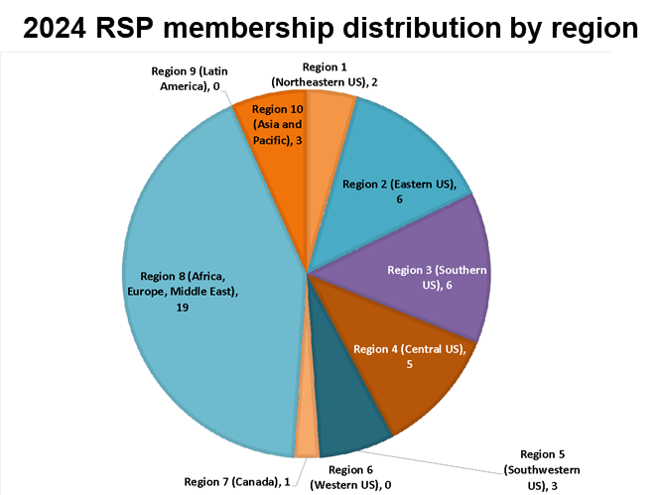
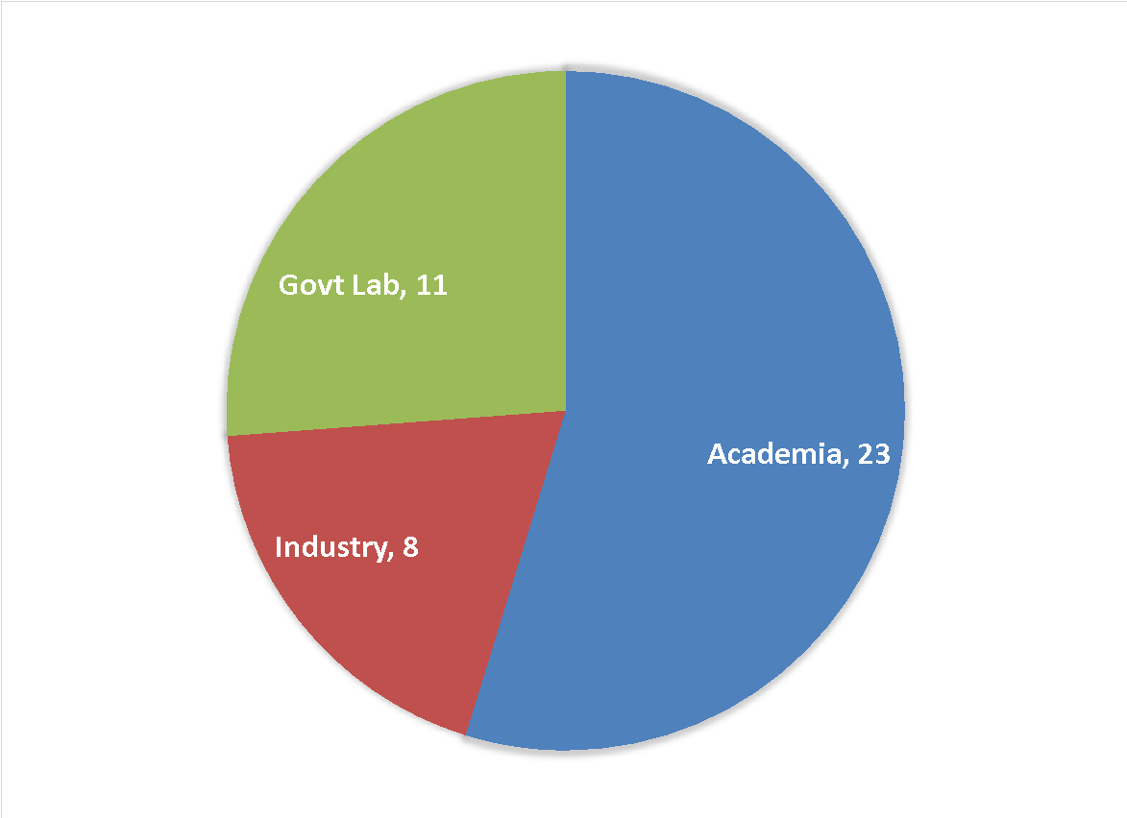
RSP 2024 EOY Report
Nominations and Appointment Committee (N&A)
New Member Selection Process Begun
Seeking Nominations for 2025-2027 term
New member voting will happen late October 2024
Slate and voting for RSP Chair and Vice Chair will occur short after
2024 RSP membership by institution

Slide 14
RSP 2024 EOY Report
Spectral Innovation Committee Activities
Created new spectral innovation committee best practices document
Was working under original Waveform Diversity committee best practices document
SIC Best Practices (paraphrased)
Serve as RSP POC for all spectral-innovation-related topics/activities
Organize conference keynote presentations and panel discussions
Organize and promote tutorials, workshops, webinars, dataset challenges, and conference special sessions
Curate a taxonomy of technology areas and problem sets with keyword definitions.
Organize a history of major national and international spectral policy changes and programs related to or that can impact spectral innovation for radar applications.
Planning committee meeting for this Fall

Slide 15
RSP 2024 EOY Report
Civilian Radar Activities
RSP committee members’ activite in promoting and organizing activities on Civilian Radar, including:
Conference presentations (5)
Special sessions in conferences (5)
Tutorials (3)
Seminars (2)
Distinguished lectures (4)
Guest lectures (2)

Slide 16
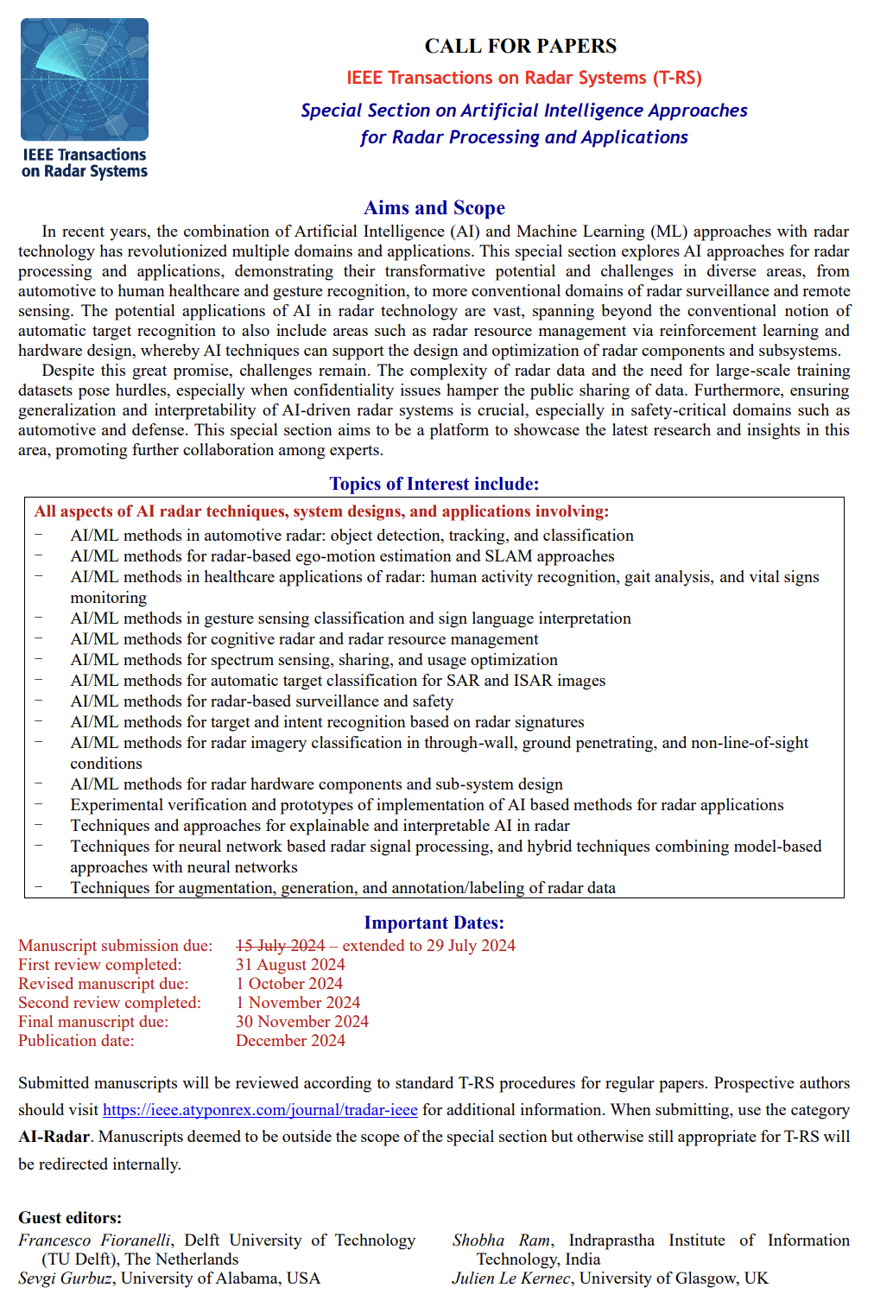
RSP 2024 EOY Report
Publications
Many members are Senior and Associate Editors for either TAES or TRS
RSP members have organized several TAES and TRS special editions and sections
TRS: Artificial Intelligence Approaches for Radar Processing and Applications (closed July 2024 with 37 submissions)
RSP contributing with partner societies on a special issue in the IEEE Journal of Biomedical and Health Informatics: "Radar-based Physiological Measurement Techniques for Healthcare and Health Monitoring“
Further ideas:
Advertise IEEE AESS journal at virtual and in-person Distinguished Lectures
Ensure IEEE references are included in our publications.

Slide 17
RSP - Future Plans
Complete and finalize revision of Committees Best Practice
Awaiting new AESS policies for Awards committee
Finalize new policies for proposal selection for IEEE Radar Conference series
Verify with AESS status of MoU for International Radar Conference, particularly with China
Continue to organize the «new» Radar Challange
Request for AESS support for students to attend the Challenge in person.

