Slide 1
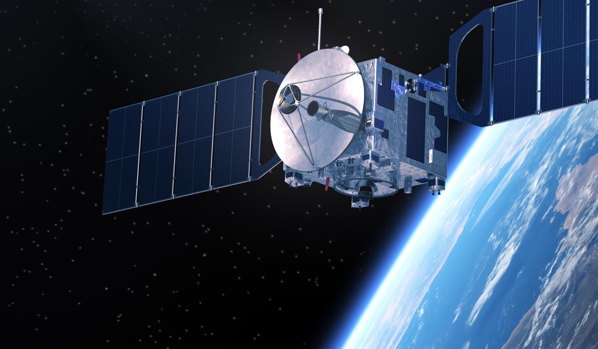
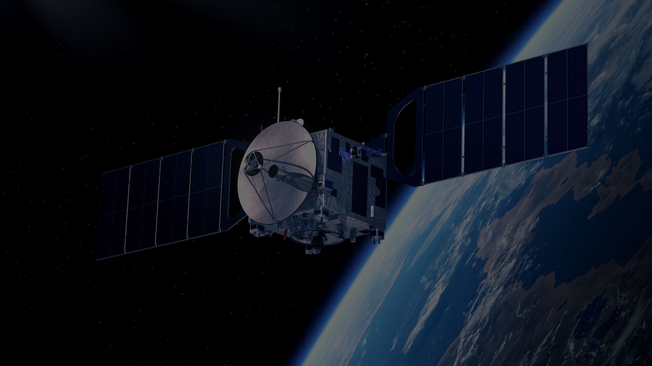

IEEE AEROSPACE AND ELECTRONIC SYSTEMS SOCIETY
ieee-aess.org

Slide 2



Field of Interest
The organization, systems engineering, design, development, integration, and operation of complex systems for space, air, ocean, or ground environments. These systems include but are not limited to navigation, avionics, mobile electric power and electronics, radar, sonar, telemetry, military, law-enforcement, automatic test, simulators, and command and control.

Slide 3


About AESS
Comprised of professionals who share your technical interests, joining AESS allows you to deepen ties to your technical community and take advantage of specialized opportunities. AESS has over 7,000 members and more than 180 chapters and student branch chapters worldwide with programs like our Mentoring, Students, and Young Professionals to increase engagement and membership.
Conferences
Member Services
Publications
Education
Technical Panels
Awards
Notes:
Conferences: AESS financially and technically sponsors and co-sponsors over 30 conferences. Members are encouraged to submit papers, attend the conference, and network with your colleagues.
Publications: AESS sponsors and co-sponsors publications that provide differing levels of technology, invention and information to readers.
Technical Panels and Community: The creation of IEEE Standards, support of IEEE Conferences, and building a technical community are a primary responsibilities of the 6 AESS technical panels.
Member Services: AESS has over 7,000 members and more than 180 chapters worldwide with programs like our Mentoring, Students, and Young Professionals to increase engagement and membership.
Education: Provide technical content in-person and online to our members through the Distinguished Lecturers Program and Short Courses.
Awards: AESS has 18 awards recognizing our members for their contributions to publications, conferences, and technical achievements and two scholarships for undergraduate and graduate students.

Slide 4
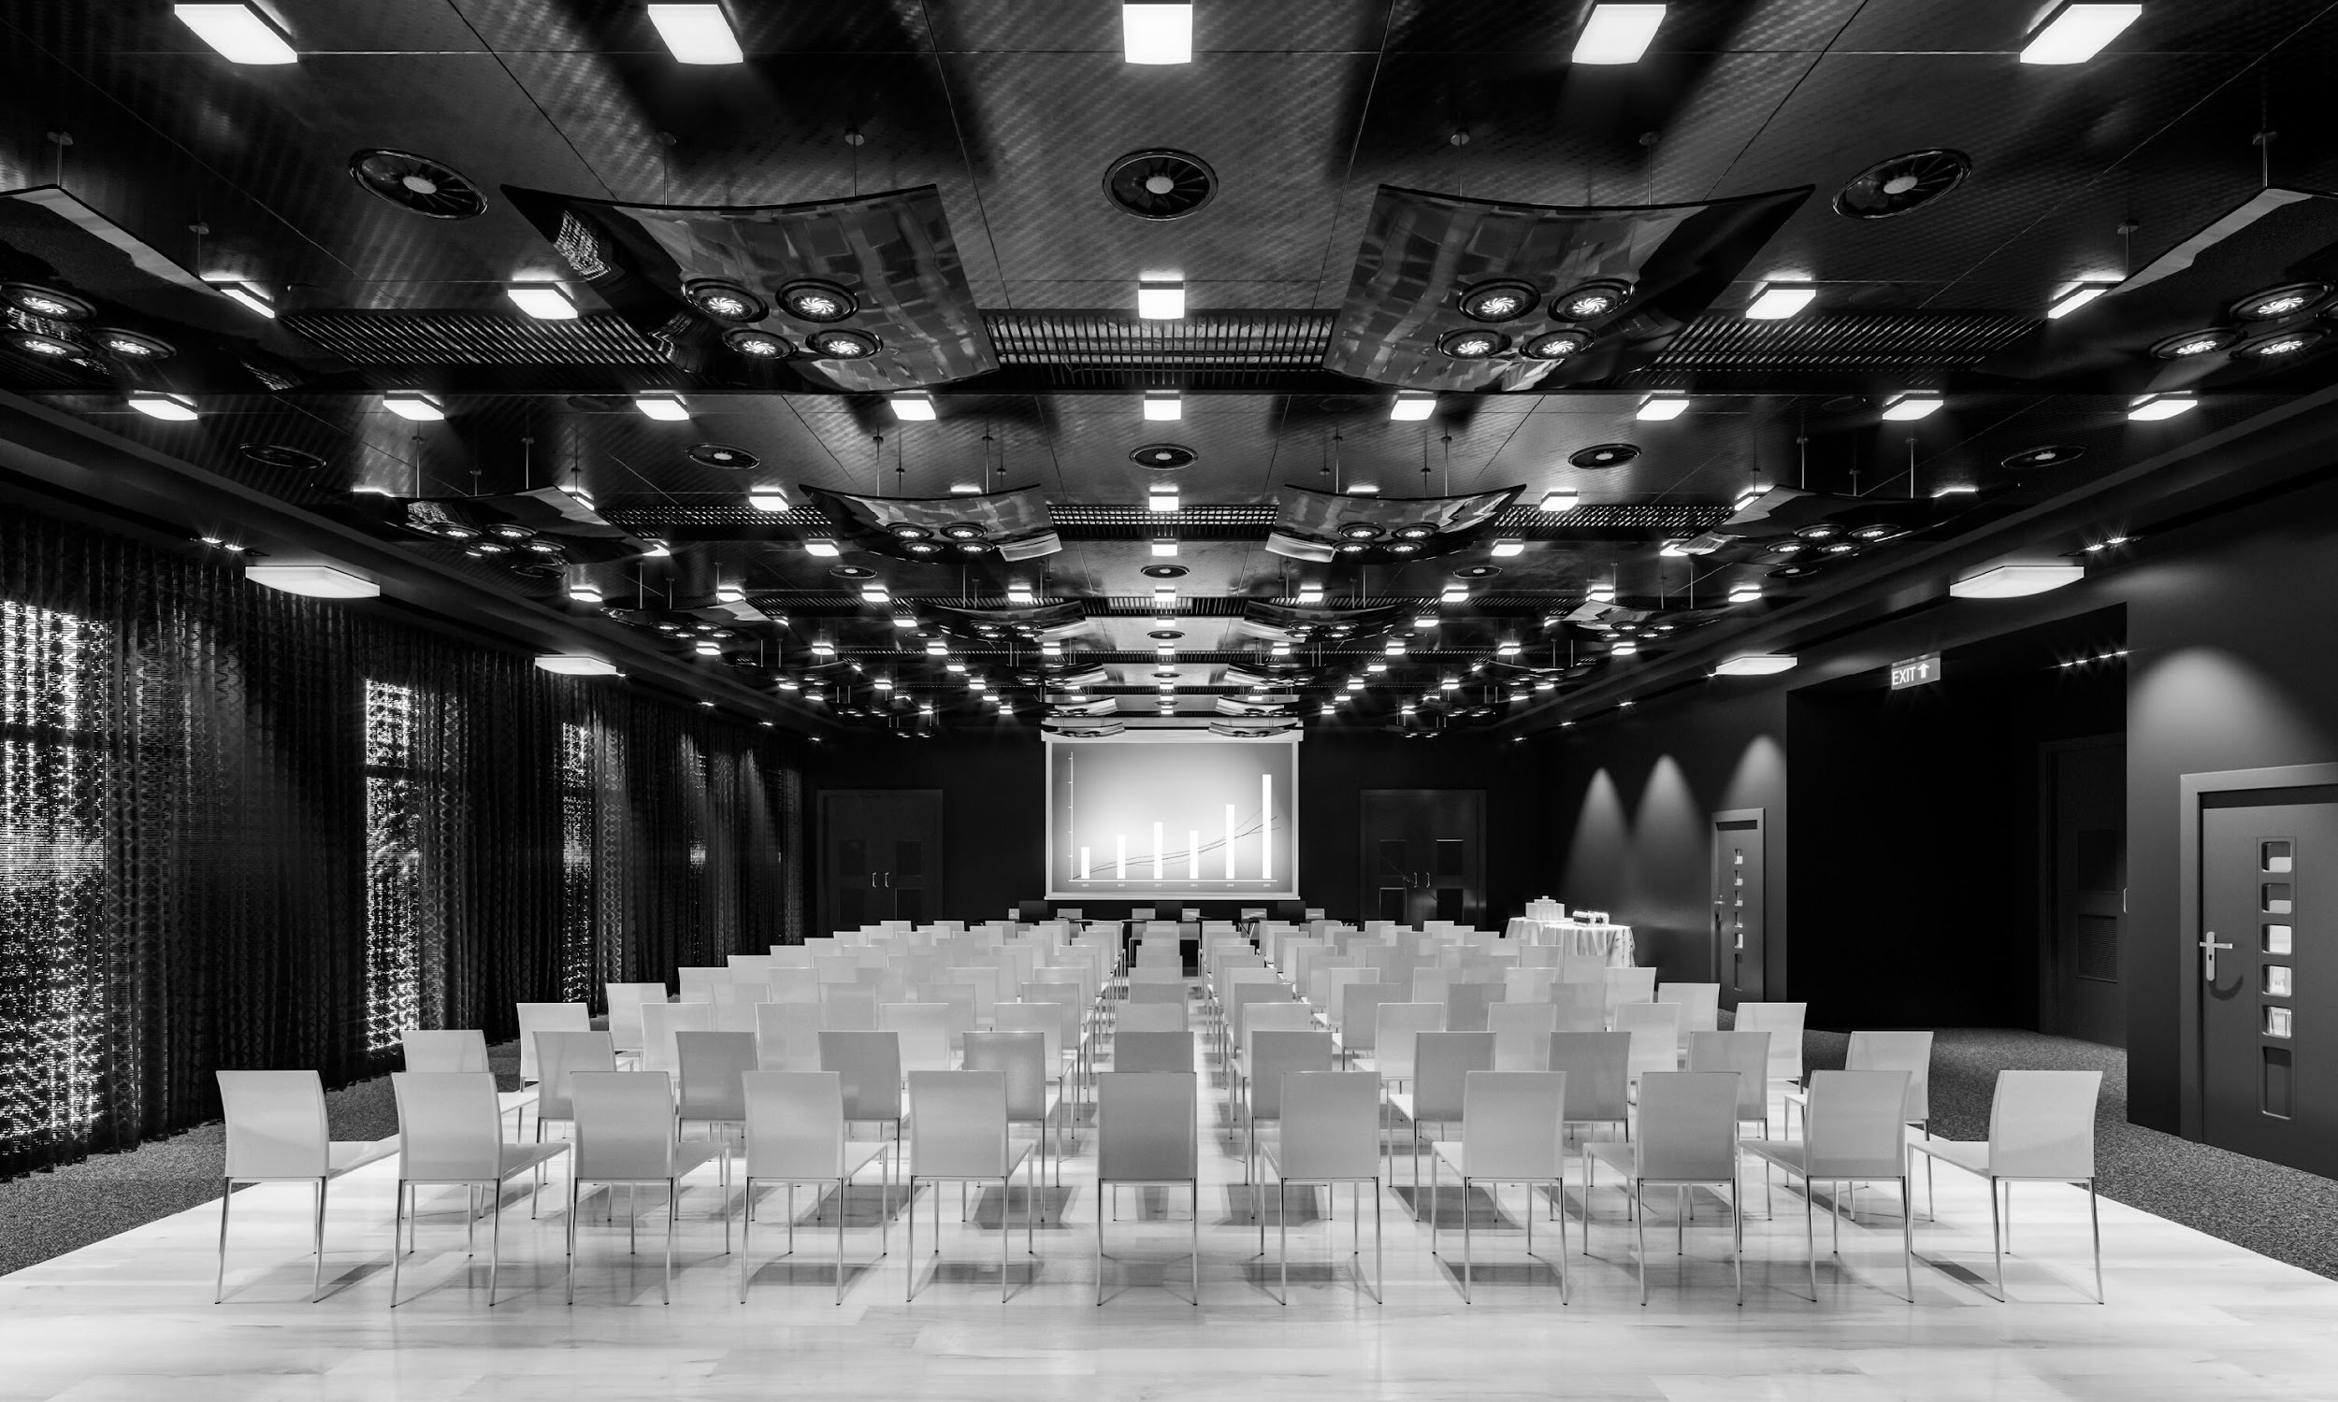






Conferences
AESS Financially and Technically Sponsors 30 Conferences Annually
AESS Members receive discounts to sponsored conferences.
Visit the AESS website for a full listing of sponsored conferences.
Promotes interdisciplinary understanding of aerospace systems and applications for gov/commercial.
Promotes radar engineering and hosts technical sessions, tutorials, and student challenges.
Offers a comprehensive technical program presenting the latest developments in navigation systems and their applications.
The preeminent R&D conference in the field of digital avionics offered.

Slide 5

100+
Distinguished Lecturers Program
In-Person and Online Lecturers
DL talk titles to choose from in a variety of technical fields
AESS Chapters and IEEE Sections are encouraged to take advantage of the AESS Distinguished Lecturer and Tutorial Program for their regular or special meetings, that allows them to select from an outstanding list of truly distinguished speakers who are experts in the technical fields of the society.
40
available DLs providing lectures online and in person at your next meeting, chapter event, and more
Education
Focused on providing technical content in-person and online to our members
Short Courses
While the desire is for short courses to be in-person and open to all members, they may be run virtually or exclusively to a specific company. To date, short courses have been run on four different continents, with a mixture of openly run in-person, virtual and exclusive offerings.
Online Library
165+ available recordings to watch on the IEEE Learning Network and growing!

Slide 6
2026 Officers
President – Braham Himed
President Elect – Lorenzo Lo Monte
Past President – Sabrina Greco
VP Conferences – Scott Goldstein
VP Publications – Luke Rosenberg
VP Education – Puneet Kumar Mishra
VP Finance – Steve Butler
VP Member Services – Vince Socci
VP Technical Operations – Rob Sabatini
VP Industry Relations – Barry Tilton
Secretary – Walter D. Downing
Treasurer – Fulvio Gini
Contact Us
www.ieee-aess.org
admin@ieee-aess.org

Slide 7
AESS Distinguished Lecturer
NAME
AFFILIATON
LECTURE NAME
Watch on the IEEE Learning Network

Slide 8
Biography
Add Distinguished Lecture Biography from AESS Website.

