Slide 1




IEEE AESS Distinguished Lecture
Multiple-Hypothesis Tracking (MHT)
Dr. Stefano Coraluppi
STR Chief Scientist
IEEE Fellow
Online, 26 October 2023

Slide 2
Outline
Estimation theory
Target modeling
Multi-target tracking
Multiple-hypothesis tracking
Recent advances

Slide 3
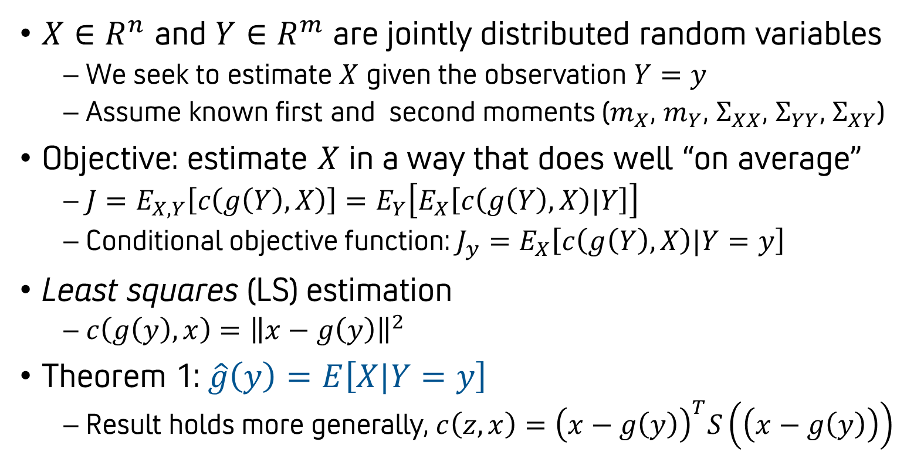
Estimation theory¹
$X∈R^{n}$ and $Y∈R^{m}$ are jointly distributed random variables
  We seek to estimate $X$ given the observation $Y=y$
  Assume known first and second moments ($m_{X}$, $m_{Y}$, $Σ_{XX}$, $Σ_{YY}$, $Σ_{XY}$)
Objective: estimate $X$ in a way that does well “on average”
  $J=E_{X,Y}\left[c\left(g\left(Y\right),X\right)\right]=E_{Y}\left[E_{X}\left[c\left(g\left(Y\right),X\right)|Y\right]\right]$
  Conditional objective function: $J_{y}=E_{X}\left[c\left(g\left(Y\right),X\right)|Y=y\right]$
Least squares (LS) estimation
  $c\left(g\left(y\right),x\right)={\left\|x−g\left(y\right)\right\|}^{2}$
Theorem 1: $\hat{g}\left(y\right)=E\left[X|Y=y\right]$
  Result holds more generally, $c\left(z,x\right)={\left(x−g\left(y\right)\right)}^{T}S\left(\left(x−g\left(y\right)\right)\right)$

Slide 4
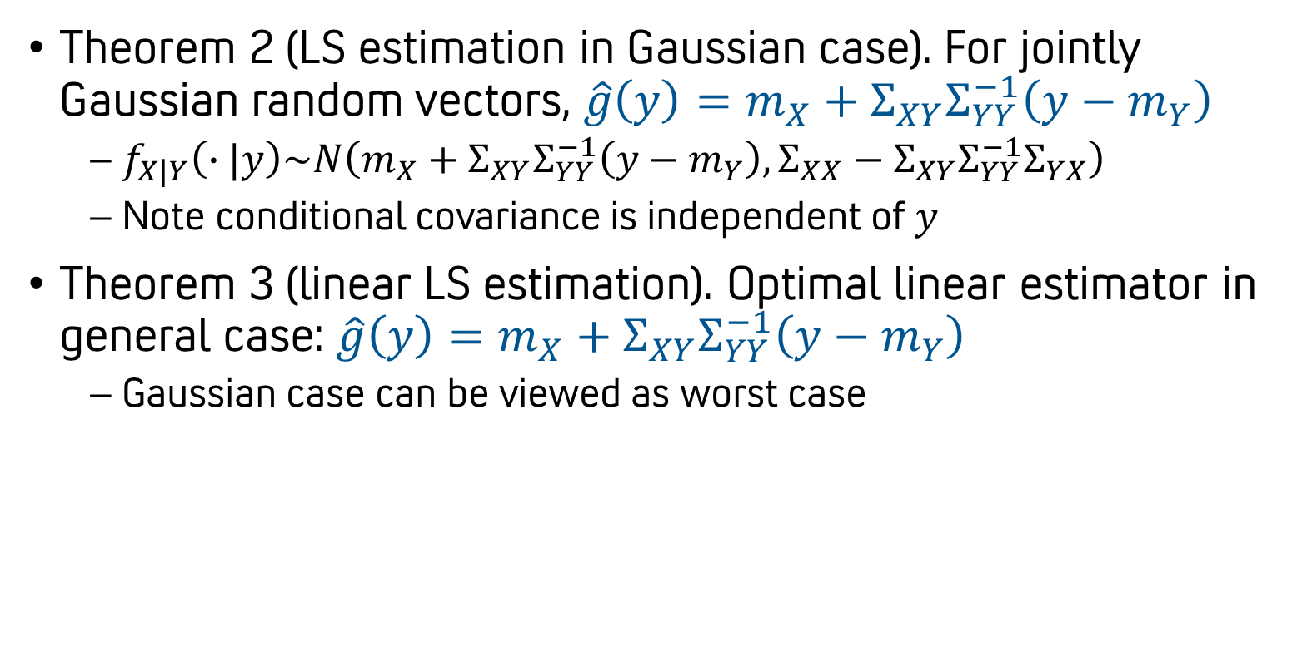
Estimation theory²
Theorem 2 (LS estimation in Gaussian case). For jointly Gaussian random vectors, $\hat{g}\left(y\right)=m_{X}+Σ_{XY}Σ_{YY}^{−1}\left(y−m_{Y}\right)$
  $f_{X|Y}\left(∙|y\right)\sim N\left(m_{X}+Σ_{XY}Σ_{YY}^{−1}\left(y−m_{Y}\right),Σ_{XX}−Σ_{XY}Σ_{YY}^{−1}Σ_{YX}\right)$
  Note conditional covariance is independent of $y$
Theorem 3 (linear LS estimation). Optimal linear estimator in general case: $\hat{g}\left(y\right)=m_{X}+Σ_{XY}Σ_{YY}^{−1}\left(y−m_{Y}\right)$
  Gaussian case can be viewed as worst case

Slide 5

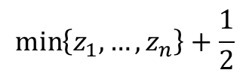
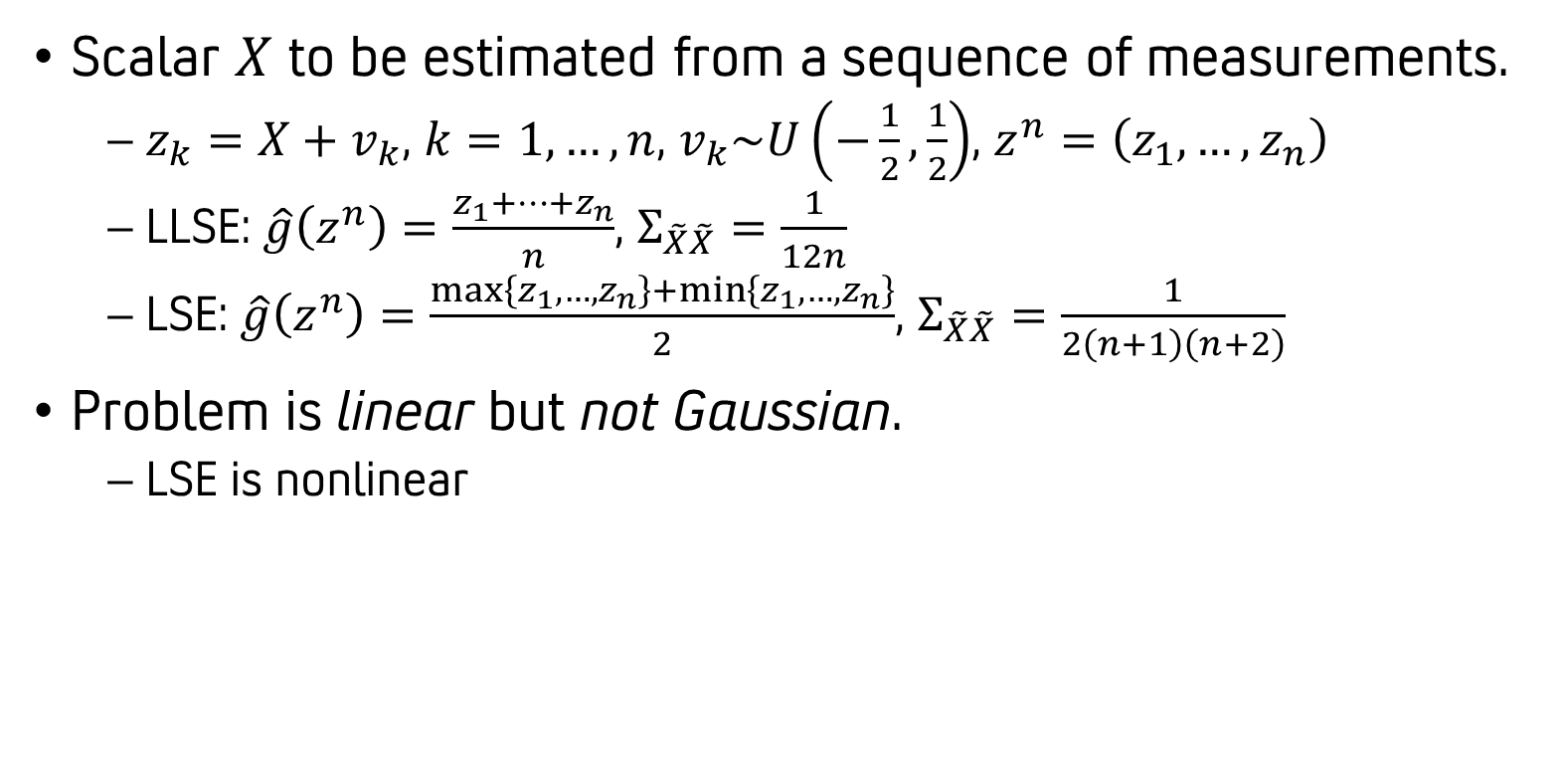
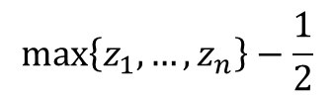


Example: uniformly distributed noise
Scalar $X$ to be estimated from a sequence of measurements.
  $z_{k}=X+v_{k}$, $k=1,…,n$, $v_{k}\sim U\left(−\frac{1}{2},\frac{1}{2}\right)$, $z^{n}=\left(z_{1},…,z_{n}\right)$
  LLSE: $\hat{g}\left(z^{n}\right)=\frac{z_{1}+…+z_{n}}{n}$, $Σ_{\tilde{X}\tilde{X}}=\frac{1}{12n}$
  LSE: $\hat{g}\left(z^{n}\right)=\frac{\max\left\{z_{1},…,z_{n}\right\}+\min\left\{z_{1},…,z_{n}\right\}}{2}$, $Σ_{\tilde{X}\tilde{X}}=\frac{1}{2\left(n+1\right)\left(n+2\right)}$
Problem is linear but not Gaussian.
  LSE is nonlinear
$$\max\left\{z_{1},…,z_{n}\right\}−\frac{1}{2}$$
$$\min\left\{z_{1},…,z_{n}\right\}+\frac{1}{2}$$
$$z_{1}$$
$$z_{2}$$
$$z_{3}$$
feasibility

Slide 6
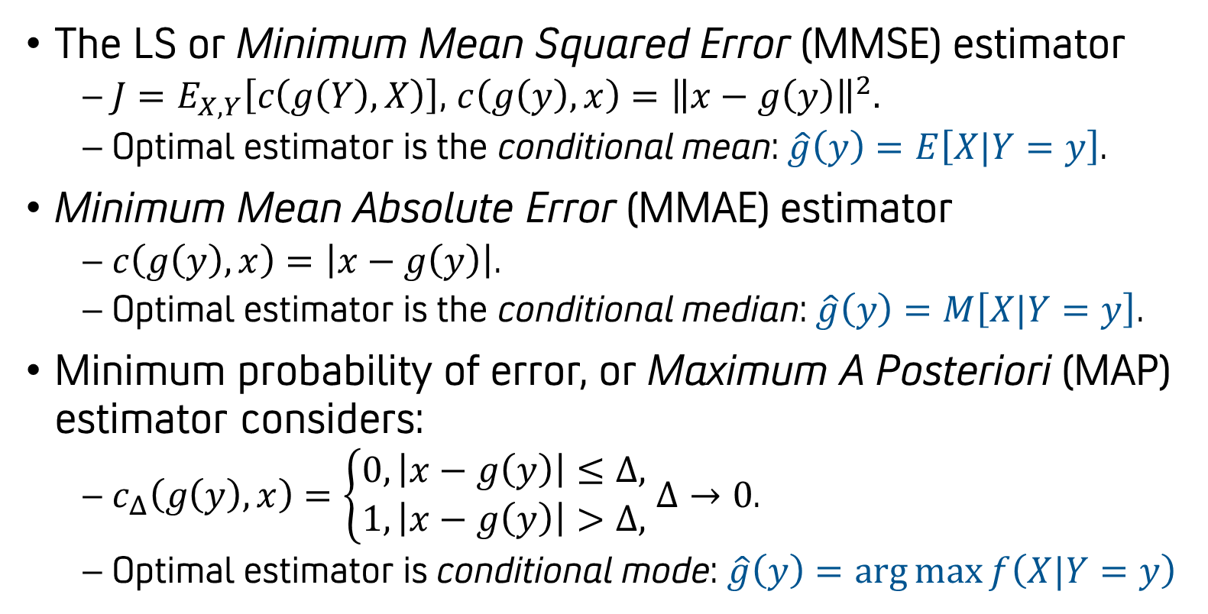
Other estimation criteria¹
The LS or Minimum Mean Squared Error (MMSE) estimator
  $J=E_{X,Y}\left[c\left(g\left(Y\right),X\right)\right]$, $c\left(g\left(y\right),x\right)={\left\|x−g\left(y\right)\right\|}^{2}.$
  Optimal estimator is the conditional mean: $\hat{g}\left(y\right)=E\left[X|Y=y\right]$.
Minimum Mean Absolute Error (MMAE) estimator
  $c\left(g\left(y\right),x\right)=\left|x−g\left(y\right)\right|$.
  Optimal estimator is the conditional median: $\hat{g}\left(y\right)=M\left[X|Y=y\right]$.
Minimum probability of error, or Maximum A Posteriori (MAP) estimator considers:
  $c_{Δ}\left(g\left(y\right),x\right)=\left\{\begin{matrix}0, \left|x−g\left(y\right)\right|≤Δ, \\ 1,\left|x−g\left(y\right)\right|>Δ,\end{matrix}\right.$ $Δ→0$.
  Optimal estimator is conditional mode: $\hat{g}\left(y\right)=\arg{\max{f\left(X|Y=y\right)}}$

Slide 7
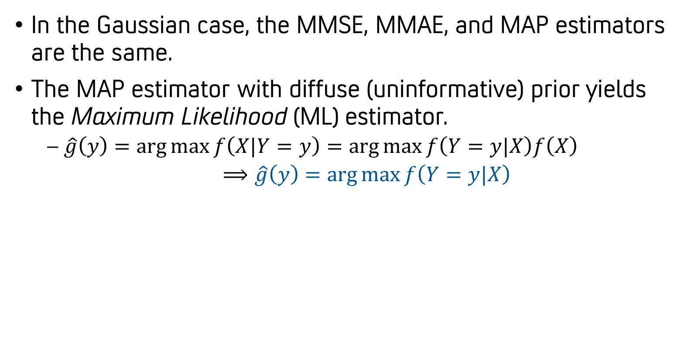
Other estimation criteria²
In the Gaussian case, the MMSE, MMAE, and MAP estimators are the same.
The MAP estimator with diffuse (uninformative) prior yields the Maximum Likelihood (ML) estimator.
  $\hat{g}\left(y\right)=\arg{\max{f\left(X|Y=y\right)}}=\arg{\max{f\left(Y=y|X\right)f\left(X\right)}}$
  $⟹\hat{g}\left(y\right)=\arg{\max{f\left(Y=y|X\right)}}$

Slide 8
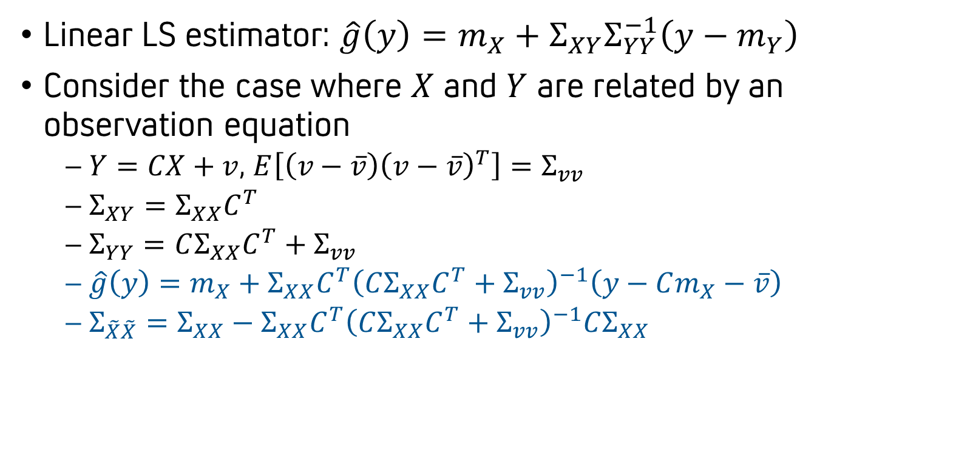
Observation equation form
Linear LS estimator: $\hat{g}\left(y\right)=m_{X}+Σ_{XY}Σ_{YY}^{−1}\left(y−m_{Y}\right)$
Consider the case where $X$ and $Y$ are related by an observation equation
  $Y=CX+v$, $E\left[\left(v−\overline{v}\right){\left(v−\overline{v}\right)}^{T}\right]=Σ_{vv}$
  $Σ_{XY}=Σ_{XX}C^{T}$
  $Σ_{YY}=CΣ_{XX}C^{T}+Σ_{vv}$
  $\hat{g}\left(y\right)=m_{X}+Σ_{XX}C^{T}{\left(CΣ_{XX}C^{T}+Σ_{vv}\right)}^{−1}\left(y−Cm_{X}−\overline{v}\right)$
  $Σ_{\tilde{X}\tilde{X}}=Σ_{XX}−Σ_{XX}C^{T}{\left(CΣ_{XX}C^{T}+Σ_{vv}\right)}^{−1}CΣ_{XX}$

Slide 9
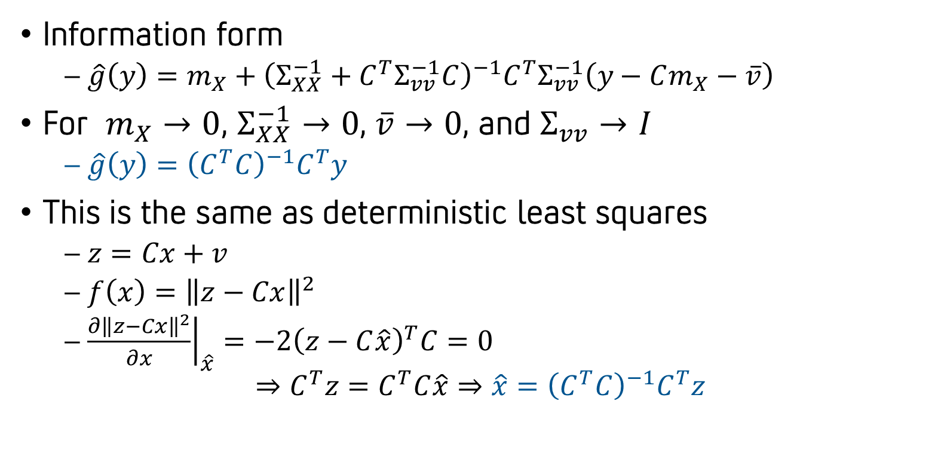
Limiting case of interest
Information form
  $\hat{g}\left(y\right)=m_{X}+{\left(Σ_{XX}^{−1}+C^{T}Σ_{vv}^{−1}C\right)}^{−1}C^{T}Σ_{vv}^{−1}\left(y−Cm_{X}−\overline{v}\right)$
For $m_{X}→0$, $Σ_{XX}^{−1}→0$, $\overline{v}→0$, and $Σ_{vv}→I$
  $\hat{g}\left(y\right)={\left(C^{T}C\right)}^{−1}C^{T}y$
This is the same as deterministic least squares
  $z=Cx+v$
  $f\left(x\right)={\left\|z−Cx\right\|}^{2}$
  ${\left.\frac{∂{\left\|z−Cx\right\|}^{2}}{∂x}\right|}_{\hat{x}}=−2{\left(z−C\hat{x}\right)}^{T}C=0$
$$⇒C^{T}z=C^{T}C\hat{x}⇒\hat{x}={\left(C^{T}C\right)}^{−1}C^{T}z$$

Slide 10
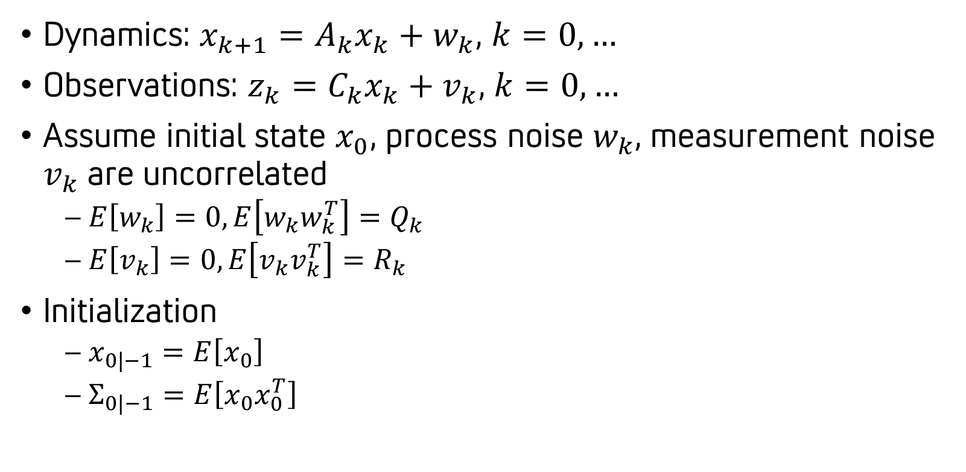
Recursive estimation: the Kalman filter¹
Dynamics: $x_{k+1}=A_{k}x_{k}+w_{k}$, $k=0,…$
Observations: $z_{k}=C_{k}x_{k}+v_{k}$, $k=0,…$
Assume initial state $x_{0}$, process noise $w_{k}$, measurement noise $v_{k}$are uncorrelated
  $E\left[w_{k}\right]=0,E\left[w_{k}w_{k}^{T}\right]=Q_{k}$
  $E\left[v_{k}\right]=0, E\left[v_{k}v_{k}^{T}\right]=R_{k}$
Initialization
  $x_{0|−1}=E\left[x_{0}\right]$
  $Σ_{0|−1}=E\left[x_{0}x_{0}^{T}\right]$

Slide 11
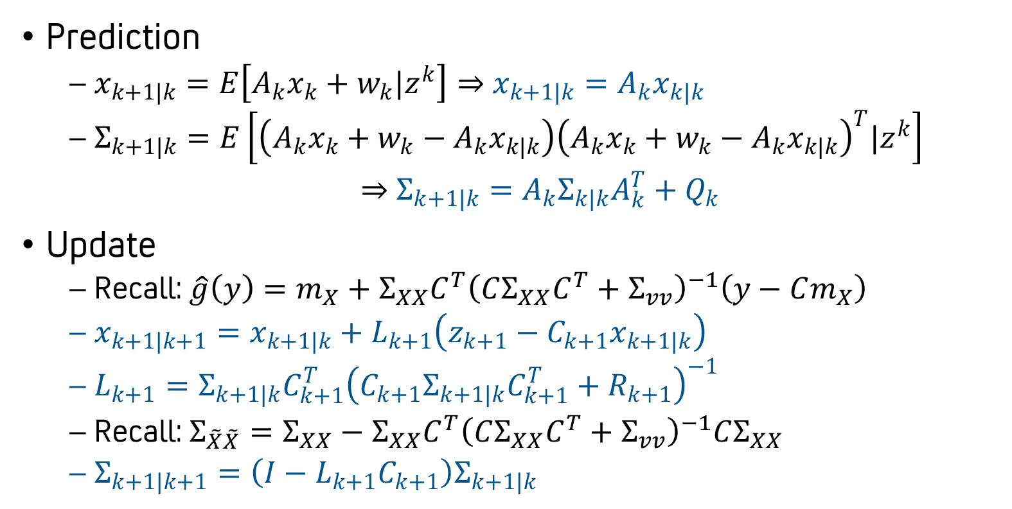
Recursive estimation: the Kalman filter²
Prediction
  $x_{k+1|k}=E\left[A_{k}x_{k}+w_{k}|z^{k}\right]⇒$ $x_{k+1|k}=A_{k}x_{k|k}$
  $Σ_{k+1|k}=E\left[\left(A_{k}x_{k}+w_{k}−A_{k}x_{k|k}\right){\left(A_{k}x_{k}+w_{k}−A_{k}x_{k|k}\right)}^{T}|z^{k}\right]$
  $⇒$ $Σ_{k+1|k}=A_{k}Σ_{k|k}A_{k}^{T}+Q_{k}$
Update
  Recall: $\hat{g}\left(y\right)=m_{X}+Σ_{XX}C^{T}{\left(CΣ_{XX}C^{T}+Σ_{vv}\right)}^{−1}\left(y−Cm_{X}\right)$
  $x_{k+1|k+1}=x_{k+1|k}+L_{k+1}\left(z_{k+1}−C_{k+1}x_{k+1|k}\right)$
  $L_{k+1}=Σ_{k+1|k}C_{k+1}^{T}{\left(C_{k+1}Σ_{k+1|k}C_{k+1}^{T}+R_{k+1}\right)}^{−1}$
  Recall: $Σ_{\tilde{X}\tilde{X}}=Σ_{XX}−Σ_{XX}C^{T}{\left(CΣ_{XX}C^{T}+Σ_{vv}\right)}^{−1}CΣ_{XX}$
  $Σ_{k+1|k+1}=\left(I−L_{k+1}C_{k+1}\right)Σ_{k+1|k}$

Slide 12
Outline
Estimation theory
Target modeling
Multi-target tracking
Multiple-hypothesis tracking
Recent advances

Slide 13
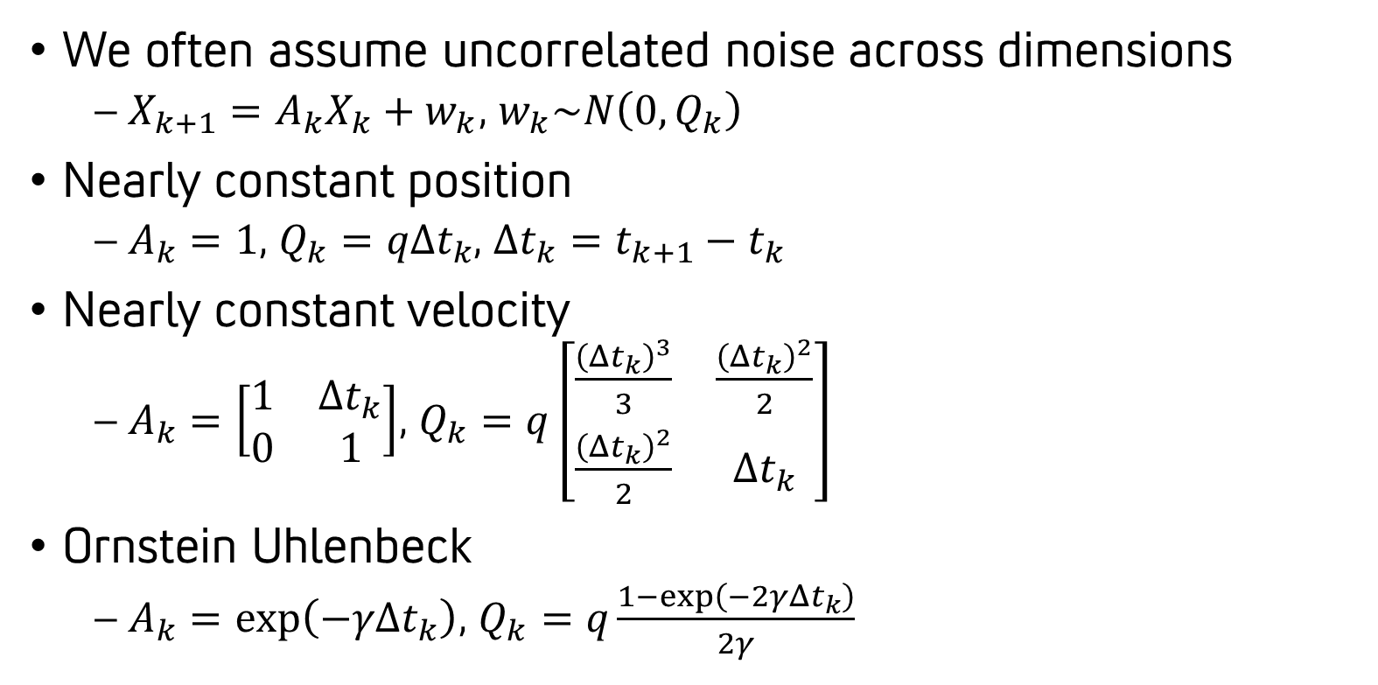
Kinematic modeling
We often assume uncorrelated noise across dimensions
  $X_{k+1}=A_{k}X_{k}+w_{k}$, $w_{k}\sim N\left(0,Q_{k}\right)$
Nearly constant position
  $A_{k}=1$, $Q_{k}=qΔt_{k}$, $Δt_{k}=t_{k+1}−t_{k}$
Nearly constant velocity
  $A_{k}=\left[\begin{matrix}1 & Δt_{k} \\ 0 & 1\end{matrix}\right]$, $Q_{k}=q\left[\begin{matrix}\frac{{\left(Δt_{k}\right)}^{3}}{3} & \frac{{\left(Δt_{k}\right)}^{2}}{2} \\ \frac{{\left(Δt_{k}\right)}^{2}}{2} & Δt_{k}\end{matrix}\right]$
Ornstein Uhlenbeck
  $A_{k}=\exp\left(−γΔt_{k}\right)$, $Q_{k}=q\frac{1−\exp\left(−2γΔt_{k}\right)}{2γ}$

Slide 14


























Summary of linear Gaussian models
Nearly-constant position
Nearly-constant velocity
Nearly-constant acceleration
∫
∫
$$\dot{x}$$
∫
∫
$$\ddot{x}$$
∫
$$\dot{x}$$
∫
$$x$$
$$w$$
$$x$$
$$w$$
$$x$$
$$w$$
Ornstein-Uhlenbeck
Integrated Ornstein-Uhlenbeck
Singer model
∫
∫
$$\dot{x}$$
∫
∫
$$\ddot{x}$$
∫
$$\dot{x}$$
∫
$$x$$
$$w$$
+
$$x$$
$$w$$
+
$$x$$
$$w$$
+
$$−γ$$
$$−γ$$
$$−γ$$
2nd order Ornstein-Uhlenbeck
∫
$$\dot{x}$$
∫
$$w$$
+
$$x$$
$$−{\hat{γ}}_{2}$$
$$−{\hat{γ}}_{1}$$

Slide 15
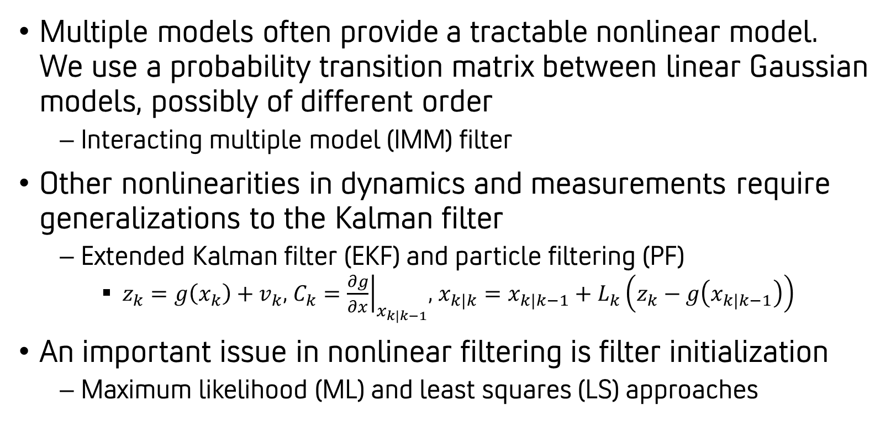
Further words on models and filters
Multiple models often provide a tractable nonlinear model. We use a probability transition matrix between linear Gaussian models, possibly of different order
  Interacting multiple model (IMM) filter
Other nonlinearities in dynamics and measurements require generalizations to the Kalman filter
  Extended Kalman filter (EKF) and particle filtering (PF)
    $z_{k}=g\left(x_{k}\right)+v_{k}$, $C_{k}={\left.\frac{∂g}{∂x}\right|}_{x_{k|k−1}}$, $x_{k|k}=x_{k|k−1}+L_{k}\left(z_{k}−g\left(x_{k|k−1}\right)\right)$
An important issue in nonlinear filtering is filter initialization
  Maximum likelihood (ML) and least squares (LS) approaches

Slide 16
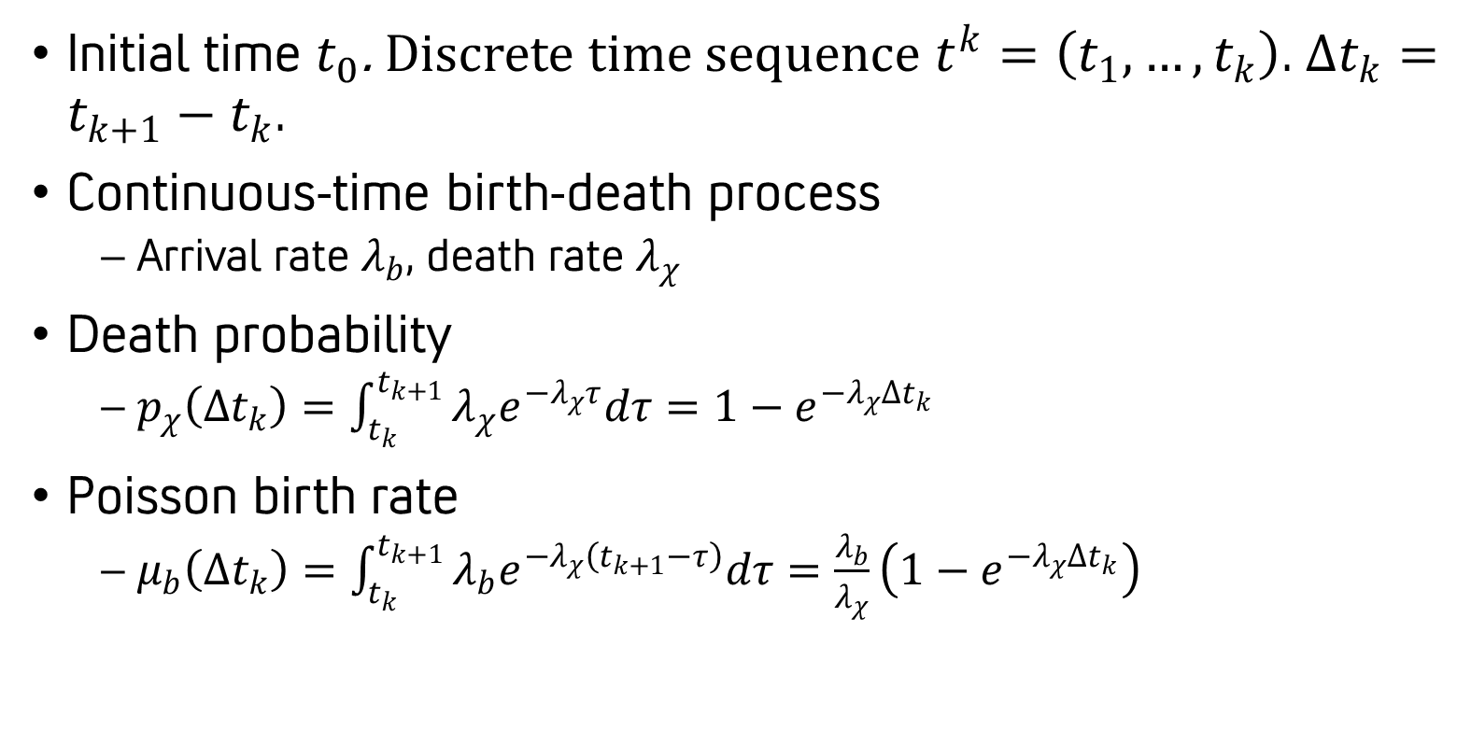
Existence modeling
Initial time $t_{0}$. Discrete time sequence $t^{k}=\left(t_{1},…,t_{k}\right)$. $∆t_{k}=t_{k+1}−t_{k}$.
Continuous-time birth-death process
  Arrival rate $λ_{b}$, death rate $λ_{χ}$
Death probability
  $p_{χ}\left(∆t_{k}\right)=\int_{t_{k}}^{t_{k+1}}{λ_{χ}e^{−λ_{χ}τ}dτ}=1−e^{−λ_{χ}∆t_{k}}$
Poisson birth rate
  $μ_{b}\left(∆t_{k}\right)=\int_{t_{k}}^{t_{k+1}}{λ_{b}e^{−λ_{χ}\left(t_{k+1}−τ\right)}dτ}=\frac{λ_{b}}{λ_{χ}}\left(1−e^{−λ_{χ}∆t_{k}}\right)$

Slide 17
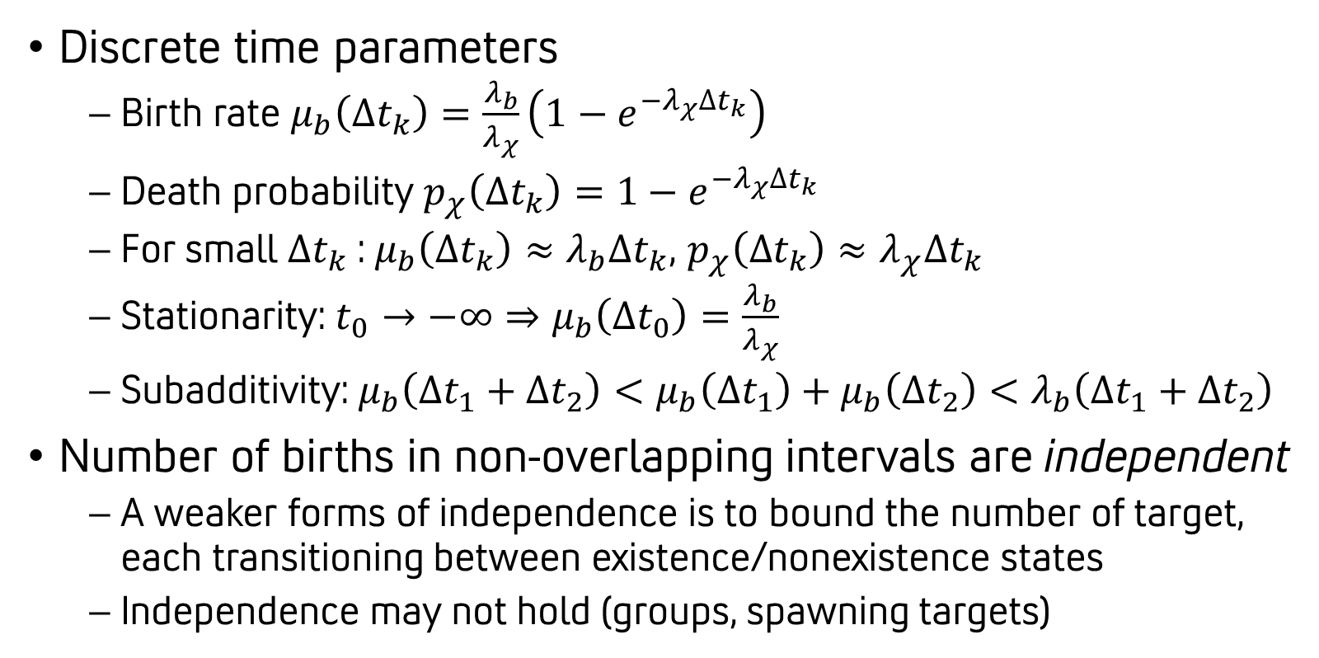
Interesting properties
Discrete time parameters
  Birth rate $μ_{b}\left(∆t_{k}\right)=\frac{λ_{b}}{λ_{χ}}\left(1−e^{−λ_{χ}∆t_{k}}\right)$
  Death probability $p_{χ}\left(∆t_{k}\right)=1−e^{−λ_{χ}∆t_{k}}$
  For small $∆t_{k}$: $μ_{b}\left(∆t_{k}\right)≈λ_{b}∆t_{k}$, $p_{χ}\left(∆t_{k}\right)≈λ_{χ}∆t_{k}$
  Stationarity: $t_{0}→−∞⇒μ_{b}\left(∆t_{0}\right)=\frac{λ_{b}}{λ_{χ}}$
  Subadditivity: $μ_{b}\left(∆t_{1}+∆t_{2}\right)<μ_{b}\left(∆t_{1}\right)+μ_{b}\left(∆t_{2}\right)<λ_{b}\left(∆t_{1}+∆t_{2}\right)$
Number of births in non-overlapping intervals are independent
  A weaker forms of independence is to bound the number of target, each transitioning between existence/nonexistence states
  Independence may not hold (groups, spawning targets)

Slide 18
Outline
Estimation theory
Target modeling
Multi-target tracking
Multiple-hypothesis tracking
Recent advances

Slide 19
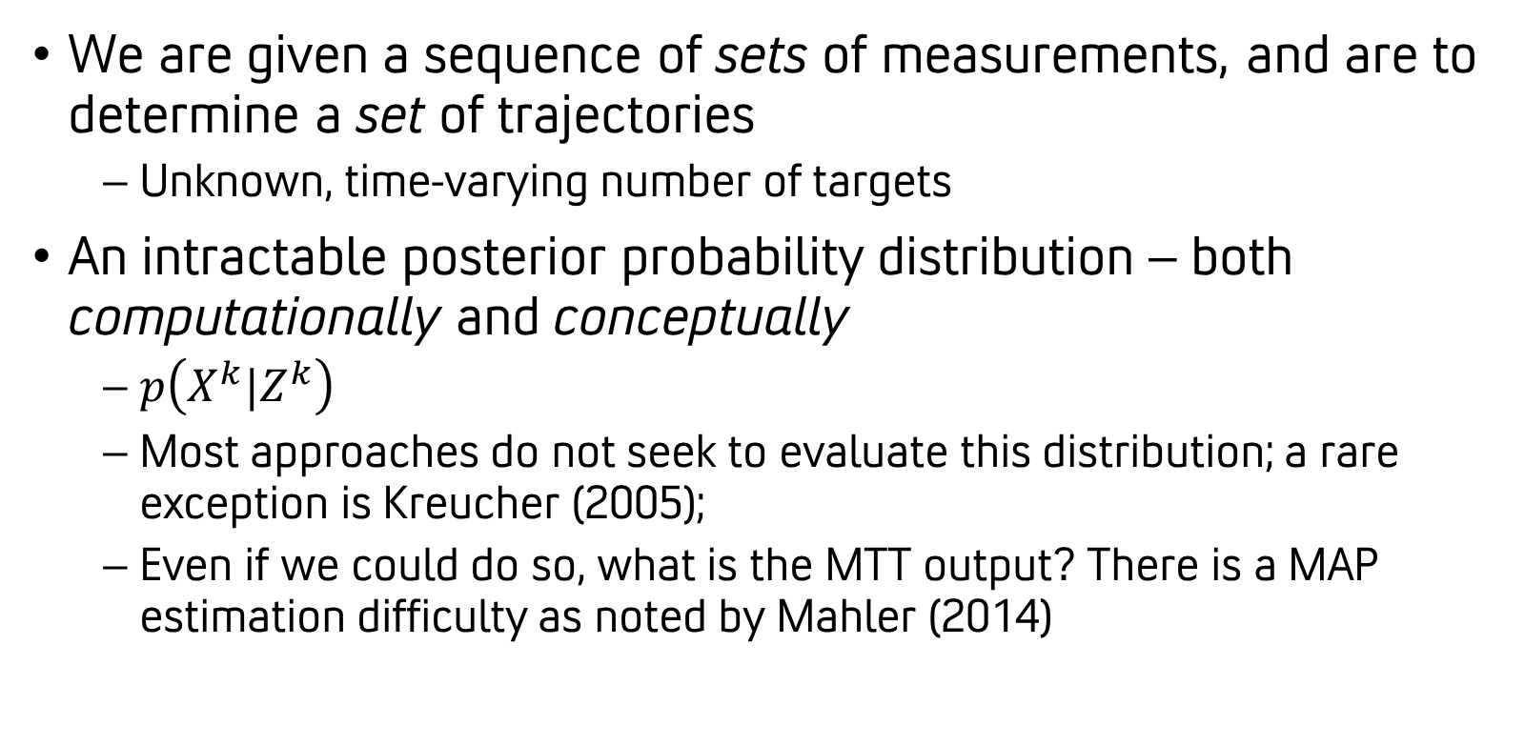
Multi-target tracking (MTT)
We are given a sequence of sets of measurements, and are to determine a set of trajectories
  Unknown, time-varying number of targets
An intractable posterior probability distribution – both computationally and conceptually
  $p\left(X^{k}|Z^{k}\right)$
  Most approaches do not seek to evaluate this distribution; a rare exception is Kreucher (2005);
  Even if we could do so, what is the MTT output? There is a MAP estimation difficulty as noted by Mahler (2014)

Slide 20
Taxonomy of MTT paradigms
?
?
?
?
 | Labeled Tracks | Unlabeled Tracks
Implicit Data Association | Symmetric Measurement Equations (SME) Define derived measurements independent of data association Labelled and trajectory RFS methods Active area of research | Random finite sets (RFS) Identifies regions where targets exist Potentially better for state estimation Includes Probability Hypothesis Density (PHD) and related methods
Explicit Data Association | Hard Data Association (Global) Nearest Neighbor ((G)NN) Multiple-Hypothesis Tracking (MHT) Markov chain Monte Carlo (MCMC) Soft Data Association (Joint) Probabilistic Data Association ((J)PDA) Probabilistic Multiple Hypothesis Tracking (PMHT) Belief propagation (BP) | Set JPDA, set MHT Mix tracking solutions for improved state estimation
Leading operational approach

Slide 21
Some comments on MTT methods
Some MTT methods focus primarily on multi-target filtering, with no automated track management
  GNN, JPDA, PMHT
  Track management is handled externally, e.g. Integrated JPDA (JIPDA)
Some MTT methods directly address both track management and multi-target filtering
  MHT, MCMC, PHD
There is a distinct literature on identity management (IM) algorithms that addresses the coupling in target identity estimates

Slide 22
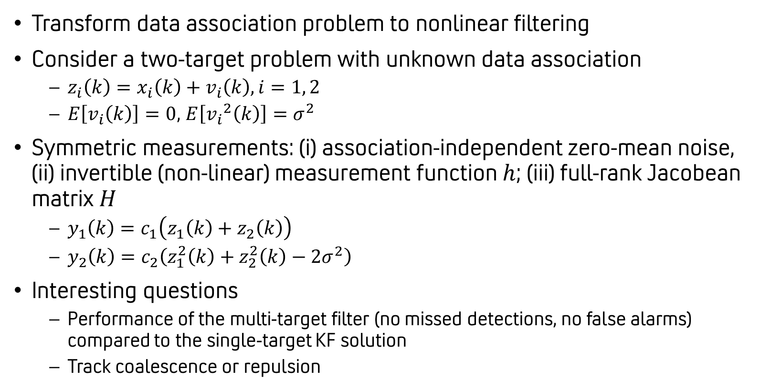
Symmetric measurement equation
Transform data association problem to nonlinear filtering
Consider a two-target problem with unknown data association
  $z_{i}\left(k\right)=x_{i}\left(k\right)+v_{i}\left(k\right),i=1, 2$
  $E\left[v_{i}\left(k\right)\right]=0$, $E\left[{v_{i}}^{2}\left(k\right)\right]=σ^{2}$
Symmetric measurements: (i) association-independent zero-mean noise, (ii) invertible (non-linear) measurement function $h$; (iii) full-rank Jacobean matrix $H$
  $y_{1}\left(k\right)=c_{1}\left(z_{1}\left(k\right)+z_{2}\left(k\right)\right)$
  $y_{2}\left(k\right)=c_{2}\left(z_{1}^{2}\left(k\right)+z_{2}^{2}\left(k\right)−2σ^{2}\right)$
Interesting questions
  Performance of the multi-target filter (no missed detections, no false alarms) compared to the single-target KF solution
  Track coalescence or repulsion

Slide 23
Operational performance metrics
Multi-target tracking (MTT) yields a set of track trajectories
  How do we compare this to the set of true trajectories?
Operational performance metrics
  Multiple measures are of interest: coupled and non-exhaustive
  Most measures are not metrics in a mathematical sense
Scalar performance evaluation
  OSPA, GOSPA, and track-level GOSPA
  Scalar assessment (albeit with some parameters)
  Satisfies requirements to be a mathematical metric

Slide 24
Completeness, purity, estimation error
Track fragmentation (this lowers target purity)
Non-tracked target (this lowers target completeness)
Legend
Target
Track
State estimation error (this is averaged over all target-track associations)
Track swap (this lowers track purity)
False tracks (these lower track completeness)

Slide 25
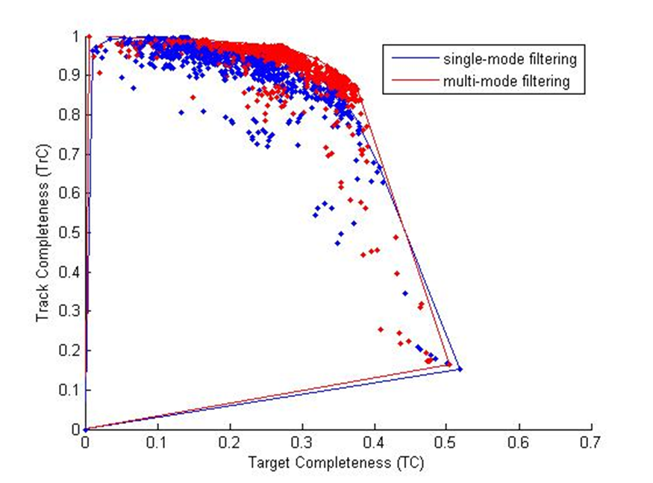
Towards a scalar objective
Like in detection-level receiver operating characteristics (ROC) curves, there are track-level performance tradeoffs

Slide 26
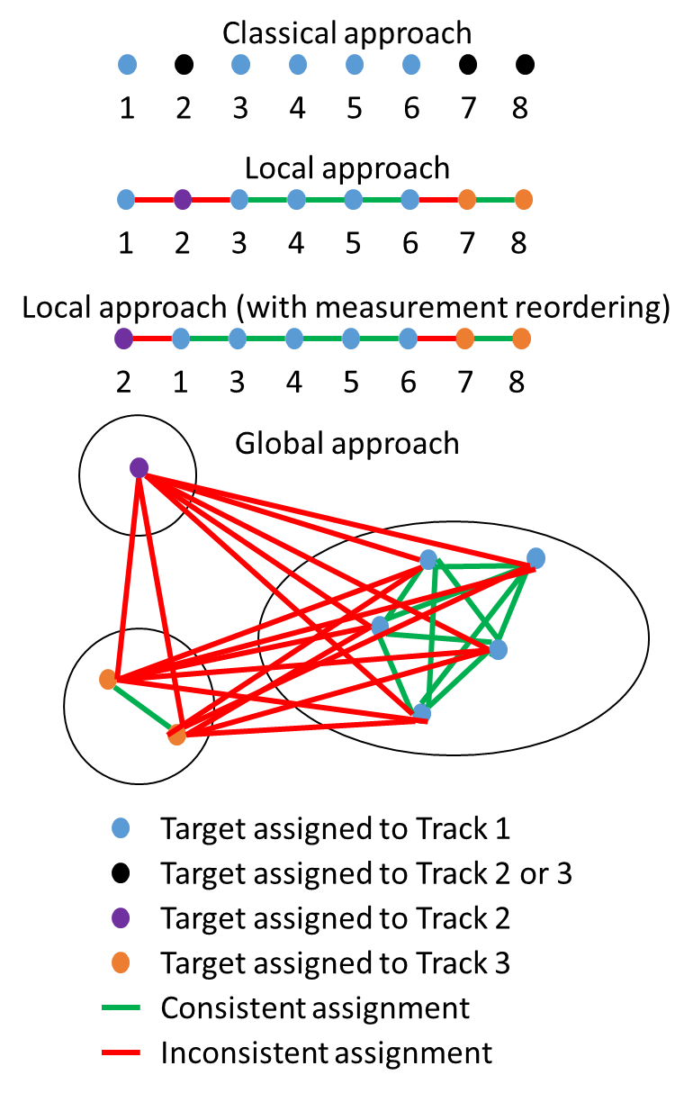
Some issues in performance evaluation
Use of velocity or classification states in 2D assignment
Some quantities not reflected
  False track rate
  Repeated tracks (or coasted terminal tracks) vs. false tracks
  Solution execution time and reporting latency
  Precision, robustness, consistency of purity computations
  Track uncertainty

Slide 27
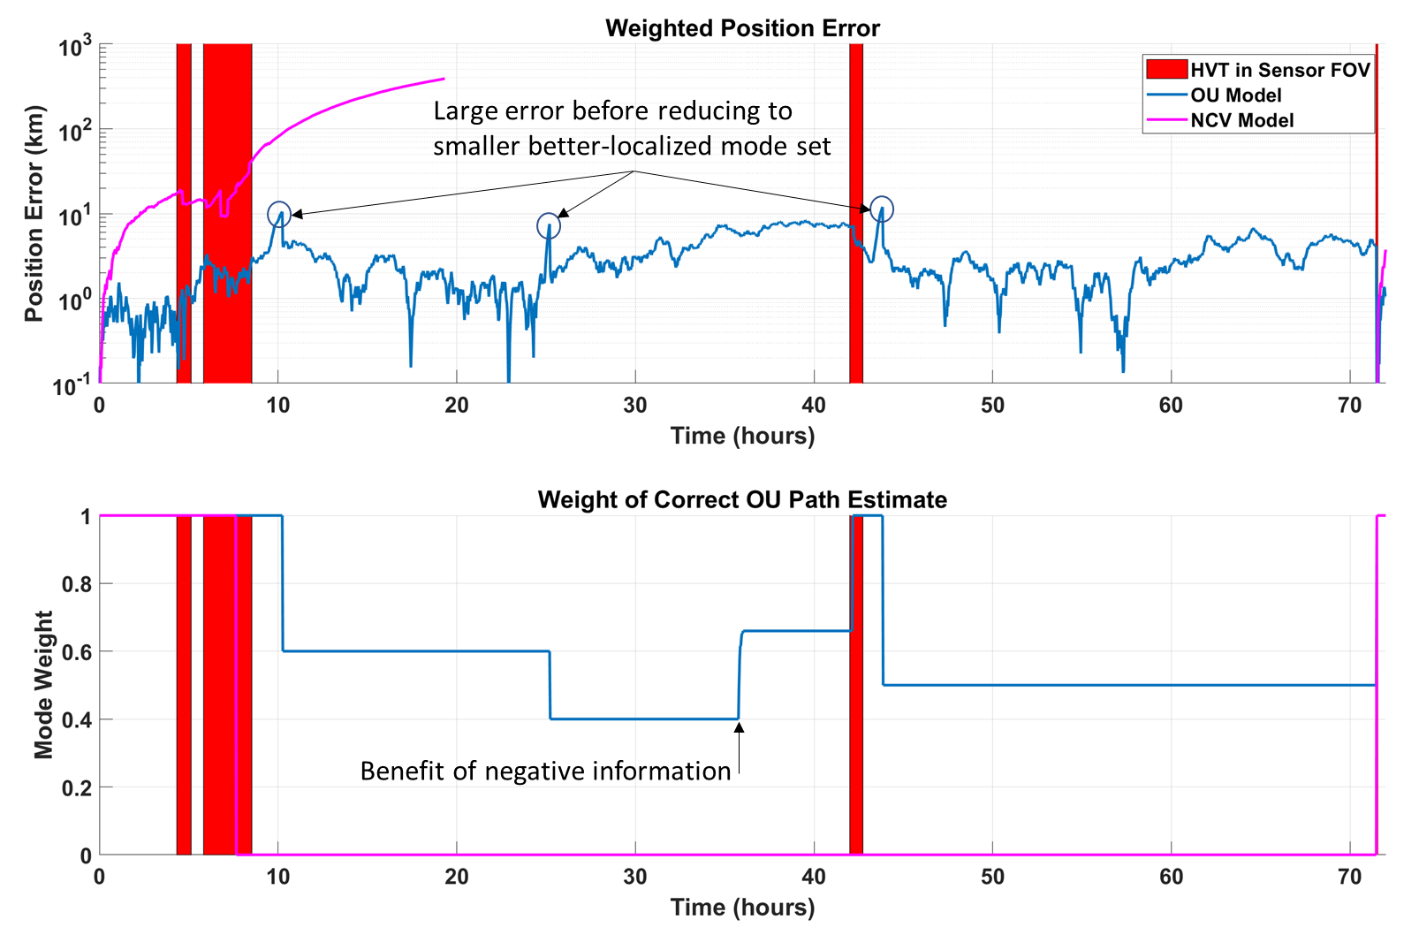
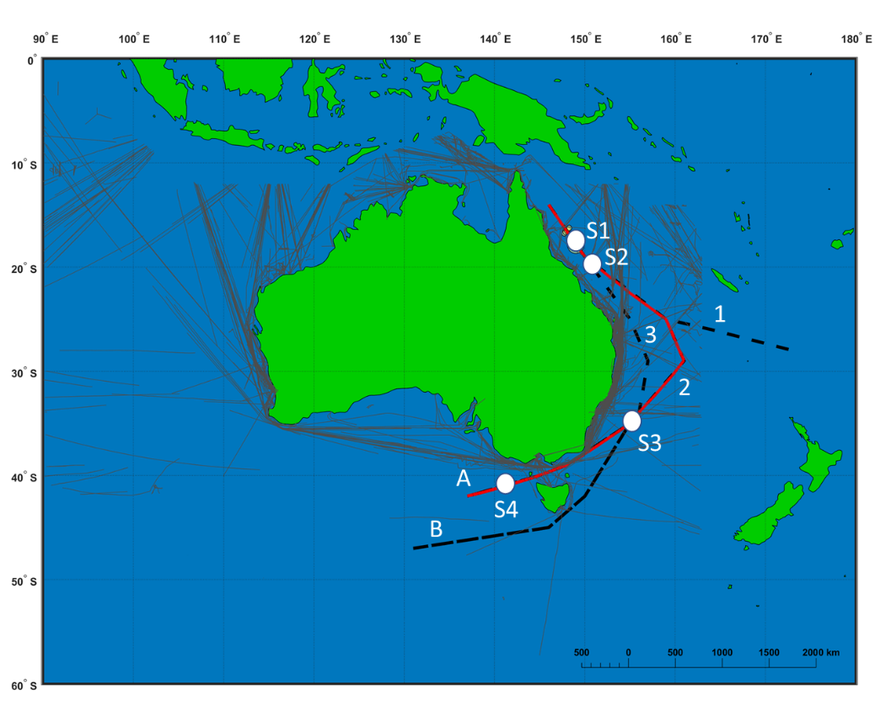
Relaxing the point-track assumption
Gaussian mixture example illustrates localization-completeness tradeoff

Slide 28
Outline
Estimation theory
Target modeling
Multi-target tracking
Multiple-hypothesis tracking
Recent advances

Slide 29
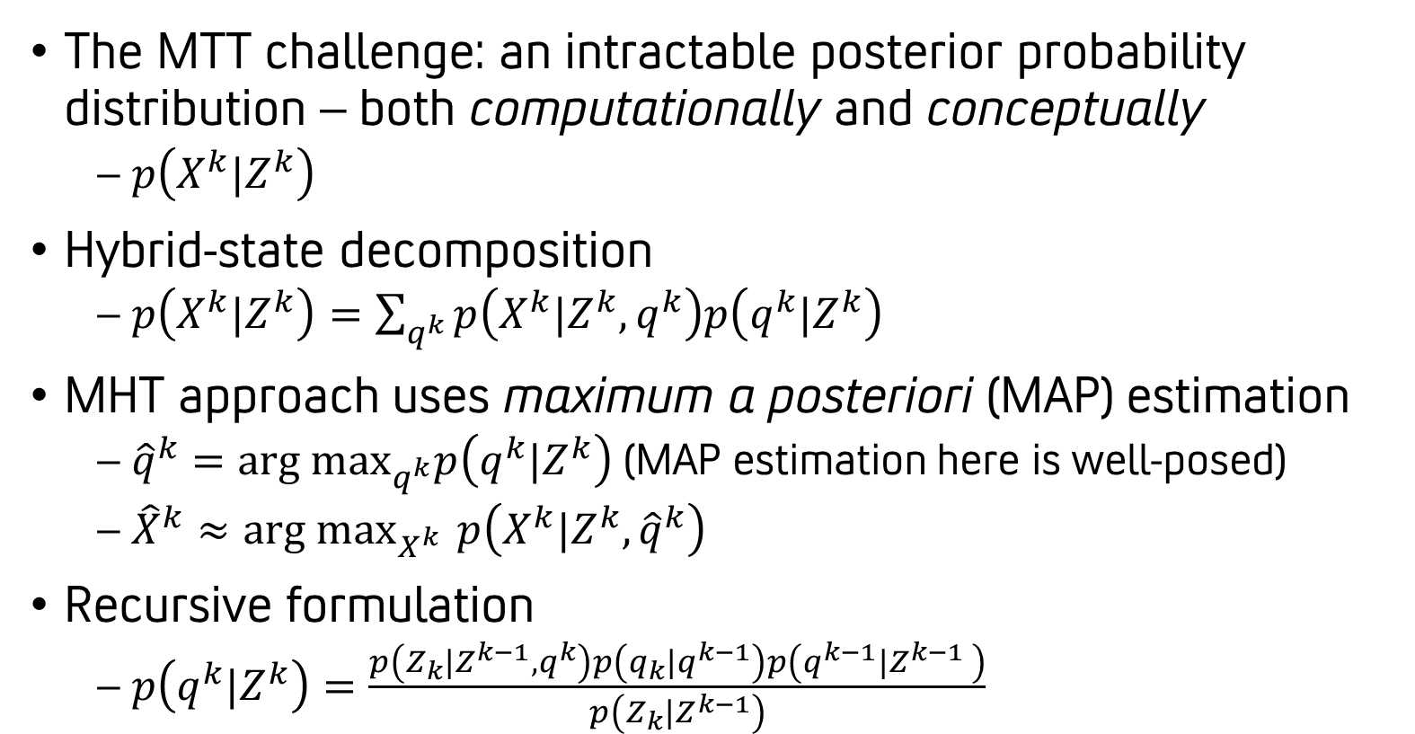
Multiple-hypothesis tracking (MHT)
The MTT challenge: an intractable posterior probability distribution – both computationally and conceptually
  $p\left(X^{k}|Z^{k}\right)$
Hybrid-state decomposition
  $p\left(X^{k}|Z^{k}\right)=\sum_{q^{k}}{p\left(X^{k}|Z^{k},q^{k}\right)p\left(q^{k}|Z^{k}\right)}$
MHT approach uses maximum a posteriori (MAP) estimation
  ${\hat{q}}^{k}={arg max}_{q^{k}}p\left(q^{k}|Z^{k}\right)$ (MAP estimation here is well-posed)
  ${\hat{X}}^{k}≈{arg max}_{X^{k} }{p\left(X^{k}|Z^{k},{\hat{q}}^{k}\right)}$
Recursive formulation
  $p\left(q^{k}|Z^{k}\right)=\frac{p\left(Z_{k}|Z^{k−1},q^{k}\right)p\left(q_{k}|q^{k−1}\right)p\left(q^{k−1}|Z^{k−1} \right)}{p\left(Z_{k}|Z^{k−1}\right)}$

Slide 30
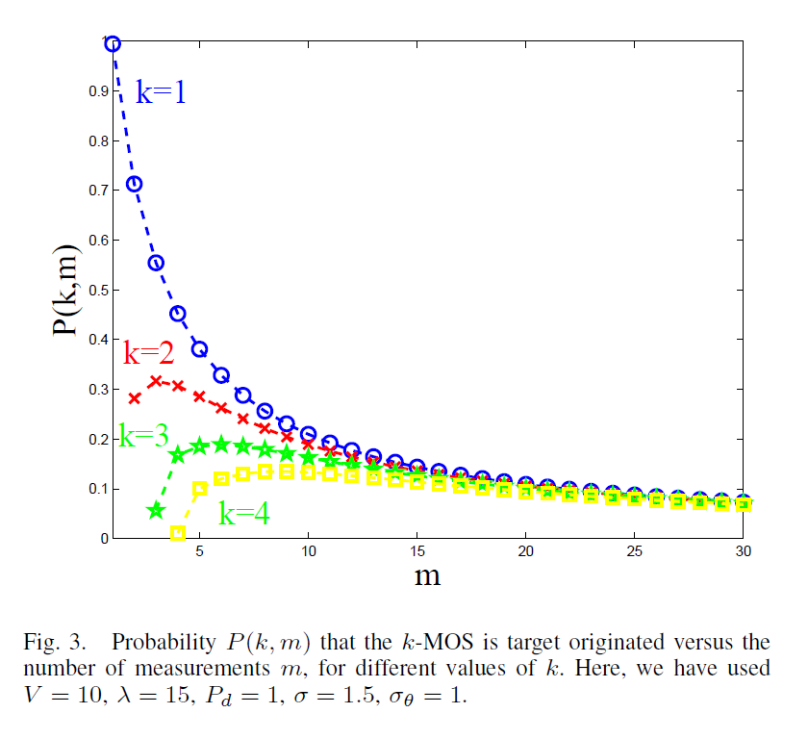
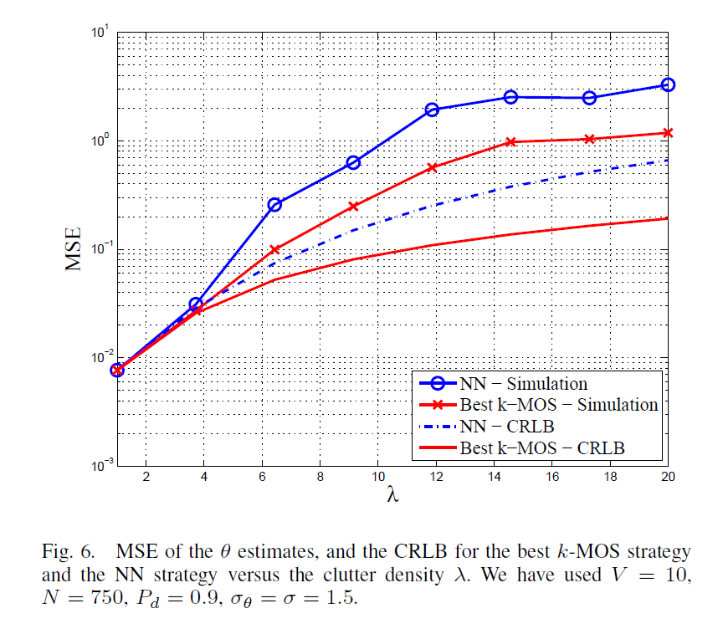
Is MAP estimation a good idea?
Single-target tracking: MAP doesn’t minimize mean squared error (MSE)!
  Recall MMSE, MMAE, and MAP criteria lead to the same estimator under very narrow assumptions (linearity and Gaussianity)
  MAP criterion is often easier (no need for normalization), and tractable for MTT
Which measurement to select?
Braca et al. (2010)

Slide 31
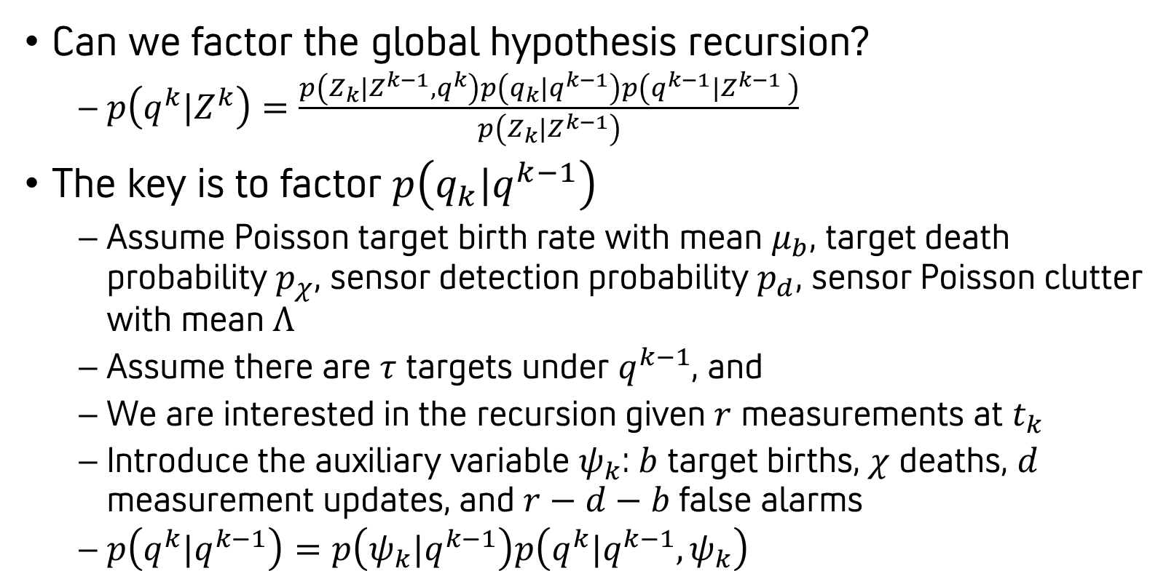
Hypothesis-oriented MHT
Can we factor the global hypothesis recursion?
  $p\left(q^{k}|Z^{k}\right)=\frac{p\left(Z_{k}|Z^{k−1},q^{k}\right)p\left(q_{k}|q^{k−1}\right)p\left(q^{k−1}|Z^{k−1} \right)}{p\left(Z_{k}|Z^{k−1}\right)}$
The key is to factor $p\left(q_{k}|q^{k−1}\right)$
  Assume Poisson target birth rate with mean $μ_{b}$, target death probability $p_{χ}$, sensor detection probability $p_{d}$, sensor Poisson clutter with mean $Λ$
  Assume there are $τ$ targets under $q^{k−1}$, and
  We are interested in the recursion given $r$ measurements at $t_{k}$
  Introduce the auxiliary variable $ψ_{k}$: $b$ target births, $χ$ deaths, $d$ measurement updates, and $r−d−b$ false alarms
  $p\left(q^{k}|q^{k−1}\right)=p\left(ψ_{k}|q^{k−1}\right)p\left(q^{k}|q^{k−1},ψ_{k}\right)$

Slide 32
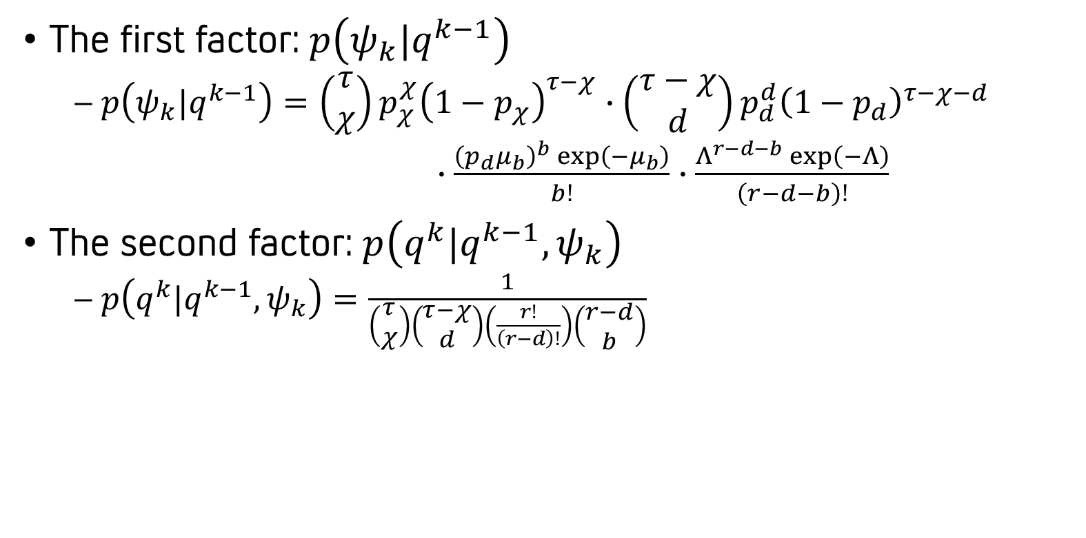
Grinding through the math
The first factor: $p\left(ψ_{k}|q^{k−1}\right)$
  $p\left(ψ_{k}|q^{k−1}\right)=\left(\begin{matrix}τ \\ χ\end{matrix}\right)p_{χ}^{χ}{\left(1−p_{χ}\right)}^{τ−χ}$ $∙\left(\begin{matrix}τ−χ \\ d\end{matrix}\right)p_{d}^{d}{\left(1−p_{d}\right)}^{τ−χ−d}$
  $∙\frac{{\left(p_{d}μ_{b}\right)}^{b}\exp\left(−μ_{b}\right)}{b!}$ $∙\frac{Λ^{r−d−b}\exp\left(−Λ\right)}{\left(r−d−b\right)!}$
The second factor: $p\left(q^{k}|q^{k−1},ψ_{k}\right)$
  $p\left(q^{k}|q^{k−1},ψ_{k}\right)=\frac{1}{\left(\begin{matrix}τ \\ χ\end{matrix}\right)\left(\begin{matrix}τ−χ \\ d\end{matrix}\right)\left(\frac{r!}{\left(r−d\right)!}\right)\left(\begin{matrix}r−d \\ b\end{matrix}\right)}$

Slide 33
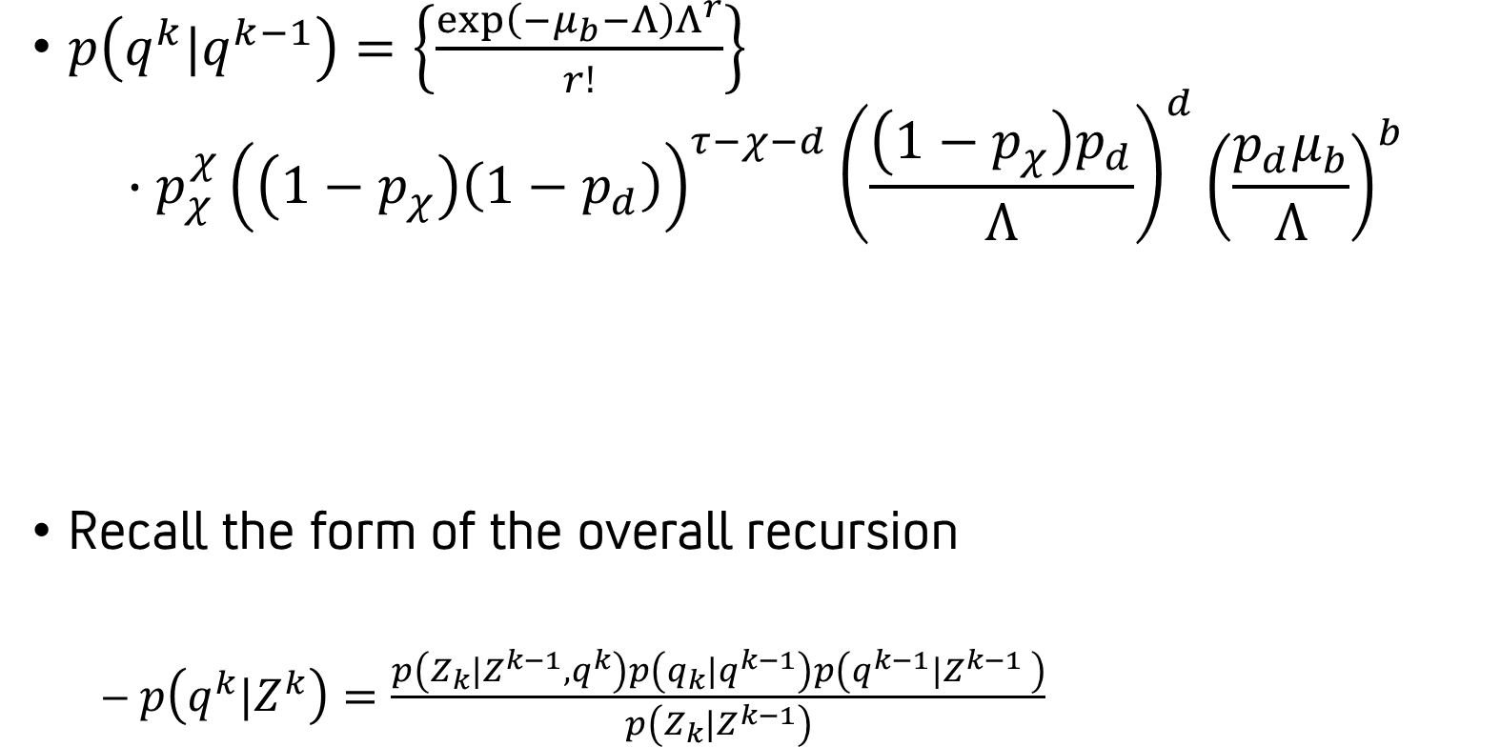
Factored form of predicted hypothesis
Normalizing constant: this is the probability of the null hypothesis (no births, all r measurements are false)
$p\left(q^{k}|q^{k−1}\right)=\left\{\frac{\exp\left(−μ_{b}−Λ\right)Λ^{r}}{r!}\right\}$
$$∙p_{χ}^{χ}{\left(\left(1−p_{χ}\right)\left(1−p_{d}\right)\right)}^{τ−χ−d}{\left(\frac{\left(1−p_{χ}\right)p_{d}}{Λ}\right)}^{d}{\left(\frac{p_{d}μ_{b}}{Λ}\right)}^{b}$$
Recall the form of the overall recursion
  $p\left(q^{k}|Z^{k}\right)=\frac{p\left(Z_{k}|Z^{k−1},q^{k}\right)p\left(q_{k}|q^{k−1}\right)p\left(q^{k−1}|Z^{k−1} \right)}{p\left(Z_{k}|Z^{k−1}\right)}$
Contribution for each track death
Contribution for each target that remains alive and is undetected
Contribution for each target that remains alive and is detected
Contribution for each target birth
This is above

Slide 34
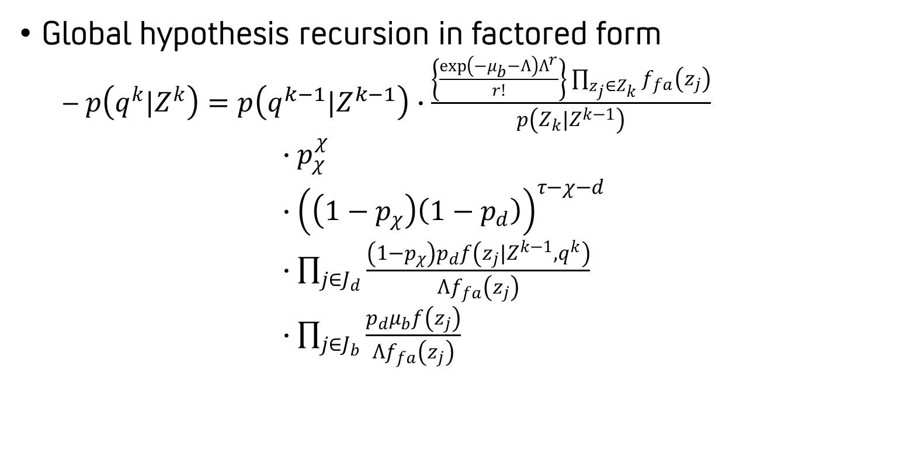
The track-oriented MHT recursion
Global hypothesis recursion in factored form
  $p\left(q^{k}|Z^{k}\right)=p\left(q^{k−1}|Z^{k−1}\right)∙\frac{\left\{\frac{\exp\left(−μ_{b}−Λ\right)Λ^{r}}{r!}\right\}\prod_{z_{j}∈Z_{k}}{f_{fa}\left(z_{j}\right)}}{p\left(Z_{k}|Z^{k−1}\right)}$
  $∙p_{χ}^{χ}$
  $∙{\left(\left(1−p_{χ}\right)\left(1−p_{d}\right)\right)}^{τ−χ−d}$
  $∙\prod_{j∈J_{d}}{\frac{\left(1−p_{χ}\right)p_{d}f\left(z_{j}|Z^{k−1},q^{k}\right)}{Λf_{fa}\left(z_{j}\right)}}$
  $∙\prod_{j∈J_{b}}{\frac{p_{d}μ_{b}f\left(z_{j}\right)}{Λf_{fa}\left(z_{j}\right)}}$
Common to all global hypotheses
Target deaths
Target missed detections
Detection of previously existing targets
New target detections

Slide 35
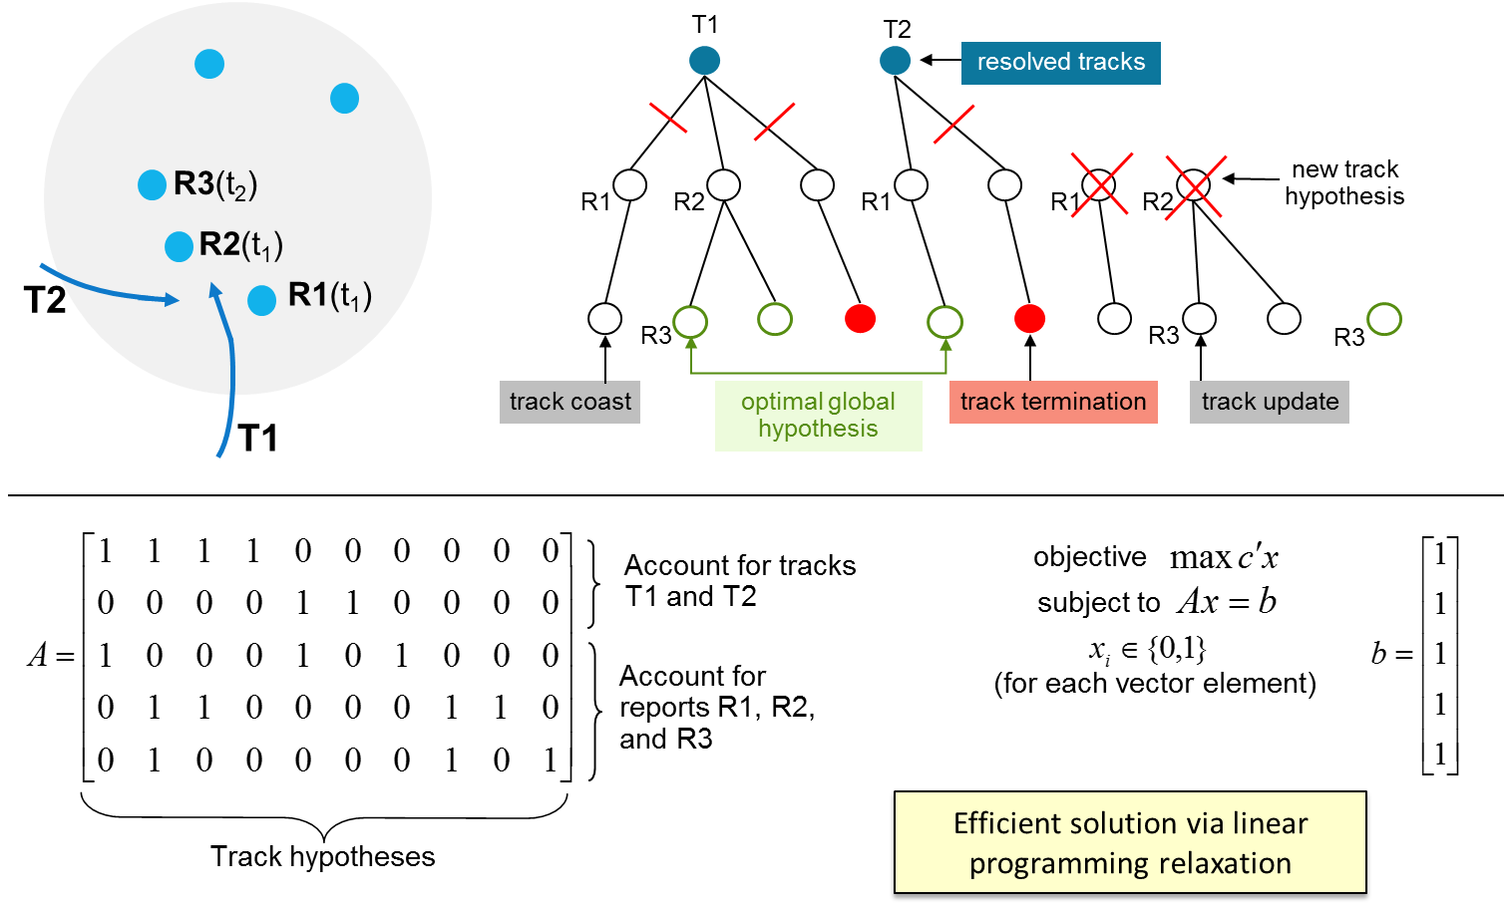
Example
Online MHT identifies (approximately) the MAP data association solution over a sliding time window
  Hypothesis forest depth is n-scan (set to one in example below)

Slide 36
More to MHT than scoring recursion
The MHT equations prescribe a batch optimal solution; practical solutions involve judicious simplification
  Sliding-window processing
  Decouple data association and track management
Logic-based track management
M-of-N confirmation
K missed detections
T timeout
Hypothesis Management
Track Management
Detections
and/or Tracks
Tracks
Nonlinear Filtering
Data Association
MHT

Slide 37
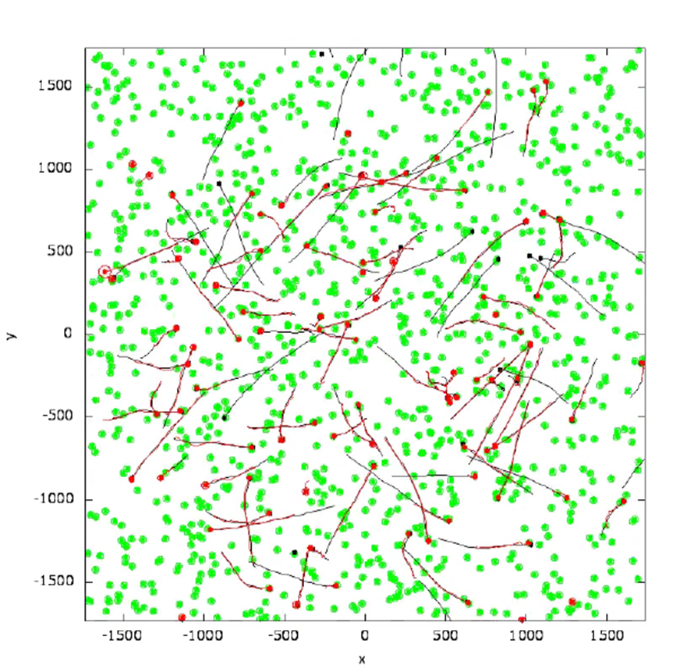
In ideal settings things work very well
Benign conditions
  Data is well-matched to modeling assumptions
  No complex detection or measurement effects (e.g. fading, bias errors, nonlinearity, limited observability, merged/repeated measurements)
  No acquisition, processing, or communication delays
  Manageable data volume with like sensors
Performance trends match expectations
  Benefit of increasing hypothesis depth
  Benefit of increasing sensor data rate

Slide 38
Outline
Estimation theory
Target modeling
Multi-target tracking
Multiple-hypothesis tracking
Recent advances

Slide 39
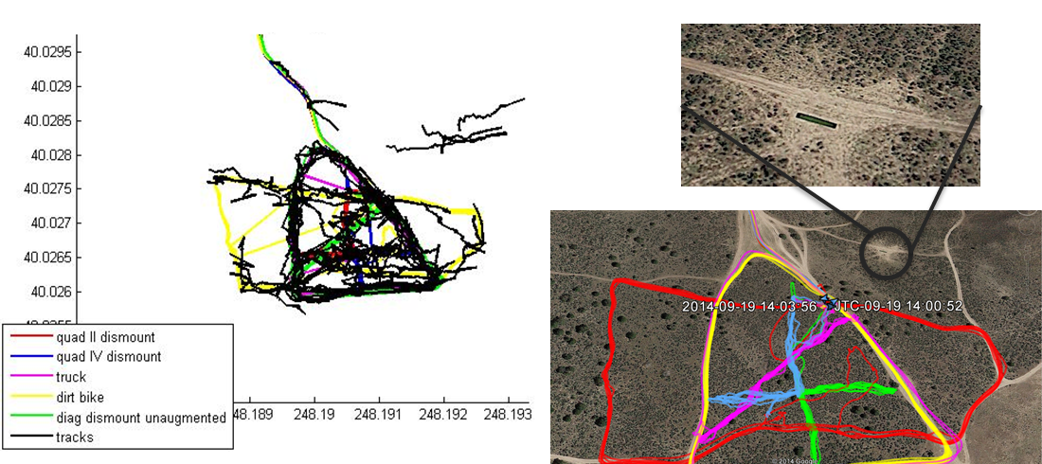
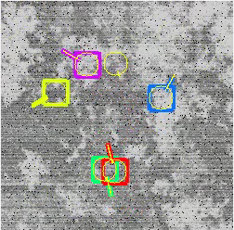
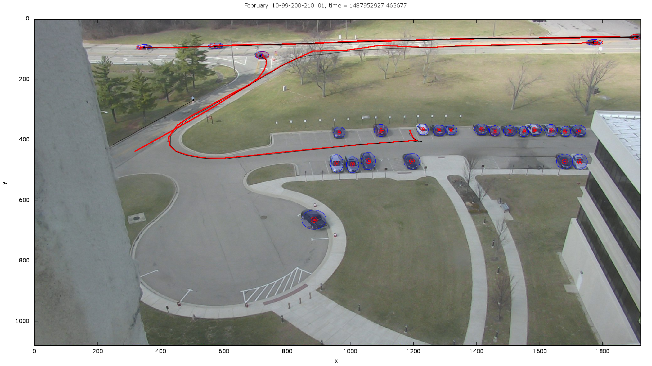
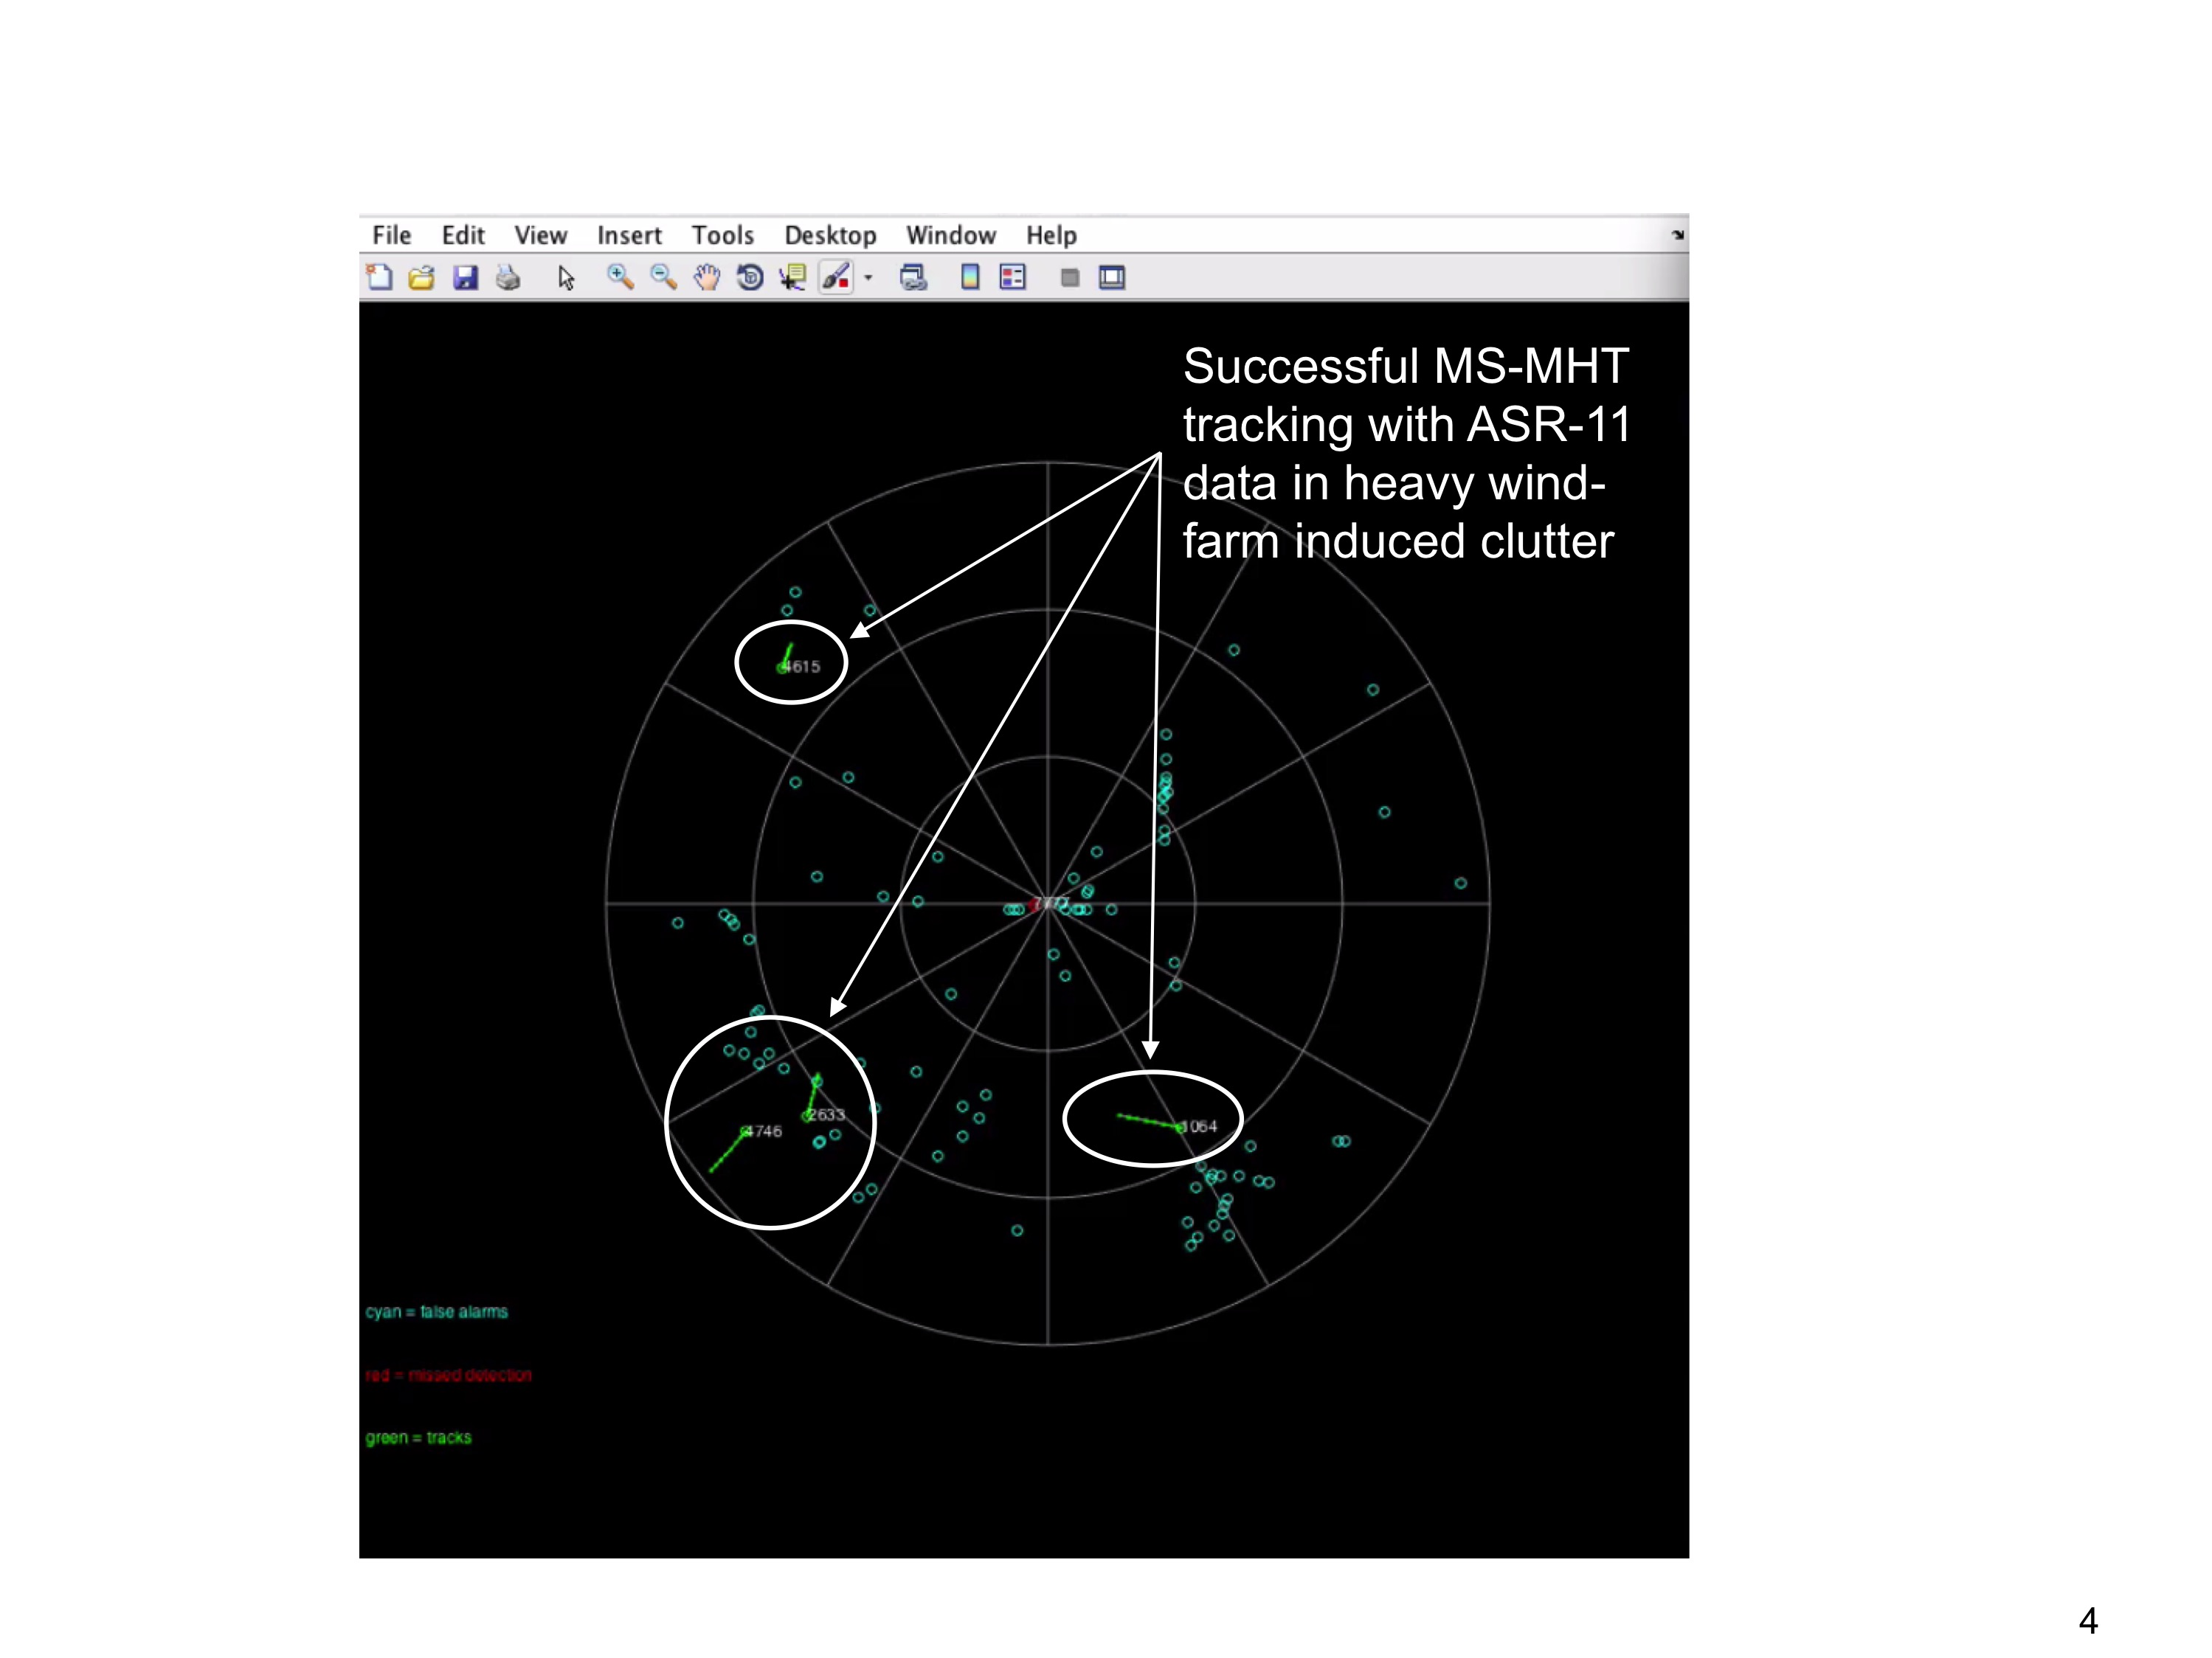
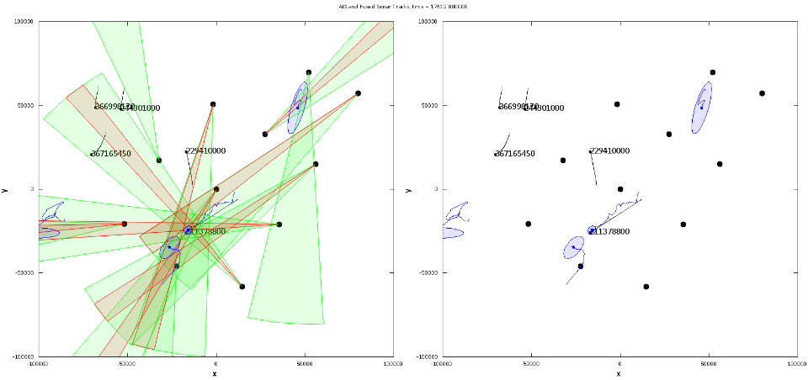
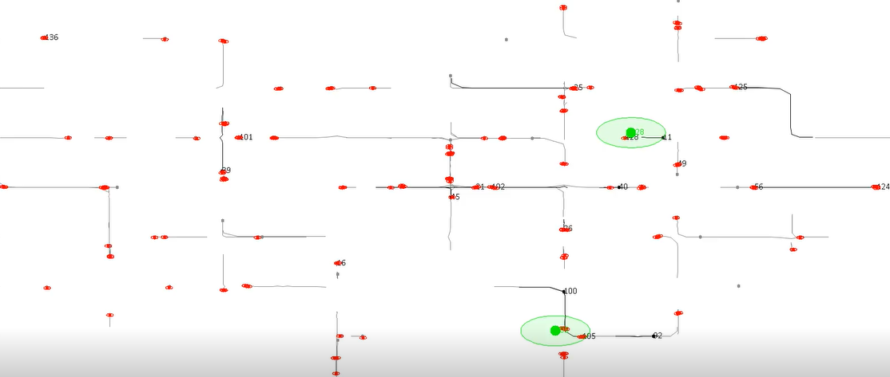
Achieving performance requires more
GMTI Tracking
OPIR Tracking
Video Tracking
Single Sensor
Illustrations of STR Multi-Stage MHT (MS-MHT)
Air Surveillance
Passive Sonar Tracking
Multi-INT Fusion
Multiple Sensor

Slide 40
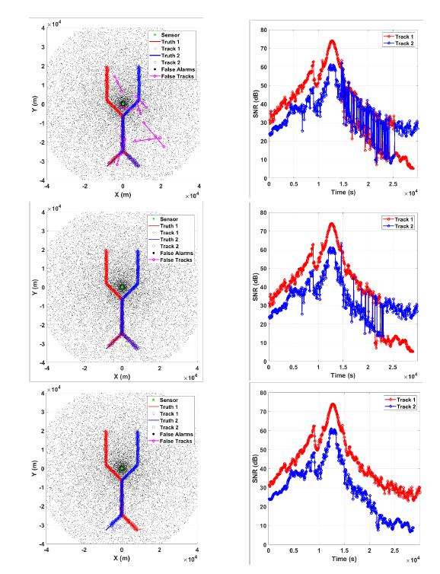
Areas of MHT progress
baseline
Nonlinear MHT
  ML vs. Geometric track initialization
  Sequential EFK, multiple-model filtering, particle filtering
Feature-aided MHT
  Enhanced likelihood ratio, state augmentation
Enhanced MHT recursion
Distributed and hierarchical MHT
Graph-based tracking
Context-aware MHT
Enhanced ratio
Enhanced ratio and state augmentation

Slide 41
Enhanced MHT recursion
classical
enhanced
Aggregate over data-indistinguishable global hypotheses
Aggregate over similar global hypotheses
Allow for merged and repeated measurements
Enhanced MHT identifies optimal birth time interval
Classical MHT assumes birth occurs in preceding interval
Coraluppi and Carthel, IEEE T-AES 2014
time
measurement
Coraluppi and Carthel, IEEE T-AES 2018
Coraluppi and Carthel, IEEE Aerospace 2012

Slide 42
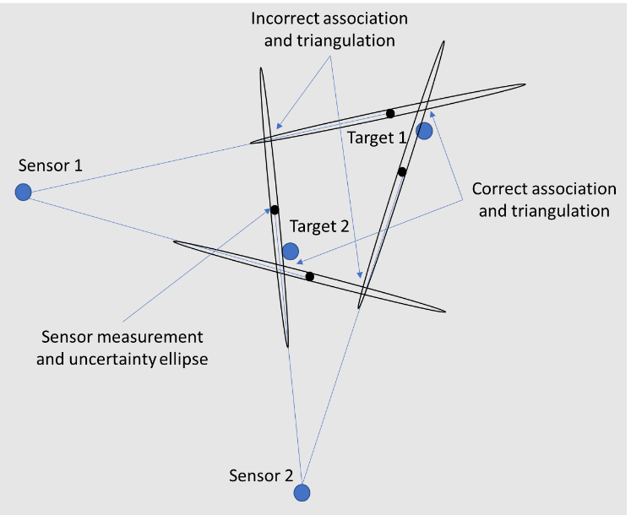
Distributed tracking
Centralized tracking is optimal given no processing constraints
Empirical advantages of distributed tracking
  Robust to detection fading and measurement biases
  Robust to high frame rate (track before track) or large networks of degraded sensors (fuse before track)
  Effective for limited-observability sensors or highly-disparate sensors (track before fuse)
  Enables asynchronous data association
MHT
MHT
MHT
Distributed processing

Slide 43
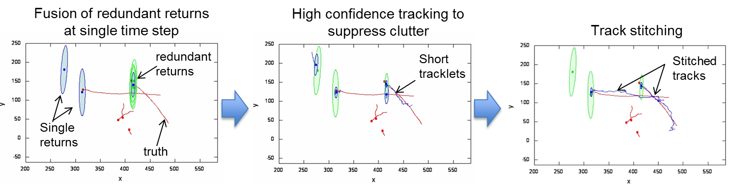
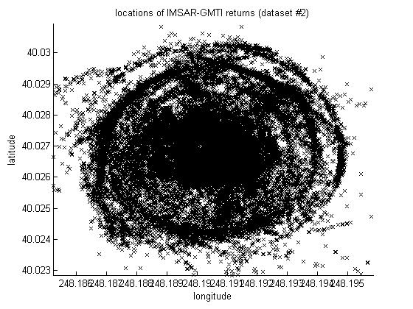
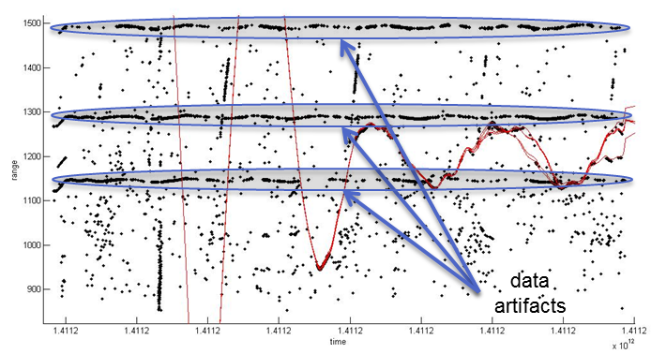
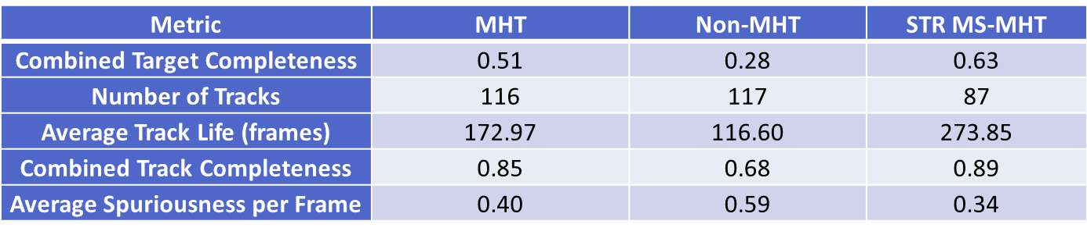
A single-sensor GMTI tracking example
Static fusion
High-confidence tracking
Track stitching
Input
250
250
250
100
100
100
-50
-50
-50
200
400
550
200
400
550
200
400
550
Track suppression
Output
Coraluppi et al., NSSDF 2016
Excellent benchmark results compared to other solutions

Slide 44
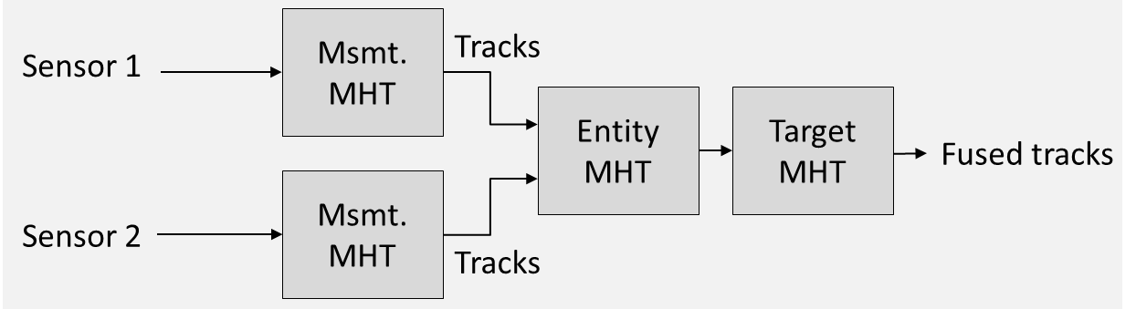
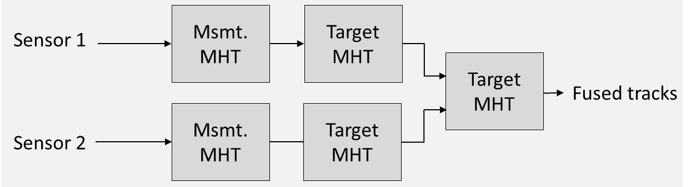
Hierarchical tracking
Relevant to passive sonar & radar
  Observability and repeated-measurement challenges
Architecture 1
Architecture 2
Coraluppi et al., FUSION 2021

Slide 45
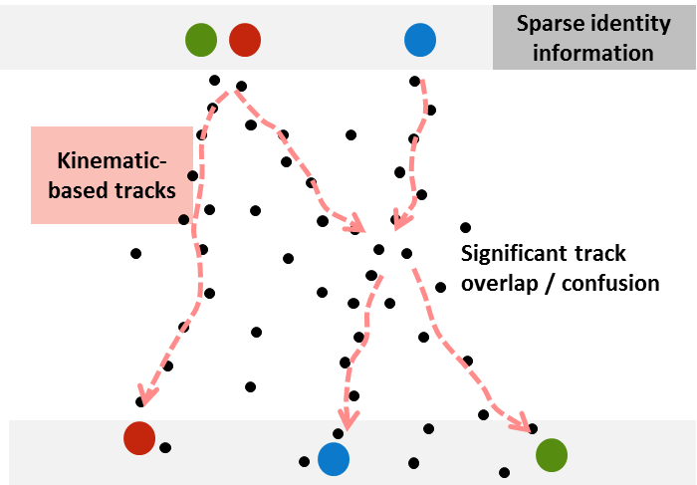
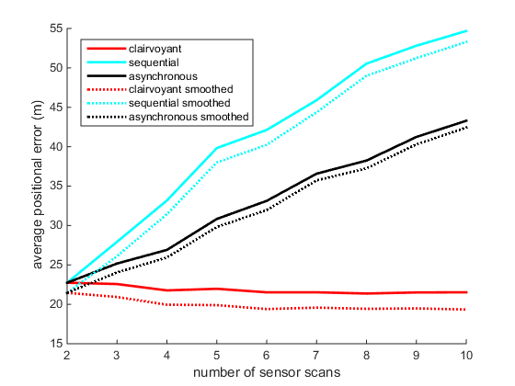
Multi-INT fusion
Distributed MHT is insufficient
  Asynchronous MHT provides some improvement (Coraluppi et al, IEEE Aerospace 2016)
Hypothesis-oriented MHT can be simplified in many ways
  Hybrid scheme exploits elements of MHT and classical graph-based tracking (GBT)
Assumptions | General | Partially Markov data | Markov data
General | HO-MHT (Reid 1979) | not investigated | Viterbi (Wolf et al. 1989)
Poisson targets and clutter | TO-MHT (Kurien 1990) | Graph-based fusion (GBF) (Coraluppi et al. FUSION 2016) | GBT (Castañón 1990)

Slide 46
GBF Illustration
Scenario: color indicates identity data
GBF representation is compact and nearly lossless
GBF
0
A
B
space
A
1
3
C
1
2
1
2
1
2
2
4
B
3
4
3
4
3
4
time
C
Subgraph R
(red)
Null subgraph
Subgraph G
(green)
A
MHT
B
1
2
1
2
1
2
3
4
3
4
3
4
3
4
3
4
3
4
3
4
3
4
3
4
C
C
C
C
C
C
C
C
C
C
C
C
C
C
C
C
C
C

Slide 47
GBF vs. MHT performance (notional)
MHT has slightly better performance that GBF for a given n-scan
GBF has lower computational effort than MHT for a given n-scan
Operating points
Performance
MHT
performance
gain
GBF
GBF
Hypothesis depth
Performance
MHT
processing
constraint
Complexity
MHT
Complexity
GBF
Empirical results in: C. Carthel, J. LeNoach, S. Coraluppi, A. Willsky, and B. Bale, FUSION 2020
Hypothesis depth

Slide 48
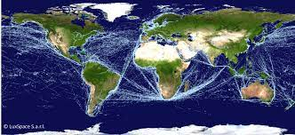
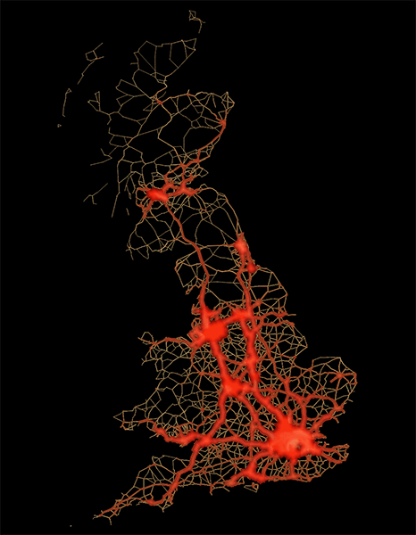
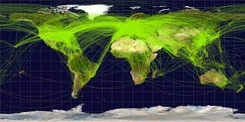
General context-aware tracking
Types of context
  Aggregate patterns life
  Motion constraints
  Partial knowledge of target objectives (avoid detection, achieve mission, etc.)
Approaches
  Modifying or augmenting sensor data
  Modify target dynamics, including Gaussian-mixture filters and particle filters
Maritime traffic
Ground traffic
Air traffic

Slide 49








Single-model context-aware tracking
All available context and prior information should be exploited
  This is particularly beneficial in limited-coverage settings
One approach to do so is to embed such information in a nominal trajectory
Context-aware target model
$$x_{det}$$
Conventional target model
Plan or learned pattern
$$x$$
Nearly-constant velocity (NCV)
2nd order OU process
+
Actual
trajectory
∫
$$\dot{x}$$
∫
$$x$$
∫
$${\dot{x}}_{sto}$$
∫
$$x_{sto}$$
$$w$$
$$w$$
+
Actual
trajectory

Slide 50
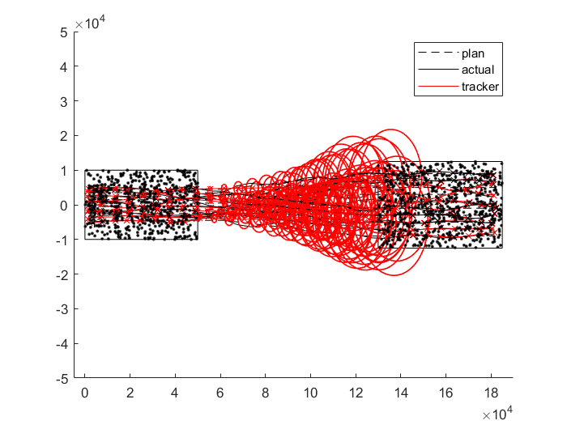
Conventional processing
3. Error ellipses exhibit cubic growth in positional uncertainty (consistent with NCV model)
1. Good tracking in area of good coverage
4. Target reacquisition (with mostly incorrect association, despite principled MHT likelihood scoring)
2. Track extrapolation where data is absent (tracks are not terminated due to known coverage gap)

Slide 51

Context-aware processing
1. Good tracking in area of good coverage
2. Track extrapolation where data is absent maintains bounded uncertainty and exploits nominal flight-plan information
3. High-accuracy target reacquisition

Slide 52


Single-model context aware tracking
In simulations with N targets and large coverage gaps, probability of correct association (PCA) with data association processing degrades to the performance lower bound
  $PCA≈\frac{1}{N}$
Use of generalized Ornstein-Uhlenbeck filters leads to a substantial performance gain
  When coverage is good, tracking performance is similar to conventional processing
  When coverage is poor, track filters give more weight to context, maintaining bounded and statistically-consistent uncertainty
  Resulting target reacquisition is greatly facilitated

Slide 53

Summary comments
MHT is a leading paradigm for MTT
MHT seeks the MAP data association solution
  Leads to good performance with respect to operational performance assessment
Many enhancements to MHT have been developed over the years
  Distributed and graph-based methods show particular promise
Some open challenges
  Hybrid paradigms to combine strengths of multiple methods
  Sensor resource management that contends with data association and latency

Slide 54



Please join us at FUSION 2024 !
Sponsors:
Where: Venice, Italy
When: 7-11 July 2024
https://fusion2024.org/

