Slide 1
Ultra Wide Band Surveillance Radar
AESS Distinguished Lecture Series
28 May 2024
Dr. Mark E Davis
IEEE Life Fellow
AESS Past-President (2024-2025)
medavis@ieee.org
Clinton NY USA
Approved for Public Release, Distribution Unlimited DISTAR Case 31857 11/4/19

Slide 2
Join AESS!
Go to http://ieee-aess.org/ and click on ‘membership’ to join today!
The AESS Is The Only Professional Society Dealing With Total Integrated Electronic Systems And The Enabling Technologies. AESS Pioneered Large-scale Integrated Interoperable Systems. We Interact With All Technical Societies And Organizations. Additional Benefits Include:
  Panel And Committee Membership
  Conferences And Symposia
  Present Papers
  Prizes And Awards For Technical Accomplishments
  Benefit From Our Distinguished Lecturer Series
  All Members Receive Aerospace And Electronic Systems Magazine And A Discount On Transactions.

Slide 3
Outline - AESS Distinguished Lecture
Objective: Provide A History Of Airborne Surveillance Radars, And Review Advanced Capabilities With Emerging Technologies
History Of Airborne Surveillance Systems
Ultra Wideband Antennas
Ultra Wideband Synthetic Aperture Radar Processing
Interferometric Radar Modes
Ultra Wideband Ground Moving Target Detection
UWB Multimode Operation (SAR and GMTI)
References

Slide 4
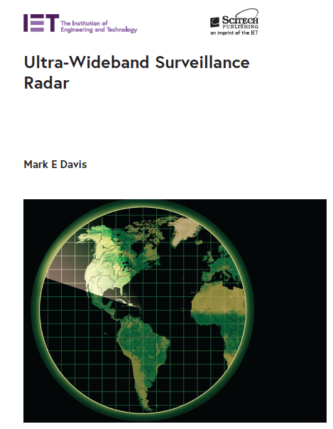
Extended References Available
References on each page listed in back of Course Material
e.g. [besse99]
First Textbook On UWB
Surveillance Radar
  Covers extensive material for an AESS Short Course
  Focused on UWB phenomena
Published January 2021,
360 pages
Available through:
  IET/Scitech Publishing
[davi21]

Slide 5
Ultra Wide Band Radar Objectives
Ultra Wide Band (UWB) Radar Has Many Applications:
  Significant Improvements In Range And Cross Range Resolution For Discrimination/Characterization Of Objects From Clutter
  Foliage Penetration – Detection and Characterization of Objects Under Dense Foliage
  Ground Penetration – Detection of Buried Objects
  And Unexploded Ordinance
  Land Use/ Land Characterization For Earth Observation
Key Technology Advances Have Facilitated These Objectives :
  Global Positioning Systems, Solid State Transmitters, High Dynamic Range Digitization, High Performance Computation
Commercialization Of Digital/Personal Communications Has Significantly Complicated Frequency Use Licensing
  Stringent Requirements On Spectrum Use And Spectral Purity
[davi21]
Notes:
UWB radar has the potential for improving many applications over the earlier battlefield surveillance radar: improved range and cross range resolution, penetration of foliage and camouflage, detection of buried objects and unexploded ordinance, and characterizing land for earth observation.
These UWB radar systems were developed based on a rapid advancement in the key RF and computational technologies: global positioning system, solid state transmitters, high dynamic range analog to digital converters and the implementation of high performance computers. Moore’s Law has been credited with the continuous advance in all of these technologies over the years beyond 1975.
However, as the same RF technology enabled wideband digital and personal communications, the ability to deploy UWB radar systems has been significantly curtailed. There are stringent requirement on use of the RF spectrum, and demands on improving the spectral purity of the systems.
These factors will be covered in this tutorial.

Slide 6
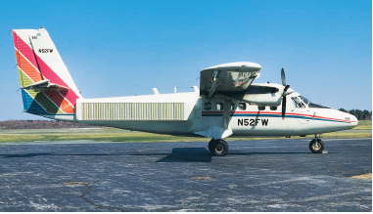
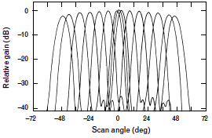
Multiple Aperture Surveillance Radar (MASR)
Experimental GMTI Radar System – MIT Lincoln Laboratory
L-Band With Unique Multiple Channel Phased Array Architecture
  42 Vertical Columns Of Low Sidelobe Radiators
  Excellent Phase Match Switching Between Sections Of Antenna
Achieved > 46 dB Clutter Cancellation
  Switching Between Along Track Elements Pulse-to-Pulse
  Ideal Displaced Phase Center Antenna (DPCA)
  for Stationary Clutter Cancellation
[brya00]
Notes:
MASR was an experimental L-band GMTI system built by MIT Lincoln Laboratory for wide area scan of the region, and use Displaced Phase Center Antenna techniques for very strong cancellation of stationary clutter. This system was successful in demonstrating a phased array antenna with inter-channel match far superior from earlier applications. By switching the individual elements between pulses, short term correlation of the clutter could be cancelled up to 46 dB, and slow moving targets could be discriminated.

Slide 7
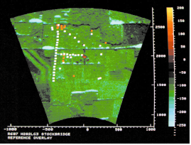
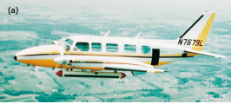
Hostile Weapons Locator Systems (HOWLS)
Early Battlefield Surveillance Radar Intended For Remotely Piloted Vehicles (RPV)
Ku Band Electronically Scanned Antenna With Coherent Multimode Operation
  Ground Moving Target Indication Against Tracked And Wheeled Vehicles
  Detection And Characterization Of Artillery Pieces
  Early Doppler Beam Sharpened Mapping For Stationary Vehicles And Structures
Data Link To Ground-base Signal Processing And Data Recording System
[brya00]
Notes:
HOWLS was a concept for the Army to provide real time assessment of movement of military vehicles in a battel area, and provide real time detection and characterization of artillery fire to a small unit. The original use was to employ the technology on a small Remotely Piloted Vehicle, such as Amber prototype. The program was funded out of DARPA Tactical Technology Office, system integration was provided by MIT Lincoln Laboratory, and the radar was developed and operated by GE Aerospace Electronics Department.
The Ku band electronically scanned antenna (ESA) provide rapid mode switching between fixed and moving target detection. The objective was to segregate the returns of small vehicles and artillery rounds from the clutter, and use Doppler processing to locate and characterize their location. The coherent radar could switch modes in 4 milliseconds, and maintain up to 4 interleaved modes. A tactical display was located in a ground shelter for both algorithm varication and test objectives. All data was sent to the ground over a tactical data link for ground processing. A radar ground map was displayed with updates on the detection of targets.
Several emerging air to ground modes were prototyped and tested for their applicability to this new radar concept. Those modes included
frequency agile non coherent mode for despeckling the clutter
Coherent Doppler processing to measure the separation of target returns and Doppler artifacts from background clutter
Doppler beam sharpening mode to increase the ground map resolution in short CPIs, for correlation to GMTI detection.

Slide 8
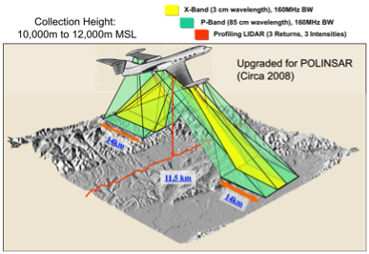
GeoSAR Interferometric Mapping System
System Characteristics
Designed By NASA Jet Propulsion Laboratory
For Bald Earth Mapping Under Foliage, &
Characterization Of Dense Forests
Funded by DARPA Under Dual Use
“Other Transactions” Authority
Dual Frequency For Mapping Tops and
Near-bottom of Forests
Continuous Operation World-wide 2003 - 2015
FOPEN
[hens07]
Notes:
GeoSAR was funded by DARPA Information Systems Office, and developed by NASA Jet Propulsion Laboratory with the express objective of demonstrating rapid characterization of land use characteristics in the open and under dense foliage. The two frequencies were X-band to map the tops of the trees and ground clutter (and buildings) and P-band for penetration of dense foliage. This rationale for this development was to characterized terrain slopes and characteristics in areas that microwave radar could not measure. The combination of both frequencies have been instrumental in many geophysical experiments such as earth quake remediation, detection of downed aircraft in forested regions, assessment of distress on forests and crop lands by drought, floods, illegal forestry cutting.
The Digital Elevation Map characteristics have been used world wide for planning roads and flood plane engineering. The P-band radar is fully polarimetric to enable efficient characterization of objects under the foliage, as well as measuring the health of the biomass. The planimetric accuracy is sufficient for topological mapping and planning.
This system has been in continuous operation by a commercial company since 2003

Slide 9

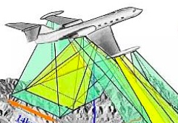
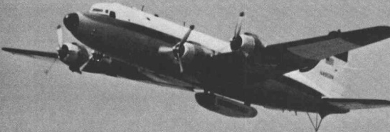

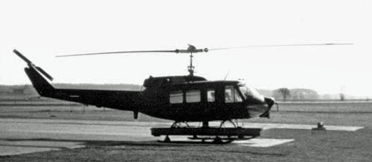
Airborne Surveillance Radar Progression To
Ultra Wide Bandwidth
100
P3 UWB
UHF
50
GeoSAR
X/UHF
UWB Threshold
10
MASR
L-Band
MB/MSR
Ku-Band
Percentage Bandwidth
5
AirSAR
P, L, C-band
SOTAS
X-Band
HOWLS
Ku-Band
1
1970
1975
1980
1985
1990
1995
2000
Technology Year
[davi21]
Notes:
This figure illustrates several advanced development radars being tested from 1970 to 2000. It can be seen that more of these systems have become UWB.
The early battlefield surveillance radars shown are not UWB. Because of the maturity of the technology, or risk in implementation, the spatial resolution was significantly lower than the 500 MHz. However, it can be seen that the impetus for UWB was recognized in 1990. And more examples of UWB applications . These radar systems will be explored during the tutorial, in terms of their technologies and technical requiremetns.

Slide 10
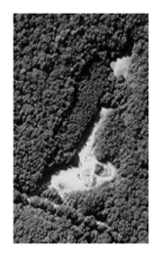
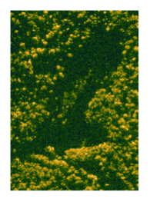
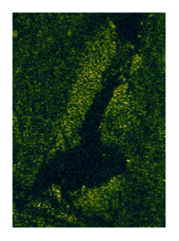
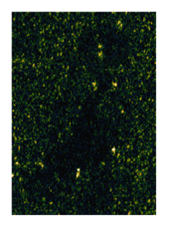
Comparison of UWB Surveillance Imagery
Aerial Photograph
X-Band SAR
P-3 UWB UHF
HH polarization
CARABAS VHF
HH polarization
The Critical Tradeoff Is Between Resolution And
Ability To Detect Targets In Dense Clutter
[davi11]
Notes:
Many surveillance systems were developed for characterizing the imagery for military applications. This chart illustrates the surveillance of an area in Pennsylvania at four frequencies: optical, microwave and long wavelength frequencies. The image shows tracked roads in dense forest along with open area, new growth single canopy woods and old growth double canopy forests. There are 32 military vehicles in the region, with different concealment to deny detection by the surveillance systems.
Both optical and microwave frequencies deny the surveillance system to detect the targets. And both the UHF and VHF long wavelength sensors reveal the concealed targets; but with variation in the false alarm rate due to the tree trunks and large limbs. This chapter will cover the basic surveillance modes for fixed and moving targets. Subsequent chapters will cover the advanced radar mode processing to determine the utility of these modes at microwave and long wavelength frequencies.

Slide 11
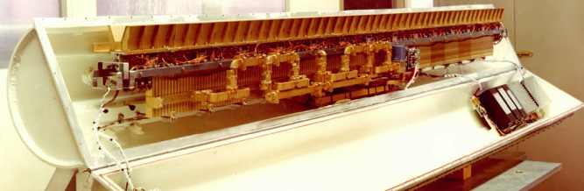
Phased Array Architectures
HOWLS
Passive Array
ca. 1977
Loss
[bark76]
[manc08]
Thales
Active Array
ca. 2007
Passive Array
Active Array
+ High Efficiency UWB Transmitter (Tube)
+ Reciprocal Tx and Rx Signal Paths
- High Loss After Tx, and Before Rx NF
- Tx Taper Through Feed Structure
- Very Heavy ESA Assembly
+ Small Light Weight TR Modules
+ Low Loss After Tx, and Before Rx NF
+ Moderate Efficiency Solid State Tx
- Difficult Tx Taper For High Efficiency
- Tx and Rx Spectral Mismatch
MIMIC Program Introduced Single TR Chips by 2001 → UAV Applications
[davi21]
Notes:
Advances in RF microwave integrated circuits have significantly reduced the cost, size, weight and power of electrically scanned antennas.
The antenna on the left was developed for the HOWLS program in 1975, and used a combination of waveguide and PIN diode phase shifters to provide the antenna control. The transmitter was a high efficiency traveling wave tube amplifier, and all of the microwave control of the signal to transmit and receive passed through lossy circuits. There was no additional amplification, so the signal power was attenuated in both transmit and receive paths. As a result, the radar range equation had a loss of signal, and a reduction of the noise figure in both paths. This made for a very inefficient radar operation.. The main advantage of the passive ESA was that the aperture on transmit could be weighted to provide low sidelobes.
The antenna on the left is representative of the Vehicle and Dismount Exploitation Radar (VADER) system developed by DARPA with Northrop Grumman in 2006. The aperture was and active ESA, and each element had a small transmit receive module immediately behind the radiating element. As a result, both the transmission loss and the noise figure were improved by the different in loss between the active ESA and passive ESA design. Furthermore, both the transmit and receive amplification and signal control can be integrated into the AESA assembly. The solid state TR modules had moderate efficiency with the GaAs devices used. The main disadvantage of this approach is htat the GaAs MIMIC devices need to be operaten in saturation (Class C operation) as a result, the ability to do amplitude taper on transmit was limited. The second technical evaluation was the spectral match across the band and scan angle will cause issues with the correlation of the signal for clutter mitigation or target direction. These effects are minor, since it is possible to do pre-emphasis on transmit and adaptive equalization on receive.
The advent of MIMIC designs was significant in providing light weight and small form factor for small UAV operation.

Slide 12
Wideband Electronic Scanned Array (ESA)
Wide Band Array Scanning
Linear Wide Band Array
Array Normal
d
ΔS
. . . . . . .
ϕ₁
ϕ₂
ϕ_{Ν}
ϕ₁
ϕ₂
ϕ_{N}
ϕ₁
ϕ₂
ϕ_{N}
Scan Angle
ϕ_{s}
Σ
Σ
Σ
τ_{d}
τ_{d}
τ_{d}
τ_{d}
τ_{d}
τ_{d}
τ_{d}
τ_{d}
Σ
Σ
Combination Of Phase And Time Delay Steering Required To Maintain Constant Phase Front Over Wide Bandwidth
[aalf13]
Notes:
Transitioning wideband AESA to ultra wideband requires a critical change in the normal ULA array steering vector. For the narrow band implementation, the center frequency can be used in calculating the phase progression across the face of the array. However, for wideband, it is important to use the actual frequency within the signal bandwidth. Because the wave front is delayed for each increment of the array, a phase correction cannot be used. The actual distance divided by the speed of light needs to be employed.
The most accurate approach is to use a true time delay steering at each element, employing the distance from a planar front to each element. This will require long time delays for wide scan angles or ultra wideband waveforms. For lower frequencies where the separation is a large physical distance, true time delay can be used at each element. However, for microwave frequencies it is not feasible due to the large increase in the number of time delay units. Hence, for microwave frequencies, subarrays have been used with phase shifters on the subarray, and time delay units at the subarray output.
There are two control factors in the subarray steering of an UWB ULA
Subarray pattern where the pattern is “allowed” to steer with frequency. The approach is to pick a size of the subarray so that there is not sufficient time delay between the edges of the subarray to affect the waveform over the total bandwidth
Array factor where the digital time delays are applied to provide collimated addition of the signal with appropriate time delay for the scan angle. The time delay effectively takes the beam steering effects out of the aperture
With today’s high speed digital processing, the UWB antenna can be used for a multibeam architecture, employing both time delay and adaptive weighting of each of the subarrays (for each of the M independent beams).

Slide 13
Digital Multiple Beam Forming
IF
IQ
M-Beams
Digital Beamform
1
SV-1
Spatial
Domain
N Elements
or Subarrays
SV-2
Microwave Array
N-pt FFT
k-space
Domain
.
.
.
.
.
.
SV-3
SV-M
N
A Narrow Band Signal Can Be Beam Steered With Phase Only Controls
Wideband Array Requires A Combination Of Time Delay And Phase To Avoid Beam Squint During The Radar Operation
Equalization Can Be Applied On Each Channel As Part Of Sidelobe Weighting
Multiple Channel Digital Beamforming Has Been Demonstrated On Commercially Available FPGA Processors
[aalf13]
Notes:
The advantage of digital beamforming is that multiple beams can be synthesized based on the digital output of the ADC at each element or subarray.
Once the signal has been digitized at the Nyquist rate, it can be converted from the time domain to the frequency domain using FFT processing. In the Doppler or k-space, multiple beams are then synthesized and steered digitally to cover the spatial extent of the search area. This is illustrated in the figure above.
More details will be given in subsequent chapters of the tutorial under multimode processing.

Slide 14
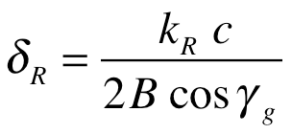
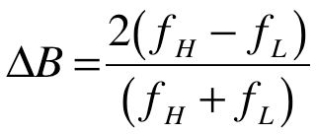
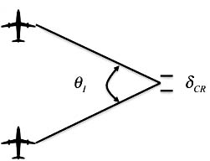
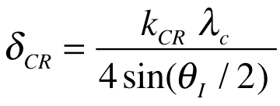
Important Radar Waveform Relationships
Range Resolution:
  Waveform Bandwidth B
  Grazing Angle To Image Surface
  Weighting For Range Sidelobes k_{R}
Fractional Bandwidth
  Ultra Wide Band If > 25 Percent
Cross-range (Azimuth) Resolution:
  Valid For Center Wavelength
  Depends On Integration Angle
  Weighting For Cross-range Sidelobes k_{CR}
[carr95]
Notes:
As noted, there are several simplistic equations for SAR processing. The first is range resolution which depends on the bandwidth B of the signal. To estimate the resolution in the ground plane, one can divide by the grazing angle between the slant range and the local ground plane.
We have already discussed the fractional bandwidth, which is a critical parameter for understanding the ultra wideband criterion. If DB is greater than 25 percent, the system is considered to be UWB.
The cross-range resolution is estimated by the integration angle τηετα of a resolution cell in the scene. The synthetic aperture length is R tan(theta/2), and the angle is approximated by L/R_{a.} Using this approximation, the cross range resolution is given by the equation above.

Slide 15
UWB SAR Integration Angle
Microwave Frequencies Have Most Efficient SAR Collection
UWB Operation Requires Large Angles For Resolution
Integration Times Depend On Platform Speed and Angle
[davi99]
Notes:
This chart illustrates the required integration angle for three frequencies VHF – 50 MHz, UHF -- 450 MHz, and X-band – 10 GHz.
The VHF SAR is limited to approximately 3 meters, due to the long wavelength. The UHF is evaluated at 1 meter resolution, and the X-band at 0.3 meter resolution. The size of the angle is indicated on the flight path to the right. It is now clear why microwave SAR collection times are short in duration, and allow an interleaving of SAR and GMTI during a surveillance path.
We will examine the objective of simultaneous SAR and GMTI later in the tutorial.

Slide 16

UWB SAR Data Pulse Collection
Range Curvature
Number Range Bins
R₀
W_{S} - Output
Range Swath
Input
Range
Swath
Along Track
Number of Pulses
[davi11]
Notes:
The first aspect of ultra wideband SAR to be considered is the range swath needed for forming the cross range resolution. A sufficiently long integration aperture must be collected to form the cross range resolution desired. The number of pulses to be integrated can be approximated base on the range to the swath R₀ and the desired resolution ρ_{cr}.
For UHF and L-band SAR, the number of pulses can be very large .
The other aspect of UWB SAR is the effect of range curvature on the image. As illustrated, to support the resolution in the middle of the swath length, data must be collected from the beginning of the swath through to the end. So the range of the data must be larger than the desired range so that the data at the ends coincide with the pixel in the middle of the swath.
These considerations will now be quantified.

Slide 17
Additional Swath Width vs Integration Angle
Significant Range Curvature Experienced in UWB SAR Image Formation
  UHF Image ~ 0.5 Km to 1.0 Km Cross Range Resolution
  L-band Image ~ 2.0 Km to 3.0 Km Cross Range Resolution
Range Curvature Not As Significant In Microwave SAR, A Little Extra Data
[davi11]
Notes:
The range curvature during a long SAR collection makes a requirement on the data collection. This excess range extent is illustrated for frequencies from UHF to microwave. Because of the integration angle, the curvature at longer wavelength is significant. As the standoff range is increased this become several kilometers of data. With range resolutions near a meter, this quickly becomes several thousand range bins.
It is clear that microwave frequencies do not have as significant increase in range bins. However, at L and UHF, this will impact the collection, motion compensation and signal processing operations.

Slide 18
Range Curvature – UHF vs L-band SAR
SAR Fast Time Return
Range Compressed
600
600
UHF SAR Image
f_{c} = 400 MHz
0
0
SAR Slow Time [m]
SAR Slow Time [m]
-600
-600
1.3
1.4
1.5
1.3
1.4
Fast Time [sec 10⁻⁵]
Fast Time [sec 10⁻⁵]
150
150
L-band SAR Image
f_{c} = 1400 MHz
0
0
SAR Slow Time [m]
SAR Slow Time [m]
-150
1.3
1.4
1.5
-150
1.3
1.4
Fast Time [sec 10⁻⁵]
Fast Time [sec 10⁻⁵]
Integration Angle And Range Curvature Difference
Illustrated At Two SAR Frequencies
[davi21]
Notes:
The BPA was carried out for both an UHF and L-band image. The integration angle for the same cross range resolution is seen in the fast time vs slow time plot. Clearly the UHF requires more integration angle than L-band, and the range curvature is evident.

Slide 19
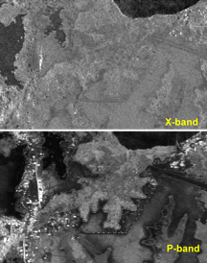
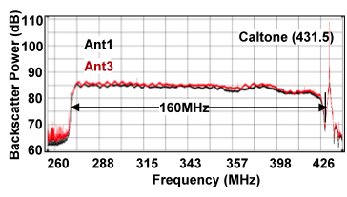
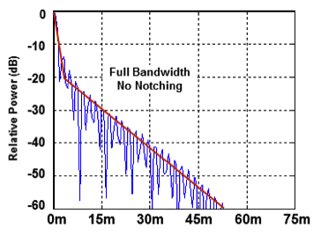
SAR Images For Geoscience Applications
160MHz X-Band SAR
P-Band Transmit Spectrum
P & X-Band Impulse Response
160MHz P-Band SAR
[davi15B]
Dual-Frequency GeoSAR Interferometric SAR
Notes:
SAR systems have been used for both battlefield surveillance and geoscience applications. The GeoSAR system incorporated both an X-band and P-band interferometric radar on a platform. This provided the ability to collect multiple images for comparison of the returns provided by angle and wavelength diversity. This chart shows both of the two independent radar images formed with a 160 MHz bandwidth. The system utilized 1-meter post spacing to provide DTED 3 estimation of the terrain height . The images are from the Brazilian Amazon basin where the tests for terrain height measurements were conducted.
The X-band image clearly showed the tops of the jungle in a mountainous region, and with underlying rivers. The P-band image shows the returns from below the tops of the trees.
The follow charts will detail the requirements for forming SAR images.

Slide 20
GeoSAR Application Results
Collection Height
10,00 m to 12,500 m
X-band, λ=3cm
2 Views of Ground In X and P Simultaneously Both sides of Plan Interferometric
P-band, λ=85cm
Profiling LIDAR 3 looks
GeoSAR Has The Capability To Collect Two Bands Of Interferometric SAR Data Out Of Both Sides Of The Gulfstream Aircraft
By Using Both The X And P-band Imagery And DEM, The Image Processing Will Provide A Representation Of Bare Earth
[reis05]
Notes:
GeoSAR has the capability to collect two bands of interferometric SAR data out of both sides of the Gulfstream aircraft as seen in the figure on the chart
At X-band the products include orthorectifies intensity models, surface reflectance elevation and detailed visualization and analysis of the image.
At P-band the DEM represents near bare-earth and provides derived layers such as slope and contours.
By using both the X and P-band imagery and DEM, the image processing will provide a representation of bare earth. The GeoSAR radar system simultaneously collects high accuracy elevation and image data at more than 288 km²/minute with swaths of 14 kilometers for each band, and on both sides of the flight line

Slide 21
Cross Track Interferometry Geometry
Platform Velocity
Baseline B
Reference Aperture
Terrain
[rose00]
Notes:
The techniques for IFSAR system development and signal processing are widely reported. This section will provide the basic cross track image collection and DEM formation
The backscatter from a resolution cell on the ground surface is measured at each aperture; and the amplitude and phase from the resolution cell are anticipated to be the same
if there are no differences in the transmission path. The difference in the two returns are determined by the range from the SAR apertures to the resolution cell, based on the accurate GPS/IMU navigation measurement and radar timing

Slide 22
GeoSAR DEM at X and P-band In
Colombia, South America
X-band Image
P-band Image
Spatial Profile for P-band DEM
[reis05]
Notes:
GeoSAR has been able to provide mapping of geologic structures in areas where forest canopy obscures the terrain
The figure shows two SAR images of a region in the Colombian forest
the X-band image of the area with significant forest cover on the left side. In contrast, the P-band image, with the contours and geologic structure of the hills below the trees. These measurements have been used to characterize the hydrological characteristics of the surface contours as well as map river, stream and flooding below the forest canopy.
The tops of the trees are very clear in the left image, with no indication of the terrain slope below the canopy. And for the open field in the center of the image, there is significant clutter return along with features of paths and isolated trees. In contrast on the right image, the forested area has a speckled return with some bright returns from individual trees.

Slide 23
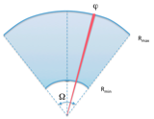
Wide Area Surveillance - GMTI
Wide Area Surveillance Geometry
v_{T}
Moving Target Detection
Area Coverage Rate
v_{P}
Moving Platform Causes Clutter To Spread Across Beamwidth
Target Radial Velocity v_{T} Needs To Be Greater Than Clutter Spread
Critical Figure of Merit –> Area Coverage Rate (ACR)
= Footprint Area / Coherent Processing Interval (CPI)
Notes:
Ground moving target integration (GMTI) scans a narrow beam over an annular region, and dwells for a sufficient time that the moving target can be discriminated from the background clutter. The Doppler spread across the beam depends on the velocity of the radar platform, and the beamwidth of the antenna. A target can be detected (assuming exoclutter) when the radial velocity of the target is greater than the Doppler spread across the beam. This represtation is approximate and assumes a rotating antenna. For electronic scanned antennas, the beamwidth will vary by the cosec of the scan angle.
An important aspect of GMTI is the area coverage rate. For a uniform scan, the coverage rate can be approximated by the area of the annular sector of the scan, divided by the coherent processing interval. However, when there is a variation in the beamwidth, and the projection of the search beam on the surface of the earth, more detailed assessment of the composite ACR needs to be provided. Furthermore, if there is a mixture of SAR and GMTI modes interleaved in time, the ACR will be a facto of the percentage of time spent in each mode.

Slide 24
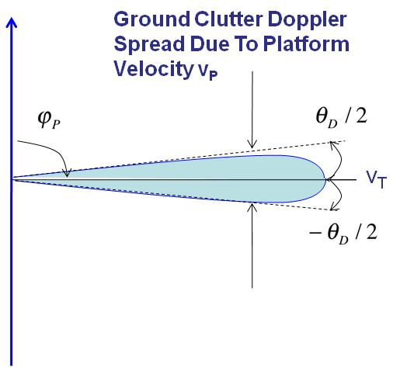
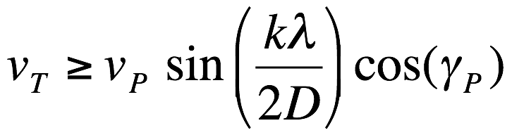
Ground Moving Target Indication Radar
v_{P}
(With MTI Processing)
[davi11]
Notes:
The problem of detecting a target via Doppler in a real beam radar is well known. When the platform has a velocity v_{P} and there is a finite beamwidth 𝜑_𝐷, the clutter will spread in azimuth within the beam.
Targets will need to have a radial velocity greater than the clutter spread within the beam to be detected. Many techniques have been developed to reduce the effective main beam spread through MTI pulse Doppler and space time adaptive processing (STAP). MTI will normally cancel the clutter to the half beamwidth, and STAP down to a 10th of a beamwidth, if there is no internal clutter motion.
However, there is going to be a residual Doppler width to compete with low minimum discernable velocity (MDV) targets. More importantly, MTI and STAP processing will attenuate slow moving targets making it more difficult to detect the signal.

Slide 25
Ground Moving Target Indication
X – Band MDV
UHF MDV
Microwave Frequencies Enables Slow Moving Target Detection
  Minimizes Beamwidth With Moderate Antenna Lengths
UHF Long Wavelength Creates Difficulties For Effective Ground Moving Target Indication (GMTI) Radar
  Excessively Large Antenna Needed For Low MDV
Advanced Signal Processing Techniques
  Space Time Adaptive Processing or Along Track Interferometry
[davi11]
Notes:
The most effective technique to reduce main beam clutter spread in MTI radar systems is to increase the aperture. At microwave frequencies it is possible to get main beam spread below 0.5 meter per second. This has been demonstrated on several systems as effective for wide area surveillance where the vehicles are not moving toward the radar.
However, at UHF frequencies the antenna will be excessively long to eliminate the main beam clutter spread. Little can be done with MTI or STAP processing with a real beam antenna. There are two approaches that can be considered:
tether the antenna on an aerostat or helicopter to minimize the platform motion
form a synthetic aperture radar to proved narrow azimuth resolution cells, and cancel the ground clutter with a displaced phase center antenna.
The first approach has been demonstrated in the early Camp Sentry FOPEN system from a MTI radar on a tall tower, with limited range and no mobility. The SOTAS radar, albeit at microwave frequency, was demonstrated on a helicopter at longer ranges. But we know microwave frequencies do not allow foliage penetration.

Slide 26
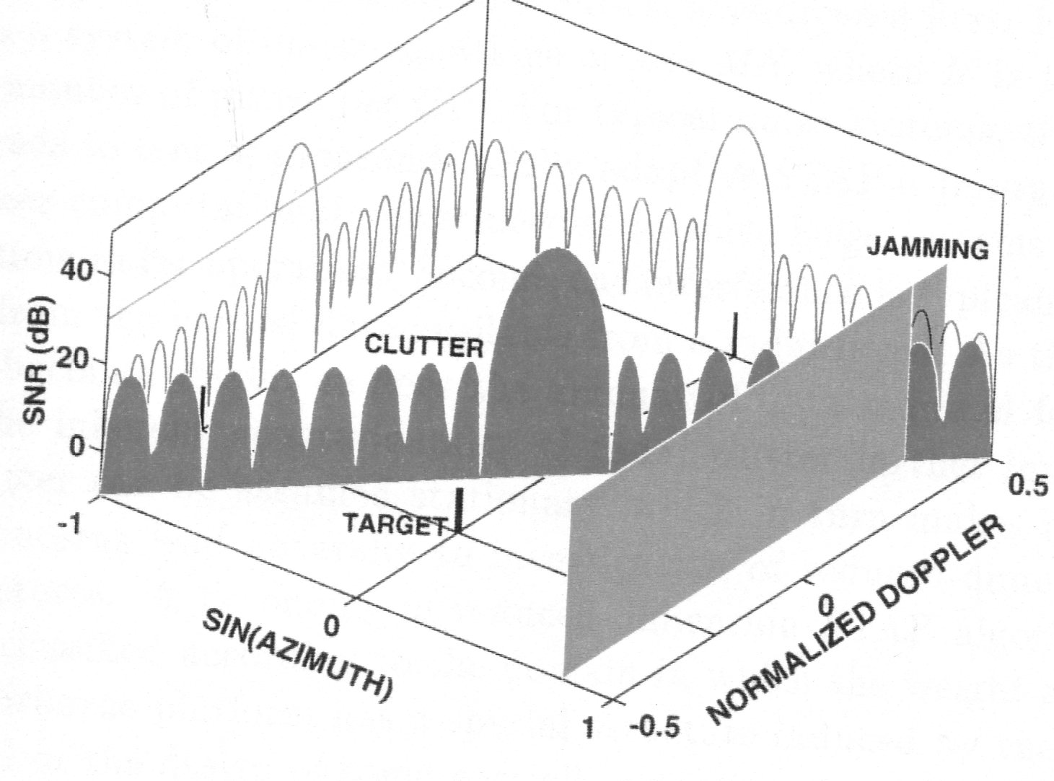
Space Time Adaptive Processing (STAP)
Antenna
Directivity
Doppler
Filter
Jamming
Clutter
Target
GMTI Systems Are Integrated On Airborne Platforms,
  Clutter Return Determined By The Antenna Directivity
  Range And Doppler Characterized By The Waveform.
STAP Combines The Signals Received From:
  Multiple Elements Of An Antenna Array (The Spatial Dimension)
  Multiple Pulse Repetition Periods (The Temporal Dimension)
Both The Mainbeam And The Sidelobes Of The Antenna Affect
The Minimum Detectable Velocity (MDV)
[ward94]
Notes:
STAP has been developed for large GMTI radar systems over the past 2 decades. By adding the spatial diversity in the radar architecture, independent looks at both the ground clutter and targets. The clutter return is limited primarily by the size of the aperture, where the spatial directivity will limit ground clutter extend by the velocity of the platform. Similarly, the range and Doppler characteristics of the target will be determined by the waveform being used in GMTI modes. It should also be noted that STAP can also assist in removal of discrete RF interference (or jamming) along an angular sector of the surveillance space.
STAP combines signal in both the spatial (multiple channels) and temporal ( Doppler processing within the pulse repetition frequency). The design of the sidelobes of the antenna and Doppler filtering will provide the ability to discriminate the moving target from distributed clutter and interference.
The ability to improve the MDV of targets is affected by the correlation between the main beam and sidelobes of the antennas. As a result, channel match and balance is important in implementing STAP processing and obtaining low MDV.

Slide 27
GMTI Clutter Spread with Platform Velocity
V_{P} = 1 meter / sec.
V_{P} = 50 meter / sec.
Clutter to
Noise of
GMTI Radar.
Signal to
Interference
Plus Noise
From
Ideal STAP
MDV ~0.5 m/s
MDV ~2.0 m/s
MDV Directly Affected By Clutter Spread With
Platform Doppler, and Antenna/Waveform Sidelobes
[davi11]
Notes:
This figure examines a multiple channel radar at UHF. The clutter ridge can be seen clearly in this pair of figures. For the 1 m/sec “hovering” helicopter, the ridge has a slope of 0.0045 sec-1. the MDV is measured at the -10 dB loss point. There are three curves, depending on the internal clutter motion. In this instance the MDV is less than 0/5 m/sec, which is comparable with a person walking. However, when the platform is moving at 50 meters per second, the MDV is approximately 2 m/sec. This is sufficient to detect slowly moving vehicles, but not persons.
These analytic results give the estimate of an ideal GMTI platform with stationary clutter. When there is significant movement in the clutter, or the clutter spatial variation is great between the spatial channels, the MDV will be affected. A second point is that the bandwidth is low on these GMTI measurements, so that the moving target cannot transition either range or Doppler cells during the CPI. We need to understand the effects of wideband operation on the STAP performance.

Slide 28
Multiple Channel Radar with Sub-banding
A Modern Radar Has Multiple, Digitized Channels
These Channels Need Sub-banding To
  Channel Matching Amplitude and Phase
  Handle The Processing Complexity
  Maintain Coherence Or Channel Balance
[hoff00]
Notes:
Digital filter banks are used in a large number of communications applications
Radar processing is significantly different than digital communications; because of the need to equalize channels over wide bandwidth, to provide match filtering to increase channel cancellation ratio, and to achieve required interference mitigation metrics.
A modern radar has multiple, digitized channels and needs subbanding to handle the processing complexity to maintain coherence or channel balance. The figure shaws a generic flow of such a system. After digital conversion on each channel, it is beneficial to subband the signals for preparation of the next signal processing steps
Each radar channel is then processed as shown. The channelizer decomposes an input signal into N components. And within the channel combiner, the N components are recombined to form a recovered signal $\hat{x}(n)$.

Slide 29
UWB STAP SINR Loss Reconstruction
STAP Sub-Band Processing
STAP MDV
Narrow Band STAP Has Efficient Detection Of Slow Moving Targets
UWB STAP Suffers Significant Losses Due To Decorrelation Of The
Independent Channels Due To Dispersion In Time And Doppler
Losses Can Be Circumvented By Decomposing The Wideband Signal
Into A Bank Of Narrow Sub-bands
STAP Is Applied To Each Narrow Sub-bands, Followed By
Recombining Into Wideband Signal For Targets After Clutter Suppression
Losses Are Greatly Reduced, And MDV Is Maintained
[hime04]
Notes:
STAP algorithms have been under development for over 30 years. They are primarily used in narrow to moderate band GMTI systems. Howver, with the need for high resolution imaging for target characterization, ultra wideband waveforms have increasingly been used.
In narrow band STAP, when there are sufficient independent samples to train for adaptive weights, the detection of low MDV targets can be carried out with minimal attenuation of the tartet signal to interference plus noise ration (SINR).
With UWB waveforms, the target dispersion in both range and Doppler appears as loss across the Doppler clutter free region. This has a major impact on the detections probability as well as target location. It is necessary that alternative algorithms be employed to reduce the target signal loss.
One approach is to use a filter bank such as polyphase filters to provide narrow subbands of the measurements in the spatial channels. Within these narrow bands, STAP can be run to cancel the clutter. Once the clutter is removed from the channels, the UWB signal is recovered by providing a inverse transformation back into the UWB frequency span. The SINR loss is mitigated, and the target can be processed for detection and characterization.

Slide 30
Along-Track Interferometry for
Slow Moving Target Detection
v
v
S
z
S
z
Α
Theoretical ATI MDV Limit
Α
2
2
B
y
Α
y
Α
ρ
1
ρ
1
2
2
θ
θ
ρ
ρ
1
1
v
v
T
T
T
T
Along-Track Separation Provides Phase Information
Phase Change Is Related To Radial Velocity
Minimal Discernable Velocity Is A Function Of Along-Track Separation
Along-Track Separation Drives Velocity Ambiguities
x
x
[kapf13]
Notes:
Along Track Interferometry exploits the stationarity of clutter and man-made objects in a scene. It is analogous to cross track interferometry which enables the measurement of terrain and building heights in mapping DTED. However, in ATI the Doppler content of the signals are measured to interpret their displacement in cross track, and indicate the movement in the scene.
The process is to form two SAR images from different channels of the radar. The picture illustrates two subapertures moving together along the flight path. One aperture is used to measure the primary SAR image, and the second aperture forms a scene that is either delayed or precedes the main aperture. The process is to measure phase changes between the two apertures, which will indicate a movement during the SAR integration time. This ATI phase is directly related to the velocity of the image motion, as related to the separation between the pixels in the two images.
There is an ATI velocity ambiguity when the ATI phase wraps by 2𝜋. This is a primary system limitation for fast targets, which will transition many range and Doppler bins during the CPI..
The variation in ATI phase with platform velocity and baseline separation between the two apertures will be investigated for a couple of cases.
This analysis will cover a UHF array with 2 meter separation between the phase centers. The unambiguous radial velocity is +/- 22.5 meters per second

Slide 31
Target Defocus Impact On Detection Accuracy
ATI Smear Loss vs Cross Range Resolution
ATI Velocity Errors vs Target Radial Velocity
ATI Of Moving Targets In SAR Image Before Focus
Cross Range Resolution Requires Long Integration Times
  Doppler Walk Increases With Target Velocity
Defocus Of Targets Directly Affects Measurement of ATI Phase
Focus Before Detection Critical For UWB GMTI Operation
[chen04]
Notes:
The faster the moving target, the more defocus of the point spread performance in SAR images.
At UHF, the integration times for cross-range resolution requires several seconds. During that time the targets will walk in both range and Doppler, and the return will be smeared in the clutter return This represents a loss of signal to clutter ratio, directly affecting the detection probability.
It is necessary that these defocused targets be refocused for detection and measurement of the velocity. Once the radial velocity has been accurately estimated, the targets can then be replaced on the SAR image.
It is important that the ATI phase be accurately estimated for this geolocation process. Chen has derived an error model for SCR in the ATI processing of targets. This can be used for estimating the velocity error as a function of the target radial velocity.
The next step is to define a method for focusing the targets prior to the ATI processing and velocity estimation.

Slide 32
Multiple Channel/Beam Architectures
SAR
Wide Beamwidth
Integration Angle
Instantaneous BW
Very large Data Cube
GMTI
Wide Tx Beamwidth
Multiple Rcv Beams
Spatial DOF for STAP
Multiple Data Cubes
ATI
Wide Beamwidth
Integration Angle
Instantaneous BW
Two channels phase
Very large Data Cube
Multiple Channel Architecture Required
Emerging Technologies
  Wideband, Coherent Digital Waveform Synthesis
  Wide bandwidth, High Dynamic Range Analog to Digital Converter
  High Performance, Embedded Computing (multiple TFLOPS)
[kapf12]
Notes:
The antenna architecture is different for the three modes. SAR has a wide beamwidth to image the area for cross range resolution. GMTI requires multiple spatial channels for STAP, and should have a broad transmit beam and multiple receive beams for obtaining the ACR. And the along tract interferometry needs to have multiple subarrays for forming SAR images, and processing for discriminating the moving objects in the scene.
The evolving RF technologies can be used to develop such a system. And the rapid development of high performance embedded computing will provide multiple teraflops of processing to handle the data flow of this system.

Slide 33
Simultaneous SAR/GMTI Waveform
Common SAR/GMTI Waveform
Common SAR GMTI Waveform
f_{N}
f₅
Center Frequencies
f₄
f₃
f₂
f₁
PRI₁
PRI₂
PRI₃
PRI_{M}
SAR Waveform
Receiver Blanking
Time Freq. Align
SAR Waveform
Frequency
Df
M GMTI Waveforms
M GMTI Waveforms
f₁
f₂
Frequency
f_{N}
time →
[kapf12]
Notes:
The common waveform for both SAR and GMTI is illustrated using a frequency jmp burst of short LFM waveforms of moderate bandwidth, and switching the center frequency between sub pulses to gain the UWB objectives.
For SAR, each subpulse is combined by delaying the waveforms into a wideband signal over the scene to be imaged. For GMTI, each subpulse is coherently added between the PRIs to get a modest bandwidth return. There are multiple GMTI waveforms with frequency agility to improve the signal to noise requirements

Slide 34
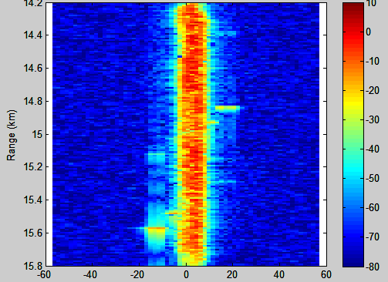
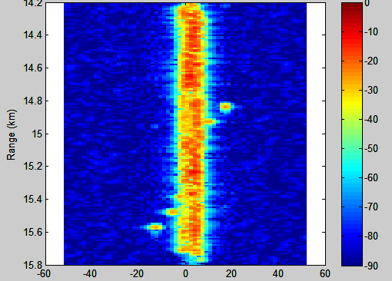
GMTI Sub-pulse Processing
GMTI Baseband Conversion
Each 15 MHz Sub-pulse Is Extracted Sequentially From The 120 MHz Common Waveform.
Frequency Conversion Of The Channel To Baseband
Applying A Complex Zero-phase Low-pass FIR Filter.
  80 dB stop band
  Equal-Ripple
Low Pass Filter for GMTI Sub-pulse Processing
Range-Doppler
After Sub-pulse
FIR Filtering &
PC Weighting
Composite Return
From 8 Frequency
Sub-pulses
[kapf12]
Notes:
Because the radar has an UWB front end, the targets at several frequencies will show up between the subpulses. It is necessary that each sub band be filtered to remove the effects of the other frequencies. This is analogous to the filtering previously discussed for UWB STAP processing.
This figure illustrates a low pass filter centered at the RF frequency of a sub pulse. The range-Doppler map to the left shows the composite of returns from multiple frequencies. And the one on the right shows the returns after the low pass filter. These processes will be done digitally in the actual radar. The folding of the pulses is removed in the channel for the appropriate sub band.

Slide 35
RLSTAP Data for SAR Imaging
SAR Imaging Path
Moving Targets --
Displaced Along Track
Fixed Targets
Simulation Used Range/Doppler Weighting
Verified SAR Range and Cross-Range Resolution with FJB Waveform
Moving Targets Exhibited Cross-Range Displacement and Range Walk Defocus
[kapf12]
Notes:
The monostatic SAR was formed by simulating a data cube from the 20 Km slant range platform and “flying” it North at 75 meters per second. The image was constructed using the back projection algorithm to the pixels in the scene.
The image on the left is for the full 1 Km2 scene. The target groups in the open field are easily detected. For targets in the tree line the SNR and CNR make it difficult to detect these targets.
The line plots on the bottom are latitude or longitude slices through the target groupings. With the transmitter at the West of the scene, range resolution is in the longitude dimension, and cross range resolution is in latitude dimension.
Several features can be observed:
The forest clutter returns are significantly higher than the open field as expected.
the image resolution is comparable for range and azimuth, approximately 5 meters
only 4 of the individual scatterers are discernable at the 5 meter resolution. The three closer space scatterers combine in an enhanced cross section.

Slide 36
SAR/ATI Receiver Operating Characteristics
Unfocused
MB SAR
Autofocus
w/ ICE
ICM Model
Billingsley model
  Wind speed: 10 mph
  Shape Parameter: 8
0.5 dB increase in power
10% increase in Doppler spectrum
Clutter Spectrum
ICM
Intuitive Results, Focusing On Moving Targets Improve Coherent Integration In Back Projection, And With
Improve Detection Performance.
Stationary
[kapf13]
Notes:
The detection results for this ATI analysis is shown for the unfocused targets in SAR images, use of Phase Gradient Autofocus, and the Moving Baseline SAR focus of the targets. The solid lines are based on the simulation without internal clutter motion. And the dottel lines uses the Billingsley model with wind speed of 10 mph and shape factor of 8.
This verifies that focusing moving targets can improve the ATI detection performance.

Slide 37
Summary
UWB Radar Systems Have Been In Development For
Over 40 Years – Primarily For Military Applications
Commercial And Personal Communications Are Ubiquitous:
  eCommerce Is The Major Source Of Many Businesses
  Digital Communications Is Important For Security
Adaptive Transmit and Receive Waveforms Required For Operation In Contested RF Environment
  Cognitive Radio & Radar Technologies Developing
  Machine Learning For Sparce Spectrum Access
The International Radar Community Needs To Adapt And Develop New Technologies – Analogous To Cognitive Radio
Notes:
The summary of this first section provides the history of applications of coherent radars from several airborne platforms. In parallel to these radar technology developments, the communications community have been active in applying the monolithic integrated cirtcutes for reducing the size weight and power of devices. Commercial systems have been used everywhere in the world. As such the radio frequency spectrum has shrunk to the point that radar has to accommodate their presence Spectrum regulation agencies world wide have established protocols for obtaining spectrum and compliance with their rules. These changes have directly impacted the application of UWB radar systems. Later chapters will illustrate these impacts and the need for more aggressive system and adaptive processing techniques

Slide 38
References I
Reference | Authors | Title | Source
aalf13 | David Aalfs | Adaptive Digital Beamforming | Principals of Modern Radar - Advanced Techniques, Chapt.9 Scitech Pub 2013
bani83 | W. Banister, C.E Grove, J Song | Multibeam Antenna Development and Test Program | Final Report AFWAL-TR-3-1049, Contract F33615-79-C-1907 March 1983 AD078907
bark76 | J. Barker, M.E.Davis | Ku-band Linear Phased Array | Microwave Journal, vol. 20, Oct. 1977, p. 44-57
bart05 | Barton, D. K | Radar System Analysis and Modeling | Artech House, Norwood MA, 2005, pp. 94-99
bind95 | B.T. Binder, M.F. Toups, S. Ayasli, EM. Adams | SAR Foliage Penetration Phenomenology of Tropical Rain Forest and Northen US Forest | Proc. 1995 IEEE International Radar Conference, Washington DC May 1995 p 158
brya00 | T.G. Bryant, G.B. Morse, L.M. Novak, J.C. Henry | Tactical Radars for Ground Sureillance | Linclon Laboratory Journal, v. 12, no. 2, 2000, p 341
carr95 | W.G. Carrara, R.S. Goodman, R.M.Majewski | Spotlight Sythetic Aperture Radar | Artech House, Norwood MA, 1995
chen04 | C.W. Chen | Performance Assessment of Along-track Interferometry For Detecting Ground Moving Targets | Proc. 2004 IEEE Radar Conference, Philadelphia PA, April 2004
davi11 | M.E.Davis | Foliage Penetration Radar - Detection and Characerization of Objects Under trees | Scitech Publishing, Raleigh NC, April 2011
davi15B | M.E. Davis, J.J. Reis | Operation of GeoSAR Foiage Penetration Modes in Spectrum Regulated Environment | Proc. 2015 IEEE Radar Conference, Pretoria South Africa, October 2015
davi21 | M.E. Davis | Ultra Wideband Surveillance Radar | IET Publications, London UK, January 2011

Slide 39
References 2
Reference | Authors | Title | Source
davi99 | M.E. Davis, P.G. Tomlinson, R.P. Maloney | Technical Challenges in Ultra Wideband Radar Development for Target Detection and Terrain Mapping | Proc 1999 IEEE Radar Conference Boston MA April 1999 p 1
fant95 | R.L. Fante | Multifrequency Detection of Slowly Fluctuating Targets | Unpublished MITRE Memo MTR 95B00021, Bedford MA, February 1995
hens07 | Hensley, S., Madsen, S.N., | Interferometric Radar Waveform Design and the Effective Interferometric Wavelength | Proceedings 2007 Waveform Diversity & Design Conference, Pisa Italy, June 2007
hime04 | B Himed, K Kim, Y Zhand, A Haggari | A New Approach to Widband Space Time Adaptive Processing (W-STAP) | Proc. 2004 IEEE Sensor Array and Multichannel Signal Processing Workshop, Barcelona Spain, July 2004, pp. 672 - 676
hoff00 | A Hoffman S.M.Kogon | Subband STAP in wideband Rdar Systems | Proc. 2000 IEEE International Radar Conference, Arlington VA, pp.256-60
kapf13 | R.M.Kapfer, M.Pohl, M.E.Davis | Detection Improvement for UWB Along Track Interferometery of Moving Targets Under Foliage | Proc. 2013 IEEE Radar Conference, Atlanta GA, May 2013
reis05 | Reis, J.J., Hensley, S., | GeoSAR P-band and X-band Performance in Southern California and Colombia, South America | ISPRS International Workshop, Banff, Canada, June 2005
rose00 | P.A. Rosen, S. Hensley, et.al | Synthetic Aperture Radar Interferometry | Proc IEEE, Vol. 88, No.3, March 2000, p.333-81
simk98 | Simkins, W.L | Air Defense Initiative Clutter Model | Report AFRL-SN-RS-TR-1998-95 , PAR Corporation, New Hartford NY, April 1998, DTIC A346972
vanz97 | Van Zyl, J.J., Chu, A., Hensley, S., Lou, Y. Kim, Y.J., Madsen, S.N., | The AIRSAR/TOPSAR Integrated Multi-frequency Polarimetric and Interferometric SAR Processor | Proceedings 1997 IGARS Symposium, vol. 3, Singapore, 1997
ward94 | J. Ward | Space Time Adaptive Processing for Airborne Radar | MIT Lincoln Laboratory Technical Report TR-1015, Lexington MA December 1994

