Slide 1
IEEE Aerospace Electronic Systems VP Member Services
Luke Rosenberg
(on behalf of Lorenzo Lo Monte)
AESS 2024 Strategic Meeting
10 and 12 February 2024
Orlando, FL

Slide 2
Part 1: Statistics
Notes:
The next slides are just “STATUS QUO” to tell the people where we are.
All VP Members show these types of plot at each meeting.
These plots are appreciated by the people to understand how AESS members are doing.
Typically, people presents 20-30 slides. I prefer to cut them to the bare bone, otherwise the meeting would be too long.
If people have specific types of stats that they would like to see, please note them down and let me know.
However, in general, the following slides are usually enough.

Slide 3
Membership Overview (Jan 2024)
Notes:
This slide shows where members are worldwide.
As usual, our largest membership is in Italy/Germany/UK.
However, very recently, thanks to Puneet Mishra, we see an immense spike in India, in particular Bangalore, his own chapter!
Please congratulate Puneet for his achievents.
There is also some strong activity in Colombia and Peru. That’s thanks to Giovanna Ramirez. Please congratulate her as well!
30 sec is enugh
Explore
/Dashboards for All Volunteers
/Geo OU Analysis
/IEEE/Society Member Summary

Slide 4
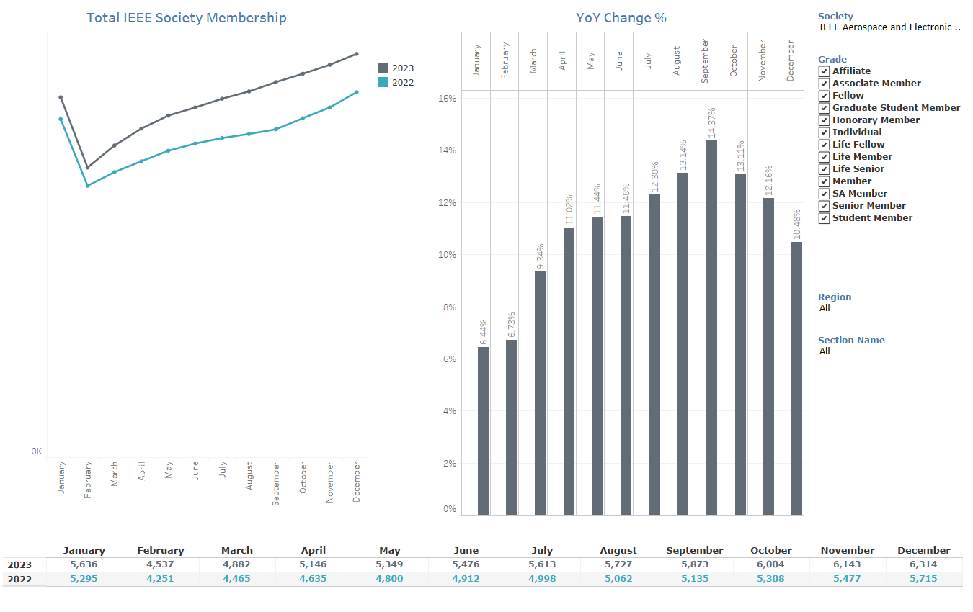
AESS Membership Monthly Statistics
Notes:
In here, all you want to say is that the members are growing organically.
10-15 sec
-------------
Memberships and Subscriptions Monthly Statistics
Year over Year Analysis
Society Membership

Slide 5
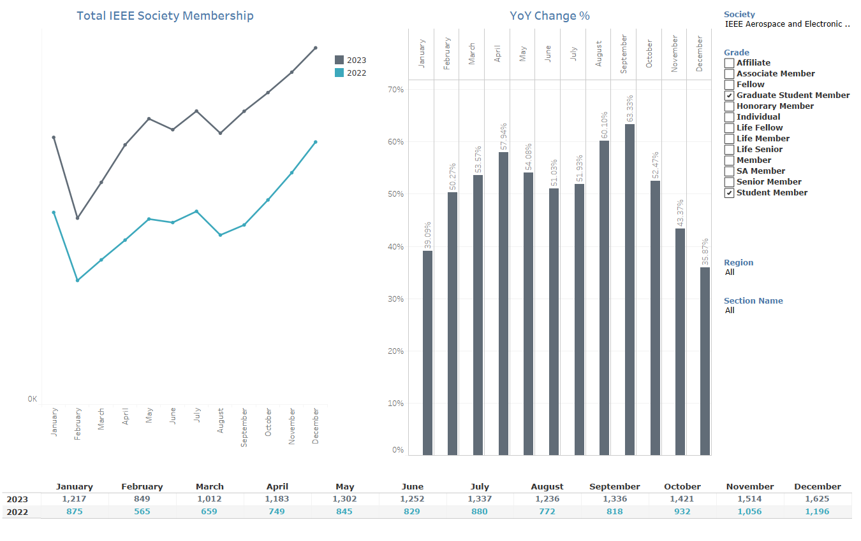
AESS Student Members Monthly Statistics
Notes:
In here, we focus on the student.
Clearly, students are growing by A LOT
If people ask you the numbers, please look at the bottom: somehow OU Analytics doesn’t create axes…
10-15 sec

Slide 6
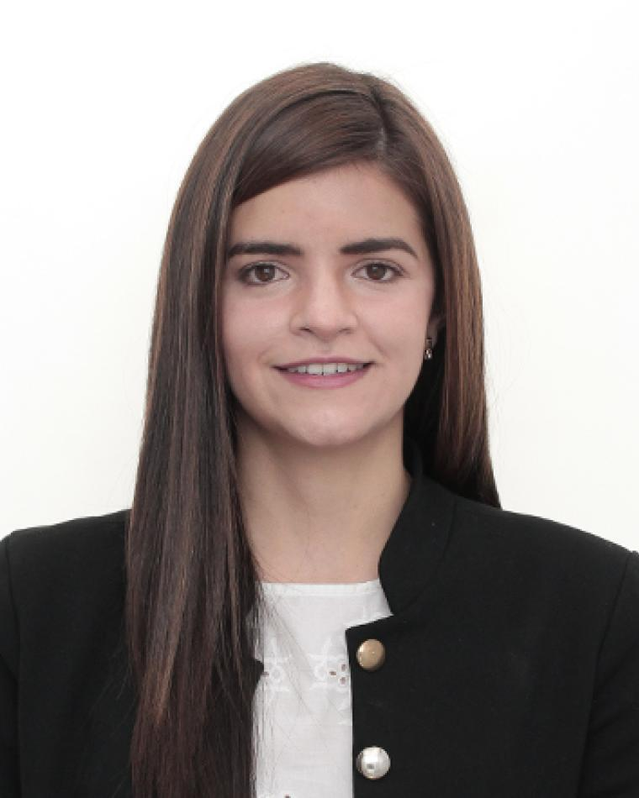
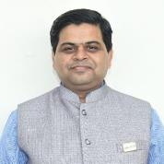
Year over Year: Region 9 and 10 Chapters
Notes:
Again, this slide is to congratulate specifically Giovanna Ramirez (for Region 9) and Puneet Mishra.
You can clearly see how fast the membership is growing thanks to their recent introduction into the BoG
30 sec is enough.

Slide 7
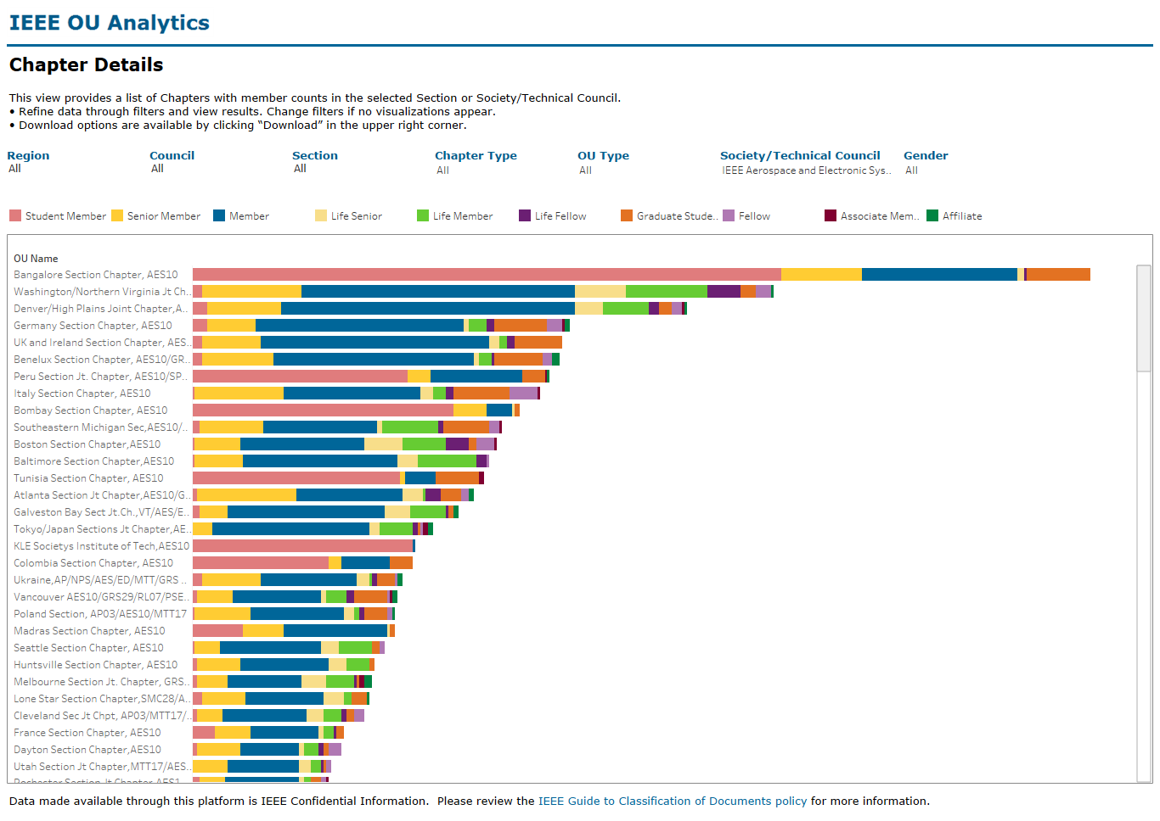
Most Populous AESS Chapters
Notes:
People like to see this plot showing the most populous chapters. Bangalore is first (Puneet), you can read the few next ones, but don’t spend more than 30 seconds.
Explore
/Dashboards for All Volunteers
/Geo OU Analysis
/Member Count by Chapter

Slide 8
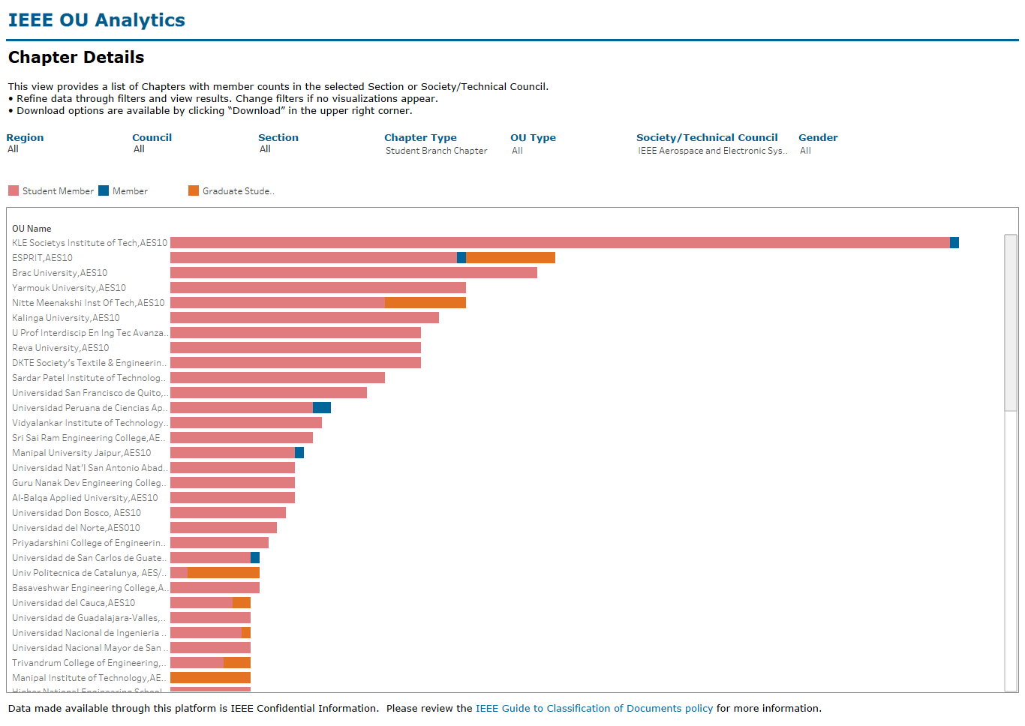
Most Populous Student Branch Chapters
India (R10)
Tunisia (R8)
Bangladesh (10)
Jordan (R8)
Mexico (R9)
Ecuador (R9)
Peru (R9)
San Salvador (R9)
Colombia (R9)
Guatemala (R9)
Spain (R8)
Notes:
This is specifically for the Student Branch Chapters.
I also placed the flag of each Student Branch (nobody knows where these branches are from so I did the work for them).
For people who don’t know flags, I made a legend on the left ;)
I think the key message is that, sadly, there is no U.S. found, or Australia. Europe comes last with a student chapter in Spain… It’s a “sad” story for the “developed” world.
If I was in person, I would have given my personal story: I’ve been in India, Tunisia, Peru, San Salvador, Colombia and Sri Lanka and witnessed firsthand why they are very successful, while “we” developed-world can’t make it.
Two things strike me:
The sense of community that a student chapter has in these countries. Students meet off work in these places to work and play fun stuff together. They have simple but fun projects. We don’t have such sense: engineers are “lone” people who go home after the class is over. This is cultural, and it is hard to change it…
The focus on space and satellites. In all of these countries, they misinterpret “AESS” as something to do with astronauts, space station, satellites. Some people stick robot drones and drones competition. Sadly, despite that what they thin we do, we actually do very little of these things. This is a problem that we, as AESS, need to address to stay relevant. Nobody in the student community cares about Radar, or Tracking, or Inertial Navigations. We have to change our message if we want to keep these people in our side.
Explore
/Dashboards for All Volunteers
/Geo OU Analysis
/Member Count by Chapter

Slide 9
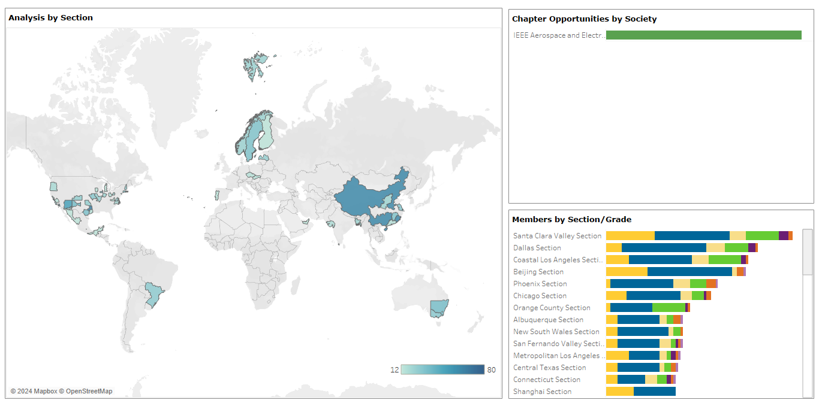
Potential New Chapter Map
Unchanged from last year
Notes:
OU Analytics:
Explore
/Dashboards for All Volunteers
/Geo OU Analysis
/Potential Chapters

Slide 10
Part 2: Strategy
Notes:
In here, I’ll give a summary of the 3 main goals I’d like to purse by the end of the year.
Complete the Global Merchandise Program
Increase funding to Chapters
Plan more Chapter Summits

Slide 11
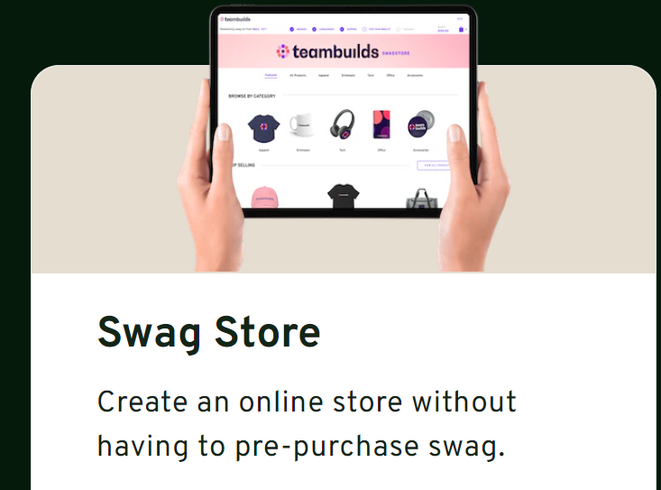
AESS Global Merchandise Program
Partner with SwagMagic
www.swagmagic.com
SwagMagic is a swag store accessible across 170+ countries
AESS creates an “online” store
Volunteers can select merchandise and have it shipped to their place
No international shipping fees
No additional effort for Members Committee or Conference Catalyst
Notes:
I recommend you to have Amanda speak when you’re here. She knows this program very well.
It’s a way for us to create an online store where all Chapter Chairs can request merchandise and it will be shipped at a VERY LOW cost.
The issue for us has been that shipping a package in India may cost $500, even if the value is just $50. it’s unsustainable. Through this program the merchandise will cost $50 no matter where you are in the world!!!
The details of the program are difficult to explain. Amanda knows that and have her speak if questions arise.

Slide 12
Global Merchandise Program: Timeline
BoG Approval
AESS Store Created / Merchandise Selected
Program Launch
IEEE Payment to SwagMagic
Volunteers request Merchandise up to $300
AESS Global Merchandise Form created
Members Committee Approves
CC Sends Email to Volunteer
Volunteer Selects Swags using Credit
Merchandise is Shipped to Volunteer
We are here!
Notes:
The Global Merchanise Program was approved by the BoG ($20,000) last year.
Right now, we are still waiting for IEEE to pay for SwagMagic… IEEE is slow.
Amanda can tell you more updates.
However, by the end of the year, this program will launch, and chapter chairs will order stuff online.

Slide 13
Goal: AESS Trickle Down Economics ☺
Goal is to Increase the awareness and usage of existing mechanisms to fund
Chapters and SBC
Member Services
Chapter ABC
Student Branch
Student Branch
Chapter DEF
Student Branch
Chapter GHI
Student Branch
Annual Funds
Major Initiatives
Awards
Happy Members
Happy Members
Happy Members
Notes:
The title is an American parody: “trickle down economics” was quoted by George Bush, and many people deride the term. So use it in a funny way ;)
But the concept is simple.
In the Bush Era, the idea was to give more money to the “rich people” so that they can spend more on stores/stuff so that they can employ more people so that wages go up.
In here, I’m borrowing the same concept, but for a “good cause:”
The issue is that we can’t fund members directly (and we shouldn’t). We can only fund their local activities. Local activities are organized by student branches and AESS chapters. So, to make sure that members are happy (with lots of activities), we HAVE TO keep sending more and more money to chapters and student branches.
We already have mechanisms in place, such as the “annual funds” the “chapter award” and, the most important one “the Major Initiatives”
But they are seldom used because people DON’T know about it, or are afraid/concerned.
I have proof that, once we “force” a person to submit a request, and he/she gets it, he/she will ask for more funding in the next months, finally breaking the cycle of inactivity!!
Funding chapters works! People do more stuff, and members are happier. I don’t care if people say we’re spending money: we’re spending them to make MEMBERS happy, so it’s good money spent!

Slide 14
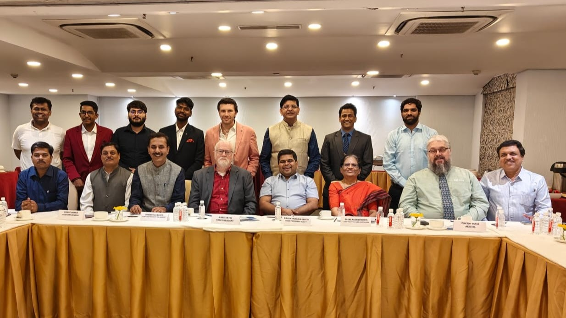
Goal: More Chapter Summits!
Chapter Summits do work!
Sharp increase of funding requests and questions from places recently visited through Chapter Summits
Many starting student branch chapters worldwide. Many also pondering starting their own chapter
A chance for future volunteers to understand the intricacies of IEEE policies, guidelines and inner works
A chance for volunteers to meet AESS leadership (they appreciate that a lot!!)
A chance for AESS leadership to learn the local issues, and solve problems on the spot.
Within budgetary constraints, we plan to organize more Chapter Summits.
Chapter Summit for South America (Peru) is planned for March 4th .
Chapter Summit at planned AESS conferences (e.g. radarconf)
Thinking of organizing one in Africa (no plans yet).
Notes:
I think this slides is self-describing.
In any case, the message is that we do see the practical advantage of having these chapter summits.
People get engaged right after we have one.
People learn the basics of how IEEE works, AESS works, and how to organize chapter events.
People meet the AESS leadership, and vice-versa.
Recently, I’ve been handling the entire Chapter Summit myself (under the role of Chapter Coordinator). In the past, we have had different VPs coming, but that becomes quite expensive if many people travel. In the end, the AESS leadership (either president, past president or similar) is always coming, so they can fill in in case there are specific questions. But usually 99% of the questions from chapter chairs are about chapter activities, distinguished lectures and ways to get more funding.
I honestly don’t have firm plans yet. I noticed many requests from Tunisia, Kenya and Tanzania, so I’m thinking of planning one in Africa (we’ve never done one). But again, it’s just speculation at this stage.
We will do Chapter Summits at RadarConf events as usual.

