Slide 1
IEEE Aerospace Electronic Systems
VP Conferences
Braham Himed
AESS Board of Governors Meeting – Spring 2024
10 and 11 May 2024
Denver, CO, USA

Slide 2
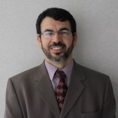
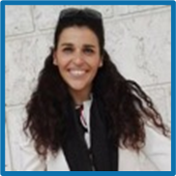
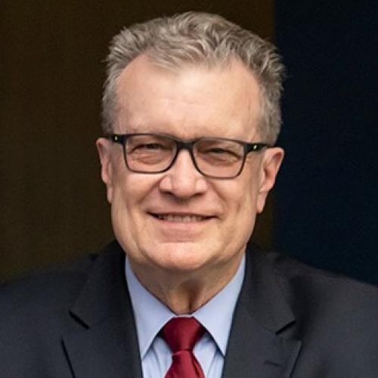
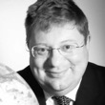
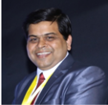
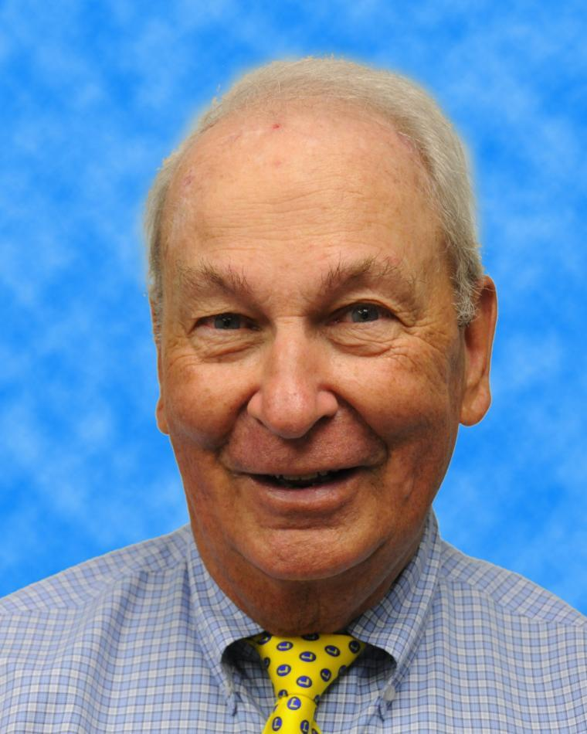
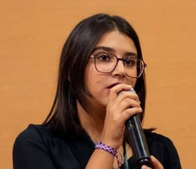
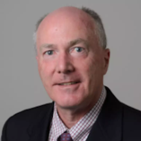
2024 Conference Committee
Braham Himed
VP-Conferences
Fabiola Colone
Walt Downing
Hugh Griffiths
Puneet Mishra
Bob Rassa
Abir Tabarki
Peter Willett

Slide 3
What so far, since November 2023
Actively engaged in coordination and approval of financially and technically – sponsored conferences, symposia, and workshops
  Detailed review of applications, including budgets (more importantly)
Addressing AESS participation/visibility/engagement at newly identified events
  Received several requests for sponsorship (grants)
    Europe, North Africa, Middle East, and Asia
Received record number of MOUs, including proposals for financial and technical sponsorship

Slide 4
Short term goal (SWOT Planning)
Continue offering and supporting high quality and healthy conferences / symposia / workshops
  Flagship conferences (Aerospace, AUTOTESTCON, RadarConf)
    Strong financially, well attended, and provide excellent surpluses
Increase joint (IEEE and others) workshops/conferences
Encourage student participation in under-developed regions via subsidy & travel grants to offset high cost of attendance
  Offer special / reduced rates
Create Action Group to develop strategy and roadmap for engagement with Africa and Asia – Proper and swift engagement
Create AESS conference advising committee
Address strong competition from other conferences

Slide 5
Question (Motion)
Motion to set aside $10,000 annually to fund activities in under-developed regions/countries
  Status
  Procedure?
  Accounting?

