Slide 1
IEEE Aerospace Electronic Systems
DSTEI Phase 1 Evaluation
Phase 2 Selection
Mark E Davis. DSTEI Project Manager
AESS Board of Governors Meeting – Spring 2024
10 and 11 May 2024
Denver, CO, USA

Slide 2
DSTEI Project Teams
Region 9 -- South America
  AESS Board Liaison – Giovanna Ramirez Ruiz, Bogota Colombia
  “Drone Swarm System for Agricultural Surveillance of Coffee Crops ", Univ. del Cauca, Cauca Colombia, IEEE Colombia Section
    Camilo Segura, Student Branch ; Dr. Liseth Viviana Campo, Student Branch Advisor
  “Smart Drones for Prevention of Forest Fires", Universidad National San Antonio Abad del Cusco (UNSAAC), Cusco Peru, AESS Peru Section
    Alberto Arturo Quinones, Student Branch; Dr. Walter Mego, Student Branch Advisor
Region 10 – India
  AESS Board Liaison – Puneet Mishra, Bangalore, India
  “ Fire Extinguisher Unmanned Aerial Vehicle ”, Nitte Meenakshi Inst Of Tech Student (NMIT), Bengaluru, India, AESS Bangalore Section
    Pradeep Kumar, Student Branch ; Dr. Parameshachari B. D, Student Branch Advisor
  , “Drones for Smart Agriculture”, Sardar Patel Institute of Technology (SPIT), Mumbai, India
  AESS Bombay Section
    Aditya Kulkarni, Student Branch; Dr. Sujata Kulkarni, Student Branch Advisor
Complementary Project Teams With Variation In Project Objectives, Sensors And Signal Processing, Membership Growth

Slide 3
2023+2 DSTEI Project Schedule
Phase 2 Ground Assy/Test
Phase 3 Air Integ/Test
Phase 1 Education/System Design
Q1
Q2
Q3
Q4
Year 2
Year 3
Kickoff
Chapter Meeting
Quarter Report
PDR/Short Course
Annual Report
Annual Report
Annual Report
Section
CDR
WBS/Schedule
Final Report
Brassboard Assy.
Gnd Test
Platform Integ.
Flight Test
Region 9
Baseline Design
Bread Board Assembly
Breadboard Testing
Ground Proc.
Ground Control
KPP & Analyses
Tradeoff Design
Instrument & SW.
Flight Safety
TAB Approval
Industry
TAB Approval
Transition
AES Lectures & Tutorials
Kickoff
Quarter Report
PDR /
Short Course
Chapter Meeting
Annual Report
CDR
Annual Report
TRR
Annual Report
Region 10
Section
WBS/Schedule
Final Report
Brassboard Assy.
Gnd Test
Platform Integ.
Flight Test
Baseline Design
Bread Board Assembly
Breadboard Testing
Ground Proc.
Ground Control
KPP & Analyses
Tradeoff Design
Instrument & SW.
Flight Safety
Industry
Transition
TAB Phaes 2 Budget Approved
Region 10 PDR and Short Course Concluded 30-31 October 2023, Bangalore India
Region 9 PDR and Short Course Planned For 2-3 March 2024, Cusco Peru
Delivery of Phase 1 Final Report And Phase 2 Proposals On 15 April 2024, For Phase 2 Start

Slide 4
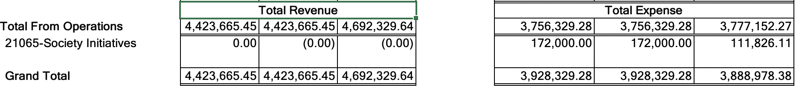
IEEE Finance Update for DSTEI Project
February 2024 IEEE Finance Update
MGA Sent Grant Funds In Phase 1 To Four Student Branch Chapters
  4 SBC Were Provided $25,000 Each Through Region/Sections
  Additional Funds $72,000 Were For PDR, Short Course
  And Chapter Summits
DSTEI Expenditures Split Over Calendar Due To Funding Delay
  Region 10 PDR And Short Course Conducted In October 2023
  Region 9 PDR And Short Courses Were Conducted In March 2024
  The Large Delay In Funding Swept Up ($60.17K) On 1 January 2024
TAB Finance Approved $170K For DSTEI Phase 2
  TAB Finance Allowed Remaining Of Phase 1 In 1stQ Of 2024
  TAB Will Process Phase 2 After Selection Of SBC Proposals

Slide 5
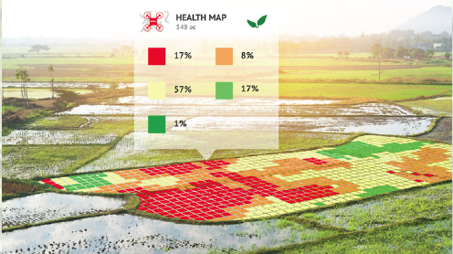
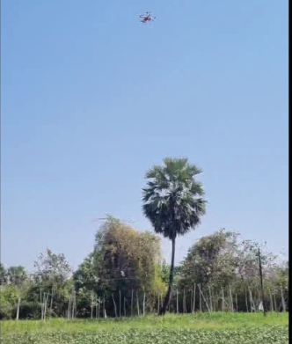
DSTEI S.P.I.T Student Branch PDR + QPR
Drones for Smart Agriculture
Flight Tests Phase 1 Drone
2 kg Drone, Pixhawk FC, RGB Camera,
RPi via MAVLink
Phase 1 Accomplishments
  High Level System Architecture
  Live Video Connection With RGB To Drone
  Collected Crops for Demo KPP
  NDVI Multispectral Analysis Demo
  Path Optimization For Robot Sensors
  Ground Robot (ROV) For Crop Spraying
Phase 2 Plan
  Design for 5 kg Drone, ROV Fertilizer
  PARROT Multispectral Camera
S.P.I.T. Student Branch Growth
  14 Students, With Succession Plan
  Advisor Dr. Kulkarni: Faculty Advisor
  Strong Interface With AESS Mumbai
Alliances With Students and YP
  STEM Workshop on AESS Membership
  Drone Workshop on Bombay Section
Collaboration With Regional Crop Growers
Opened 4 Student Branch Chapters
Phase 1 Score: 42.75

Slide 6
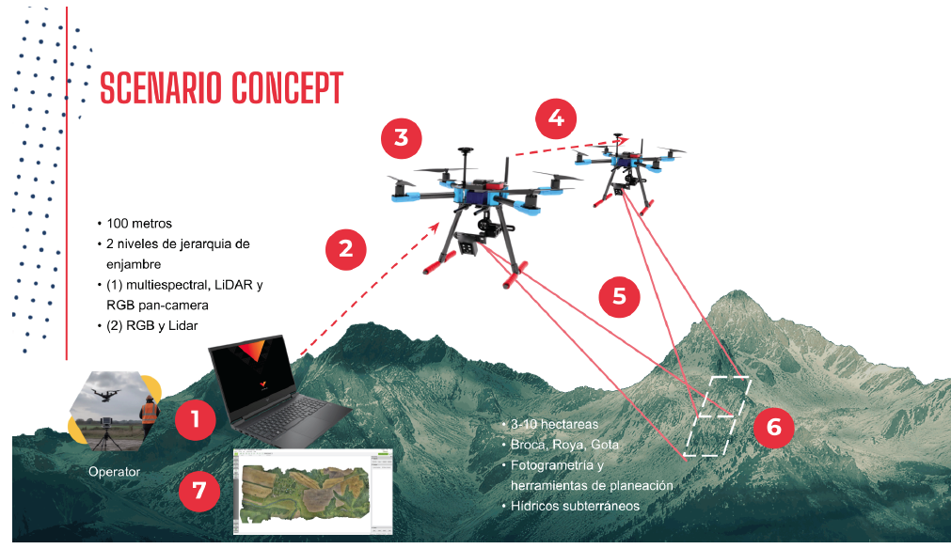

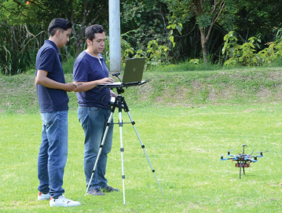
DSTEI UniCauca Student Branch PDR
Flight Tests 2 Drone Types
UniCauca Student Branch Growth
  17 Students, With Succession Plan
  Advisor Dr. Campo: Innovative Mgt. In Drone Management, Crop Applications
  Strong Interface With AESS COL
Alliances With Students and YP
  Colombia SBC Meetings
  Embry Riddle Univ. USA
  Small Business in Colombia, Ireland & Mexico
Collaboration With Regional Crop Growers
Phase 1 Accomplishments
  High Level System Architecture
  Tradeoff On 2 Drone Platforms
  Flew Multispectral 4-Band Sensor
  Demo Key Performance Parameters
  Machine Learning On Crop Health
  Real Time Processing Breadboard
  Comm/Cyber Protocol
Phase 2 Plan
  UAV/ROV Geoscience Network
  Mentorship With Multiple AES Chapters
  Grow Industry Supporters
Phase 1 Score: 37.25

Slide 7
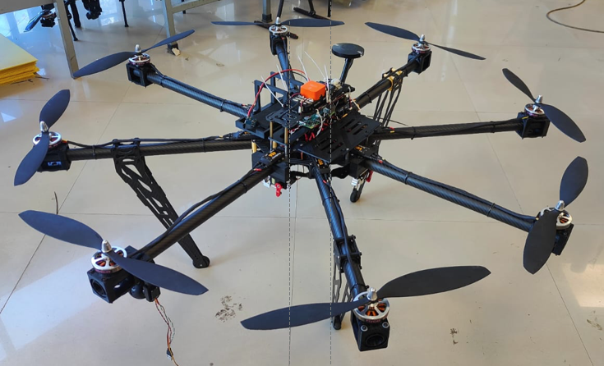
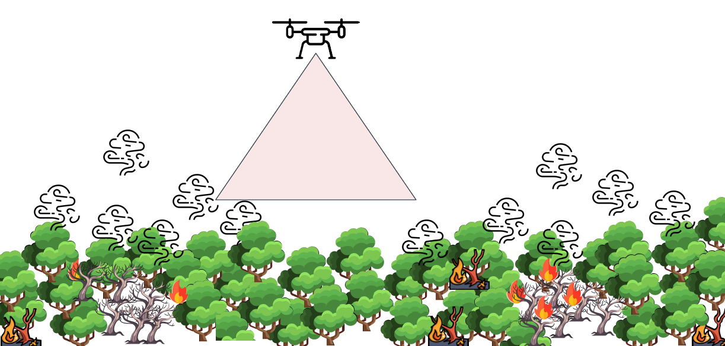
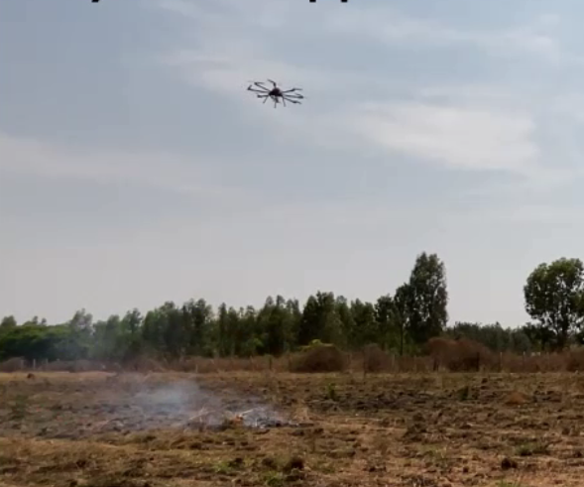
DSTEI N.M.I.T. Student Branch PDR + QPR
Fire Extinguisher UAV
Fire Ball Released
NMIT Student Branch Growth
  7 Students, With Succession Plan
  Faculty Advisor Dr. Parameshachari BD
  Strong Interface With AESS Bengaluru
Alliances With Students and YP
  Invited Local SBC For PDR In October 2023
  NMIT Technology Transition Coordinator
  Bangalore 2024 Best Chapter From Section
Collaboration With AEROGO Industry
Phase 1 Accomplishments
  High Level System Architecture
  Developed And Flew An Octocopter Drone
  PixHawk UAS Flight Controller
  Operated 3D CAD Stress Analysis
  Machine Learning Algorithms
  Day Night Fire Suppression Test
Phase 2 Plan
  Work With AEROGO Mentor On Sensor
  Complete Cyber and Thermal Fusion Design
  Grow Industry Supporters
Phase 1 Score: 35.33

Slide 8
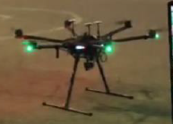
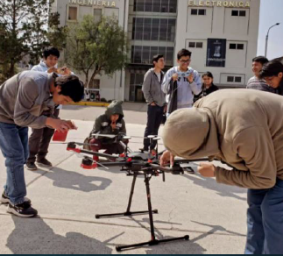
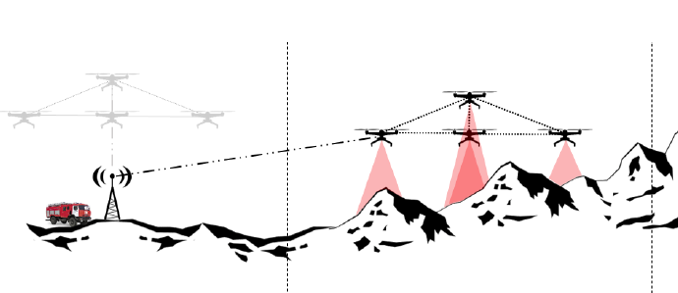
DSTEI UNSAAC Student Branch PDR
Matrice Drone In Mountain Terrain
Demo Drone At ELCON 2023
Matrice 600 Pro
UNSAAC Student Branch Growth
  44 Students, With Succession Plan
  Advisor Dr. Walter Mego:
Alliances With Students and YP
  4 SBC Meetings In 2023 With 5 Peru SBC
  Project Ar Peru Zagi and ROV
  2023 Student Branch Award
Collaboration With Peru Emergency & Fires
  Tighter Financial Linkage To Peru Section
Phase 1 Accomplishments
  Matrice 600 Pro Drone Flight Test
  Technical Performance Measurements
  Sensor Fusion System Data Processing
  Drone Flight Mg’ment and Sensor Control
  Ground Control System Protocol for Environmental and Geographic Factors
  Key Parameters With Peru Fire Experts.
Phase 2 Plan
  Integrate Thermal Sensor To Drone
  Grow Government & Emergency Organization Supporters
Phase 1 Score: 31.38

Slide 9
DSTEI Growth of AESS Student Members
Student Branch | Kickoff Meeting | Phase 1 Final Report | Liaison With Other SBCs
S.P.I.T | 14 | 17 (M), 38 (C ) | 1
N.M.I.T | 6 | 8 (M), 47 (C ) | 1
UniCauca | 9 | 14 (M), 9 (C ) | 3
UNSAAC | 3 | 17 (M), 43 (C) | 4
(M) DSTEI Member, (C ) Collaborator
Student Branch Chapters Measured Increasing New Members
Increase Of Members Minimum Of 2-times From
Kickoff Meeting to Phase 1 PDR and Final Report
Each SBC Has Continuously Liaised With Other Chapters, Government Agencies and Industries In Region/Sections
Outstanding Chapter Attendance During PDR/Chapter Summits

Slide 10
“Committee Rating” Of DSTEI Phase 2 SBCs
Weighting Factors
Final Weighted Scores From 4 Committee Evaluators
All 4 Student Branch Chapters Made “Satisfactory Grades”
  Based On PDR Presentations And Phase 1 Final Report
  Proposal Details Need To Be Adjusted Before Phase 2 Kickoff
  Stressing More Industry Outreach In Phase 2
  Critical Design Review In Second Half Of Phase 2
IEEE TAB Requests Grant Funding Be Limited To $25,000 each
  Need To Negotiate Down On A Couple Of SBCs
  Section Funding Issues Need To Be Rectified
Recommending For Funding 2 or 3 SBCs For Phase 2

Slide 11
Summary Of DSTEI Phase 2 Selection
Phase 1 Funding Expected To Be Sufficient To 15 May 2024
Phase 2 Grant Funding By 15 June 2024
  Requires IEEE Sections Approving Finance Transfer To SBCs,
  Based On Phase 1 Process
  Cost Proposal: Grants Identical With Phase1, With CDR & Chapter Summit With Two Regions (India & South America)
Each Successful Phase 2 Proposal Will Include A Technology Transition Roadmap For The Growth Of AES Engineers And Technology Collaboration With The Local Academics And Industry.
A Letter Of Intent Will Be Provided In The Proposal To Identify The Funding Process From AESS And The Section To The SBC; And It Will Be Signed By The Appropriate IEEE Section And An AESS Chapter (If Available).
Process To Get TAB VP For Approval Based On 11 May BoG Vote
Selection For 2 or 3 SBCs Phase 2 Based On Technical and Cost Proposals

Slide 12
DSTEI Transition To Phase 2 Motion
The Distributed Sensor Technology & Education Initiative (DSTEI) Proposes To Allocate the 2024 Initiative Funding For:
  Phase 1 Funding For 2023 Spent In 2024 ($19.25 K)
  Phase 2 Funding Grant For 3 Student Branch Chapters ($75K)
  Phase 2 Support For Critical Design Review, Section 9 & 10 Chapter Summits, And Meetings With Industry and Governments For Technology Transfer ($25.75)
AES Budget Initiative: IEEE TAB Has Approved 2024 Initiative; Awaiting SBCs Evaluations On Phase 1 Final Report and Phase 2 Proposal
Pros:
  All 4 Student Branch Chapters Have Successfully Documented Their Objectives
  Breadboard Drones With Sensors Exhibited System Feasibility
  Significant Growth Of Students Members and Student Chapters in 2023
Cons:
  Funding Schedule Will Continue To Move Into 2025 (Phase 3)
  Section Support Difficult With SBC Grant Funding
Financial Implications: $120K USD In AESS Initiative 2024 Budget For Phase 1 Completion, And Successful SBC Transition To Phase 2

