Slide 1
IEEE Aerospace Electronic Systems
VP Education
Alexander Charlish
AESS Board of Governors Meeting – Spring 2024
10 and 11 May 2024
Denver, CO, USA

Slide 2
What so far, since November 2023
Virtual Distinguished Lecturer Program
  31 webinars scheduled for 2024.
  28 VDL webinars hosted in 2023 with an average attendance of 125 attendees per webinar.
  Members from 81 different countries attended VDLs in 2023.
Distinguished Lecturer Program
  34 requests from 14 lecturers for financial support for DL travel totaling $16,112.00 in 2023.
  14 requests from 4 lecturers for financial support for DL travel totaling $4,078.00 in 2024.
Educational Events
  RadarConf: Boot camp, Radar challenge and YP event.
  Fusion: Boot camp and YP event.
  Our strategy of transferring funds to the conference accounts appears to now be a problem IEEE.
Robert Hill Best Dissertation Award
  Deadline on 31st October 2023, notifications sent on February 2nd 2024.
  12 nominations.
  Winner: David Luong “Quantum Radar Signal Processing.”

Slide 3
What so far, since November 2023
YP Travel Grants
87 applications submitted by the 1st March deadline.
  RadarConf: 29, Fusion: 18, AutotestCon 6, DASC: 12, International Radar Conference: 9.
Decisions made on RadarConf, Fusion and AutotestCon.
  Recipients for RadarConf: Tarun Cousik (US), Neeraja P K (India), Gong Chen (Singapore)
  Recipients for Fusion: Ramin Norouzi (Turkey), Rihana Luz Avila Huatuco (Peru), Suhita Karmakar (India)
  Recipient for AutotestCon: Kerlos Atia Abdalmalak Dawoud (Spain)
Requests made for grants for 5 financially co-sponsored conferences.
Necessary: Extend the funding from 3 AESS conferences to 5 AESS conferences.
A large number of applications were PhD students who would likely attend the conference anyway.
Next year: limit the grants to post-students.
Applications this year appeared to make a large use of ChatGPT.
  44% of applications to Fusion ended their statement with:
  Thank you for considering my application. <Follow on sentence>, for example:
  Thank you for considering my application. I am looking forward to the possibility of being a part of this esteemed program and am eager to demonstrate my commitment and capabilities.

Slide 4
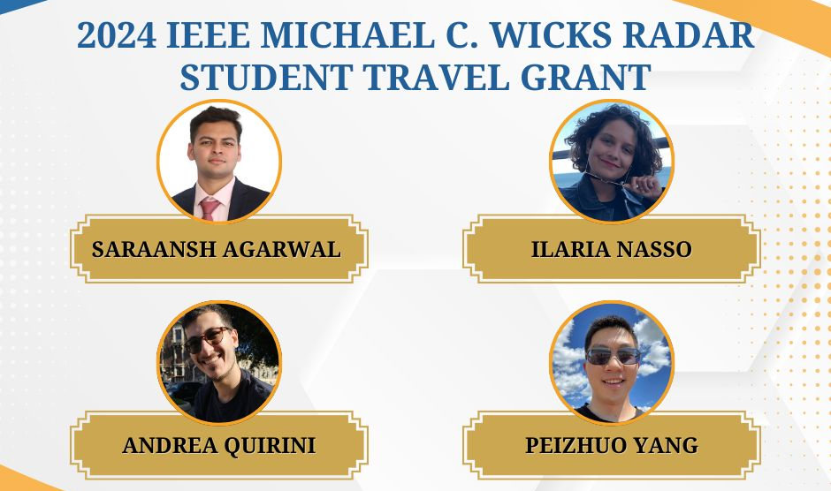
What so far, since November 2023
Michael Wicks Award

Slide 5
What so far, since November 2023
Engineering Scholarship
Committee: Fabiola Colone (Chair), Hugh Griffiths, Peter Willett
Applications deadline: December 1st, 2023 extended to February 28th, 2024
Number of applications: Graduate Student 6, Undergraduate Student 25
Notifications sent around 26th March 2024.
Lesson Learnt:
  Deadline and decision process to be brought inline with other AESS awards in order to improve visibility and hence number of applications
  Diversity (geographical, institution) might be an issue → increase visibility using different strategies, there including local Chapters
  The applicants should clearly state the scoring system used in their Country and have their GPA mapped into an equivalent 4-point grading scale
  The winners should be invited to an award ceremony at one of the AESS conference → this brings in an issue regarding the travel expenses

Slide 6
Short term goal (SWOT Planning)
Short Term Goals
Maintain the current educational offerings: DL events, VDL program, ILN and Vimeo resources, YP travel grants, AESS scholarship, Michael Wicks Award, Robert T. Hill Award, and support for summer schools, YP events, challenge events.
Host 31 webinars as part of the VDL program. Add the videos to ILN and to our site using Vimeo.
New round of DL appointments at the end of 2024.
Keep the judging for the Engineering Scholarships and Robert T. Hill Best Dissertation Award to within three months.
Send YPs to three (or five) AESS financially co-sponsored conferences in 2024. Improve the process for 2025.

Slide 7
Motion – 2025 YP Grant Budget
MOTION: Alex Charlish moves to fund five AESS financially sponsored conferences for the Young Professional Travel Grants in 2025 in the amount of $25,000, an increase from 15,000 in 2024.
Currently we have funds allocated to provide YP travel grants to three AESS conferences. However, we have applications from YPs to attend five different AESS conferences. In order to send YPs to other AESS conferences, it is necessary to extend the existing support.
Pros:
  Advance the professional development of YPs.
  Help engage YPs from typically underrepresented regions who face greater financial challenges in attending conferences than YPs from developed countries.
  Attract new AESS YPs and retain existing YPs.
  Increased conference participation.
Cons:
  Cost
  Additional effort in judging the applications and arranging the travel grants
Financial Implications: $10,000.00 (on top of existing $15,000.00).

Slide 8
Background
Approach from Mary Lanzerotti to Alex Charlish
‘to collect oral histories of distinguished leaders in IEEE to archive their life stories in perpetuity at ETHW (ethw.org) for the IEEE History Center. I am trained as an IEEE oral history interviewer by the IEEE Historian. This effort involves reaching out to the distinguished individuals, preparing and conducting their oral history interview (1-2 hours), and working with the IEEE History Center to archive the interviews. The IEEE History Center and I are seeking funding from interested societies for my consulting and their transcription time’.
The AES Magazine has published a couple of interview pieces in recent years, which have been well received.

Slide 9
Examples:
1. Mildred Dresselhaus, an oral history conducted in 2013 by Kelsey Irvin, IEEE History Center, Hoboken, NJ, USA. [Online]. Available: http://ethw.org/Oral-History:Mildred_Dresselhaus.
2. Deborah Anderson, an oral history conducted in 2013 by Kelsey Irvin, IEEE History Center, Hoboken, NJ, USA. [Online]. Available: http://ethw.org/Oral-History:Deborah_Anderson.
3. Jennie S. Hwang, an oral history conducted in 2013 by Kelsey Irvin, IEEE History Center, Hoboken, NJ, USA. [Online]. Available: http://ethw.org/Oral-History:Jennie_S._Hwang
4. Elizabeth Paté-Cornell, an oral history conducted in 2015 by Kelsey Irvin, IEEE History Center, Hoboken, NJ, USA. [Online]. Available: http://ethw.org/Oral-History:Elisabeth_Paté-Cornell
5. Heidi Ries, an oral history conducted in 2015 by Hannah Bech, IEEE History Center, IEEE History Center, Hoboken, NJ, USA. [Online]. Available: http://ethw.org/Oral-History:Heidi_Ries

Slide 10
Motion - Lanzerotti’s Oral History
MOTION: Alex Charlish moves to support Lanzerotti’s Oral History project for a trial year, and commits a budget of $5,000 for 2024.
Pros:
  We need to do a better job of recording and preserving the lives and careers of leading engineers in our domain
Cons:
  The proposed process is perhaps too formulaic, and not good value for money
Financial Implications: $5,00 for one year

Slide 11
Short Course Program

Slide 12
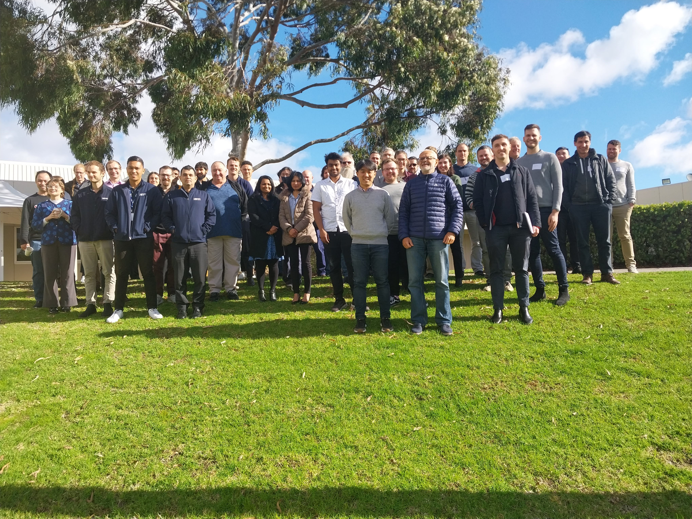
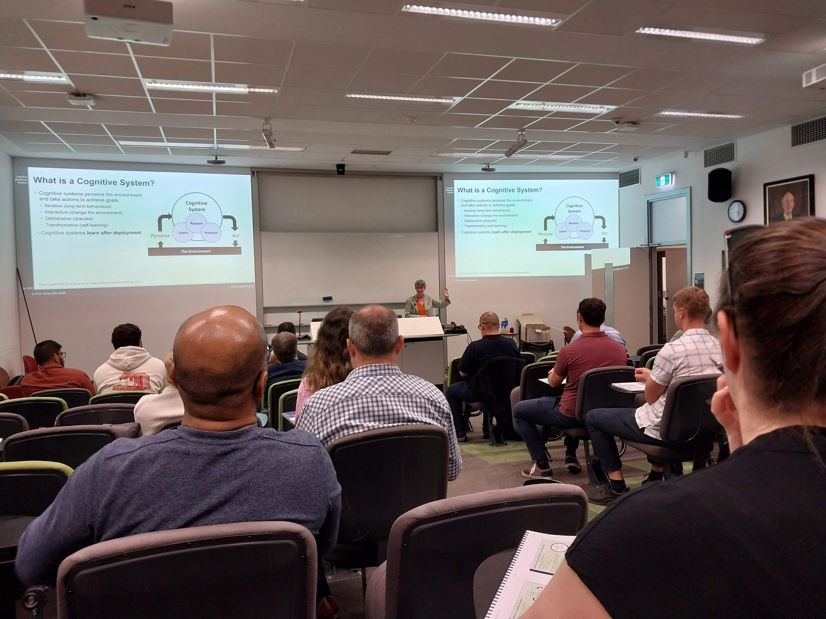
Short Course Program
Short Course Options
  In-person/hybrid course run at a public venue, open to everyone
  Virtual course open to everyone - more attractive for chapters with less money.
  Industry focused short course, run for a specific company.
Short course website
  New form for logging short courses – not widely used
Previous short courses since Nov. 2023
  Joe Fabrizio - Over the Horizon Radar – various venues / audiences
  Karen Haigh and David Brown – Introduction to EW / Cognitive EW joint course with AOC Australia, November 13-17 in Brisbane and Adelaide.
Upcoming short courses:
  Joe Fabrizio - Over the Horizon Radar – courses planned for June and August
12

Slide 13
Short Course Program
Communication
  Contacted all AESS short course presenters in May 2023 to encourage them to be pro-active and reach out to local AESS chapters and/or industry directly
  Further communication required to promote short course program to AESS Chapters
  Short course slides presented by Lorenzo at the India R10 meeting and Peru region 9 meetings.
Ideas going forward
  Work closer with AESS industry group to test out this newer working model
  Further outreach to AESS chapters – continue to talk at the region summits
  Online training session for each region – how to coordinate?
13

Slide 14
Short Course Program
DSTEI program (short course / tutorial style lectures focused on a single topic)
  Mark Davis – Distributed Sensor Systems Management
  Mike Braasch – UAV Navigation Technology
  Roberto Sabertini - Avionics and Cyber-Security
  Vince Socci - UAV Operations Planning
  Stefano Coraluppi - Sensor Fusion Technology
AESS Lecture Tour Plan
  Part of the Distributed Sensing Technology and Education Initiative to reach AESS chapters in Regions 8/9/10.
  Lecture series focused on a single topic with a group of up to 4 presenters
  Local chapters can propose for the lecture tour to visit (max. 4 locations spread over 2 regions).
  Suggestion is for 4 x half-day lectures / short-courses over 2 days per location (max. 2 week trip)
  Choose one person to lead the tour and let them suggest colleagues to include
  Motion passed in San Antonio with a $30K maximum budget
14

