Slide 1
IEEE Aerospace Electronic Systems
VP Industry Relations
Stefano Coraluppi
AESS Board of Governors Meeting – Spring 2024
10 and 11 May 2024
Denver, CO, USA

Slide 2
Recent progress
Assemble IR committee
  Stefano Coraluppi (Chair), Steven Butler, Michael Noble, Roberto Sabatini, Barry Tilton
  First coordination meeting to be held soon after FUSION 2024
Identify high-level goals
  Industry member recognition
  AESS events
  IEEE-wide activities

Slide 3
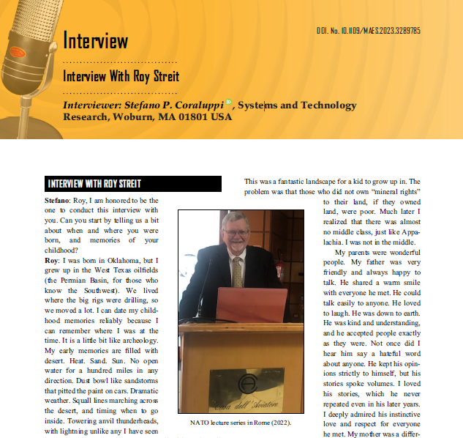
First goal: industry member recognition
Awards
  In coordination with VP Awards (Blair)
  Industrial Innovation Award
    Chaired by Mila Mihaylova
    Three nominees evaluated for 2024 award
Elevation to Senior Member
  In coordination with VP Member Services (Lo Monte)
  Direct outreach, email blast, social media postings
Interviews
  In coordination with VP Publications (Rosenberg)
  Interviews is AES-M
    Fall 2023: Interview with Roy Streit

Slide 4
Second goal: AESS panel discussions
AESS Virtual Panel: How to Succeed in Your Engineering Career
  First edition
    17 March 2023 (90min)
    Moderated by Mike Noble
    Panelists: Arik Brown, Steven Butler, Stefano Coraluppi, Robert Rassa, Francesca Scire-Scappuzzo
  Proposed timing: Fall 2024
AESS Virtual Panel: Issues in Autonomy and Defense
  Potential panelists
    Wolfgang Koch (AESS DL), Ariel Conn (IEEE SA Research Group on Issues of Autonomy for Defense Systems), Matthew Cornick (STR VP), Gokhan Inalhan (AESS DL), Heather Roff (Center for Naval Analyses), etc.
  Proposed timing: Spring 2025
AESS Conference Industry Panels

Slide 5
Third goal: IEEE-wide activities
Web-based Industry Relations Platform (IRP)
  POC: Patrick Russoniello, IEEE Senior Corporate Development Lead
World Technology Summit
  POC: Michael Condry, IEEE Technology and Engineering Management Society Past President
IEEE Industry Engagement Committee
  POC: Celia Desmond, IEEE Technical Activities (Engagement and Governance)
  Meeting with Eugene Chang (and others) held on 6 May 2024

Slide 6
Summary
Industry members (many in defense technology) are a key component of AESS membership
The IR Committee focus is on recognition and services for this constituency
  Industry member recognition
  AESS events
  IEEE-wide activities
SWOT Analysis
  The limitations on what we can achieve are dictated by volunteer time
  No dedicated funds are needed (and no BoG motions) at present

