Slide 1
IEEE Aerospace Electronic Systems
VP Member Services
Chapter Coordinator
Lorenzo Lo Monte
AESS Board of Governors Meeting – Spring 2024
10 and 11 May 2024
Denver, CO, USA

Slide 2
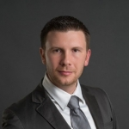
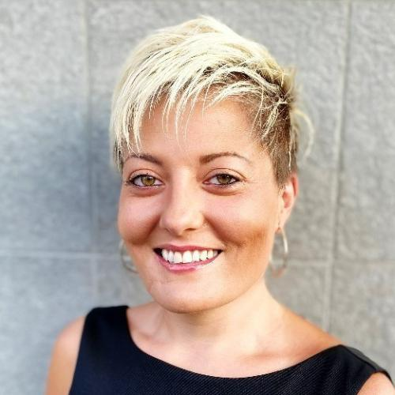
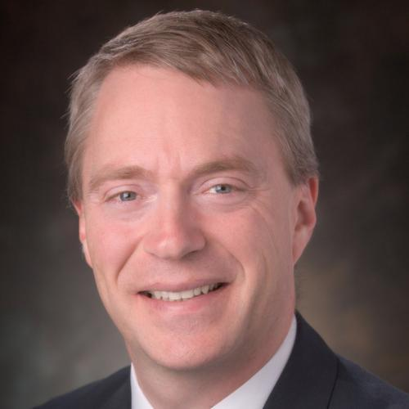
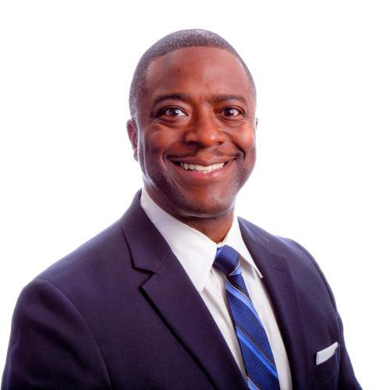
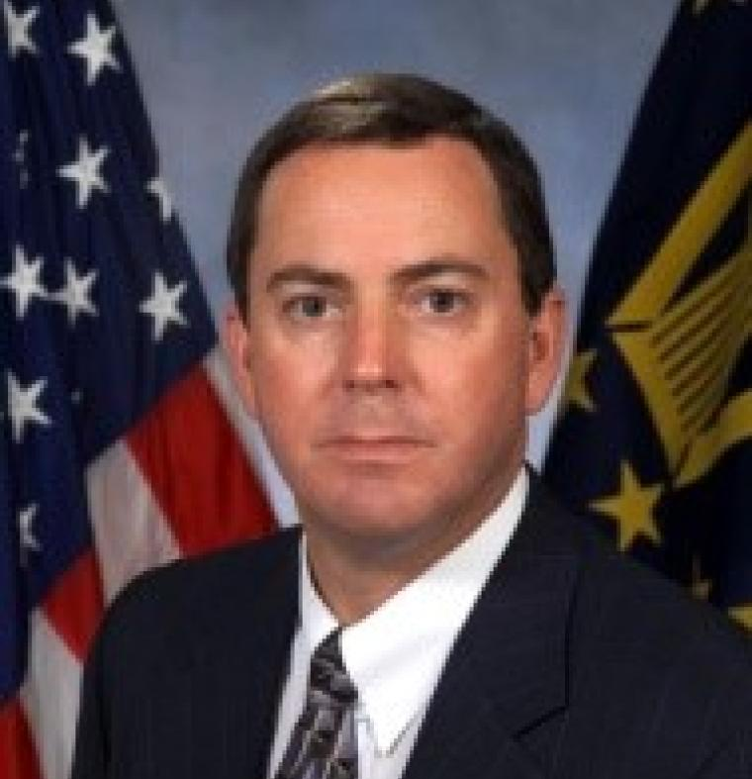
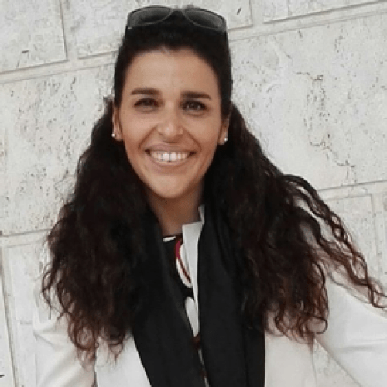
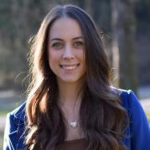
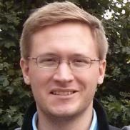
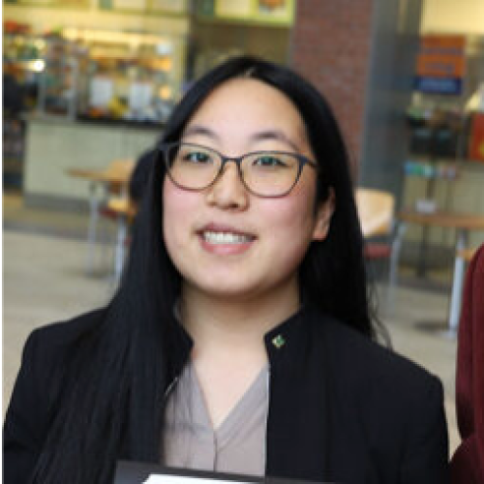
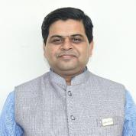
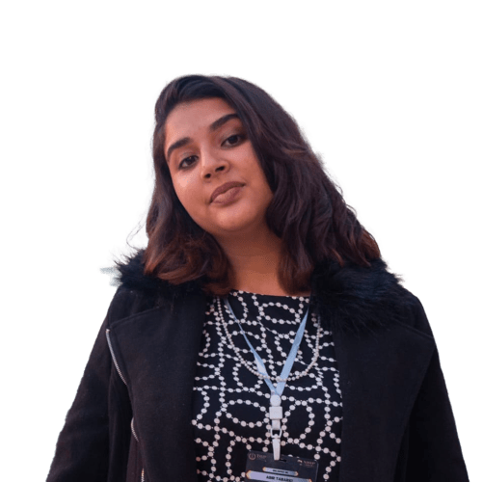
Member Service Committee
Lorenzo
Lo Monte
Laura Anitori
Michael
Braasch
Arik
Brown
Steve
Butler
Fabiola
Colone
Francesca
Filippini
Philipp Markiton
Puneet Mishra
Abir Tabarki
Jemma
Mallia

Slide 3
Part 1: Statistics

Slide 4
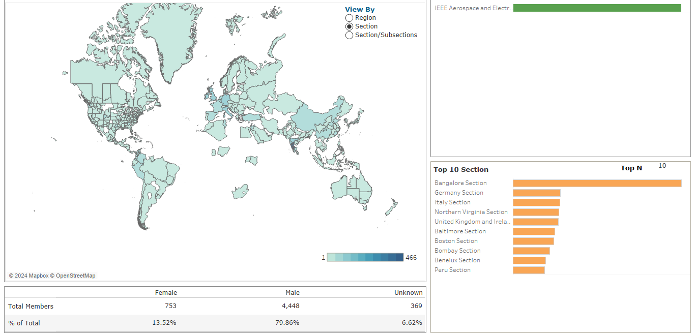
Membership Overview (May 2024)
Notes:
Explore
/Dashboards for All Volunteers
/Geo OU Analysis
/IEEE/Society Member Summary

Slide 5
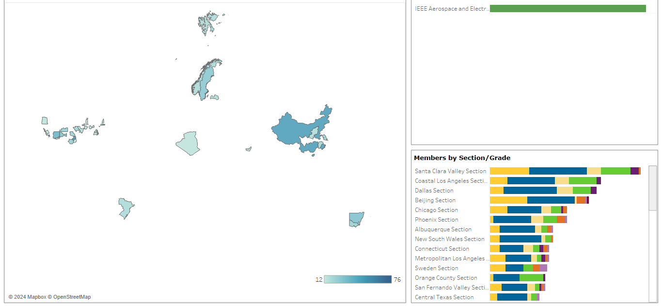
Potential Chapter Opportunities

Slide 6
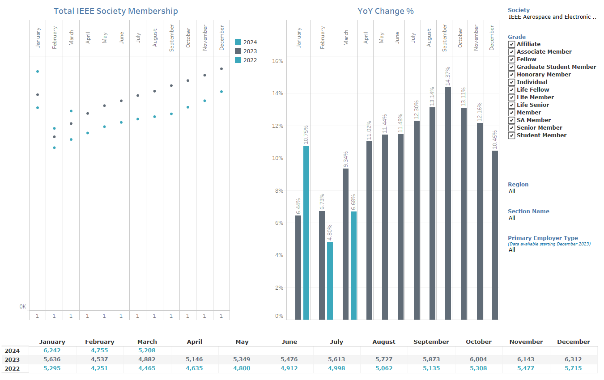
AESS Membership Monthly Statistics
6k
5k
4k
3k
2k
1k
0k
Notes:
Memberships and Subscriptions Monthly Statistics
Year over Year Analysis
Society Membership

Slide 7
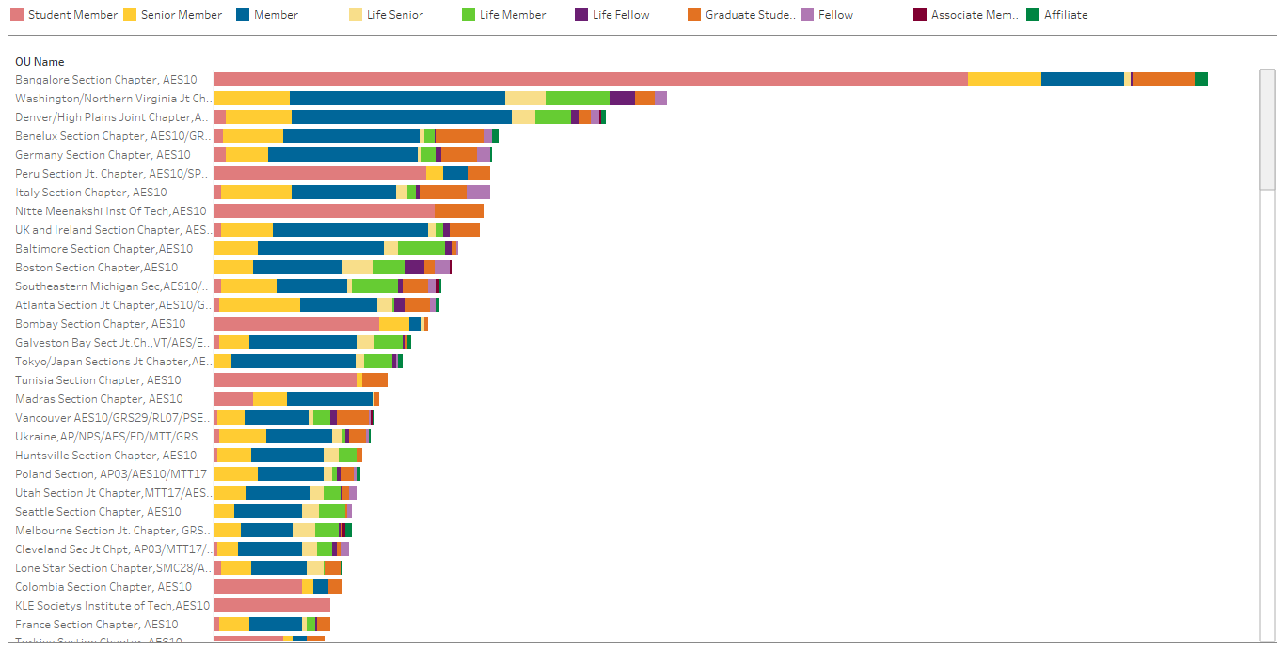
Most Populous AESS Chapters
Notes:
Explore
/Dashboards for All Volunteers
/Geo OU Analysis
/Member Count by Chapter

Slide 8
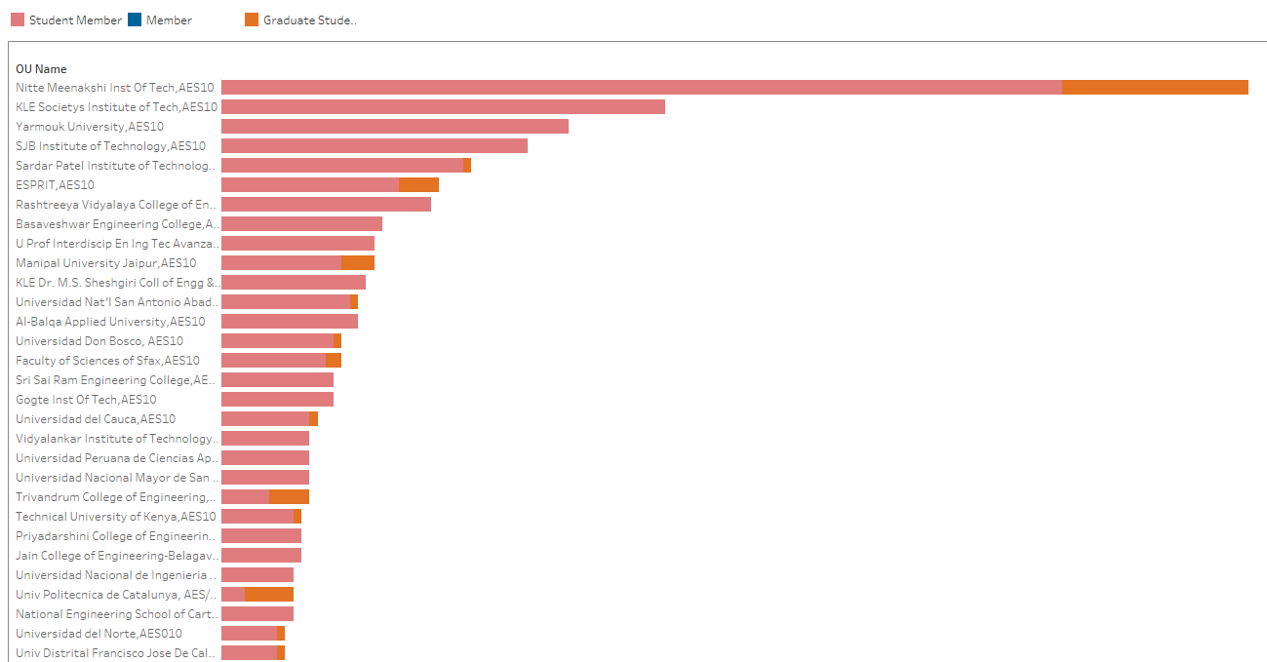


Most Populous Student Branch Chapters
India
India
Jordan
India
India
Tunisia
India
India
Mexico
India
India
Peru
Jordan
El Salvador
Tunisia
India
India
Colombia
Notes:
Explore
/Dashboards for All Volunteers
/Geo OU Analysis
/Member Count by Chapter

Slide 9
Chapter Activities YTD

Slide 10
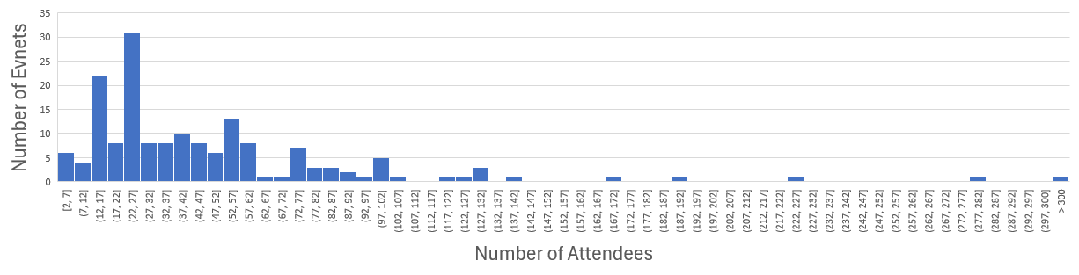
Chapter Events – Attendee Statistics
Median number of attendees: 35
Max number of attendees:
  1655 (IEEE Aerosphere 2024, Turkey)
  280 (Civil Engineering Symposium, Kenya)
  233 (Galaxy giggles, Tunisia)

Slide 11
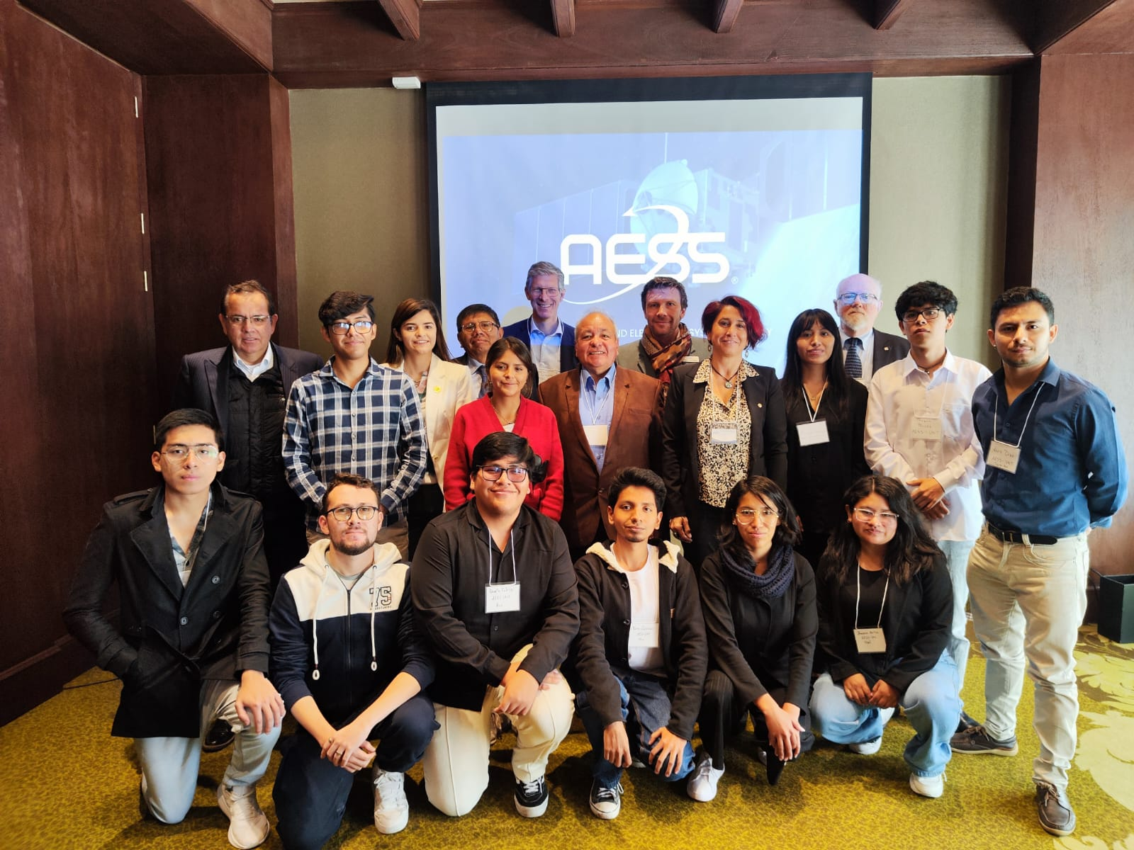
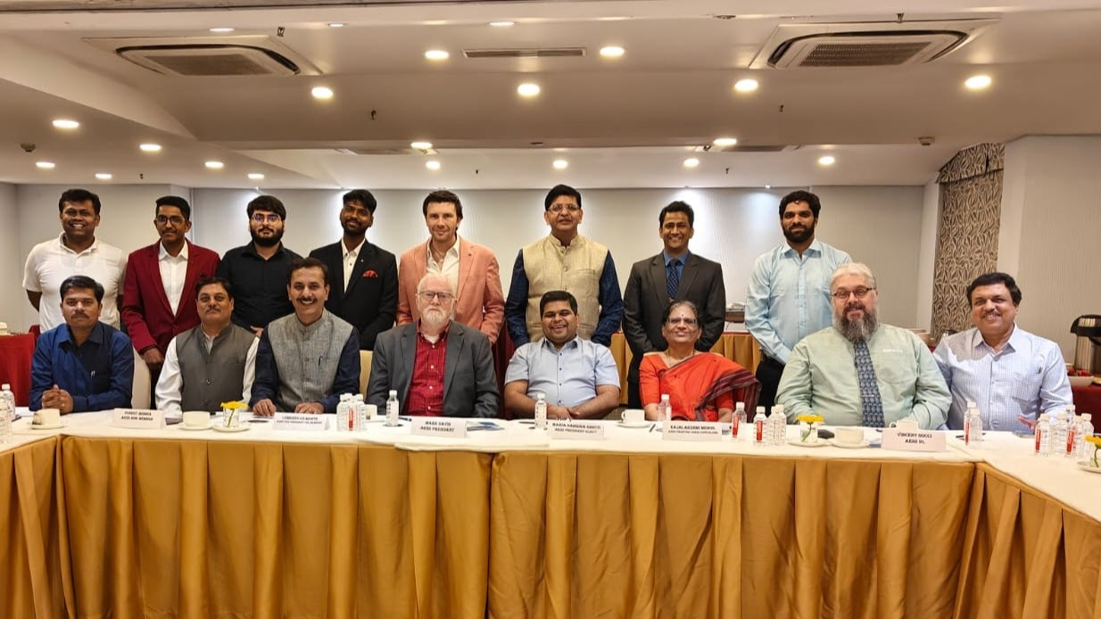
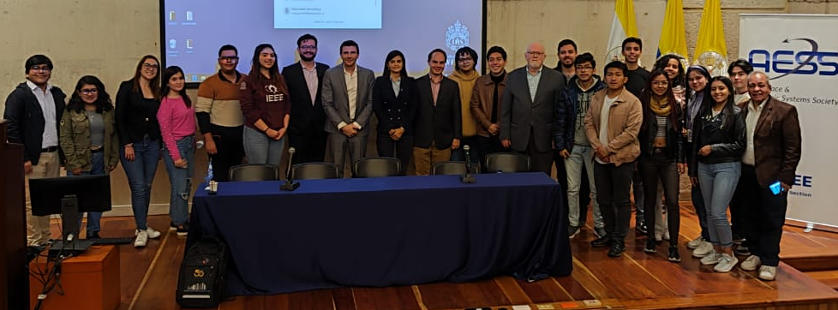
Goal: More Chapter Summits!
Chapter Summits do work!
  Sharp increase of funding requests and questions from places recently visited through Chapter Summits
  Many are starting SBC worldwide. Many also pondered starting their own chapter
  A chance for future volunteers to understand the intricacies of IEEE policies, guidelines, and inner works
  A chance for volunteers to meet AESS leadership (they greatly appreciate that!!)
  A chance for AESS leadership to learn the local issues and solve problems on the spot.
Within budgetary constraints, we plan to organize more Chapter Summits.
Notes:
I think this slides is self-describing.
In any case, the message is that we do see the practical advantage of having these chapter summits.
People get engaged right after we have one.
People learn the basics of how IEEE works, AESS works, and how to organize chapter events.
People meet the AESS leadership, and vice-versa.
Recently, I’ve been handling the entire Chapter Summit myself (under the role of Chapter Coordinator). In the past, we have had different VPs coming, but that becomes quite expensive if many people travel. In the end, the AESS leadership (either president, past president or similar) is always coming, so they can fill in in case there are specific questions. But usually 99% of the questions from chapter chairs are about chapter activities, distinguished lectures and ways to get more funding.
I honestly don’t have firm plans yet. I noticed many requests from Tunisia, Kenya and Tanzania, so I’m thinking of planning one in Africa (we’ve never done one). But again, it’s just speculation at this stage.
We will do Chapter Summits at RadarConf events as usual.

Slide 12



Goal: AESS Trickle Down Economics ☺
Goal is to Increase the awareness and usage of existing mechanisms to fund
Chapters and SBC
Member Services
Chapter ABC
Student Branch
Student Branch
Chapter DEF
Student Branch
Chapter GHI
Student Branch
Annual Funds
Major Initiatives
Awards
Happy Members
Happy Members
Happy Members
Notes:
The title is an American parody: “trickle down economics” was quoted by George Bush, and many people deride the term. So use it in a funny way ;)
But the concept is simple.
In the Bush Era, the idea was to give more money to the “rich people” so that they can spend more on stores/stuff so that they can employ more people so that wages go up.
In here, I’m borrowing the same concept, but for a “good cause:”
The issue is that we can’t fund members directly (and we shouldn’t). We can only fund their local activities. Local activities are organized by student branches and AESS chapters. So, to make sure that members are happy (with lots of activities), we HAVE TO keep sending more and more money to chapters and student branches.
We already have mechanisms in place, such as the “annual funds” the “chapter award” and, the most important one “the Major Initiatives”
But they are seldom used because people DON’T know about it, or are afraid/concerned.
I have proof that, once we “force” a person to submit a request, and he/she gets it, he/she will ask for more funding in the next months, finally breaking the cycle of inactivity!!
Funding chapters works! People do more stuff, and members are happier. I don’t care if people say we’re spending money: we’re spending them to make MEMBERS happy, so it’s good money spent!

Slide 13
Part 2: Merchandise Program

Slide 14
Current Situation
Chapters, Conference Chairs, and Volunteers need Merchandise
Only 3 Options
Annual Funding
Major Funding
President Approval

Slide 15
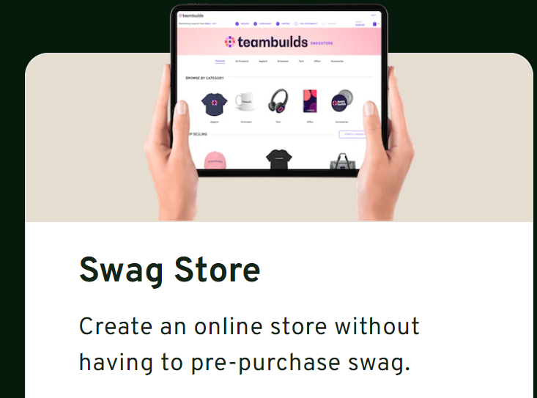
AESS Global Merchandise Program
Partner with SwagMagic
www.swagmagic.com
SwagMagic is a swag store
accessible across 170+ countries
AESS creates an “online” store
Volunteers can select merchandise
and have it shipped to their place
  No international shipping fees
  No additional effort for Members Committee or Conference Catalyst

Slide 16
Part 3: AESS Student YP Congress

Slide 17

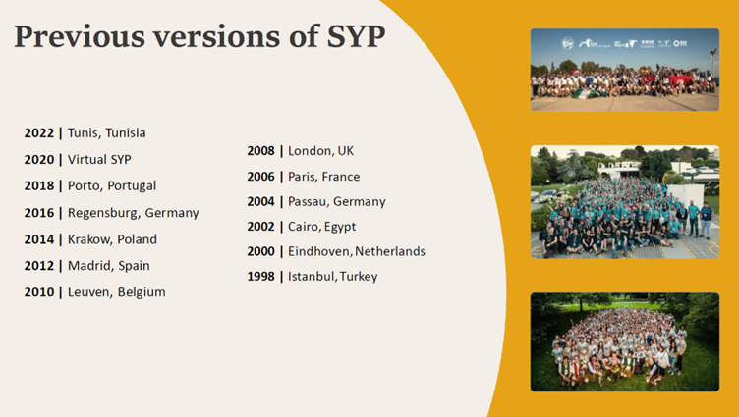


Formation of AESS Student and YP Congress

Slide 18
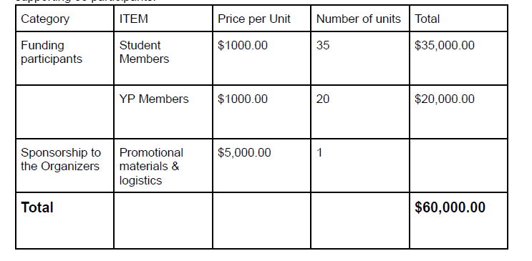
Society SYP Congress – Typical Budget

Slide 19
Thank you!

