Slide 1
IEEE Aerospace Electronic Systems
Networking & Mentorship Committee Chair
Arik Brown
AESS Board of Governors Meeting – Spring 2024
10 and 11 May 2024
Denver, CO, USA

Slide 2
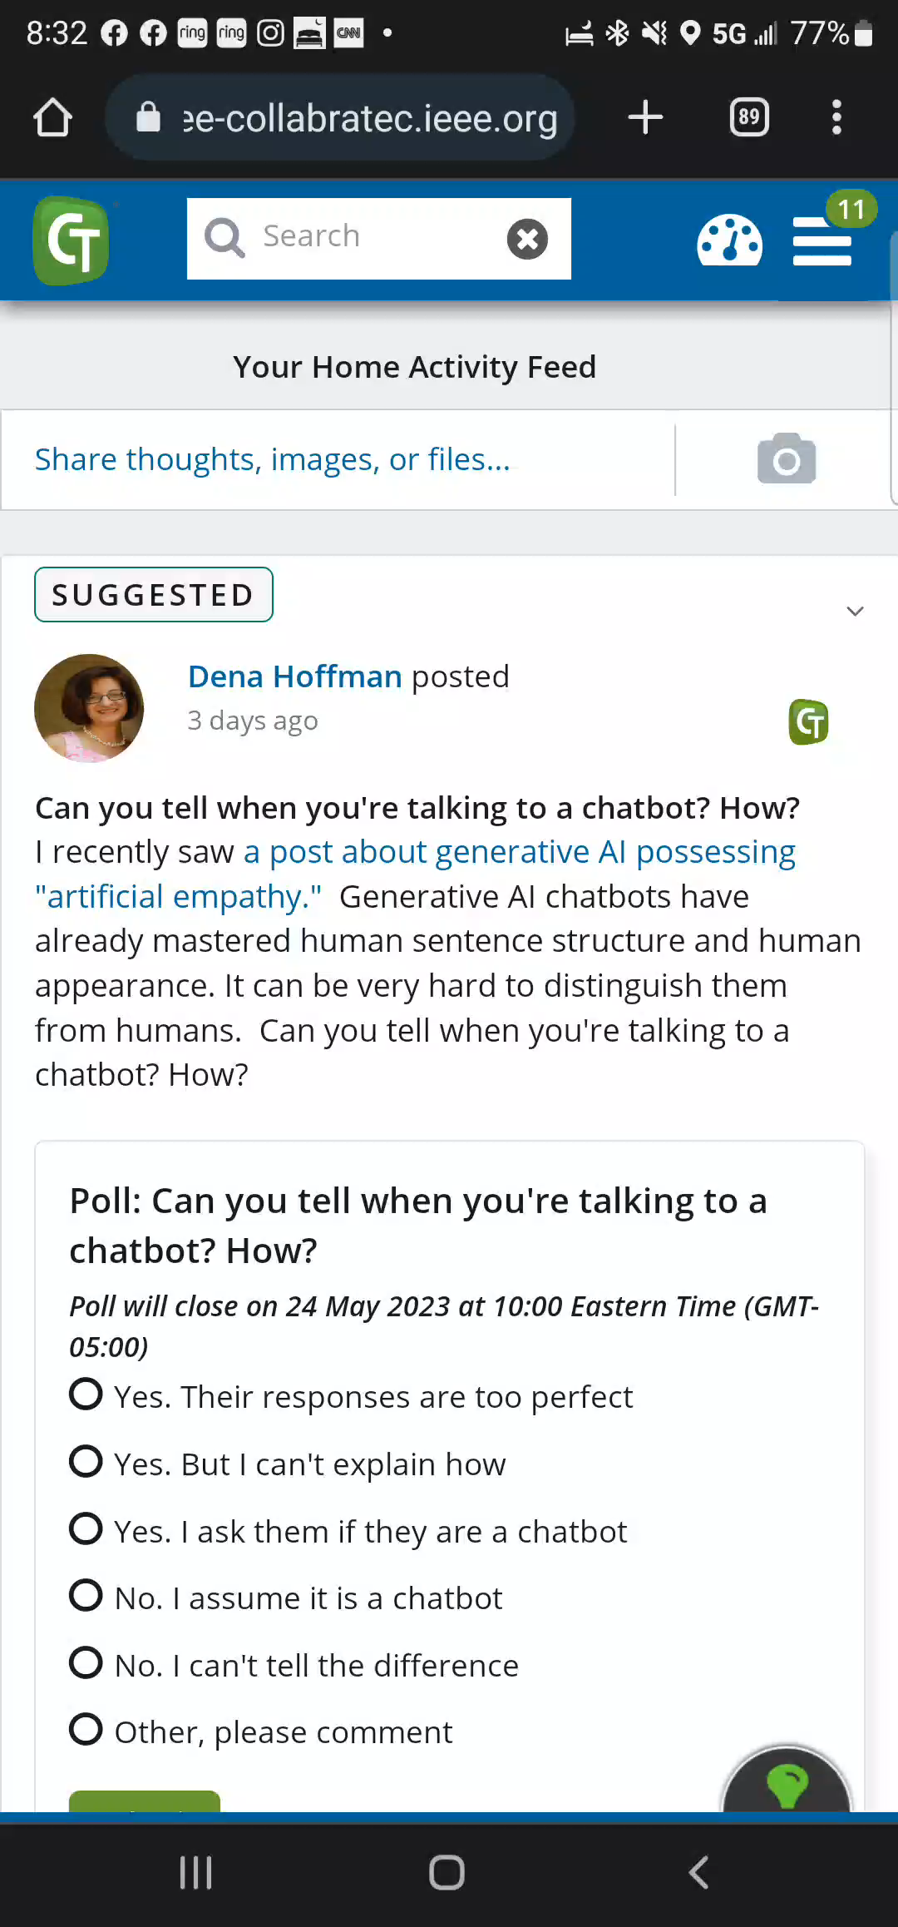
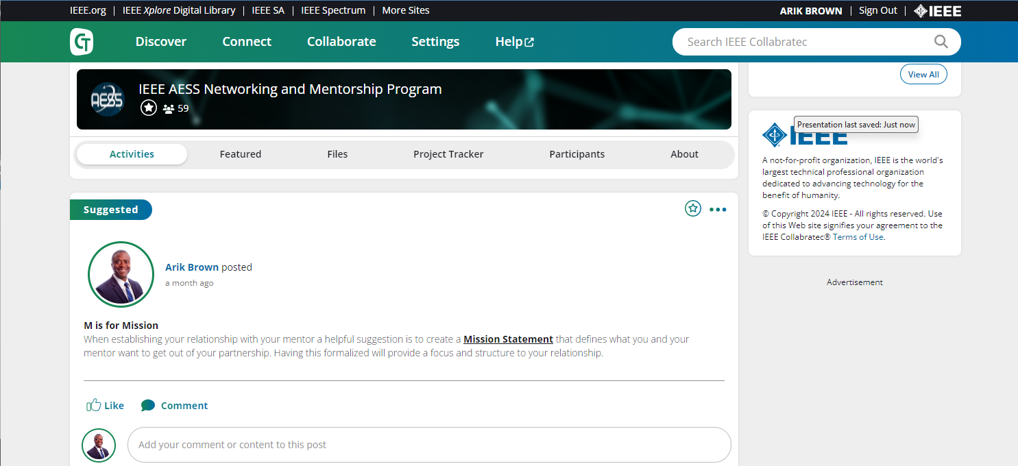
Status: Building Momentum Is Still A Work In Progress
Several goals accomplished in 2023
Other goals in progress
Collabratec Sign Up Instruction
2023 Goals | Result
Transition from spreadsheet to a more efficient tracking tool | Created Networking & Mentorship Workspace in Collabratec
Create updated guidelines for program participation and instruction | Leveraged current IEEE mentorship program guidelines and established AESS guidelines and instruction with video
Start disseminating mentoring guidelines and tips | Provided M.E.N.T.O.R. tips from “The Power of Mentoring: Claire Diaz-Ortiz”
Begin tracking mentor and mentee partnerships (metrics) | In progress
Identify successful partnerships for Spotlight opportunity | In progress
Mission
Engagement
Networking
Trust
Opportunity
Review/Renewal
Collabratec Workspace

Slide 3
Short Term Goals (SWOT Planning)
Increase productivity of the Collabratec tool
  Identifying mentor/mentee pairs is not as efficient as initially thought
  Currently have identified a process with our Collabratec SME that is in progress
  Collabratec does fit the needs of the program however we’ll need to increase our efforts in implementing it…which leads to the next bullet
Start online engagement with a two-part plan near mid-year
  Online Networking & Mentoring program video call with members
    Explain the purpose/goal of the program
    Show how to get involved
    Walk through how to get setup in Collabratec
  Send out a short video on signing up in Collabratec and finding a Mentor

Slide 4
2024 - 2025 Goals
2024 Goals
  Solidify metrics output for mentor/mentee pairs to gauge progress
  Online Networking & Mentoring meeting with AESS members(1 hr)
  Online Follow-up Meeting with AESS members focused on a summary of the program status and address any questions/suggestions (30 min)
  Send to AESS members a short video to advertise the program and how to get involved (signing up with Collabratec included)
  Send out a highlight of at least one successful mentor and mentee partnership
2025 Goal
  Mentor/Mentee in-person event at the Radar Conference in Atlanta, GA
  Potential joint event with Radar Conference Inclusion Chair Dr. Jackie Fairley

Slide 5
SWOT Summary
Strengths | Collabratec infrastructure setup Guidelines and instructions in place
Weaknesses | Need to build interest/momentum for the program Process for generating metrics not complete yet
Opportunities | Online engagement opportunities In-person event at next year’s conference in Atlanta
Threats | None

