Slide 1
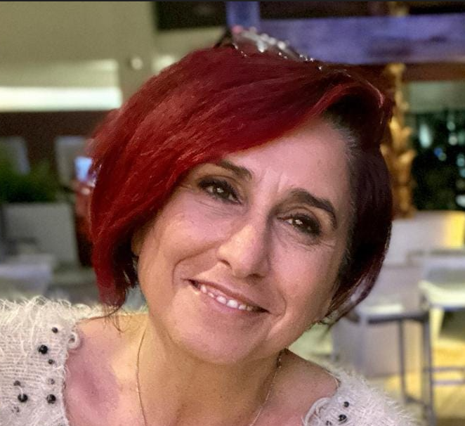
IEEE Aerospace Electronic Systems
President
Maria Sabrina Greco
AESS Board of Governors Meeting – Spring 2024
10 and 11 May 2024
Denver, CO, USA

Slide 2
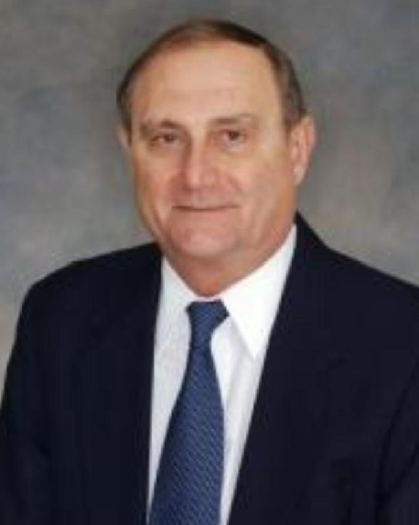
In Memoriam: George Schmidt
2024-2024 Conferences Committee Member (Conferences Committee)
2023-2024 Board of Governor Member-at-Large (BoG)
2022-2024 Technical Operations Committee Member (Technical Operations Committee)
2020-2024 Early Career Award Chair (Early Career Award Selection Committee)
2020-2022 Board of Governor Member-at-Large (BoG)
2018-2020 Vice President Technical Operations (Officers)
2018-2020 Vice President Technical Operations (Technical Operations Committee)
2018-2020 Vice President Technical Operations (Systems Magazine Editorial Board)
2014-2016 Vice President Member Services (Officers)
2014-2016 Vice President Member Services (Member Services Committee)

Slide 3
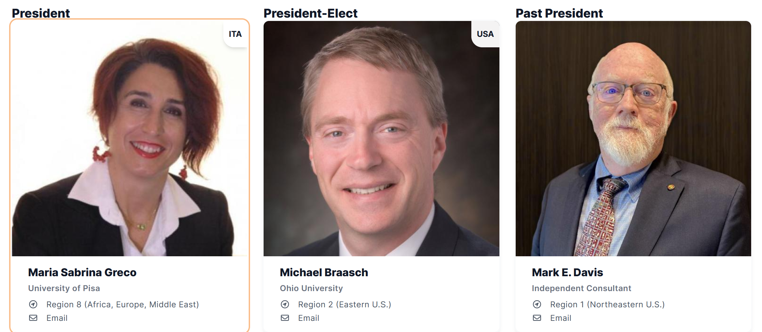
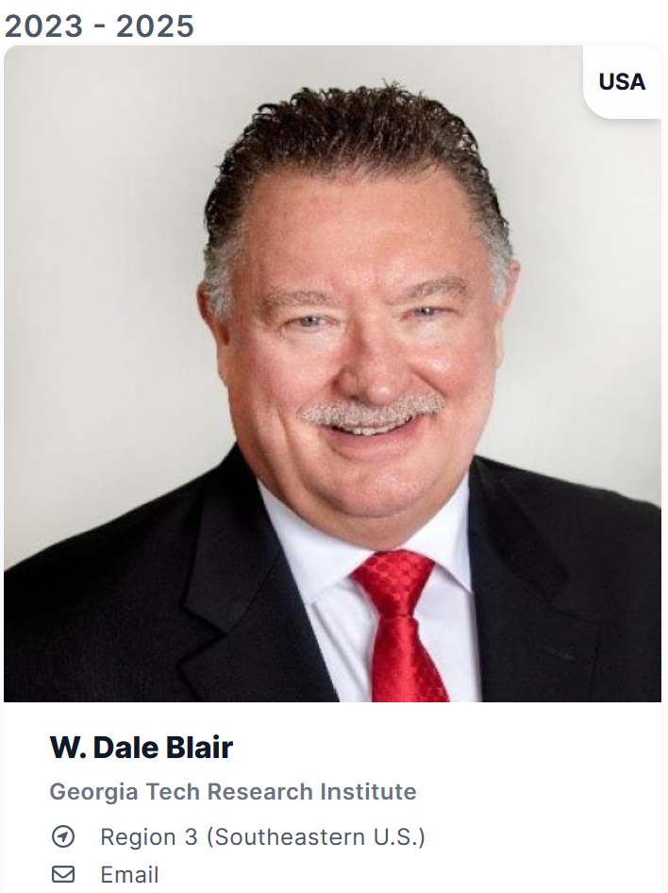
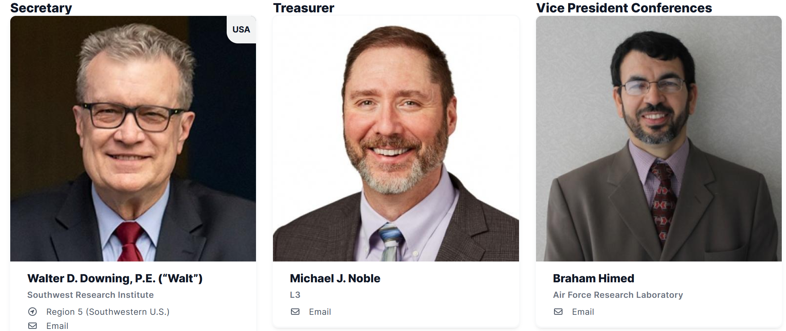
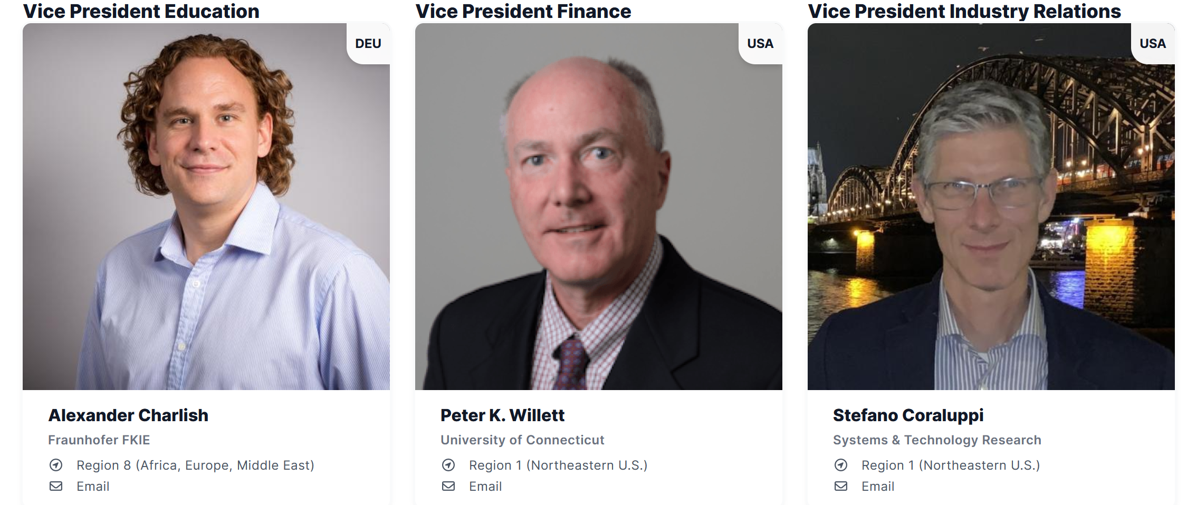
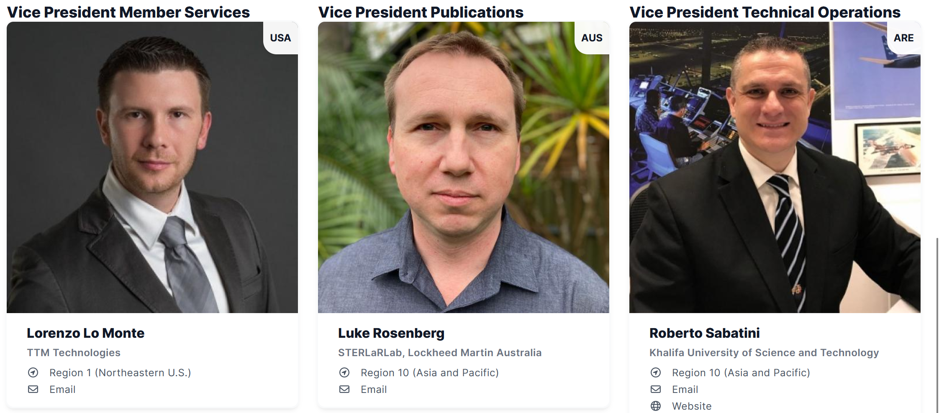
AESS Officers

Slide 4
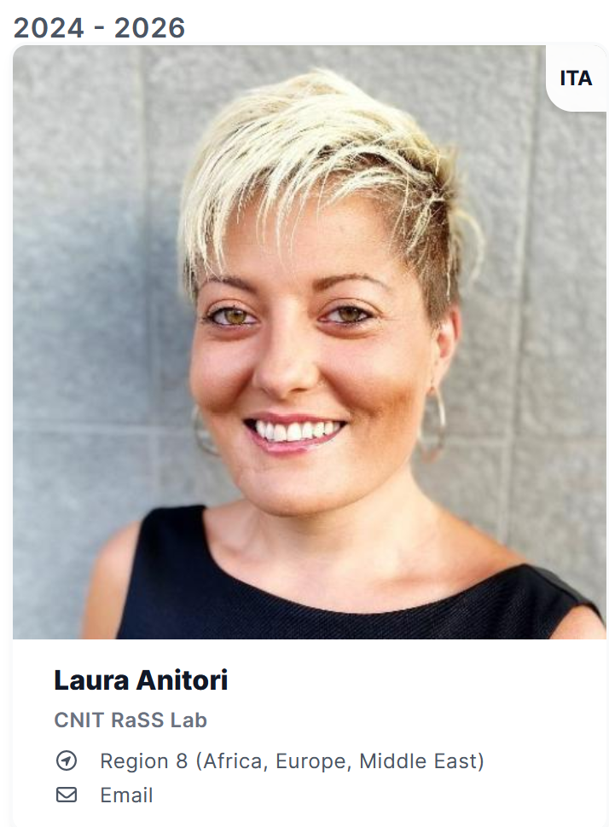
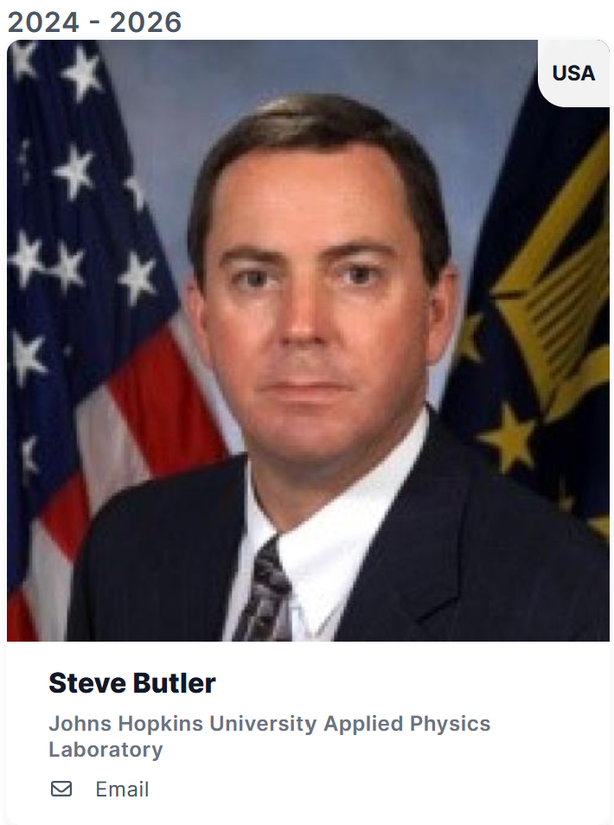
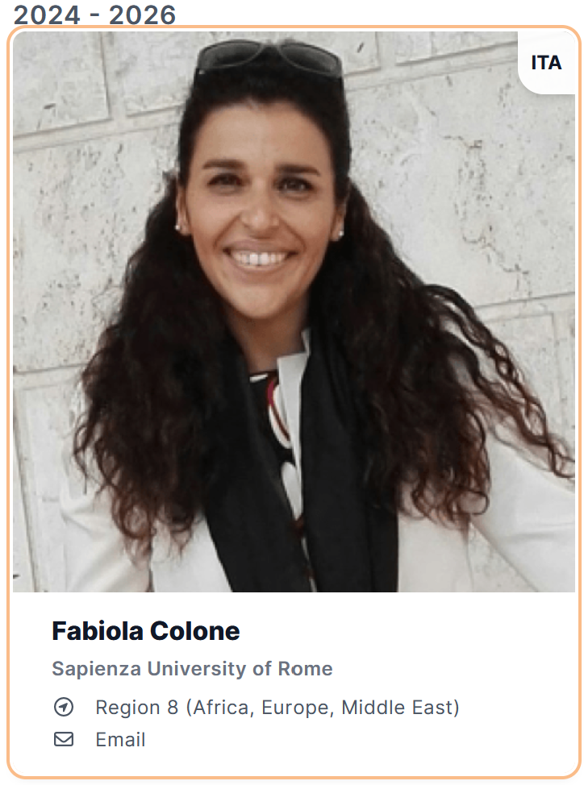
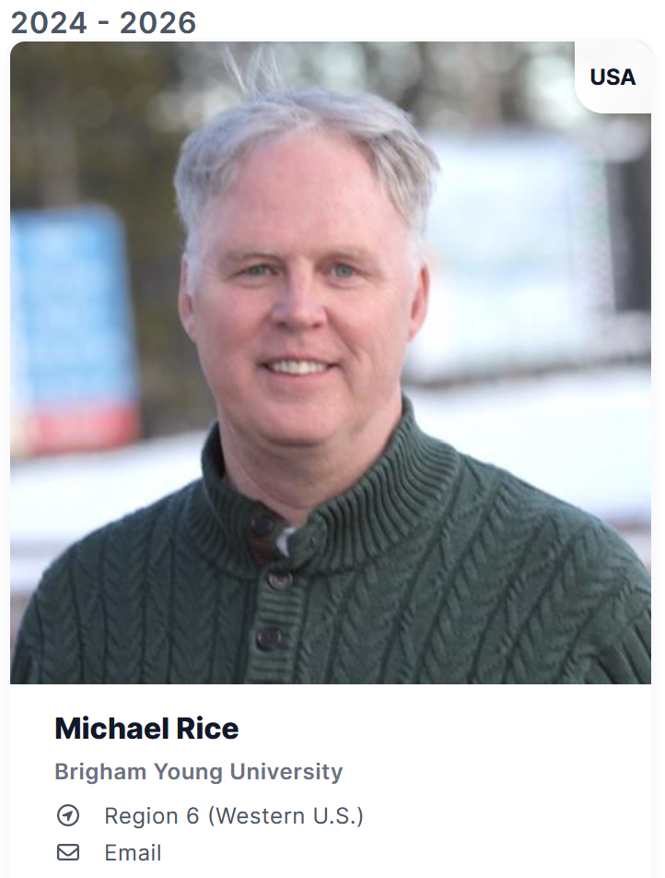
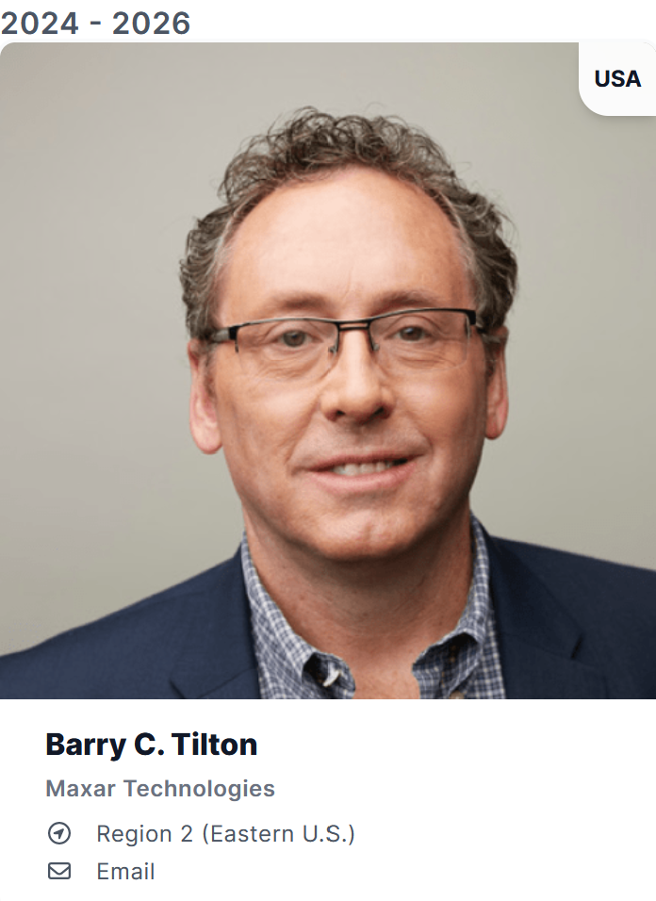
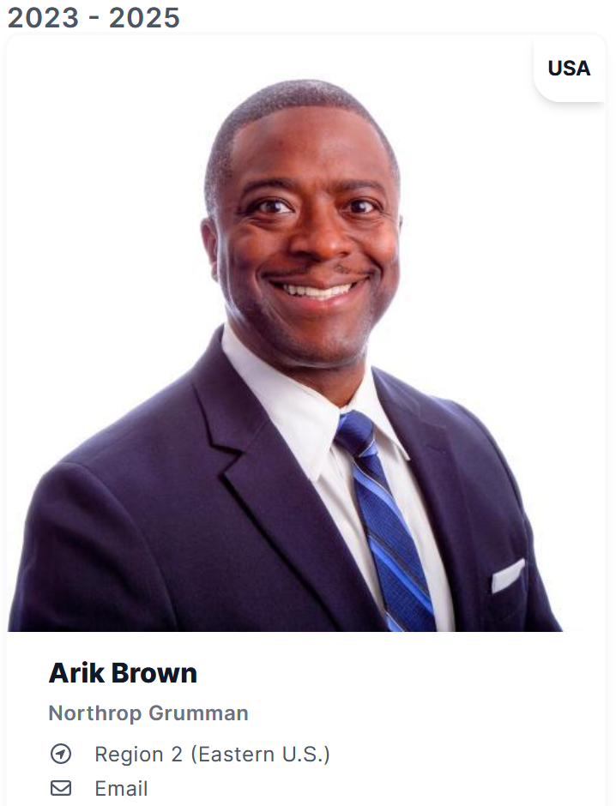

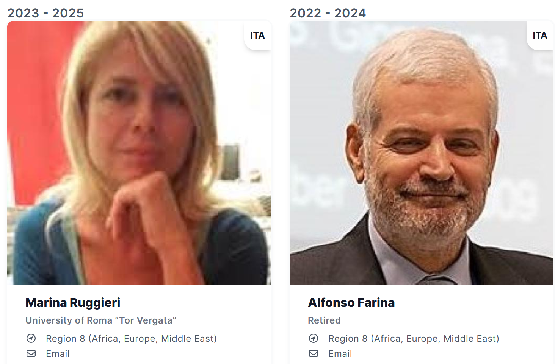
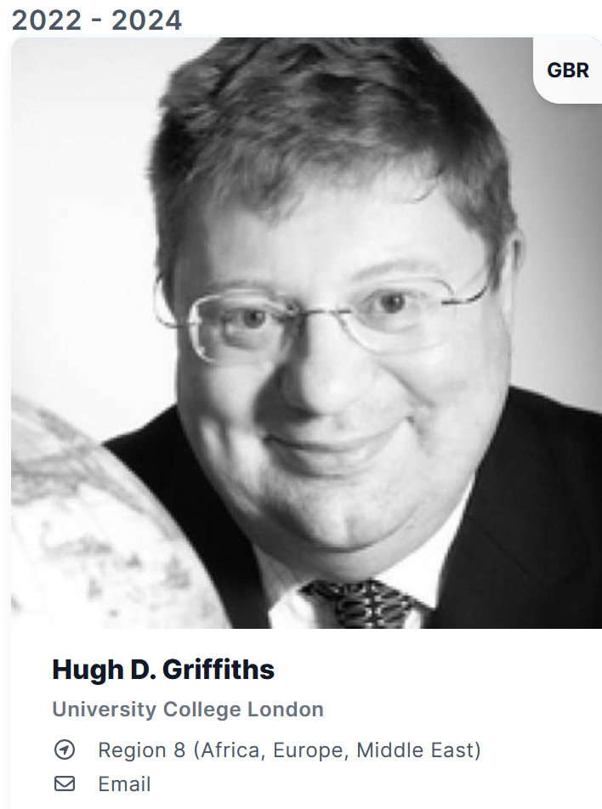
Members-at-Large

Slide 5
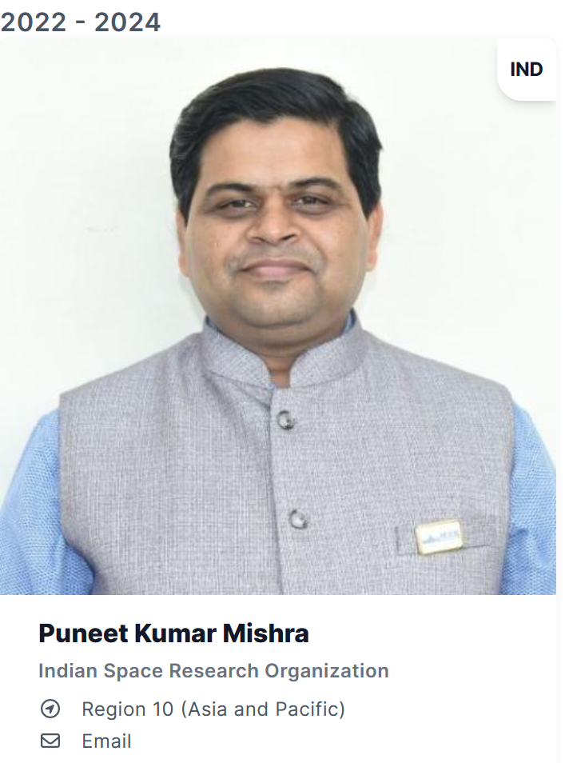
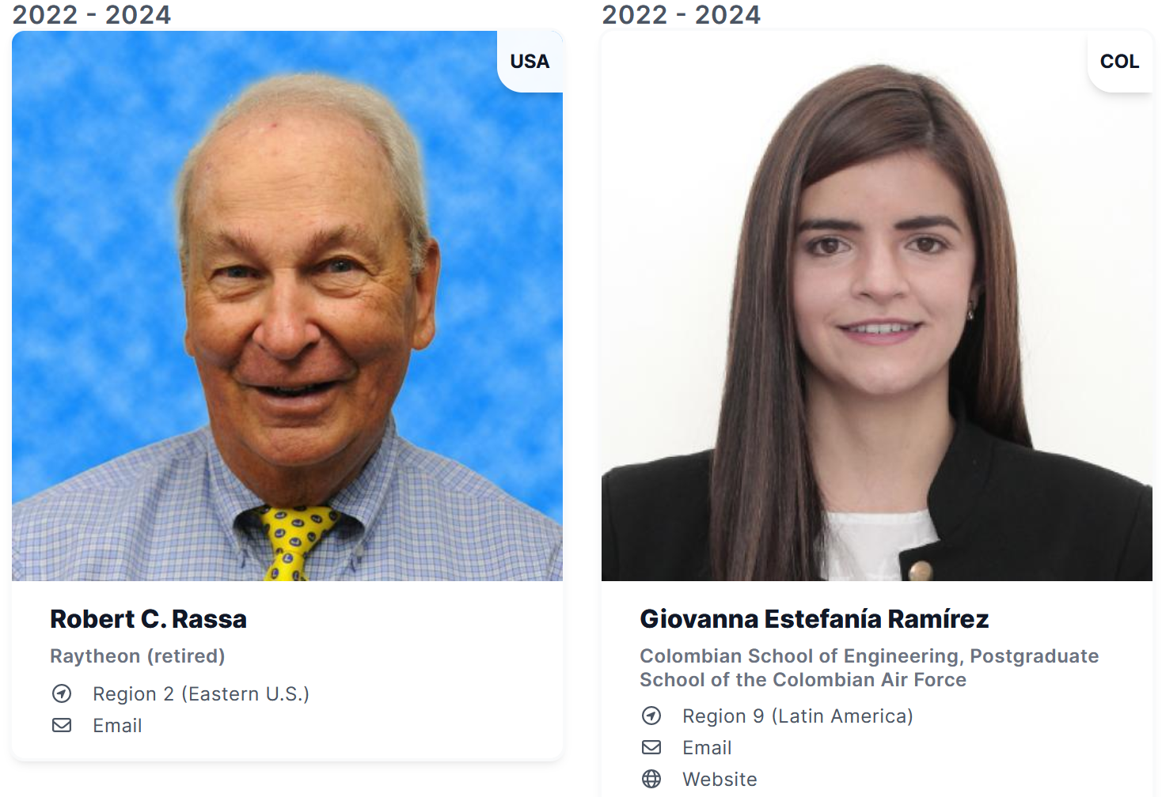
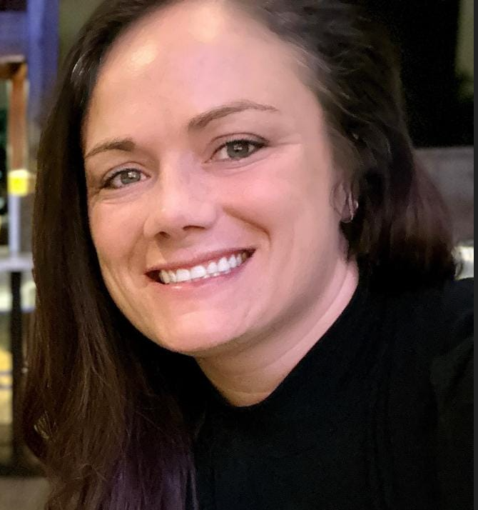
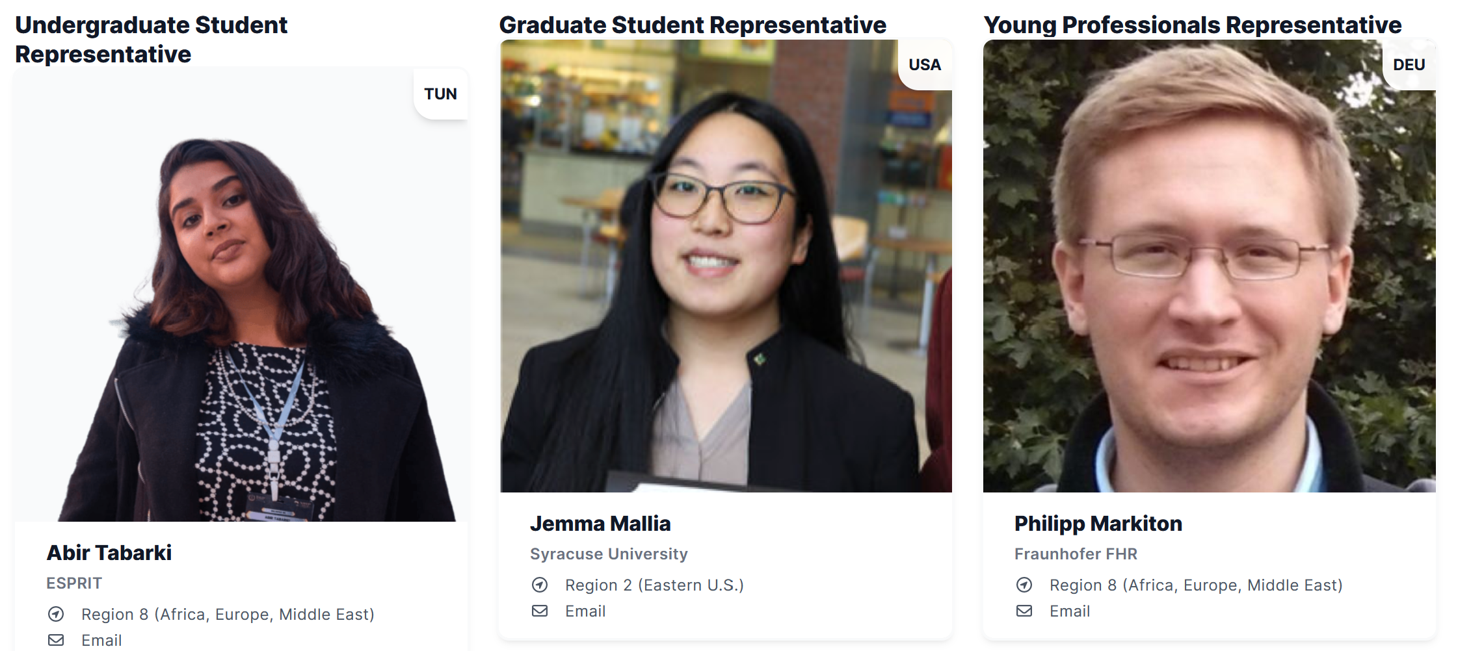
Members-at-Large – Appointed Members
Amanda Osborn
Operations Management

