Slide 1
IEEE Aerospace Electronic Systems
VP Publications
Luke Rosenberg
AESS Board of Governors Meeting – Spring 2024
10 and 11 May 2024
Denver, CO, USA

Slide 2
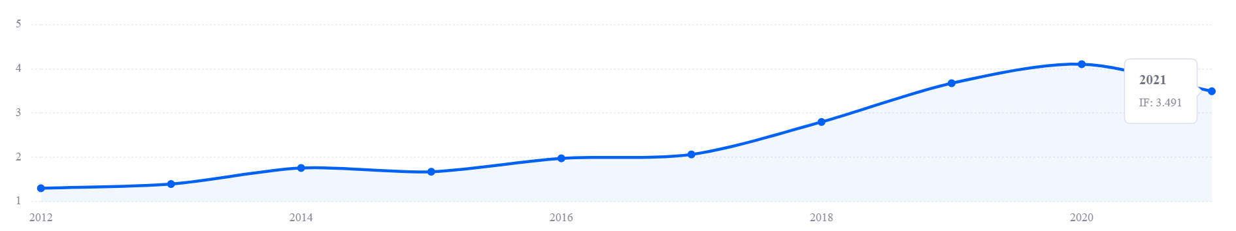
TAES Journal update
Impact factor (IEEExplore) is 4.4
Large increase in the number of submitted papers, backlog being reduced.
No. paper published in 2022/2023: 418/713 - acceptance rate is around 30%
Desire to accept around 600 papers in 2024 which translates to 7500 pages / year.
Based on trends, could be a 10% increase in submissions based on trends – 2 new SEs appointed to help with volume
  Last 3 years, submissions have increased from 1200 to 1600 to > 2000!
Amit needs support due to the increased load and significant pre-screening effort (3/4 papers returned to authors!)
  Too much overlap, poor referencing including prev. work, formatting, use of ‘new / novel’
Open access (OA) = 25/713 = 4% - Insufficient to remain in transformative OA agreement (needed 11%)
Diversity of editors:
  105 Associate editors (AE) and 16 Senior editors (SE) – most in regions 8 and 10
  Male / Female: AEs - 90%/10%, SEs – 80%/20%
  Industry / Academia / Government: AEs - 10%/85%/5%, SEs – 40%/53%/7%
Notes:
Last few years: 1200 to 1600 to 2000 over 3 years
Primarily from R10 (China)
Amit may need support
Pre-screening needs a panel as it takes a long time
Aes need some feedback – change the workflow so the SE reviews the decions
¾ papers from China – too much overlap, poor referencing, not referencing prev. work, use of new / novel, format, declaration of rejecting papers
Event for SEs / EICs – get boards approval for funding.

Slide 3

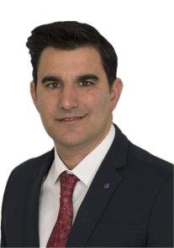
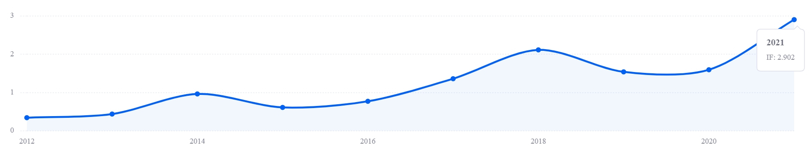
Systems Magazine update
Current impact factor (IEEEXplore) is 3.6
New EIC position appointed – Dr Pau Closas (left)
Associate EIC appointed – Dr Alessio Balleri (right)
No. of magazine submissions has reduced (no backlog).
Small number of good quality special issue proposals.
A number of AEs are not very responsive and need replacing.
No. paper published in 2022/2023: 258 / 227
Diversity of editors:
  15 Associate editors (AE)
  1 from R10, 7 from USA (R1-6), 7 from Europe (R8)
  Male / Female: AEs - 93%/7%

Slide 4
Quarterly Email Blast
Going well, but not many clicks on the hyperlinked stories.
Suggestion to increase reports on student activities.
Approached by student in Nigeria – plan to ask him to write a short story to kick this off.
Email Campaign Report
Title: | AESS QEB - Q4 2023
Subject Line: | IEEE Aerospace & Electronic Systems Society Newsletter -- Q4 2023
Delivery Date/Time: | Thu, Dec 28, 2023 11:26 am
Overall Stats
Total Recipients: | 9,627
Successful Deliveries: | 9,597
Bounces: | 30 (0.3%)
Times Forwarded: | 0
Forwarded Opens: | 0
Recipients Who Opened: | 2,219 (23.1%)
Total Opens: | 3,480
Last Open Date: | 1/16/24 1:06PM
Recipients Who Clicked: | 141 (1.5%)
Total Clicks: | 275
Last Click Date: | 1/16/24 7:59AM
Total Unsubs: | 4
Total Abuse Complaints: | 0
Times Liked on Facebook: | 0
Clicks by URL
URL | Total Clicks | Unique Clicks
https://ieee-aess.org/post/announcement/ieee-fellow-class-2024 | 42 | 29
https://ieee-aess.org/post/blog/history-column-acoustic-detection-aircraft | 39 | 31
https://ieee-aess.org/post/blog/story-behind-success-2023-international-radar-conference-best-student-paper-award-winners | 36 | 30
https://wie.ieee.org/riko-chan-aeronautical-engineer/?utm_source=Website&utm_medium=Facebook&utm_campaign=Manga+Comic | 24 | 16
https://ieee-aess.org/post/announcement/2024-aess-officers-elected | 19 | 10
https://ieee-aess.org/awards/senior-members | 15 | 10
https://ieeexplore.ieee.org/xpl/mostRecentIssue.jsp?punumber=7 | 13 | 11
https://ieee-aess.org/post/blog/international-radar-conference-2023-recap | 13 | 8
https://ieee-aess.org/post/announcement/alfonso-farina-inducted-international-member-national-academy-engineering-nae-usa | 10 | 8

Slide 5
Co-sponsored Journals
Transactions on Radar
  AESS has 24% share
  Going strong, but difficult to coordinate special sections
  October 2021 – 2023 (14 months): No. submissions / accepted publications: 68 accepted / 254 submitted = 35% acceptance
  Average time to decision: 37 days
Journal of Lightwave Technology
  AESS has 2.5% share
  Impact factor (IEEExplore) is 4.7
  MoU expiring in April 2024
Journal of Miniaturization for Air and Space Systems (J-MASS)
  MoU renewed in August 2023, AESS share is now 20%
  Impact factor is 1.5
  2023: No. publications: 57
  2022: No. publications: 50
Open Journal of Systems Engineering
  MOA being signed, AESS has 20% share
  First year: No. publications: 18
  Many special issues – didn’t generate many papers
  On the Periodicals Watch List due to < 20 papers – needed to outline plan to improve
  Slow start due to specialised area.

Slide 6
SWOT Planning
Strengths:
  Impact factor of the Systems Magazine has grown from 0.77 to 3.6 over the past five years
  Transactions on Radar Systems has had an amazing start with many papers and short turn around with reviews.
  Number of submissions for the TAES has significantly increased in 2023 – should lead to an improved impact factor.
  Timeliness of TAES has improved to 13 avg weeks for submission to publication.
Weaknesses:
  Some systems magazine AEs need to be replaced.
  No. of magazine submissions has reduced (no backlog)
  TAES structure is not suitable for the number of incoming papers.
  Not many people reading the stories in the QEB.
Opportunities:
  Could advertise for new Systems Magazine AEs.
  Renewed focus on special issues/sections for the Magazine and TAES – could include conference special editions / sections
  Special issues in new OJSE Journal
  Day long meeting with the SEs / EIC to plan a way forward with TAES
  Promote student initiatives in the QEB
Threats:
  T-RS – Possible lack of consensus over disparate organisations

Slide 7
2024 Objectives
TAES
  Changes proposed:
    Remove single page submission,
    Switch to author central for submissions,
    Remove bimonthly volumes and go to single volume per year – articles get published immediately after typesetting,
    Reduce review time from 60 to 45 days.
  Advertise for new special sections which are complimentary open access.
  Setup an editorial advisory group with VP Pubs, EiC and past EiCs to meet twice yearly and discuss any issues.
  TAES - workshop to get the EICs and SEs together to plan a strategy to deal with increased workload.
  Complete operations manual.
Systems Magazine
  Work with the new EiC / AEIC to expand the content in the Systems Magazine and increase submissions.
  Introduce 3-year terms (with second term possible) and define expectations.
  Draft operations manual similar to the TAES.
  Remove AEs who are not performing and recruit new AEs.
  Advertise for new Special Editions, including tutorials.
QEB
  Develop student ‘corner’ to increase readership.

Slide 8
Motion – TAES Editor Meeting
Overview
  Number of papers submitted to the TAES are increasing substantially.
  The increase in submissions is accompanied by an increase in problems/potential misconduct. The burden on pre-screening has grown at an unsustainable pace.
  The editorial process needs to restructure and we believe this should be done in consultation with the Senior Editors (16).
  Senior editor Julien Marzat (ONERA) has offered to host in Paris prior to Radar 2024 conference.
Draft meeting agenda
  Morning
    Introductions from TAES EIC and AESS VP Publications
    Overview of the submission screening process and how the current editorial process works
    Options for how the submission editorial process can be streamlined to deal with growing number of submissions
    Brainstorming workshop in small groups
    Proposals presented to group for discussion
  Afternoon
    Details on the move to the IEEE author center
    Tools for gathering statistics on publications with a live demo
    Presentation on author misconduct and what to look for in submissions
    Open discussion about other relevant issues

Slide 9
Motion – TAES Editor Meeting
Motion: Luke Rosenberg moves that the AESS to support a Senior Editor Planning workshop for the TAES journal for up to $35K
Pros:
  Ability to refocus the prescreening process so it can succeed with the growing number of submissions
  Reduce the workload of the EiC who is heading towards burnout
  Opportunity to educate senior editors about the broader publication environment including issues of misconduct
Cons:
  Long distance to travel for some senior editors
Financial Implications: Up to $35K
  Poll has seen that maximum 14 SEs need travel funding + Gokhan (EiC)
  Some senior editors will likely join by zoom which will reduce cost
Seconded by Michael Rice

Slide 10
Motion – TAES Editor Meeting
Luke Rosenberg moves that the AESS to support a Senior Editor Planning workshop for the TAES journal for up to $35K

