Slide 1
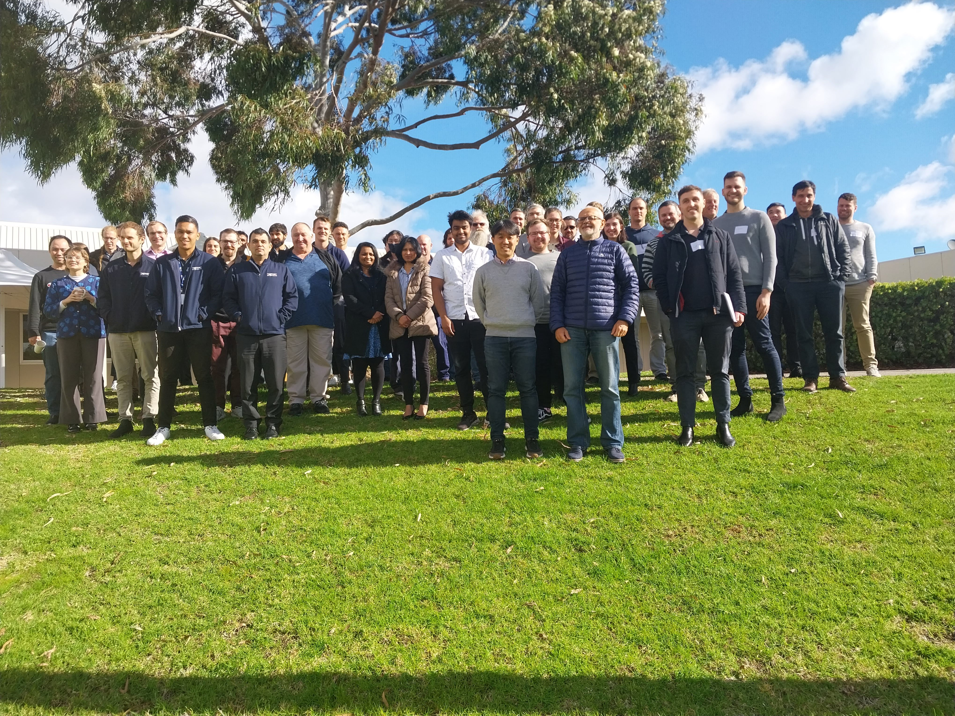
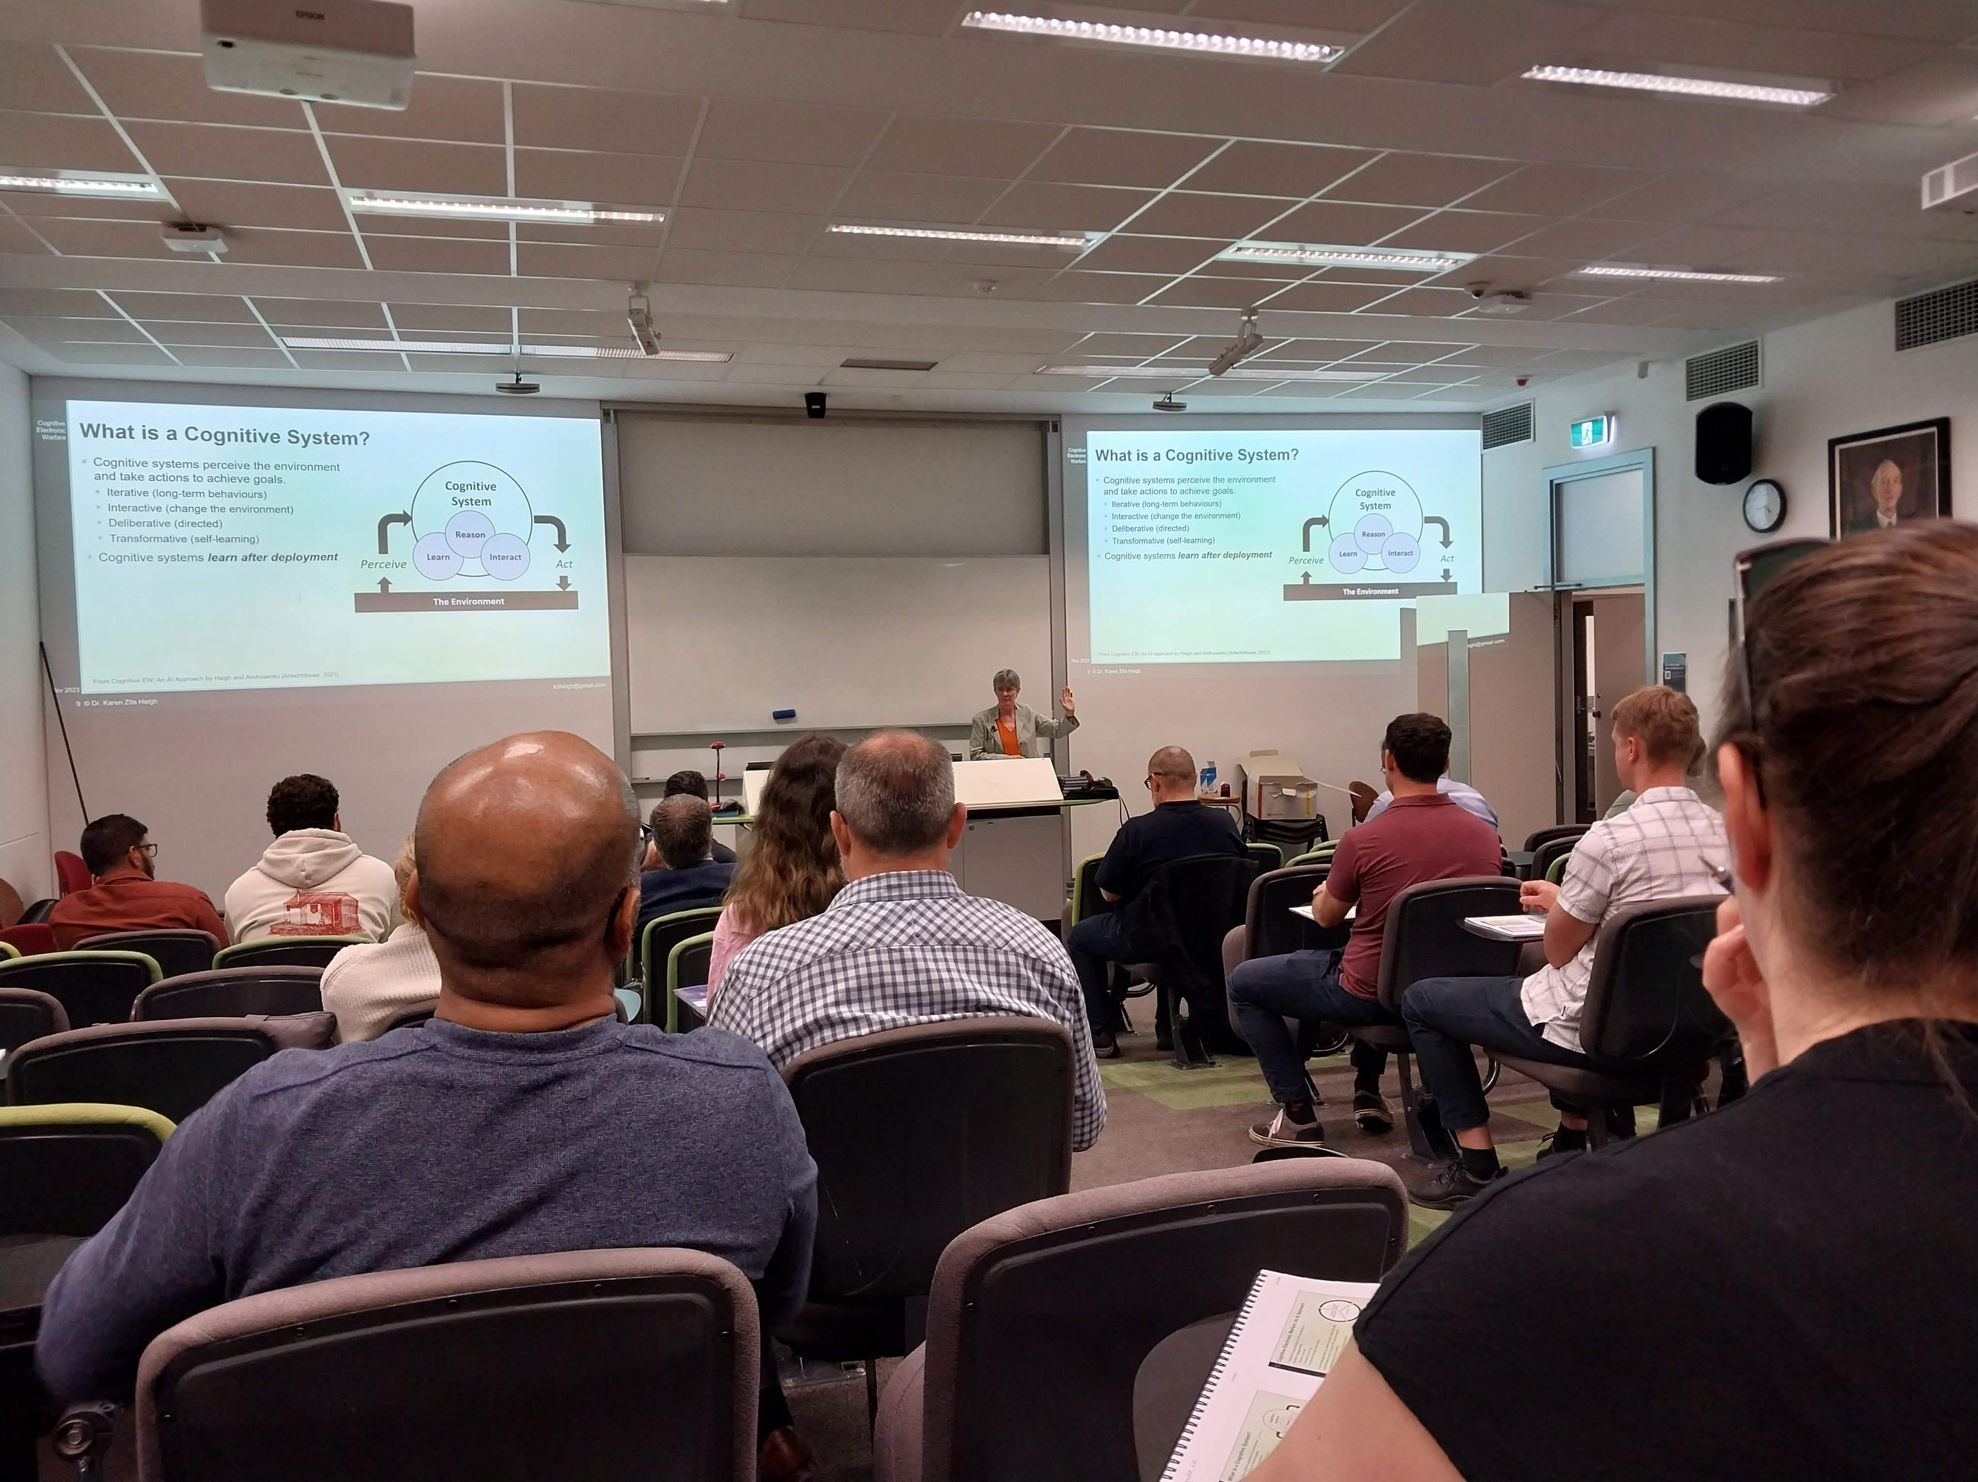
Short Course Program
Short Course Options
  In-person/hybrid course run at a public venue, open to everyone
  Virtual course open to everyone - more attractive for chapters with less money.
  Industry focused short course, run for a specific company.
Short course website
  New form for logging short courses – not widely used
Previous short courses since Nov. 2023
  Joe Fabrizio - Over the Horizon Radar – various venues / audiences
  Karen Haigh and David Brown – Introduction to EW / Cognitive EW joint course with AOC Australia, November 13-17 in Brisbane and Adelaide.
Upcoming short courses:
  Joe Fabrizio - Over the Horizon Radar – courses planned for June and August
1

Slide 2
Short Course Program
Communication
  Contacted all AESS short course presenters in May 2023 to encourage them to be pro-active and reach out to local AESS chapters and/or industry directly
  Further communication required to promote short course program to AESS Chapters
  Short course slides presented by Lorenzo at the India R10 meeting and Peru region 9 meetings.
Ideas going forward
  Work closer with AESS industry group to test out this newer working model
  Further outreach to AESS chapters – continue to talk at the region summits
  Online training session for each region – how to coordinate?
2

Slide 3
Short Course Program
DSTEI program (short course / tutorial style lectures focused on a single topic)
  Mark Davis – Distributed Sensor Systems Management
  Mike Braasch – UAV Navigation Technology
  Roberto Sabertini - Avionics and Cyber-Security
  Vince Socci - UAV Operations Planning
  Stefano Coraluppi - Sensor Fusion Technology
AESS Lecture Tour Plan
  Part of the Distributed Sensing Technology and Education Initiative to reach AESS chapters in Regions 8/9/10.
  Lecture series focused on a single topic with a group of up to 4 presenters
  Local chapters can propose for the lecture tour to visit (max. 4 locations spread over 2 regions).
  Suggestion is for 4 x half-day lectures / short-courses over 2 days per location (max. 2 week trip)
  Choose one person to lead the tour and let them suggest colleagues to include
  Motion passed in San Antonio with a $30K maximum budget
3

