Slide 1
IEEE Aerospace Electronic Systems
VP Technical Operations
Rob Sabatini
AESS Board of Governors Meeting – Spring 2024
10 and 11 May 2024
Denver, CO, USA

Slide 2
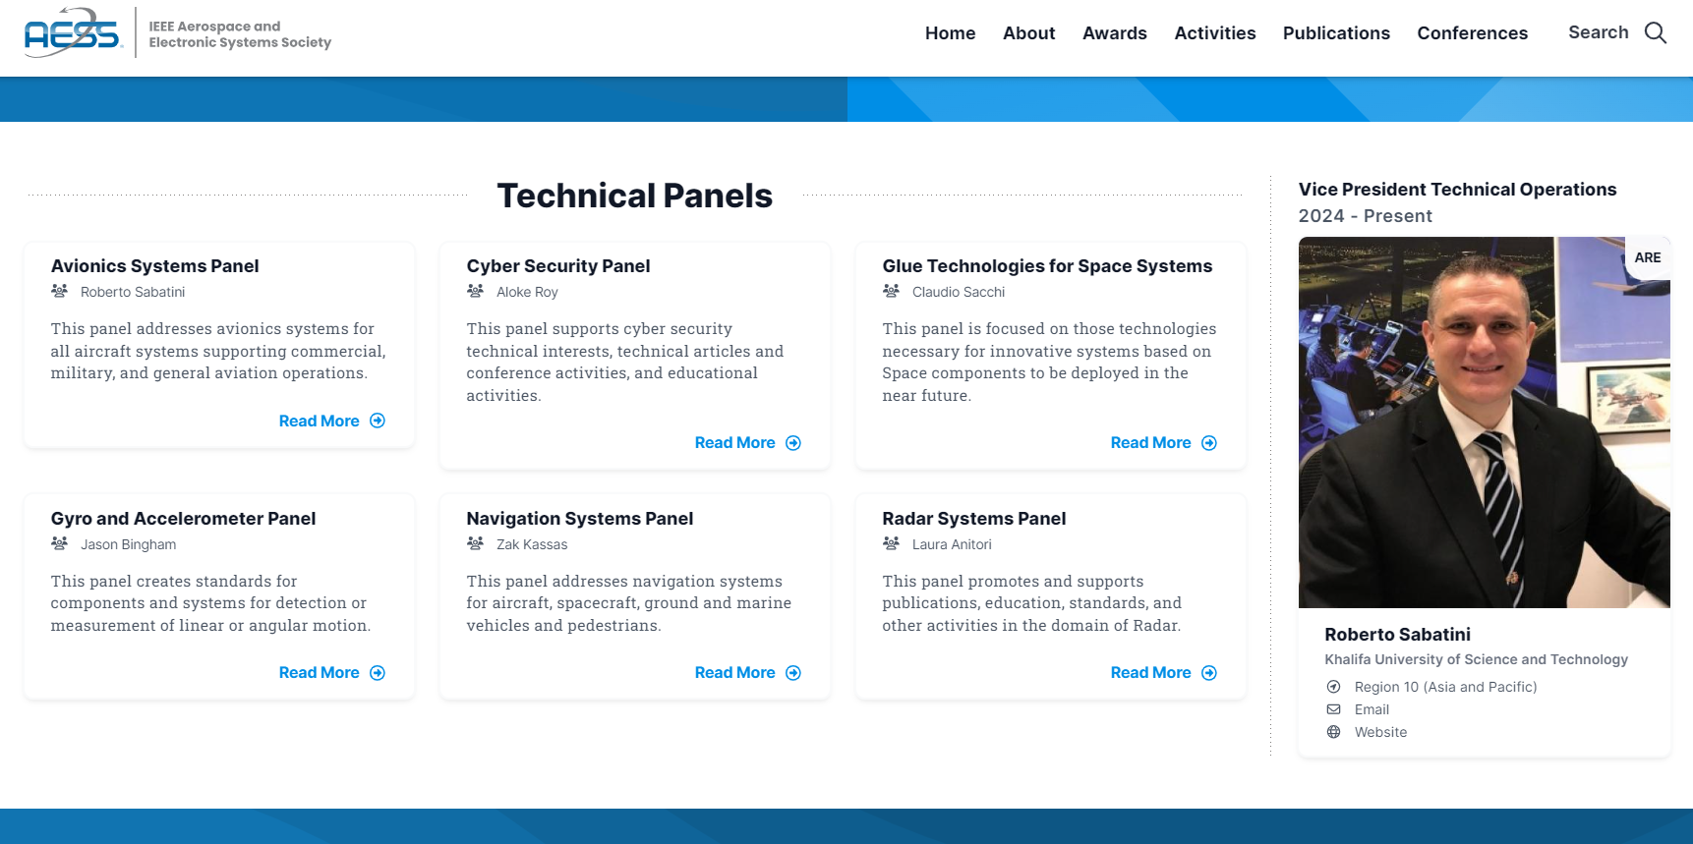
What so far, since November 2023

Slide 3
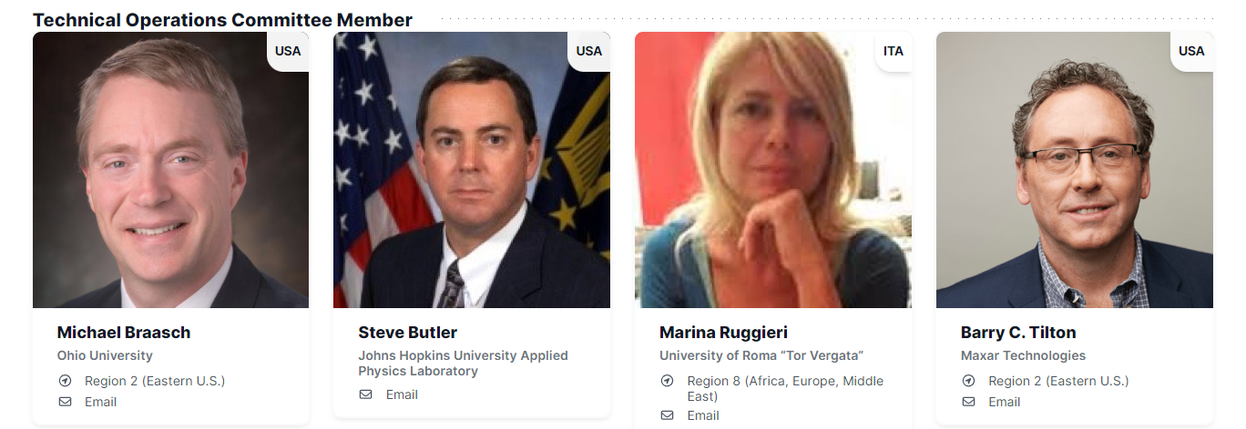
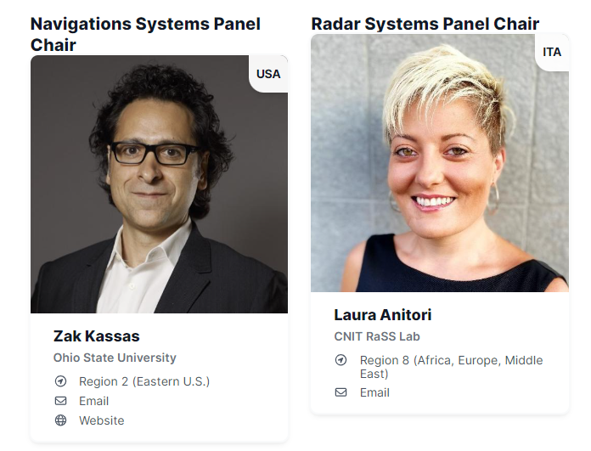
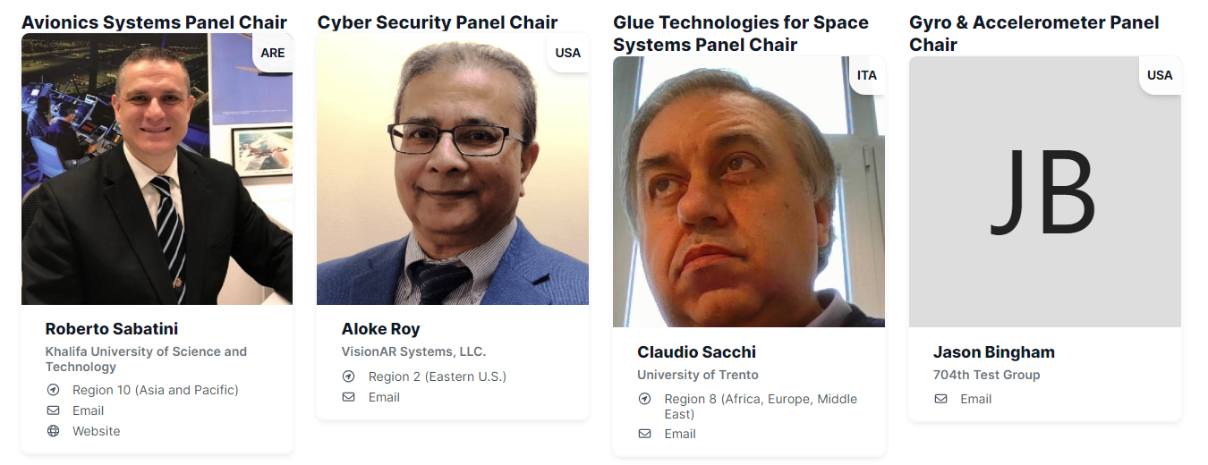
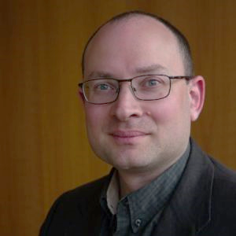
What so far, since November 2023
Supertopic Committee Chair
Joe Dauncey
IEEE Region: Region 8
Country: GBR

Slide 4
What so far, since November 2023
Dedicated 1-to-1 meetings with all Technical Panel Chairs and the Supertopic Committee Chair were held to discuss possible funded and unfunded initiatives:
  The panel chairs were informed that AESS will financially support initiatives and proposals were elicited
  Various proposals were discussed. There is consensus to fund participation of one Technical Panel member to one AESS conference per year. This is in relation to leadership roles and pro-bono activities undertaken by panel members (student competitions, challenges, lecture series, tutorials, etc.) which might not be funded by their employer organizations.
  Possible summer bootcamps and participation to high-impact student competitions (also not associated to conferences) are also being considered over the next 1-2 years. Panel Chairs will report on emerging opportunities. TechOps VP will coordinate with VP Education (Alex) and VP Conferences (Braham).
Propose closing this action item.
Propose updating this action item to ‘In Progress’ and adding a Fall 2024 BoG due date.
Continues on next page

Slide 5
What so far, since November 2023
Efforts to revitalize the Cyber-Security Panel (CSP) and increase its contributions to AESS Tech Ops, alongside fostering collaborations with other technical panels and our broader community:
  Dedicated meetings with current CPS Chair (Aloke Roy), who confirmed his full commitment to continue leading the panel and contributing significantly to its revitalization. Aloke has the right technical and management skills. He is also a strong team player with the necessary charisma and leadership qualities.
  The recent challenges Aloke faced were primarily due to a lack of engagement from the previous Cyber-Security Panel members after Kathleen Kramer stepped down from the Chair role. Over the last few months, he tried his best but he needed some help from us to regain momentum.
  Thanks to the BoG’s contributions in recommending new members and some dedicated meetings with cyber-security experts that took place since last BoG meeting, the Cyber-Security Panel has a new roster, comprising several well-qualified and motivated members.
  A meeting of the CSP took place in April (independently from the ASP) and it was well attended and contributed to. In the upcoming weeks, I will continue monitoring the situation closely, collaborating with Aloke and the other members to expedite the revamp of the CSP.
Propose closing this action item.

Slide 6
What so far, since November 2023
Possible unfunded initiatives were also discussed, there is broad consensus on the following:
  Update the AESS portal with addition of the Technical Panel presentations at the BoG meetings and the meeting minutes (last updates available online were made in 2019).
  There must be a solid mechanism for Fellow application advising. The BoG Fellow Search Committee Chair position is vacant and the Fellow Evaluation Committee Chair/Members are not allowed to provide advice to the applicants. This is aggravated by the fact that, for legal reasons, it is not possible to provide any feedback on unsuccessful nominations. Additionally, no feedback is provided to unsuccessful candidates and there is no procedure for appeal.
  A digital platform to share documents is seen as essential. The current Dropbox arrangements are not sufficient for some of the panels, which are forced to use alternative and less than effective tools.
  All Technical Panels would be willing to have “Quarterly highlights” published in the AESS Magazine. This idea should be discussed at the BoG and brought forward if agreed upon.

Slide 7
What so far, since November 2023
Status of the “Supertopic” Committee activities and progress to integrated the findings of the committee into the Technical Panels’ activities:
  A dedicated meeting was held with the Supertopic Committee Chair (Joe Dauncey), who confirmed that the committee is currently in a ‘dormant’ status, expecting to receive feedback from the Technical Panels.
  To accelerate this task, I requested a copy of the accepted AESS Magazine manuscript and sent it to all TP Chairs eliciting comments form all TP members. Several comments were provided.
  One very interesting comment was:
  “The paper does not consider the fundamental drive of industry profit/revenue. How does AESS plan to get global society on board to create a more sustainable Earth and Space if industry (large or small businesses from most countries) are driven by profit and customer needs and overlook sustainability? IEEE AESS panels and panel members can do their part, but how do you influence industry to change its way to consider sustainability and yet, still be profitable?”
  This should be the basis for further developments. A solid Triple-Bottom-Line (TBL) approach is essential (involving industry in the debate).
  In general, there were positive comments regarding the “Concrete initiatives’ proposed in the paper.
Propose closing this action item.
Continues on next page

Slide 8
What so far, since November 2023
Proposals for Supertopic-related initiatives include the following:
  Injection of the autonomy for sustainability topic in panels and special sessions at AESS conferences.
  Organization of ad-hoc events on the topic, such as webinars and workshops, where colleagues with different roles and responsibilities can exchange their views.
  Preparation of special issues of AESS journals and white papers, which deal with the supertopic.
  Organization of challenges, contests for ideas and awards focused on this vision, in order to stimulate students and the young professional community.
  Publication of periodic “panel recommendations” by the AESS Technical Panels which address how the AESS vision and strategy can be propagated forward.
  Promotion of an AESS PhD network program, to prepare a new class of professionals with the competences needed to develop innovative autonomous systems to address specific sustainability challenges.
  The possibility of delivering a public tutorial on the supertopic was also discussed and it was agreed that the ASP will develop and deliver a tutorial focusing on Automation/Autonomy for Sustainability at the next Digital Avionics Systems Conference (San Diego, Oct 2024).
Propose closing this action item.

Slide 9
What so far, since November 2023
The Navigation Systems and Avionics Systems Technical Panel Chairs discussed about the creation of a new Conference in Europe. Key topics discussed:
  A possible topic bridging NSP and ASP focus areas would be “Aerospace Navigation and Guidance Systems.” It is felt that such topic would have a significant traction and audience in the European, African and Middle Eastern region (IEEE Region 8), while also attracting contributions from North America and the Asia-Pacific regions
  To maximize contributions and to allow cross-fertilization among different application domains beyond aerospace (e.g., ITS, ground robotics, maritime systems) there is consensus that an IEEE Guidance, Navigation and Control Conference would be the best option
  The AIAA GNC conference has been embedded in SciTech and the IEEE community does not feel that this was a great move. International attendance has decreased and this fact also complicates a possible IEEE/AIAA co-sponsorship
  On the other hand, there are no European conferences covering the whole spectrum of GNC systems
Continues on next page

Slide 10
What so far, since November 2023
  The European Navigation Conference (ENC) only addresses navigation systems (i.e., no emphasis on guidance and control) and is sponsored by the national “Institutes of navigation” of the hosting country, which are different every year
  Additionally, the ENC proceedings are not indexed, which limits academic attendance
  Other conferences are ION and the only ION/IEEE co-sponsored conference is PLANS, which always takes place in the US
  This must be further discussed at the BoG in order to identify the next steps
Propose updating this action item to ‘In Progress’ and adding a Fall 2024 BoG due date.

Slide 11
What so far, since November 2023
The annual AESS Technical Panel of the Year Award is currently conferred based on the contributions documented in the presentations submitted to the BoG semi-annual meetings. The following points emerged:
  A standardized reporting template was provided to all Panel Chairs receiving positive feedback
  Based on the discussions, none of the Chairs or panel members complained with the current approach
  There are advantages in using the presentations, as this allows a clear and evidence-based approach
  The TechOps Committee is required to assess the presentation material but this is not an issue
  It is concluded that the current approach is acceptable and it is recommended to continue
  An experimental phase is recommended to test the current template
  A refined template can be provided at a later stage if needed
  This should be further discussed at the BoG to achieve consensus
Propose to close this action or to rephrase it as in progress.

Slide 12
TechOps SWOT Analysis
Strengths
Dedicated Leadership: TP Chairs are well-qualified and motivated. CPS Panel challenges have been properly addressed
Financial Support: AESS's willingness to financially support TP initiatives indicates a supportive environment for new endeavors
Panel Members: The periodic addition of well-qualified and motivated members enhances the panels’ capabilities and potential contributions
Weaknesses
Engagement Issues: Challenges faced due to a lack of engagement from some panel members highlight a historical weakness that needs addressing to maintain momentum (rosters must reflect reality!)
Vacancies and Lack of Procedure: The vacant BoG position for advising Fellow applications and the absence of a feedback mechanism for unsuccessful nominations create procedural weaknesses
Digital Infrastructure: Current digital document-sharing tools like Dropbox are deemed insufficient, indicating a weakness in the existing digital infrastructure supporting panel activities

Slide 13
TechOps SWOT Analysis
Opportunities
Collaborations: Fostering collaborations among the technical panels and the broader community presents an opportunity for knowledge exchange and joint initiatives (e.g., Supertopic and its evolutions)
New Initiatives Funding: The availability of funding for new initiatives opens avenues for innovative projects and improvements in the education, research/dissemination and standardization initiatives of the TPs
Publication and Engagement: Initiatives like updating the AESS portal, quarterly highlights in the AESS Magazine, and promoting a PhD network program create opportunities for increased visibility and engagement
Supertopic Integration: Integrating Supertopic-related initiatives into panel activities and conferences can enhance the relevance and impact of AESS in addressing real-world industry challenges
Threats
Sustainability and Profit Conflict: Industry focus on profit and customer needs over sustainability poses a challenge in aligning industry practices with AESS’s Supertopic goals. Industry engagement is essential to develop a TBM approach
Conference Dynamics: Challenges in organizing new conferences, such as potential difficulties in co-sponsorship or competition with existing events, pose threats to successful event development and execution
Procedural Limitations: Procedural limitations, such as the lack of feedback mechanisms and vacancies in key advisory roles, may impede the smooth operation and progress of core initiatives (e.g., AESS Fellow nominations)

Slide 14
Long term goals (SWOT Planning)
1. Strengths – Action Plan
  Enhance TP Support: Provide financial resources to TPs and fund at least one TP delegate to represent the AESS at key conferences aligned with the Panel objectives and contributions (pro-bono initiatives: student competitions/challenges, free lecture series, free seminars)
  New Panel Members: Organize orientation sessions and workshops to integrate new panel members seamlessly into ongoing initiatives and projects
  Optimize Financial Support: Review and streamline the process for accessing financial support, ensuring transparency, accountability and efficient utilization of funds
2. Weaknesses - Action Plan
  Address Procedural Gaps: Develop and implement clear procedures for Awards and Fellow application advising, feedback mechanisms and digital document-sharing platforms
  Boost Member Engagement: Implement a structured communication plan, recognition programs and incentives to increase member engagement and participation
3. Opportunities - Action Plan
  Contributions to Standards: Support active participation of TPs to strategically aligned standardization initiatives. Maximize the synergies with the IEEE SA and with external bodies (e.g., ICAO, SAE, EuroCAE, RTCA, etc.)
  Promote Collaborative Initiatives: Facilitate networking events, joint workshops and knowledge-sharing platforms to encourage collaboration among Technical Panels and the broader AESS community
  Maximize Funding Opportunities: Create a task force to evaluate and prioritize innovative proposals, explore external funding sources and optimize resource allocation for impactful initiatives
4. Threats - Action Plan
  Strategic Conference Planning: Conduct comprehensive market research, engage stakeholders and develop a strategic roadmap for organizing successful conferences, mitigating risks related to competition and sponsorship challenges
  Advocate for Sustainability: Launch awareness campaigns, industry forums and incentive programs to promote sustainable practices and demonstrate the alignment of industry profitability and sustainability goals

Slide 15
Short term goals (SWOT Planning)
1. Strengths – Action Plan
  Enhance TP Support: Provide financial resources to TPs and fund at least one TP delegate to represent the AESS at key conferences aligned with the Panel objectives and contributions (pro-bono initiatives: student competitions/challenges, free lecture series, free seminars)
  New Panel Members: Organize orientation sessions and workshops to integrate new panel members seamlessly into ongoing initiatives and projects
  Optimize Financial Support: Review and streamline the process for accessing financial support, ensuring transparency, accountability and efficient utilization of funds
2. Weaknesses - Action Plan
  Address Procedural Gaps: Develop and implement clear procedures for Awards and Fellow application advising, feedback mechanisms and digital document-sharing platforms
  Boost Member Engagement: Implement a structured communication plan, recognition programs and incentives to increase member engagement and participation
3. Opportunities - Action Plan
  Contributions to Standards: Support active participation of TPs to strategically aligned standardization initiatives. Maximize the synergies with the IEEE SA and with external bodies (e.g., ICAO, SAE, EuroCAE, RTCA, etc.)
  Promote Collaborative Initiatives: Facilitate networking events, joint workshops and knowledge-sharing platforms to encourage collaboration among Technical Panels and the broader AESS community
  Maximize Funding Opportunities: Create a task force to evaluate and prioritize innovative proposals, explore external funding sources and optimize resource allocation for impactful initiatives
4. Threats - Action Plan
  Strategic Conference Planning: Conduct comprehensive market research, engage stakeholders and develop a strategic roadmap for organizing successful conferences, mitigating risks related to competition and sponsorship challenges
  Advocate for Sustainability: Launch awareness campaigns, industry forums and incentive programs to promote sustainable practices and demonstrate the alignment of industry profitability and sustainability goals
A
B
C
D

Slide 16
Discussion Items and Motions

Slide 17
TechOps Discussion Item 1
A
The AESS Technical Panels propose to provide financial support to each TP for the participation of Technical Panel members (Chair or delegates) to perform pro-bono educational activities aligned with the Panel’s mission. The roles eligible for funding do not include standard Organizing Committee Roles (General Chair, Program Chair, Track Chair, Session Chair, etc.). Pro-bono activities that can be funded include (1) Organizing a student competition or challenge, (2) Delivering a free short course, or (3) Delivering a free tutorial. Financial support will only apply when the TP member’s employer organization or the host does not fund these activities.
This motion seeks the BoG’s approval for a budget of $10,000 per year to be allocated to the Technical Panels for this activity.
Pros:
  Empowers Technical Panels: Provides financial assistance to Technical Panels, empowering them to actively participate in educational activities aligned with their mission.
  Enhances the standing of Technical Panels within AESS, making them more appealing to potential talents and aiding in expanding AESS's membership base.
  Encourages active participation and leadership roles within Technical Panels, fostering a dynamic and engaged community.
  Cons:
  There are no identified cons associated with this initiative, as it aligns with AESS's strategic goals and supports the development of Technical Panels and their members.
Financial Implications: 10,000 USD per year

Slide 18
TechOps Motion 1
Rob Sabatini moves to have a budget of USD 10,000 per financial year allocated to each Technical Panel to perform pro-bono educational activities aligned with their mission. Financial support will only apply when the TP member’s employer organization or the host does not fund these activities. Applications for funding shall be submitted by the TPs to the VP Technical Operations and shall be approved by the Technical Operations Committee with a majority vote.
Pros:
  Empowers Technical Panels
  Enhances the standing of Technical Panels.
  Encourages active participation and leadership.
  Cons:
  There are no identified cons associated with this initiative.
Financial Implications: USD 60,000 per financial year (USD 10,000 for each Panel)

Slide 19
TechOps Discussion Item 2
B
The AESS Technical Panels have agreed on the importance of providing appropriate guidance to IEEE Fellow applicants. Recognizing that the required experience may be limited in some of the Technical Panels, there is a clear need to staff the Fellowship Search Committee, which is already contemplated in the BoG charter.
This discussion item seeks to attain the BoG’s consensus to prioritize the recruitment of appropriate AESS members for the Fellowship Search Committee.
Pros:
  Ensures that Fellow applicants identified by the AESS Technical Panels receive comprehensive and informed guidance, enhancing the quality of applications, promoting excellence within the AESS and fair competition with other IEEE societies.
  Strengthens the BoG's capacity to identify and provide mentorship/support to deserving professionals in the aerospace and electronic systems community.
Cons:
  No identified cons associated with this activity, as it addresses a critical need without imposing financial obligations.
Financial Implications: No financial implications.
AGREED BY THE BOG. NO NEED FOR A MOTION

Slide 20
TechOps Discussion Item 3
C
The AESS Technical Panels have prompted the need of financial assistance to participate to international Standardization Body formal meetings on behalf of the IEEE AESS and not representing their employers. Recognizing the importance of standardization activities in the TP scope of activities, there is a need to identify ways of funding these activities.
This discussion item seeks to attain the BoG’s consensus to fund standardization activities aligned with their mission, in view of submitting a motion at a future BoG meeting.
Pros:
  Supports AESS Strategic Goals: The initiative aligns with the strategic goals of the AESS, emphasizing the importance of standardization activities within the Technical Panels' scope of work.
  Empowers Technical Panels: Provides financial assistance to Technical Panels, empowering them to actively participate in international Standardization Body activities on behalf of the IEEE AESS.
  Strengthens Representation: Ensures that representatives participating in these activities are doing so on behalf of the AESS and not just their individual employers, strengthening the organization's presence and voice in international standardization efforts.
  Encourages Collaboration: Facilitates collaboration and engagement among Technical Panels, fostering a more cohesive and productive environment for standards development and advancement.
Cons:
  There are no identified cons associated with this initiative, as it aligns with AESS's strategic goals and supports the development of Technical Panels and their mission.
Financial Implications: TBD.

Slide 21
TechOps Motion 2
Rob Sabatini moves to have a budget of USD 10,000 per financial year allocated to each TP to fund the participation to prominent standardization working groups aligned with their mission. Applications for funding shall be submitted by the TPs to the VP Technical Operations and shall be approved by the Technical Operations Committee with a majority vote.
Pros:
  Supports AESS Strategic Goals
  Empowers Technical Panels
  Strengthens Representation
  Encourages Collaboration
Cons:
  There are no identified cons associated with this initiative
Financial Implications: USD 60,000 per financial year (USD 10,000 for each Panel).

Slide 22
TechOps Discussion Item 3
D
During discussions among the Navigation Systems Panel (NSP) and Avionics Systems Panel (ASP) Chairs (in response to AI-1056), a compelling idea emerged for establishing a new conference in Europe/Middle-East/Africa (IEEE Region 8) on Guidance, Navigation and Control Systems. This proposed conference aims to bridge the NSP and ASP focus areas, attracting a diverse global audience and fostering cross-fertilization among aerospace, Intelligent Transportation Systems (ITS), ground robotics, and maritime systems.
This discussion item seeks to achieve the BoG’s consensus to initiate the work required for the establishment and launch of the IEEE Guidance, Navigation and Control Conference. This conference could have a best-paper award entitled to George Schmidt, who was a world-renowned expert in this field.
Pros:
  Enhanced collaboration and multidisciplinary engagement in an important area.
  Expansion of AESS's global reach and creation of new opportunities.
  Limited competition with existing events in the region.
  Cons:
  Resource allocation and management challenges (financial investments, logistical support and volunteer efforts), essential to ensure the success of the event.
  Need for strategic marketing and clear value proposition to attract participants and stakeholders.
  Financial Implications:
  TBD budget allocation for venue booking, marketing and logistical expenses.
  TBD revenue generation strategies through registration fees, sponsorships and partnerships to ensure financial viability and long-term sustainability.
AGREED BY THE BOG. NO NEED FOR A MOTION

Slide 23
Technical Operations Panels
Semi-Annual Reports

Slide 24
Avionics Systems
Technical Operations Panel Report
Rob Sabatini
Chair, Avionics Systems Panel
2023 AESS Fall Board of Governors Meeting
10-11 November 2023
Sydney, NSW, Australia

Slide 25

Avionics Systems Panel
The Avionics Systems Panel (ASP) is composed of IEEE Associate or higher level members who are representatives of industry, government laboratories, educational institutions and professional societies, and who are active in the domain of Avionics. Its main objectives are:
  Promote and support collaborative research initiatives in the domain of Avionics
  Develop and disseminate high-quality IEEE publications in the domain of Avionics
  Promote and support educational activities in the domain of Avionics
  Sustain and oversee the programs of the IEEE/AIAA Digital Avionics Systems Conference (DASC) and the Integrated CNS Conference; and contribute to other conferences and dissemination initiatives
  Manage the nomination and selection of candidates for IEEE Awards in the domain of Avionics
  Encourage submission of nominations for IEEE Fellows and Senior Members in the domain of Avionics
  Recommend and support new IEEE avionics standards or revisions of existing standards

Slide 26
ASP Committees and Regular Meetings
The ASP relies on a diverse community of experts (currently from US, EU, UK and Asia), contributing to the work of five different committees. The panel holds regular monthly meetings addressing the following topics:
  Research and Innovation (R&I). Participation to NASA UTM and AAM activities; connections/collaborations with NextGen in the US and SESAR in the EU; other national and international Avionics/ATM/UAS programs; Collaborations with JARUS, ICAO, IFATCA, and others
  Publications Committee. Editorial Board and reviewer contributions to the Transactions on Aerospace and Electronic Systems and AESS Systems Magazine; Special Issues on Avionics, UTM/UAM and Space Systems; joint journal publication initiatives (e.g., Avionics Systems for Trusted Autonomy, Multi-Domain Traffic Management, Avionics Education)
  Conferences. IEEE/AIAA Digital Avionics Systems Conference (DASC); IEEE/AIAA Integrated Communications, Navigation and Surveillance Systems (ICNS) Conference; IEEE/AIAA/PHM Aerospace Conference; other conferences
  Education Activities. AESS Distinguished Lecturers/VDL Program updates; Webinars, Tutorials and Short Course initiatives
  Industry Engagement and Standards. UAS/Autonomy, AI, V2X Communications, Cyber Security, etc.
Joint meetings with the Cyber Security Panel are held on a bi-monthly basis

Slide 27
ASP Current Activities
The ASP focuses on avionics systems for commercial, military, and general aviation applications. Relevant avionics functions include: communications; navigation; surveillance; command and control; manned/unmanned air traffic management; and space systems (launch vehicles, satellites, and other space platforms)
The ASP monitors, analyzes and supports industry and government activities that impact the future of aviation and space operations, such as the ICAO, RTCA/EUROCAE and AEEC standardization initiatives, the FAA NextGen program, the SESAR program, the NASA UTM and Advanced Air Mobility (AAM) initiatives, the JARUS working groups, the UNOOSA and COPUOS activities, and the NOAA-OSC Space Situation Awareness and Space Traffic Management (SSA/STM) policy developments
The ASP also supports research and education activities related to the social, environmental, and economic impact of aviation and space systems, with specific emphasis on the development and industry uptake of digital technologies. The ongoing transformations of the airspace (both low-altitude and high-altitude operations) and the increasing congestion of the near-Earth space environment are prompting the need to integrate legacy ATM with emerging UTM, AAM and STM systems
The establishment of a Multi-Domain Traffic Management (MDTM) framework requires significant technological and regulatory advances, especially in the area of autonomous systems, trustworthy/certifiable AI, and cognitive human-machine systems. This next-generation of avionics systems will support safer and more efficient flight operations, offering an array of new services and supporting a more sustainable development of the aerospace sector

Slide 28
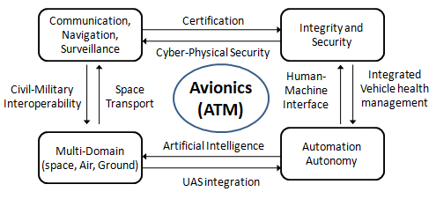
2024 Semi-Annual Updates
Research and Innovation
1) Communication, Navigation and Surveillance for Air Traffic Management (CNS/ATM):
  Evolution of the certification framework for integrated CNS +Avionics
  Civil and military airspace integration and CNS+A systems interoperability;
2) Avionics Systems Integration and Security:
  Fault-tolerant avionics design and Integrated Vehicle Health Management (IVHM) systems;
  Cyber-physical security of avionics and CNS/ATM systems;
3) Multi-Domain Traffic Management (MDTM):
  UAS integration in all classes of airspace and UTM;
  Avionics for space transport, Space Traffic Management (STM) and intelligent satellite systems;
4) Automation and Autonomy:
  Development of Avionics Human-Machine Interfaces and Interactions (HMI²); and
  Artificial Intelligence (AI)/Machine Learning (ML) in avionics systems design and operations (including the challenges of certification and the role of explainable AI).
28

Slide 29


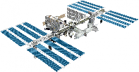
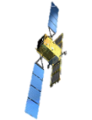
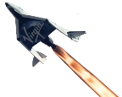










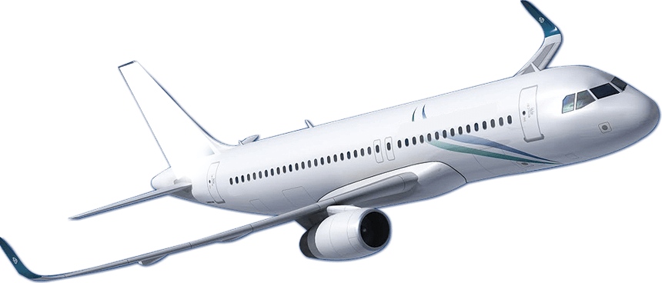




2024 Semi-Annual Updates
Research and Innovation (cont.)
SPACE DOMAIN
FL
IGHT
DOMAINS
Satellite Launch and Exploration
Other Spaceflight Missions
325 kft/100 km
Karman Line
High-Altitude Airspace (>FL600)
ATM DOMAIN
60 kft/18 km
Current ATM Domain
Low-Altitude ATM
29

Slide 30
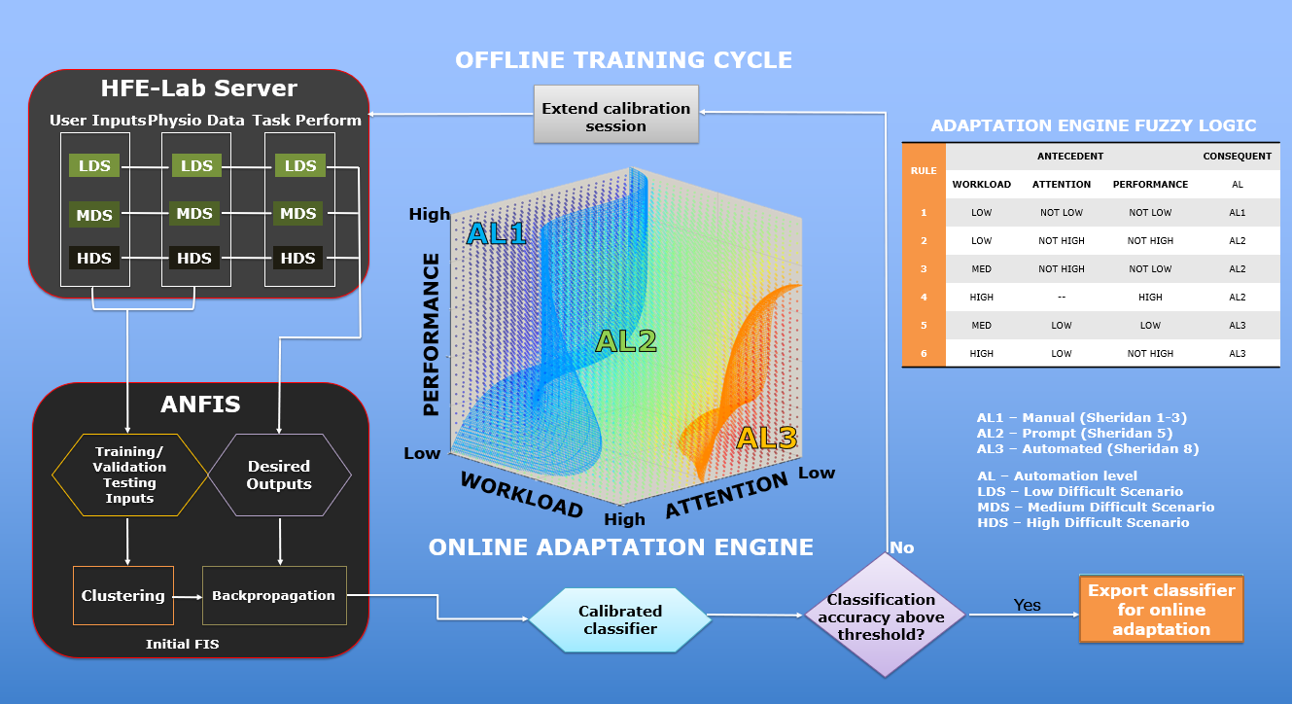
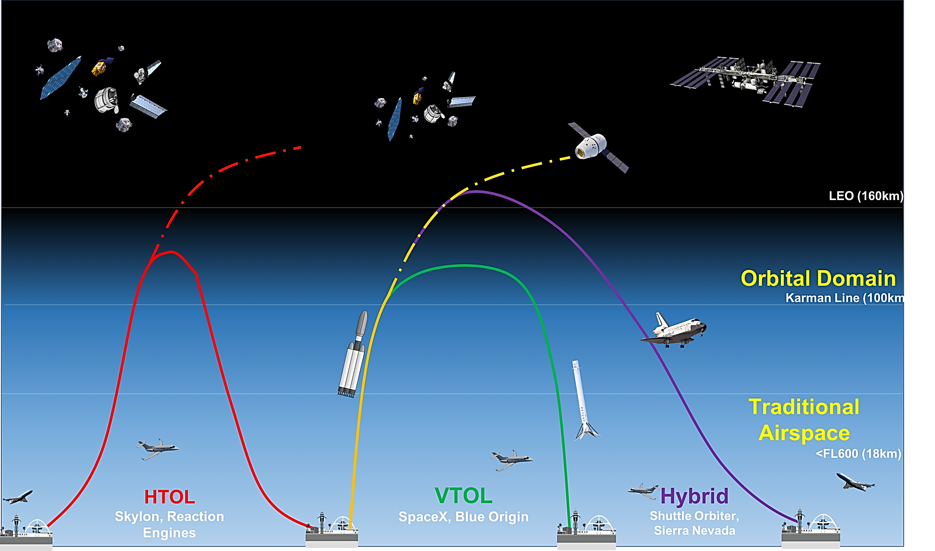
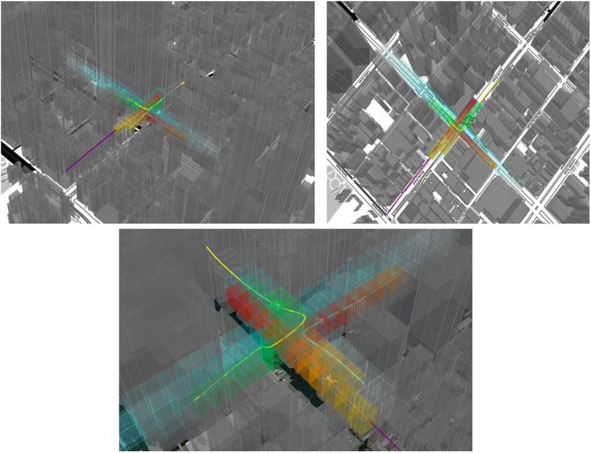
2024 Semi-Annual Updates
Research and Innovation (cont.)
The concept of Multi-Domain Traffic Management (MDTM) has emerged and various AI-based Cyber-Physical System (iCPS) architectures are being studied to support CNS/ATM and Avionics (CNS+A) system evolutions for trusted autonomous air and space transport operations
30

Slide 31
2024 Semi-Annual Updates
Conferences
The ASP is actively contributing to the organization of the 43nd IEEE/AIAA Digital Avionics Systems Conference, to be held in San Diego, CA, UAS on 29 Sept – 03 October 2024
ASP members are contributing to the UAS and student paper competitions, and will give some tutorials (Avionics, Spaceflight and Autonomous Systems) as well as chairing various track and sessions
Following the successful experience of last two editions, the ASP is currently developing a public tutorial at DASC 2024, focusing on the panel ongoing R&I activities: ”Avionics for Sustainability.”
ASP members also had a leadership role in the organization of IEEE/AIAA ICNS 2024 and contributed to the Avionics and Sensor Fusion Sessions of the IEEE/AIAA/PHM AeroConf 2024
31

Slide 32
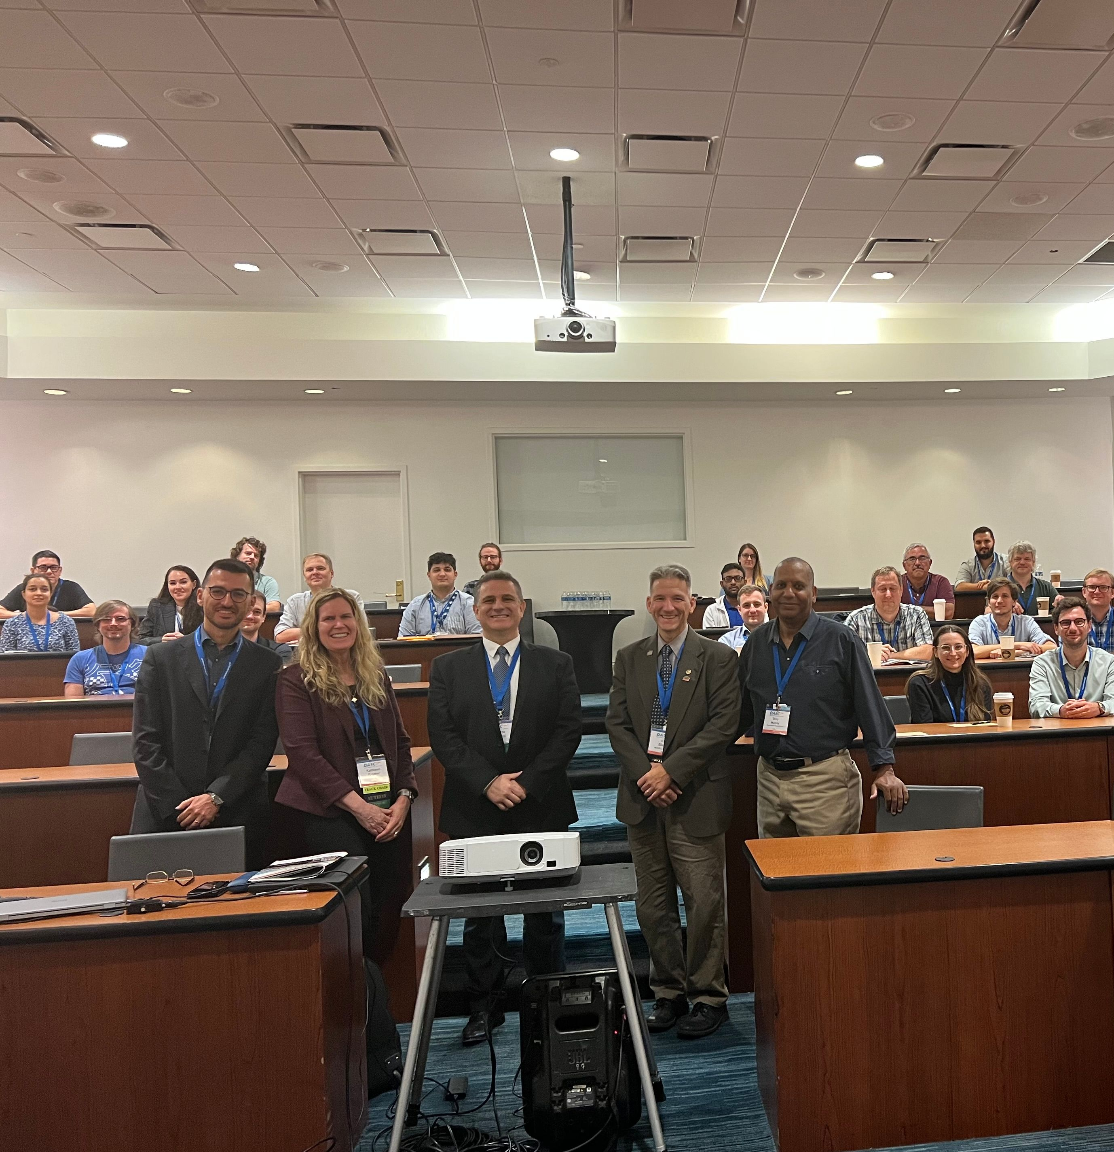
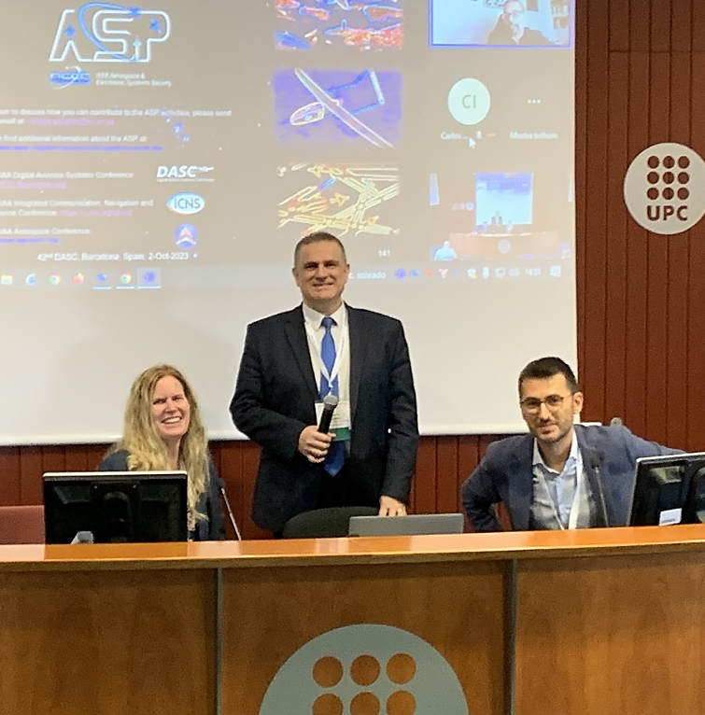
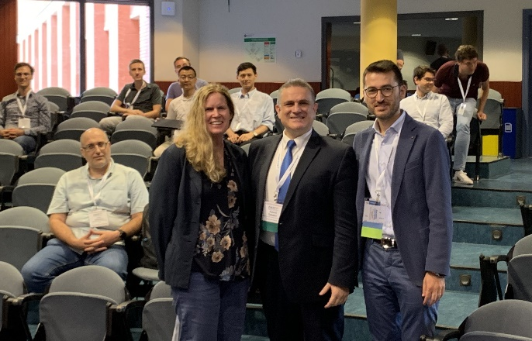
2024 Semi-Annual Updates
Recent AESS Tutorials Delivered at DASC
32

Slide 33
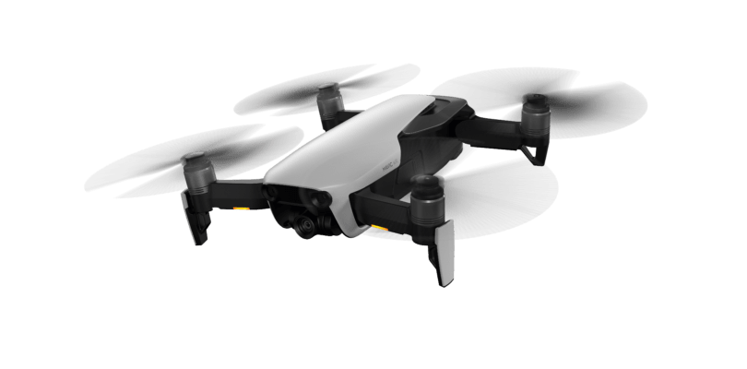
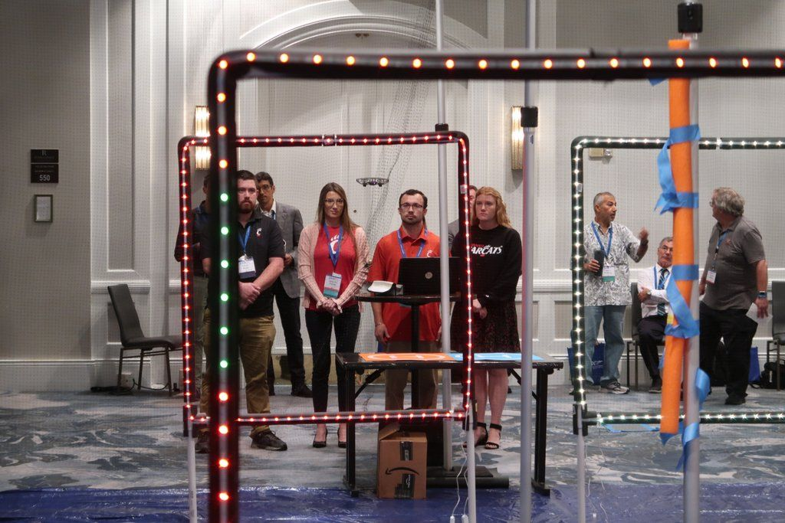
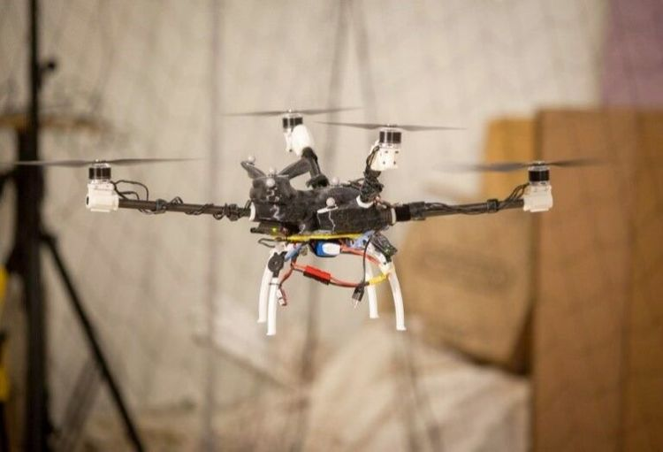
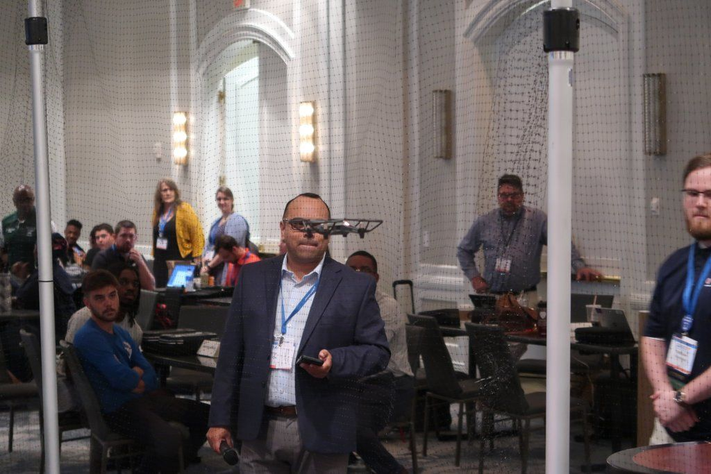
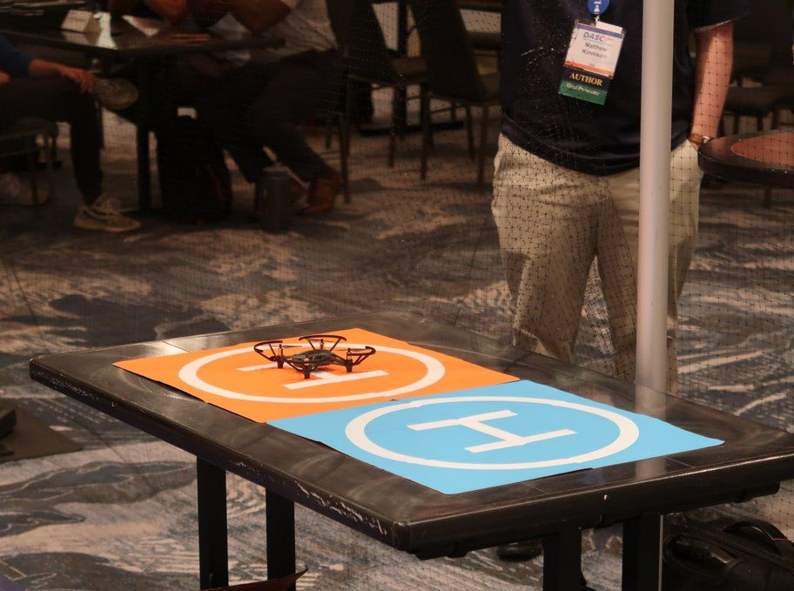
2024 Semi-Annual Updates
Recent DASC UAS Student Competitions
33
33

Slide 34
2024 Semi-Annual Updates
Publication Activities
The ASP is contributing to the AESS editorial activities in the area of Avionics Systems. These activities include:
  Senior Editor (Avionics), IEEE Transactions on Aerospace and Electronic Systems, Giancarmine Fasano
  Series Editor, IEEE Press – Progress in Aeronautics and Astronautics Systems, Roberto Sabatini
  Associate Editor, IEEE Transactions on Aerospace and Electronic Systems, Roberto Sabatini
  Associate Editor, IEEE Aerospace and Electronic Systems Magazine, Erik Blasch
  Associate Editor, IEEE Aerospace and Electronic Systems Magazine, Roberto Sabatini
  ASP members are also reviewers for TAES and the AESS magazine
  The ASP is currently working on two AESS Magazine SI proposals: (1) Low-altitude ATM/U-Space Navigiation; and Space Domain Awareness/STM
34

Slide 35
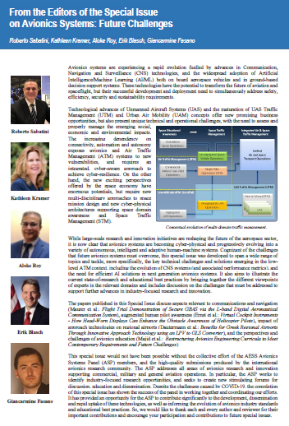
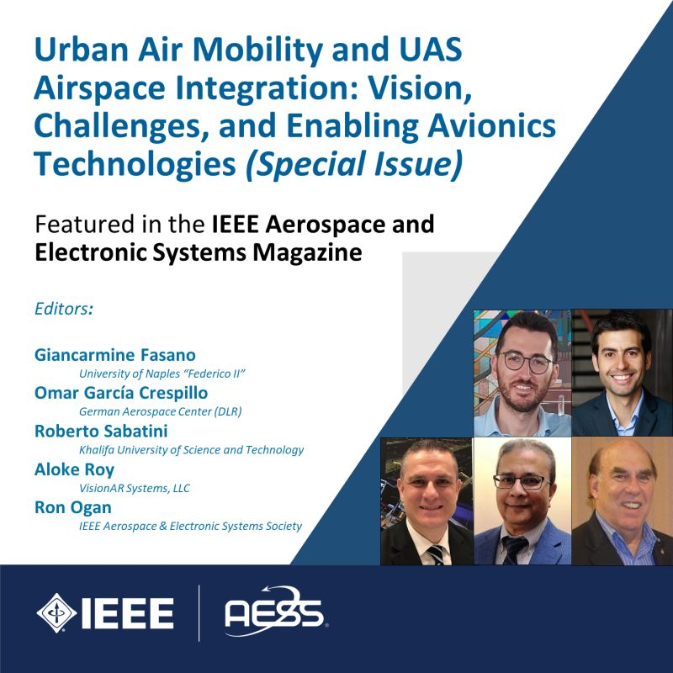
Recent Panel Publications
[1] G. Fasano, O. G. Crespillo, R. Sabatini, A. Roy, and R. Ogan, "From the Editors of the Special Issue on Urban Air Mobility and UAS Airspace Integration: Vision, Challenges, and Enabling Avionics Technologies." IEEE Aerospace and Electronic Systems Magazine, Vol. 38, No. 5, pp. 4-5, May 2023
[2] I. Majid, R. Sabatini, K. A. Kramer, E. Blasch, G. Fasano, G. Andrews, C. Camargo and A. Roy, “Restructuring Avionics Engineering Curricula to Meet Contemporary Requirements and Future Challenges.” IEEE Aerospace and Electronic Systems Magazine, 36(4): 46-58, April 2021.
[3] R. Sabatini, K. A. Kramer, E. Blasch, A. Roy and G. Fasano, "From the Editors of the Special Issue on Avionics Systems: Future Challenges." IEEE Aerospace and Electronic Systems Magazine, 36(4): 5-6, April 2021
[4] R. Sabatini, A. Roy, E. Blasch, K. A. Kramer, G. Fasano, I. Majid, O. G. Crespillo, D. A. Brown, R. Ogan, “Avionics Systems Panel Research and Innovation Perspectives,” IEEE Aerospace And Electronics Systems Magazine, 35(12):58-72, December 2020.
[5] E. Blasch, R. Sabatini, A. Roy, K. Kramer, G. Andrew, G. Schmidt, C. Insaurralde, and G. Fasano, "Cyber Awareness Trends in Avionics," 2019 IEEE/AIAA 38th Digital Avionics Systems Conference (DASC), October 2019

Slide 36

Other ASP Publication Initiatives
Currently working to a new position paper for the AESS Systems Magazine on industry-focused Avionics Research and Innovation (R&I) perspectives, focusing on AI opportunities and challenges
Discussing a possible update of the paper published in April 2021 on Avionics Systems Education, with stronger focus on “system thinking” and practical avionics systems design (HW/SW) for certification and Test and Evaluation (T&E) skills
The ASP is developing a book proposal for the IEEE Series on Aeronautics and Astronautics Systems. The goal is to send this new book proposal by the end of 2024. The provisional title is “Advances in Digital Avionics and Space Systems.” Current chapters include:
  Chapter 1: Avionics Research and Innovation Perspectives
  Chapter 2: CNS/ATM and Avionics Evolutions to Meet future Air Traffic Requirements
  Chapter 3: UTM and AAM Implementation Challenges
  Chapter 4: Avionics Systems for Urban Air Mobility
  Chapter 5: Avionics Systems for Spacecraft Operations
  Chapter 6: Cyber Security Aspects in Future Avionics Systems
  Chapter 7: Avionics Human-Machine Interactive Interfaces
  Chapter 8: Architectures to Support Future On-Board Avionics
  Chapter 9: Avionics Hardware and Software Certification Aspects
  Chapter 10: Certification of AI/ML in Safety-Critical Avionics Systems
  Chapter 11: Avionics Education and Training to Support Industry Needs and Future Trends

Slide 37
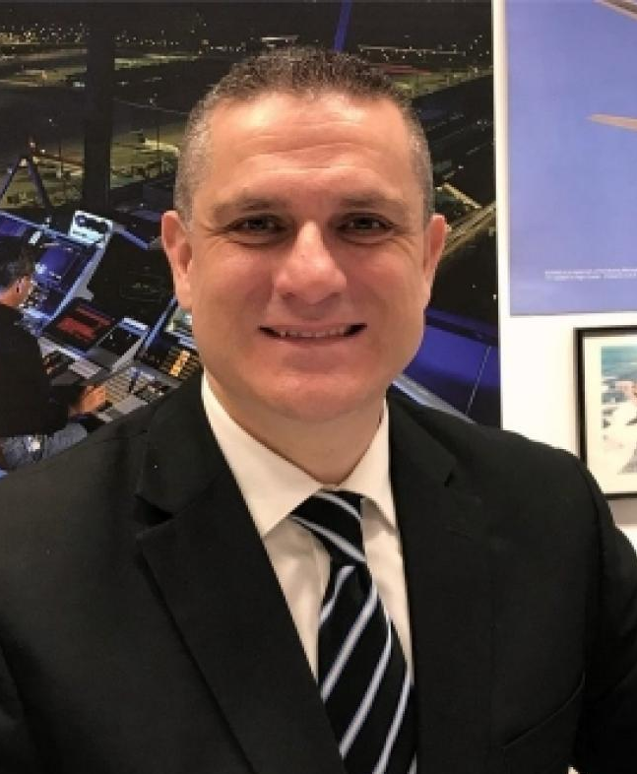
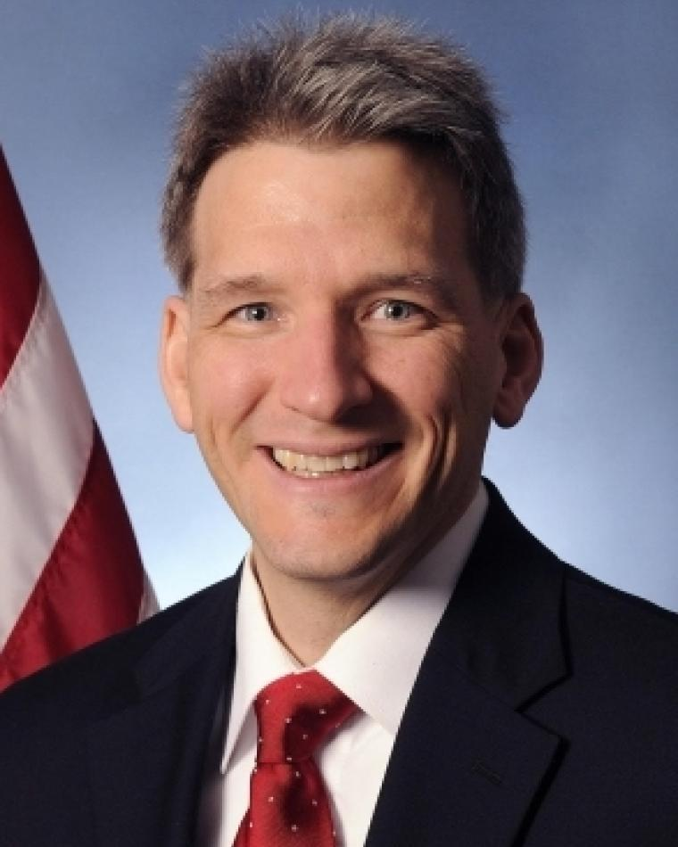
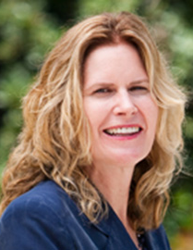
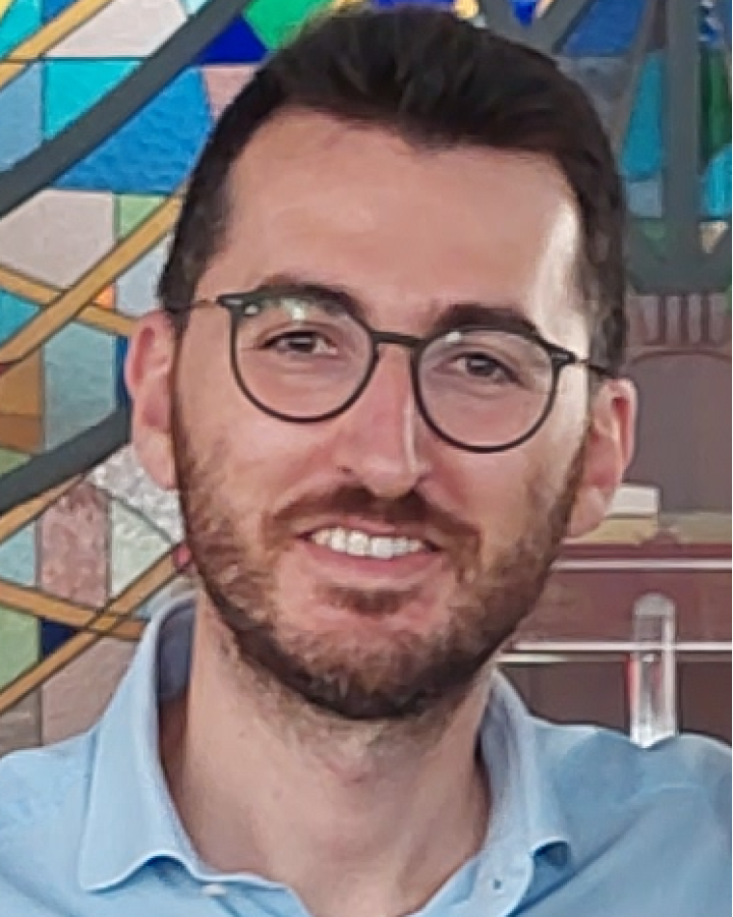
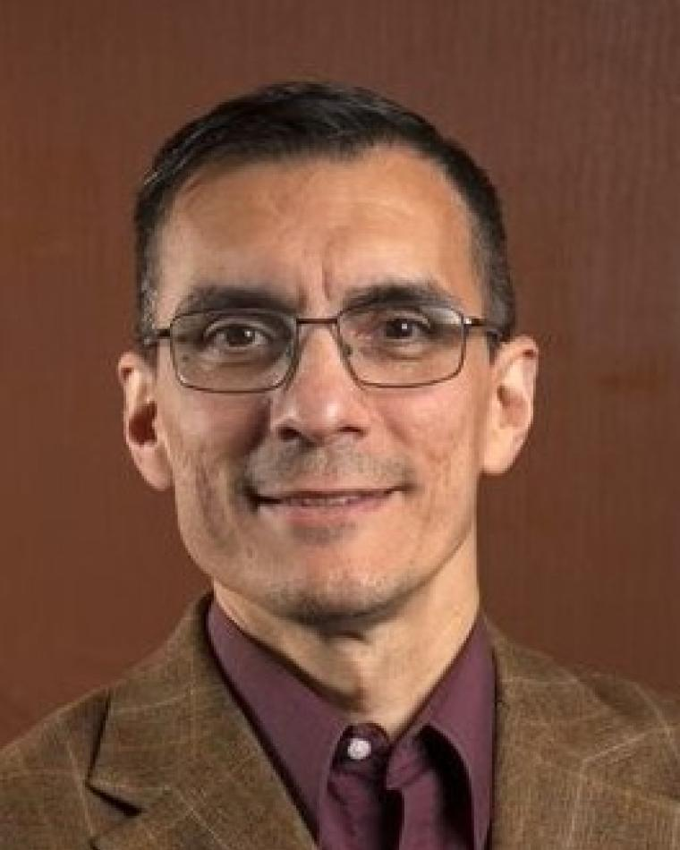
2024 Semi-Annual Updates
Education Activities
Various ASP members serve as Distinguished Lecturers (DL) and are actively contributing to the Virtual DL (VDL) Webinar Series:
  Roberto Sabatini – Aerospace Intelligent and Autonomous Systems
  Erik Blasch – Multisensor Systems and Data Fusion
  Kathleen Kramer – Navigation and Cyber-Security in Avionics
  Giancarmine Fasano – Unmanned Aerial Vehicles
  Carlos Insaurralde – Modelling and Decision Making for ATM
37

Slide 38
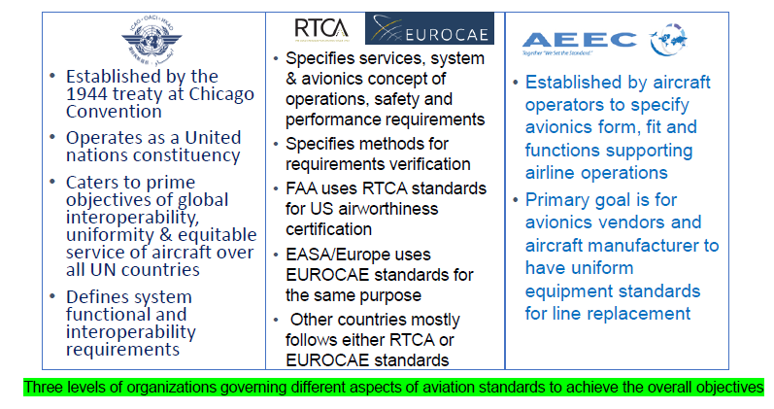
2024 Semi-Annual Updates
Industry Engagement and Standards
ASP members are contributing to the advancement of ICAO, RTCA, EUROCAE/SAE and AEEC avionics standards.
38

Slide 39

2024 Semi-Annual Updates
Future Standards
The ASP is collaborating with ICAO, IFATCA, EASA, EUROCAE and SESAR initiatives to promote avionics research/innovation, education and the evolution of certification standards for UAS Traffic Management and Advanced Air Mobility
ASP members contributed to weekly meetings of the JARUS (Joint Authorities for Rulemaking on Unmanned Systems) Working Group 7 – Automation Concept of Operations. Current activities focus on:
  ATM and UTM Automation
  Flight Rules for Autonomous Operations
  Infrastructure, Aerodromes and Ground Equipment
  Considerations for Technology Maturity
  Automation and Trusted Autonomy Use Cases
  Multiple Simultaneous Operations
39

Slide 40
2024 Semi-Annual Updates
Future Standards (cont.)
In addition to JARUS Automation/Autonomy, recent ASP contributions have focused on AI/ML certification (SAE G-34/EUROCAE WG-114), which was also a topic of the DASC 2022 and 2023 ASP tutorials:
SAE G-34/EUROCAE WG-114, Artificial intelligence in Aviation - Reviews current aerospace software, hardware, and system development standards used in the certification/approval process of safety-critical airborne and ground-based systems, and assesses whether these standards are compatible with a typical Artificial Intelligence (AI) and Machine Learning (ML) development approach.
Published Standard: AIR6988 / ER-022 Artificial Intelligence in Aeronautical Systems: Statement of Concerns (2021).
Works In Progress:
  AS6983 / ED-xxx Process Standard for Development and Certification / Approval of Aeronautical Safety-Related Products Implementing AI;
  AIR6987 / ER-xxx Artificial Intelligence in Aeronautical Systems: Taxonomy;
  AIR6994 / ER-xxx Artificial Intelligence in Aeronautical Systems: Use Cases Considerations.
40

Slide 41
Cybersecurity
Technical Operations Panel Report
Aloke Roy
Chair, Cybersecurity Panel
2024 AESS Spring Board of Governors Meeting
10-12 May 2024
Denver, CO, USA

Slide 42
About the Cybersecurity Panel
2024 Semi-Annual Updates
The Cybersecurity Panel (CSP) activities reinitiated after reorganization in the First quarter of 2024.
The current roaster is composed of 26 IEEE members who are representatives of industry, government laboratories, educational institutions and professional societies.
  Eight of these 26 members are new additions to the Panel.
The members are involved with cybersecurity research, development, implementations and application of cybersecurity concepts to real-world problems of the aerospace, transportation and electronics sectors.

Slide 43
2024 Semi-Annual Updates
The Objectives of the Cybersecurity Panel are:
  To understand the cybersecurity threats and risks that affect the AESS sectors. This will be accomplished by developing and maintaining a comprehensive knowledge base of cybersecurity vulnerabilities and threats that can affect the sectors of interest and their respective assets. The threats and vulnerabilities will be prioritized to identify the most critical cybersecurity vulnerabilities.
  To develop recommended mitigation strategies and controls for the ecosystem of each sector that can prevent, detect, respond to, and recover from cybersecurity incidents.
  To promote and support the adoption of cybersecurity best practices throughout the AESS to improve its cybersecurity posture.
  To Provide cybersecurity training and education to associated industry personnel to equip them with the skills and knowledge to deal with cybersecurity incidents. This will be accomplished by papers and publications in various industry and cybersecurity conferences, magazines, and journals. In addition, distinguished lectures will be prepared by the Panel member and offered to IEEE member organizations, Local Chapters and through virtual media.
  To enhance the cybersecurity awareness and knowledge of AESS industry personnel to enable them to detect and respond to cybersecurity incidents.
  To collaborate with other stakeholders to ensure a coordinated and comprehensive approach to AESS cybersecurity that aligns with the underlying sector's needs and priorities.

Slide 44
2024 Semi-Annual Updates
Goals of the Cybersecurity Panel:
  Develop and maintain a comprehensive understanding of the cybersecurity threats and risks to the aerospace sector.
  Identify and prioritize the most critical cybersecurity vulnerabilities and threats.
  Develop and implement effective cybersecurity mitigation strategies and controls.
  Promote and support the adoption of cybersecurity best practices throughout the aerospace sector.
  Enhance the cybersecurity awareness and knowledge of aerospace industry personnel.
  Coordinate and collaborate with other stakeholders to ensure a coordinated and comprehensive approach to aerospace cybersecurity.

Slide 45
2024 Semi-Annual Updates
The CSP held its first virtual meeting on April 4, after establishment of the Charter, Goals and Objectives
The telecon was attended by members from the US, EU, UK and Asia)
  The attendees reviewed the Charter and the Goals and reached agreement
  As the near-term action, the team agreed to write a Systems Magazine article on “risk management methodologies in the aerospace sector”.
  The group agreed to meet bi-monthly
  The Chair agreed to explore collaboration opportunities with other IEEE Panels and industry conferences
  Next CSP meeting will be held on June 6.
Joint meetings with the Avionics System Panel maybe held on a quarterly basis.
45

Slide 46
2024 Semi-Annual Updates
Conferences
The CSP was actively contributing to the organization of the 24th Integrated Communication, Navigation and Surveillance Conference.
  Keynote address were delivered by the CTO of Boeing, Director of Airspace Operations and Safety Program from NASA and Deputy Director of the ICAO Air Navigation Bureau
  Conference had a dedicated technical track on Communications and Cybersecurity
The CSP is also actively contributing to the 43rd IEEE/AIAA Digital Avionics Systems Conference, to be held in San Diego, California, on 01-03 October 2024
The CSP Chair is invited by the Conference Chair to host a Panel discussion on cybersecurity
The CSP Chair was an invited Panelist and Moderator at the first Aviation Cybersecurity Workshop jointly sponsored by the Embry-Riddle Aeronautical University, NASA and NSF. The Workshop was held at Prescot, AZ on 17th & 18th April.
46

Slide 47
2024 Semi-Annual Updates
Publication Activities
The CSP is developing an AESS System Magazine article on “risk management methodologies in the aerospace sector”.
The CSP plans to develop one or more Distinguished Lectures in the near future.
47

Slide 48
Gyro and Accelerometer
Technical Operations Panel Report
Jason Bingham
Chair, Gyro and Accelerometer Panel
2024 AESS Spring Board of Governors Meeting
10-12 May 2024
Denver, CO, USA

Slide 49
About the Gyro and Accelerometer Panel
2024 Semi-Annual Updates
The Gyro and Accelerometer Panel (GAP) is composed of representatives of industry, government laboratories, educational institutions and professional societies, and who are active in the domain of inertial sensors and systems. Its main objectives are:
  Create and maintain terminology, specification format, and test procedure standards for components and systems designed to detect or measure inertial motion.
  Promote understanding of inertial components and systems.
  Establish accepted ways to describe inertial technologies and products.
  Create a common language that can be used by the inertial industry.

Slide 50
2024 Semi-Annual Updates
The GAP held bimonthly meetings to address the following standards:
  IEEE Std 836 Recommended Practice for 2 Precision Centrifuge Testing of Linear 3 Accelerometers – Working to revise the standard to address technical issues and bring it inline with current industry practices. Work on this standard is nearing completion.
  IEEE Std 1431 IEEE Standard for Specifying and Testing Coriolis Vibratory Gyros – Working to revise the standard to address technical issues and bring it inline with current industry practices. Revision of this standard continues and will require a PAR extension to allow for a complete update to current industry practices.
  Draft Inertial Navigation System Standard Initial concept development of a future standard to address the recommended practice for specifying inertial navigation systems.
Past meeting hosts:
  Sandia National Laboratories (Nov ’23), IEEE (Jan ‘24), Ideal Aerosmith (Mar ‘24, May ‘24)
Future meeting hosts:
  Honeywell (15-16 Jul ‘24), Acutronic (16-17 Sep ‘24), Cleon Barker Consulting (11-12 Nov ‘24)
50

Slide 51
Navigation Systems
Technical Operations Panel Report
Zak Kassas
Chair, Navigation Systems Panel
2024 AESS Spring Board of Governors Meeting
10-12 May 2024
Denver, CO, USA

Slide 52
About the Navigation Systems Panel
The Panel shall address navigation systems for aircraft, spacecraft, ground and marine vehicles and pedestrians as well as history of navigation systems and navigation education.
Objectives
The objectives of this Panel are:
Work with the Institute of Navigation (ION) and the PLANS Executive Committee to select and support volunteers for PLANS (e.g., track chairs, session chairs, etc.).
Maintain a repository of past conference Budgets, Final Reports, Best Practices and lessons learned.
Promote the submission of navigation manuscripts to the IEEE Transactions on Aerospace and Electronic Systems and the AESS Magazine.
Facilitate NSP nominations/endorsements for Senior Member and Fellow Grade.
Develop, as needed, new conferences related to the NSP’s areas of interest.

Slide 53

2024 Navigation Systems Panel Activities
Panel Meetings
Virtual meetings in October 2023, January 2024, and April 2024.
Vision and Perspectives
Chair Zak Kassas participated the AESS Tech Ops VP Committee on Vision and Perspectives and co-authored an article in IEEE AES Magazine with the Panel members about AESS’ Vision on Autonomy for Sustainability. The article was accepted and is scheduled for publication in June 2024.
Distinguished Lectures
Panelists Braasch and Kassas delivered virtual and in-person Distinguished Lectures on topics related to the panel’s scope (navigation systems).
Conference Activities
IEEE/ION PLANS 2025
  Discussed various proposals to improve the quality and participation of PLANS 2025:
    3 Plenary presentations
    Poster presentations
    Invited sessions
  Worked with NSP-nominated PLANS Program Chair (Christian Gentner, German Aerospace Institute- DLR) on several initiatives for IEEE/ION PLANS
  Identified several Track/Session chairs
Discussed new conference: IEEE Navigation Systems Conference during PLANS “off-years.” DLR (Munich) is a potential host.
Notes:
Blasch and Walsh, Erik Thienissen, Aloke Roy (DASC34, DASC35 TPCs) William Claycomb, Gordon Thomas (ICCST chairs in 2016 and 17)
Others volunteer and participate in conference sessions (I have them sign in).

Slide 54
Glue Technologies for Space Systems
Technical Operations Panel Report
Claudio Sacchi
Chair, Glue Tech Panel
2024 AESS Spring Board of Governors Meeting
10-12 May 2024
Denver, CO, USA

Slide 55
About the Glue Tech Panel
2024 Semi-Annual Updates
The Glue Technologies for Space Systems (Glue-Tech) is composed by members who are representatives of industry, research laboratories, educational institutions and professional societies, and who are active in the domain of future Space systems, where Space communications are regarded as the “glue” for a new interconnected world. The panel aims to:
  Promote the coordination of the technical activities related to the technologies that constitute the necessary common platform for innovative Space Systems.
  Promote and support publications concerning the panel topics;
  Organize panels and special sessions in featured-topic conferences.
  Promote educational activities.
  Encourage the submission of nominations for IEEE Fellows and Senior Members in the fields of interest of the panel.
  Manage the nomination and selection of candidates for IEEE Awards in the fields of interest of the panel.
  Create of communities and forums cooperating in the development of panel technical activities.

Slide 56
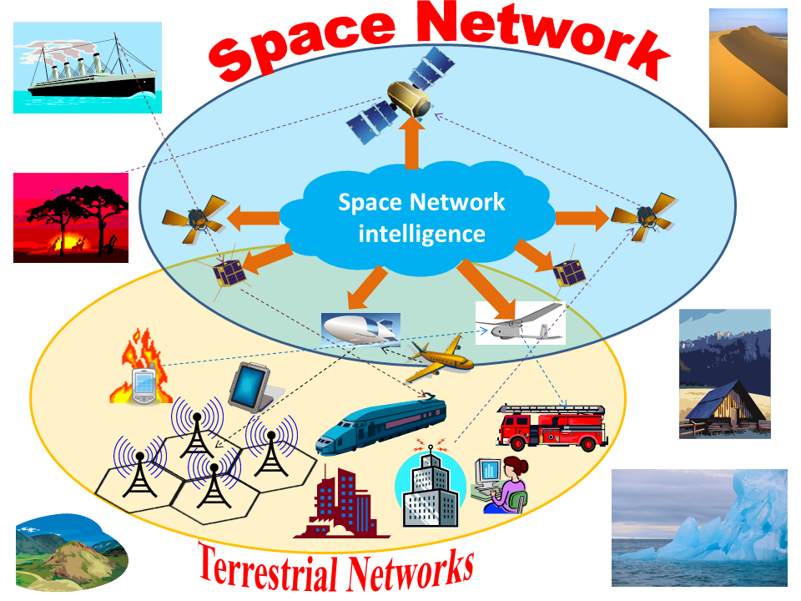
2024 Semi-Annual Updates
Research and Innovation
7) Integrated communications, navigation and sensing
8) Advanced signal processing and data fusion techniques for Space applications
9) Interplanetary and extra-terrestrial networking
  Lunar communications
  Martian communications
1) Broadband space transmissions:
  Multibeam satellites, EHF for satellite transmission;
  Free-space optical links for IOL, optical satellites;
2) Softwarization of Space networking:
  Software Defined Radio, Software Defined Networking, AI in the Space;
  Cloud-RAN in the Space, Resource virtualization;
3) Internet of Remote Things and Internet of Space Things:
  Using also small satellites and CubeSats;
4) Seamless integration of intelligent aerial networks and with cognitive and softwarized sky networks:
  Multi-layered integrated Terrestrial—Non-Terrestrial Networks (T-NTN) in the framework of “6G and beyond”.
5) Augmented 3D reality for manned exploration missions (e.g.: on Mars)
  Digital Twin for emulating extra-terrestrial environments.
6) End-to-end system considerations for Space systems
GLUE TECHNOLOGY is inside the Space Network Intelligence and the (true) seamless integration with terrestrial networks
56

Slide 57
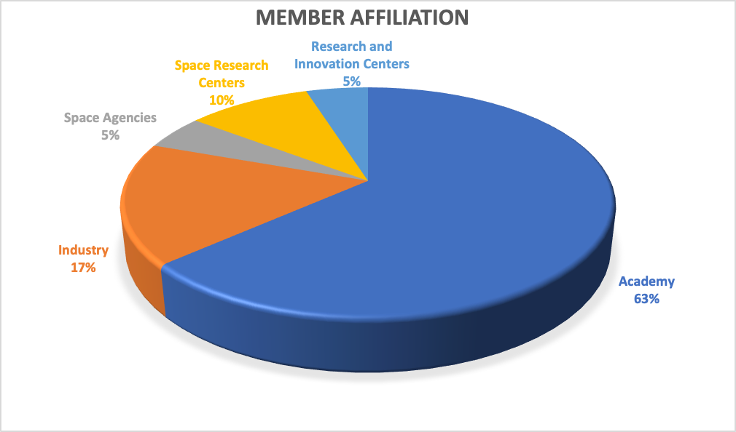
2024 Semi-Annual Updates
Update about the panel membership
So far, the panel accounts 41 members, distributed in terms of geography, affiliation and fields of interest as follows (picture updated on May 3, 2024):
57

Slide 58


2024 Semi-Annual Updates
Conferences
The Glue Tech panel actively contributed to IEEE Aerospace Conference 2024 (Big Sky, MT, March 2024) by organizing a special session 4.03 (”Next Generation Space Systems – AESS Glue”) and contributing to the organization of sessions 4.09 (“Communications and/or Related Systems: Theory, Simulation, and Signal Processing”) and 4.10 (“Wideband Communications Systems”).
Moreover, Glue Tech established a liaison with the IEEE MetroAeroSpace Workshop, organizing in the 2024 edition (Lublin, Poland, 3-5 June 2024) a special track: Criteria and Technologies for the Development of a “New Space” Ecosystem (CASTAWAYS)
58

Slide 59
2024 Semi-Annual Updates
Publication Activities
The Glue Tech panel submit sponsored in the first half of 2024 contributions to IEEE journals and conferences dealing with related research topics.
For 2024, a collective submission to IEEE Communications Surveys and Tutorials has been planned by Glue Tech panel, targeted at presenting an updated state-of-the-art picture about the evolution of Space technologies toward the future “Space 2.0” perspective.
Many panel members are currently involved in the editorial boards of AESS journals.
59

Slide 60


2024 Semi-Annual Updates
Education Activities
The Glue Tech panel organizes two yearly Summer Schools:
  Frontier Technologies for ”Space 2.0” Communications (planned period: end August-early September 2024): organized online (last edition: 40 attending students)
  Space 4U – EUSPACE (planned period: September 2024): organized in presence at Imperia (Italy) and in cooperation with the Jean Monnet Chair of EU (last edition: 15 attending students)
Moreover, the panel members hold seminars and plenary lectures about panel topics in top-ranked Universities and Research centers.
60

Slide 61
Radar Systems
Technical Operations Panel Report
Laura Anitori
Chair, Radar Systems Panel
2024 AESS Spring Board of Governors Meeting
10-12 May 2024
Denver, CO, USA

Slide 62
About the Radar Systems Panel
2024 Semi-Annual Updates
The Radar Systems Panel (RSP) is composed of IEEE members who are representatives of industry, government laboratories, educational institutions and professional societies, and who are active in the domain of Radar.
Its main objectives are:
  Sustain and oversee the program of IEEE Radar Conferences;
  Manage the nomination and selection of candidates for IEEE Awards in the domain of radar;
  Promote and support publications in the domain of radar;
  Promote educational activities in the domain of radar;
  Encourage the submission of nominations for IEEE Fellows and Senior Members in the domain of radar;
  Provide periodic revision of IEEE Standards pertaining to the domain of radar.

Slide 63
2024 Semi-Annual Updates
The RSP meets yearly at IEEE Radar Conferences, and ad-hoc at IEEE Int. Radar conferences. Throughout the year, activities are carried out by the committees via online meetings and emails.
The RSP consists of 8 committees and also provides representatives to AESS committees, including:
  Radar Conference Committee
  Awards Committee
  Standards Committee
  Education Committee
  Nomination and Appointments Committee
  Spectral Innovation Committee
  Civilian Radar Committee
  Publications Committee
  AESS ISAC Working Group (WG) representatives
63

Slide 64
2024 Semi-Annual Updates
General updates from past 6 months
The RSP is continuing to
  update/create “best practice” reference documents for all committees;
  set up the RSP Google drive to archive and share RSP documents;
  establish the use of digital forms for voting and surveys;
All committees are very active in both monitoring progress/promoting existing activities and initiating new ones;
RSP is establishing new policies for the RadarConf series proposals’ presentation and evaluation, and for hand-over meetings between conference organizing committees;
RSP has established a new policy (March 2024) for vice-chair automatic succession to Chair position (updated charter and ToR).
64

Slide 65
2024 Semi-Annual Updates
Conferences Activities
New Committee Best Practices Document
  Previous “Best Practices” was tips for conference hosting
  New “Best Practices” is committee operations guidance
New Host Committee Summaries
  Aid annual handoff; capture each conf sub-committee chair roles, responsibilities, lesson learned
New Conference Proposal Template
  Common Executive Summary to ease review, scoring, and comparison
  IEEE Budget template
New Conference Proposal Scoring Rules
  Review score based on metrics in various proposal categories (Committee scores) + full RSP location preference vote (old method was only RSP vote)
New Conference Reporting Templates
  Standardizes information reporting across all conferences
Upcoming conferences
  2024 IEEE Radar Conference: May 6-10, 2024 in Denver (Justin Metcalf & Braham Himed)
  RADAR 2024: Oct 21-25 in Rennes, France (Myriam Nouvel)
  2025 IEEE International Radar Conf: May 3-9, 2025 in Atlanta, GA (Ryan Hersey)
  2025 IEEE Radar Conf: Oct 4-10, 2025, in Krakow, POL (Mateusz Malanowski & Piotr Samczynski)
  2026 IEEE Radar Conf: May 11-15, 2026, Phoenix, AZ (Brian Cordill & Dan Bliss)
  2027 IEEE Radar Conf: draft proposals received; final selection summer 2024
65

Slide 66
2024 Semi-Annual Updates
Awards Activities
Publicized nominations for and selected winners of Nathanson and White Awards with winners as follows
  Nathanson – Francesco Fioranelli
  White – Antonio De Maio
Encouraged selection of RSP Award winners as lecturers in 2024 Radar Boot Camp to create a cycle of service back to the community
Updated Best Practices document for RSP Awards
Collected feedback from all RSP members on how to better publicize awards
Surveyed RSP membership regarding the 2023 Awards (presented in 2024) with improved participation from previous year
  35 participated in survey
  94% aware of RSP award deadlines
  31% nominated/endorsed candidate for Picard Medal
  31% nominated/endorsed candidate for IEEE Fellow
  9% nominated/endorsed candidate for Mimno Award
  9% nominated/endorsed candidate for Carlton Award
  6% nominated/endorsed candidate for Robert T. Hill Best Dissertation Award
  14% nominated/endorsed candidate for Pioneer Award
  0% nominated/endorsed candidate for Distinguished Service Award
  6% nominated/endorsed candidate for Industrial Innovation Award
66

Slide 67
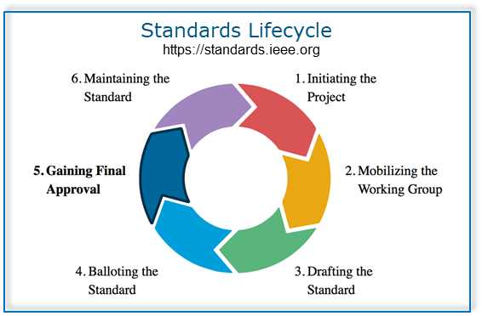
2024 Semi-Annual Updates
Standards Committee Activities
RSP very active in definition and update of several IEEE Standards, including:
SASC: Many WGs (#2 and #3)
P4002: Will move to #4 in about a year
686-2023: Will move from #5 to #6 soon
521-2019: Will move from #1 to #2 soon
RSP participates in new Synthetic Aperture Standards Committee (SASC):
Operating since January 2022, RSP is well-represented: leadership (Mishra) and SA-TWG (Mishra, Ram);
Radar Study Group has been mobilized and now called the “P3355 Synthetic Aperture Radar Working group”. A large team has been assembled to achieve working group tasks. New working groups:
  P3399 Automotive SAR
  P3397 Synthetic Aperture Radar (SAR) Image Quality Metrics
  P3384 ISAC Vocabulary
  P3383 ISAC Performance Metrics
  P3370 Collocated Multiple-Input Multiple-Output (MIMO) SAR
67

Slide 68

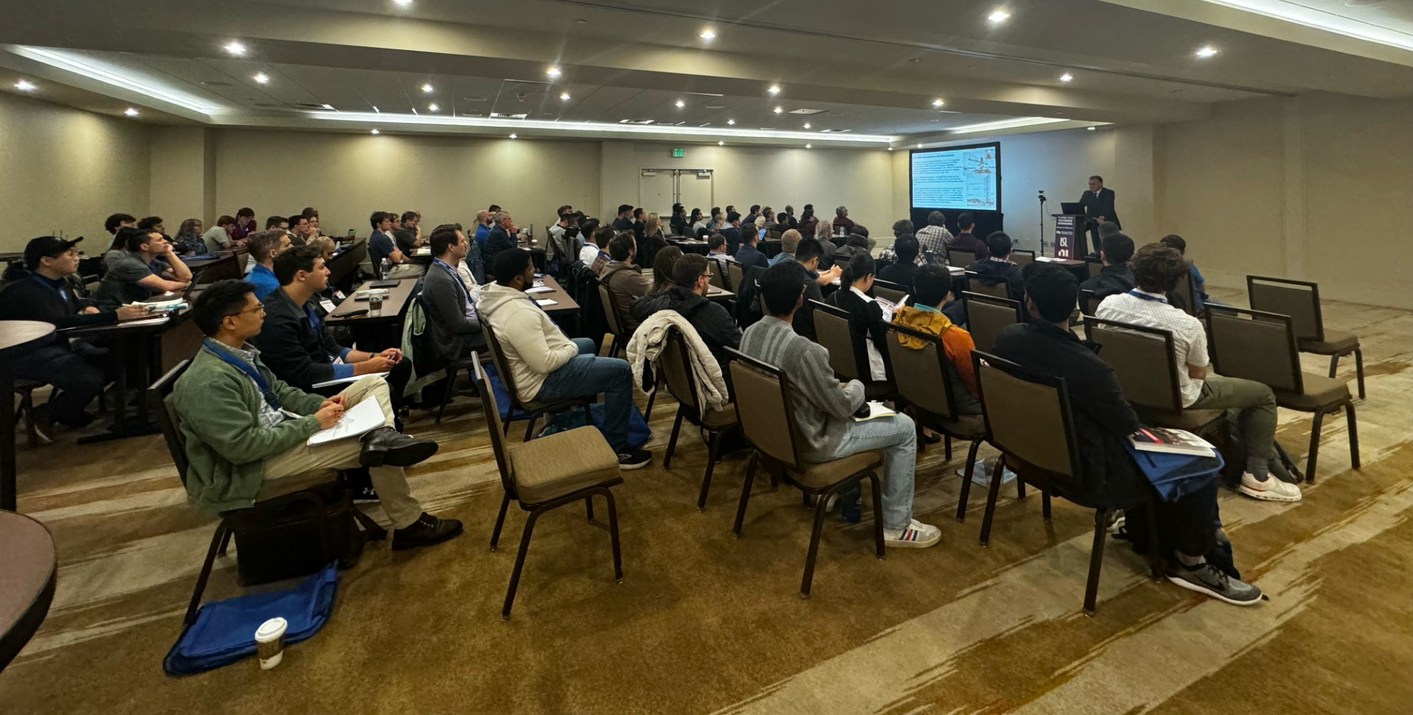
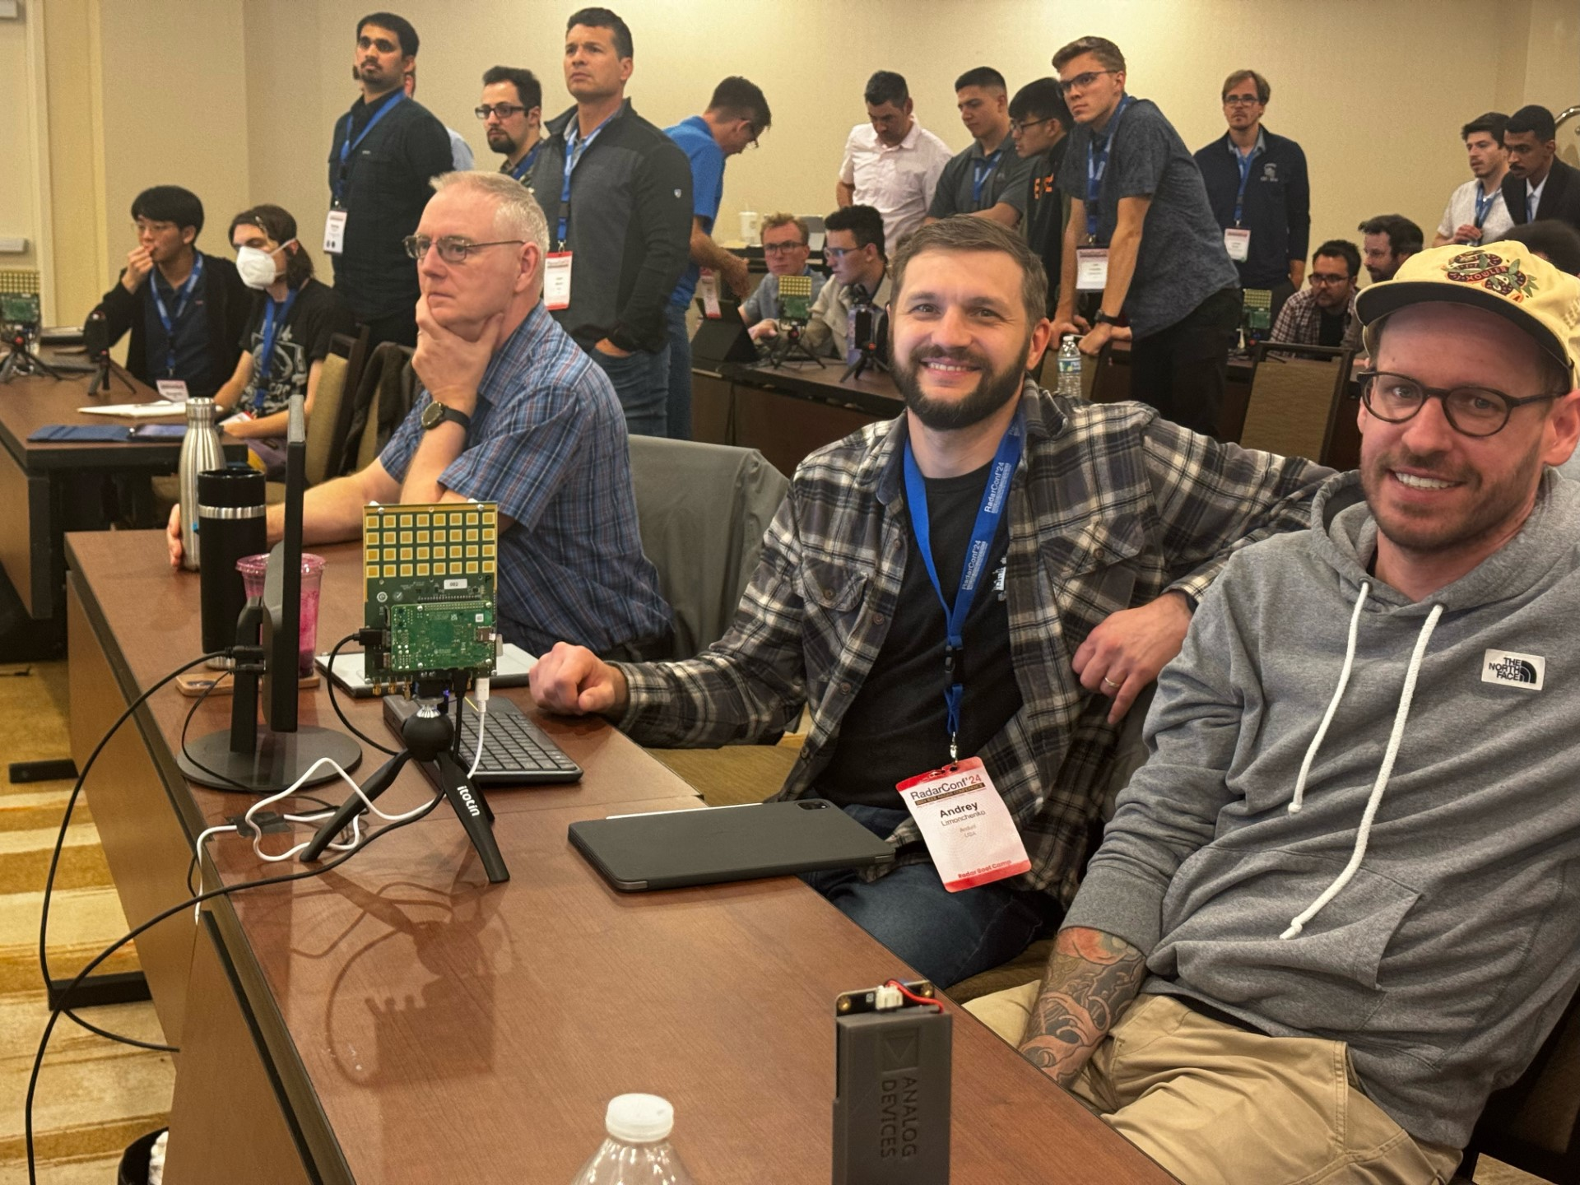
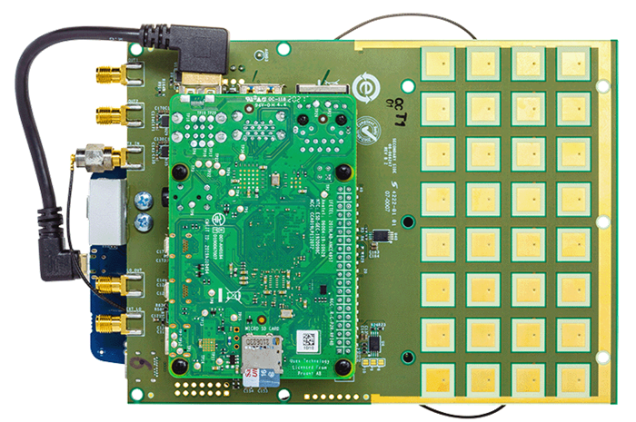
2024 Semi-Annual Updates
Educational Activities
Radar Boot Camp (RBC) @ RadarConf24
  2024 RBC to be held in-person in Denver @ RadarConf on 4-5 May 2024
  2024 Agenda:
    8 lectures by noted experts
    Several hands-on demos for students
  Lectures recorded & will be posted online @ ILN
  2024 Registration: 106 enrolled (~100% increase)
New Radar Challenge @ RadarConf24
  The Radar Challenge 2024 has partnered with Analog Devices & MathWorks to provide an exciting opportunity to practice skills with state-of-the-art radar hardware (10GHz AD Phased Array platform CN0566).
  Participating groups were sent the kit to develop a creative demonstration (e.g., beamforming, tracking, SAR-inspired algorithms). They will then showcase at the conference their demo and a prize will be awarded to the best demo(s).
  22 teams submitted proposals, then narrowed down to 10, and 7 made it through the process.
Radar
Kit
Radar Challenge, Monday May 6th, 17:15-19:00 in Colorado F
68

Slide 69
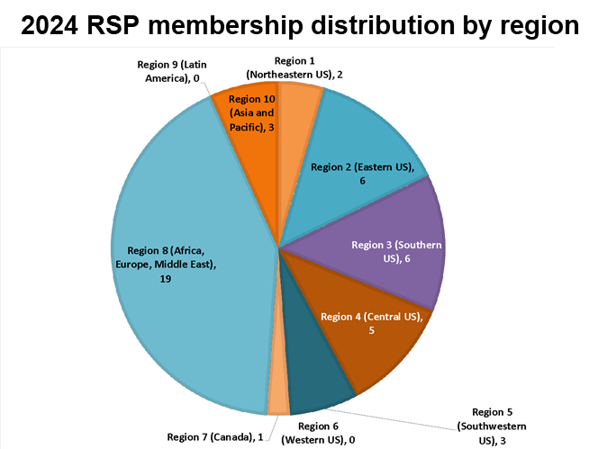
2024 Semi-Annual Updates
Nominations and Appointment Committee (N&A)
Revised RSP Charter and N&A Terms of Reference:
  Vice Chair automatically elevated to Chair following 2-year term
  Process to begin fall of ’24 (Votes 19-12)
  Require 1-year of remaining eligibility to serve as RSP Chair / Vice Chair (Votes 23-8)
  Added succession plan for RSP Chair / Vice Chair (Votes 26-5)
2024 RSP membership by institution
69

Slide 70
2024 Semi-Annual Updates
Spectral Innovation Committee Activities
Article requested by committee and written by Bill Melvin published in August 2023 edition of AESS magazine:
  W. L. Melvin, "An Overview of Radar Operation in the Presence of Diminishing Spectrum," in IEEE Aerospace and Electronic Systems Magazine, vol. 38, no. 8, pp. 48-60, 1 Aug. 2023
Frank Sanders from NTIA chosen as plenary speaker at RC24
Created new spectral innovation committee best practices document
  Was working under original Waveform Diversity committee best practices document
SIC Best Practices (paraphrased)
  Serve as RSP POC for all spectral-innovation-related topics/activities
  Organize conference keynote presentations and panel discussions
  Organize and promote tutorials, workshops, webinars, dataset challenges, and conference special sessions
  Curate a taxonomy of technology areas and problem sets with keyword definitions.
  Organize a history of major national and international spectral policy changes and programs related to or that can impact spectral innovation for radar applications.

Slide 71
2024 Semi-Annual Updates
Civilian Radar Activities
RSP committee members’ activite in promoting and organizing activities on Civilian Radar, including:
  Conference presentations (18)
  Special sessions in conferences (3)
  Publications (7 Special Issues)
  Tutorials (4)
  Short courses (1)
  Workshops (1)
  Keynotes (2)
  Books (3 published and 2 upcoming)
  Seminars (12)
  AESS Industrial Innovation Award for Contribution to Automotive Radar
71

Slide 72
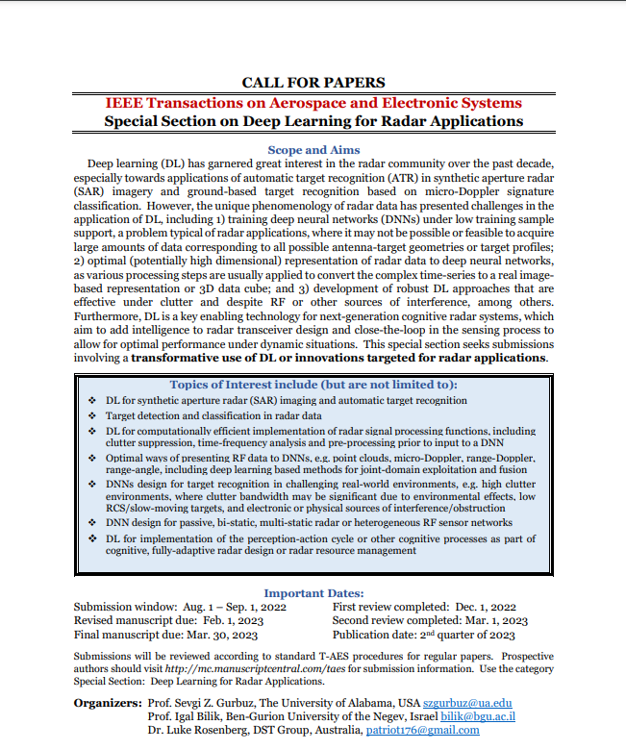
2024 Semi-Annual Updates
Publications
Many members are Associate Editors for either TAES or TRS
RSP members have organized several TAES and TRS special editions and sections
RSP contributing with partner societies on a special issue in the IEEE Journal of Biomedical and Health Informatics: "Radar-based Physiological Measurement Techniques for Healthcare and Health Monitoring“
Further ideas:
  Advertise IEEE AESS journal at organised DL (including two next month);
  Ensure IEEE references are included in our publications.

Slide 73
2024 Semi-Annual Updates
Publications (stats past 12 months)
TAES Statistics
  No. paper published in 2022/2023 (12 months): 418/713 - acceptance rate is around 30%
  Special section papers: 29
  Most submissions: China (70%), USA (7.8%), Italy (3%), South Korea, (2.7%), Germany (2.4%), Iran (2.3%)
TRS Statistics
  October 2021 – 2023 (14 months): No. submissions / accepted publications: 68 accepted / 254 submitted = 35% acceptance
  Special section papers: 40
  Most submissions: US (21.0%), China (19.2%), India (15.5%), Germany (5.5%), UK (4.1%), Canada (4.1%)
Special sessions open
  Artificial Intelligence Approaches for Radar Processing and Applications (TRS)
Special sections completed
  Deep Learning for Radar Applications (TAES, 13 papers accepted)
  Automotive Imaging and Super-Resolution Radar Systems (TAES, 4 papers accepted)
Special sections closed
  Fully Digital Arrays for Radar: From Architectures to Algorithms (TRS, 16 papers)
  Innovations in Radar Spectrum: Deconfliction, Containment, Sharing, and Multifunction (TRS, 13 papers)
  Advances in Radar Imaging (TRS, 11 papers)
Open call for proposals
  TRS (1 April, 1 Oct)
  TAES: any time

