Slide 1
IEEE Aerospace Electronic Systems
<<VP Area/Chair>>
Abir TABARKI
AESS Board of Governors Meeting – Spring 2024
10 and 11 May 2024
Denver, CO, USA

Slide 2
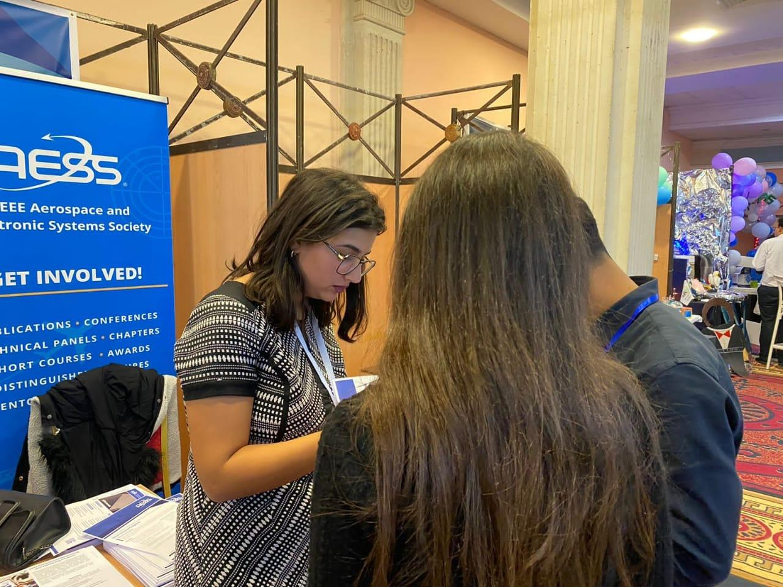
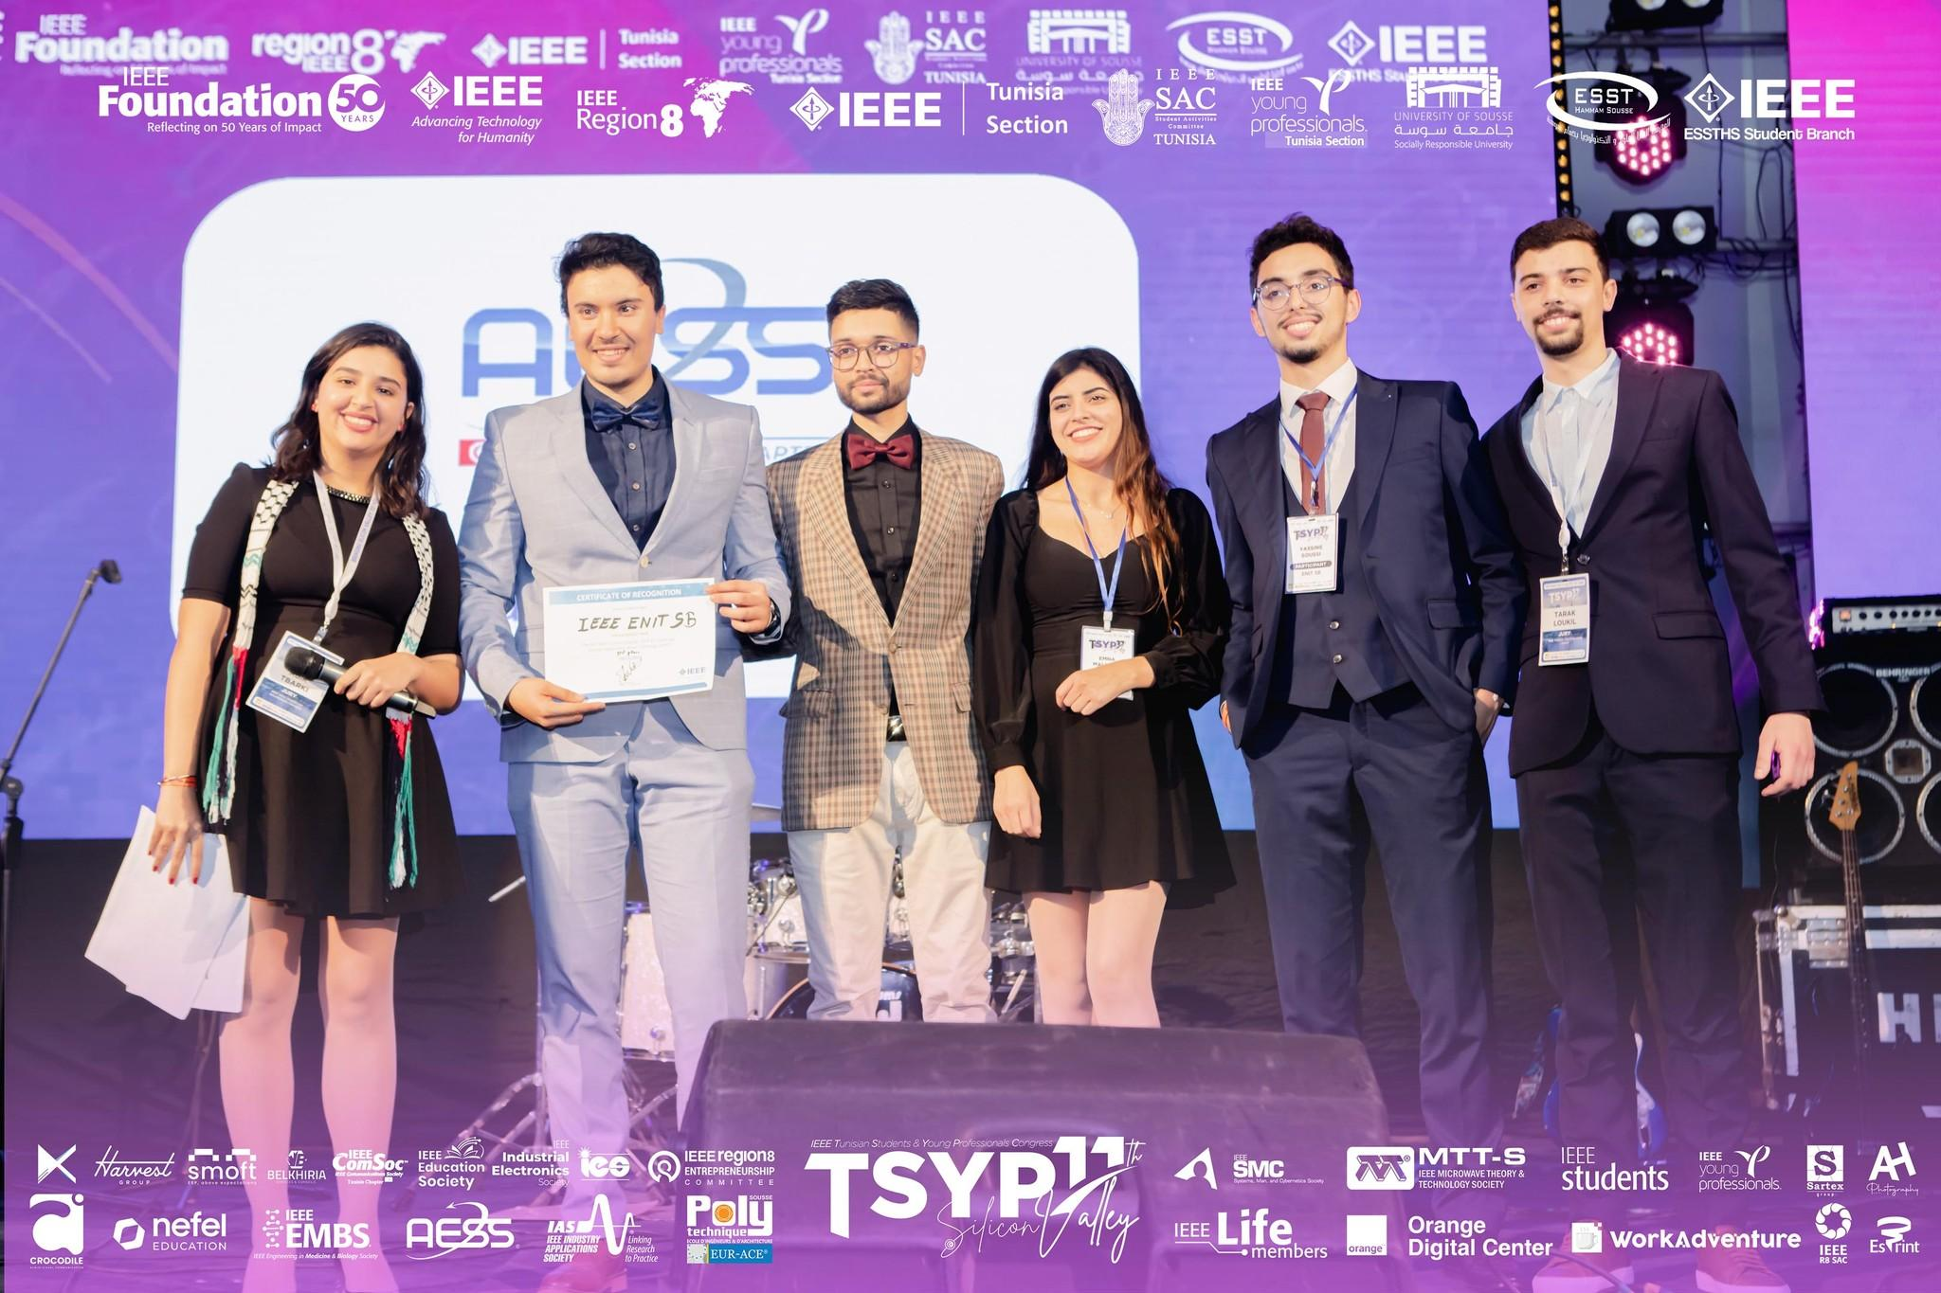

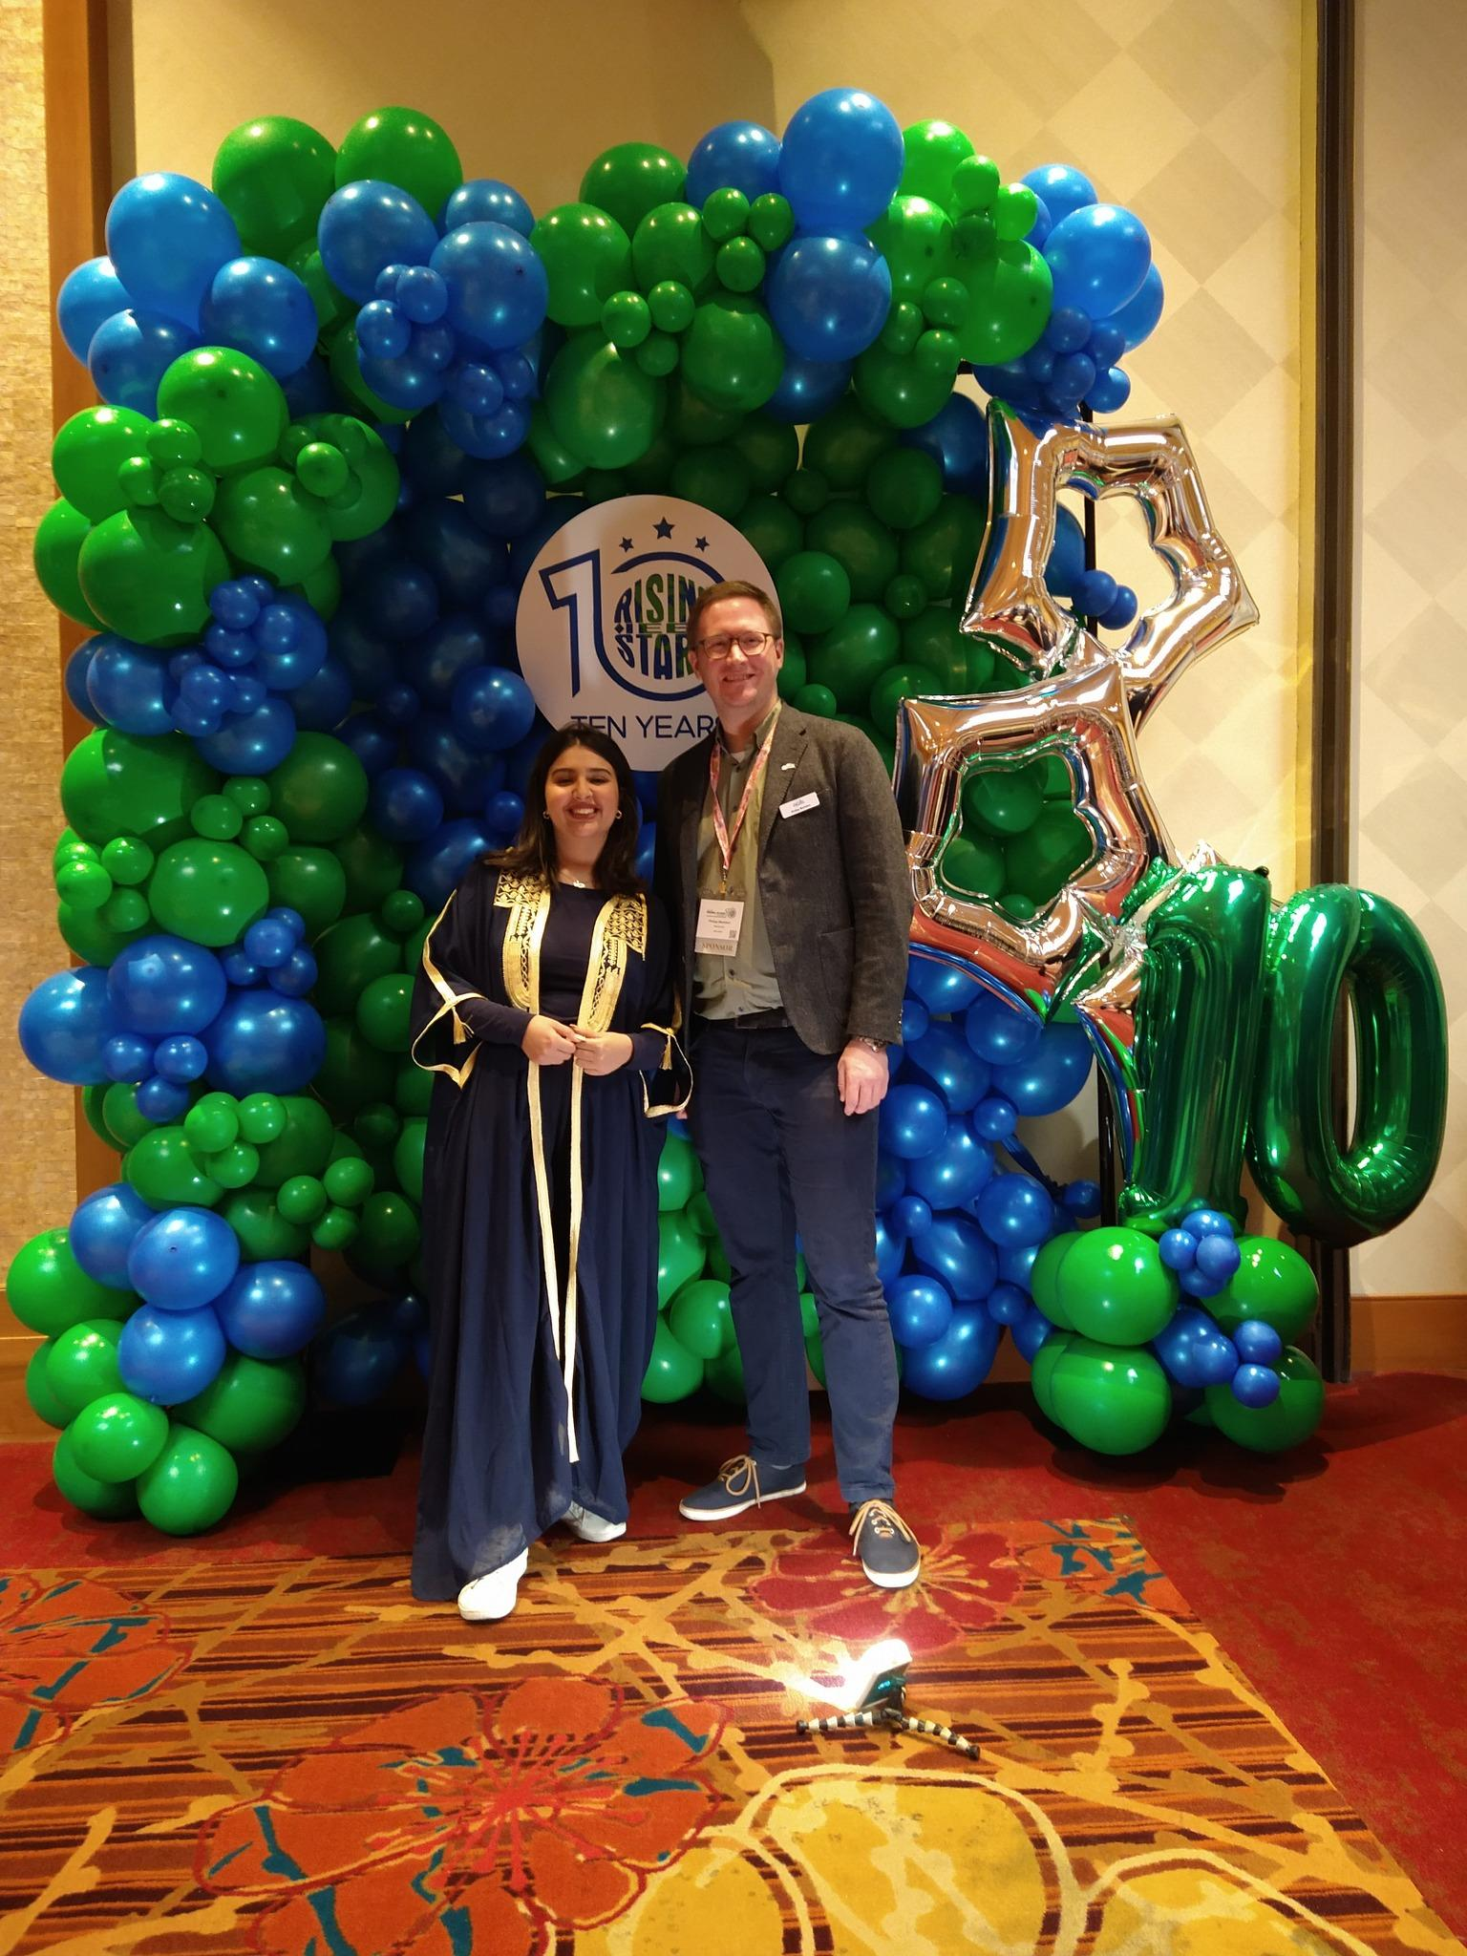
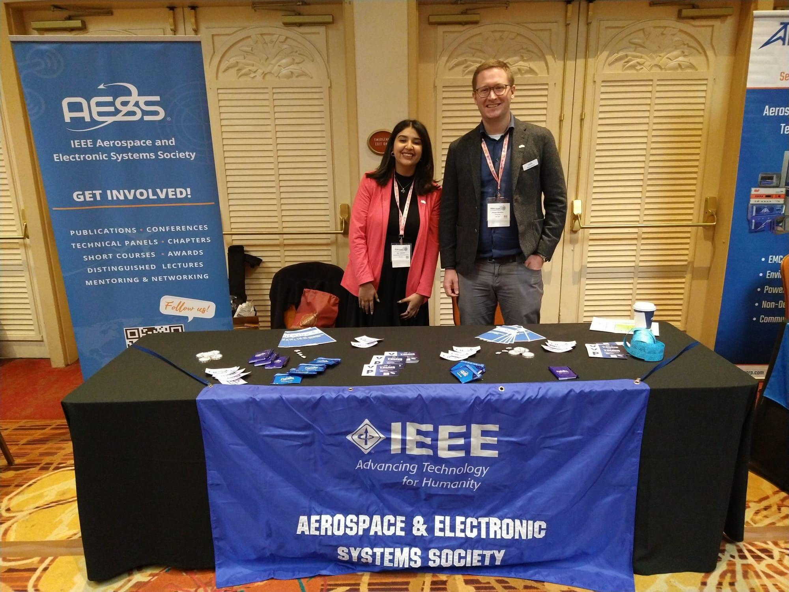
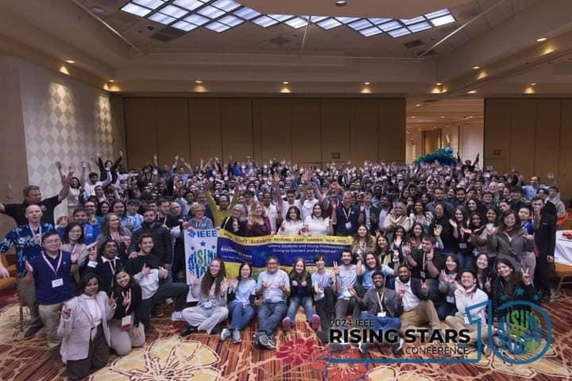
What so far, since November 2023
Present AESS in TSYP11 with a booth and hosting a technical challenge for participants and engage and answer their questions [1100 participants]
Present AESS in Rising stars with Yp Rep Mr Philipp with a booth and focused on sharing the benefits of being AESS member specifically for students ( focused on scholarship opportunities )[300 participants]

Slide 3

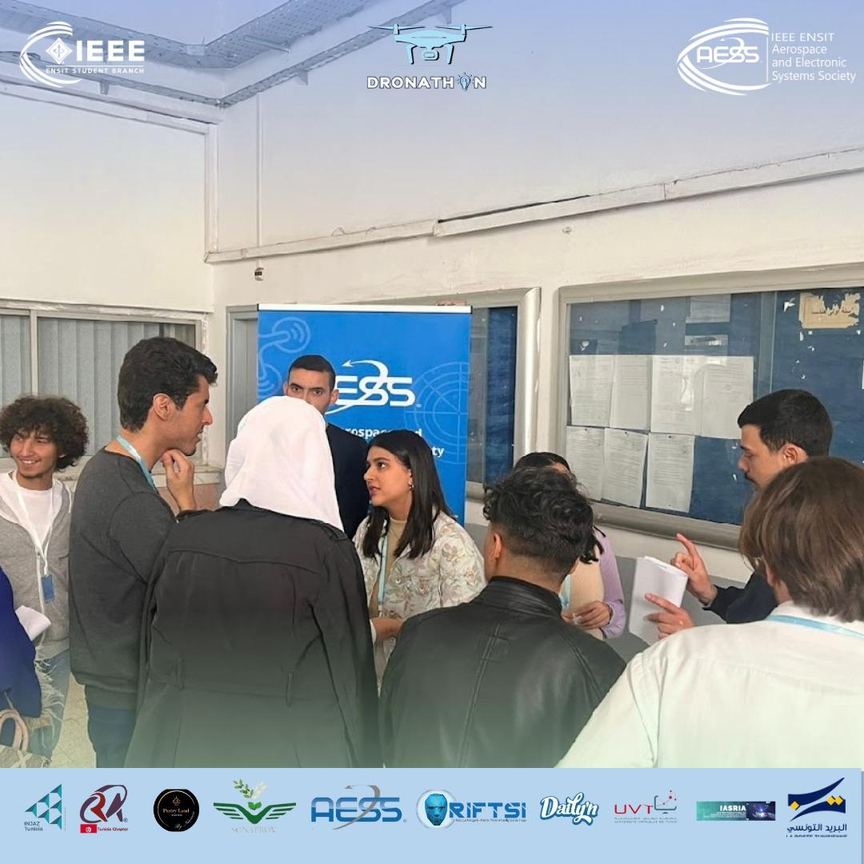
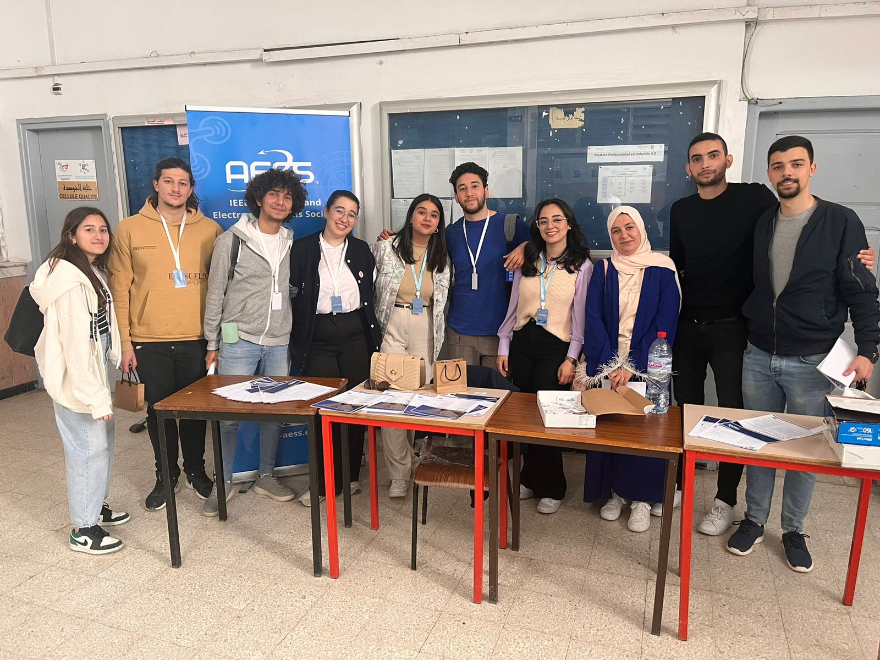
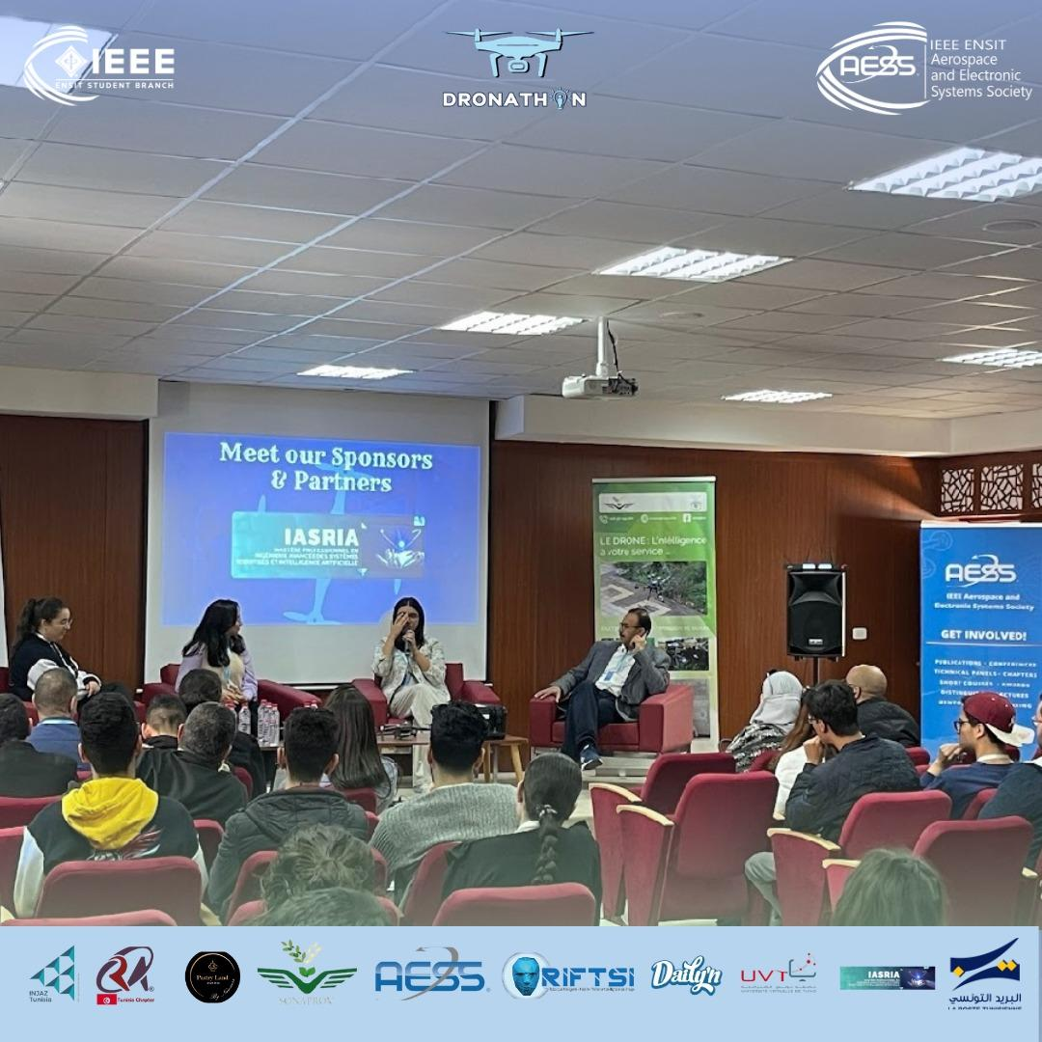
What so far, since November 2023
Engaged with Students via a webinar organized by IEEE Student to talk about our activities as student branch chapters
Booth and round table at dronathon Tunisia to engage with students and talk about opening new AESS chapters procedure

Slide 4
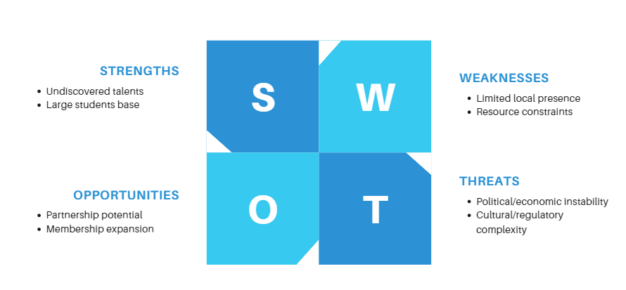
Short term goal (SWOT Planning)
SWOT Analysis: Engaging Africa and Middle East Regions
Tool: Participating in Region 8 Students and young professionals congress and engaging with the large community present

