Slide 1
IEEE Aerospace Electronic Systems
Philipp Markiton, YP rep
AESS Board of Governors Meeting – Spring 2024
10 and 11 May 2024
Denver, CO, USA

Slide 2
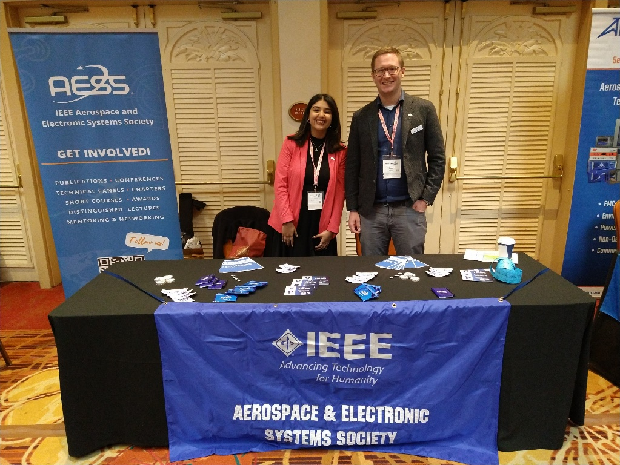
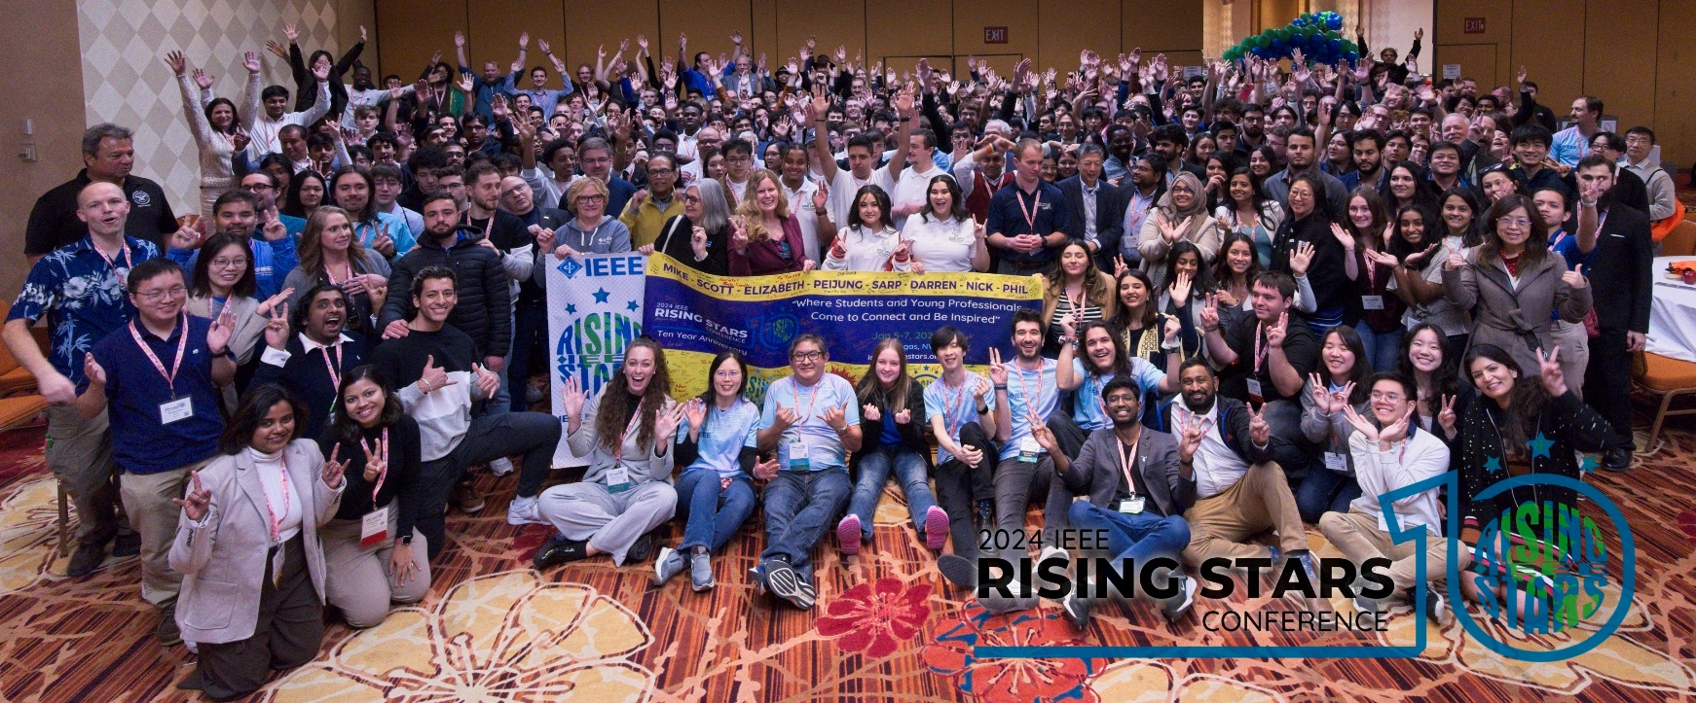
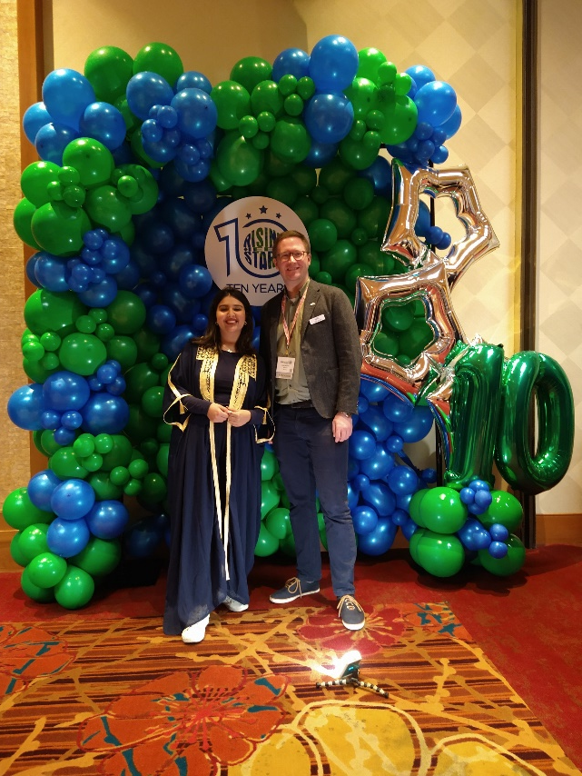

Update on activities 2023/2024
IEEE Rising Stars 2024:
  January 5-7, Las Vegas, NV, USA.
  Sponsorship from AESS.
  Attendance: Philipp Markiton and Abir Tabarki
  QEB article.

Slide 3
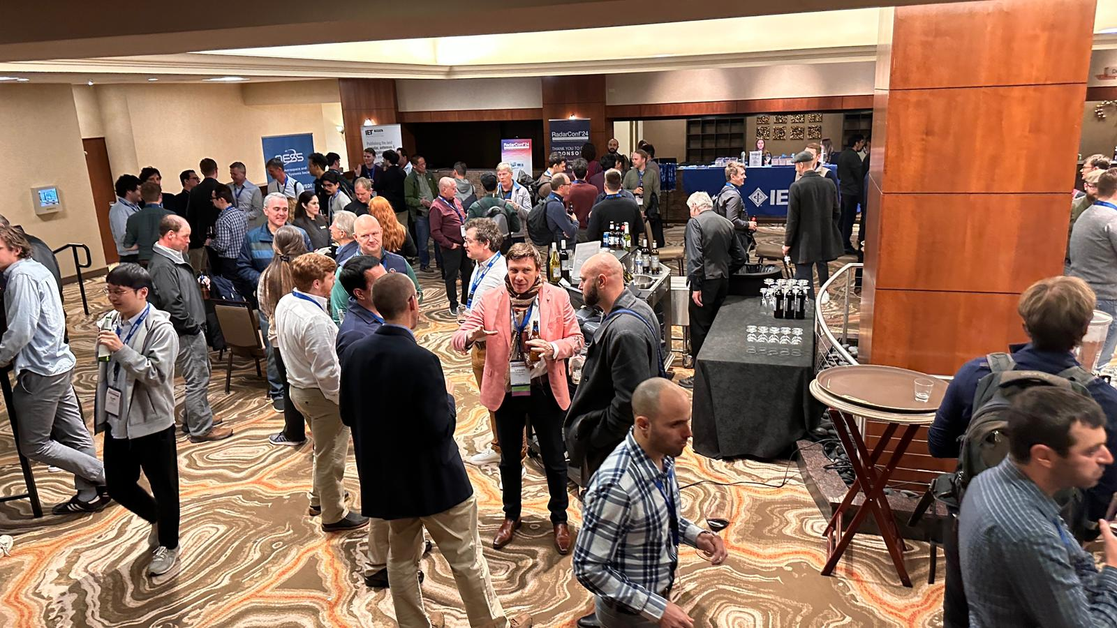
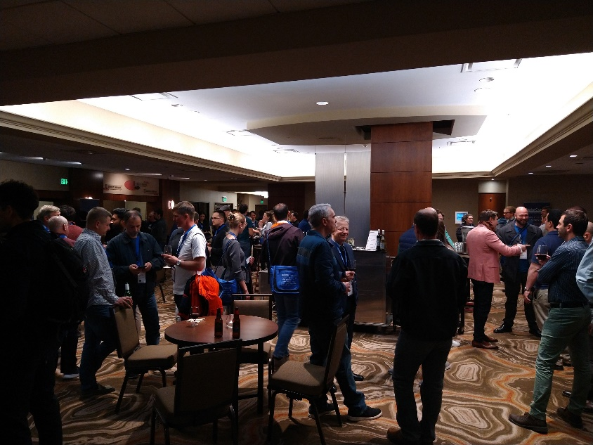
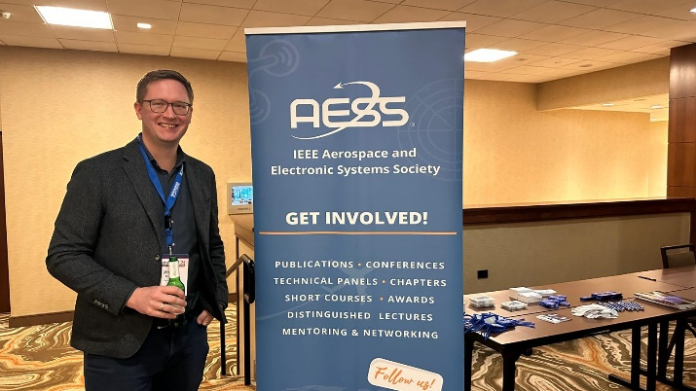
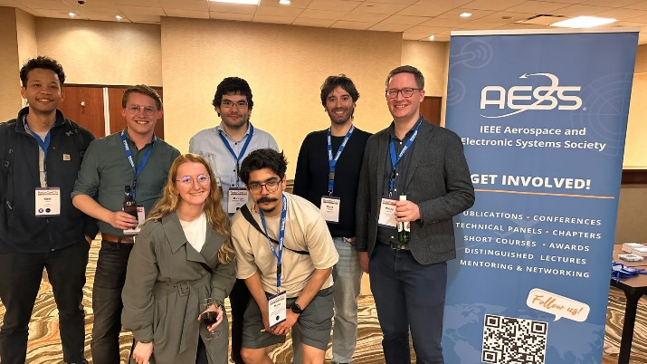
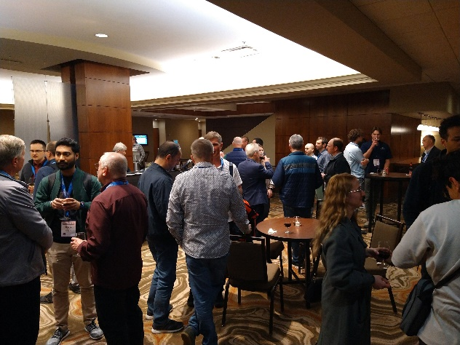
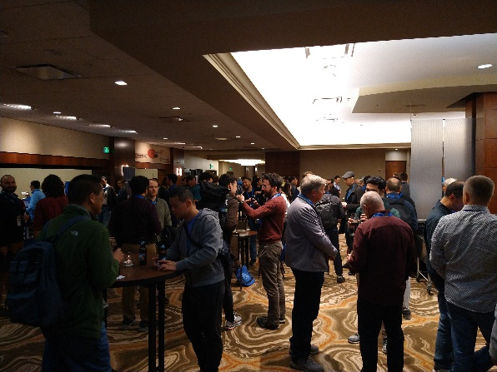
Update on activities 2022/2023
YP event at IEEE Radarconf 2024 in Denver, CO, USA:
  Monday, May 6.
  High attendance, many YPs.
  Great networking!
Before networking…
After networking!!

Slide 4
Next…
Tunisian Students and Young Professionals Congress (TSYP):
  December, 17-19, 2024
  Hammamet, Tunisia
  Sponsorship from AESS?
  Attendance from AESS, booth, talk?
IEEE Young Professionals in Space
  July, 13-15, 2024, Istanbul / Turkiye.
  Sponsorship and Talk from AESS (Lorenzo).

