Slide 1
IEEE Aerospace Electronic Systems Graduate Student Representative
Jemma Mallia
AESS Fall 2023 Board of Governors Meeting
10 and 11 November 2023
Sydney, Australia

Slide 2
Objectives
Increase awareness and involvement at the graduate level
Facilitate the transition from Graduate to Young Professional
Provide value to graduate students

Slide 3
Accomplishments
Outreach:
Planning a lecture event with UC Berkeley IEEE student chapter
Connecting with other student/professional chapter leaders in the San Francisco Bay

Slide 4
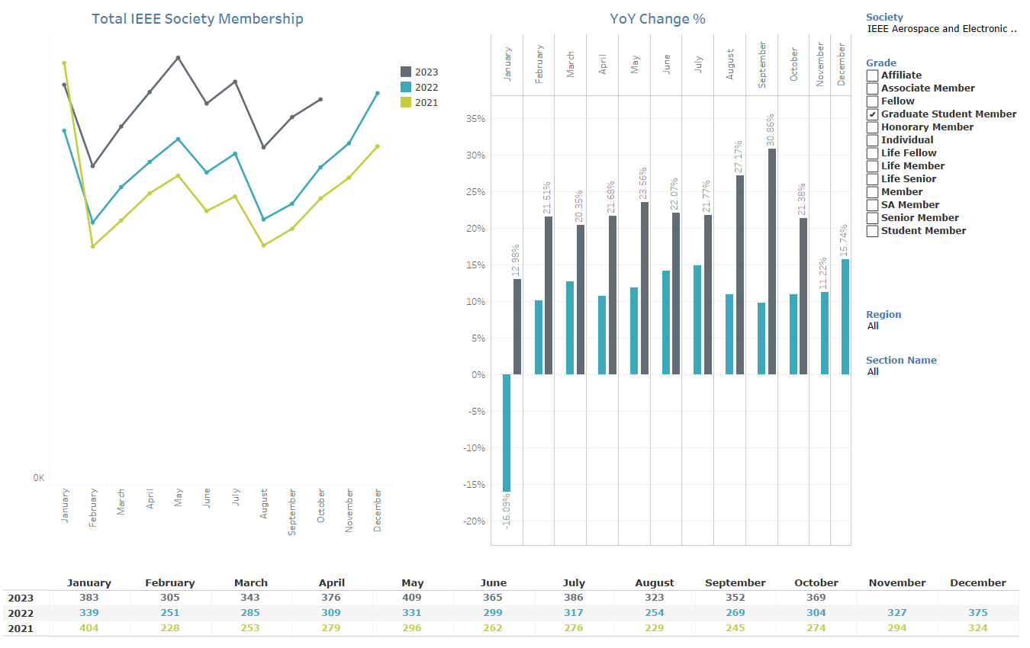
Challenges

Slide 5
Future Plans
Strengths: Opportunities for Graduate Students
Scholarship, conferences, and mentorship
Weaknesses: Student Membership Trends
Decreasing AESS and IEEE student membership across Regions 1-7
Opportunities: Student Branches and Young Professional Programming
Engagement from undergrad -> graduate -> YP -> long-term membership
Threats: Awareness of AESS
General lack of awareness at the graduate and undergraduate level
Notes:
S: Check scholarship application stats (for non-citizens so more opportunities for the general grad population), conference funding/grants, mentorship/building connections
W: See slide
O: Building a pipeline from UG through career (recognize attrition)
T: More advertising/target specific areas of interest (schools with topics/where we have established ties, etc.)

