Slide 1
IEEE Aerospace Electronic Systems
VP Publications
Lance Kaplan
AESS Fall 2023 Board of Governors Meeting
10 and 11 November 2023
Sydney, Australia

Slide 2
Objectives
Address the exponential growth of TAES by developing a dedicated prescreening process
Transition leadership of the AESM to a new EIC starting the middle of 2024
Reinvigorate special issues for the AESM
Continue to explore opportunities to provide valuable content for industrial members

Slide 3
Accomplishments
TAES
AESM
TRS
OJSE
QEB
JMASS – New MOU increases AESS support from 5% to 25%
JLT – AESS sponsorship is 2.5%, Current MOU expires Dec 31, 2023
See Subsequent Slides

Slide 4

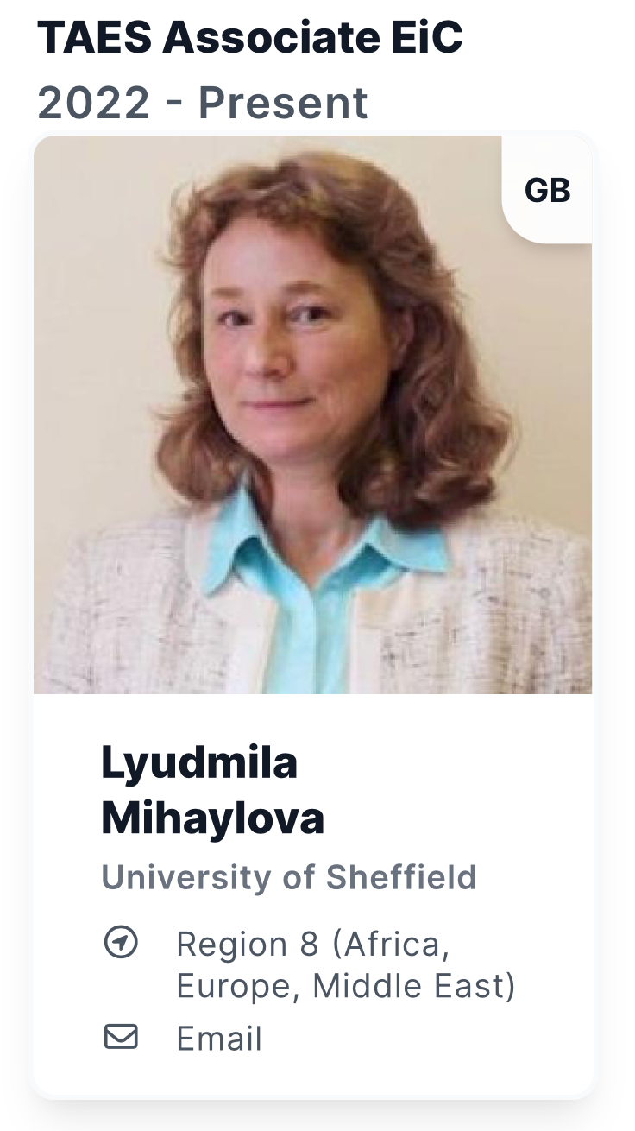
TAES Updates

Slide 5
Timeliness
Q2 2023 Results
Publication Title (Sponsors) | Number of Articles Included | A. Average Weeks Submitted to First Decision | B. Average Weeks Submitted to Online Post
Quarterly Summary of These IEEE Publications by Publication--Journals** | 15,793 | 12,2 | 28,5
Aerospace and Electronic Systems, IEEE Transactions on | 149 | 12.9 | 34
Quarterly Trends 2017-2023

Slide 6
Associate Editors Appointed Since Spring 23 BoG Meeting
  Autonomous Systems
    Sean Phillips (R6)
    Vitaly Shaferman (R8)
  Electronic Warfare
    Marry Lanzerotti (R2)
  Guidance and Control
    Chang-Hun Lee (R10)
  Navigation
    Yulong Huang (R10)
    Jindrich Dunik (R8)
Radar Systems
  Jun Liu (R10)
  Batu Chalise (R1)
Target Tracking
  Ondrej Straka (R8)
  Martin Ulmke (R8)
There were no new SE appointments.

Slide 7
TAES Special Sections
Special Sections that have been recently completed (Q3 2023)
  Deep Learning for Radar Applications
    Guest Editors: Sevgi Gurbuz, Igal Bilik, Luke Rosenberg
  Machine Learning Methods for Aerial and Space Positioning and Navigation
    Guest Editors: Keegen Yu, Michael Braasch, Pau Closas, Jindrich Dunik, Fabio Dovis
  Automotive Imaging and Super-Resolution Radar Systems
    Guest Editors: Igal Bilik, Joseph Tabrikian, Fulvio Gini

Slide 8
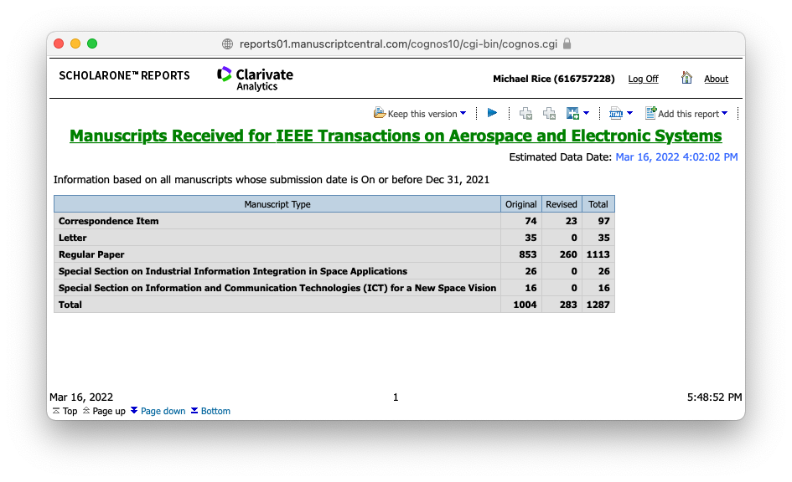
Submission for 2021
A record number of new submissions to TAES for a total of 10 months

Slide 9
Submissions for 2022
A record number of new submissions to TAES in a calendar year!

Slide 10
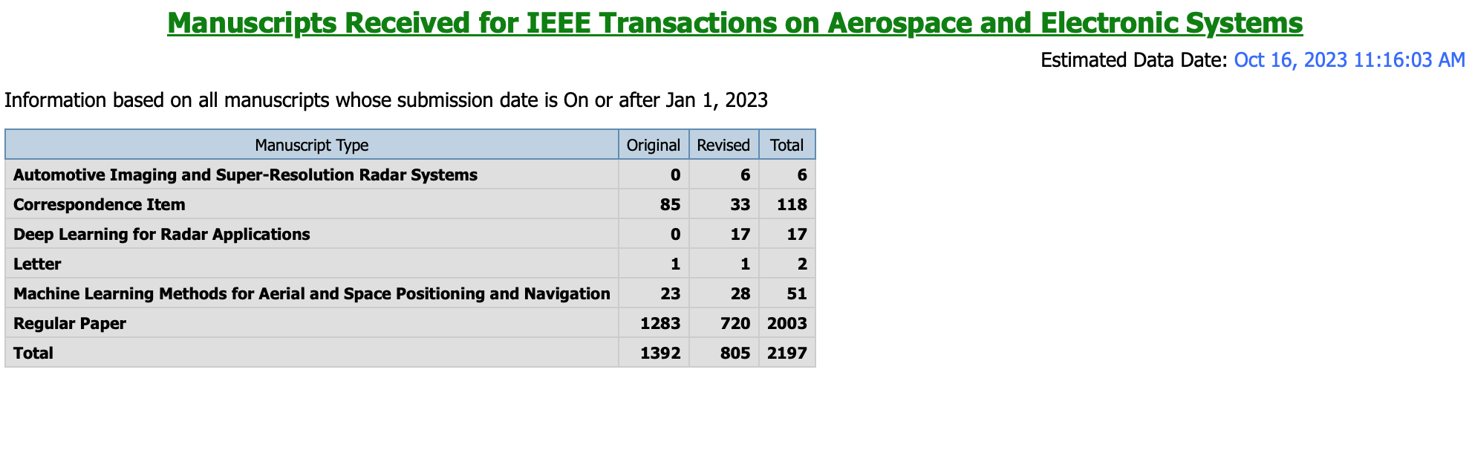
Submission for 2023 (for only 10 months)
A record number of new submissions to TAES in any 10 months! We will be passing 2022 numbers in November. We have literally doubled in submissions in three years…

Slide 11
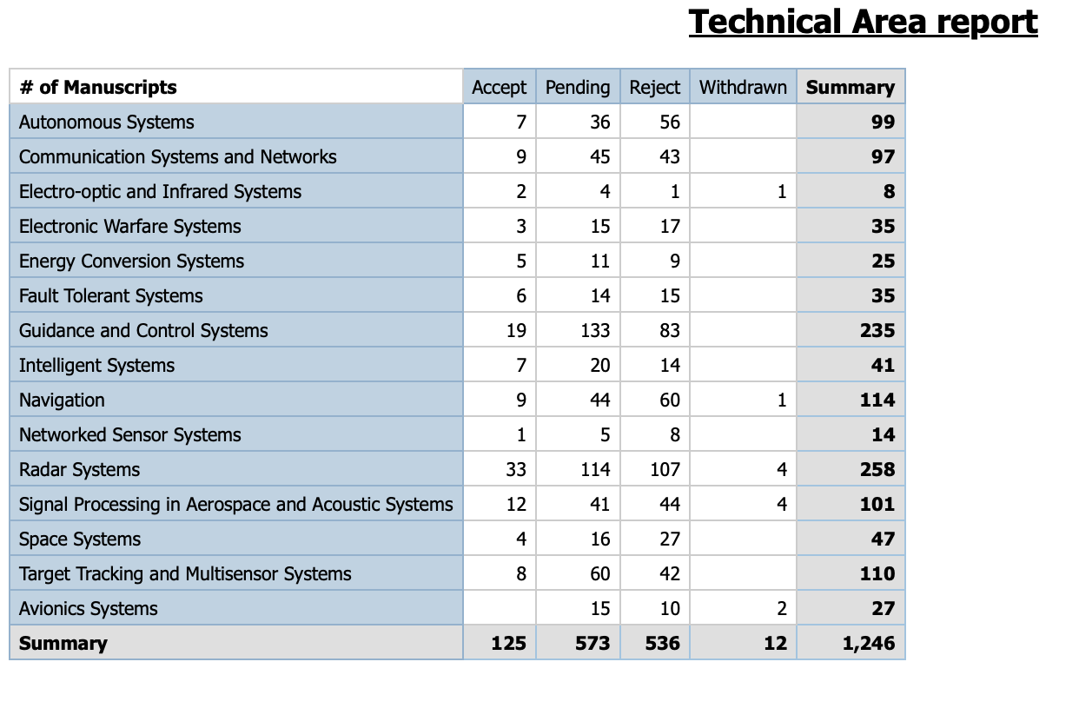
Technical Areas in 2023

Slide 12
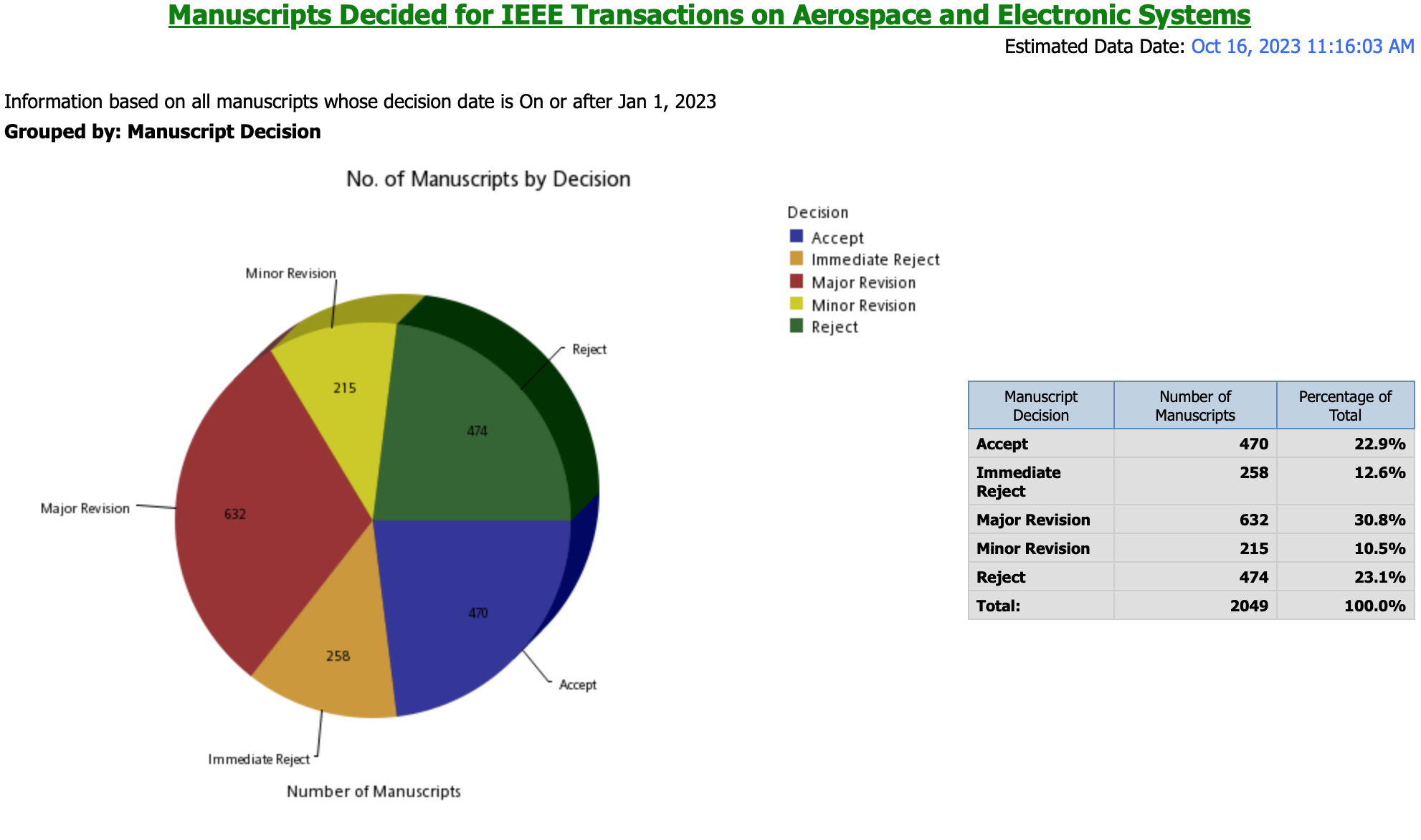
Distribution of Decisions

Slide 13
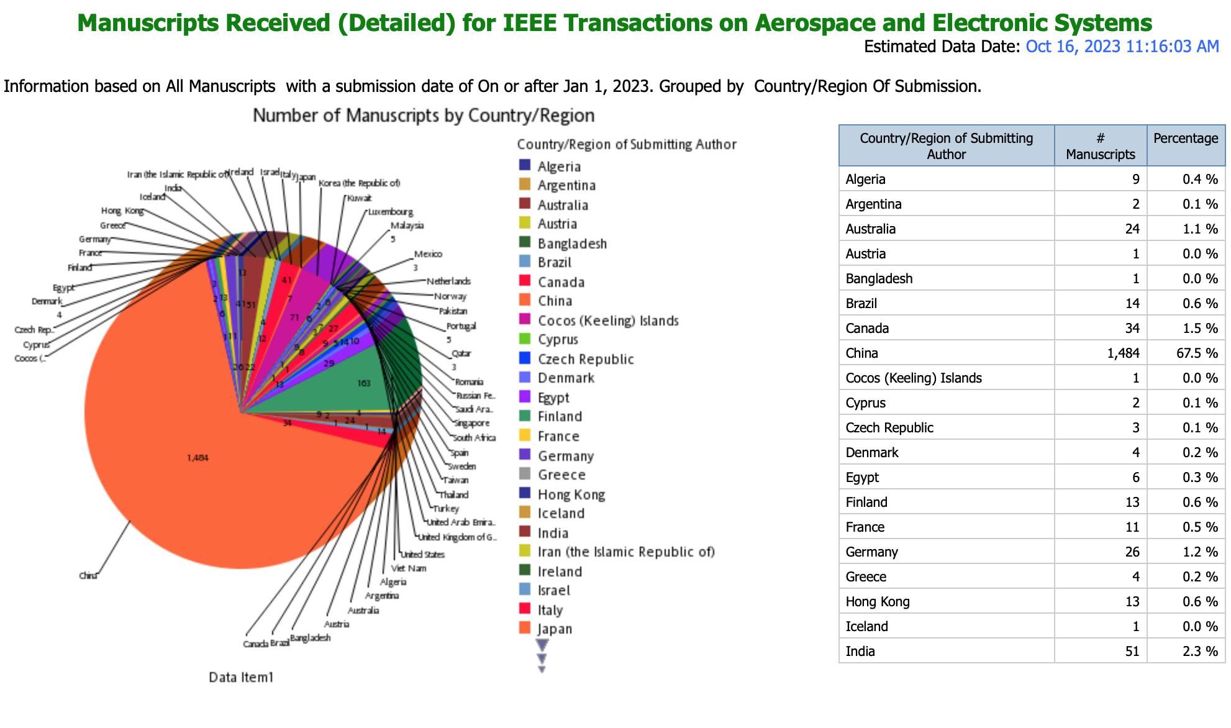
Distribution of Submissions by Country
#1

Slide 14
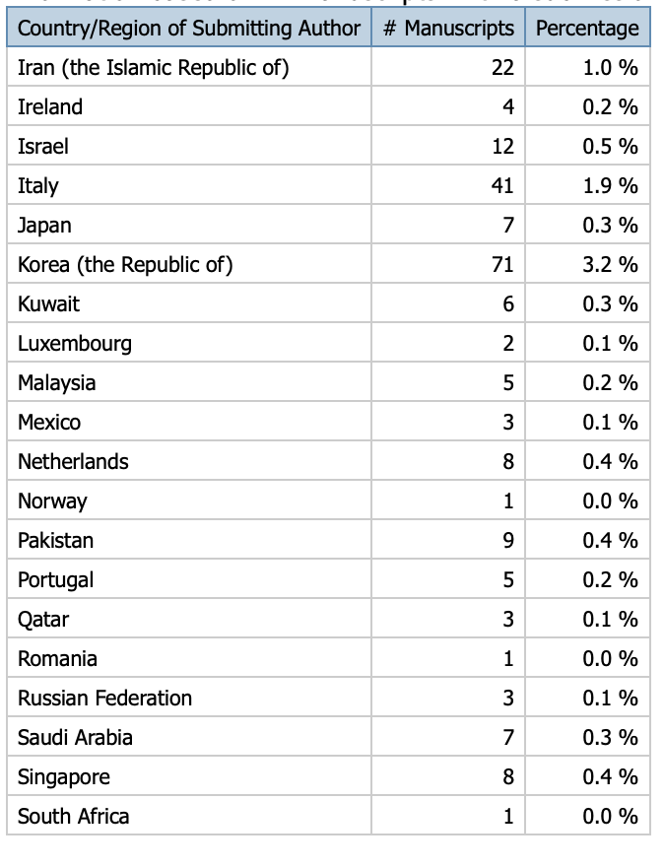
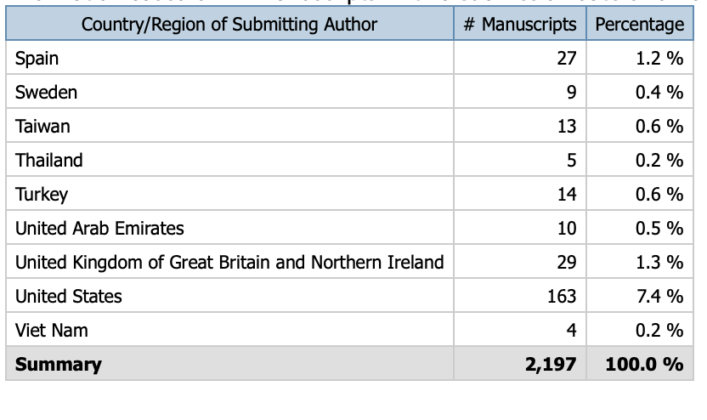
Submissions by Country I
#2
#3

Slide 15
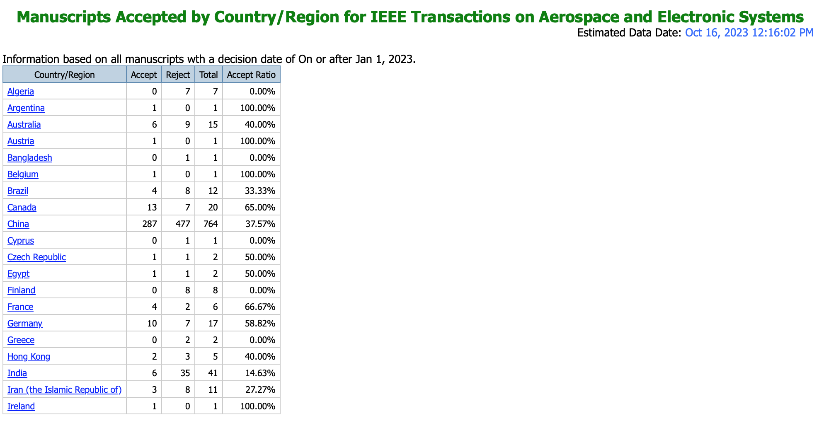
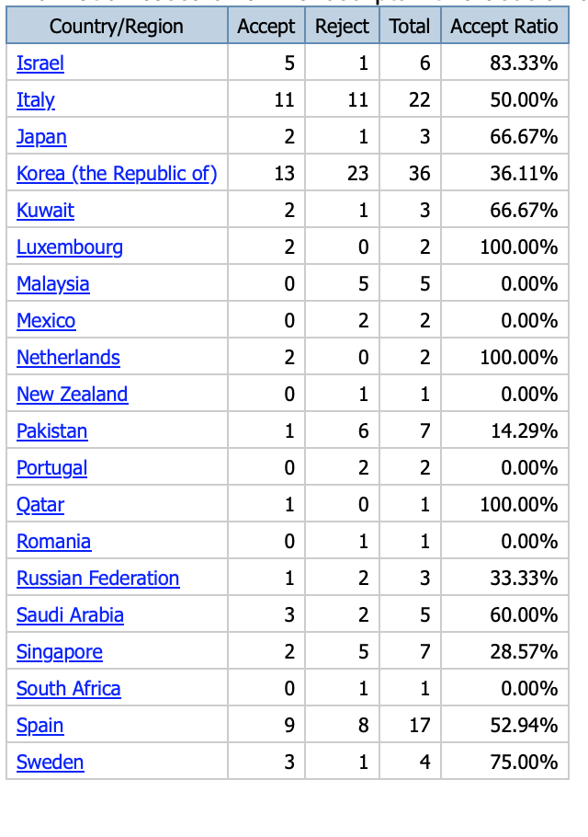
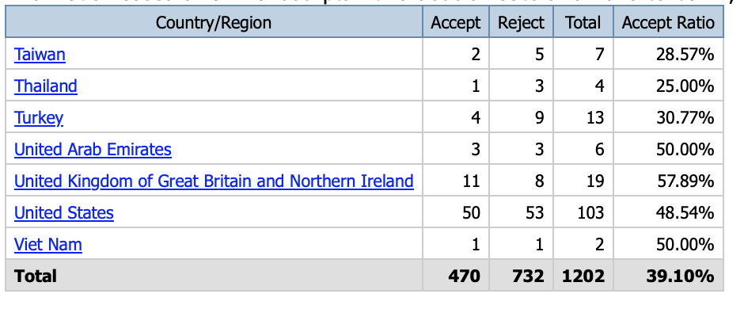
Acceptance Rate by Country

Slide 16
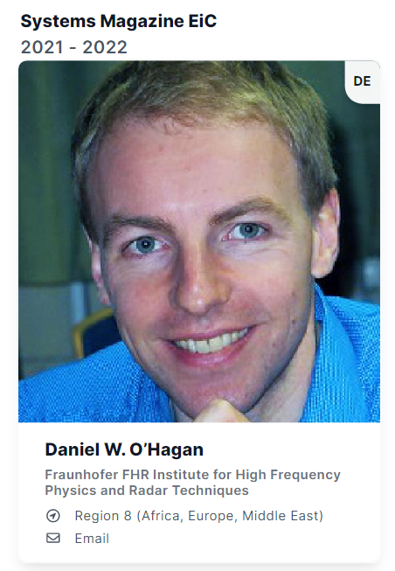
AES Magazine Update

Slide 17
Associate Editors
Scott Bawden (Energy Conversion Systems)
W. Dale Blair (Tutorials)
Erik Blasch (Aeronautics and Astronautics)
Stefan Brueggenwirth (Applications of Artificial Intelligence and Machine Learning to Aerospace Systems)
  Resigned as AE – owing to small number of papers we propose to close this area
Michael Cardinale (EO/IR Systems and Image Processing)
Mauro De Sanctis (Signal Processing and Communication in Aerospace Systems)
Dietrich Fraenken (Fusion & Signal Processing)
Giancarmine Fasano (Unmanned Aircraft Systems)
New: Carlos Insaurralde (Unmanned Aircraft Systems)
Jason Gross (Navigation, Positioning)
Raktim Bhattacharya (Space Systems)
  New AE is Leonardo Millefiori (Space Systems)
Khanh Pham (Space Communications)
Federico Lombardi (Student Highlights)
Daniel O’Hagan (EiC and AE for Radar Systems)
Roberto Sabatini (Avionics)
Samuel Shapero (Book Reviews)
Ruhai Wang (Systems Engineering)
Marco Frasca (Quantum Technologies in Aerospace Systems)
Michael Brandfass (AE Radar Systems)

Slide 18
Upcoming Special Issues
Special Issue on Space Domain Systems (Blasch, Linares, Jah) – Expect to publish in first quarter 2024
Special Issue on Hypersonic Weapons: Threat and Defence (O’Hagan, Brandfass, Bahmeier, Schmidt, de Bruijn)
Special Issue on Ethics, Values, Laws, and Standards for Responsible AI (Conn, Grey, Koch)
In 2023 multiple Special Issue proposals were received from people outside the AESS community. The proposals were not relevant to AESS Magazine.
Low number of good quality Special Issues proposals coming in.

Slide 19

Published Special Issues 2023
Special Issue on Urban Air Mobility and UAS Airspace Integration: Vision, Challenges, and Enabling Avionics Technologies Published May 2023

Slide 20
News & Views
AESS MAGAZINE Editorial Calendar provided to Naylor in January 2023
 | 2023
Identifier | Issue Date | Theme | Additional Distribution, e.g., Tutorials Issue (tentative - also depends on conference situation) | Ad Close Date**
38maes01 | January | Special Issue: 50th Anniversary of IEEE AESS
38maes02 | February | Regular Issue
38maes03 | March | Regular Issue |  | 01.02.2022
38maes04 | April | Regular Issue |  | 01.03.2023
38maes05 | May | Special Issue: Urban Air Mobility and UAS Airspace Integration: Vision, Challenges, and Enabling Avionics Technologies |  | 01.04.2023
38maes06 | June | Regular Issue |  | 01.05.2023
38maes07 | July | Regular Issue |  | 01.06.2023
38maes08 | August | Regular Issue |  | 01.07.2023
38maes09 | September | Special Issue: Space Domain Systems |  | 01.08.2023
38maes10 | October | Regular Issue | Tutorial Issue | 01.09.2023
38maes11 | November | Regular Issue |  | 01.10.2023

Slide 21


QEB Update

Slide 22



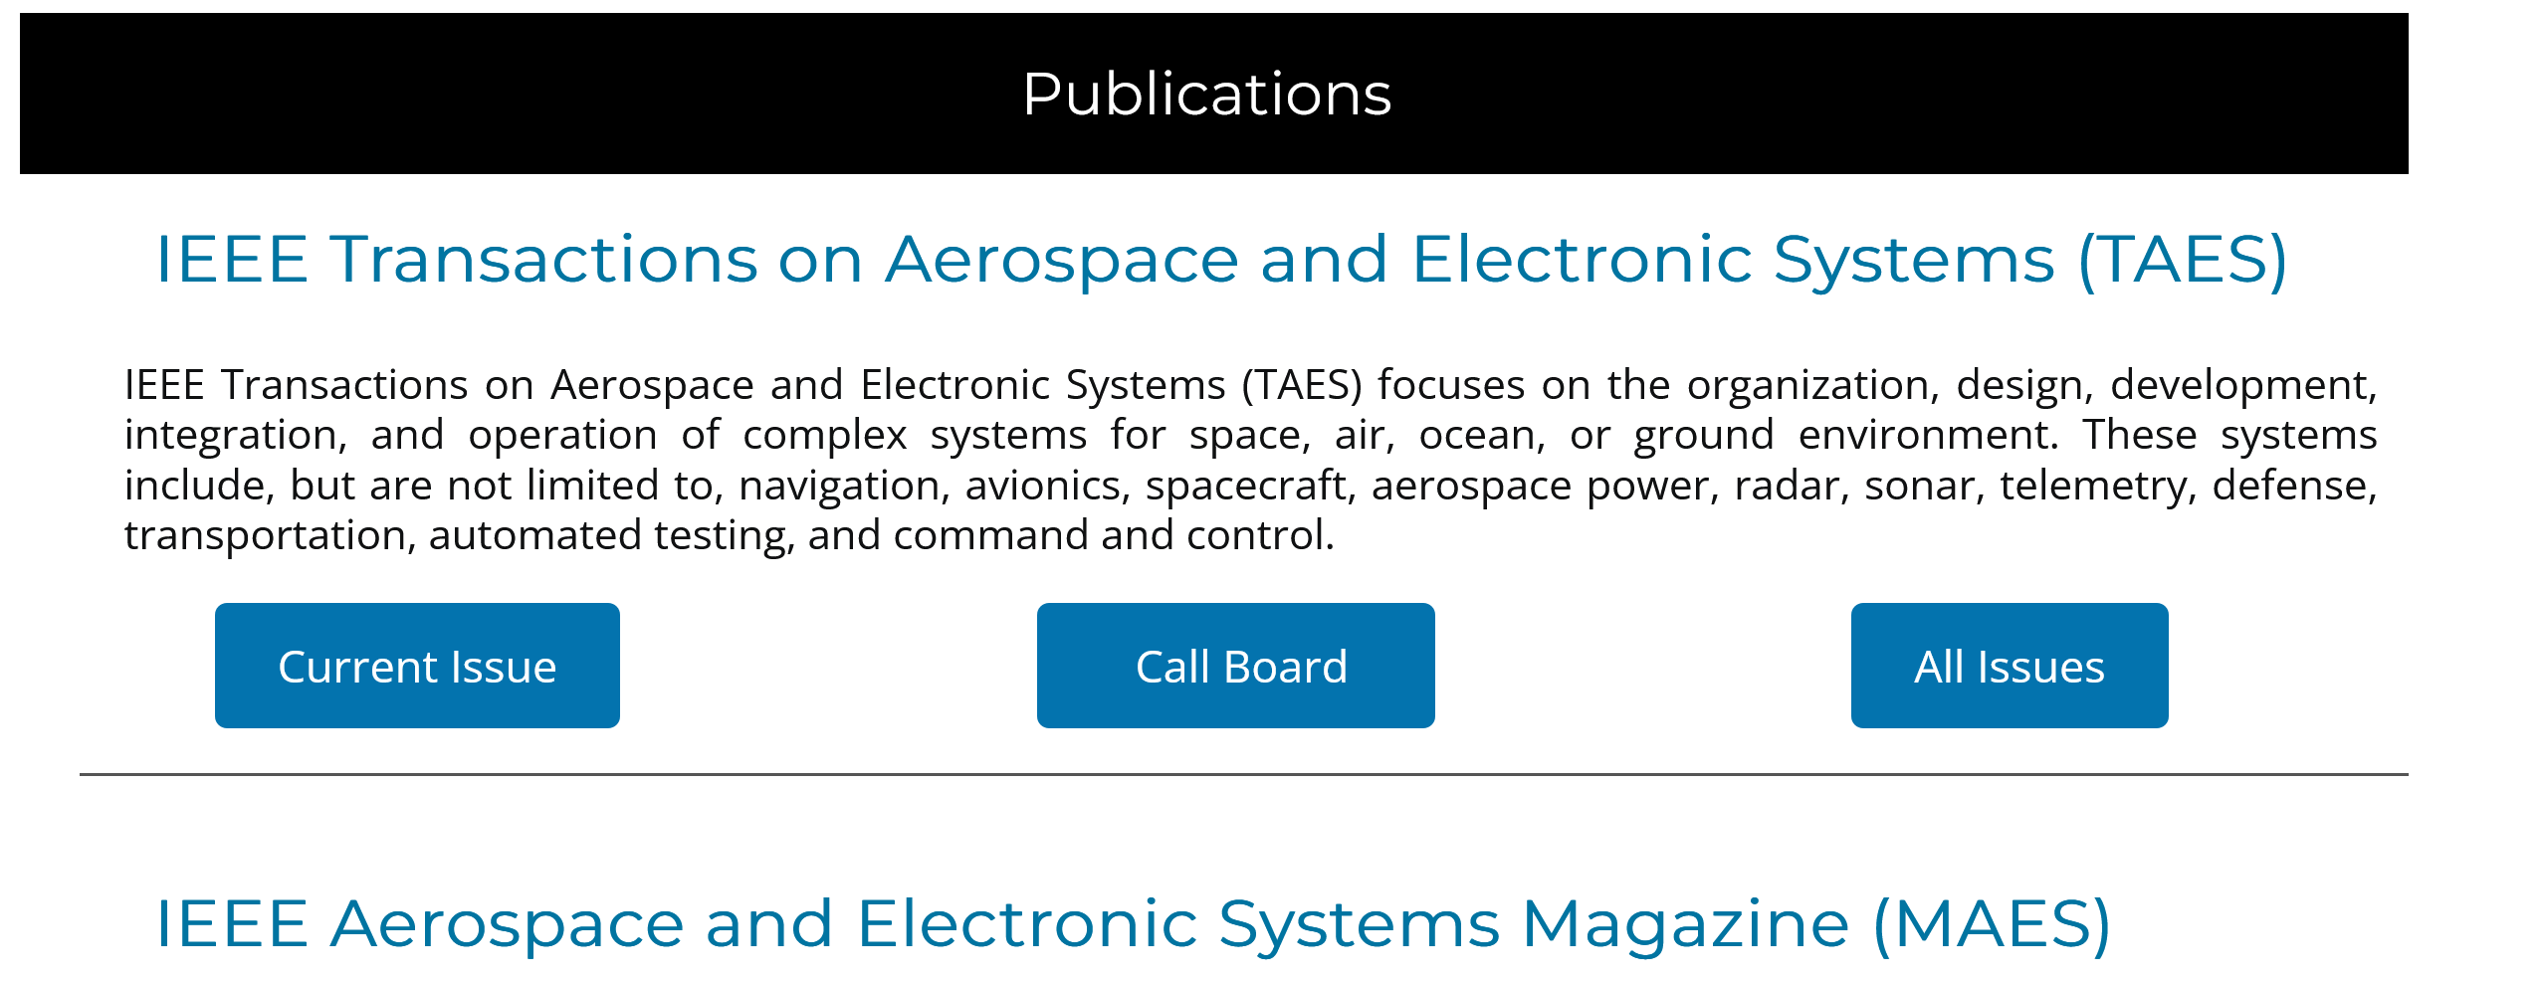
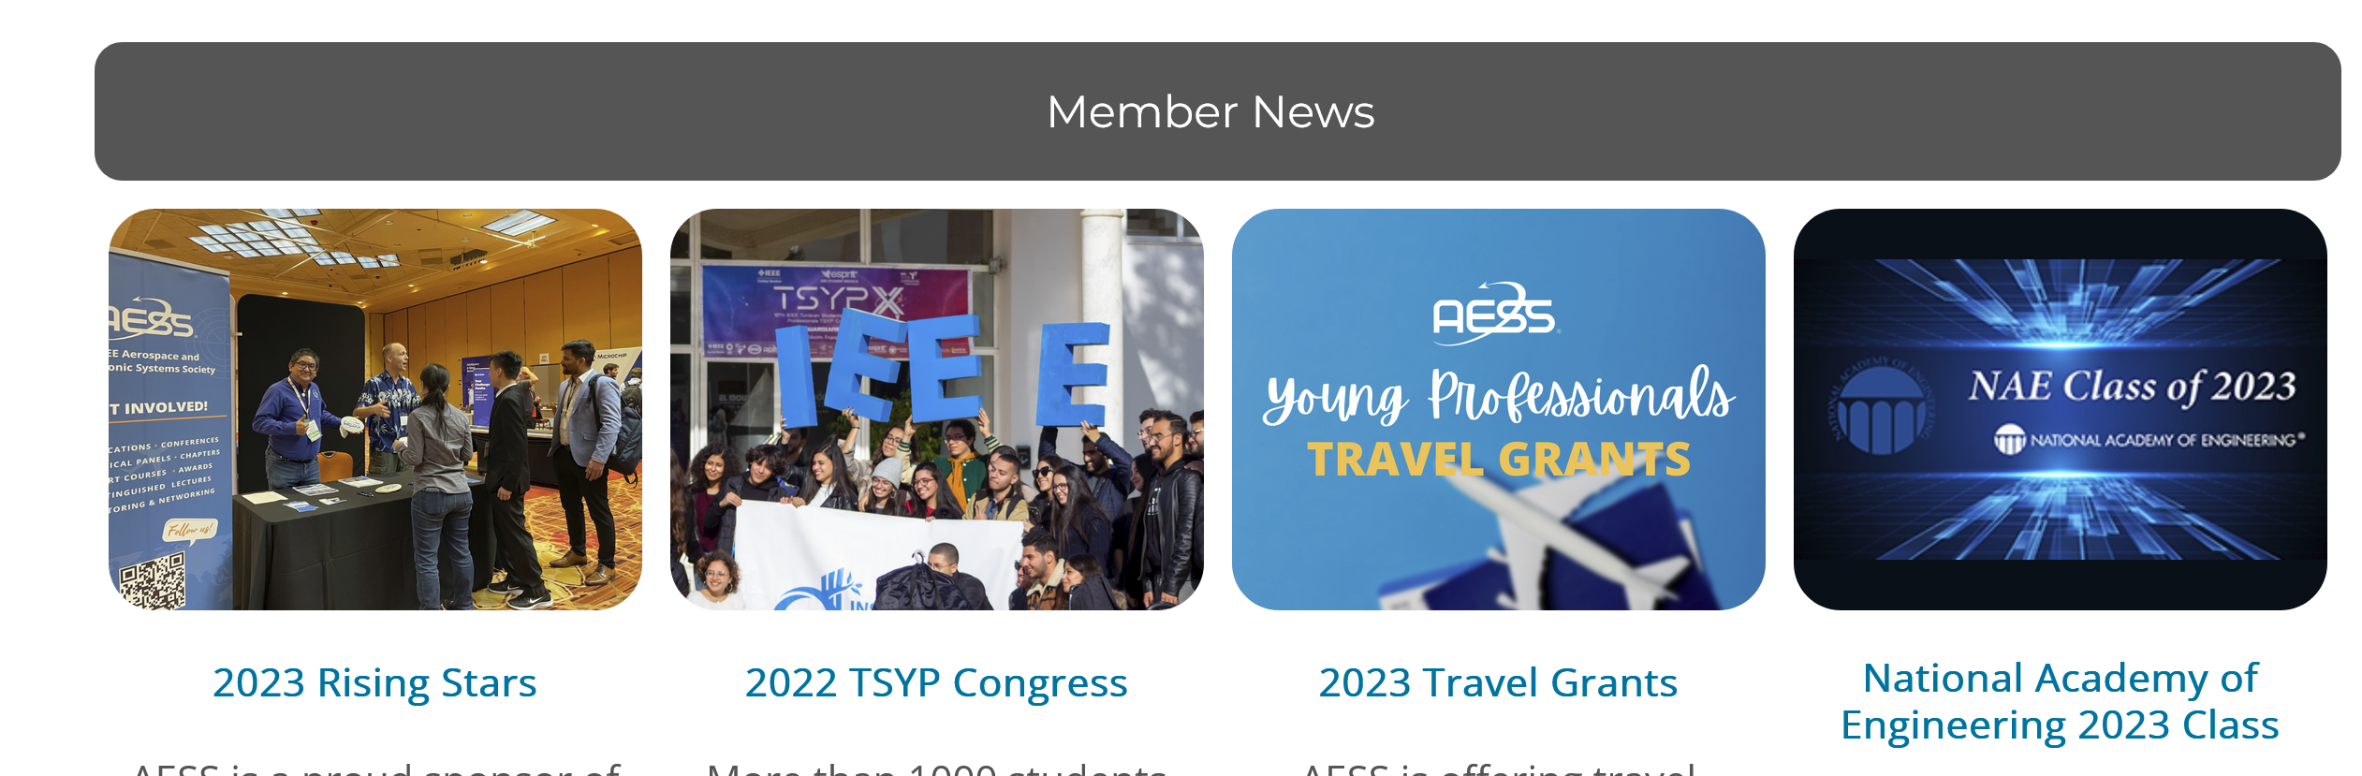
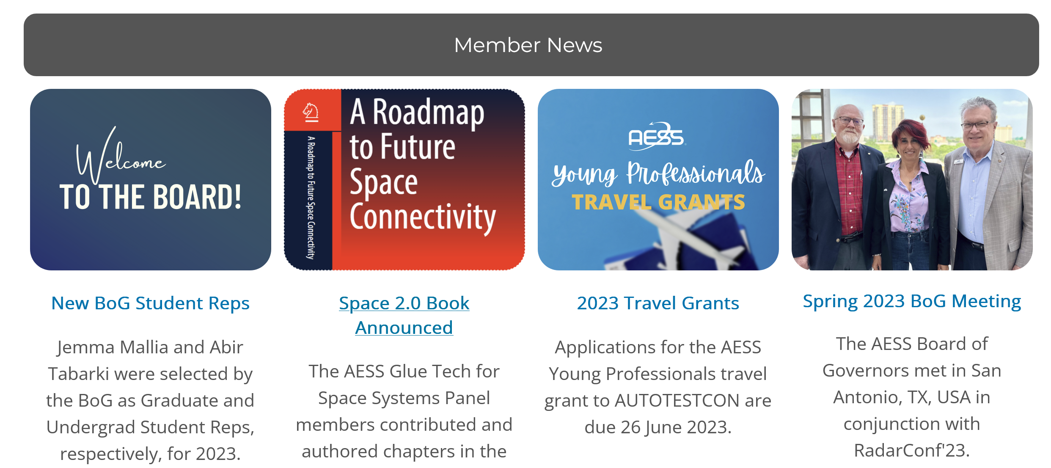

Update on 2023 Objectives
  Work in progress
  Monitor statistics.
  Review content:
    Based on: Number of clicks / opened links.
    Potentially reduce or improve to generate more interest and awareness.
  Next steps
  Based on statistics:
    Improve sections with low, but constant click rates:
      Highlight content, get more relevant articles.
  Find reason for different click rates for each article / section.

Slide 23
Review of QEB performance (I)
Based on QEB statistics until 2nd Qrt 2022
  Percentage of opened QEB mails has decreased until 2021 3rd Qrt.
  Ratio of clicked hyperlinks to opened mails: slowly increasing after decrease.
Legend:
%opened = ratio of opened mails to sent mails in percentage.
Clicked to opened ratio = ratio of clicked hyperlinks to opened mails in percentage.
No data for 2022, 2nd Qrt – 4th Qrt

Slide 24
Review of QEB performance (II)
Based on QEB statistics from 1st Qrt 2023 until 3rd Qrt 2023:
  Total clicks on hyperlinks in QEB.
  Grouped by first directory, e.g.:
    (…)/presentation/webinar/introduction-mimo-radar-waveforms ->
    (…)/presentation/
  Directories /publications (TAES, MAES) and /publication (EQB) are grouped.

Slide 25
Review of QEB performance (II)
Strong decrease from 1st qrt to 2nd qrt for:
  ieee-aess.org
  /conferences
  /awards
  Social media
  /publications
Increase from 2nd qrt to 3rd qrt only for:
  ieee-aess.org
  /conferences
  /publications
Constant click rate for
  /post (Story-behind-the-success, history-column, events, etc.)
  /webinar
  Relevant content due to constant demand.
  Potential to attract more click rates!

Slide 26
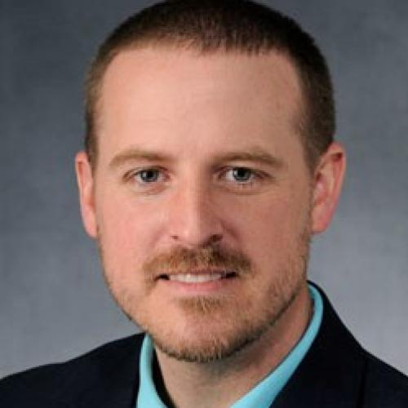


TRS Updates
Shannon Blunt
EIC
Fabiola Colone
Assoc. EIC
Martin Vossiek
Assoc. EIC

Slide 27
TRS Status
Launch: Oct. 20, 2022
20 Associate Editors on the Editorial Board
207 submissions
Terminal decisions: 55 accept, 76 rejects, 25 out of scope
Three special sections
  Fully Digital Arrays
  Innovations in Radar Spectrum
  Advance in Radar Imaging
Far exceeded minimum publication goal of 20 in 2023
Average time to first decision is 38.7 days
Submissions: 21% USA, 19% China, 15% India

Slide 28

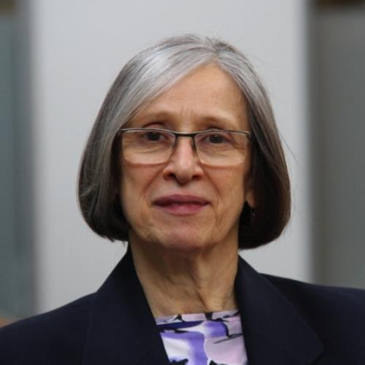
OJSE Update
W. Dale Blair
EIC
Ljiljana Trajkovic
Assoc. EIC

Slide 29
OJSE Status
Launch: April 2022
6 Associate Editors on the Editorial Board
46 submissions (1 Survey and 3 Challenge Problems)
Terminal decisions: 15 accepts, 17 rejections
Four special sections
  Artificial Intelligence and Systems Engineering
  Resilience in Systems Engineering
  Front-end Need Analysis
  System Engineering Processes for Predictive Maintenance
Types of paper: Regular Technical Papers, Technical Surveys, Tutorials, Problem Definition with Challenge Problems
10 published and 4 early access manuscripts

Slide 30
Challenges
Open Access
  Our authors do not appear to be embracing it
  Taking a “holding steady” approach
Rapid growth of the TAES
  Overwhelming for the EIC
  Clearing out a backlog – 4500 pages → 7500 pages → 9850 pages
Maintain viability of Radar in TAES while supporting TRS
New EIC for AESM in 2024
New IEEE policy → IEEE charges Societies when a paper production is final

Slide 31

Future Plans
Assist incoming VP Pubs who will need to prepare for the 2025 PRAC review
Relax!!!
Find new ways to support AESS from the sidelines

Slide 32
Motion(s)
None!

