Slide 1
IEEE Aerospace Electronic Systems Chapter Coordinator
Kathleen A. Kramer
AESS Fall 2023 Board of Governors Meeting
10 and 11 November 2023
Sydney, Australia

Slide 2
Chapter Activities 2023
204 AESS chapter activities reported in 2023 worldwide.
(218 more student events). Chapter of Year submissions due December 1.
17 events in R1, plus 1 STB event at Syracuse U
5 events in R2, including Swiss Chapter Chair for Dayton Chapter and Baltimore Chapter activities
26 events in R3: Huntsville, Melbourne (FL), Tampa, Atlanta activities
3 events in R4: Rochester (MI), Minneapolis. [Chicago section’s biggest event was Airventures in July.]
27 events in R5: Denver/High Plains, Lone Star
16 events in R6: San Diego, Buenaventura, Utah
13 events in R7: Quebec, Toronto, Ottawa, Vancouver

Slide 3
Chapter Activities 2023
49 chapter events in R8 – really a geographical divide for student events
49 chapter events (Poland, UK/Ireland, Russia, and several others).
Some strong chapters, including last year’s chapter of the year (Poland) but most are at two per year and maintaining active status. The total number of chapters is what’s leading to high total.
48 student events (many in Tunisia)
4 chapter events in R9 – but 145 student events
4 chapter events (Peru Chapter (AESS Day Peru), 1 Guadalajara)
145 student events
43 chapter events in R10
43 chapter events (South Australia, Indonesia, Singapore, Hyderabad – plus others in Australia and India)
31 student events - all in India, concentrated at 3-4 institutions

Slide 4
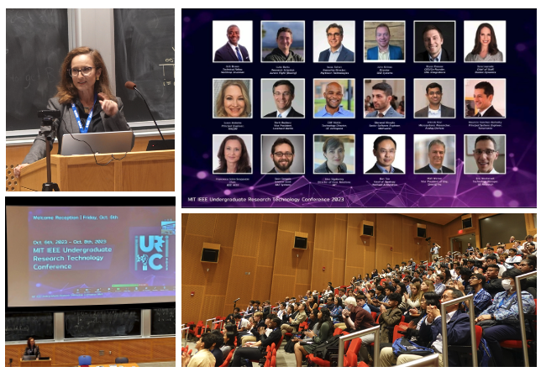
Boston Chapter Report
2023-2024 AESS funded Initiative to foster collaboration between University and Academia
IEEE AESS Boston Section Chapter
Chair:
Dr. Francesca Scire-Scappuzzo
Prepared for the IEEE AESS BoG - November 6, 2023

Slide 5
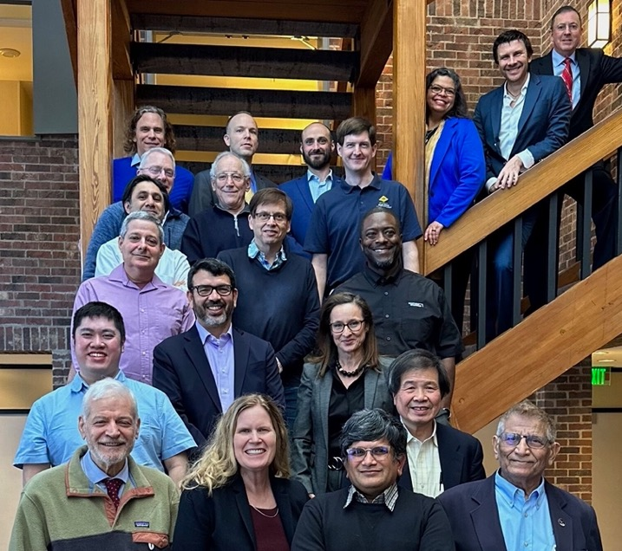
Boston Initiative
Initial Discussion
February 14, 2023:
IEEE AESS 50th anniversary
Princeton, NJ
IEEE AESS Proposal & Award
March - May 2023
Proposed Events Timeline
Phase I: October 6, 2023 – Welcome Dinner for the 2023 URTC at MIT, Cambridge, MA, USA. Presentation of initiative, Dinner, and Networking event at MIT in Cambridge. (~400 attendees)
Phase II: February 2024 – Thesis proposals to industry
Phase III: May 2024 – Award ceremony
2023 Chapter Summit in Princeton

Slide 6
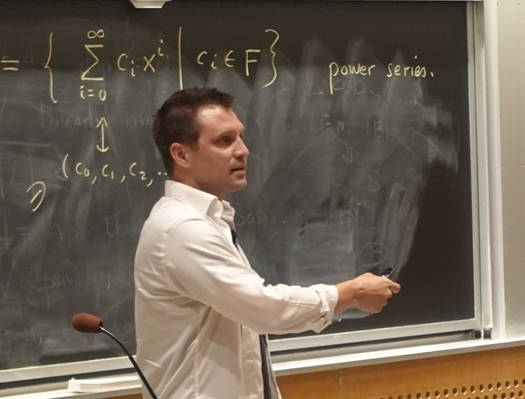
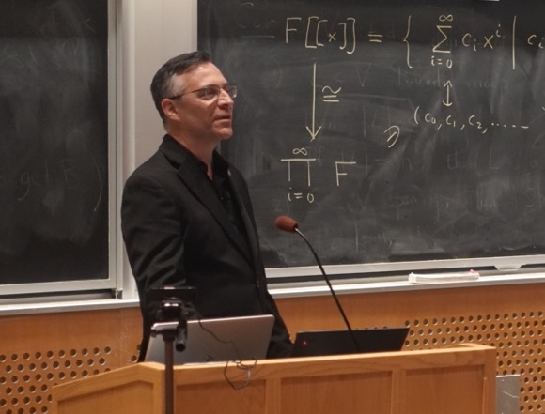
Summary of Boston Initiative
Goal
Foster closer collaboration between
university and industry through graduate work and/or
internships carried out by students in industry.
Benefits
For Industry:
Access to specialized engineering talent (especially Digital Engineering expertise)
Awareness of cutting-edge technologies and emerging trends in science
For Students:
Hands-on experience
Visibility and awareness of a wide range of professional opportunities
For Professors:
Funded applied research and graduate students’ tuition
Awareness of problems of interest for industry
University
Industry
Graduate Students
Mr. Bryan Knouse – Owl Technologies
Dr. Mark Maybury – Lockheed Martin

Slide 7
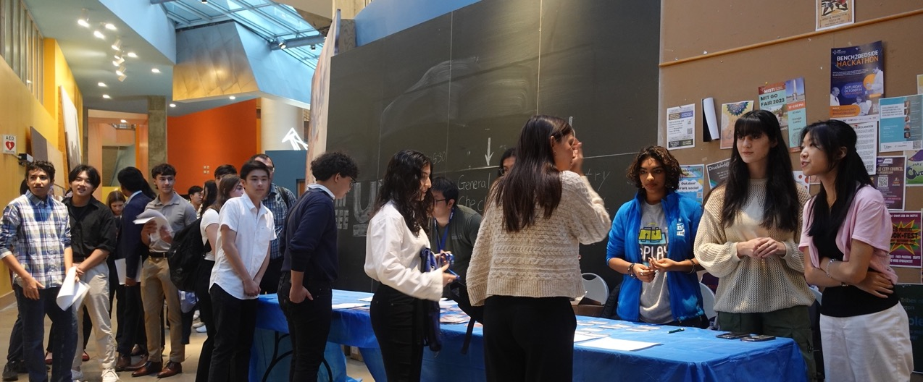
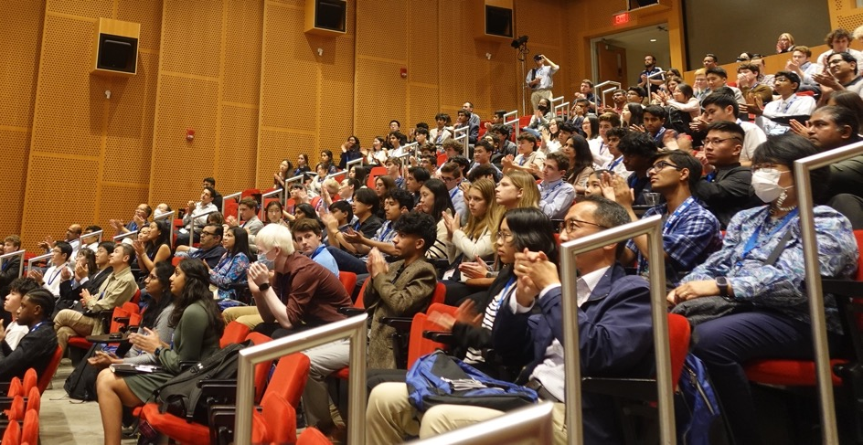
Industry –Academic-Student Collaboration

Slide 8
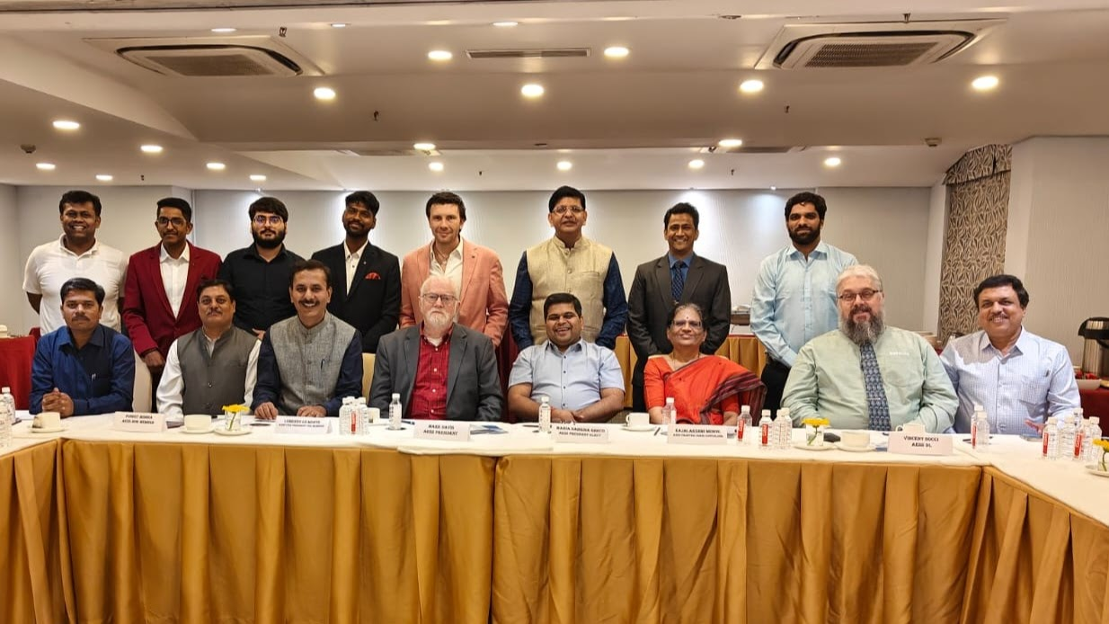
Chapter Summit in India
Second chapter summit of 2023 held just last week.
Followed DSTEI program event.
All India chapter chairs and top 10 student branch chapter chairs => 21 chairs.

Slide 9
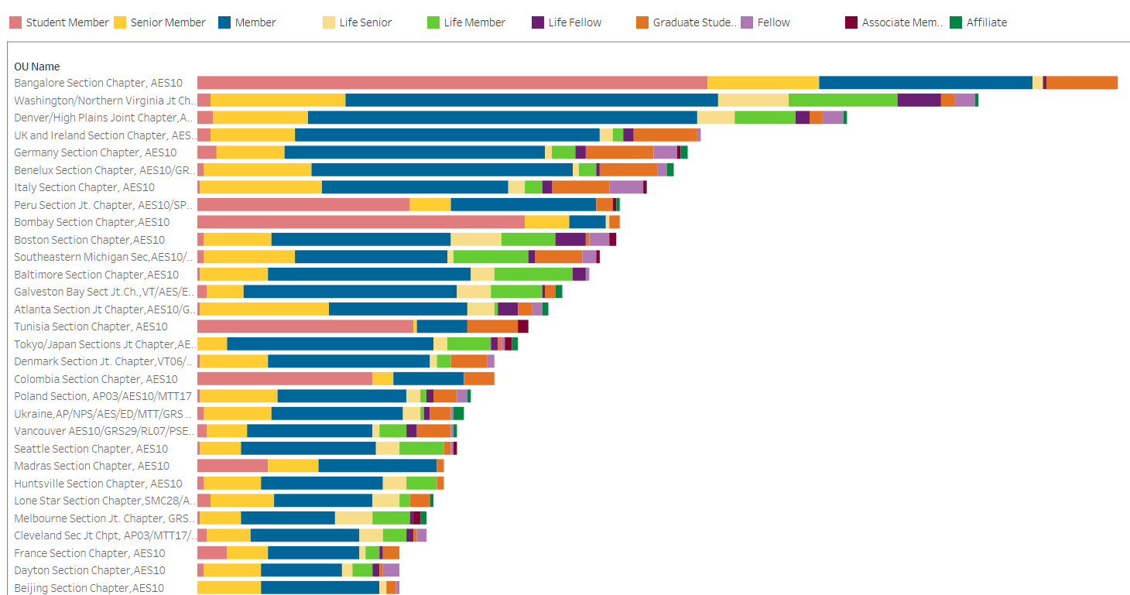
Most Populous AESS Chapters
Queensland Chapter successful young chapter. 11 (and climbing) new SBCs.
Notes:
Explore
/Dashboards for All Volunteers
/Geo OU Analysis
/Member Count by Chapter

Slide 10
Most Populous Student Branch Chapters
Notes:
Explore
/Dashboards for All Volunteers
/Geo OU Analysis
/Member Count by Chapter

Slide 11
More in Other Reports
For a later report by Mark Davis– recent DSTEI and related activities in India ahead of this meeting
Fully support VP-Membership initiative to provide branded giveaways in a more effective manner
Next slide: remember the shoemaker’s children need shoes too.

Slide 12
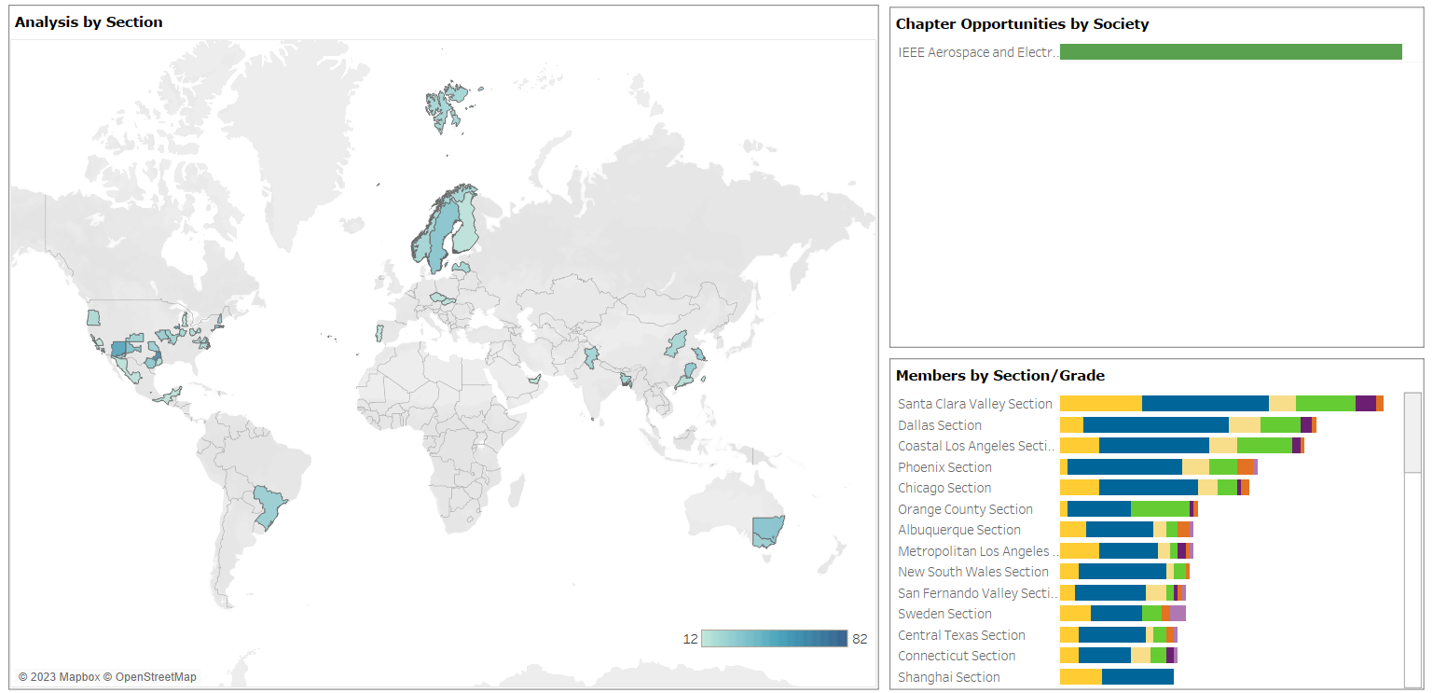
Potential New Chapter Map
Santa Clara Valley (SCV), Chicago, and Coastal Los Angeles (CLAS) are in frequent contact. Also, not listed here, because the chapter used to exist, Orange County (CA). The most workable solution is a joint chapter. SCV with VTS was outlined in June. CLAS has a Systems chapter – basically due to lack of response from AESS way back when. Also, useful to have active chapters expand areas served/invited to include neighboring sections. Action/call for an active member (of BoG, DL, …) in those sections to effect and reactivate.
Notes:
OU Analytics:
Explore
/Dashboards for All Volunteers
/Geo OU Analysis
/Potential Chapters

