Slide 1
IEEE Aerospace Electronic Systems
Conferences
Braham Himed
2023 AESS Fall Board of Governors Meeting
10-11 November 2023
Sydney, Australia

Slide 2
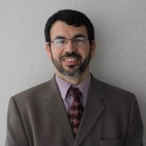
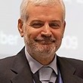
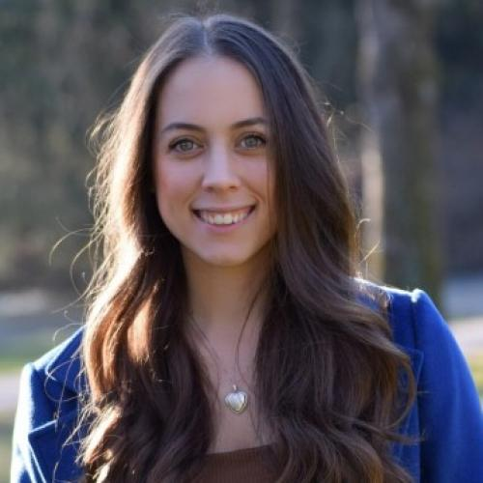
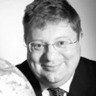
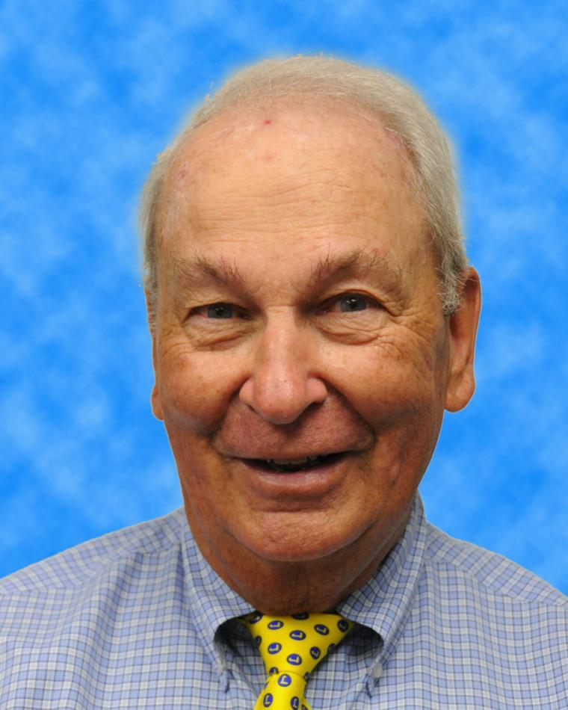
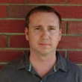
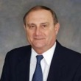
2023 Conference Committee
Braham Himed
VP-Conferences
Michael Braasch
Alfonso Farina
Francesca Filippini
Hugh Griffiths
Bob Rassa
Luke Rosenberg
George Schmidt

Slide 3
SWOT
Strengths
AESS continues to offer and support high quality and healthy conferences/symposia/workshops
Flagship conferences (Aerospace, AUTOTESTCON, RadarConf) are still strong financially, well attended, and provide excellent surpluses
Weaknesses
There needs to be early and constant interaction between conference organizing committees and AESS for improved efficiency
Eliminate unnecessary delays
Financial and final reports are not always submitted on time
Work with AESS treasurer to ensure closing books within 6 months after conference
High cost for attendance
Offer reduced rates and subsidy/travel grants for students

Slide 4
SWOT
Opportunities
Make all conference material (lectures, plenary talks, tutorials, etc.) online
Conduct joint workshops/conferences with other IEEE societies
Increase participation and support for students (undergraduate and graduate), young professionals, and under-developed regions
Create AESS conference advising committee (may be outside conference committee)
Integrate impact on local community as part of conference proposal
What is the impact a proposed conference will have on the local community
Organize events for disadvantaged students (middle, high-school, and college)
Threats
Strong competition from other conferences (IEEE and non-IEEE)

Slide 5
Accomplishments
AESS has so far received more than 27 MOUs, including proposals for sponsorship both Financial and Technical

Slide 6
Financially Supported Conferences
Aerospace Conference
IEEE Radar Conference (RadarConf)
International Radar Conference
International Workshop on Metrology for AeroSpace (MetroAeroSpace)
International Conference on Information Fusion (FUSION)
IEEE AUTOTESTCON
IEEE/AIAA 42nd Digital Avionics Systems Conference (DASC)
Integrated Communications, Navigation, Surveillance Conference (ICNS)
IEEE International Carnahan Conference on Security Technology
IEEE International Conference on Microwaves, Communications, Antennas, Biomedical Engineering and Electronic Systems (COMCAS)
IEEE Symposium Sensor Data Fusion and International Conference on Multisensor Fusion and Integration (SDF-MFI)
IEEE International Symposium on Phased Array Systems and Technology (ARRAY)

Slide 7
Technically Supported Conferences
Sensor Data Fusion (SDF)
International SpaceWire and SapceFibre Conference (ICS)
International Workshop on Tracking, Telemetry, & Command Systems for Space Applications (TTC)
IEEE Radio and Wireless Symposium (RWS)
IEEE/ION Position, Location and Navigation Symposium (PLANS)
Signal Processing Symposium (SPS)
European Radar Conference (EuRAD)
European Microwave Week (EUMW)
International Radar Symposium (IRS)
Saint Petersburg International Conference on Integrated Navigation Systems (ICINS)
International Conference on Recent Advances in Air and Space Technologies (RAST)
International Conference on Localization and GNSS (ICL-GNSS)
DGON Inertial Sensors and Systems (ISS)
European Space Power Conference (ESPC)

Slide 8
Question
Has the motion for setting aside $10,000 annually to fund activities (conferences, workshops, competitions, etc.) in underdeveloped regions and countries been approved?
If yes, how to proceed?
POC?
Procedure?
Accounting?

