Slide 1
IEEE Aerospace Electronic Systems DSTEI Project -- Update
Mark E Davis, AESS President
AESS Board of Governors
11 November 2023
Sydney Australia

Slide 2
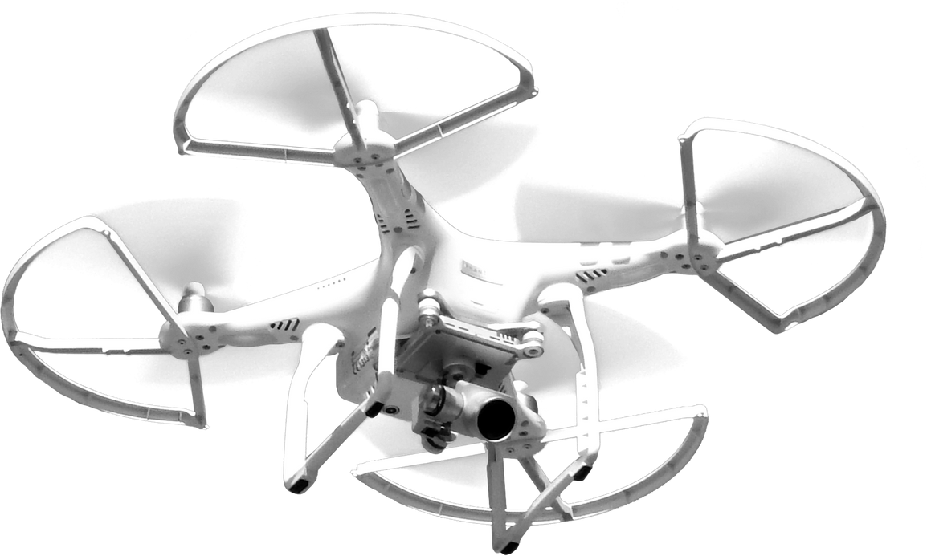
DSTEI
Distributed Sensing Technology and Education Initiatives
3-Year Initiative for Underrepresented Regions
New businesses that support commercial growth in distributed sensing technology
Increase AESS membership
Courses for engineering growth in regional aerospace technology. Encourage YP and small businesses to establish technical and sustainable products
Expect to Grow Technical Capabilities
Focus on small drones, cyber security, and distributed sensing (Radar/EO/Data Fusion) for future commercial applications within geoscience and border security
Significant increase in students and YP for Regions 9 & 10
Encourage industry support and development of new technology courses

Slide 3
DSTEI Project Teams
Region 9 -- South America
Univ. del Cauca, Cauca Colombia, “Drone Swarm System for Agricultural Surveillance of Coffee Crops ", IEEE Colombia Section
Camilo Segura, Student Branch ; Dr. Liseth Viviana Campo, Student Branch Advisor
Universidad National San Antonio Abad del Cusco (UNSAAC), Cusco Peru, “Smart Drones for Prevention of Forest Fires", AESS Peru Section
Alberto Arturo Quinones, Student Branch; Dr. Walter Mego, Student Branch Advisor
Region 10 – India
Nitte Meenakshi Inst Of Tech Student (NMIT), Bengaluru, India, “ Fire Extinguisher Unmanned Aerial Vehicle ”, IEEE Bangalore Section
Pradeep Kumar, Student Branch ; Dr. Parameshachari B. D, Student Branch Advisor
Sardar Patel Institute of Technology (SPIT), Mumbai, India, “Drones for Smart Agriculture”, AESS Bombay Section
Aditya Kulkarni, Student Branch; Dr. Sujata Kulkarni, Student Branch Advisor
Complementary Project Teams With Variation In Project Objectives, Sensors And Signal Processing

Slide 4
2023+2 DSTEI Project Schedule
Phase 1 Education/System Design
Phase 2 Ground Assy/Test
Phase 3 Air Integ/Test
Q1
Q2
Q3
Q4
Year 2
Year 3
Kickoff
Chapter Meeting
Quarter Report
PDR
Annual Report
Annual Report
Annual Report
Section
CDR
WBS/Schedule
Final Report
Brassboard Assy.
Gnd Test
Platform Integ.
Flight Test
Region 9
Baseline Design
Bread Board Assembly
Breadboard Testing
Ground Proc.
Ground Control
KPP & Analyses
Tradeoff Design
Instrument & SW.
Flight Safety
TAB Approval
Industry
TAB Approval
Transition
AES Lectures & Tutorials
Kickoff
Quarter Report
PDR /
Chapter Mtg
Chapter Meeting
Annual Report
Annual Report
Annual Report
Section
CDR
TRR
Region 10
WBS/Schedule
Final Report
Brassboard Assy.
Gnd Test
Platform Integ.
Flight Test
Baseline Design
Bread Board Assembly
Breadboard Testing
Ground Proc.
Ground Control
KPP & Analyses
Tradeoff Design
Instrument & SW.
Flight Safety
Industry
Transition
Region 9 & 10 Have 4 Week Grant Delay Due To Differences In Section/Region Funding Issues
Asked Region 10 Student Branch Chapters To Accelerate PDR To November 2023
Desire Phase 1 Final Report And Phase 2 Proposal By 15 April 2024, For Phase 2 Start

Slide 5
AESS Short Course
UAV Operations Planning – Vince Socci Region 1
UAV Technology Overview
Operational Policies & Regulations
UAV Sensors and Cyber Protection – Roberto Sabatini Region 8
UAV Avionics For Small Sensors And Control
Cyber Protection In Flight Environments
Sensor Fusion Technology – Stefano Coraluppi, Region 1
Mathematical Foundation for Detection & Localization
Multi-object Inferencing For Performance Metrics
Advanced Topics On Distributed Tracking and Context Exploitation
UAV Navigation Technology – Michael Braasch, Region 2
GNSS/IMU Navigation Techniques
Integration Performance And Error Characteristics
Distributed Sensing Systems Engineering – Mark E Davis, Region 1
System WBS, Master Schedule, and Risk Assessment
Scenario Generation For Multiple Platforms/Sensor Motion
Evaluation Of Sensor Control & Performance Within Scenarios
AESS Short Course Presented In Bangalore 30-31 November 2023,
Will Provide To Region 9 In March 2024

Slide 6
Summary And Update Comments
The Student Branch Chapters Provided Grants ($171K) For The Distributed Sensing Technology & Education Initiative
They Are Providing Monthly Reports and Quarterly Reviews
Strong Interface To Sections And Potential For Governmental Support
IEEE TAB Supports The Formulation Of New Technologies To:
Provide “Advancing Technology for Humanity” From AESS Technology Leaders
Establish A Collaboration For New System Applications In Two Under- Represented Regions For Transition Incubation For Small Businesses And Establish Careers for Young Professionals
IEEE TAB Has Provided New Initiative Funding $170K for 2024.
Funding Initially Approved From 1.25% Of Our Reserves
Action: SBC Proposal And Successful PDR Prior To Grant Funding Transfer

Slide 7
MOU With GRSS
IEEE HQ And The Technical Activities Board Are Encouraging Collaboration Between OUs For Initiatives And Joint Chapters
Interest From Geoscience And Remote Sensing Society After Radarconf23 – Paul Rosen And Mariko Burgin
Our Efforts In Region 9 And Region 10 With Membership And The DSTEI Project Are Very Much Aligned With A Collaboration With GRSS. IGARS Is A Major Conference Held Mainly Outside Of The USA, And There Is Complementary Technical Efforts To Both Aerospace And Radar Conferences.
Puneet Mishra Has Been Working In India On A Major Conference In The Near Future. If That Can Be Planned, We Would Need To Gather Attendance In Region 8 And Region 10 To Be Viable. GRSS Has A Major Pull Through The NASA Indian SAR (NISAR) Satellite Being Launched In 2024.
Giovanna Ramirez Has Developed A Strong AESS Contingent In Colombia And Peru With Our Initiative. The Peru Section Is Very Interested In A Joint AES/GRS Chapter That Can Start A New Conference Or Leverage The ANDES 2024 Conference For AES To Help Sponsor.
GRSS Is Sponsoring Chapter Activities In India With Their Outreach For Remote Sensing. They Are Interesting To Co-fund Our DSTEI Project If There Is A Good Student Branch Idea.
It Is Easy To Start A Joint Chapter Where Both OUs Can Attract Both Students And Members.
Motion: AESS Will Sign MOU At TAB Meeting 16 November

