Slide 1
IEEE Aerospace Electronic Systems VP Education
Alexander Charlish
AESS BoG Meeting
10th – 11th November 2023

Slide 2
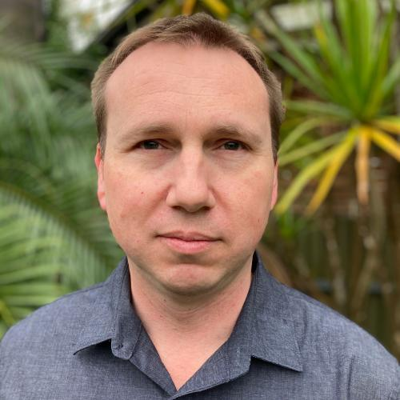
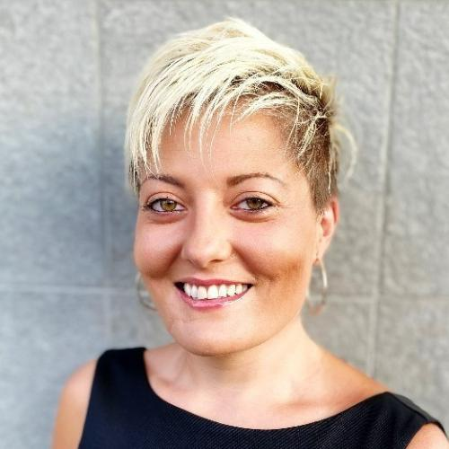
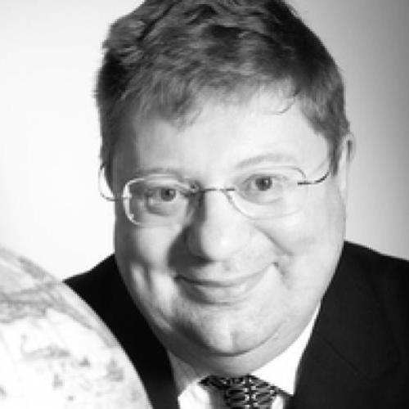
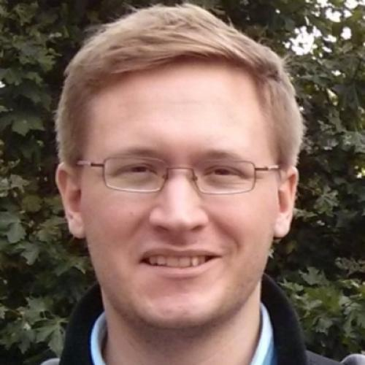
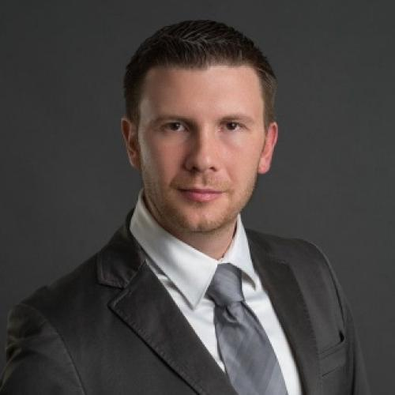
Objectives
Facilitate quality in-person and online educational events while reducing barriers to accessing education resources.
Expand online educational offerings
Facilitate the organization of in-person educational events within the society
Aid members in accessing educational resources

Slide 3
Objective 1 - Expand online educational offerings
Status:
A set of webinars as well as virtual distinguished lectures have been held throughout the year
Continued growth of videos on ILN, 96 in October ’22, 130 in April ’23, and 147 in November ‘23 ILN usage 2021 – 3 distinct users, 5 enrollments, 0 completed views ILN usage 2022 – 135 distinct users, 291 enrollments, 52 completed views ILN usage 2023 to date – 260 distinct users, 530 enrollments, 81 completed views
Online distinguished lectures are also added to Vimeo for viewing via AESS website Usage much higher: 10639 views, 160 average views per video
2023 Goals:
Organize a set of webinars (3 have been held). ✓ Host at least 23 virtual distinguished lectures (22 held, a further 6 are current scheduled).
Grow the number of videos on ILN from 96 (October ’22) to 150 videos by the end of 2023.
Run an advertising campaign to increase awareness and usage.

Slide 4
Objective 2 – In-person educational events
Status:
Boot camps held at the Fusion Conference, RadarConf ‘23, and the International Radar Conference. Glue Tech also held a summer school.
Current distinguished lecturers will continue their terms in 2024. At least 31 in-person distinguished lectures have been held at a cost of $16181.
Radar challenge event being planned for RadarConf ‘24.
YP receptions held at RadarConf ’23, Fusion ’23 and the International Radar Conference.
2023 Goals
Convince a different AESS conference to run a summer school (boot camp) and support its organization. ✓
Organize lecture series and support the DSTEI initiative. ✓
Increase the number of in-person DLs (goal 30). ✓

Slide 5
Objective 3 – Access to educational resources
Status:
Robert T. Hill Best Dissertation Award has twelve applicants.
Engineering Scholarship had 16 applicants. Number of applicants significantly increased. Education committee propose a change to the eligibility criteria.
YP Travel Grants were offered for RadarConf ‘23, Fusion and AutotestCon.
Goal is to help YPs from industry and YPs from underrepresented regions attend an AESS conference
RadarConf: 23 applicants and three recipients. Fusion: 22 applicants. 2 recipients due to costs. AutotestCon: 22 applicants. 1 recipient.
Many potential recipients had to decline the grant because they couldn’t afford the flight. Therefore, the grants often went to people who were planning on attending the conference anyway.
We would like to change the judging to also help YPs from industry and not just underrepresented regions. To really help YPs from underrepresented regions we should cover the cost of flights.
2023 Goals:
Send 9 AESS YPs to AESS conferences (achieved 6).
Reduce the scholarship decision time to three months.

Slide 6
Engineering Scholarship
Current Eligibility Statement:
IEEE student members studying electrical/electronics engineering at the undergraduate level or first professional degree, and systems engineering at the graduate level, from an accredited university, with no other scholarships and a cumulative grade point average (GPA) of 2.8 (7.5 in select countries) or above.
Proposed Eligibility Statement:
IEEE student members studying electrical/electronics engineering at the undergraduate level or first professional degree, and systems engineering at the graduate level, from an accredited university, with no other scholarships and a cumulative grade point average (GPA) of 2.8 (7.5 in select countries) or above. Graduate students are only eligible if a significant part of their studies is related to systems engineering.

Slide 7
Engineering Scholarship
Current Judging Statement:
Evaluations will be based on the application and stated financial need. The application shall include an essay on why these fields of study are important and how the applicant could have impact in these fields. At least 3 letters of recommendation shall be provided, two of which shall be from current or former university professors who taught the applicant or know him or her personally.
Proposed Judging Statement:
Evaluations will be based on the application and stated financial need. The application shall include an essay on why these fields of study are important and how the applicant could have impact in these fields. At least 3 letters of recommendation shall be provided, two of which shall be from current or former university professors who taught the applicant or know him or her personally. Graduate student applicants will also be judged on the extent to which systems engineering is involved in their studies, based on a transcript of taught modules or a statement from the student’s supervisor.

