Slide 1
IEEE Aerospace Electronic Systems
VP Industry Relations
Steve Butler
AESS Fall 2023 Board of Governors Meeting
10 and 11 November 2023
Sydney, Australia

Slide 2
SWOT
Strengths
  Diverse panel with significant experience and connectivity
Weaknesses
  Significant overlap in mission with other IEEE societies and panels
Opportunities
  Team with IEEE Corporate to make IEEE more relevant to industry
Threats
  Time compression and lack of clarity in IEEE Corporate initiative
/17
2

Slide 3
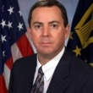



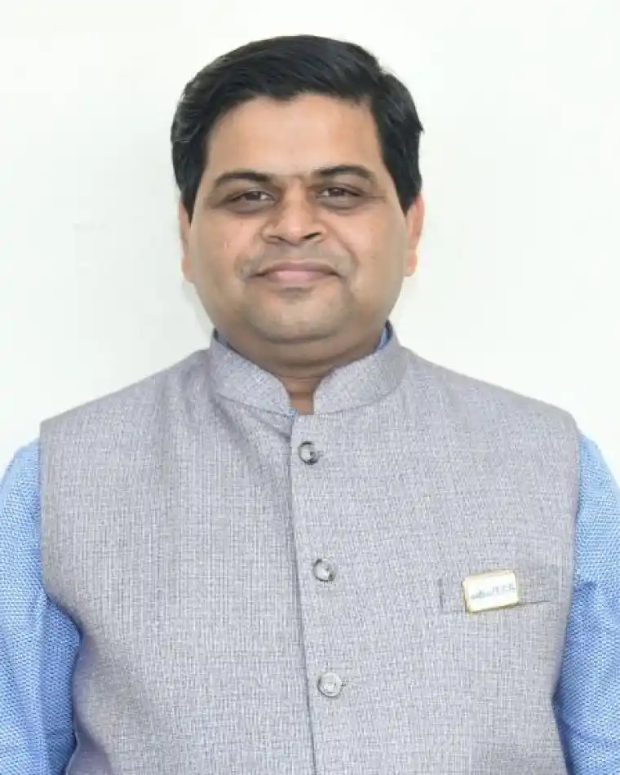

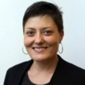
Industry Relations – 2023 Panel
Steve Butler (Chair) - steven.butler@jhuapl.edu
Mike Noble - noble@ieee.org
Michael Cardinale - cardinal@ieee.org
Stefano Coraluppi - stefano.coraluppi@ieee.org
Puneet Kumar - mishra mishra_puneet@ieee.org
Roberto Sabatini - roberto.sabatini@ku.ac.ae
Laura Anitori - laura.anitori@tno.nl
3
/17

Slide 4
Industry Panel Initiatives
Industry panels at AESS conferences - ongoing
Industry tailored short courses – on hold
Industry socials and recruiting opportunities at Chapter and conference events – merge with IEEE USA?
Industry mentoring opportunities – hope to do one more this year
Collaboration with IEEE Corp industry initiatives
  Industry Ambassador program - ongoing
Industry Innovation Award - ongoing
/17
4

Slide 5
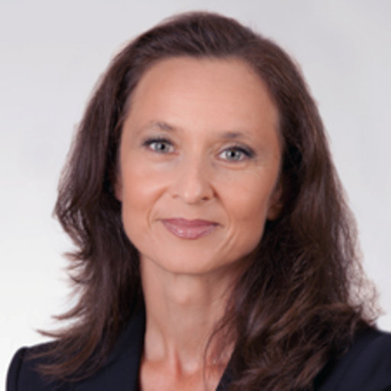
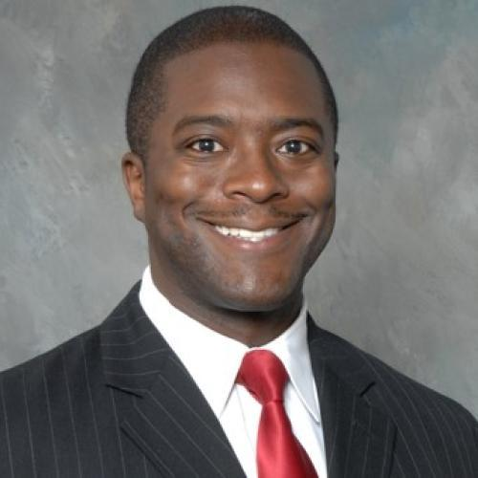

Industry Mentoring Panel
March 17, 2023 Inaugural Industry Mentoring Panel
200 Zoom participants in US, India, Ukraine, Jordan, Italy, Canada, Qatar, Luxembourg, Saudi Arabia, Bulgaria, South Africa, Netherlands, Germany, Spain, Kenya, Belgium, Nigeria, Russia, Bangladesh
6 Panel Members
  Mike Noble (Chair)
  Bob Rassa
  Arik Brown
  Francesca Scire-Scappuzzo
  Steve Butler
  Stephano Coraluppi
Plan for an Early Career Session this summer
Mike Noble
Francesca Scire-Scappuzzo
Arik Brown
Bob Rassa
Stephano Coraluppi
Steve Butler
/17
5

Slide 6
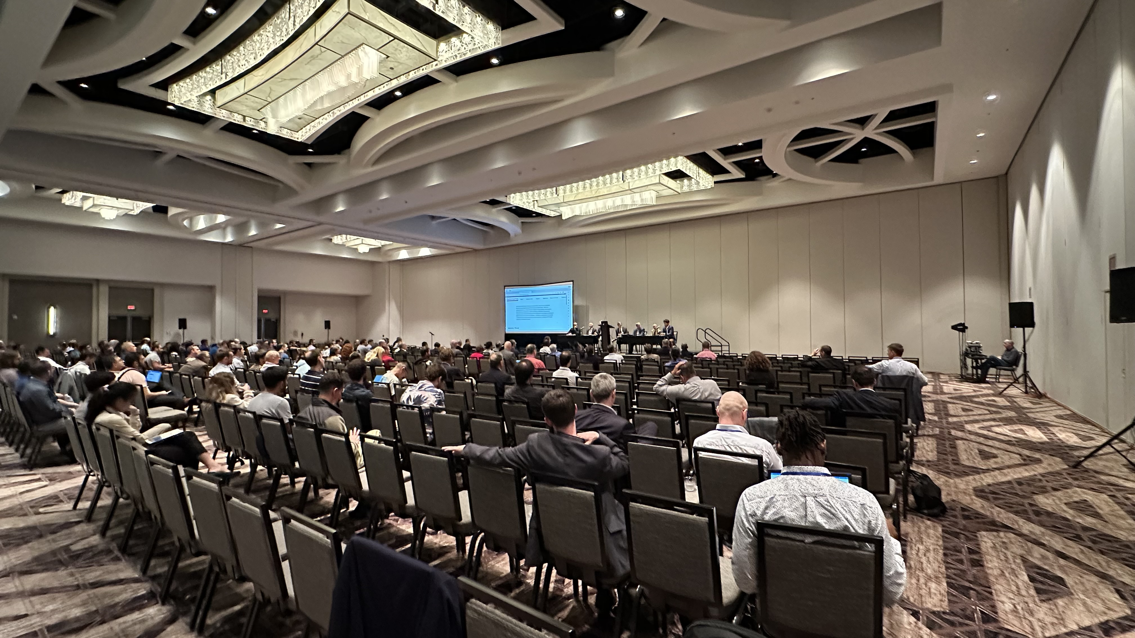
Upcoming Events
November 2023 Industry Panel in Australia
  6 Panel Members
Hope to hold Industry Panel events at all future conferences
  Fusion Conference, DASC, etc.
  Need to remember/emphasize diversity in future events
6
/17

Slide 7
IEEE USA Initiative – “Industry Days”
Many of our AESS Industry Panel initiatives had connections and overlap with IEEE Corporate and IEEE USA ongoing activities
We were asked to look for ways to integrate our AESS initiatives with those of “big” IEEE
IEEE Industry Engagement Committee (IEC) is hosting an Industry Days event and has asked for our (AESS) collaboration
/17

Slide 8


IEEE World Technology Summit
(Initially called Industry Days)
Michael W. Condry, Ph.D., IEEE Life Fellow
IEEE Industry Engagement Committee (IEC)
Events Sub-Working Group
/17

Slide 9
History
Years ago, industry leaders populated the IEEE and Society/Council boards. This enabled industry value projects within IEEE. Over time industry engagement has decreased.
The IEEE community can offer value to industry with useful research updates, technology training, and access to quality graduate students.
IEEE can also facilitate interactions across industry where technical challenges and solutions can be exchanged, partnerships formed, the need for standards identified and their programs enabled.
The objective of this program is to rebuild the value of the IEEE community to industry based on the company needs, not IEEE “thinking.”
/17

Slide 10
Technology is needed and used everywhere
Nearly all products and services utilize many technologies in their creation and execution. IEEE is a professional society whose members study, research, and apply technology in ways usable in the creation and execution of products and services.
Business success demands a suitable understanding of technologies and their changes in corporate strategy, development, marketing, and support.
Nearly all businesses are impacted including enterprise, consumer, automotive, retail, appliances, aerospace, and even small businesses.
The IEEE World Technology Summit (WTS) program is to establish new types of events from IEEE that benefit the industry community in understanding and utilizing technology in their products and services.
/17

Slide 11
Technology Programs Today
The IEEE and other professional groups offer programs on technology but the audience is the research community. These events are useful for research and students but are not organized to actively assist businesses in understanding and using technology and its changes.
Many organizations including some IEEE groups offer trade shows that focus on existing and early future product sales. These events frequently have some technical presentations, mostly focused on marketing, but have limited guidance for technology usage across the many businesses that can benefit.
The IEEE World Technology Summit is designed to “fill the gap” in technology understanding and usage to the community that plans, designs, markets and supports products and services that utilize technology for their success.
With so many markets impacted a form that has useful research summaries and training options plus a mechanism for cross-industry companies to exchange issues and concepts, prior to product creation is a second objective.
/17
11

Slide 12
Overview: World Technology Summit
Theme: Translating Science and Technology to Skills and Products
  Consider Pre-Product Challenge sharing with possible solution strategies
Key Elements:
  Training programs to enhance skills for lifetime learning, essential to the job
  Update on current technologies applicable to products, services, and business activities
  Have industry leaders share directions and needs and discuss where IEEE community can assist in addressing these needs
  Identify industry networking and partnership opportunities
  Have industry show new products and present technical challenges to research
  What do you need or like to do and can we help find solutions
Audience
  Working engineer spanning different levels of responsibility and experience (entry-level engineer, engineering management, ……. technical engineering fellow)
  Technical Leadership and Management (Marketing, Technical, Corporate leaders)
  Students/YP moving to or engaging with industry
/17
12

Slide 13

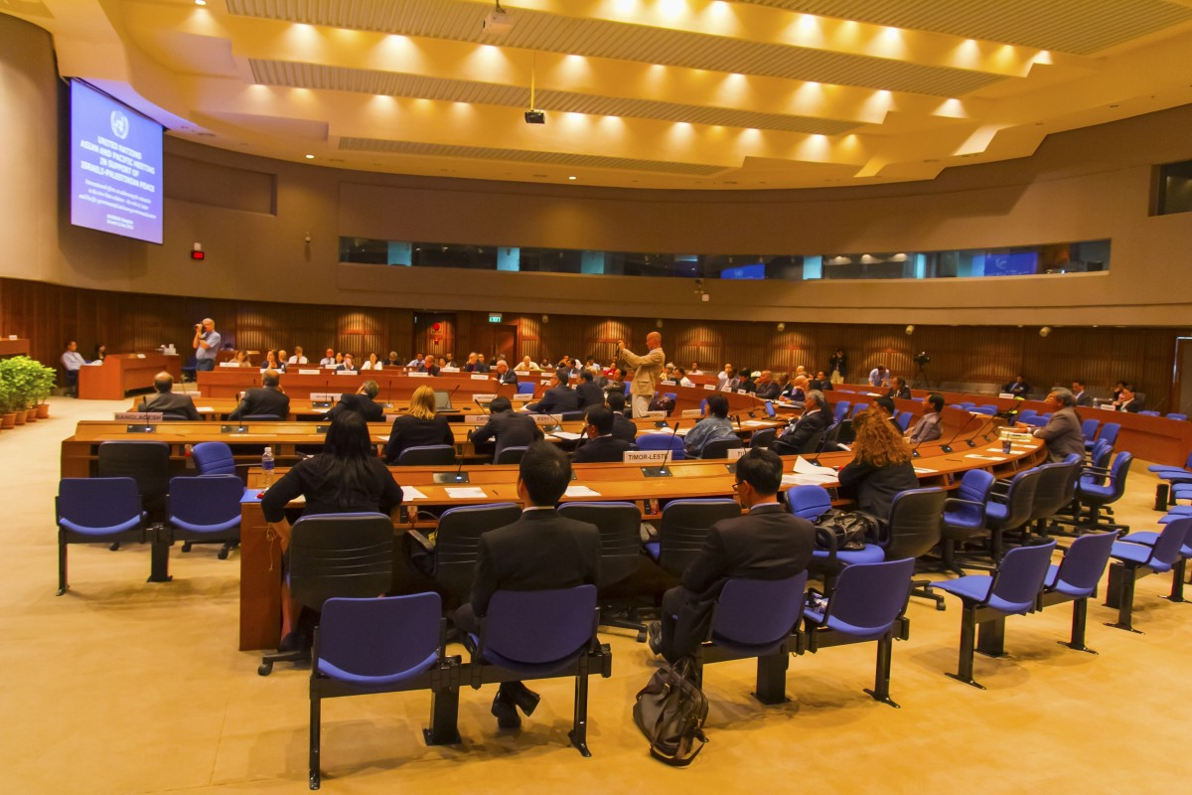
Process Behind World Technology Summit
Industry Provides Topics
Interests
Needs
IEEE Organizes
Speakers on Topics
    Training
    Research Summit
    Students
World Technology Summit Agenda approved by industry
Agenda aligned to their topics
Sessions
Exhibitions
Keynotes/Panels
Networking
Industry Steering
Committee
IEEE Organization
Committee
Industry Approved Program
/17
13

Slide 14
IEEE Community Provides
Select Technical Training
  Introductory Sessions on Technology (e.g., 1-hour class)
  Technology Update Training (e.g., 2 hours possibly multiple sessions on the same topic)
    For working engineers to apply for work
  Technology Directions: Vision or Roadmaps – 1 or 2 hour
    For technical leaders and marketing to envision product directions
    Share technology roadmaps developed by IEEE for industry usage
Technology Summit Sessions
  Research overview on desired topics by industry
  Technology roadmaps
Student recruitment for those studying on the desired topics
It is not expected that all topics will interest all industries
/17
14

Slide 15
Industry Steering Committee
Industry Leaders to review concepts and recommend areas of interest.
Request
  September/October 2023 – Discussion: progress update on topics, speakers
  October/November 2023 – Review and evaluate possible engagement
    Sponsors, Speakers, Attendees, and Exhibitors
  Fall 2024 Event
Additional Request
  List the company as an “Industry Steering Committee” to the program to attract others to engage
Requesting of AESS
  5 companies to join Industry Steering Committee for the Fall 2024 event
  Each to donate $30,000 to the event
  Each to provide a participating panel member – company representative to the event
/17

Slide 16







Industries Expressing Engagement
Scheduling:
Samsung
JP Morgan Chase
Daimler
Toyota
Others: Retail, Aerospace, etc.
Basics: Computing, Networking, Security, Cloud, Power
Application: Manufacturing, Automotive, Aerospace, Consumer, Industry, Healthcare
/17

Slide 17


