Slide 1
IEEE Aerospace Electronic Systems VP Member Services
Lorenzo Lo Monte
AESS Fall 2023 Board of Governors Meeting
10 and 11 November 2023
Sydney, Australia

Slide 2
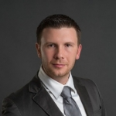
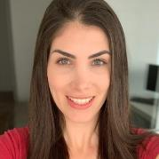
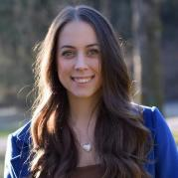
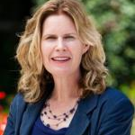
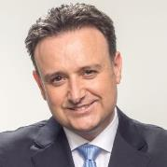
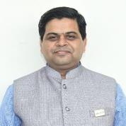
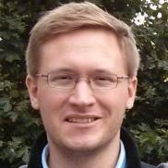
Member Service Committee
Lorenzo
Lo Monte
Laila
Moreira
Francesca Filippini
Kathleen Kramer
Laura Anitori
Joe Fabrizio
Puneet Mishra
Philipp Markiton

Slide 3
Part 1: Statistics

Slide 4
Membership Overview (Nov 2023)
Notes:
Explore
/Dashboards for All Volunteers
/Geo OU Analysis
/IEEE/Society Member Summary

Slide 5
AESS Membership Monthly Statistics
All AESS Member Types
Only AESS Student Member
Notes:
Memberships and Subscriptions Monthly Statistics
Year over Year Analysis

Slide 6
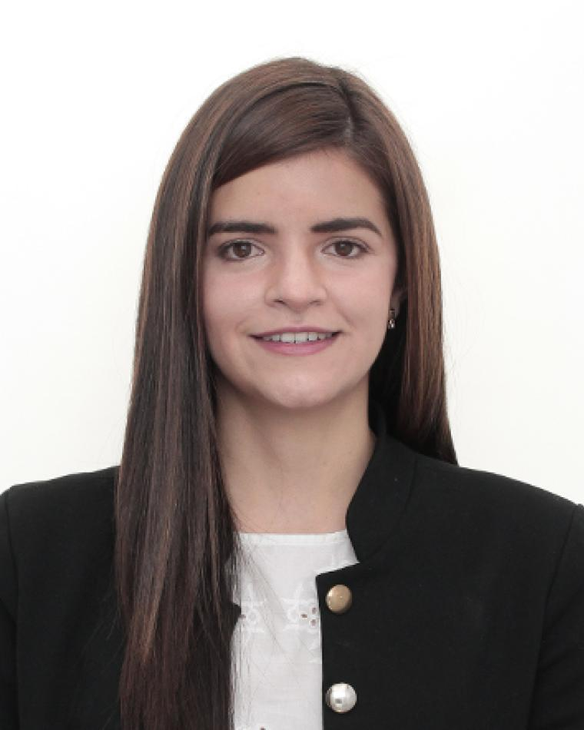
Year over Year: Region 9 and India Chapters

Slide 7
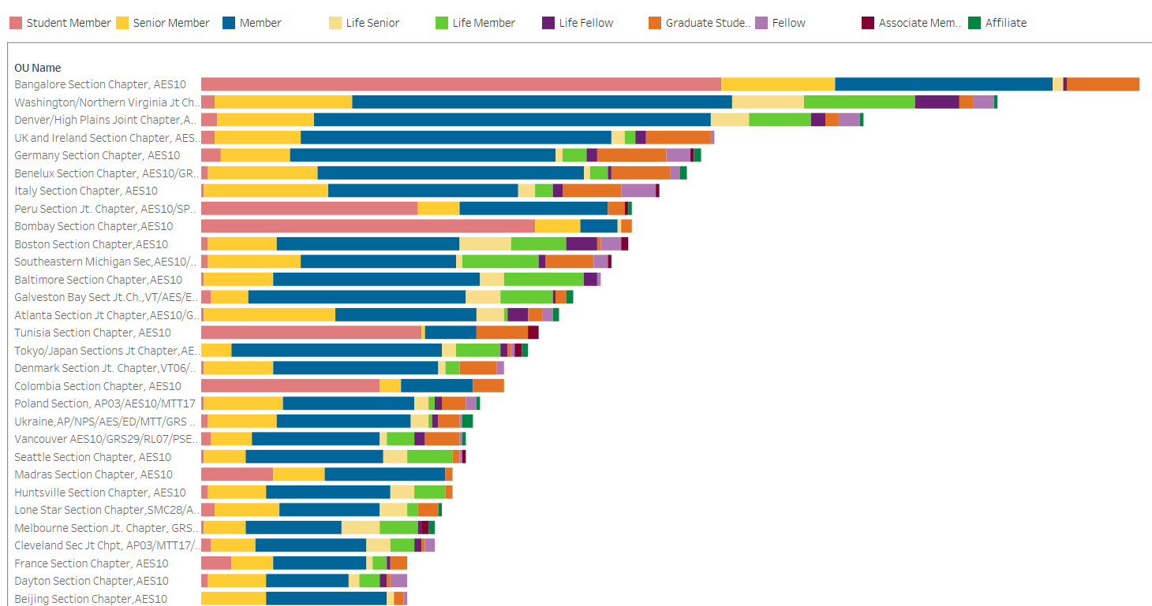
Most Populous AESS Chapters
Notes:
Explore
/Dashboards for All Volunteers
/Geo OU Analysis
/Member Count by Chapter

Slide 8
Most Populous Student Branch Chapters
Notes:
Explore
/Dashboards for All Volunteers
/Geo OU Analysis
/Member Count by Chapter

Slide 9
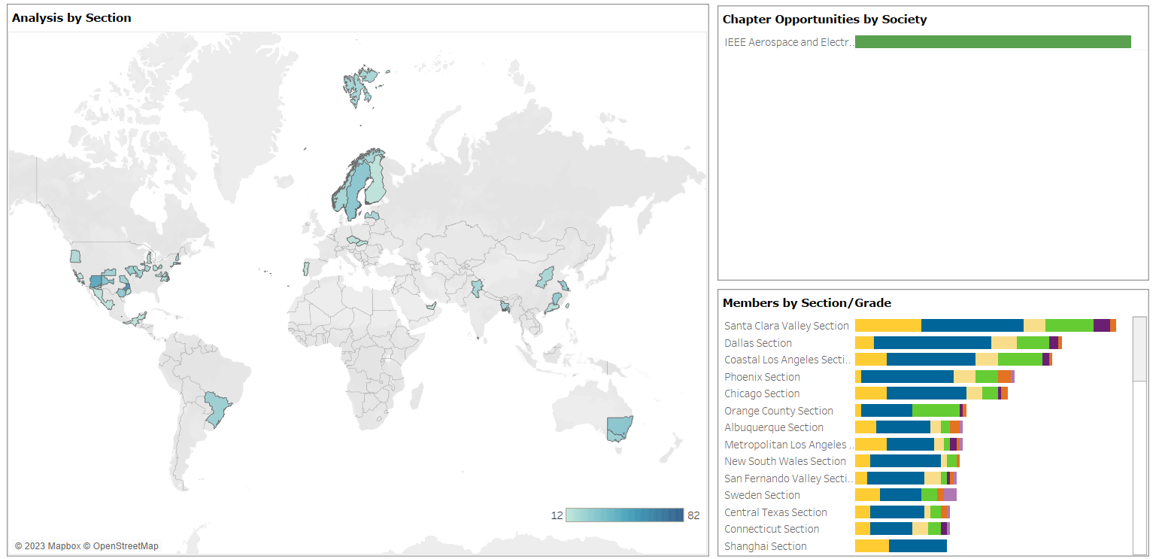
Potential New Chapter Map
Notes:
OU Analytics:
Explore
/Dashboards for All Volunteers
/Geo OU Analysis
/Potential Chapters

Slide 10
Part 2: Merchandise Program

Slide 11
Current Situation
Chapters, Conference Chairs, and Volunteers need Merchandise
Only 3 Options
Annual Funding
Major Funding
President Approval

Slide 12
Issues with Current System
Annual Funding
Major Initiative
Direct Presidential Approval
Not enough money to execute merchandise orders
Never used so far…
Difficult to track expenditures
Volunteers are generally unable to purchase merchandise locally
Eligible only for Chapter Chairs…
Exorbitant shipping price
Extensive labor from CC
Very few approvals among many requests
Inconsistent Quality
Hard Labor
Most common

Slide 13
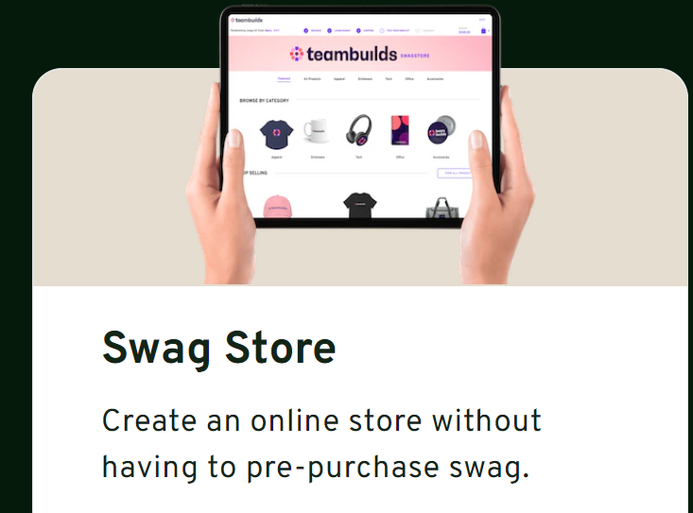
AESS Global Merchandise Program
Partner with SwagMagic
www.swagmagic.com
SwagMagic is a swag store accessible across 170+ countries
AESS creates an “online” store
Volunteers can select merchandise and have it shipped to their place
No international shipping fees
No additional effort for Members Committee or Conference Catalyst

Slide 14
Timeline
BoG Approval
AESS Store Created / Merchandise Selected
Program Launch
by Jan 1st
IEEE Payment to SwagMagic
Volunteers request Merchandise up to $300
AESS Global Merchandise Form created
Members Committee Approves
CC Sends Email to Volunteer
Volunteer Selects Swags using Credit
Merchandise is Shipped to Volunteer

Slide 15
Motion
Motion: Lorenzo Lo Monte moves to approve that AESS funds $20,000 towards the AESS Global Merchandise Program
Pros:
All AESS Volunteers (Chapter Chairs, SBC Chairs, Conference Organizers, etc..) can easily request, via online form, standardized AESS Merchandise anywhere in the world at low cost
Reduces labor for Conference Catalysis and Members Committee
Improves member outreach worldwide
Better tracking metrics
Cons:
None, except the high upfront cost to start the program.
Financial Implications: $20,000

