Slide 1
IEEE Aerospace Electronic Systems
Mentorship Program Report
Arik Brown
AESS Fall 2023 Board of Governors Meeting
Sydney, Australia

Slide 2
Outline
SWOT Summary
Current Status of Mentors and Mentees
Collaboration Exploration with Other Mentor Programs
2024 Future Plans

Slide 3
SWOT Summary
Strengths | High interest expressed by AESS members in joining/continuing in the program. Initial partnerships were formed using Collabratec.
Weaknesses | Discrepancy in tracking mentors and mentees. Working to resolve this.
Opportunities | Leverage features from the Global Talent Mentoring program.
Threats | Collabratec tracking may not be as robust as originally thought.

Slide 4
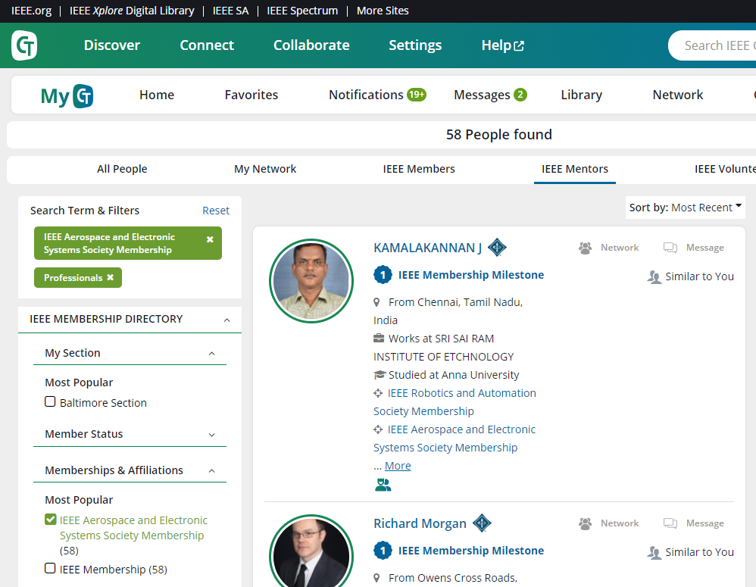
Current Status
Collabratec reports there are 58 mentors signed up to AESS’s Mentorship Program
I’m not sure if this is correct
In the process of confirming the accuracy of the number of mentors and mentees
I believe the filtering may be mixing up those who are in the general IEEE membership program and the AESS program
Action Plan
Confirm mentor and mentee program participants with Victor Manganaro (Collabratec SME)
Poll current mentors and mentees in Collabratec and cross-check responses
Finalize numbers in Dec ‘23

Slide 5
Mentorship Programs Explored For Potential Partnership
Met with two representatives from Global Talent Mentoring (GTM) – July 17th, 2023
Dr. Daniel Balestrini, COO
Ildiko Gyoryne Csomo, Area Coordinator, Branding & Networking
Online mentoring program to develop technical talent
Talent Equity
Professional Development
Access to Global Talent
Networking and Interdisciplinary Collaboration
GTM has it’s own process/program and is not setup for collaboration with other mentoring programs
GTM is looking to spread the news about their program and was looking for mentors to add to the program
Potential to adopt or leverage current features of the GTM program

Slide 6
2024 Plan
Planned Events
Online meeting for all mentors and mentees
Goals and expectations
Mentor/Mentee communication cadence
Field Questions (May have Victor Manganaro support – Collabratec SME)
General Online Meeting Every 4 months
2024 February, June, October
Engagement Activities
Mentor/Mentee Spotlight Quarterly (March/June/Sept/Dec) – Highlight a successful mentor/mentee partnership
Post on the AESS Mentorship website and on the Collabratec Page
Program membership poll (January)
Solicit inputs for improvements
Periodic tips and strategies for successful mentoring partnerships (Cadence TBD)

