Slide 1
IEEE Aerospace Electronic Systems Nominations and Appointments
Walt Downing
2023 AESS Fall Board of Governors Meeting
10-11 November 2023
Sydney, Australia

Slide 2
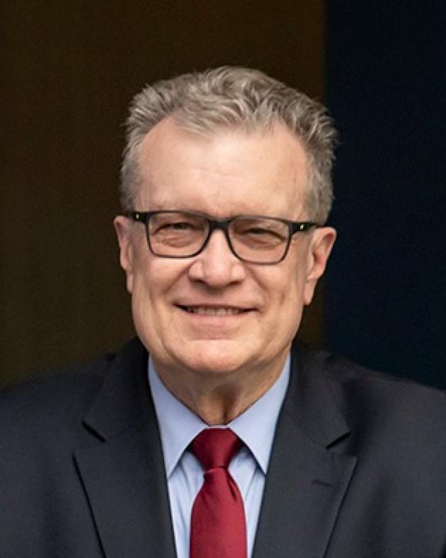
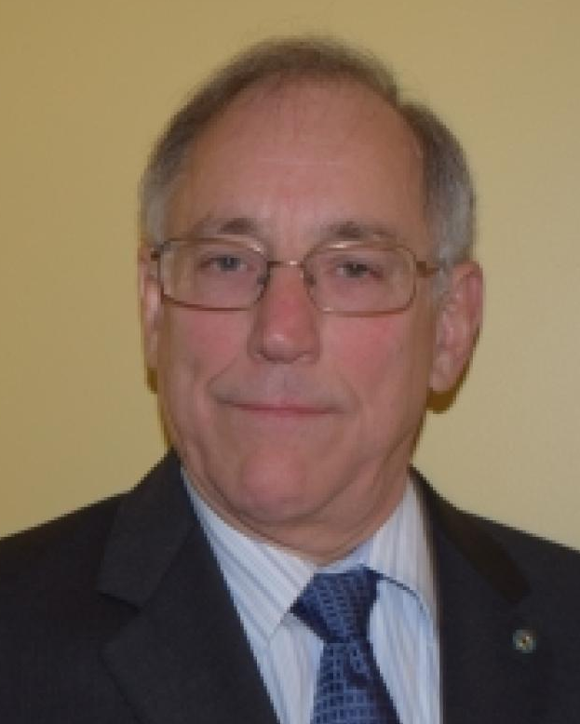
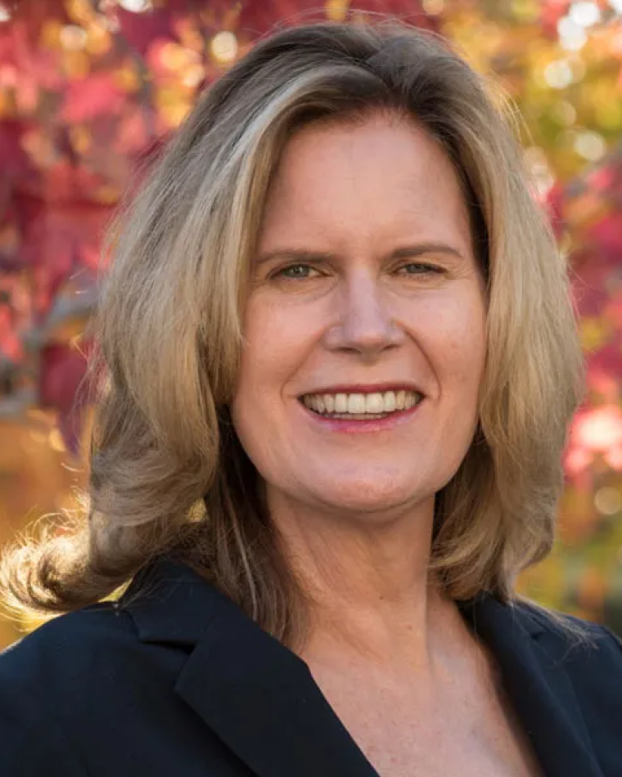
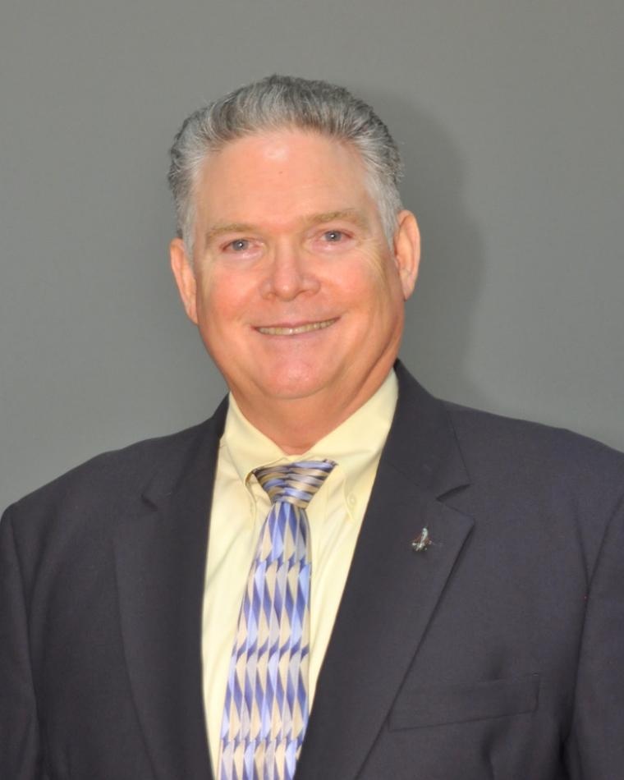
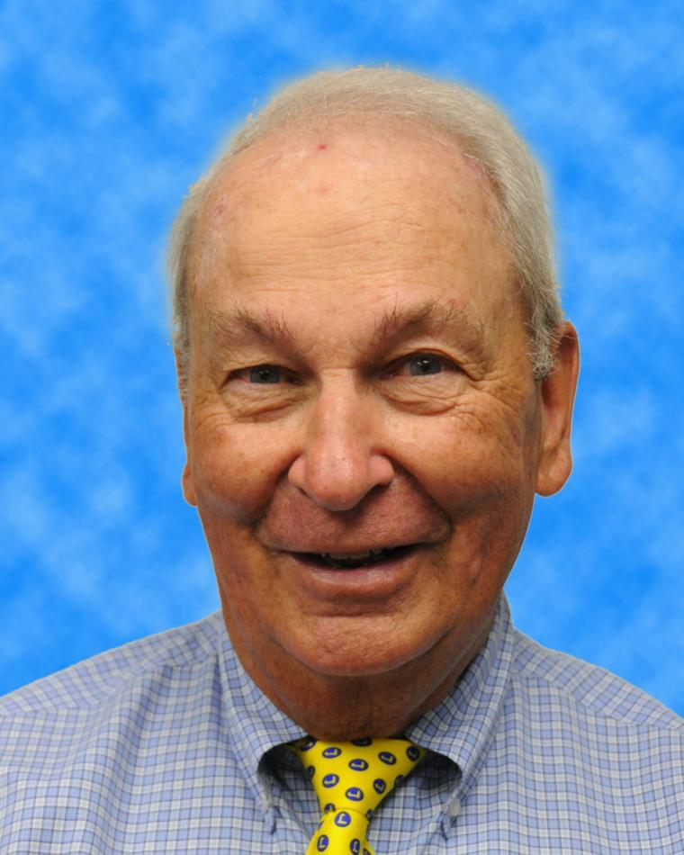
2023 N&A Committee
Walt Downing
Past-President/N&A Chair
Michael Cardinale
Kathleen Kramer
Bob Lyons
Bob Rassa

Slide 3
Nominations
BoG 2024-2026 Slate
Laura Anitori
Michael Braasch
Steven Butler
Alexander Charlish
Fabiola Colone
Steven Harbour
Braham Himed
Kumar Vijay Mishra
Michael Rice
Avid Roman-Gonzalez
Barry C. Tilton
Selected by Membership
Laura Anitori
Michael Braasch
Steven Butler
Alexander Charlish
Fabiola Colone
Michael Rice
Final 2 Selected by BoG
Braham Himed
Barry C. Tilton

Slide 4
Committee Ongoing Activities
N&A Timeline - BoG 2024-2026
January 4 – Call for Nominations
January 3-31 – Approval of N&A Committee
February 28 – Nominations Close
March 1-8 – N&A Committee Reviews Packets
March 8 – IEEE confirms eligibility of slate
March 20-April 4 – AESS BoG Discussion Period
April 4-April 19– AESS BoG Voting Period
April 19 – Slate sent to IEEE
May 15-June 15 – IEEE Voting
June 16-June 30– Discussion Period for 2 final candidates
July 5-19– Voting for 2 Final Candidates
July 1-August 1– N&A Committee Prepare Officer Slate
November 10 – BoG Vote on Officer Slate

Slide 5
AESS Officer Election Process
At a meeting of the Board of Governors, normally held before the first of November of every year, the Board of Governors shall appoint, from among current members, all Vice Presidents as defined in the Constitution who will take office on the First of January of the Following year. Such appointment shall occur after selection of their preferred candidate from the proposed slate. The President shall annually appoint, with the concurrence of a majority of the Board of Governors, a Secretary and a Treasurer.

Slide 6
AESS Officer Election Process
We will elect each VP one at a time. Each candidate will have 5 minutes to address the board, followed by 5 minutes for questions. The President-Elect candidates will have 10 minutes to address the board. When not speaking and during discussion, candidates will be moved into the Waiting Room.
Only voting members will be in the room to vote. We will move all non-voting members to the Waiting Room. Once the vote has taken place, the platform tallies the votes automatically and anonymously. Please be reminded that the President will only vote to break a tie.
Each vote will be taking by the polling feature in Zoom. Before we begin, Judy will take us through a practice vote. TAKE PRACTICE VOTE.
There is no reason to abstain in a secret ballot vote, but if someone does abstain, it will not count one way or another in the vote count, nor will it be included in the total count to figure how many votes required for a majority vote.
Please be reminded that you must be in the room (either in-person or virtually) in order to vote.
For Discussion, please only use the Zoom platform to raise hands to speak, even if you are in the room. Do not use the general chat for discussion of candidates, as this will not be private.
All candidates will present on Zoom, as to not give advantage to in-person candidates.
who will take office on the First of January of the Following year. Such appointment shall occur after selection of their preferred candidate from the proposed slate. The President shall annually appoint, with the concurrence of a majority of the Board of Governors, a Secretary and a Treasurer.

Slide 7
Pause meeting recording

Slide 8
Officer Slate Proposed by N&A Committee
The order of offices for election are in alphabetical order after President-Elect, which will be first. The names to be considered are in alphabetical order.
President-Elect
Dale Blair
Michael Braasch
VP Awards (NEW!)
Dale Blair
Puneet Kumar Mishra
Mike Noble
VP Conferences
Braham Himed (3rd Term)
VP Education
Alex Charlish (3rd Term)
Alfonso Farina
VP Finance
Peter Willett (3rd Term)
VP Industry Relations
Stefano Coraluppi
VP Member Services
Lorenzo Lo Monte (2nd Term)
VP Publications
Michael Rice
Luke Rosenberg
VP Technical Operations
Michael Braasch (3rd Term)
Roberto Sabatini

Slide 9
President-Elect

Slide 10
President-Elect
Dale Blair
Michael Braasch
Are there any Nominations from the floor?
Michael Braasch to the Waiting Room.
Dale will have 10 minutes to address the Board and then there will be 10 minutes for Q&A.

Slide 11
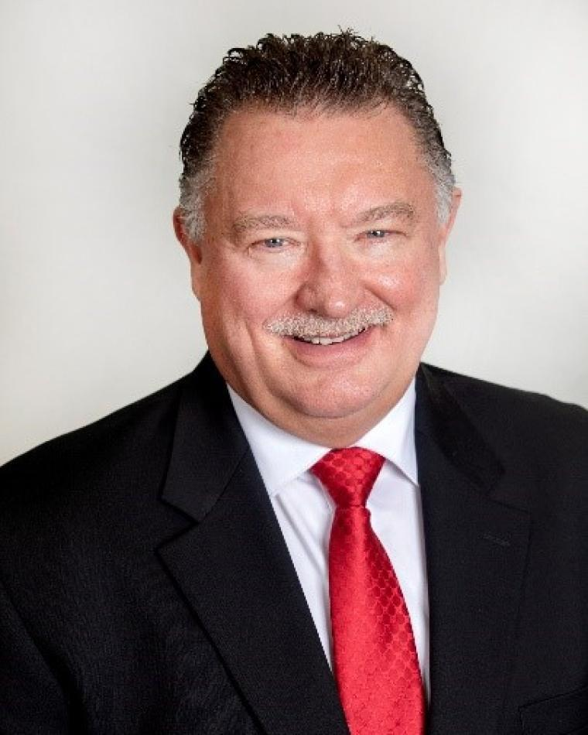
Dale Blair Bio
Dale Blair is a Principal Research Engineer with the Georgia Tech Research Institute (GTRI) and GTRI Fellow. He received the BS and MS degrees in Electrical Engineering from Tennessee Tech in 1985 and 1987, respectively. He received the Ph.D. degree in Electrical Engineering from the University of Virginia in 1998. Dale is an IEEE Fellow class of 2002 and recipient of the 2001 IEEE Fred Nathanson Award and the 2023 Warren White Award. His publications include coeditor and coauthor of Multitarget-Multisensor Tracking: Applications and Advances III (ARTECH House, 2000); two chapters in Principles of Modern Radar: Vol I (SciTech Publishing, 2010); a chapter in Modeling and Simulation Support for System of Systems Engineering Applications (Wiley, 2015); 38 refereed journal articles, more than 100 refereed conference papers; and more than 200 other technical papers and reports. His editorial accomplishments include Editor for Radar Systems of the IEEE Transactions on Aerospace and Electronic Systems (T-AES) (1996-1999), Editor-In-Chief (EIC) of the T-AES (1999-2005), and founding EIC for the Journal for Advances in Information Fusion (2005-2013). He currently serves as the founding EIC for the IEEE Open Journal of Systems Engineering (OJSE). Dale has served the IEEE AESS BoG as Associate VP for Publications (2008-2011), Chair for Strategic Planning (2009-2010), and VP for Publications (2015-2017). He is serving in his 22th year as a member of the BoG. Dr. Blair served International Society for Information Fusion (ISIF) as President in 2005, as VP for Conferences (2006-2012), and VP for Publications (2012-present). Dr. Blair has served as the general chair for two IEEE conferences and a key member of the organizing committee for more than ten professional conferences. He reviews regularly for conferences and journals and currently serves as Tutorial Editor for the IEEE Aerospace and Electronic Systems Magazine.

Slide 12
Dale Blair Statement
IEEE is as an organization that supports advancement of the professional of electrical, electronic, and computer engineers and IEEE AESS focuses on those of us involved in the area of aerospace and electronic systems. As President of IEEE AESS, I will see to expand our impact to more of our members through enhancing our conferences, publications, technical panels, awards, IEEE Standards, and industrial relations. IEEE AESS does these very well already. More specifically, I will focus on our engagement of members in industry and impacting students. As President, I would like to pursue the engagement of students through the funding of senior capstone projects at the levels of about $2.5k and fund many of those. I would like to involve IEEE AESS members from industry as the customers for those projects. We could take proposals for capstone projects from our members joined with universities. If members of the IEEE AESS BoG could develop standard capstone problems, IEEE AESS could sponsor bake off events at one our conferences or a regional event. I think making a positive impact on students is the best avenue to growing our membership as they join us in the advancement of our profession.

Slide 13
President-Elect
Dale Blair to the Waiting Room.
Re-admit Michael Braasch to the meeting.
Michael Braasch will have 10 minutes to address the Board and then there will be 10 minutes for Q&A.

Slide 14
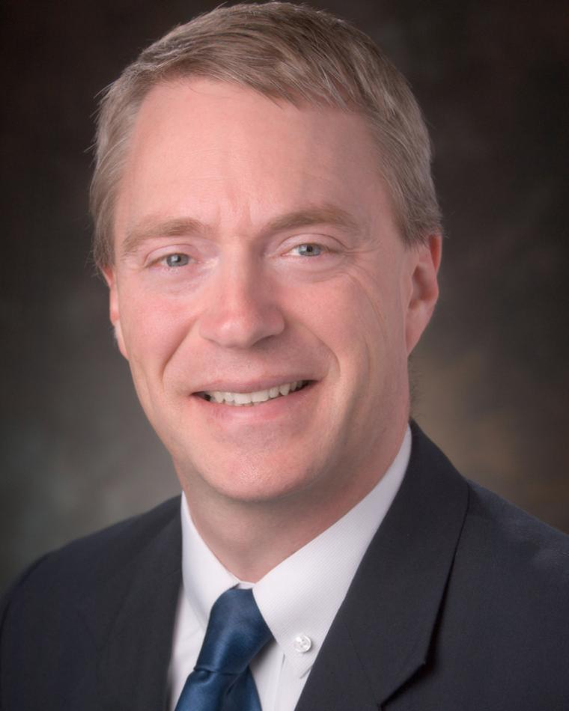
Michael Braasch Bio
Michael Braasch holds the Thomas Professorship in the Ohio University School of Electrical Engineering and Computer Science and is a Principal Investigator with the Ohio University Avionics Engineering Center. He has been performing navigation system research since 1985 and was elevated to IEEE Fellow in 2023 for his work in characterizing and mitigating the effects of GPS multipath.
In the mid-1990s, Mike led the Ohio University research group that pioneered the GPS software-defined receiver. Mike’s recent work has focused on GNSS-aided inertial navigation including the development of gravity modeling techniques for safety-of-life applications such as civil aviation. Mike also has more than three decades of flight-testing experience with Ohio University’s fleet of research aircraft. Mike also has significant industrial experience having worked extensively on-site at both Boeing and Northrop Grumman.
Mike has served as a visiting scientist in The Netherlands and has lectured for NATO AGARD in Russia, Turkey, and Ukraine. Mike has served as an associate and technical editor for navigation for the TAES and has also served as an associate editor for navigation for SYSTEMS. Since 2014 he has served as the IEEE/AESS liaison to the ION/IEEE Position, Location and Navigation Symposium (PLANS). From 2017-2023, he has served as the founding Chair of the AESS Navigation Systems Panel. He has served on the AESS BoG since 2017 and served as the AESS VP-Conferences for 2019-2021. He has served as VP-Technical Operations for the past two years and has been an AESS Distinguished Lecturer since 2020.

Slide 15
Michael Braasch Statement
It has been my privilege to serve on the BoG for the past seven years and I appreciate the confidence the BoG has shown by electing me three times to the position of VP-Conferences and twice to the position of VP-Technical Operations. AESS’ core mission is to serve our members. Our publications are highly regarded and continue to have significant impact. Although the conference ‘landscape’ has changed due to the pandemic, we remain committed to providing high quality events that also return a reasonable surplus. We must continue to support our long-established programs as well as our more recent successes (such as the Virtual DL Program) while regularly assessing our performance and seeking ways to improve service to our membership. We have a mix of active and not-so-active chapters around the world. Vibrant chapters have highly engaged members that value and promote AES membership. We should promote the ‘best practices’ of our active chapters and thereby increase the AES value proposition.

Slide 16
President-Elect
Move candidate(s) to the Waiting Room.
BoG Discussion
Re-admit candidat(es)
Vote
Announce Winner

Slide 17
VP Awards

Slide 18
VP Awards
Dale Blair
Puneet Kumar Mishra
Mike Noble
Are there any Nominations from the floor?
Puneet Kumar Mishra and Mike Noble to the Waiting Room.
Dale will have 5 minutes to address the Board and then there will be 5 minutes for Q&A.

Slide 19
Dale Blair Bio
Dale Blair is a Principal Research Engineer with the Georgia Tech Research Institute (GTRI) and GTRI Fellow. He received the BS and MS degrees in Electrical Engineering from Tennessee Tech in 1985 and 1987, respectively. He received the Ph.D. degree in Electrical Engineering from the University of Virginia in 1998. Dale is an IEEE Fellow class of 2002 and recipient of the 2001 IEEE Fred Nathanson Award and the 2023 Warren White Award. His publications include coeditor and coauthor of Multitarget-Multisensor Tracking: Applications and Advances III (ARTECH House, 2000); two chapters in Principles of Modern Radar: Vol I (SciTech Publishing, 2010); a chapter in Modeling and Simulation Support for System of Systems Engineering Applications (Wiley, 2015); 38 refereed journal articles, more than 100 refereed conference papers; and more than 200 other technical papers and reports. His editorial accomplishments include Editor for Radar Systems of the IEEE Transactions on Aerospace and Electronic Systems (T-AES) (1996-1999), Editor-In-Chief (EIC) of the T-AES (1999-2005), and founding EIC for the Journal for Advances in Information Fusion (2005-2013). He currently serves as the founding EIC for the IEEE Open Journal of Systems Engineering (OJSE). Dale has served the IEEE AESS BoG as Associate VP for Publications (2008-2011), Chair for Strategic Planning (2009-2010), and VP for Publications (2015-2017). He is serving in his 22th year as a member of the BoG. Dr. Blair served International Society for Information Fusion (ISIF) as President in 2005, as VP for Conferences (2006-2012), and VP for Publications (2012-present). Dr. Blair has served as the general chair for two IEEE conferences and a key member of the organizing committee for more than ten professional conferences. He reviews regularly for conferences and journals and currently serves as Tutorial Editor for the IEEE Aerospace and Electronic Systems Magazine.

Slide 20
Dale Blair Statement
IEEE is as an organization that supports advancement of the professional of electrical, electronic, and computer engineers and IEEE AESS focuses on those of us involved in the area of aerospace and electronic systems. As Vice President for Awards, I will seek to continue our excellent awards program and expand our impact to more of our members through more nominations from throughout our membership.

Slide 21
VP Awards
Dale Blair to the Waiting Room.
Re-admit Puneet Kumar Mishra to the meeting.
Puneet Kumar Mishra will have 5 minutes to address the Board and then there will be 5 minutes for Q&A.

Slide 22
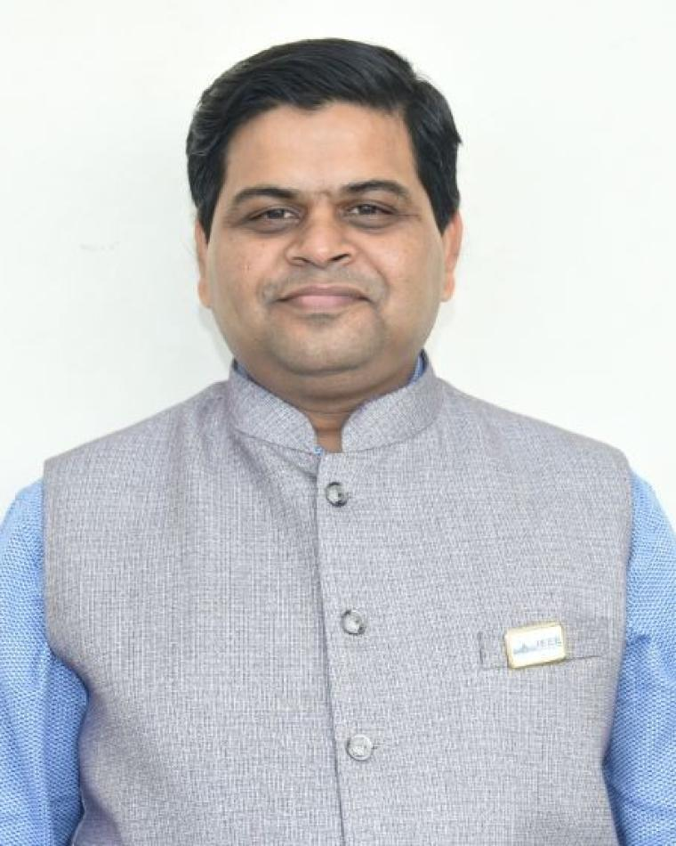
Puneet Kumar Mishra Bio
Puneet Kumar Mishra earned his M.Tech (RF & Microwave) from IIT Roorkee in the year 2004. Since 2004 he is with U R Rao Satellite Centre (URSC), Bangalore. Presently, he is heading Satellite Antenna Characterization, Test & Design Section. He has rich experience of RF characterization of 49 Satellites, 350 antennas and radomes. He has indigenously developed C-Band, Ku-Band and Ka-Band Compact range feeds to meet various requirements of ISRO’s satellite program. He has played a pivotal role in establishing satellite level EMC facility and Asia’s largest Magnetic Field Measurement Facility. He is also responsible for conceiving, conceptualizing and establishing World’s first compact range with 10 m quiet zone. He has received IETE-IRSI Young Scientist Awards in the year 2012, ISRO Young Scientist Award in the year 2013, ASI-ISRO Space Gold Medal in the year 2014, GE Foundation Award for Academic Excellence and Leadership (2002-2004), IEEE MGA Achievement Award 2017 and 6 best paper awards. He has indigenously developed a payload to study the RF blackout phenomenon during re-entry of space vehicle. He has successfully developed Indigenous BusBars for High power satellites, which are used in multiple spacecrafts. He has published more than 60 technical papers in International conferences and IEEE Transactions. He is Senior Member of IEEE, Fellow of IETE & IE(I) and Life Member of ASI. He is a passionate Volunteer and served Bangalore Section (2013-2021) at various capacities including Chair 2020 and India Council (2017-2023) as Vice Chair(Industry Relations), Secretary and Vice Chair(Professional Activities) and Vice Chair (Technical Activities). Presently he is serving as BoG IEEE AESS and Member of Global Committees of IEEE New Initiatives Committee (NIC) IEEE Industry Engagement (IEC), and IEEE Technical Program Integrity Committee (TPIC).

Slide 23
Puneet Kumar Mishra Statement
As the VP-Awards my focus will be to make AESS Awards truly global, inclusive and
ensure that they reflect geographic distributions of its membership. I have established
or played pivotal role in establishing following IEEE Awards:
Global (1): Women in Technology and Leadership Award : Secured $75K sponsorship from Walmart Global Tech for 5 Years
IEEE India Council (3): Technologist of the year, Women Technologist of the Year, Startup of the year
Bangalore Section (9): Technologist of the year, Women Technologist of the Year, Startup of the year, Technology Corporate (Large/Medium) of the Year, Medal of Honor, Outstanding Student Branch (Large/Medium/Small), Outstanding Student Branch Councilor (Large/Medium/Small), Outstanding YP Volunteer Award, Outstanding WIE Volunteer
CASS Bangalore Chapter (1): Women in Technology and Leadership (Industry/Academia)
Student Travel Grants in IEEE Conferences: CONECCT, MAPCON, InCAP
Best Paper Awards for Industry Paper: CONECCT, MAPCON
Having proven track record of establishing several awards at various OU levels and
executing them successfully. I will work ceaselessly to get more equitable participation
of AESS members in these awards including YP and WiE members. This will make
the Society Awards more relevant to practicing technologists and academics and
attract potential awardees and in turn members across globe

Slide 24
VP Awards
Puneet Kumar Mishra to the Waiting Room.
Re-admit Mike Noble to the meeting.
Mike Noble will have 5 minutes to address the Board and then there will be 5 minutes for Q&A.

Slide 25
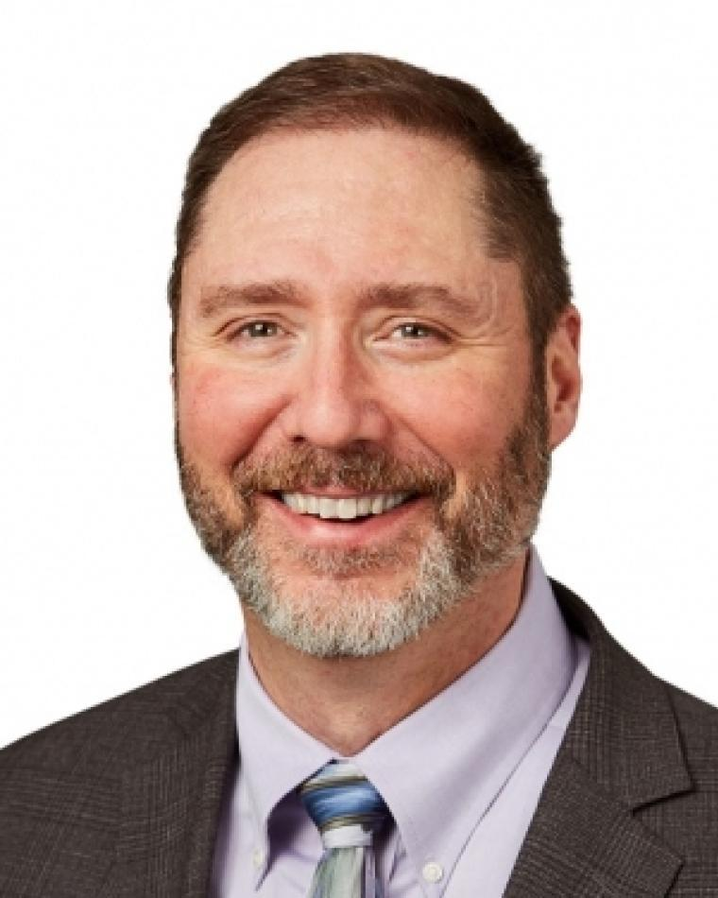
Mike Noble Bio
Dr. Noble leads the capture and development of major advanced mission systems. Moreover, Mike leads Anduril’s engagement across the advanced research and development community.
Previously, Dr. Noble developed technology strategy and novel new multi-domain mission solutions as a direct report to the L3Harris CTO. And, he helped lead company outreach to academia and Silicon Valley to access and collaborate with a broad set of non-traditional innovators.
Before joining industry, Dr. Noble served 26 years as a United States Air Force acquisition officer, focusing largely on advanced systems, technology, and prototyping. He led a 450-person government-industry team executing a three-billion dollar budget developing, testing, and deploying several Presidential-priority space capabilities; co-led the Space Based Infrared Systems directorate; and commanded a Missile Defense Agency test squadron. At the Pentagon he led multiple national-priority programs. He stood up a technology accelerator office at the NRO and ran advanced ISR and EW programs at Hanscom AFB. And, he performed hands-on research on multi-spectral sensors and semiconductor lasers at the Air Force Research Laboratory.
Dr. Noble graduated from Rensselaer Polytechnic Institute with a BSEE. He received his Ph.D. from the Air Force Institute of Technology as the top doctoral student. He has received over a dozen Air Force Research Laboratory technical achievement awards and the AFRL award for best fundamental sensors research. Dr Noble has published in multiple IEEE journals and has presented at IEEE and SPIE conferences. He co-holds a patent with three fellow inventors for a novel Vertical Cavity Surface Emitting Laser.

Slide 26
Mike Noble Statement
My first priority as VP Awards will be to build off the superb work of Fulvio Gini and continue to expand the competitive pool for each award by
Increasing publicity of these awards in an expanding sphere beyond IEEE and AESS events and publications to include both solicitations and announcements of winners,
Increasing exercise of board leaders’ extended networks to engage prospective nominators,
Exploring ways to grow the significance of these awards, not necessarily just in prestige, but also to the winners’ technical communities, e.g., through relevant charitable donations, to increase participation.
My second priority will be to expand the pool of awards to reflect the broadening technical reach of the society. With, for example, the blending of sensing and communications, growth in heterogeneous data fusion and target tracking, and proliferation of machine learning, e.g., for electronic warfare, the areas where we may recognize and thereby incentivize technical leadership is growing. My aim will be to work with the committee to develop at least one candidate new award in these or other AESS areas.

Slide 27
VP Awards
Move candidate(s) to the Waiting Room.
BoG Discussion
Re-admit candidates
Vote
Announce Winner

Slide 28
VP Conferences

Slide 29
VP Conferences
Braham Himed
Are there any Nominations from the floor?

Slide 30
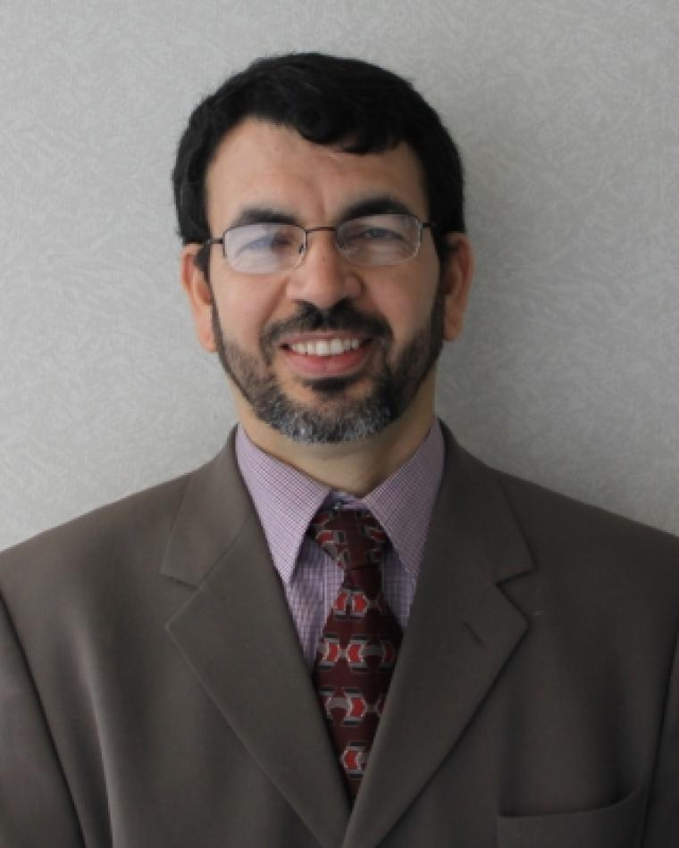
Braham Himed Bio
Braham received his Ph.D. degree in electrical engineering from Syracuse University in 1990. From 1990 to 1991 he was an Assistant Professor in the ECE department at Syracuse University, and from 1991 to 2006, he was an Adjunct Professor with the same department, teaching mostly graduate classes in signal processing and communications. In 1991, he joined Adaptive Technology, Inc, Syracuse, NY, where he was responsible for radar systems analyses. In 1994, he joined Research Associates for Defense Conversion, Marcy, NY, where he was responsible for several radar developments. From 1999-2006, he was a senior research engineer with Air Force Research Laboratory (AFRL), Rome, NY, where he led scientific and management aspects of airborne/spaceborne phased array radar systems. From 2006-2008, he served as Chief Research Officer with Signal Labs, Reston VA, directing R&D. From 2008-2018, he served as Technical Advisor at the AFRL RF Technology Branch. Since 2019, he has been a Division Research Fellow, working on joint radar-communications, distributed passive/active MIMO radar, and over the horizon radar. He served as technical chair for the 2010 and 2015 IEEE International Radar Conferences. His publication record includes over 380 journal and conference papers. He is the recipient of the 2001 IEEE region 1 award for his work on bistatic radar systems. He is a Fellow of the IEEE, the recipient of the 2012 Warren White award, and Fellow of AFRL. Braham served as chair of the AESS radar system panel from 2016 to 2018, and VP-Conferences on the AESS BoG from 2022-2023.

Slide 31
Braham Himed Statement
It is a privilege to be elected to the IEEE AESS Board of Governors and I appreciate the opportunity to serve as VP of Conferences again. I have held this position for almost 2 years and have enjoyed working with the AESS conference committee, the different conference organizing committees, and IEEE MCE. Through proactive engagement, AESS has been able to increase the number of technically sponsored conferences by almost 30%. I have also been able to work with different student and young professional conferences and advocated for increased AESS partnership. The events were a great opportunity to showcase the many benefits of AESS membership, including products and services. My goal for the upcoming years is to work with AESS panels to strengthen the health of their financially sponsored conferences, especially the smaller ones. Further, I propose AESS institute a new vision for conferences and establish new criteria for site selections, to include creating lasting impacts on the local communities. New players will need to be involved to help achieve the desired technical and social objectives.

Slide 32
VP Conferences
Move candidate(s) to the Waiting Room.
BoG Discussion
Re-admit candidat(es)
Vote
Announce Winner

Slide 33
VP Education

Slide 34
VP Education
Alexander Charlish
Alfonso Farina
Are there any Nominations from the floor?
Alfonso Farina to the Waiting Room.
Alexander will have 5 minutes to address the Board and then there will be 5 minutes for Q&A.

Slide 35
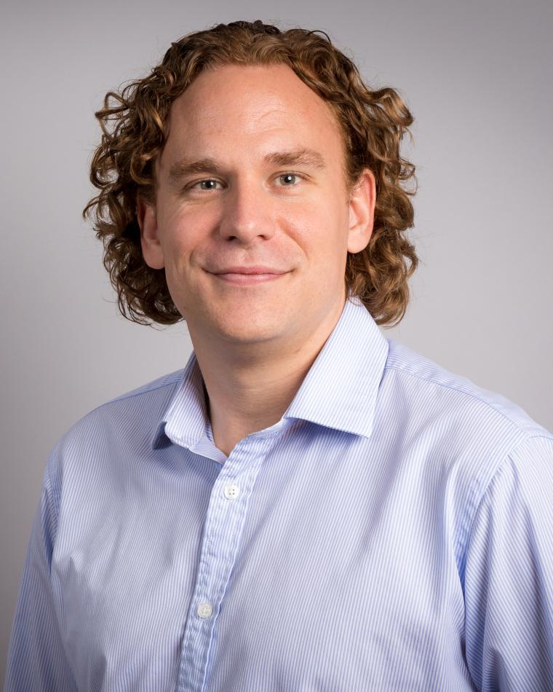
Alexander Charlish Bio
Alexander Charlish obtained his M.Eng. degree from the University of Nottingham in 2006 and received his Ph.D. degree from University College London in 2011 on the topic of multifunction radar resources management. In 2011, he joined the Sensor Data and Information Fusion (SDF) Department at the Fraunhofer Institute for Communication, Information Processing and Ergonomics (FKIE), where he now leads the Sensor and Resources Management Group. In this role, he leads a group of scientists conducting research on intelligent sensing with a focus on cognitive radar and resources management for sensor systems. Additionally, he is a visiting lecturer at RWTH Aachen University. He is currently an Associate Editor for IEEE Transactions on Radar Systems, an Editorial Board Member for IET Radar, Sonar and Navigation, and a Subject Editor for Radar, Sonar and Navigation for IET Electronic Letters. He served as an Associate Editor for Radar Systems for IEEE Transactions on Aerospace and Electronic Systems between 2015 and 2023. He is a senior member of the IEEE and a member of the IEEE AESS Board of Governors for the terms 2021 – 2023 and 2024 – 2026. He is also active in the NATO community, where he currently co-chairs the Cognitive Radar Research Task Group. He has received the NATO SET Panel Excellence Award and the 2019 NATO SET Panel Early Career Award. Alexander Charlish is the 2021 recipient of the IEEE AESS Fred Nathanson Memorial Radar Award and a co-recipient of the IEEE AESS 2019 Harry Rowe Mimno Award.

Slide 36
Alexander Charlish Statement
I believe that education plays a crucial role in our world and that everyone from every way of life should have access to good quality education. In addition to serving as VP Education in 2022 and 2023 I have also participated in and chaired the education committee of the AESS Radar Systems Panel. On this committee I was involved in launching new educational initiatives such as the Radar Summer School and the Radar Challenge. As VP Education I have placed a focus on expanding the AESS’s online offerings. If re-elected as VP Education, I would like to continue hosting regular online webinars on average every two weeks, continue increasing the number of videos that the AESS offers for streaming via platforms such as the IEEE Learning Network, and raise awareness for these online resources. I also want to motivate conferences to host educational events such as summer schools and challenge events and support the organizers in making these events as accessible as possible to AESS members from all regions, through initiatives such as travel grants.

Slide 37
VP Education
Alexander Charlish to the Waiting Room.
Re-admit Alfonso Farina to the meeting.
Alfonso Farina will have 5 minutes to address the Board and then there will be 5 minutes for Q&A.

Slide 38
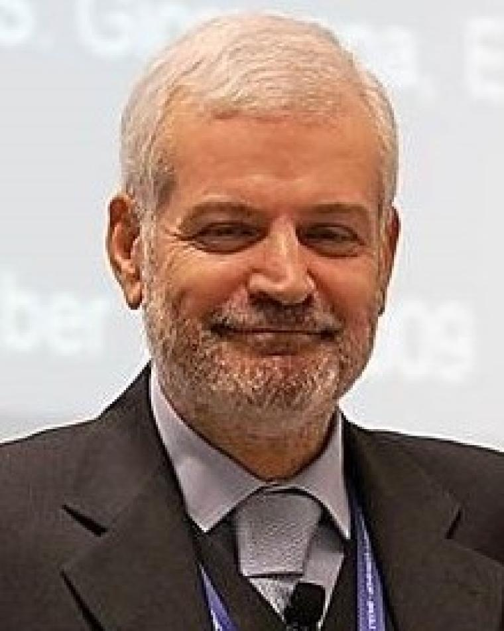
Alfonso Farina Bio
Alfonso Farina received the Dr.Ing. Degree in electronic engineering from the University of Rome, Rome, Italy, in 1973. In 1974, he joined Selenia, then Selex ES, where he became the Director of the Analysis of Integrated Systems Unit and subsequently the Director of Engineering of the Large Business Systems Division. In 2012, he was Senior VP and Chief Technology Officer of the company, whereas, from 2013 to 2014, he was senior advisor to the CTO. He retired in October 2014.
From 1979 to 1985, he was also a Professor of Radar Techniques with the University of Naples. He is the author of more than 1000 peer-reviewed technical publications, books, and monographs. He is Visiting Professor with the University College London, U.K. and Visiting Professor with Cranfield University, U.K. Currently, he is a Consultant and the President of the Radar & Sensors Academy of Leonardo S.p.A. Electronic Division, Italy.
Dr. Farina is an IEE/IET Fellow, IEEE Fellow, International Fellow of the Royal Academy of Engineering, Fellow of EURASIP, Fellow of theEuropean Academy of Science, and has been named "Académico Correspondiente de la Real Academia de Ingeniería de España." Since 2023, he is also an International Member of the United States National Academy of Engineering (NAE).
Dr. Farina was a recipient of the Fred Nathanson Memorial Radar Award (1987), Finmeccanica Award for Innovation Technology (2004), EURASIP Annual European Group Technical Achievement Award (2006), IEEE Dennis J. Picard Medal for Radar Technologies and Applications (2010), co-recipient of Oscar Masi Award (2012), IET Achievement Medal (2014), Industrial Leadership Award (2017) from the IEEE Signal Processing Society, Christian Hülsmeyer Award from the German Institute of Navigation (2019), and IEEE AESS Pioneer Award (2020). His main best paper awards include the B. Carlton of the IEEE Transactions on Aerospace and Electronic Systems (2001, 2003, and 2013), the IET Proceedings on Radar Sonar and Navigation (2009–2010), and the International Conference on Fusion (2005).
Currently, Dr. Farina is ranked in the list of 2% world top scientists.

Slide 39
Alfonso Farina Statement
Today, Continuous-Education is a "must" due to the fast evolution of technology and systems. I propose to set up an AESS Academy for several topics of the IEEE AESS. The Academy will have a Board and a Secretary, and will include a group of teachers from both the IEEE AESS as well as from industry, academia, and research centers. Video recording of key topics (e.g., the Fourier transform; electromagnetic wave equations; probability, random variables, and stochastic processes; navigation, etc) should be the basis for all topics pertaining to the Society. Syllabuses will be conceived for basic, intermediate, and advanced courses for various topics. Also, comments should be collected from attendees as a means to improve the Academy, whereas certificates should be released to attendees. Extensive use of the DL data base should be encompassed. Thus, the purpose of the Academy is to spread technical culture and invite people to a continuous-education. A logo and a video trailer of the IEEE AESS Academy should be conceived as well.

Slide 40
VP Education
Move candidate(s) to the Waiting Room.
BoG Discussion
Re-admit candidates
Vote
Announce Winner

Slide 41
VP Finance

Slide 42
VP Finance
Peter Willett
Are there any Nominations from the floor?

Slide 43
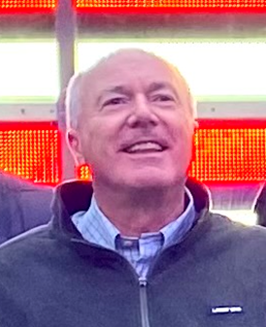
Peter Willett Bio
Peter Willett received his BASc (Engineering Science) from the University of Toronto in 1982, and his PhD degree from Princeton University in 1986. He has been a faculty member at the University of Connecticut, and since 1998, a Professor. He has published 290 journal articles, 511 conference papers, 14 book chapters and one book. He was awarded IEEE Fellow status effective 2003. His primary areas of research have been statistical signal processing, radar and sonar detection, machine learning, data fusion and tracking, and he has interests in and has published in the areas of change/abnormality detection, optical pattern recognition, communications and industrial/security condition monitoring. He has been an AESS BoG member for more than 10 years, total. He has managed publications activity as a Society Officer, specifically as VP for Publications for IEEE AESS 2012-2014 and as VP Finance 2022-2023. He has managed publications editorially as Associate or Technical Editor for six journals and as EIC for three journals: the AESS Transactions (2006-2011), the AESS Magazine (2018-2021) and Signal Processing Letters (2014-2016). He has had management roles in many conferences, including as General (or equivalent) chair of three FUSION conferences as well as one large SPS Workshop (2019), and was Technical Co-Chair of five major conferences. For the Signal Processing Society he was Chair of the Sensor Array and Multichannel TC, a member of its Conference Board, its Conference Executive Board and Nomination and Awards Committee. He has consulted for NUWC, GTRI, STR, Sandia and many other organizations.

Slide 44
Peter Willett Statement
AESS has been ably served by the able financial leadership of past VPs of Finance and of past & present Treasurers.
The good: AESS is in good financial shape, with an unusually balanced mix of revenue from conferences versus publications. As a non-profit service organization, we have dual responsibilities: to be sound financial stewards and to use our resources for maximum benefit within our professional mandate. I have worked with AESS Officers to identify and budget for opportunities to do so, via the new IEEE NextGen web-based budgeting tool (which, while transparent, requires some experience), and hope to continue to do so.
The worrying: IEEE is pivoting to Gold Open Access publication. AESS publications can remain “hybrid”, but the larger IEEE trend will impact IEL revenues regardless. There is a potential threat of the same, for conferences.
The plans: The present AESS budget relies on opaque “Operations” subcategories, and this makes it difficult for officers to understand their expenses to date and to plan for opportunities. I intended to address this in future budgets.

Slide 45
VP Finance
Move candidate(s) to the Waiting Room.
BoG Discussion
Re-admit candidates
Vote
Announce Winner

Slide 46
VP Industry Relations

Slide 47
VP Industry Relations
Stefano Coraluppi
Are there any Nominations from the floor?

Slide 48
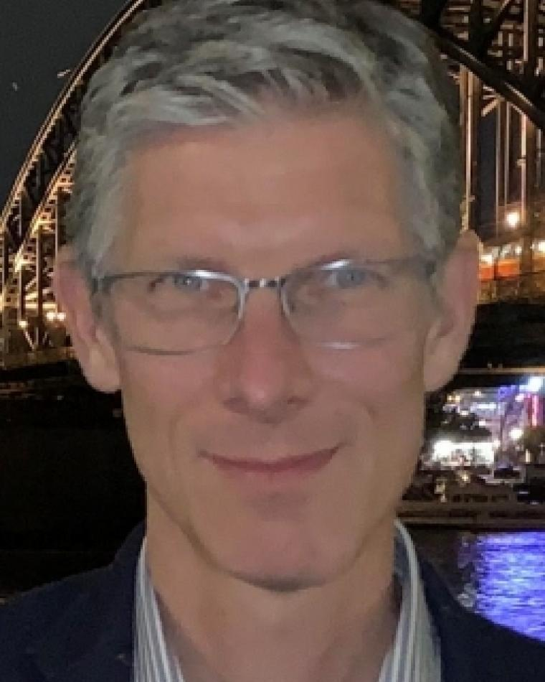
Stefano Coraluppi Bio
Stefano Coraluppi is a Chief Scientist at Systems & Technology Research (STR). He received the BS degree in Electrical Engineering and Mathematics from Carnegie Mellon University in 1990, and MS and PhD degrees in Electrical Engineering from the University of Maryland in 1992 and 1997. He has held research staff positions at ALPHATECH Inc. (1997-2002), the NATO Undersea Research Centre (2002-2010), Compunetix Inc. (2010-2014), and STR (since 2014). His research interests include multi-target tracking, multi-sensor data fusion, distributed detection and estimation, nonlinear filtering, and stochastic control.
Dr. Coraluppi serves on the IEEE AESS Board of Governors and the ISIF Board of Directors. He is Editor-in-Chief for the ISIF Journal of Advances in Information Fusion, and previously served as Associate Editor-in-Chief for the IEEE Transactions on Aerospace and Electronic Systems. He is a Fellow of IEEE and an IEEE AESS Distinguished Lecturer. He lectures regularly for the NATO Science and Technology Organization.
Dr. Coraluppi served as General Co-Chair (with Peter Willett) for the ISIF/IEEE 9th International Conference on Information Fusion (FUSION) in Florence, Italy in 2006. He is General Co-Chair (with Lauro Snidaro) for the 27th FUSION conference, to be held in July 2024 in Venice, Italy.

Slide 49
Stefano Coraluppi Statement
Throughout my career, IEEE has been my professional home. Engineers and scientists must recognize the value of professional societies, and of IEEE as the world’s largest technical society. Here are actions that I will focus on as AESS VP Industry Relations (IR):
Organizing panel discussions (at least twice a year in fall and spring) to discuss challenges associated with careers in industry. This will follow the highly successful panel organized by then-VP IR Mike Noble in 2022.
2Continuing efforts to bring AESS and ISIF closer together. There is significant overlap in these communities, and I will facilitate discussions on strategies for closer collaboration.
Expanding collaborative IR initiatives across IEEE Societies. This will expand upon early efforts to build the online IEEE Industry Relations Platform (IRP) pilot.
Extending AESS participation in the IEEE Standards Association (SA) efforts to address challenges in responsible use of AI. Given the significant defense and industry footprint of AESS, our presence in these discussions is important and will generate great interest among our industry members.

Slide 50
VP Industry Relations
Move candidate(s) to the Waiting Room.
BoG Discussion
Re-admit candidates
Vote
Announce Winner

Slide 51
VP Member Services

Slide 52
VP Member Services
Lorenzo Lo Monte
Are there any Nominations from the floor?

Slide 53
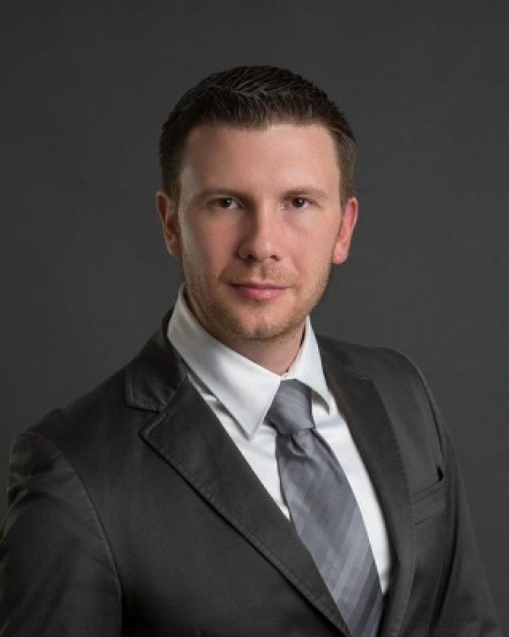
Lorenzo Lo Monte Bio
Dr. Lorenzo Lo Monte serves as Chief Scientist at Telephonics (now TTM), a top-40 defense corporation. Prior to that, he was a professor at the University of Dayton, worked for the U.S. Air Force Research Laboratory, and served as a consultant for many small businesses. Dr. Lo Monte has published > 70 journal/conference papers, book chapters, and patents.
During his 5 year tenure in the AESS BoG, his major accomplishments are:
As YP Representative, he initiated a series of YP Social Events at key AESS conferences
As part of the Member Services Committee, he started the engagement with Colombia, Peru, Bolivia, Tunisia, Saudi Arabia, ultimately leading to the formation of AESS chapters. Dr. Lo Monte is well-known for his passion for reaching out, and caring for, under-served areas worldwide.
As Rep for the IEEE Sensors, he became the Technical Editor for the IEEE Sensor Journal.
As a Distinguished Lecturer, he held > 20 lectures, one of them reaching > 900 participants.
As a Short Course Instructor, he held six AESS-sponsored lectures.
As VP Education, he increased the submissions for the Nathanson Award from 4 to 16
As VP Education, he introduced and led the Virtual Distinguished Lecture program: during its first year, > 60 Virtual Lectures were offered, averaging 60 participants per lecture.
As VP Education, he started the IEEE Learning Network for AESS.
With VP Member Services, he initiated the new AESS LinkedIn page
He is probably best known for serving as General Chair for IEEE RadarConf’22 held in Times Square.

Slide 54
Lorenzo Lo Monte Statement
AESS has lots to offer to its members, but they are genuinely unaware. Therefore, my objectives are simple and achievable:
Populate the (successful) email blast, webpage, and LinkedIn pages. I recommend that all AESS activities worldwide are listed, with the hope of catching the interest of remote members.
Disseminate the Membership Brochure to all AESS/YP/StM-sponsored conferences.
Increase the frequency of Region Chapter Summits.
Let YP/Student IEEE Members be aware of the benefits of an AESS membership, in particular, the Mentoring Program. My connections with YP will help me achieve this.
Outreach to the underserved areas, with the goal of forming new local chapters.
Facilitate/expedite fund transfers to local chapters
These objectives aren’t grandiose initiatives, specifically because Membership Development is on the right path: if we keep sustaining, expanding, and improving current initiatives, we will achieve steady growth. Thomas Edison once said “achieving your goal is 1% inspiration and 99% execution:” my goal is to focus on the 99% execution.

Slide 55
VP Member Services
Move candidate(s) to the Waiting Room.
BoG Discussion
Re-admit candidates
Vote
Announce Winner

Slide 56
VP Publications

Slide 57
VP Publications
Michael Rice
Luke Rosenberg
Are there any Nominations from the floor?
Luke Rosenberg to the Waiting Room.
Michael Rice will have 5 minutes to address the Board and then there will be 5 minutes for Q&A.

Slide 58
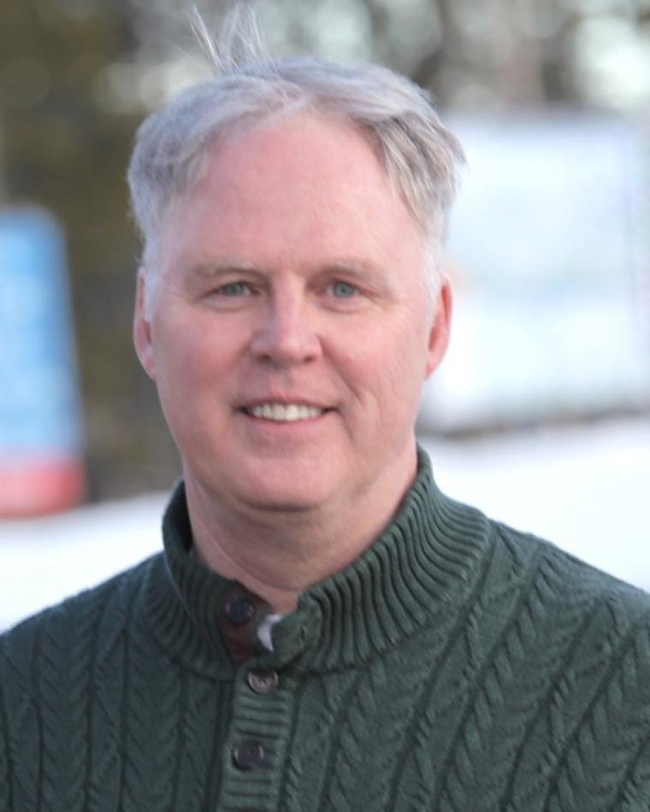
Michael Rice Bio
Michael Rice (M'82, SM'98, F’17) received the PhD from Georgia Tech in 1991. Dr. Rice was with Digital Transmission Systems, Inc. in Atlanta and joined the faculty at Brigham Young University in 1991 where he is currently a Professor in the Department of Electrical & Computer Engineering. Professor Rice was a NASA/ASEE Summer Faculty Fellow at the Jet Propulsion Laboratory during 1994 and 1995 where he worked on land mobile satellite systems. During the 1999-2000 academic year, Professor Rice was a visiting scholar at the Communication Systems and Signal Processing Institute at San Diego State University.
Professor Rice's research interests are in digital communication theory and signal processing with a special interest in applications to aeronautical mobile telemetry and software defined radio design. He has been a consultant to both government and industry on telemetry related issues. He authored the textbook Digital Communications: A Discrete-Time Approach, published in 2009. He was elevated to IEEE Fellow in 2017 “for contributions to communication waveforms, detection algorithms, and channel models for aeronautical telemetry.” He received the Pioneer Award from the International Foundation for Telemetering in 2019.
In the telemetry community, he has served as General Chair of the International Telemetering Conference (ITC) three times (2008, 2016, 2022), ITC Technical Program Chair in 2002, and has won the ITC Best Paper Award eight times.
Professor Rice is a member of the IEEE Communications Society (COMSOC) and the Aerospace and Electronic Systems Society (AESS). He is past chair of the Communication Theory Technical Committee and has served on several COMSOC conference committees. In AESS, he has served on the editorial board for IEEE Transactions on Aerospace and Electronic Systems (TAES) as Technical Editor for Command, Control, and Communications (2005-2016), Associate Editor-in-Chief (20016-2018), and Editor-in-Chief (2018-2022). In addition, he served as Editor-in-Chief of the AESS Quarterly Email Blast (2016-2017), on the AESS N&E Committee (2022) and the AESS Fellows Committee (2022). He served on the AESS Board of Governors from 2016-2021.
At the local level, he has served as chair of the IEEE Utah Section 1997-1999, IEEE Region 6 Student Activities Chair 2001-2002, an Area Chair in IEEE Region 6 (2005-2006), and as Chair of the Communications and Signal Processing Society Chapter of the Utah Section (2001-2003, 2013-2015).
He has received Phi Kappa Phi Distinguished Faculty Award at Brigham Young University for 2016-2017 academic year and received the Wesley Lloyd Award for Distinction in Graduate Education at Brigham Young University in 2011.

Slide 59
Michael Rice Statement
AESS Publications are one of the most visible things AESS does. For most AESS members, the Magazine is the face of AESS. The Transactions on AES is the medium of written technical interchange in the research areas within the AESS scope. (The Transactions is also one of the oldest IEEE journals.) Two recent journal launches, the IEEE Open Journal of Systems Engineering and the IEEE Transactions on Radar Systems, both of which are co-sponsored but whose inaugural Editor-in-Chief is an active AESS member, have the potential to IEEE members and researchers who might not know much about AESS; the new journals are an excellent introduction to AESS. Outstanding leadership from the past Publications VPs has left the AESS publications in very good shape.
The good state of affairs does not mean there is no room for improvement. If elected, my goals are to learn from my predecessors and apply that experience, together with my own, to improve experiences of readers, authors, editors and reviewers while keeping a watchful eye on the open access developments.

Slide 60
VP Publications
Michael Rice to the Waiting Room.
Re-admit Luke Rosenberg to the meeting.
Luke Rosenberg will have 5 minutes to address the Board and then there will be 5 minutes for Q&A.

Slide 61
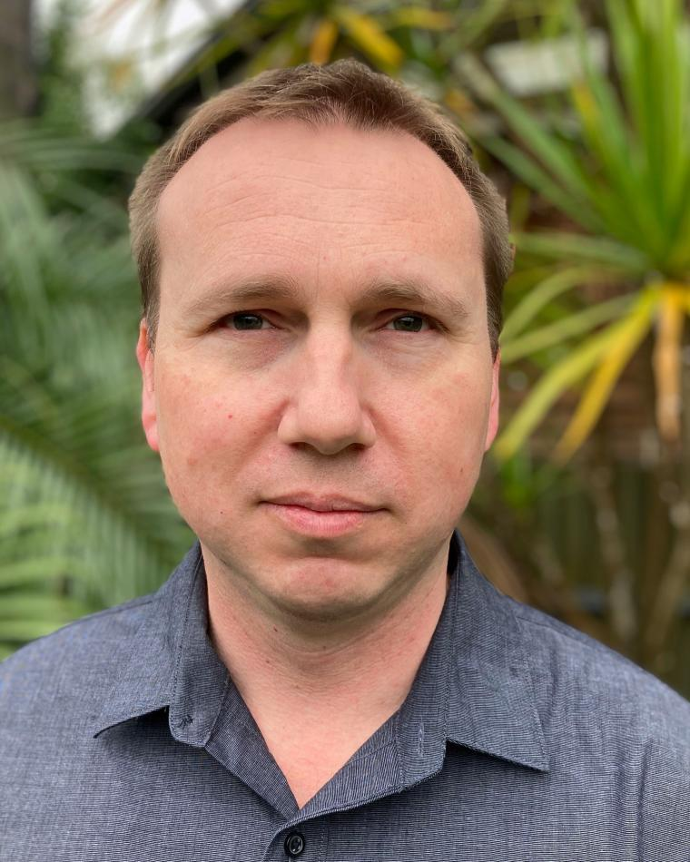
Luke Rosenberg Bio
Luke Rosenberg received the bachelor’s degree in electrical and electronic engineering, the master’s degree in signal and information processing, and the Ph.D degree from the University of Adelaide, Australia in 1999, 2001, and 2007, respectively. He is currently an adjunct Associate Professor with the University of Adelaide and a Senior Research Engineer at STELaRLab, Lockheed Martin Australia. Prior to this he worked at the Defence Science and Technology Group Australia as a research specialist in maritime radar and during 2021-2022 as an acting Group Leader, leading teams across a wide range of radar technologies.
In 2014, Dr Rosenberg spent twelve months with the U.S. Naval Research Laboratory working on algorithms for focusing moving scatterers in synthetic aperture radar imagery. Dr. Rosenberg received the prestigious Defence Science and Technology Achievement Award for Science and Engineering Excellence in 2016 and the IEEE AESS Fred Nathanson award in 2018 for ‘Fundamental Experimental and Theoretical Work in Characterizing Radar Sea Clutter’. He is a senior member of the IEEE, the past chair of the IEEE South Australian section and a past chair of the local AESS chapter. He is a distinguished lecturer for the AESS, a senior editor for the Transactions on Aerospace and Electronic Systems and a member of Radar Systems panel and the AESS Board of Governors. Dr Rosenberg has been involved in several NATO SET groups and is the general co-chair for the International Radar conference in 2023. He has published over 170 technical publications, several book chapters and an authored book.

Slide 62
Luke Rosenberg Statement
The TAES has been gradually reducing its time to publication to meet the average across the IEEE. In my role as the Radar Systems Senior Editor, I’ve observed that most people still leave reviews till the last minute, and reducing the required time from two months to one would make little difference. Secondly, there are still issues with the online publication platform, making it difficult for associate editors to find suitable reviewers and then work with reviewers who don’t complete their review. I plan to work with Manuscript Centre to improve this issue and others that our associate editors and authors are experiencing.
Where there is a cross over in technical areas between IEEE societies, I want to encourage authors to publish with the AESS by increasing the scope and number of special editions. We can offer incentives such as free pages, making their paper open access and also linking the AESS journals to conferences with extended special editions. I will also continue to advocate that we should keep our journals hybrid with both traditional and open access options.

Slide 63
VP Publications
Move candidate(s) to the Waiting Room.
BoG Discussion
Re-admit candidates
Vote
Announce Winner

Slide 64
VP Technical Operations

Slide 65
VP Technical Operations
Michael Braasch
Roberto Sabatini
Are there any Nominations from the floor?
Roberto Sabatini to the Waiting Room.
Michael Braasch will have 5 minutes to address the Board and then there will be 5 minutes for Q&A.

Slide 66
Michael Braasch Bio
Michael Braasch holds the Thomas Professorship in the Ohio University School of Electrical Engineering and Computer Science and is a Principal Investigator with the Ohio University Avionics Engineering Center. He has been performing navigation system research since 1985 and was elevated to IEEE Fellow in 2023 for his work in characterizing and mitigating the effects of GPS multipath.
In the mid-1990s, Mike led the Ohio University research group that pioneered the GPS software-defined receiver. Mike’s recent work has focused on GNSS-aided inertial navigation including the development of gravity modeling techniques for safety-of-life applications such as civil aviation. Mike also has more than three decades of flight-testing experience with Ohio University’s fleet of research aircraft. Mike also has significant industrial experience having worked extensively on-site at both Boeing and Northrop Grumman.
Mike has served as a visiting scientist in The Netherlands and has lectured for NATO AGARD in Russia, Turkey, and Ukraine. Mike has served as an associate and technical editor for navigation for the TAES and has also served as an associate editor for navigation for SYSTEMS. Since 2014 he has served as the IEEE/AESS liaison to the ION/IEEE Position, Location and Navigation Symposium (PLANS). From 2017-2023, he has served as the founding Chair of the AESS Navigation Systems Panel. He has served on the AESS BoG since 2017 and served as the AESS VP-Conferences for 2019-2021. He has served as VP-Technical Operations for the past two years and has been an AESS Distinguished Lecturer since 2020.

Slide 67
Michael Braasch Statement
I appreciate the confidence the BoG has shown by electing me twice as VP-Technical Operations. My experience in helping to create and lead the AESS Navigation Systems Panel, as well as past service on the Technical Operations committee, has provided me with a deep appreciation for the importance of the AESS technical panels. I will not address every panel but some highlights include: most of the panels have significant responsibility for a major portion, if not all, of a prestigious international conference and the Gyro and Accelerometer Panel is responsible for shepherding IEEE standards. The Technical Operations committee must maintain contact with each of the panels to ensure they have the support needed for continued success. As the need arises, the Technical Operations committee must also be the advocate for the creation of new panels. Occasionally panels need to be abolished and the committee must oversee this process as well. If re-elected, I will endeavor to further these objectives.

Slide 68
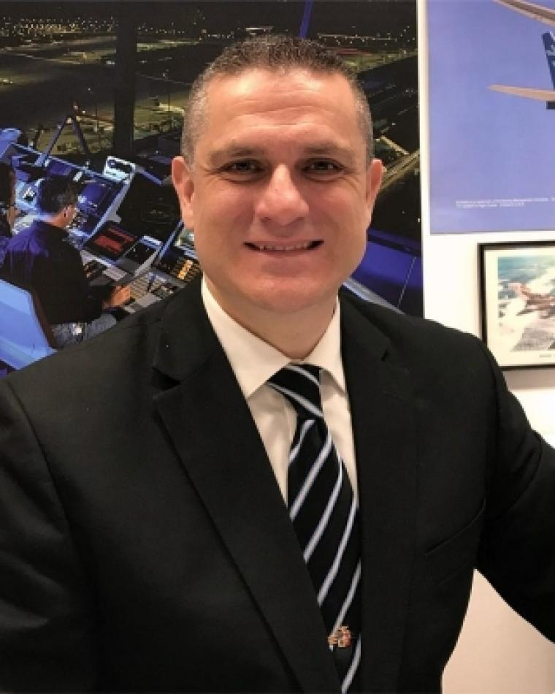
Roberto Sabatini Bio
Rob Sabatini is a Professor of Aeronautics and Astronautics with three decades of experience in aerospace and defense systems research and education, having served in various industry, government and academic organizations in Europe, North America, Australia, and the Middle-East. His research addresses key contemporary challenges in avionics, spaceflight and robotics/autonomous systems design, test and certification, focusing on the central role played by cyber-physical systems and AI in the digital transformation and sustainable development of the aerospace sector. Currently, he serves as Professor at Khalifa University of Science and Technology (UAE) and Honorary Professor at RMIT University (Australia). Rob holds various academic qualifications, including a PhD in Aerospace/Avionics Systems (Cranfield University) and a PhD in Space Geodesy/Satellite Navigation (University of Nottingham). Throughout his career, he led several industry and government funded research projects and he authored or co-authored more than 350 peer-reviewed international publications and several books. Rob is a Senior Member of IEEE and a Fellow of the Institution of Engineers Australia, the Royal Aeronautical Society, and the Royal Institute of Navigation. In addition to his primary academic duties and various honorary/consulting appointments in Europe, North America, Australia, Asia and South Africa, he contributes to the IEEE community as member of the AESS Board of Governors, Chair of the Avionics Systems Panel, and AESS Distinguished Lecturer, as well as editorial board member for various IEEE journals and book series, including the Transaction on Aerospace and Electronic Systems, the IEEE Series on Aeronautics and Astronautics Systems, and the Systems Magazine.

Slide 69
Roberto Sabatini Statement
As VP Technical Operations of the IEEE AESS, I envision a future where our society capitalizes on its strengths, embraces constant improvement, and fully leverages collaboration opportunities to maximize impact. I bring to the role three decades of experience in aerospace and defense systems research and education, and across four continents. Additionally, having actively contributed to our society for many years and in various roles, I am ideally positioned to lead our Technical Operations.
As VP Technical Operations, I will uphold the high-quality of our technical work, facilitating collaborations with industry, government and academia, harmonizing the activities of our Technical Panels, and contributing to high-impact events, publications, and standards. I will also address areas of improvements, such as the possible creation of a dedicated Unmanned Systems Panel. The "Autonomy for Sustainability" supertopic is an exciting opportunity and I will continue along this path, allowing us to operate at the intersection of digital transformation, sustainable development, and innovation management.
I am convinced that collaboration is pivotal, both internally within the AESS and externally across our membership community. So, I will work closely with the other AESS VPs and other key leadership roles within the AESS. Our collective efforts will bridge the gaps between academia and industry, nurturing talent and addressing the most important research, innovation, and educational challenges of our time. Collaboration with the other IEEE Societies (e.g., ComSoc, RAS, VTS, SMC, and I&M), and with the IEEE Standards Association will also contribute to broaden our engagement and impact.
Working together in the dynamic landscape of aerospace and electronic systems, we will shape a future where innovation, excellence, and collaboration drive our society to new heights.

Slide 70
VP Technical Operations
Michael Braasch to the Waiting Room.
Re-admit Roberto Sabatini to the meeting.
Roberto Sabatini will have 5 minutes to address the Board and then there will be 5 minutes for Q&A.

Slide 71
VP Technical Operations
Move candidate(s) to the Waiting Room.
BoG Discussion
Re-admit candidates
Vote
Announce Winner

Slide 72
Resume meeting recording

